Slide 1
CONSUMER BEHAVIOR
WEEK 3
CONSUMER MOTIVATION
BY DR. WANJIKU KINYANJUI

Slide 2
Learning Objectives
To understand how motives, needs, and goals shape consumer behavior.
To understand the systems of classifying needs.
To understand the impact of hidden motives on consumer behavior.
To realize the need for Motivation research

Slide 3
Human / consumer needs are the basis of all modern marketing.
Marketing orientation focuses on the needs of the buyer
The key to a firms survival, profitability and growth in a highly competitive marketplace is in its ability to identify and satisfy unfulfilled consumer needs better and sooner than the competition.
Successful marketers define their markets in terms of the needs they presume to satisfy, not in terms of the products they sell

Slide 4
Consumer Motivation
Motivation is the driving force within individuals that impels them to action.
This driving force is produced by a state of tension which exists as the result of an unfulfilled need. The specific goals they select and the patterns of action they undertake to fulfill these needs are the results of individual thinking and learning.

Slide 5
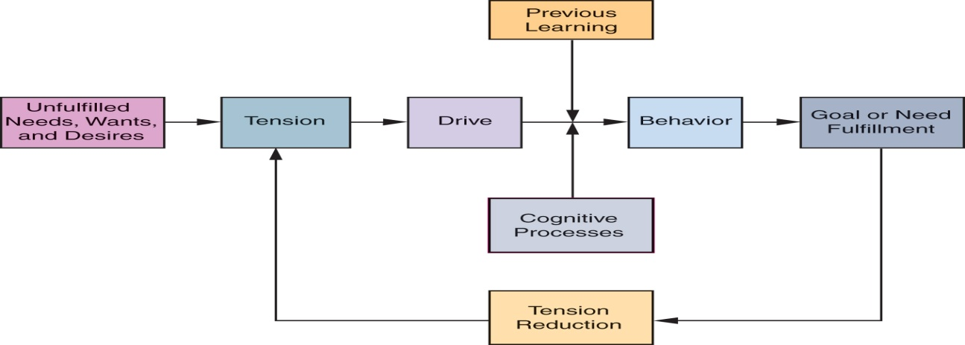
Motivation Process Model
The diagram shows how unfulfilled needs create psychological tension and drives that impel people to act.
Marketers do not create needs, although in many instances they make consumers more keenly aware of unfelt or undeveloped needs

Slide 6
Types of motives
Rational motives – rationality assumes that consumers behave rationally by carefully considering all alternatives and choosing those that give them the greatest utility; Consumers select goals based on totally objective criteria (price, weight, size)
Emotional motives imply selection of goals according to personal or subjective criteria (pride, fear, affection, status). Assumes that the subjective /emotional criteria may not maximize utility.
Motives can be positive or negative.

Slide 7
Positive motivation is a driving force towards some object or condition e.g a person may be impelled to start exercising in order to look attractive which is a positive outcome.
  Needs, wants, desires
  A positive goal is one toward which behavior is directed – referred to as an approach object

Slide 8
Negative motivation is a driving force way from some object. A person may be impelled to start exercising in order to avoid health problems which is a negative outcome
  Fears, aversions
  A negative goal is one away from which behavior is directed – referred to as an avoidance object

Slide 9
Needs
Needs are circumstances or things that are wanted or required, and therefore direct the motivational forces.
Unfulfilled needs form motivational desires that impel consumers to purchase goods and services.
Desired outcomes create tensions which consumers strive to relieve, both consciously and subconsciously, by forming purchase-related goals and subsequent behavior that they anticipate will fulfill their needs

Slide 10
Every individual has needs.
Primary (Innate) needs are physiological (biogenic)
  water, food, air, clothing, shelter
  needed to sustain biological life
Secondary (acquired) needs are learned in response to our culture or environment
  self esteem, prestige, affection, power
  are generally psychological (psychogenic)
  result from individuals subjective psychological state and from relationships with others

Slide 11
Types and Systems of needs
Everyone has the same set of needs but individuals differ in their priority ranking of these needs. Maslows theory of hierachy of needs identifies five basic levels of human needs.
Individuals seek to satisfy lower level needs before higher level needs emerge. Higher order needs become the driving force behind human behavior as lower level needs are satisfied
The lowest level of need the individual experiences serves to motivate his behavior. When this level is satisfied, a new need emerges.

Slide 12
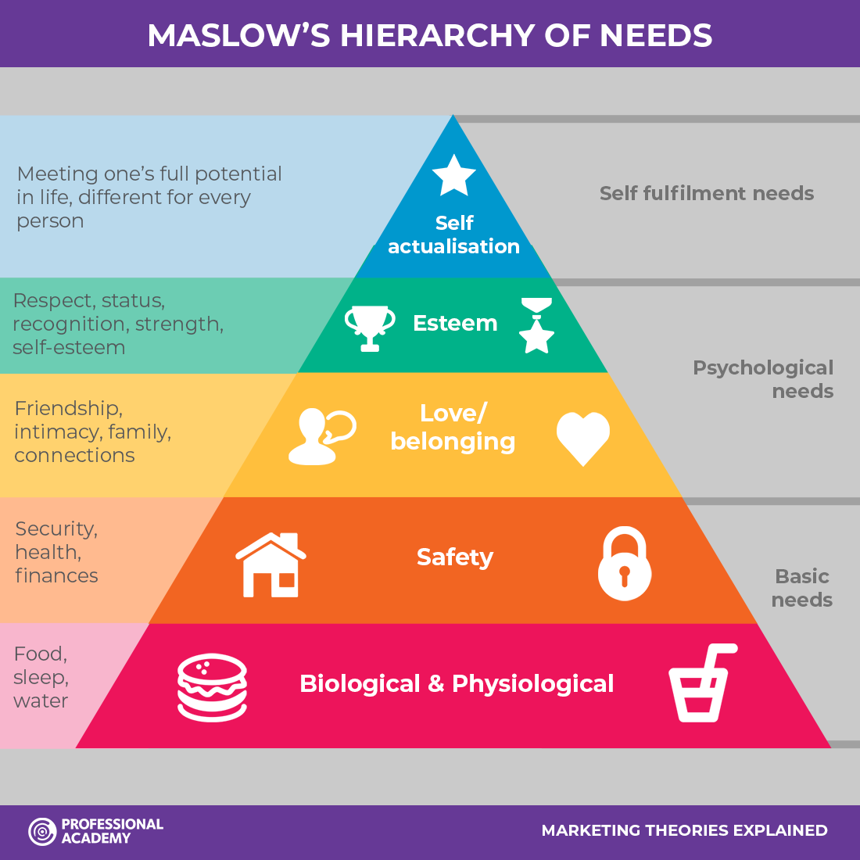
Abraham Maslow's Hierarchy of needs: Adopted from Maslow (1943, 1954) Https://www.Professionalacademy.Com/professional-qualifications/cim-marketing-qualifications/marketing-theories/

Slide 13
Level 1: Physiological needs
According to Maslow, physiological needs are dominant when they are chronically unsatisfied: “For the man who is extremely hungry, no other interest exists but food. He dreams food, he remembers food, he thinks about food, he emotes only about food, he perceives only food, and he wants only food.

Slide 14
Level 2: Safety & security needs
Safety and security needs become the driving force behind an individual’s behavior. These needs are concerned not only with physical safety but also with order, stability, routine, familiarity, and control over one’s life and environment.
For example, health and the availability of health care are important safety concerns. Savings accounts, insurance policies, education, and vocational training are all means by which individuals satisfy the need for security

Slide 15
Level 3: Social needs
The social needs in Maslow’s hierarchy include love, acceptance, and belonging. At this level, the need for emotional relationships drives human behavior. Some of the things that satisfy this need include:
  Friendships, Romantic attachments, Family relationships
  Social groups, Community groups, Churches and religious organizations
In order to avoid loneliness, depression, and anxiety, it is important for people to feel loved and accepted by others. Personal relationships with friends, family, and lovers play an important role, as does involvement in groups—such as religious groups, sports teams, book clubs, and other group activities.

Slide 16
Level 4: Egoistic needs (self acceptance, self esteem, success, reputation, status)
At this level, it becomes increasingly important to gain the respect and appreciation of others. People have a need to accomplish things, then have their efforts recognized. In addition to the need for feelings of accomplishment and prestige, esteem needs include such things as self-esteem and personal worth.

Slide 17
Level 5: Need for Self Actualization – individuals desire to fulfill his potential – to become everything he is capable of becoming
At this point people are self-aware, concerned with personal growth, less concerned with the opinions of others, and interested in fulfilling their potential.
Maslow’s said of self-actualization: "It may be loosely described as the full use and exploitation of talents, capabilities, potentialities, etc. Such people seem to be fulfilling themselves and to be doing the best that they are capable of doing. They are people who have developed or are developing to the full stature of which they capable.

Slide 18
Henry Murray’s 24 psychogenic needs
According to Murray, all people have these psychogenic needs, but each individual tends to have a certain level of each need. ﻿ Each person's unique levels of needs play a role in shaping their individual personality.

Slide 19
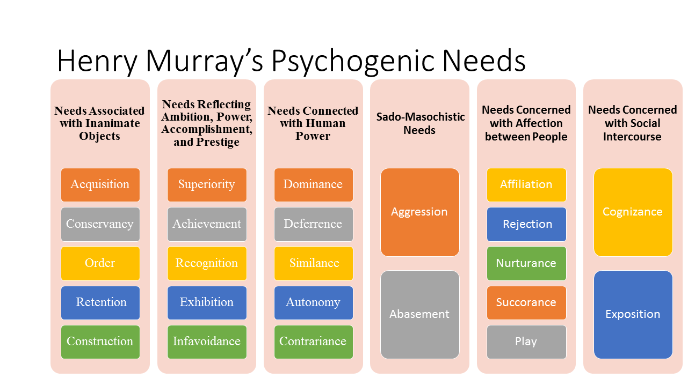
Shiffman, Kanuk & Wisenblit (2010)

Slide 20
Trio of needs
McClelland's Human Motivation Theory states that every person has one of three main driving motivators: the needs for achievement, affiliation, or power. These motivators are not inherent; we develop them through our culture and life experiences.
Achievers like to solve problems and achieve goals. Those with a strong need for affiliation don't like to stand out or take risk, and they value relationships above anything else. Those with a strong power motivator like to control others and be in charge.

Slide 21
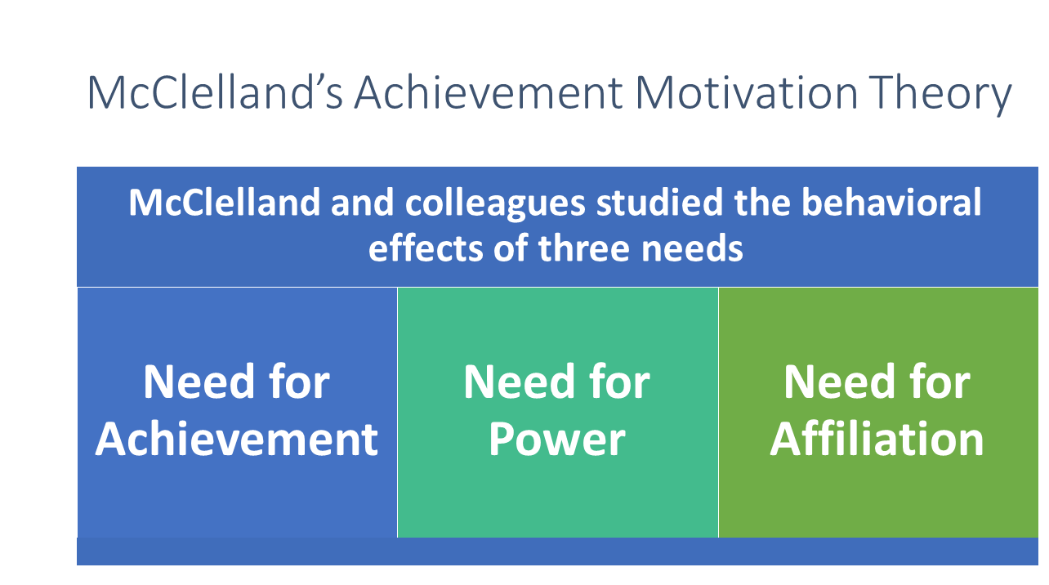
Shiffman, Kanuk & Wisenblit (2010)

Slide 22
Goals
Goals are the sought after results of motivated behavior.
  Generic goals – general class or category of goals that consumers see as a way to fulfill their needs.
  Product specific goals – the specifically branded product or service that consumers select for goal fulfillment
Individuals set goals on the basis of their personal values and they select means that they believe will help them achieve their desired goals. E.g an individual may start a blog to encourage comments from others

Slide 23
Goals Selection
The goals selected by an individual depend on:
  Personal experiences- personality, and others’ opinions
  Physical capacity eg strength, stamina or balance
  Prevailing cultural norms and values
  Goal’s accessibility in the physical and social environment

Slide 24
Motivations and Goals
Positive
Negative
  Motivation
    A driving force toward some object or condition
  Approach Goal
    A positive goal toward which behaviour is directed
  Motivation
    A driving force away from some object or condition
  Avoidance Goal
    A negative goal from which behaviour is directed away
Schiffman & Wisenblit (2019)
Notes:
In an earlier slide we learnt that needs can be positive or negative. The same is true for goals which can be positive or negative. A positive goal would include joining a gym to get strong and train for an upcoming race. Another person, with a negative goal, might join the gym to avoid health problems that will certainly exist if they do not exercise regularly. Which are you?

Slide 25
Substitute Goals
It is very common that a consumer cannot attain a goal.
This may be due to a lack of money, ability, desire, or accessibility. In this instance, the consumer often substitutes a different goal to reduce the tension created from the existence of this need.
In time, this substitute goal might replace the initial goal.
  For instance, if a consumer wanted a certain cable television service, but it was not available in their area, they might choose a satellite television provider. Over time, they may be very satisfied with this choice and feel that they actually prefer the satellite service over the cable television service.

Slide 26
Substitute Goals: Characteristics
Are used when a consumer cannot attain a specific goal he/she anticipates will satisfy a need
The substitute goal will dispel tension
Substitute goals may actually replace the primary goal over time

Slide 27
Frustration Due to Unmet needs
Failure/ inability to achieve goals often results in feelings of frustration. The barrier preventing attainment of goals may be personal (limited finances or physically) or social environment.
Products may represent creative responses to the concept of frustration
People who cannot cope with frustration often mentally redefine their frustrating situations in order to protect their self image and self esteem

Slide 28
Marketers must realize what consumers’ responses might be and how they can address these responses.
The understanding of these defense mechanisms will help provide many opportunities to craft advertising messages to reach the emotional side of the consumers.

Slide 29
Defense mechanisms
Defense mechanisms are used when people cannot cope with frustration. They are often developed to protect one’s ego from feelings of failure when goals are not achieved
Aggression-individuals may resort to aggressive behavior in attempting to protect their self esteem. e.g a tennis player may slam his racket on the ground after losing or consumer may boycott some products or stores.

Slide 30
Regression-an individual may react in childish or immature way e.g a customer attending a sale may see something they like and as they are just about to pick it someone else picks it as well hence they start fighting for it and may even damage it so that the other shopper doesn’t get it.
Withdrawal-frustration may be resolved by simply withdrawing from the situation. E.g an individual who doesn’t get a promotion may decide to go use his skills elsewhere so he quits.

Slide 31
Projection-an individual may redefine a frustrating situation by projecting blame for his own or her own failures and inabilities on other objects or persons.
Repression-an individual can avoid tension arising from the frustration by repressing the unsatisfied needs. They may force the need out of their conscious awareness.

Slide 32
Rationalization-people may solve frustration by inventing reasons for being unable to attain their goals e.g. not having enough time to read.
Daydreaming- Fantasizing enables the individual to attain imaginary gratification of unfulfilled needs. A person who is shy and lonely, for example, may daydream about a romantic love affair

Slide 33
The Measurement of Motives
How are motives identified and measured?
Motives cant be observed by any of the five senses, hence are hypothetical constructs
Measurements techniques need to be:
  Valid (ensure test measures what it purports to measure)
  Reliable (consistency with which the test measures what it does measure)

Slide 34
Methods of identifying and measuring human motives
Observation and inference
Subjective reports (self data)
Qualitative research (including projective techniques),
None of these is completely reliable by itself, so researchers combine them

Slide 35
Motivational Research
Refers to qualitative research designed to uncover the consumer’s subconscious or hidden motivations
Based on the assumption that consumers are not always aware of the reasons for their action, motivational research attempts to discover underlying feelings, attitudes and emotions concerning product, service or brand use.
Use of projective techniques to tap into the consumers hidden motivations through storytelling or drawing pictures

Slide 36
Contd:
Motivational research is an important tool for marketers to gain deeper insights into the whys of consumer behavior than conventional marketing research techniques give
Since it reveals unsuspected consumer motivations concerning brand usage, its useful in development of new ideas for promotional campaigns, ideas that can appeal to unrecognized needs
Provides marketers with a basic orientation for new product categories; enables them to explore consumer reactions to ideas and advertising copy early to avoid costly errors

Slide 37
Provides researchers with basic insights that enable them to design structured, quantitative research studies to be conducted on larger samples of consumers
Main drawback of motivational research:
The analysis of projective tests and in-depth interviews is highly subjective and poses a major weakness

Slide 38
Conclusion
Motivation is highly dynamic and constantly changes in response to life experiences.
Motivations change as we age, interact with others, change careers, acquire wealth, become ill, marry or divorce, or pursue education.
Humans constantly have needs. This is due in part to the fact that our needs are never fully satisfied, or once satisfied, reappear.

Slide 39
Needs are never fully satisfied because humans constantly have needs.
New needs emerge as old needs are satisfied (as in Maslow’s hierarchy of needs )

Slide 40
References
Berntson, G. G., & Cacioppo, J. T. (2008). The neuroevolution of motivation. In J. Y. Shah & W. L. Gardner (Eds.), Handbook of motivation science (pp. 188–200). New York: Guilford Publications, Inc.
Gargasz (2010); http://www.gargasz.info/maslow_hierarchy/, (Accessed Date: 10.10.2022)
Randheer, K., Almotairi, M., & Naeem, H. A. (2013). Anti-smoking environment: a perspective from Murray's psychogenic needs theory. Global journal of health science, 6(1), 99–106. https://doi.org/10.5539/gjhs.v6n1p99
Schiffman L.G & Wisenblit J.L (2019) Consumer Behavior, 12th ed, Pearson, New York
Schiffman, L.G, Kanuk,L.L., &Wisenblit,J.,(2010)Consumer Behavior, 10th ed,
Pearson Prentice Hall.

