Slide 1
CONSUMER BEHAVIOR
WEEK 4
CONSUMER LEARNING
By: DR.WANJIKU KINYANJUI

Slide 2
Learning Defined
Consumer learning is a process by which individuals acquire the purchase and consumption knowledge and experience that they apply to future related behavior.
Learning are those behaviors that result from:
      Repeated experience
      Thinking.

Slide 3
Importance of Learning
Marketers must teach consumers:
  where to buy
  how to use
  how to maintain
  how to dispose of products
  Learning occurs through interactions with the environment and that environment shapes behavior.

Slide 4
Consumer learning is a process that evolves and changes as consumers acquire knowledge from experience, observation, and interactions with others.
This newly acquired knowledge affects future behavior. It ranges from simple and often reflexive responses to marketing stimuli (such as packaging, product colors, and promotional messages), to learning abstract concepts and making decisions about purchasing complex and expensive products.

Slide 5
Forms of Learning
Not all learning is deliberately sought.
  Intentional (i.e., it is acquired as the result of a search for information),
  Incidental, acquired by accident or without much effort

Slide 6
Elements of Learning
Four elements central to how consumers learn are:
  Drive/ Motive: A need that moves an individual to action
  Cue: A stimulus or symbol perceived by consumers
  Response: The action taken by a consumer to satisfy the drive.
  Reinforcement: The reward.

Slide 7
Motives
For example, men and women who want to take up bicycle riding for fitness and recreation are motivated to learn all they can about bike riding and practice often. They may seek information concerning the prices, quality, and characteristics of bicycles and learn which bicycles are the best for the kind of riding they do.
Conversely, individuals who are not interested in bike riding are likely to ignore all information related to that activity.
The degree of relevance, or “involvement,” determines each consumer’s level of motivation to search for information about a product or service and, potentially, engage in learning
Uncovering consumer motives is the primary objective of marketers who seek to teach consumers how they can fill their needs by buying certain products and brands. Unfilled needs lead to motivation, which spurs learning.

Slide 8
Cues
An advertisement for a trip that includes bike riding may serve as a cue for bike riders who might suddenly “recognize” that they “need” a vacation. The ad is the cue (or stimulus) that suggests a specific way to satisfy a salient motive.
For example, consumers expect designer clothes to be expensive and to be sold in upscale retail stores. Thus, high-fashion designers should sell their clothes only through exclusive stores and advertise only in upscale fashion magazines.
Cues are stimuli that direct motivated behavior. In marketing, price, styling, packaging, advertising, and store displays are cues designed to persuade consumers to fulfill their needs by buying specific products. Only cues that are consistent with consumer expectations can drive motivation.
Thus, marketers must provide cues that match those expectations. Each aspect of the marketing mix must reinforce the others if cues are to become stimuli that guide consumer actions in the direction the marketer desires

Slide 9
Response
An automobile manufacturer who provides consistent cues to a consumer may not always succeed in stimulating a purchase. However, if the manufacturer succeeds in forming a favorable image of a particular automobile model in the consumer’s mind, it is likely that the consumer will consider that make or model when he or she is ready to buy a car.
In the context of learning, response is an individual’s reaction to a drive or a cue. Learning can occur even when responses are not overt. A response is not tied to a need in a one-to-one fashion.
Cues provide some direction, but there are many cues competing for the consumer’s attention. Which response the consumer makes depends heavily on previous learning; that, in turn, depends on how previous, related responses have been reinforced

Slide 10
Reinforcement
Reinforcement is the reward—the pleasure, enjoyment, and benefits—that the consumer receives after buying and using a product or service.
For the marketer, the challenge is to continue to provide consumers with an ongoing positive product or service, thus reinforcing future purchases. To illustrate, if a person visits a restaurant for the first time, likes the food, service, and ambience, and also feels he or she received value for the money paid, that customer was reinforced and is likely to dine at the restaurant again

Slide 11
Behavioral Learning Theories
Classical Conditioning
Instrumental Conditioning
Modeling or Observational Learning

Slide 12
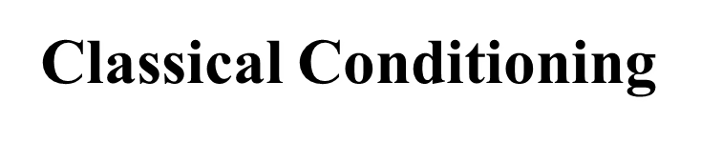
A behavioral learning theory according to which a stimulus is paired with another stimulus that elicits a known response that serves to produce the same response when used alone.
This type of learning can explain why we buy the same things over and over again.
We have been conditioned to respond to and be attracted to certain brands, goods and products.

Slide 13
Pavlovian Model of Classical Conditioning
Unconditioned Stimulus
Meat
Unconditioned Response
Salivation
Conditioned Stimulus
Bell
AFTER REPEATED PAIRINGS
Conditioned Stimulus
Bell
Conditioned Response
Salivation

Slide 14
An unconditioned stimulus(US) is a trigger that leads to an automatic response. Eg. When its cold you shiver, the cold breeze is an unconditioned stimulus; it produces an involuntary response (the shivering).
A neutral stimulus is a stimulus that doesn't initially trigger a response on its own. If you hear the sound of a fan but don't feel the breeze, for example, it wouldn't necessarily trigger a response.
A conditioned stimulus(CS) is a stimulus that was once neutral (didn't trigger a response) but now leads to a response. Eg If you previously didn't pay attention to dogs, but then got bit by one, you are now fearful every time you see a dog, the dog has become a conditioned stimulus.
.

Slide 15
An unconditioned response(UR) is an automatic response or a response that occurs without thought when an unconditioned stimulus is present. If you smell your favorite food and your mouth starts watering, the watering is an unconditioned response.
A conditioned response(CR) is a learned response or a response that is created where no response existed before. Going back to the example of being bit by a dog, the fear you experience after the bite is a conditioned response

Slide 16
Repetition increases the strength of the association between two stimuli and slows down forgetting this connection. However, the amount of repetition that aids retention is limited. Although repetition beyond what is necessary for the initial learning assists in retention, at some point an individual becomes satiated with numerous exposures, and both attention and retention decline.
This effect is called advertising wear-out, and marketers reduce it by using different ads expressing the same message or advertising themes

Slide 17
Stimulus Generalizations
According to classical conditioning theorists, learning depends not only on repetition but also on individuals’ ability to “generalize.” Pavlov, for example, found that a dog could learn to salivate not only to the sound of a bell but also to similar sounds such as jangling keys or coins. Responding the same way to slightly different stimuli is called stimulus generalization

Slide 18
There are four strategic applications of stimulus generalization to branding and managing product lines:
  Product line extensions
  Product form extensions
  Family branding
  Licensing

Slide 19
Product line extensions -Additions of related items to an established brand because they are likely to be adopted, since they come under a known and trusted brand name, which is a marketing application of stimulus generalization.
Product form extension Offering the same product in a different form but under the same brand, which is a marketing application of stimulus generalization.

Slide 20
Family branding Marketing a whole line of products under the same brand name, which is a marketing application of stimulus generalization.
Licensing An application of stimulus generalization that contractually allows affixing a brand name to the products of another manufacturer.

Slide 21
Operant conditioning is a method of learning that employs rewards and punishments for behavior.
Through operant conditioning, an association is made between a behavior and a consequence whether negative or positive
Instrumental (Operant) Conditioning

Slide 22
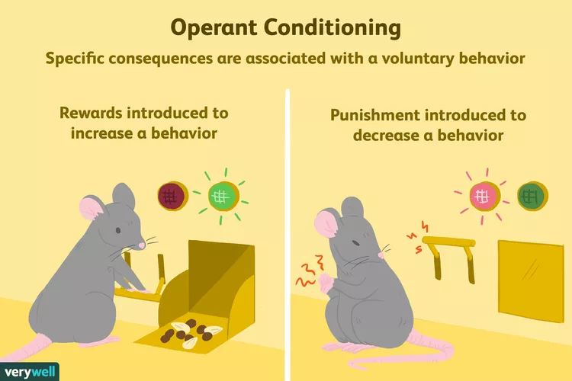
https://www.verywellmind.com/operant-conditioning-a2-2794863
Notes:
When lab rats press a lever when a green light is on, they receive a food pellet as a reward. When they press the lever when a red light is on, they receive a mild electric shock. As a result, they learn to press the lever when the green light is on and avoid the red light.

Slide 23
Reinforcement
Skinner distinguished between two types of reinforcement that influence the likelihood that a response will be repeated.
  Positive reinforcement, rewards a particular behavior and thus strengthens the likelihood of a specific response during the same or similar situation.
  Negative reinforcement is the removal of an unpleasant stimulus and it strengthens the likelihood of a given response during the same or similar circumstances.

Slide 24
Punishment
Punishment is the presentation of an adverse event or outcome that causes a decrease in the behavior it follows. There are two kinds of punishment. In both of these cases, the behavior decreases.
Positive punishment, sometimes referred to as punishment by application, presents an unfavorable event or outcome in order to weaken the response it follows. Spanking for misbehavior is an example of punishment by application.
Negative punishment, also known as punishment by removal, occurs when a favorable event or outcome is removed after a behavior occurs. Taking away a child's video game following misbehavior is an example of negative punishment

Slide 25
Observational
Learning
A process by which individuals observe the behavior of others, and consequences of such behavior.
It emphasizes the importance of observing, modelling, and imitating the behaviors, attitudes, and emotional reactions of others.

Slide 26
Albert Bandura who is the proponent of this theory believed that human beings are active information processors and think about the relationship between their behavior and its consequences.
Observational learning could not occur unless cognitive processes were at work. These mental factors mediate and intervene in the learning process to determine whether a new response is acquired.
This means that individuals do not automatically observe the behavior of a model and imitate it. There is some thought prior to imitation, and this consideration is called mediational processes. This occurs between observing the behavior (stimulus) and imitating it or not (response)

Slide 27
Attention to the model –In order for the behavior to be learned, the observer must see the modeled behavior. For a behavior to be imitated, it has to grab our attention.
Retention of details –The observer must be able to recall the modeled behavior.
Motor reproduction –The observer must have the motor skills to reproduce the action, the observer must also have the motivation to carry out the action.
Motivation and opportunity –The observer must be motivated to carry out the action they have observed and remembered, and must have the opportunity to do so. Motivations may include past reinforcement, promised incentives, and vicarious reinforcement. Punishment may discourage repetition of the behavior

Slide 28
Cognitive Learning
A lot of learning occurs through consumer thinking and problem solving. Sometimes we resolve purchase-related dilemmas instantly.
In other situations, we search for information and carefully evaluate what we learned. This kind of learning, called cognitive learning, consists of mental processing of data rather than instinctive responses to stimuli.
The components of information processing are storing data, encoding data, and retrieving and retaining information.

Slide 29
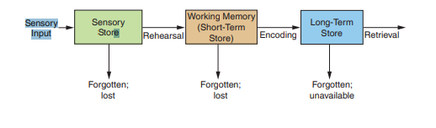
Information Processing
Storing Data
The human memory is the center of information processing. Information processing occurs in stages and in three sequential “storehouses” where information is kept: the sensory, short term, and long-term stores.
Source: Sciffman & Wisenblit, 2019

Slide 30
The sensory store is the mental “space” in the human mind where sensory input lasts for just a second or two. If it is not processed immediately, it is lost.
The short-term store is where information is processed and held for just a brief period. Anyone who has ever been told someone’s name at a party and doesn’t use it immediately knows how briefly information lasts in short-term storage.
The long-term store is the mental “space” where information is retained for extended periods of time. This is in contrast to the short-term store, where information lasts only a few seconds. Although it is possible to forget something within a few minutes after the information reaches long-term storage, it is more common for data in long-term storage to last for days, weeks, or even years

Slide 31
Encoding Data
Encoding involves assigning a word or visual image in order to represent an object during communications. Marketers help consumers encode brands by using brand symbols.
Processing and remembering a picture takes less time than learning verbal information, but both types of information are important in forming an overall mental image. A print ad with both an illustration and body copy is more likely to be encoded and stored than an illustration without verbal information

Slide 32
Retrieving and Retaining Data
Data retrieval is the process by which people recover information from the long-term store; it is frequently triggered by external cues. For example, when you see a product in the store or on TV, you automatically retrieve the applicable information your brain has stored. If the brand is distinctive and heavily advertised, or if you had a memorable experience using it, the retrieval will be quicker than that for less sought-after brands.

Slide 33
Outcomes and Measures of Consumer Learning
Marketers need to assess how much information consumers have learned.
The most popular measures of consumer learning are recognition and recall of messages, and attitudinal and behavioral evaluations of brand loyalty

Slide 34
Recognition & Recall
The purpose of recognition and recall tests is to determine whether consumers remember seeing an ad and the extent to which they have read it and can recall its content.
Recognition tests are based on aided recall where the consumer is shown an ad and asked whether he or she remembers seeing it and can remember any of its salient points.

Slide 35
Recall tests use unaided recall whereby the consumer is asked whether he or she has read a specific magazine or watched a specific television show, and, if so, whether he or she can recall any ads or commercials seen, the product and brand advertised, and any notable points about the offerings promoted

Slide 36
Aided recall is a recognition test, that measures the effectiveness of learning and communications, where consumers are shown ads and asked whether or not they remember seeing them and can recall any of their salient points.
Unaided recall is a recall test, that measures the effectiveness of learning and communications, where consumers are asked whether or not they have read a particular magazine or have watched a particular TV show. Afterwards, they are asked whether they can recall any of the ads featured in these media and their salient points

Slide 37
Brand Loyalty
Brand loyalty is a measure of how often consumers buy a given brand; whether or not they switch brands and, if they do, how often; and the extent of their commitment to buying the brand regularly.
To marketers, a high degree of brand loyalty is the most desired outcome of consumer learning and an indication that they have effectively “taught” consumers a given behavior.

Slide 38
Components of Brand Loyalty
Attitudinal measures gauge consumers’ overall feelings about the brand, including their future purchase intentions.
Behavioral measures focus on observable, factual behaviors, such as the quantity purchased, purchase frequency, and repeated buying

Slide 39
Summary
Consumer learning is a process that evolves and changes as consumers acquire knowledge from experience, observation, and interactions with others.
Newly acquired knowledge affects future behavior

Slide 40
References
Pascale Q, Simone P, Sally R H, Foula K, Del H. (2014), Consumer Behaviour: Implications for Marketing Strategy, (7th Ed.), Australia: McGraw-Hill Irwin.
Schiffman, L.G and Kanuk, L (2010) Consumer Behaviour, 10th Ed. Pearson Education Publishers, New Jersey
Schiffman L.G & Wisenblit J.L (2019) Consumer Behavior, 12th ed, Pearson, New York
Staddon J.E, Cerutti D.T.(2003) Operant Conditioning, Annual Rev Psychol. 2003;54:115-44. doi:10.1146/annurev.psych.54.101601.145124

