Slide 1
CONSUMER BEHAVIOR
WEEK 6
CONSUMER PERSONALITY
BY
DR. WANJIKU KINYANJUI

Slide 2
Learning Objectives
To Recognize how Personality Reflects Consumers’ Inner Differences.
To Understand how Freudian, Neo-Freudian, and Trait Theories Each Explain the Influence of Personality on Consumers’ Attitudes and Behaviour.
To Appreciate how Personality Reflects Consumers’ Responses to Product and Marketing Messages.
To Fathom how Marketers Seek to Create Brand Personalities-Like Traits.
Notes:
Here is an outline of the topics for Chapter Five.

Slide 3
Personality Defined
The inner psychological characteristics that both determine and reflect how a person responds to his or her environment.
The inner characteristics are those specific qualities, attributes, traits, factors and mannerisms that distinguish one individual from other individuals.
Notes:
The study of personality has been approached in many different ways. Heredity, early childhood experiences, and other social influences have a strong effect on who you become. The definition given here is on inner characteristics which distinguish one individual from others. The web link on this page brings you to one of the thousands of personality tests you can find online.
There are some interesting findings regarding the nature of personality. First of all, personality reflects individual differences. Because no two people are exactly the same, marketers can look for certain similar personality traits in different consumers. These consumers can then be grouped together based on this identified personality train. Personality is consistent and enduring. This helps marketers predict consumer behavior over time in terms of personality. Finally, personality can change due to major life events, such as marriage. You may notice personally that your personality has changed somewhat as you have grown – certainly your personality now is somewhat different then from when you were 7 years old.

Slide 4
The Nature of Personality
The Nature of Personality:
  Personality reflects individual differences
  Personality is consistent and enduring
  Personality can change

Slide 5
Personality reflects individual difference-Due to the different individual characteristics, no two individuals are alike, however many individuals may be similar in terms of a single personality characteristic but not in terms of others. Personality is a useful concept because it enables us to categorize consumers into different groups on the basis of one or even several traits. If each person were different in terms of all personality traits it would be impossible to group consumers into segments.

Slide 6
Personality is consistent and enduring-a sibling who comments that her sister has always cared a great deal about her clothes from the time she was little is supporting that personality has both consistency and endurance. Both qualities are essential if marketers are to explain or predict consumer behavior in terms of personality. Marketers cannot change personalities to conform to their products but they can attempt to appeal to the traits.

Slide 7
Personality can change- an individual’s personality may be altered by major life events such as marriage, birth of a child, change of job/profession. An individual’s personality changes not only in response to an abrupt event but also as part of a gradual maturing process. There is also evidence that personality stereotypes may change over time e.g women’s personality has seemed to become more masculine due to changing roles of women today. Traditionally women would stay home and take care of children but today this occupation has changed.

Slide 8
Personality Traits
The human brain is divided into the left and right hemisphere.
The left hemisphere specializes in logical, analytical, sequential processes while the right hemisphere does the intuitive, emotional, visual thinking.
This is further subdivided into the cerebral and limbic centers

Slide 9
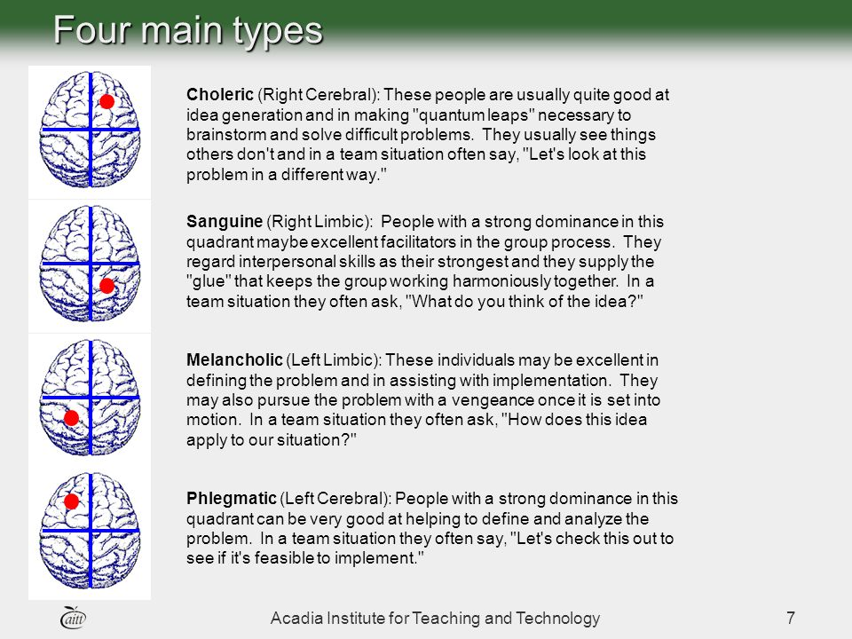
Source: (“Acadia University - Ranked One of the Top Undergraduate Universities in Nova Scotia,” 2022)

Slide 10
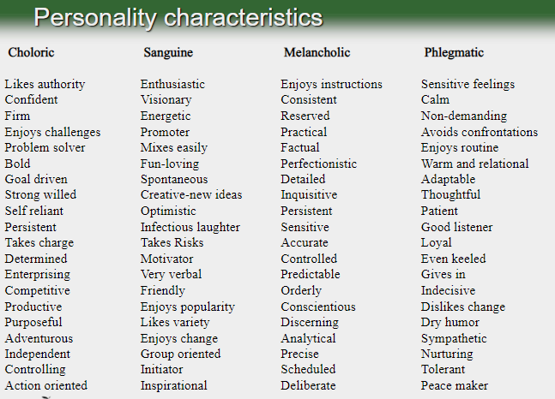
Source: (“Acadia University - Ranked One of the Top Undergraduate Universities in Nova Scotia,” 2022)

Slide 11
Theories of Personality
Freudian theory
  Unconscious needs or drives are at the heart of human motivation
Neo-Freudian personality theory
  Social relationships are fundamental to the formation and development of personality
Trait theory
  Quantitative approach to personality as a set of psychological traits
Notes:
These are the three major theories of personalities. There are many more but these three have been chosen because they are important to the relationship between personality and consumer behavior. Each will be discussed in detail on the next couple of slides.

Slide 12
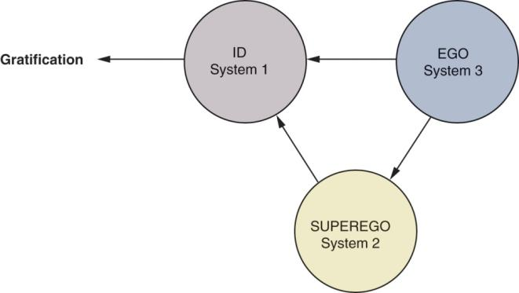
Freudian Theory
Id
  Warehouse of primitive or instinctual needs for which individual seeks immediate satisfaction.
  Such as hunger, thirst, and sex which are driven by pleasure principle and immediate gratification
Superego
  Individual’s internal expression of society’s moral and ethical codes of conduct
  Drives the individual to fulfill their needs in a socially acceptable way
Ego
  Individual’s conscious control that balances the demands of the id and superego.
  An internal monitor that balances the needs of the id and the superego.
Schiffman,Kanuk & Wisenblit (2019)
Notes:
Sigmund Freud was one of the most important and influential psychiatrists of all time. There are many web sited devoted to him and his theories. The web link on this page will take you to one such site.
Freudian theory itself is based on the existence of unconscious needs or drives as the heart of human motivation and personality. According to Freud, human personality consists of these three systems, the id, super ego and the ego. The Id is the “warehouse” of primitive drives, basic physiological needs such as hunger, thirst, and sex. The superego drives the individual to fulfill their needs in a socially acceptable function. Finally, the ego is the internal monitor that balances the needs of the id and the superego.

Slide 13
basic physiological needs such as hunger, thirst, and sex which are driven by pleasure principle and immediate gratification. The superego Finally, the ego is the internal monitor that balances the needs of the id and the superego.

Slide 14
Neo-Freudian Personality Theory
Social relationships are fundamental to personality
Alfred Adler:
  Style of life
  Feelings of inferiority
Harry Stack Sullivan
  We establish relationships with others to reduce tensions
Karen Horney’s three personality groups
  Compliant: move toward others. A compliant individual desires to be loved, wanted and appreciated.
  Aggressive: move against others. Aggressive individuals desires to excel and win admirations.
  Detached: move away from others. A detached person desires independence, self reliance and freedom from obligation
Notes:
As opposed to Freud’s theories which were based heavily on development, Neo-Freudian’s are concerned with social relationships. These relationships are formed to reduce feelings of inferiority or tension. Furthermore, people can be classified as to how they interact with others – are they compliant, aggressive, or detached. A compliant individual desires attention, an aggressive desires admirations, and a detached person desires independence and freedom from obligation. What is particularly interesting is how research has shown that these different personality groups differ in their brand usage.

Slide 15
Trait Theory
Focus on measurement of personality in terms of traits
Trait - any distinguishing, relatively enduring way in which one individual differs from another
Personality is linked to broad product categories and NOT specific brands.
Tests can be done to measure single traits in consumers such as how receptive they are to new experiences (innovativeness), their attachment to possessions (materialism), and their likelihood to accept or reject foreign-made products (ethnocentrism).
Notes:
Unlike Freudian and Neo-Freudian theories, trait theory is less qualitative and more focused on measurement of personality. Tests can be done to measure single traits in consumers such as how receptive they are to new experiences (innovativeness), their attachment to worldly possessions (materialism), and their likelihood to accept or reject foreign-made products (ethnocentrism).

Slide 16
1. Consumer Innovativeness and Personality Traits
Consumer innovativeness
Dogmatism
Social character
Need for uniqueness
Optimum stimulation level
Sensation seeking
Variety-novelty seeking
Schiffman,Kanuk & Wisenblit (2019)
Notes:
Marketers are very interested in the link between personality and consumer behavior. These are seven topics which are examined on the following slides.

Slide 17
Consumer Innovativeness
Consumer innovativeness is the tendency to try new products
Companies consider consumer innovativeness to be very important when introducing new products or brand extensions.
For hi-tech products, innovativeness can be at two types:
  Global /General innovativeness (overall consumer innovative level of willingness to buy new and different products or brands at any category).
  Domain-specific innovativeness (when consumer deals with particular product category such as computers, cameras, fashion, or watches).
Notes:
Consumer innovators are the group of consumers that are very open to new ideas and are usually the first to purchase products. Innovativeness is the underlying trait that describes a consumer’s willingness to try new products. Companies have found this very important when introducing brand extensions because it is a key factor in the consumer’s likelihood to try the new product. For hi-tech products, we see that innovativeness can be explained at three levels. The first, global innovativeness, is the overall innovative level of the consumer. Drilling down further, domain-specific innovativeness has to do with the particular product category, and finally, the innovative behavior is the actual purchase of the new product.

Slide 18
Dogmatism
A personality trait that reflects the degree of rigidity a person displays toward the unfamiliar and toward information that is contrary to his or her own established beliefs.
A person who is highly dogmatic will rarely consider the unfamiliar and tend to be very close minded.
Marketers have realized this type of customer appreciates advertising appeals with celebrities and other experts.
Notes:
Dogmatic is a personality trait that describes how rigid or open a person is to new and unfamiliar ideas and products. A person who is highly dogmatic approaches the unfamiliar defensively and with discomfort. They will rarely consider the unfamiliar and tend to be very close minded. Marketers have realized this type of customer appreciates advertising appeals with celebrities and other experts.

Slide 19
Need for Uniqueness
Consumers who avoid conforming to expectations or standards of others, either in appearance or possessions.
You may be able to identify friends with greater need for uniqueness. You can see it in their clothes and hairstyles.
Notes:
You may be able to identify friends with greater need for uniqueness. You can see it in their clothes and hairstyles. Similarly to the other personality traits we have been discussing, there is a measurement scale that researchers use to quantify an individual’s need for uniqueness. If the respondent scores high on this scale, then they have a higher need for uniqueness.

Slide 20
Optimum Stimulation Level
A personality trait that measures the level or amount of novelty(newness) or complexity that individuals seek in their personal experiences
High OSL consumers tend to accept risky and novel products more readily than low OSL consumers.
High OSL consumers are important to marketers of new products.
Notes:
Optimum stimulation levels are related to how a consumer tends to like or dislike novel, complex, and unusual experiences and products. High optimum stimulation levels lead consumers to take risks and try new products. Similar to a person with high innovativeness, these consumers are important to marketers of new products.

Slide 21
Sensation Seeking
Sensation-seeking traits tie to the need to take risks to fulfill the sensations of experiences which are different and extreme
The need for varied, novel, and complex sensations and experience. And the willingness to take social and physical risks for the sensations.
Notes:
Sensation-seeking traits tie to the need to take risks to fulfill the sensations of experiences which are different and extreme. Much research has been tied to the study of teenage males who often engage in this behavior.

Slide 22
Variety-Novelty Seeking
Measures a consumer’s degree to seek variety
Types of variety seekers include:
  Exploratory Purchase Behavior - consumers who often switch brands to experience new products.
  Use Innovativeness -consumers who display variety by using innovative products.
  Vicarious Exploration- these do not involve actual purchase of the product, but as a result of watching, listening to, or reading about it.
Notes:
Consumers seek variety in many ways. Some exhibit exploratory purchase behavior where they switch brands often to experience new products. Other consumers display variety by use innovativeness, using an existing product in a new way. Finally, vicarious exploration, which often does not involve actual purchase about the product, refers to daydreaming or thinking often about a new product. Ask yourself, for product categories, how do you exhibit variety-novelty seeking?

Slide 23
Social Character
Social character is of great interest to marketers because it differentiates the type of advertising that influences these customers.
Inner-directed people prefer ads that stress product features.
Other-directed individuals gravitate to ads that show approving social environment rather than product information – they want to look to others to understand how to act or be accepted, and the ads give an example of this

Slide 24
2. Consumers Cognitive Personality Factors
Need for cognition
The level of a consumer’s need for cognition affects how they are likely to respond to certain types of advertisements.
Those who are high in need for cognition tend to respond to ads that supply product information as opposed to those who are low in need for cognition who tend to be attracted to the background of the ad, attractive models, and cartoon characters.
Notes:
Researchers are aware that cognitive personality factors influence consumer behavior. In fact, it has been realized that the level of a consumer’s need for cognition affects how they are likely to respond to certain types of advertisements. Those that are high in need for cognition tend to respond to ads that supply product information as opposed to those who are low in need for cognition who tend to be attracted to the background of the ad, attractive models, and cartoon characters.

Slide 25
Visualizers
Prefer visual images or messages as source of information and products
Verbalizers
Prefer written or verbal information eg a question is asked then a detailed description or explanation is provided as answer to attract verbalizers
Notes:
Another cognitive personality factor that researchers have isolated is whether a consumer is a visualizer who prefers visual information or a verbalizer who prefers written or verbal information. This difference in cognitive personality factors would affect how they respond to a print ad.

Slide 26
3. Consumer Materialism
Consumer materialism, is a personality-like trait that describes how essential a person finds possessions compared to their identities and their lives

Slide 27
Materialism Traits
Acquire and show off possessions
Self centered and selfish
Materialistic People
Seek lifestyle full of possessions
Do not get greater personal satisfaction from possessions
Schiffman & Wisenblit (2019)
Notes:
Consumer researchers are interested in possession traits and their relationship to consumption. The first, consumer materialism, is a personality-like trait that describes how essential a person finds possessions in relation to their identities and their lives. Think of people you know – do some seem to have more possessions and find them more important?

Slide 28
Consumption & Possession Traits
Fixated consumption behavior
Consumers fixated on certain products or categories of products
  Characteristics
    Passionate interest in a product category
    Willingness to go to great lengths to secure objects/products
    Dedicate time and money to find products
Compulsive consumption behavior
  These people suffer from a shopping addiction called Oniomania
  “Addicted” and “out-of-control” when making purchases
Notes:
Consumer researchers are interested in possession traits and their relationship to consumption. Fixated consumption behavior is displayed by a consumer who seems “fixated” in consuming in a certain product category. For instance, people who collect Star Trek memorabilia from the original television series or comic books would display fixated consumption behavior.
Compulsive consumption behavior begins to enter the area of abnormal behavior. These individuals are somewhat out of control with their purchasing and suffer from a shopping addiction called oniomania.

Slide 29
4. Consumer Ethnocentrism and Cosmopolitanism
Ethnocentric consumers feel it is wrong to purchase foreign-made products because of the impact on the economy
  They can be targeted by stressing nationalistic themes
A cosmopolitan orientation would consider the world to be their marketplace and would be attracted to products from other cultures and countries.
For some products, the country-of-origin can be very important when marketing the product, but in other situations it must be downplayed.
Notes:
Consumer ethnocentrism has been found to differ from country to country and to change over time. Certain events in the U.S., including the terrorist attacks on 9/11, will change the ethnocentrism in the country. For some products, the country-of-origin can be very important when marketing the product, but in other situations it must be downplayed. In general, if the image of the country is positive, for example a French wine, it would be advantageous for the marketer to emphasize where the product was made. In many ways, cosmopolitanism is the opposite of ethnocentrism. There is an increase in Australia, for example, due to the multiculturalism.

Slide 30
Conclusion
Consumers’ images of themselves is very closely tied to personality and consumption behavior.
People tend to purchase products that enhance their self-concept and relate to their own personalities.
  It is likely that the new virtual personality may result in selected forms of purchase behavior. This may in turn offer marketers targeting various “online selves”
  Online, you can be anyone…
    Gender swapping
    Age differences
    Different marital status
    Mild-mannered to aggressive
    Introvert to extrovert

Slide 31
References
Acadia University - Ranked one of the top undergraduate universities in Nova Scotia. (2022, October 20). Retrieved October 19, 2022, from https://www2.acadiau.ca/search.html
Lin , H.H, & Wu,P.(2006) “The Effect of Variety on Consumer Preferences: The Role of Need for Cognition and Recommended Alternatives,” Social Behavior & Personality, 34 (7)
Pascale Q, Simone P, Sally R H, Foula K, Del H. (2014), Consumer Behaviour: Implications for Marketing Strategy, (7th Ed.), Australia: McGraw-Hill Irwin.
Schiffman, L.G and Kanuk, L (2010) Consumer Behaviour, 10th Ed. Pearson Education Publishers, New Jersey
Schiffman L.G ,Kanuk, L & Wisenblit J.L (2019) Consumer Behavior, 12th ed, Pearson, New York

