Slide 1
CONSUMER BEHAVIOR
WEEK 8
COMMUNICATION AND CONSUMER BEHAVIOR
By
Dr. Wanjiku Kinyanjui

Slide 2
Learning Objectives
To understand the components of communications,
To identify message source credibility, and barriers to effective transmissions.
Appreciate how to design persuasive communications
Notes:
Here is an outline for the topics in Chapter Nine.

Slide 3
Definition: Communication
Communication is the process of creating and exchanging meaning through symbolic interaction.
It is the transmission of a message from a sender to a receiver via a medium of transmission .
From a marketing perspective communication is the transmission of an advertising message from a marketer to a consumer via a chosen channel/medium.

Slide 4
The basic components of communications are: sender, receiver, medium, message and feedback.
a) Senders encode their messages using words, pictures, symbols, spokespersons and persuasive appeals.
b) The channel- channel is the medium, mean, manner or method through which a message is sent to its intended receiver.
    The basic channels are written (hard copy print or digital formats), oral or spoken, and electronic and multimedia.

Slide 5
c) The message-This refers to the information that the sender is relaying to the receiver
d) Receivers decode the messages; to be persuasive, the messages must be decoded as the senders intended.
e) Feedback- the receiver will provide feedback in the form of a reply to the original sender of the message. Feedback provides the recipient with the ability to ensure the sender that their message was properly received and interpreted

Slide 6
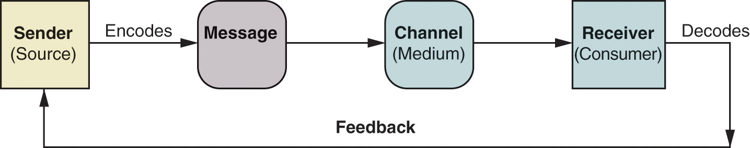
A Basic Communication Model
Source: Schiffman & Kanuk, 2019

Slide 7
The senders of interpersonal communications may be either formal sources
  e.g., a salesperson in a physical or virtual retail location or
Informal sources
  e.g., peers with whom the consumer communicates face-to-face or via electronic means

Slide 8
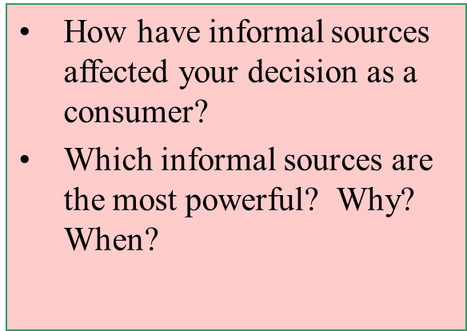
Time Passage and Credibility
Credibility of Informal Sources
Includes word of mouth
These sources also called opinion leaders
Informal sources may not always be credible

Slide 9
The Message Initiator (source)
Credibility of Formal Sources
Neutral sources have the greatest credibility
Source credibility judged on past performance, reputation, service, quality, spokesperson image, retailers, social responsibility
Institutional advertising used to promote favorable company image

Slide 10
The Message Initiator (source)
Credibility of Spokespersons and Endorsers
Effectiveness related to:
  The message
  Synergy between endorser and type of product
  Demographic characteristics of endorser
  Corporate credibility
  Endorsement wording

Slide 11
Endorser Credibility
  The message- Endorser credibility is important when message comprehension is low
Match must exist between product attributes and endorser attributes
Credibility is higher when endorser’s demographic characteristics are similar to those of target audience
Endorser credibility is not a substitute for corporate credibility

Slide 12
The Message Initiator (source)
Message Credibility
  Credibility of retailers
  Reputation of the medium that carries the ad
  Consumer’s previous experience with product

Slide 13
The Source
Informal Sources and Word of Mouth
Informal Sources
  Opinion leaders
Word of Mouth and eWOM
  Two-way communication
  Social networks
  Brand communities
  Message boards and Blogs

Slide 14
Barriers to communication
Selective exposure to messages
  reflects differences in consumers’ levels of attention to advertising messages. Most consumers read ads carefully for products they are interested in and tend to ignore advertisements that have no interest or relevance to them.

Slide 15
  Psychological noise/ Message clutter
    Defined as competing advertising messages or distracting thoughts that impact the reception of promotional messages

Slide 16
Overcoming Psychological Noise
Repeating exposure to advertising messages
  This overcomes psychological noise and facilitates message reception. Thus, repeating an ad several times is essential.
  The principle of redundancy is also reflected in advertisements that use both illustrations and text copy to emphasize the same points.
    To achieve even more advertising redundancy, many marketers now place their messages in such places as video games, movie theaters, elevators, supermarket floors and even public restrooms

Slide 17
Overcoming Psychological Noise
Contrast to break through clutter
  Copywriters often use contrast to break through the psychological noise and advertising clutter and attract consumers’ attention.
  Contrast includes featuring an unexpected outcome; increasing the amount of sensory input (such as color, scent, or sound);
  and identifying the message appeals that attract more attention

Slide 18
Overcoming Psychological Noise
Customized promotion messages
  Digital technologies allow marketers to monitor a consumer’s visits to websites, infer the person’s interests, and design and send customized promotional messages to that person.

Slide 19
Overcoming Psychological Noise
Effective positioning
  Advertisements for products that are perceived to be unique and to provide better value than competitive products are more likely to be received in their intended ways than other promotional messages within the advertising clutter.
  Effective positioning and providing value are the most effective ways to ensure that a promotional message stands out and is received and decoded appropriately by the target audience.

Slide 20
Designing Persuasive Communications
Communications strategy requires decisions in
  Defining the objectives
  Defining the target audience
  Defining the media strategy
  Defining the message strategy

Slide 21
Designing Persuasive Communications
i) Define Communications objectives
  creating awareness of a service
  promoting sales of a product
  encouraging or discouraging certain practices
  attracting retail patronage
  reducing post purchase dissonance
  creating good-will, favorable image

Slide 22
The AIDA model is a framework for persuasive communication from the world of marketing. Its four stages are: awareness, interest, desire and action.
It’s a hierarchy of effects model that follows the CAB process. It starts by developing awareness (Cognition) then desire (Affect) before stimulating action (Behavior).

Slide 23
Designing Persuasive Communications
  ii) Determine Target Audience/receivers
  Segmentation is key, motivation
  Need to know and understand target group very well
    Know what the product can do for the target group
    What the product can mean to them
    How the product can help consumers reach their goals

Slide 24
Designing Persuasive Communications
iii) Determine the media strategy /channel
Consumer profiles
Audience profiles
A cost-effective media choice is one
that closely matches the
advertiser’s consumer profile
with the medium’s audience profile.

Slide 25
Elements of media/channel
Addressable
Customized and addressed to different receivers
Interactive
Receivers can interact with the sender
Response measurable
Receiver's response can be measured

Slide 26
Newspaper : Capabilities and Limitations
Access to large audiences
Effective for local reach
Flexible
Fast
Feedback possible through coupon redemption, etc.
Not selective
Short message life
Clutter
Cost varies based on ad size and vehicle circulation

Slide 27
Magazines : Capabilities and Limitations
Highly selective
Selective binding possible
High quality production
High credibility
Long message life
High pass along rate
Long lead time
High clutter
Delayed and indirect feedback
Rates vary based on circulation and selectivity

Slide 28
Television : Capabilities and Limitations
Large audiences possible
Appeals to many senses
Emotion and attention possible
Demonstration possible
Very high costs overall
Low costs per contact
Long lead time
High clutter
Short message life
Viewers can avoid exposure

Slide 29
Radio : Capabilities and Limitations
Short exposure time
Audio only
High clutter
Delayed feedback through day-after recall tests
High geographic and demographic selectivity
Short lead time
Relatively inexpensive
Good local coverage

Slide 30
Internet : Capabilities and Limitations
Potential for audience selectivity
Customized tracking possible and other feedback tools possible
Useful for branding and reinforcement of messages
Demographic skew to audience
Very high clutter
Great variation in pricing
Privacy concerns

Slide 31
Nontraditional Media
Out-of-home and On-the-go
  Advertising screens in buildings and transit
  Digital billboards on roads
  Ambient advertising (in new places)
Online and Mobile
  Includes consumer-generated media
  Narrowcast messages
Interactive TV (iTV)

Slide 32
iv) Determine the message strategy
The message is the thought idea, attitude, image or other information that the sender wishes to convey to the intended audience
Has to convince consumers – why they should buy? In what way is it special? what are the benefits? Value it offers?
Marketers need to phrase or encode their message in ways that fall within their target audience’s zone of understanding and familiarity

Slide 33
Feedback
Determining Effectiveness
Exposure
  People meters- to measure the viewing habits of TV audiences
Message Attention, Interpretation, and Recall
  Physiological measures- measuring involuntary responses to ads such as heartbeat, pupil dilation, eye movement, .
  Attitudinal measures
  Recall and recognition measures

Slide 34
References
Pelsmacker,P., Geuens, M., & Bergh, J., (2013), Marketing Communications: A European Perspective, 5th Ed, Pearson Education Ltd. UK.
Schiffman L.G & Wisenblit J.L (2019) Consumer Behavior, 12th ed, Pearson, New York

