Slide 1
Consumer Behavior
Week 9
Advertising & Consumer Behavior
by
DR. wANJIKU Kinyanjui

Slide 2
Advertising Defined
According to the Advertising Association of the UK –
  Advertising is any communication, usually paid-for, specifically intended to inform and/or influence one or more people.
According to Kotler –
  Advertising is any paid form of non-personal presentation & promotion of ideas, goods, or services by an identified sponsor.
It is a process of developing a paid communication message intended to inform people about something or to influence them to buy, try, or do something.

Slide 3
Importance of Advertising: To The Customers
Convenience: Targeted informative advertisements make the customer’s decision-making process easier as they get to know what suits their requirements and budget.
Awareness: Advertising educates the customers about different products available in the market and their features. This knowledge helps customers compare different products and choose the best product for them.
Better Quality: Only brands advertise themselves and their products. There are no advertisements for unbranded products. This ensures better customer quality and a good business model as no brand wants to waste money on false advertising.

Slide 4
Advertising Appeals
The goal of an ad is to persuade customers, and advertising appeals provide just the right hook to allow persuasion to occur.
Advertising appeals are designed to create a positive image and mindset about those who use the product or service, and are a major factor of consideration for advertisers.

Slide 5
Musical Appeals
Music can help to capture the attention of a listener because music is often linked to emotions, experiences, and memories, grabbing the attention of those not previously engaged. The use of musical appeals allows for a connection between the product or service and a catchy jingle or piece of music.
  The selection of music can involve an already familiar tune or can involve the creation of an original composition specifically for the ad. (Advertising Appeals: Types & Examples, 2016)

Slide 6
Sexual Appeal
Nudity and other sexual approaches are common and are often employed using various methods. By using subliminal techniques, the advertisement attempts to affect a viewer subconsciously.
  an advertisement may use sexual cues or icons in order to affect the viewer's subconscious, nudity or partial nudity are often used to promote the sale of items such as perfume, cologne, or even clothing. (Advertising Appeals: Types & Examples, 2016)

Slide 7
Humor Appeals
Humor is a proven appeal type for grabbing attention and keeping it. When consumers find something humorous, it has value because is causes them to watch, laugh and, most importantly, remember.
  However, humorous ads can be tricky to design because those that aren't received well result in only the ad being remembered, rather than the product or brand.

Slide 8
Fear appeals
Fear appeals fit particularly well with certain types of goods and services, particularly those products that can eliminate threats or provide a sense of personal security.
  For example, fear is often used in insurance company ads, focusing on the consequences of an untimely death. Or, a mouthwash ad can invoke a fear of bad breath.
Fear can increase a viewer's interest in an advertisement and can heighten persuasiveness, causing consumers to remember these ads more so than upbeat, warm ads.

Slide 9
Rational Appeals
By transmitting basic product information, a rational appeal provides product knowledge. In order to promote liking and preference, a rational appeal provides logical reasons as to why a particular brand or service is superior to another.
Rational appeals place emphasis on facts, details, and product benefits. The goal is moving from product awareness and knowledge to liking, product preference, conviction for the product and, finally, purchase

Slide 10
Mobile Advertising
Mobile advertising is the communication of products or services to mobile device and smartphone consumers. The mobile advertising spectrum ranges from short message service (SMS) text to interactive advertisements.

Slide 11
Because mobile advertising is a new medium, Advertisers and Marketers need to understand how and why consumers use mobile devices and their reactions to such ads. One study discovered that mobile devices provide four types of value to users:
Monetary Value: The device provides good value for the money that also exceeds the value consumers receive from using non-mobile communication devices.
Convenience Value: The device saves time and money, improves efficiency, and makes life easier.

Slide 12
Emotional Value: The user feels good and relaxed when using the device.
Social Value: The value is being accepted by others and impressing them.
The results indicated that the higher the values consumers receive from mobile devices, the more likely they are to use the devices to purchase products and engage in word-of-mouth about what they bought

Slide 13
Benefits of Mobile Ads Use
Marketers have been creating mobile ads that are fun, pay rewards, and help customers find useful information (e.g., referrals).
As smartphone screens became larger, marketers began using mobile ads that take over the entire screen.
Some mobile marketers have been experimenting with inserting ads in places where consumers do not expect to see any, in an effort to overcome consumers’ tuning-out of promotional messages.

Slide 14
Social Media and CB
Social media has revolutionized consumers purchasing trends in recent years.
The impact of social media on consumers can be seen easily with the change in consumer buying habits.
Social media, initially started as a platform to share photos and videos with friends and family but turned out to be a dominant marketing tool.

Slide 15
Social Media Engagements:
1. Sharing information with others: providing and receiving useful information
2. Convenience and entertainment: enjoying content and staying in touch with others
3. Passing time: having free time or believing that everyone else is doing so
4. Interpersonal relations: meeting others with similar interests and backgrounds
5. Promoting one’s self: sharing one’s expertise, hobbies, status, and profession
6. Bonding and social capital: messages exchanged between friends are both a product of the friendship and a means of facilitating and maintaining such friendships

Slide 16
Types of social media channels
1. Owned social media are messages sent by marketers to consumers via channels that the marketers control.
2. Paid social media are messages sent via channels that are not owned by the marketers, who pay for using the channels.
3. Earned social media are channels where consumers pass along messages about brands to one another.

Slide 17
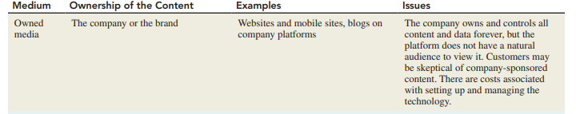
Source: Schiffman & Wisenblit, 2019

Slide 18

Source: Schiffman & Wisenblit, 2019

Slide 19
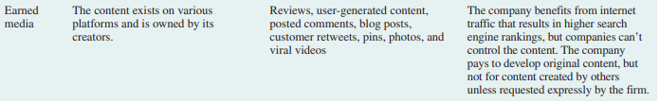
Source: Schiffman & Wisenblit, 2019

Slide 20
Social media Platforms
Branded blogs and microblogging platforms (e.g., Twitter) that encourage interactions among consumers; these messages resemble conversations
Social networks such as Facebook and Twitter.
Widgets, gaming, and other applications that users can download
Mobile phones (discussed in the following section) Most companies use several platforms simultaneously

Slide 21
Advertising Scope and Efficacy
Effective advertising is the result of careful and systematic planning. Therefore, advertisers should use the following steps in designing social media campaigns
1. Define the campaign’s objectives and strategic approaches.
2. Examine the platforms available and determine which ones to use so as to achieve the objectives.

Slide 22
3. Produce the campaign’s content using internal or external resources.
4. Examine the pricing models for securing access to social media, which, unlike pricing for advertising space on traditional print and broadcast communication channels, vary greatly. Then, set the expenditures needed to achieve the campaign objectives.
5. Measure the campaign’s effectiveness.

Slide 23
Gauging influence within Social Networks
1. Twitter is measured by the person’s number of followers, the number of people following the followers, the frequency of updating tweets, and the extent to which his or her tweets are referenced or cited.
2. Google Analytics is a service offered by Google that evaluates the effectiveness of websites and profiles their users by collecting and analyzing .
  Tracking where visitors come from (referrals, search engines, display advertising, pay-per-click networks, email campaigns, and other digital links e.g., clicks within documents
  Customers’ actions after they “land” at the initial page (viewing other pages, downloading files, registering with the site, and other actions)

Slide 24
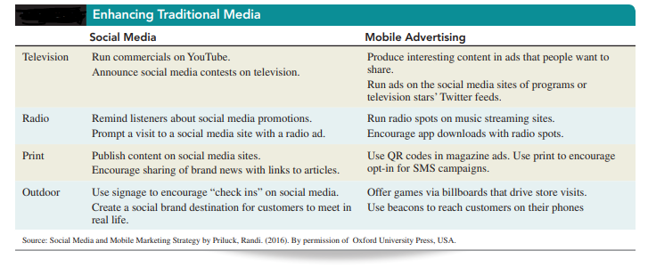
Traditional Media Evolution

Slide 25
Traditional Media Evolution
TV Advertising
Both the production and broadcast of television ads are very expensive, and, with more and more forms of communications emerging, some major TV advertisers are changing course. The feedback from TV ads has been imprecise and did not enable marketers to effectively determine which ads led to sales and which ones did not.
  A growing trend is creating interactive ads through Interactive TV (iTV) which combines the broadcasting capabilities of television and the interactivity of the internet. Interactive TV can be delivered to one’s TV, computer, or mobile device in the form of a two-way communication between subscribers and providers of cable or satellite TV

Slide 26
Radio Broadcast/Ads
The advantages of radio are its high geographic and demographic audience selectivity, as well as the short lead time needed to produce and place ads. Presently, almost all radio broadcasts, globally, are available online.

Slide 27
Print Media
Newspapers provide access to large audiences and are effective for reaching large audiences. However, when it comes to reaching consumers with particular demographics they are generally inadequate.
Newspaper ads can be designed and published quickly, but they have a short life. There is considerable clutter because of the many messages placed therein.
Newspapers have experienced accelerating drop in print advertising and forcing publishers to focus more their digital products. Global spending on newspaper print ads is expected to continue declining between 8 and 10 percent a year.

Slide 28
The decline is forcing publishers to boost alternative digital-revenue streams quickly to make up for lost revenue, and even reconsider the format of their print products and the types of content they publish.

Slide 29
Turnaround Strategies
1. Phase in digital editions bundled with subscribers’ print additions and develop price structures for digital-only access.
2. Reduced print and home delivery.
3. Market digital editions more aggressively.
4. Develop pricing tiers where subscribers to digital editions would be charged according to the volume of material they access.

Slide 30
Although most magazines and newspapers are still printed on paper, almost all now offer online editions and many are planning to phase out their paper editions. Online, both magazines and newspapers can flourish by offering readers customized editions that are based on the readers’ interests.

Slide 31
Out of Home
Out-of-home media previously called outdoor advertising consist of communications that target consumers in less cluttered environments outside of their homes.
This category consists of new promotional tools as well as some older means that were significantly updated with new technology. For instance, captive advertising screens are placed in locations where consumers spend time, such as elevators, cinemas, retail stores, restaurants, bars, fitness clubs, college campuses, and transit.
Digital billboards and displays, with interactive capabilities, are placed in transit locations, events, and stores.

Slide 32
Conclusion
Traditionally, print and electronic media (TV, radio, newspapers, and magazines) were all one-way communications but can be revolutionized using technology
New means to transmit messages have been fundamentally changing the traditional promotional strategies which has enhanced the consumers behaviors and product uptake.

Slide 33
References
Schiffman L.G & Wisenblit J.L (2019) Consumer Behavior, 12th ed, Pearson, New York
Advertising Appeals: Types & Examples. (2016, January 11). Retrieved from https://study.com/academy/lesson/advertising-appeals-types-examples.html.

