Slide 1
Consumer Behavior
WEEK 11
The Family & Consumer Behavior
By
Dr. Wanjiku Kinyanjui

Slide 2
Learning Objectives
To understand consumer socialization.
To understand the family life cycle.
To understand the consumer behavior of nontraditional families and households.

Slide 3
Introduction
The family is the primary reference group for many attitudes and behaviors.
It is also the prime target market for most products and product categories.
As the most basic membership group, a family is defined as two or more persons related by blood, marriage, or adoption who reside together.
Marketers recognize that families operate as units in terms of consumption behavior, therefore, many researchers have studied the dynamics of family decision-making as will be discussed in this topic

Slide 4
Types of Families
The nuclear family is two parents and at least one child.
If the household has at least one grandparent, it is called an extended family.
There is an increasing number of single-parent households.
There are changes that have an effect on spending patterns.

Slide 5
Role of Family
Economic Well-Being- The most important economic function of the family is to provide financial resources to its members and allocate its income in a way that supports all members adequately.
Emotional Support A core function of the family is providing its members with love, affection, and intimacy. When most women had no jobs outside the home, children received most of their emotional support from their mothers.
Suitable Lifestyles- when children set up their own households they tend to imitate their parents’ priorities regarding learning , recreational activities, hobbies, setting of career goals, media exposure, and shopping habits.

Slide 6
Family influences play two important roles in:
  The socialization of people.
  Affecting individual purchase decisions

Slide 7
Consumer Socialization
Socialization is the process of training people to behave in a way that is acceptable to their society.
This practice includes imparting children with the basic values and modes of behavior that is consistent with their cultures, comprising of moral principles, interpersonal skills, dress code, grooming standards, discipline, manners and speech.

Slide 8
It also includes guidance and counsel in the selection of suitable educational and career goals.
In the marketing context, the most important role of the family is the socialization of family members, stretching from young children to the adults

Slide 9
Parents teach children consumption skills-
  they teach them about spending versus savings, how to shop, and how to make purchase decisions. Children today are exposed to marketing messages at a very young age, especially through television advertising and the Internet.
The process by which children acquire the skills, knowledge, attitudes, and experiences necessary to function as consumer is known as consumer socialization

Slide 10
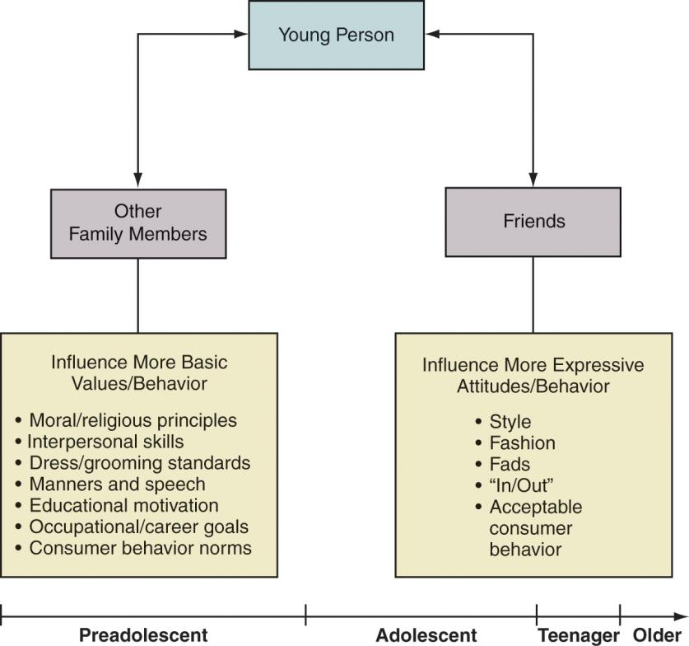
Sources of children’s socialization
From the diagram, Socialization is a two-way process. The two-directional arrows show that a young person is both socialized and influences those who are socializing them.

Slide 11
Parenting Styles
There are four main parental styles:
Indulgent parents, who are very nurturing and highly permissive during consumer socialization
Neglecting parents, who are very permissive and provide their children with little or no nurturing during consumer socialization
Authoritative parents, who are very nurturing and also very restrictive with respect to consumer socialization; and
Authoritarian parents, who are very restrictive and not nurturing during consumer socialization
(Schiffman & Wisenblit, 2019).

Slide 12
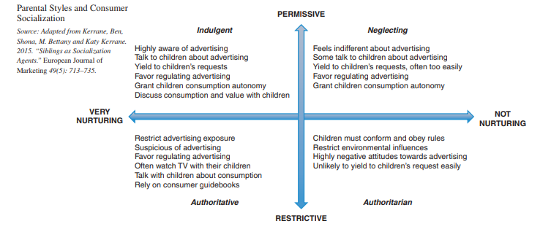
Source: (Schiffman & Wisenblit,2019)

Slide 13
Stages of Consumer Socialization
Children are not born with the skills of an adult, many cognitive and affective abilities develop only in the first few years of life. These abilities develop in the first 16 to 20 years as shown below:
Perceptual (3–7 years old)
During this stage children begin to distinguish ads from programs,
Associate brand names with product categories, and
Understand the basic principles of consumption.

Slide 14
Reflective (11–16 years),
when children understand advertising tactics and appeals,
become skeptical about ads,
understand complex shopping scripts, and
become capable of influencing purchases.

Slide 15
Analytical (7–11 years),
Children capture the persuasive intent of ads,
begin to process functional cues regarding products, and
develop purchase influence and negotiation strategies.

Slide 16
Children’s Development As Consumers
Stage 1: Shopping with Parents and Observing (12–15 months)
• Children notice products that are fun to eat and play with and begin to recall specific ones.
• Parents may buy some items to reward children for good behavior
Stage 2: Shopping with Parents and Making Requests (Age 2–3 years)
• Children begin to connect ads with items in the stores and delight parents with cognitive development.
• They request items by pointing

Slide 17
Stage 3: Shopping with Parents and Making Some Selections (Age 3–7 years)
• Children begin to distinguish ads from programs, associate brand names with product categories, and understand the basic principles of consumption. Children can evaluate products and make decisions about spending, saving, and giving to charity.
Stage 4: Shopping Independently (Age 7–11 years)
• Parents gradually allow children to go to stores or shop online alone or with friends. Children discover the wonders of shopping and deciding among choices. Children understand the persuasive intention of ads

Slide 18
Stage 5: Complex Shopping and Skepticism (Age 11–16 years)
  • Pre-teens and teenagers understand advertising tactics and appeals, become skeptical about ads, and understand complex shopping scripts. They can negotiate and are able to influence purchase decisions.

Slide 19
Family decision making roles
Families behave as a unit when it comes to consumer behavior, and many academics have investigated how families make decisions. Marketers pay close attention to how husbands and wives make decisions.
Husband–wife decision-making: Four patterns
Husband-dominated decisions are those where the husband’s influence is greater than the wife’s.
Wife-dominated decisions are those where the wife’s influence is greater than the husband’s.

Slide 20
Joint decisions are those where the husband’s and wife’s influences are equal.
Autonomic decisions are those where either the husband or the wife is the primary or only decision maker.

Slide 21
Children influence decision making
Children represent considerable market opportunities for those who can meet their distinct needs and cognitive competencies
    Greatest expenditures are in:
    Food and beverages (including sugared cereals)
    Entertainment (toys, games, movies, music)
    Clothing

Slide 22
Child Influence
Pressure: The child demands, threatens, and tries to intimidate the parents.
Exchange: The child promises something (e.g., to “be good” or to clean her or his room) in exchange.
Rational: The child uses a logical arguments and factual evidence.
Consultation: The child seeks parents’ involvement in the decision.
Ingratiation: The child tries to get the parent in a good mood first and then make the request

Slide 23
Family members roles
Another perspective on family decision-making consists of identifying the roles that members play in buying decisions and consumer behavior.
Gatekeepers: these include parents who control the information that reaches the family’s children by using the parental control features available on TVs, computers, and other communication devices.
Influencers: Family member(s) who provide information to other members about a product or service.

Slide 24
Deciders: Although children might influence the car’s purchase, the parents are the ones with the power to decide which car to buy.
Buyers: Those who manage the actual purchase. For example, one spouse might manage decorating the home and another buying the family’s transportation.
Preparers: Transform products for the consumption of the family (mainly foods)

Slide 25
Users: Uses or consumes the product or service. Particularly, for gifts given from one family member to another, the buyer and user is different.
● Maintainers: in charge of repairs so that products continue to work well.
● Disposers: Carries out the disposal of a product or discontinuation of a service

Slide 26

The Family Lifecycle
This comprises of stages that people go through as they become adults.
Each stage beings immense changes and challenges to a family
Source: Schiffman &Wisenblit, 2019

Slide 27
Stage I, Bachelorhood, includes single men and women who have moved out of their parents’ home and are living on their own.
Stage II-Honeymooners, occurs immediately after marriage before the arrival of the first child. They often have start-up expenses as they establish a new home.

Slide 28
Stage III, parenthood, occurs with the arrival of the first child. In this stage, people’s financial status often changes.
Stage IV, post-parenthood occurs when the children have left home. This is also called the empty-nest stage and is a time when couples have more time to themselves.
Stage V-Dissolution, occurs with the death of one spouse. Many in this stage will remarry or begin to live a more economical lifestyle.

Slide 29
Non-traditional Families
Nontraditional families, or less traditional families, are defined as families that do not readily fit into the family life cycle.

Slide 30
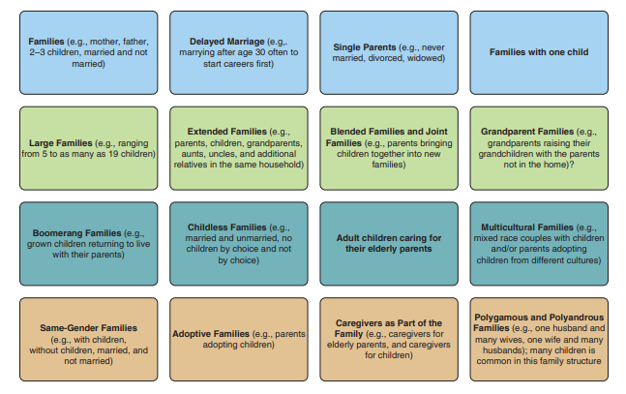
Source: Schiffman & Wisenblit, 2019

Slide 31
Consumption In Nontraditional Families
When households undergo status changes, they often undergo spontaneous changes in consumption-related preferences and thus become attractive targets for many marketers
Divorce- means buying/renting new residence, new furniture etc
Boomerang kids-When an adult child (“boomerang kids”) moves home, there may be additional contributions to household costs and thus more expendable income
Latchkey kid- this is a child who returns home from school to an empty house because the parents are away at work. This child id often left alone with very little supervision.

Slide 32
References
Roedder J, D. (2008). Stages of consumer socialization: the development of consumer knowledge skills and values from childhood to adolescence. In C. P. Haugtvedt, P. M. Herr, & F. R. Kardes (Eds.), Handbook of consumer psychology (pp. 221–246). New York: Psychology.
Schiffman L.G & Wisenblit J.L (2019) Consumer Behavior, 12th ed, Pearson, New York

