Slide 1

OPERATING SYSTEMS
Dr Victoria Mukami
University of Embu

Slide 2
Early Memory Management Systems
Lecture 2

Slide 3
Overview
Memory allocation schemes
Single-user systems
Fixed partitions
Dynamic partitions
Relocatable dynamic partitions
Memory allocation systems
Best-fit
First-fit
Role of the memory list
Memory deallocation.

Slide 4
Learning Outcomes
Identify the various memory management allocation schemes
Understand how memory allocation works in early systems
Identify the role of the memory list during allocation and deallocation

Slide 5
Overview
Review of operating systems
Evolution of operating systems
Functions of the operating systems.
How early operating systems managed memory.
Memory = main memory or Random Access Memory.

Slide 6
Memory Allocation Schemes
Four memory allocation schemes.
  Single-user schemes,
  Fixed partitions
  Dynamic partitions
  Relocatable dynamic partitions

Slide 7
Single User Contiguous
Used in the earliest operating system.
Worked by loading the entire job into memory [1].
Job allocated the entire memory that is required.
Program was too large for the available memory, then it could not be loaded
Execution couldn’t begin [1].

Slide 8
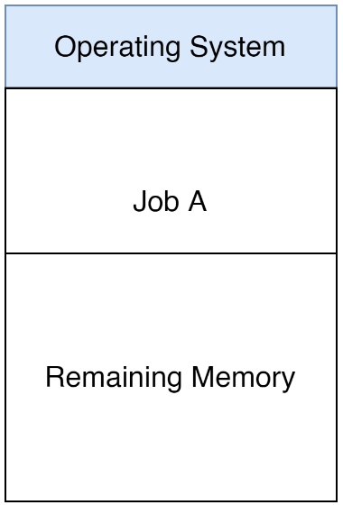
Single User Contiguous
Each job was allocated contiguous space.
Contiguous - memory allocated is next to each other or is in sequence.

Slide 9
Single User Contiguous
Operating system reserved a specific space in memory.
Incoming job is allocated memory that will be used in its execution.
Disadvantage
Memory could only hold one job or program at a given time.
Even with sufficient resources only one job could be executed at a given time.
As with the early operating system, this scheme did not multiprogramming [1].

Slide 10
Fixed Partitions Scheme
Developed to deal with the challenges of the single-user system - lack of multiprogramming.
Allowed for multiprogramming where several jobs, so long as they could fit could be allocated memory resources [1].
Used already created partitions to allocate a job space in memory.
Known as fixed partitions [1] and were configured by the systems administrator.

Slide 11
Fixed Partitions Scheme
Job received the entirety of its partition, so long as it could fit within the space.
Bigger jobs than largest partition
Systems administrator would have to recreate the partitions [1].
The operating system reserved specific space.

Slide 12
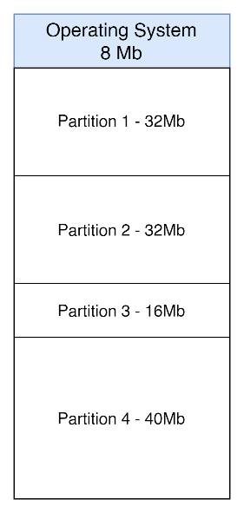
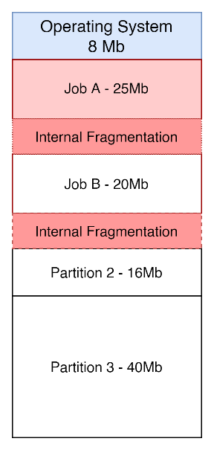
Fixed Partitions Scheme

Slide 13
Fixed Partitions Scheme
Disadvantage
Memory needed to be partitioned every time a job was too big to fit into the partitions.
System administrator needed to create optimum partition sizes that would allow for most jobs to be processed.

Slide 14
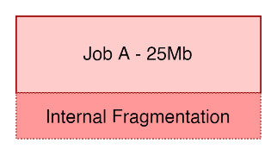
Fixed Partition Scheme
Disadvantage
System wasted a lot of space inside the partition.
Known as internal fragmentation [2]
Situation where a job would be fed into a partition so long as the partition was bigger than the job.
Job A is 25 Mb
Allocated to a 32Mb partition
The internal fragmentation is 7Mb.

Slide 15
Dynamic Partitions Scheme
Fixed partitions - lack of optimum partitions that did not generate a lot of internal fragmentation.
Used a similar system to the single-user system with a couple of exceptions.
Space was allocated contiguously to each job.
System supported multiprogramming
Several jobs could be executed at a go.
Partitions created were of a variable length and number [2].
Allocation was done on the go as job needs arose.

Slide 16
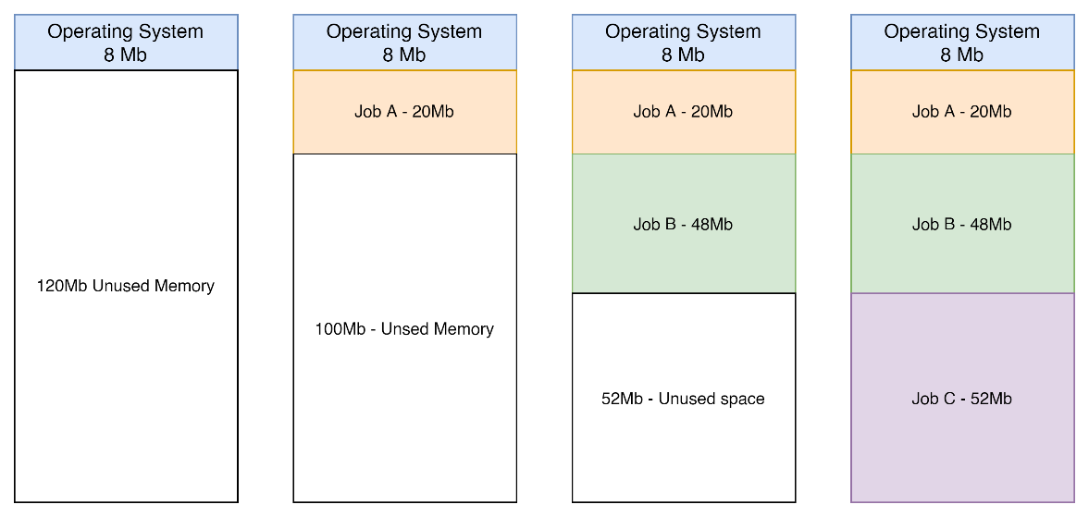
Dynamic Partitions Scheme

Slide 17
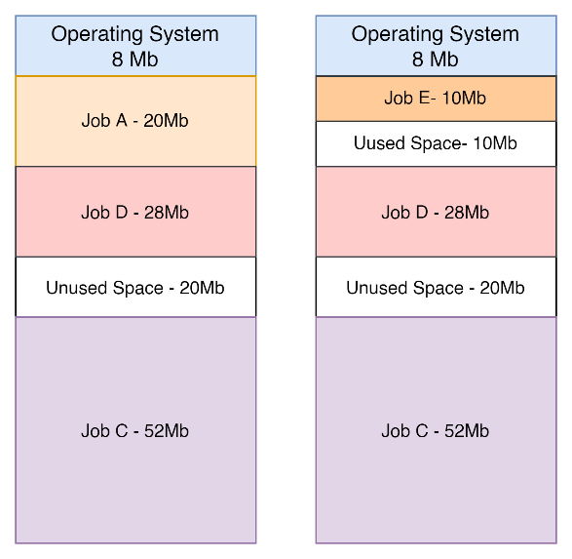
Dynamic Partitions Scheme

Slide 18
Dynamic Partitions Scheme
Entire memory was allocated three jobs (Job A, B and C).
When jobs are removed and swapped a new challenge is brought up - External fragmentation.
Space is left when Job B is swapped for D
When Job A is swapped for Job E.
External fragmentation - memory wastage outside of the partition.
May reach a point where the existing partitions cannot support the incoming jobs.

Slide 19
Relocatable Dynamic Partitions
To overcome dynamic partitions - perform compaction.
Compaction - defragmentation.
The operating system
  picks all the empty spaces
  make the jobs memory to be contiguous
  combines the unused space into a contiguous block as shown

Slide 20
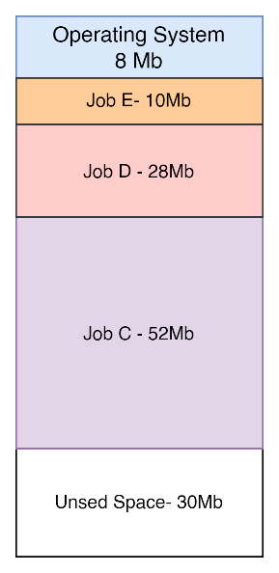
Relocatable Dynamic Partitions
Compaction can lead to a waste of the operating system resources.
It must pause all jobs, compact, and then continue.
If done too often then the computer overheads become high
If done too few times, then the process may not be useful.
Compaction is not an easy job and requires sufficient operating system resources.

Slide 21
Memory Allocation Systems
Two main allocation systems
Mainly used for the fixed partition and the dynamic partition scheme.
  Best-Fit
  First-Fit

Slide 22
Best – Fit System
Chooses the block that is closest in size to allocate the job [2].
Best fit will review based on a memory list of the number of free partitions.
Memory list is a record of all partitions, their size and their status [1].
When an incoming job needs to be allocated a partition, the operating system will check which partitions fit which job best.

Slide 23
Best-Fit
Job Number | Resources requested
Job A | 128Mb
Job B | 300Mb
Job C | 50Mb
Job D | 256Mb
Memory Block size | Job Number | Job Size | Status | Internal Fragmentation
310Mb | Job B | 300Mb | Busy | 10Mb
220Mb | Job A | 128Mb | Busy | 92Mb
50Mb | Job C | 50Mb | Busy | 0
150Mb | -------- | ----------- | Free | -----------
Total: 730Mb |  | Total: 478Mb

Slide 24
Best - Fit
Job D has to wait until memory block 1 is freed for it to be processed.
Uses memory more efficiently
Reduces the amount of internal fragmentation
Much slower to implement as the operating system needs to check against all available resources.

Slide 25
First – Fit System
Chooses the first memory block that is available and can fit the incoming job.
Will work on a job-by-job basis.

Slide 26
First – Fit System
Job Number | Resources requested
Job A | 128Mb
Job B | 300Mb
Job C | 50Mb
Job D | 256Mb
Memory Block size | Job Number | Job Size | Status | Internal Fragmentation
310Mb | Job A | 128Mb | Busy | 192Mb
220Mb | Job C | 50Mb | Busy | 170Mb
50Mb | -------- | -------- | Free | --------
150Mb | -------- | -------- | Free | --------
Total: 730Mb |  | Total: 178Mb

Slide 27
First – Fit System
Scheme is not very efficient especially since the system could have supported additional jobs.
Ends up with a lot of internal fragmentation
Memory is not used efficiently.
A fast allocation scheme as it just checks for what is available and allocates it.

Slide 28
Deallocation
Process by which memory is released after a job concludes being processed [1].
Different techniques used depending on the type of allocation scheme used.

Slide 29
Deallocation
The fixed partition scheme, when the job execution is completed the memory list is set from busy to free and the job removed [1].
The dynamic system uses a complex algorithm like the compaction method.
Reviews whether the block being released is near another free block or next to busy blocks.
This will then determine how compaction will be carried out.

Slide 30
Summary
Memory allocation schemes
Single-user systems
Fixed partitions
Dynamic partitions
Relocatable dynamic partitions
Memory allocation systems
Best-fit
First-fit
Role of the memory list
Memory deallocation.

Slide 31
Discussion Topic
Do web research and find a specific early operating system that used fixed partition systems. Identify what some challenges were especially based on its era.

Slide 32
References
[1] McHoes, A., & Flynn, I., Understanding Operating Systems. Boston: Cengage Learning, 2018
[2] Stallings, W., Operating Systems: Internals and Design Principles. Harlow: Pearson Education Limited, 2018.

Slide 33
Next lesson will cover
Memory Management: Paging and Segmentation

