Slide 1

OPERATING SYSTEMS
Dr Victoria Mukami
University of Embu

Slide 2
Paging and Segmentation
Lecture 3

Slide 3
Overview
Continuation with memory management
Features the paging memory allocation scheme
Overview of the scheme while reviewing the page replacement schemes.
First In First Out (FIFO)
Least Recently Used (LRU)
Review of segmentation

Slide 4
Learning Outcomes
Highlight the characteristics of paged memory segmentation
Explain the two types of page replacement methods
Show an understanding of segmentation

Slide 5
Overview
Reviewed the early memory management systems allocation schemes and systems.
We look at paging systems.
Operating systems have evolved to support multiprocessing and multiprogramming
Newer memory management schemes
Used to ensure that efficiency and minimal wastage of the memory.

Slide 6
Overview
Older memory systems required an entire job or program to be loaded into memory.
Newer systems do not require the entire program to be loaded into memory.
Newer systems only require the part of the program required for processing to be loaded into memory.

Slide 7
Paged Memory Allocation
A book is made of pages.
Each page could hold its content or could be a continuation of the previous content.
A book can have a few pages or a lot of pages.
Paged memory divides jobs into units of equal size with each unit called a page [1].

Slide 8
Paged Memory
Page size can be the same size as a section of main memory
Called a page frame [1].
Same is said for the sections of a magnetic disk called sectors
Should be the same size as the page.
When the page, sector and page frame are all the same size then the paged memory is very efficient [1].

Slide 9
Paged Memory
Deals with the issues of internal fragmentation from fixed partitions
External fragmentation due to dynamic partitions.
A list of free page frames is maintained by the operating system
Before execution, the operating system performs a couple of functions [1]:
  determine the number of pages within the program or job
  locate the empty page frames using the list of free page frames
  load all the program’s pages into the frames

Slide 10
Paged Memory
During initial loading
  The program is prepared in sequence
  All instructions are found on the first page and the last page
  Instructions signal the beginning and the end of the job
Pages are not loaded contiguously into memory[1].
Pages are loaded anywhere there is space within the page frames in memory.

Slide 11
Paged Memory
Operating system must figure out how to manage the non-contiguous pages.
This is done by the
  Job Table (JT)
  Page Map Table (PMT)
  Memory Map Table (MMT).

Slide 12
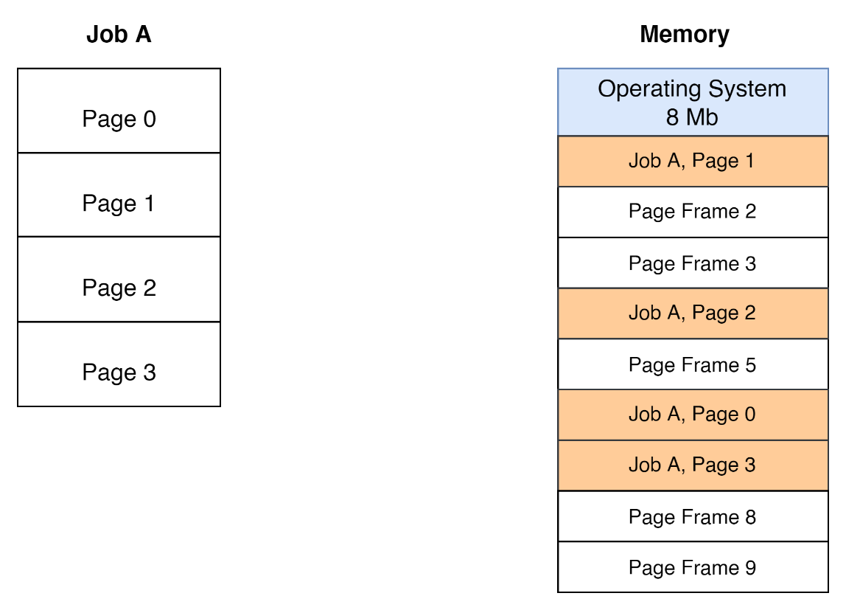
Paged Memory
Job A is divided into pages 0 to 3.
The first Page 0 and the last Page 3 contain the job instructions.
Pages are divided into similar sizes
Pages are then loaded into memory non-sequentially

Slide 13
Paged Memory
Job Table (JT) is used to
  Hold all the jobs within the system
  The resources they need and their location within the PMT.
Each job then has its own PMT.
Lists the number of pages that the job has been split into.
Memory map shows where each page is in memory and whether the memory section is free or busy [1].

Slide 14
Paged Memory
Advantage
Memory usage is more efficient
Pages are stored anywhere there is space within the page frames
Disadvantage
Pages are located anywhere in memory, more resources
The last page of any job will more often result in internal fragmentation
A small size page would result in a PMT that is lengthy
Too large a page - larger internal fragmentation.

Slide 15
Demand Paging Allocation
Demand paging allocation allows for only parts of the program to be placed into memory.
All the jobs are first divided into pages.
All these pages initially reside in secondary storage before being loaded into the main memory.
Parts of the job or program that are needed are placed into memory.

Slide 16
Demand Paging Allocation
A user is working with Microsoft Word.
When typing the document, a user may only work with one menu at a time
All the other menu items stay idle.
To change this WORD to bold, the user selects the home menu and selects B and gets WORD
All the other menu items are idle within Microsoft Word,
Premise that demand paging is built of.
By allocating only portions of the job that are necessary for processing - less memory.

Slide 17
Demand Paging Allocation
Page swapping - movement of pages from main memory to secondary storage [1].
Operating systems rely on tables to determine how pages are moved from one to the other.
  JT
  PMT
  MMT

Slide 18
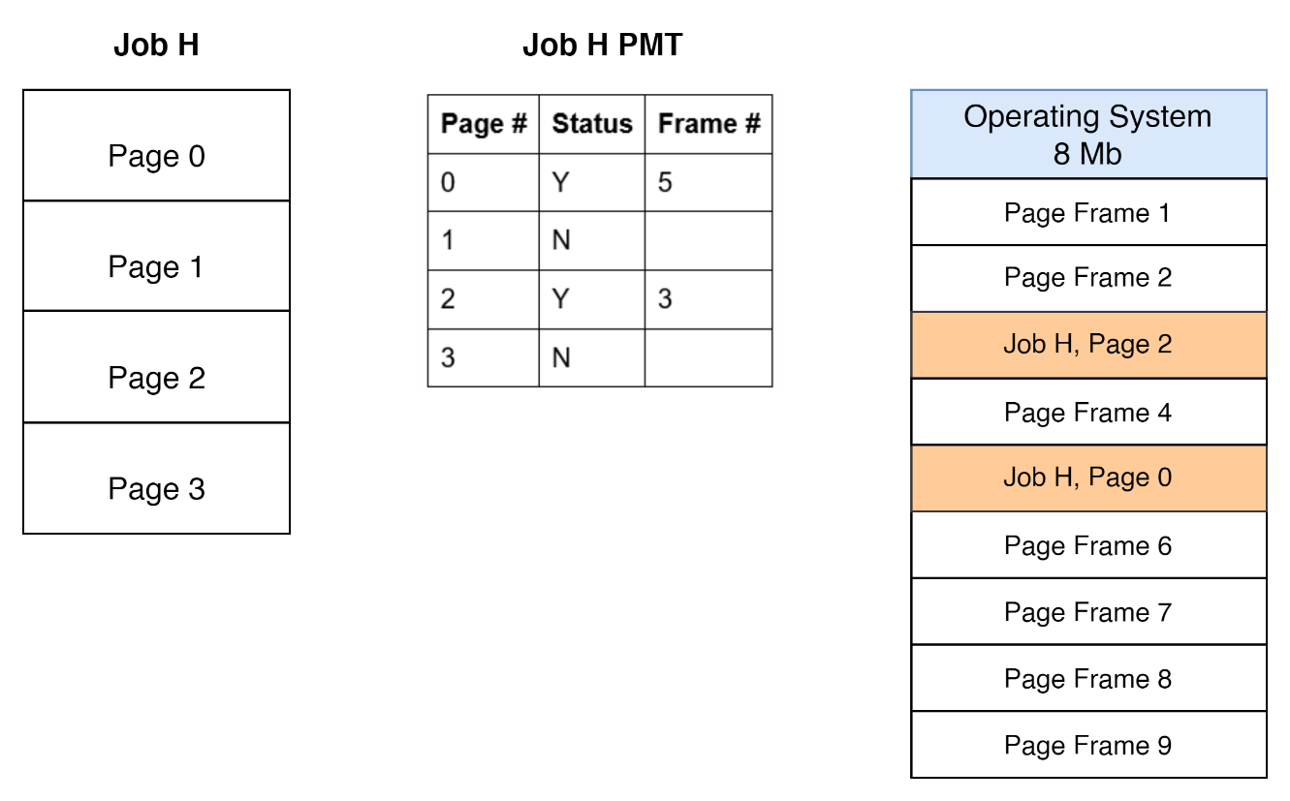
Demand Paging Allocation

Slide 19
Demand Paging Allocation
Job H has 4 pages.
Pages are loaded onto the PMT table.
PMT lists whether the page is loaded in memory or not using the status field.
Pages 0 and 2 are loaded into frames 5 and 3 respectively
Pages 1 and 2 are not loaded.

Slide 20
Demand Paging Allocation
Advantage
Does not require the entire program to be loaded into memory.
Minimal memory wastage
Disadvantage
Excessive page swapping - occurs when pages are swapped too often between the main memory and the secondary memory.
Thrashing - higher overheads by the operating system.

Slide 21
Page Replacement Policies
Requires the use of various policies that dictate how pages are swapped.
Two main policies exist
  First In First Out (FIFO)
  Least Recently Used (LRU)

Slide 22
First In First Out (FIFO)
Replacing pages from frames that have been in memory longest or those that were in the earliest [1].
Does not work efficiently especially when the page frames are few and there is excessive swapping.
A page interrupt occurs when a page is loaded in memory and whether it is swapped out or not [1].
Increasing memory regardless of the policy is not a guarantee that swapping will reduce.
Notes:
Assuming JOB H from Figure 2 needed to swap between two frames. We have pages 0 and Page 1 being loaded into Frame A and B. If page 2 needed to be swapped, it would be swapped with Page 0 as it was first placed into memory. Therefore Page 0 would be moved to the secondary storage and swapped with Page 2. With this method, it means now that Page 1 is the oldest page within memory and if Page 3 needed to be loaded it would be swapped with Page 1.

Slide 23
Least Recently Used (LRU)
Allocation scheme is used to swap out pages that show the least activity and are less likely to be used in the future [1].
A list that indicates when the page entered memory and was last used.
Any page frame will be checked for its activity and its ability to be required or used in the future. Number of swaps may reduce with a reduction in the number of pages interrupts
Pages that are required more often are left within memory.

Slide 24
Segmented Memory Allocation
How programmers structure their programs into logical modules [1].
Each job gets divided into segments of different sizes.
Dynamic sizes are the key difference between the paging method and segmentation.

Slide 25
Segmented Memory Allocation
Segmentation was developed to take care of page faults within the paging method [1].
Jobs being divided into segments of various sizes, the memory is not divided
Segments are dynamically allocated the resources that they need in memory.

Slide 26
Segmented Memory Allocation
Segmentation used a Segment Map Table (SMT).
Table is used to store details about the segment including its numbers, length, status and when it is loaded into memory and its memory location [1].
Three tables, JT, SMT and MMT are used to support the operating system

Slide 27
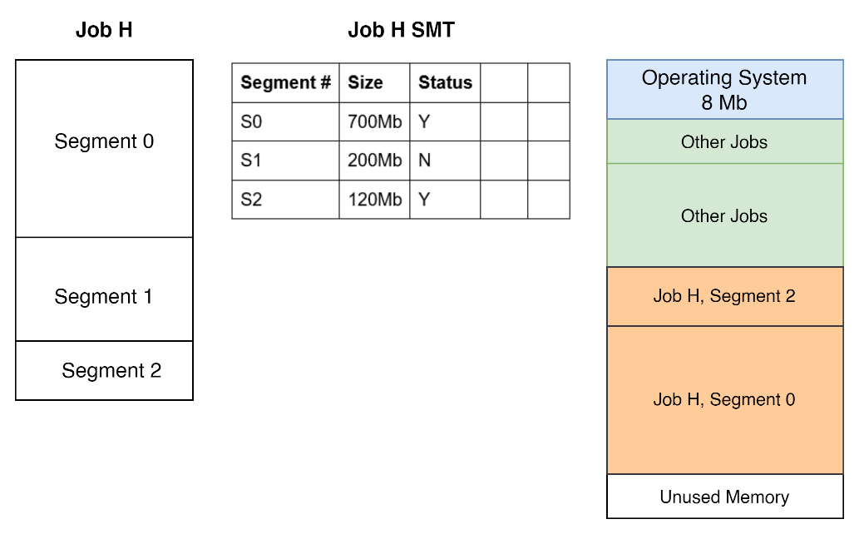
Segmented Memory Allocation
Job H is divided into segments of variable lengths.
Segments are divided into variable sizes and then stored within the SMT.
Only the needed segments are loaded into memory.

Slide 28
Segmented Memory Allocation
Advantage
Deals with the page faults from the paging method.
Disadvantage
Uses a dynamic method to allocate segments to memory.
Results in external fragmentation
Compaction is needed to ensure that memory is not wasted.

Slide 29
Segmentation vs Paging
Both methods are similar.
Paging uses pages and page frames in memory.
Segmentation uses segments and memory is dynamically allocated.
Paging pages are physical units that are invisible to the user's program
Segments - logical units that are visible to the user's program.

Slide 30
Segmented/ Demand Paged Memory Allocation
Evolved from the segmented memory and the demand paged memory.
Picks the advantages of both and merges them into one.
Same methods used in both are used here with some exceptions.
  One JT for all the jobs in the system
  Each job has its own SMT
  Each SMT has its own PMT
  MMT is for the entire system

Slide 31
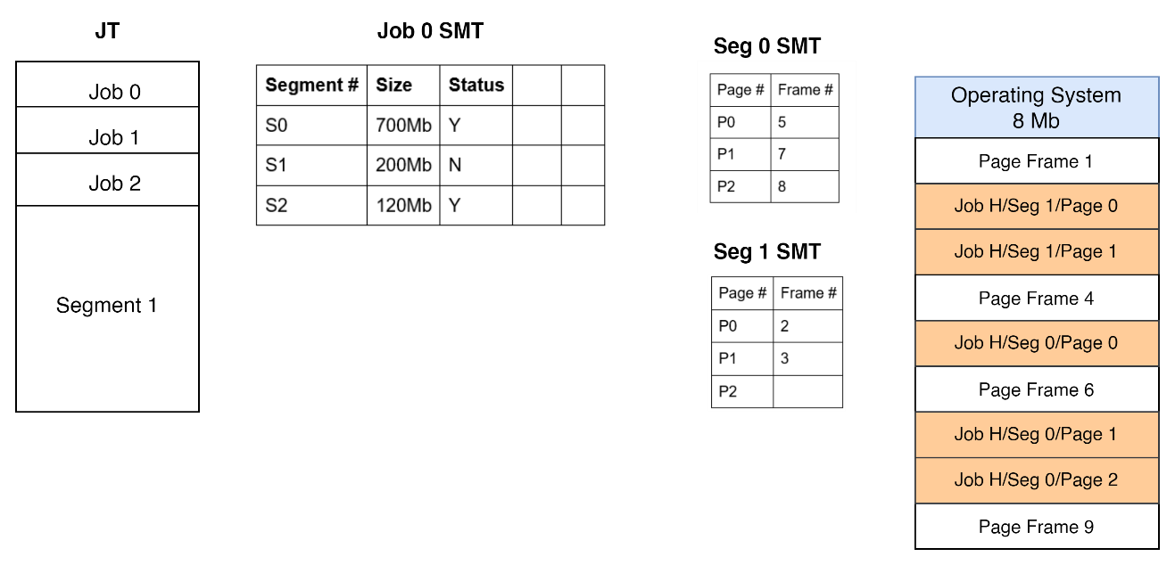
Segmented/ Demand Paged Memory Allocation
To access the location of a particular job, the scheme needs to access the Job number, then the segment number, and the page number for it to access the exact location

Slide 32
Segmented/ Demand Paged Memory Allocation
Drawback
Need to access 4 tables meaning lots of overhead
Time it takes to reference the tables.
Mitigation
Associative memory - name given to registers that are allocated to each active job [1].
The registers associate several segments and page numbers for a specific job and the main memory address [1].
Registers are generally hardware; therefore, the number of registers will be dependent on the type of machine.

Slide 33
Summary
Continuation with memory management
Features the paging memory allocation scheme
Overview of the scheme while reviewing the page replacement schemes.
First In First Out (FIFO)
Least Recently Used (LRU)
Review of segmentation

Slide 34
Discussion Topic
Throughout the lecture, we reviewed the various memory management schemes. Based on the computers or laptops that you are using, identify the various types of paging mechanisms being used. Remember this will be dependent on both the operating system and the hardware.

Slide 35
References
[1] McHoes, A., & Flynn, I., Understanding Operating Systems. Boston: Cengage Learning, 2018
[2] Stallings, W., Operating Systems: Internals and Design Principles. Harlow: Pearson Education Limited, 2018.

Slide 36
Next lesson will cover
Virtual Memory and Cache Memory

