Slide 1

OPERATING SYSTEMS
Dr Victoria Mukami
University of Embu

Slide 2
Virtual Memory and Cache Memory
Lecture 4

Slide 3
Overview
Concepts of virtual memory and cache memory.
Hardware and control structures will be reviewed.
How virtual memory works on the Windows and Linux operating systems.
A review of how cache memory works

Slide 4
Learning Outcomes
Understand various terminology associated with virtual memory
Review the inner working of virtual memory on specific operating systems
Understand how cache memory is utilized by the operating system.

Slide 5
Overview
Reviewed the various memory management systems that are used by operating systems.
Looked at the early memory management systems
More recently used memory management systems.
Review the various terminology associated with virtual memory.

Slide 6
Terminologies
Virtual Memory - Scheme that allows for secondary memory to be viewed and used like main memory [2].
Limited by the amount of secondary storage available and the addressing scheme by the computer.
Virtual Address - Address that a virtual memory location is assigned
Allows for it to be accessed as though it is the main memory [2].
Address Space - These are the memory addresses that are available for a process [2]

Slide 7
Virtual Memory
Gives a user the illusion that the computer has more memory than it does.
Takes care of the issues we have seen with previous memory allocation schemes
Jobs that required resources larger than the main memory can be processed.
Large jobs can be handled comfortably by the computer.

Slide 8
Virtual Memory
Virtual memory - result of pages being able to be allocated and deallocated to and from main memory to secondary storage [1].
Swapping pages in and out of memory give the user the illusion that the entire job is stored within memory during processing [1].
Virtual Memory can be combined with Paging and Segmentation.

Slide 9
Virtual Memory with Paging
Virtual memory requires the use of a page map table.
Programs are divided into the same size pages.
VM with paging does not have any external fragmentation
Internal fragmentation still occurs within the page frame.

Slide 10
Virtual Memory with Paging
A free frame list needs to be maintained.
All the pages do not have to be located within the main memory as they can be partly located within the secondary memory.
The absolute address of the VM is calculated using a page number and displacement [1].

Slide 11
Virtual Memory with Segmentation
Virtual memory requires the use of a segment map table.
Programs are divided into segments.
Due to dynamic allocation of memory, there is no internal fragmentation
There is external fragmentation in between memory frames.

Slide 12
Virtual Memory with Segmentation
A list of free memory spaces needs to be maintained by the operating system
All the segments do not have to be located within the main memory as they can be partly located within the secondary memory.
The absolute address of the VM is calculated using a segment number and displacement [1].

Slide 13
Virtual Memory
Allows for efficiency in multiprogramming environments.
The CPU wastes time when resources are yet to be availed to allow for the processing of a job.
In the case of VM, the CPU can move on to other jobs before the resources are availed [1].

Slide 14
Virtual Memory - Benefits
Job’s size is not restricted to the main memory size.
Memory usage is efficient as only sections (pages or segments) of a job that are required for immediate processing are stored in memory [1].
Multiprogramming is unlimited as there is either dynamic or static partitioning of memory and the inclusion of secondary memory [1].
Allows for the sharing of code and data between programs and users [1].

Slide 15
Virtual Memory - Drawbacks
Use of VM increases processor hardware costs.
Increased use of computer resources due to the overhead of handling interrupts [1]
VM increases software complexity to prevent thrashing [1].
Notes:
This is due to the use of the secondary memory acting as the main memory [1].

Slide 16
Windows Virtual Memory Management
The memory manager in charge of virtual memory oversees how memory is allocated and how paging is performed [2].
Page sizes within this system vary and range from 4Kb to 64Kb.
Windows comes in either 32-bit or 42-bit platforms.

Slide 17
Windows VM
32-bit platforms allow for up to 4GB of virtual memory per process [2].
Half of this memory is reserved for the operating system functions.
Within 64-bit systems, 8TB is available for use as VM within windows [2].
The space, either 2TB or 8TB is divided into equal size pages that can be brought into memory.
The spaces are managed in a contiguous manner by the operating system.

Slide 18
Windows VM
Virtual memory manager works with the following rules:
When there is plenty of memory, the VM manager allows the active processes to grow.
When there is scarce memory, the VM manager will recover memory by removing pages that have not been active/used recently.
Windows will continuously keep watch for large programs that keep increasing the amount of memory they need.

Slide 19
Linux Memory Management
Page sizes within Linux depend on the Linux architecture but are normally 4KB.
The Linux operating system uses a three-level page table structure [2].
The page directory is found within the main memory and represents an active process.
Page middle directory represents one page within the page table.
The page table represents one virtual page of a process.

Slide 20
Linux Memory Management
Linux uses a buddy system to maintain the pages to and from memory.
Increases the efficiency with which pages are written to and from memory.
A kernel maintains a contiguous list of fixed-size page frames [2]
The Buddy algorithm is used during allocation and deallocation

Slide 21
Cache Memory Management
Cache memory is invisible to the operating system
Interacts with other hardware systems [2].
Virtual memory and cache memory work in a similar manner.

Slide 22
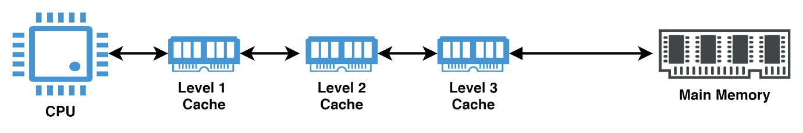
Cache Memory Management
Three levels of cache memory used in today's computer systems.
Level 1:
This is fast cache memory but can only hold small amounts of information.
Level 2:
Much slower than level 1 cache memory but can hold larger amounts of information.
Level 3:
Much slower than level 2 but holds a lot of information.

Slide 23
Cache Memory
Uses small, fast, and expensive memory to supplement the main memory, especially when dealing with the CPU [1].
Cache is very fast as compared to the main memory
Up to ten times faster.
Helps to lower the amount of time needed to access different instructions.

Slide 24
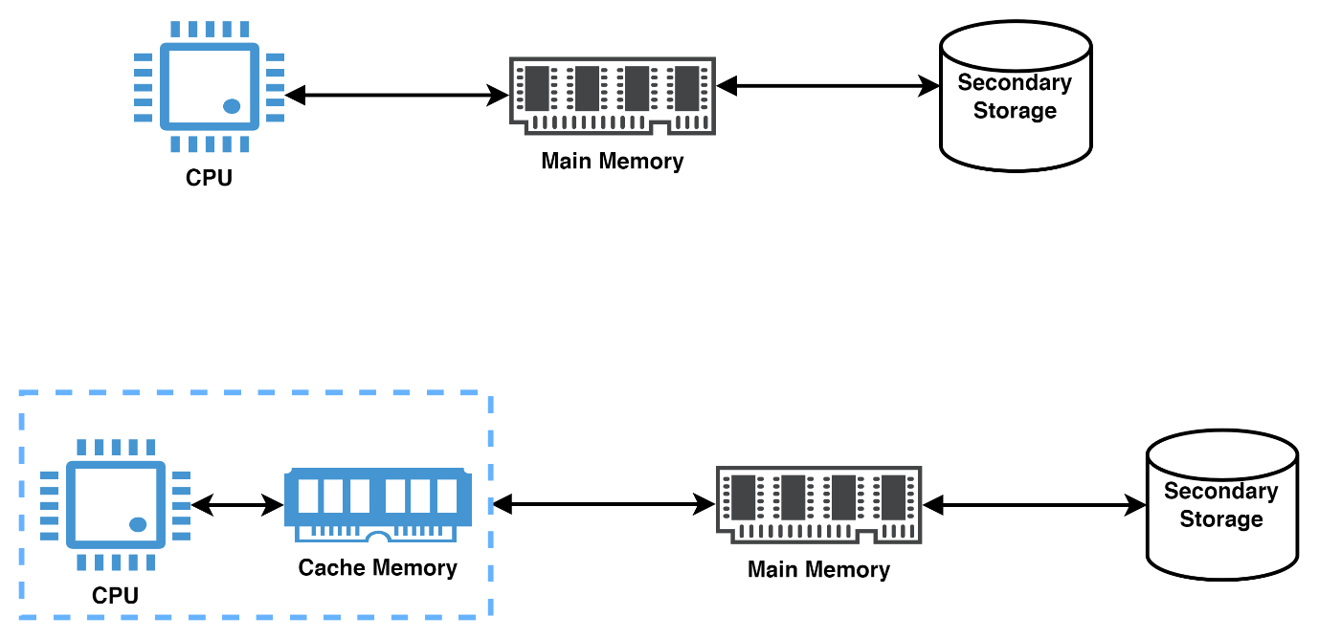
Cache Memory
Data was transferred between the secondary memory and the main memory.
Data transfer was still slow
Necessitated the need for a middleman that was faster than the main memory.
Frequently needed data or instructions are stored within the cache memory.

Slide 25
Cache Memory
The memory is first divided into equal sizes.
Cache memory is divided into equal size blocks known as slots [1].
After the CPU has requested data or instructions, they are transferred into cache memory from the main memory
Placed into any of the free slots.
Anytime the CPU needs frequently used data, it is accessed from the cache memory
If the instructions are found within the cache the main memory is not accessed.

Slide 26
Memory Allocation
The memory manager has several roles during memory management
The evolution of memory management schemes has been precipitated by previous schemes.

Slide 27
Memory Allocation
Scheme | Problem Solved | Problem Created
Single User Contiguous |  | Job limited to memory size CPU often idle
Fixed Partitions | Idle CPU Time | Internal Fragmentation Job limited to partition size
Dynamic Partitions | Internal Fragmentation | External Fragmentation
Relocatable Dynamic Partitions | External Fragmentation | Job limited to memory size Compaction overhead

Slide 28
Memory Allocation
Scheme | Problem Solved | Problem Created
Paging | Need for compaction | Memory needed for tables Job limited to memory size Internal Fragmentation
Demand Paging | Job limited to memory size Inefficient memory use | Many tables Thrashing Overheads due to page interrupt
Segmentation | Internal Fragmentation | Hard to manage variable-length segments External fragmentation
Segmented/ demand paging | Segments not loaded in demand | Overhead for table handling Memory for page and segment tables

Slide 29
Summary
Concepts of virtual memory and cache memory.
Hardware and control structures will be reviewed.
How virtual memory works on the Windows and Linux operating systems.
A review of how cache memory works

Slide 30
Discussion Topic
Throughout the last three lectures, we have reviewed the types of memory management schemes. Operating systems have come a long way in managing memory. Do online web research and find what new methods of memory management currently exist. Review the pros and cons of each.
Submit this to your instructor or present it in class.

Slide 31
References
[1] McHoes, A., & Flynn, I., Understanding Operating Systems. Boston: Cengage Learning, 2018
[2] Stallings, W., Operating Systems: Internals and Design Principles. Harlow: Pearson Education Limited, 2018.

Slide 32
Next lesson will cover
Process Management: Scheduling

