Slide 1

OPERATING SYSTEMS
Dr Victoria Mukami
University of Embu

Slide 2
Process Management: Threads
Lecture 5

Slide 3
Overview
Introduction to process management
Introduction to threads.
Define various aspects regarding threads
Identify the types of threads
Job and process states
Thread states.
Multithreading models

Slide 4
Learning Outcomes
Differentiate between threads and processes
Identify the types of threads, thread states and the role of multithreading
Understand the various multithreading models

Slide 5
Introduction
Processor management and threads.
Functions of an operating system: memory management.
Reviewed how jobs are loaded into memory
How they are unloaded (read allocation and deallocation).
Once a job is loaded into memory, then processing needs to occur.
Processing is done by the CPU
Involves several activities.

Slide 6
Definitions
Processor
Also known as the CPU (Central Processing Unit).
This is the main hardware that performs processing within a computer
Process
An active entity requiring resources to perform its function [1].
Also known as a task.
A process is a single instance of a program

Slide 7
Definitions
Program
An inactive entity that is composed of several processes [1].
This could be a stored file.
Thread
Created by a process
Can be scheduled and executed away from the main process [1].
A process can have many threads
Process owns the resources allocated to a thread.
Notes:
Not all operating systems support threads.

Slide 8
Definitions
Multiprogramming
Ability of a processor to be allocated a job for a period and deallocated at the appropriate time.
A single processor is shared by several jobs.
Multithreading
Allows an operating system to manage processes with several threads [1].
One software that uses multithreading is the browser.

Slide 9
Threads
All the threads of a process share resources of their process.
They reside in the same address space as the parent process
They have access to the same data [2].
Sharing resources, the address space, and data means
  When one thread makes a change within a multithreading environment,
  Other threads will see the changes made.

Slide 10
Threads - Benefits
It is much faster to create a new thread in an existing process than it is to create a new process [2].
It takes less time to terminate a thread than a process [2].
Switching between two threads within the same process is much faster than switching between two processes.
Threads enhance communication between different executing programs [2].

Slide 11
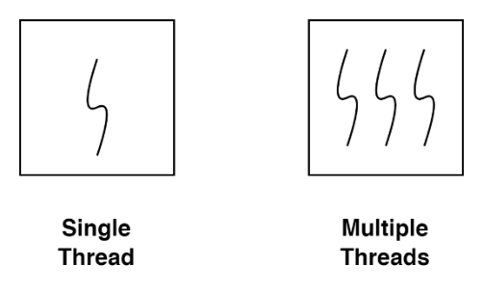
Threads
Threads are implemented as either single or multi-threaded processes.
One process can have a single thread or multiple threads

Slide 12
Process vs threads
Process | Thread
Is resource intensive | Uses fewer resources than a thread
Takes a considerably longer time to terminate | Takes a shorter time to terminate
Takes a longer time to create | Takes a shorter time to the creation

Slide 13
Process vs Threads
PROCESS | THREAD
Process switching must be done by the O/S | Thread switching does not involve the O/S
The process does not share data | Threads share data
Each process works independently of the other | Threads can read, write, or change each other’s data

Slide 14
Thread States
A thread has different states as it moves through the system.
When a process creates a thread - Ready queue [1].
When assigned to a processor - Running.
When in the Running queue, a thread can move to one of three states:
  Waiting
  Delayed
  Blocked

Slide 15
Thread States
Waiting state
When the thread is waiting for an external event
When another higher priority process interrupts the current process.
When complete a signal is sent to move from Waiting to Ready [1]

Slide 16
Thread States
A thread can be delayed for a specific period - Delayed state.
Time elapses - Ready state.
When an I/O request is issued - Blocked state [1].
When the I/0 request is fulfilled - Ready.
After a thread completes its transitioned - Finished state.

Slide 17
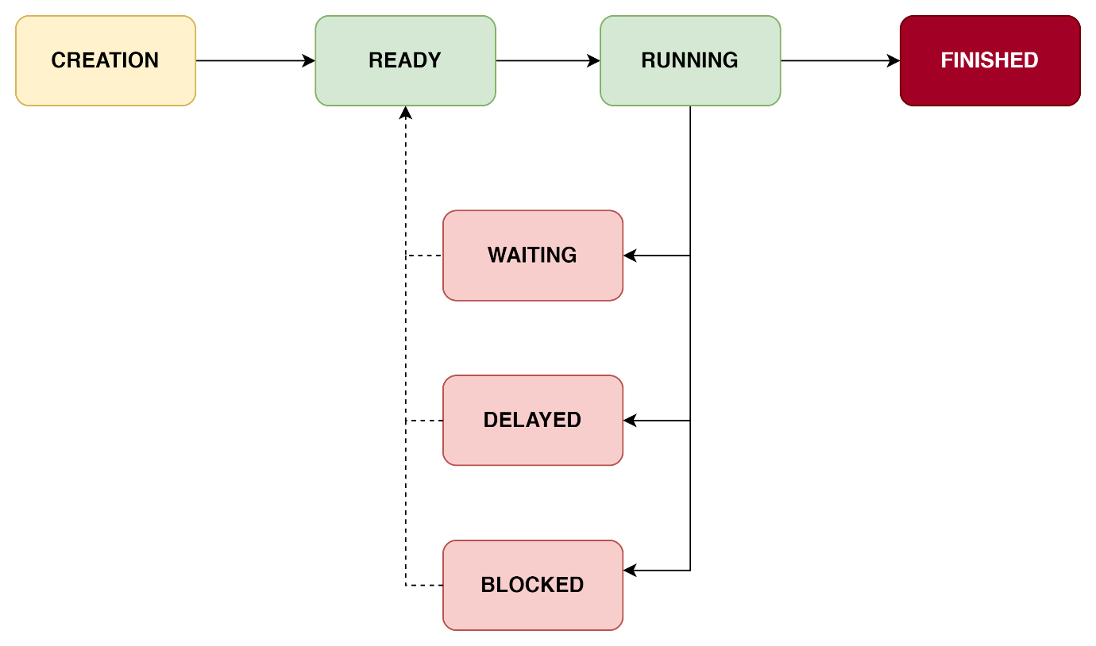
Thread States

Slide 18
Thread States
Operating System Role
Create new threads
Prepare a thread in readiness to execute
Delaying threads for a specific amount of time
Blocking threads that may have any I/O requests

Slide 19
Thread States
Operating system role
Placing threads on wait if a specific event needs to take place or has occurred
Schedule threads for execution
Synchronizing thread execution
Terminate threads and release resources

Slide 20
Job and Process States
A job or process has various states as it moves through the system.
Hold
Ready
Running
Waiting
Finished

Slide 21
Job and Process States
After the job is accepted by the system - Hold state
Placed in a queue - characteristics
  CPU time required
  Memory required
  Special I/O devices needed
Through the job scheduler, the job moves - Ready state.
Some systems will place the job into the Ready queue directly
Notes:
Spool that has a table that has the various job characteristics
Vary from system to system.
When these resources are availed then the process/job will move back to the Ready state.

Slide 22
Job and Process States
Running state - when the job is being executed.
A Running job can move back to the Ready state.
  Waiting state
  Resource is yet to be availed
  An I/0 request occurs.
Ready, Running and Waiting states are controlled - Processor scheduler.
When the job completes then it moves to the Finished state.
Finished state like the Hold state - job scheduler.

Slide 23
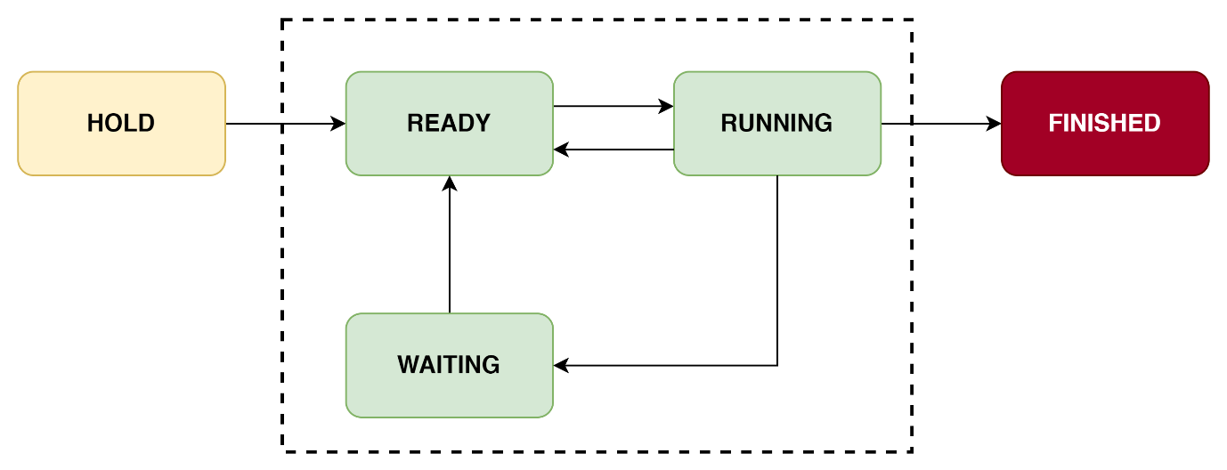
Job and Process States

Slide 24
Thread Types
Threads can be implemented as one of two kinds.
  User-level threads
  Kernel-level threads

Slide 25
User-Level Threads
Application or program manages the threads.
The kernel is not aware of the existence of any threads.
The thread library would contain code that would allow for
  Creation of threads
  Termination of threads
  Passing data between threads
  Scheduling threads.

Slide 26
Kernel-Level Threads
Thread management is conducted by the kernel.
No thread management is done within the application/program.
Threads are supported directly by the operating system.
An application can be programmed to be multithreaded.
Kernel will maintain the information for the process as a whole and threads within the process.

Slide 27
Multithreading
Operating systems sometimes provide for combined threads
Combine the user-level and kernel-level threads facilities.
There are three multithreading models.

Slide 28
Multithreading
Many-to-one
Supports many user-level threads to one kernel-level thread.
Thread management is done within the user's thread library.
One-to-One
Has a one-to-one relationship between the user-level and the kernel-level threads.
Supports multiple threads to execute in parallel on microprocessors

Slide 29
Multithreading
Many-to-Many
Supports multiple threads to an equal number or smaller number of kernel threads.
The user-level threads and corresponding kernel-level threads can run in parallel on a multiprocessor machine.

Slide 30
Summary
Introduction to process management
Introduction to threads.
Define various aspects regarding threads
Identify the types of threads
Job and process states
Thread states.
Multithreading models

Slide 31
Discussion Topic
Conduct web research on one of the application programs running on your machine. Find out whether it supports threading and specifically multithreading. Gain an understanding of the type of multithreading model it supports.
Present your findings in class.

Slide 32
References
[1] McHoes, A., & Flynn, I., Understanding Operating Systems. Boston: Cengage Learning, 2018
[2] Stallings, W., Operating Systems: Internals and Design Principles. Harlow: Pearson Education Limited, 2018.

Slide 33
Next lesson will cover
Processor Management - Scheduling

