Slide 1

OPERATING SYSTEMS
Dr Victoria Mukami
University of Embu

Slide 2
Process Management - Scheduling
Lecture 6

Slide 3
Overview
The process scheduler
Scheduling policies and algorithms
- First Come First Serve
- Priority Scheduling
- Shortest Job Next
- Shortest Remaining Time
- Round Robin
Interrupt Management

Slide 4
Learning Outcomes
Describe how scheduling managers work
Show how process scheduling algorithms work
How the processor handles interrupts

Slide 5
Introduction
Worked with memory management within the operating system
Memory- hold information for the processor
Memory - aid in faster processing.
Concentrate on how processing is conducted within the CPU.
Review processor management scheduling

Slide 6
Scheduling
Submanagers
Process manager oversees jobs - scheduled and processing takes place correctly.
Made up of the job scheduler and the process scheduler [1].
The job scheduler - initiating a job based on certain criteria [1].
Job/program goes through a hierarchy of managers [1].

Slide 7
Scheduling Submanagers
Job first encounters the job scheduler.
Job scheduler selects jobs from a queue of incoming jobs
Places them in the processor queue.
Main role of the job scheduler is to place jobs based on specifications set by the system.

Slide 8
Job Scheduler
Jobs sometimes interact with input/output (I/0) devices during processing.
Job scheduler must optimize the CPU's time.
Ensure that the CPU is not dealing with jobs that have many I/O requests.
Job scheduler should not only send jobs that have no I/O requests
Would leave the I/O devices idle.
Job schedule needs to review the requirements of each job and provide a mix.
Known as a high-level scheduler [1].

Slide 9
Process Scheduler
Process scheduler takes over from the job scheduler.
The process scheduler determines which jobs (processes) will get to the CPU
Determines at what point the jobs get to the CPU and for how long[1].
In charge of CPU interrupts based on incoming higher priority jobs.
Low-level scheduler
Works with jobs that are assigned a READY state.

Slide 10
Scheduling Algorithms
Scheduling algorithm - based on a specific scheduling policy within the system.
Scheduling policies are created by the system administrator
They determine important criteria within a system [1].
Several scheduling algorithms are used to schedule processes

Slide 11
Scheduling Algorithms
The algorithms include
  First-Come First-Served
  Shortest Job Next
  Shortest Remaining Time
  Priority Scheduling
  Round Robin.

Slide 12
Scheduling Algorithms
Two main types of policies.
Pre-emptive scheduling policies
Those that interrupt the processing of a CPU and transfer it to another job.
Non-pre-emptive scheduling policy
Functions without external interrupts.
The only interrupt would be that of an I/0 request.

Slide 13
First Come First Served
Non-pre-emptive scheduling algorithm
Handles all the incoming jobs according to their arrival time [1].
The earlier the job arrives, the earlier it is served.
Commonly used for batch systems.
FCFS does not run WAIT queues because a job runs to completion once it is sent for processing. Non-pre-emptive nature of the algorithm

Slide 14
First Come First Served
Job | Processing Time (Milliseconds)
A | 13
B | 7
C | 2
D | 5
Turnaround time
Time required to execute a job and return the output to the user [1].

Slide 15
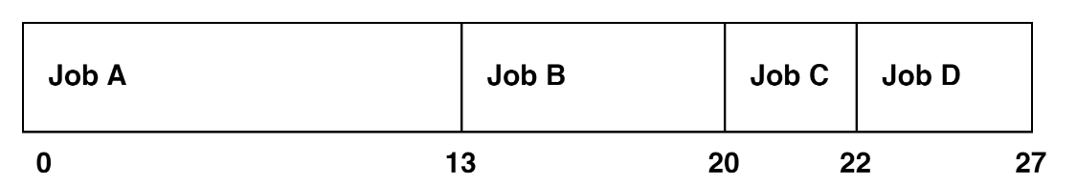
First Come First Served
Jobs are immediately processed.
Job A ends at 13ms
Job B starts at 13ms ends at 20ms
The entire time it takes to process the jobs is 27ms.

Slide 16
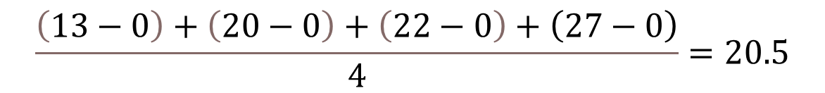
First Come First Served
If our 4 jobs arrived simultaneously at time 0
The turnaround time is calculated by subtracting the arrival time from the finish time
Job, A is 13, Job B is 20, Job C is 22, and Job D is 27ms.
The turnaround time is 20.5ms.
$$\frac{\left(13−0\right)+\left(20−0\right)+\left(22−0\right)+\left(27−0\right)}{4}=20.5$$

Slide 17
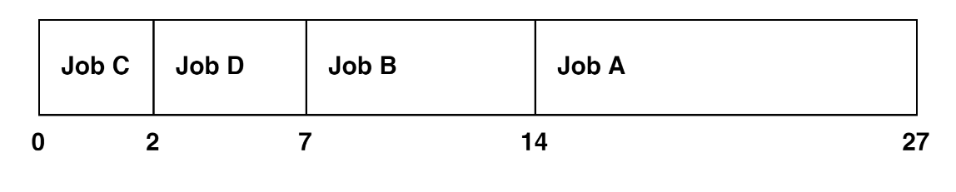
First Come First Served
Jobs arrived in a different order?
That is Job C first then Job D, Job B and finally job E t
The timeline would have looked different

Slide 18

First Come First Served
The turnaround time is 12.5 when the jobs are re-ordered.
Disparity in the turnaround time based on when the jobs first arrived.
FCFS does not provide the chance of processing the jobs at the most optimum time.
$$\frac{\left(2−0\right)+\left(7−0\right)+\left(14−0\right)+\left(27−0\right)}{4}=12.5$$

Slide 19
Shortest Job Next
Non-pre-emptive algorithm
Selects jobs based on the length of the CPU cycle time (processing time) [1].
Known as the shortest job first.
Before any job can be run, the CPU time must be known in advance.

Slide 20
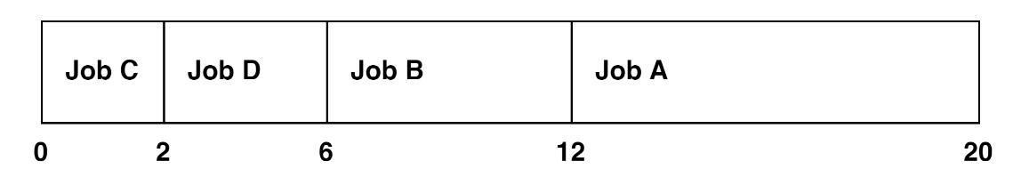
Shortest Job Next
Job with the shortest time would run first, followed by the next shortest and so on
Job | CPU Cycle
A | 8
B | 6
C | 2
D | 4

Slide 21
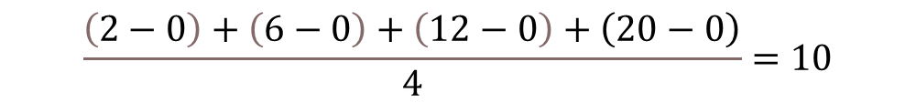
Shortest Job Next
Final CPU time is 20 while the turnaround time is 10ms
Effective when all the jobs are available at the same time
Effective when CPU estimates are accurate.
$$\frac{\left(2−0\right)+\left(6−0\right)+\left(12−0\right)+\left(20−0\right)}{4}=10$$

Slide 22
Priority Scheduling
Non-pre-emptive algorithm
Gives preferential treatment to important jobs [1].
A job that has the highest priority is processed until its CPU cycle runs out or a wait occurs
Two jobs with similar priorities arrive in the READY queue, the job that arrived first is processed first.
Notes:
due to I/O requests.

Slide 23
Priority Scheduling
Priorities are determined by the processor manager based on
  Memory requirements
  Number and type of peripheral devices
  Total CPU time
  Amount of time already spent in the system

Slide 24
Shortest Remaining Time
Pre-emptive version of the Shortest Job Next [1].
The processor is assigned the job that is closest to completion.
This algorithm requires a lot more overhead than SJN
The operating system must keep monitoring the CPU for any job in the READY queue.
Notes:
Where several jobs are waiting and have similar remaining time, the job that has been waiting for the longest goes next.

Slide 25
Shortest Job Next
The CPU pre-empts the jobs as processing is going on.
Job | CPU Cycle | Arrival Time
A | 8 | 0
B | 6 | 1
C | 2 | 2
D | 4 | 3

Slide 26
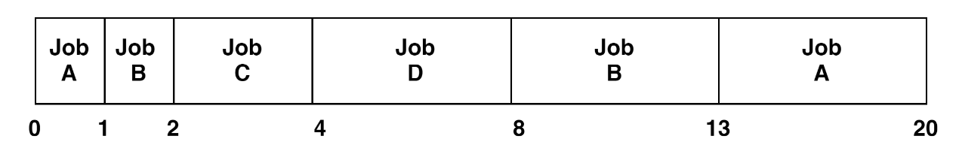
Shortest Time Next
Job A will go in
After one cycle, the CPU will check
Job B has a shorter CPU cycle than A
The CPU continues pre-empting until all jobs are processed
Notes:
which after 1 cycle will still have 7 cycles left.

Slide 27
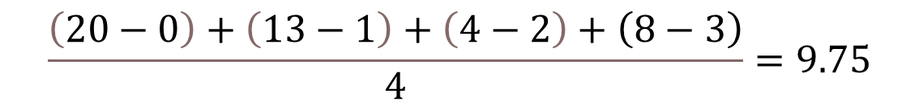
Shortest Job Next
The turnaround time for each job is calculated as its completion time minus its arrival time
$$\frac{\left(20−0\right)+\left(13−1\right)+\left(4−2\right)+\left(8−3\right)}{4}=9.75$$

Slide 28
Round Robin
Pre-emptive algorithm that is used in lots of interactive systems [1].
Easy to implement as it is not based on job characteristics but on a determined slice of time [1].
Slice of time is called a time quantum
The size is very crucial to the system performance.

Slide 29
Round Robin
Job | CPU Cycle | Arrival Time
A | 8 | 0
B | 6 | 1
C | 2 | 2
D | 4 | 3
Jobs are placed using the FCFS scheme
The processor scheduler selects the first job sets the timer and when the time expires the CPU moves to the next job.
If the job's CPU cycle is shorter than the time quantum, then all the resources are released for the next job.

Slide 30
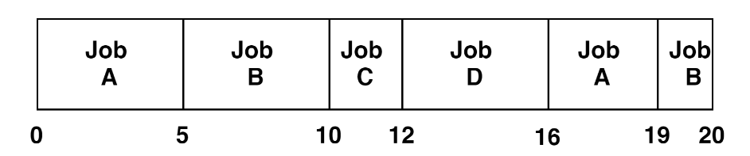
Round Robin
The time quantum is 5ms.
The jobs end at 20 but each job gets a run through the CPU.
Job A runs for 5 cycles
Job, B is already in the queue, so it goes in for processing.
Notes:
By 10ms Job C is in the READY queue and it goes in for processing. However, Job C is only 2ms therefore Job D comes in and it is only 4ms. Once Job D is complete, then Job A goes in, completes in 3ms and Job B goes in for 1ms.

Slide 31
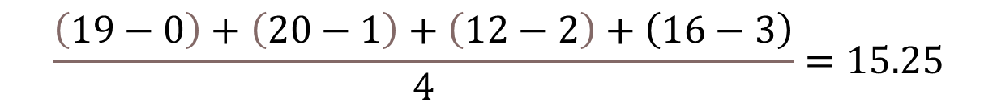
Round Robin
Average turnaround time
Efficiency of the round robin depends on the time quantum with the average CPU cycle [1].
$$\frac{\left(19−0\right)+\left(20−1\right)+\left(12−2\right)+\left(16−3\right)}{4}=15.25$$
Notes:
If the time quantum is too large, then time is wasted and if the time quantum is too short then the CPU overhead increases.

Slide 32
Round Robin
General rules used for selecting an optimum time quantum include:
  It should be long enough to allow 80% of the CPU cycle to run to completion [1]
  It should be at least 100 times longer than the time required to perform one switch [1]

Slide 33
Managing Interrupts
Interrupts occur when
  The time quantum expires
  During I/O interrupts.
Interrupts also occur when illegal operations occur
The interrupt handler deals with interruption events.
Notes:
such as dividing a sum with zero or trying to access password-protected files.

Slide 34
Managing Interrupts
When there is an error that cannot be recovered, the following happens:
  The type of interrupt is passed on to the user and a copy is stored [1]
  The state of the interrupted process is saved [ 1]
  The interrupt is processed, execution is halted, resources are released, and the job exits [1]
  The processor resumes normal operation [1]

Slide 35
Summary
The process scheduler
Scheduling policies and algorithms
- First Come First Serve
- Priority Scheduling
- Shortest Job Next
- Shortest Remaining Time
- Round Robin
Interrupt Management

Slide 36
Discussion Topic
Considering the number of multicore CPUs that currently exist, one of the scheduling algorithms is used to manage jobs in the cores.
Do web research and find the most common algorithm used in either quad or dual-core CPUs
Discuss the findings with your peers.

Slide 37
References
[1] McHoes, A., & Flynn, I., Understanding Operating Systems. Boston: Cengage Learning, 2018
[2] Stallings, W., Operating Systems: Internals and Design Principles. Harlow: Pearson Education Limited, 2018.

Slide 38
Next lesson will cover
Concurrency: Deadlock and Starvation

