Slide 1

OPERATING SYSTEMS
Dr Victoria Mukami
University of Embu

Slide 2
Deadlock and Starvation
Lecture 7

Slide 3
Overview
Deadlock and starvation
Conditions of deadlock
Deadlock prevention
Deadlock avoidance
Deadlock detection
Deadlock recovery
Starvation

Slide 4
Learning Outcomes
Show an understanding of the conditions that lead to deadlock.
Outline the different approaches to dealing with deadlocks
Understand starvation as an operating system concept

Slide 5
Introduction
Reviewed the operating system's role during memory allocation.
Various memory allocation schemes
Early memory allocation scheme
Current memory allocation scheme
Jobs are allocated within the processor

Slide 6
Deadlock
Deadlock - situation where no agreement can be reached due to a specific disagreement.
Deadlock - a permanent block by a set of processes that are competing for resources [2].

Slide 7
Deadlock - Roundabout
Notes:
Roundabout

Slide 8
Deadlock
Occurs when a particular blocked process requests a resource that is currently held by another blocked process.
Process one asks for a resource held by process two, while process two requires a resource held by process one

Slide 9
Conditions for deadlock
Conditions that create a deadlock
Mutual exclusion
Hold and wait
No pre-emption
Circular wait

Slide 10
1. Mutual Exclusion
Happens when a resource is held exclusively
Means that only one process can use a particular resource at a particular time.
Also known as the first condition of deadlock [1].

Slide 11
2. Hold and Wait
Happens when a process holds allocated resources as it waits for other resources.
This is the second condition for deadlock [1].
Notes:
Good example is tickets for a particular concert are on sale. The last two remaining tickets are taken by one person as they wait for the money. The other person has the money but cannot access the tickets.

Slide 12
3. No Pre-emption
Situation where a resource can only be released voluntarily by the process holding it.
A resource cannot be forcibly taken away from a process.
This is the third condition for deadlock [1].

Slide 13
4. Circular Wait
This is the fourth condition of deadlock [1]
Occurs when there is a chain made up of two or more processes and each process requires a particular resource by the next and so on.
Notes:
Think of the traffic gridlock example.
The first three conditions that are mutual exclusion, hold and wait and no pre-emption are conditions that could cause a deadlock. When the circular wait is introduced within those first three conditions then a deadlock exists.

Slide 14
Strategies to deal with deadlocks
Four approaches exist
Aimed at resolving or preventing deadlocks.
  Deadlock prevention
  Deadlock avoidance
  Deadlock detection
  Deadlock recovery

Slide 15
Deadlock Prevention
The operating system needs to ensure that it can prevent a deadlock from occurring
Four conditions that lead to deadlock.
O/S needs to make sure that each of these conditions are taken care of

Slide 16
Mutual Exclusion
Each process gets its resource exclusively.
Some resources must be held exclusively such as memory, the CPU, and other dedicated devices.
Resources such as files may allow simultaneous access, only allow one write access at a time [1].
Not possible for mutual exclusion to be disallowed as some resources require to be held exclusively.

Slide 17
Hold and Wait
A process will hold a resource and wait until it can use it.
Prevented by ensuring that all the resources required by a process are issued in one go [2]
Disadvantage
Resource may wait for a long time waiting for resources
Resources allocated to a process may remain unused for a long period [2].
May be hard to prevent the hold and wait especially in interactive systems.

Slide 18
No Pre-emption
A process could be denied any additional requests until it releases its original resources
Can later request the same resources together with the additional resource [2].
Preventative measure -O/S to pre-empt when a resource may require additional resources and provide this at the same time.
Only works if both processes do not have the same priority levels.

Slide 19
Circular Wait
Prevented by the o/s ensuring that the formation of a circle does not exist [1].
Use of linear ordering [2] and numbering systems [1] could be used
They ensure circles do not form.
Inefficient as some processes may be denied resources.
Notes:
Numbering Systems
One such solution proposed by Havender (1968) is based on a numbering system for the resources such as: printer 5 1, disk 5 2, scanner 5 3, plotter 5 4, and so on. The system forces each job to request its resources in ascending order: any number one devices required by the job would be requested first; any number two devices would be requested next; and so on. So if a job needed a printer and then a plotter, it would request them in this order: printer (1) first and then the plotter (4). If the job required the plotter first and then the printer, it would still request the printer first (which is a 1) even though it wouldn’t be used right away. A job could request a printer (1) and then a disk (2) and then a scanner (3); but if it needed another printer (1) late in its processing, it would still have to anticipate that need when it requested the first one, and would
have to do so before it requested the disk.
Linear ordering of resource types.
If a process has been allocated resources of type R, then it may subsequently request only those resources of types following R in the ordering. To see that this strategy works, let us associate an index with each resource type. Then resource Ri precedes Rj in the ordering if i 6 j. Now suppose two processes, A and B, are deadlocked because A has acquired Ri and requested Rj, and B has acquired Rj and requested Ri. This condition is impossible because it implies i 6 j and j 6 i.

Slide 20
Deadlock Avoidance
Very hard for an operating system to prevent or remove one of the four conditions of deadlock.
May be easier for the operating system to know in advance the sequence of events for every active process [1].
Banker's algorithm is an algorithm that explains how deadlock avoidance can be achieved.

Slide 21
Bankers Algorithm
Based on specific principles.
It looks at a bank with a fixed amount of capital.
Principles
No customer can be given a loan that is higher than the bank's capital.
Customers are initially assigned a maximum loan limit as they open their accounts.
Customers cannot be able to borrow more than their maximum loan limit.
All the loans summed up should not be more than the bank’s capital.
Notes:
Let us look at this statement practically. Let us assume the bank has 100,000 in capital regardless of the currency. If three customers come in and they have a credit of 40,000 each, only two can be given a loan of their maximum amount without breaking rule 4. Before reviewing how this algorithm works with avoidance, let us look at two states of a computer system. A safe state exists when resources are allocated without it resulting in a deadlock. An unsafe state is a state that could result in a deadlock when resources are allocated.

Slide 22
Deadlock Avoidance
Within a computer, the same principle could be applied.
The operating system will only allocate resources so long as it remains in a safe state.
Would not work especially for interactive systems which are the most used.

Slide 23
Deadlock Avoidance
Not Practical because
Jobs must predict the maximum resources needed
The number of resources must remain constant
The number of jobs must remain fixed
Resources are not well utilized since the algorithm will keep vital resources unavailable to guard against unsafe states
Jobs are kept waiting for resources therefore scheduling suffers due to poor utilization [1].

Slide 24
Deadlock Detection
Try to solve the problem of deadlock by limiting access to resources or by imposing restrictions on processes.
Does not limit resource access or restrict actions [2].

Slide 25
Deadlock Detection
A check is made frequently as each resource is requested
Or non-frequently when the operating system detects an incoming deadlock.
First method ensures early detection, and it is simple for the system to perform.
Downside to this would be the overhead resources required to run the check frequently.

Slide 26
Deadlock Detection
Algorithm tries to detect all sequences that need to be completed and could cause a deadlock.
Marks processes based on whether they may cause a deadlock.
System can use one of the strategies to prevent the deadlock.

Slide 27
Deadlock Recovery
Involves ensuring fixing the deadlock as fast as possible and returning the system to normal [1].
Most common feature in deadlock recovery algorithms
Choosing one process that will act as the victim and will be terminated [1].

Slide 28
Methods for recovery
All active jobs within the system are terminated regardless of whether they are part of the deadlock or not.
All the processes that are deadlocked are aborted.
Involves an elimination method by deleting one process at a time within the deadlock and checking whether the deadlock is resolved.
Involves placing a record of a job so that if a job is interrupted it would not need to start from the beginning.
Notes:
Each job, therefore, needs to be restarted from the beginning.
When this happens, it means that the deadlocked processes must be resubmitted by the user [1].
Once the deadlock is resolved, the remaining jobs continue with processing while the halted restart again at the beginning.
This method is best suited for jobs with a lengthy run time [1].

Slide 29
Starvation
Starving processes do not get any resources
If the operating system does not watch for the starving processes
Processes would stay within the system forever without ever getting processed.

Slide 30
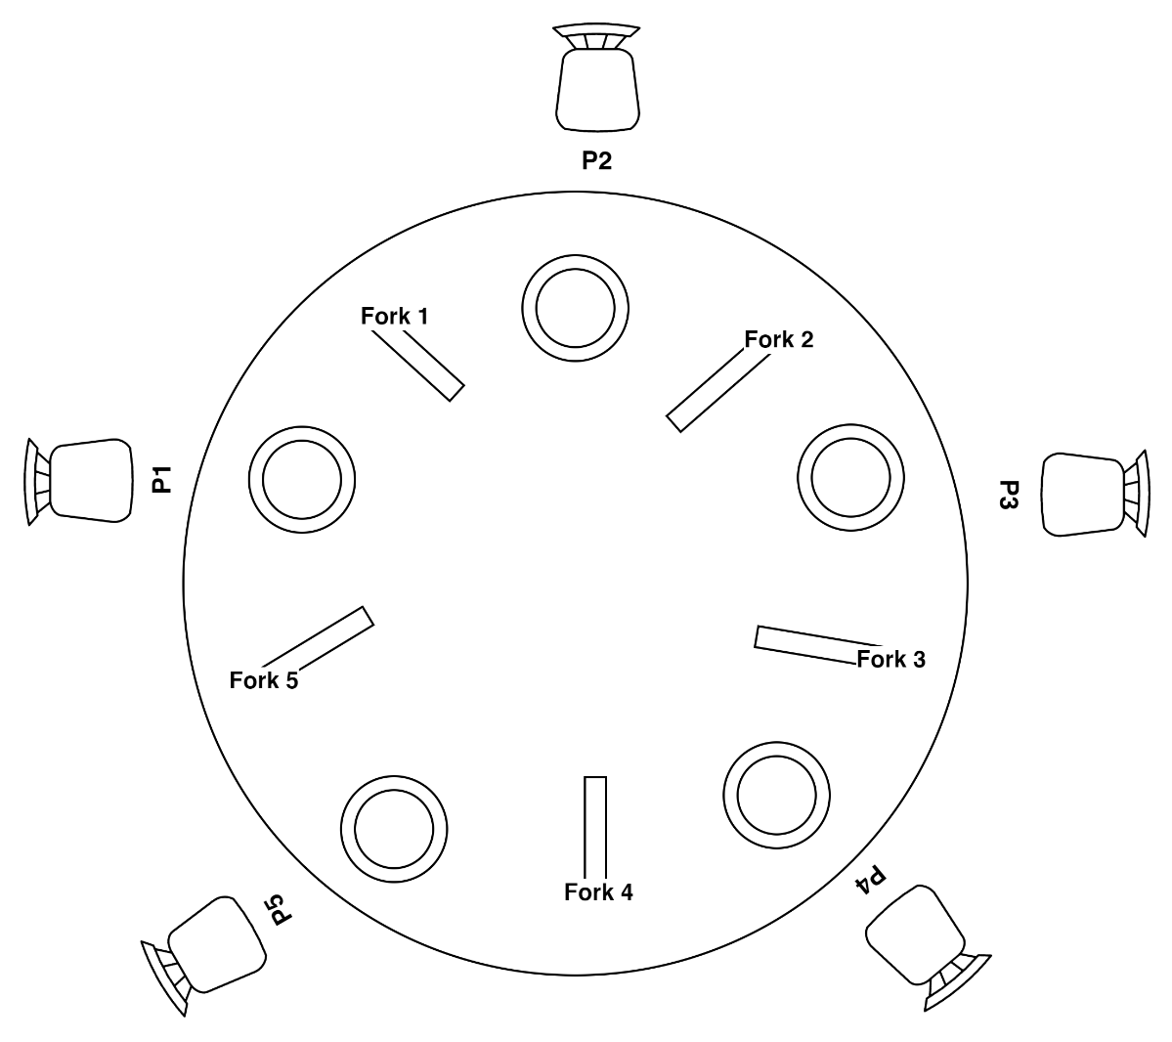
Philosophers Problem
Notes:
As seen, there are 5 philosophers, 5 spaghetti plates and five forks. Each philosopher needs two forks to eat. Philosopher 1 (P1) for instance, would pick Fork 1 and Fork 5 and use them to eat their food. While doing this, Philosopher 2 and Philosopher 5 cannot eat as they do not have a second fork with which to eat. Assuming Philosopher 1 finishes eating and puts down the fork then 2 and 5 can take up. But if philosopher 3 decides to eat, then 2 cannot be able to eat. While philosopher 2 is waiting for food, philosopher 1 decides to eat again. Philosopher 2 ends up starving as they cannot get a fork until both are available.

Slide 31
Starvation
Direct metaphor for the computing world
Forks are like resources
Competing processes are the philosophers [1].

Slide 32
Starvation
Algorithm is used to detect starving processes
How these processes can get the resources needed to end their starvation.
Block incoming processes until the starving processes are processed.
A balance needs to be done to ensure that the system doesn’t run high overheads or leave starving jobs indefinitely.

Slide 33
Summary
Deadlock and starvation
Conditions of deadlock
Deadlock prevention
Deadlock avoidance
Deadlock detection
Deadlock recovery
Starvation

Slide 34
Discussion Topic
We have started learning about concurrency and its related terms: deadlocks and starvation.
Based on the operating system that you are running, find out when deadlocks happen or better yet an example of a deadlock and measures that the operating system has taken to solve the said deadlock.

Slide 35
References
[1] McHoes, A., & Flynn, I., Understanding Operating Systems. Boston: Cengage Learning, 2018
[2] Stallings, W., Operating Systems: Internals and Design Principles. Harlow: Pearson Education Limited, 2018.

Slide 36
Next lesson will cover
Synchronization

