Slide 1

OPERATING SYSTEMS
Dr Victoria Mukami
University of Embu

Slide 2
Input/Output Management
Lecture 9

Slide 3
Overview
Input and output management.
Categories of I/O devices
How I/O performance can be improved
Various times used during the performance.
Organization of the I/O function.

Slide 4
Learning Outcomes
Describe the categories of I/O devices
Understand the organization of the I/O function
Understand the various times that are used to calculate I/O performance

Slide 5
Overview
Reviewed input/output requests
Resources that are required by jobs, processes, and threads.
Requests normally fulfilled by the processor on a job-by-job basis.
Focuses on input/output management.

Slide 6
Device Manager
The device manager oversees managing any peripheral devices required by the system.
Four basic functions:
  Device status monitoring
  Policy enforcement
  Device allocation
  Device deallocation

Slide 7
I/O Devices
External devices that engage in I/O with the processor can be grouped into three main categories:
  Human readable
  Machine-readable
  Communication

Slide 8
I/O Devices
Human readable
Devices that can communicate with the end user.
Machine-readable
They can communicate with electronic equipment
Communication
Devices enable communication with remote devices.
Notes:
Human Readable
Think output and input devices. Devices such as monitors, keyboards, mice, and printers are good examples of human-readable devices.
Machine-Readable
Such as USB keys, sensors and controllers [2].
Communication
These include routers, modems, and digital line drivers [2].

Slide 9
Device functionality
Devices can be categorized based on their functionality.
Devices are categorized as
  Dedicated
  Shared
  Virtual

Slide 10
Dedicated Device
Assigned only one job at a time [1].
Can only work on one job until they complete the job or release it.
Drawback
Only one user can be allocated a device for the duration of the job.
A user may not use the device 100% of the time.
Notes:
A printer is a good example of such a device.
The printer will only print one job at a time and another job cannot be started until the previous job is completed.

Slide 11
Shared Device
Can be allocated several jobs at the same time.
Done through interleaving which has to be handled carefully to prevent conflicts [1].
Notes:
A hard disk is a good example of a shared device as it can work with several processes.

Slide 12
Virtual
Devices are a combination of dedicated and shared devices.
Dedicated devices that have been transformed into sharing devices [1].
Management is key to avoiding deadlocks during allocation to the devices.
Notes:
Printers for instance can be shared using spooling or using servers that can hold several jobs.

Slide 13
Evolution of I/O Devices
Similar to the evolution of computers
Increase in the complexity of the I/O functions.

Slide 14
Evolution steps
The processor directly controlled a peripheral device -microprocessor-controlled device.
Controller or I/O module was added. Processor no longer controlled the peripheral devices directly.
Interrupts were introduced - saving the processor time
Notes:
2. The processor uses the I/O module without interrupts.
3. as it did not have to wait for I/0 requests to be carried out.

Slide 15
Evolution steps
Direct control of memory - I/O module could move data to and from memory without involving the processor.
I/O module - a separate processor. The I/O processor can fetch and execute these instructions without processor intervention [2].
I/O module has a local memory of its own. Several I/O devices are controlled with minimal processor involvement [2].

Slide 16
Management of I/O Requests
Device manager manages the I/O requests through three main tasks
Handled by
  I/O Traffic controller
  I/O Scheduler
  I/O device handler

Slide 17
I/O Traffic controller
Checks the status of all the i/o devices, control units and channels [1].
Must determine if there is a path available to a requested device.
Controller must determine which path will be available in the event all paths are busy.
Done through a database that contains the status and connections for each unit within the I/O module.
Notes:
If more than one path exists, then the controller must determine which path to select.

Slide 18
I/O Scheduler
Oversees the allocation and deallocation of devices [1].
Behaves the same as the process scheduler.
Decide how to satisfy requests
Which requests must be satisfied first.
No pre-emption happens with the I/O scheduler
Notes:
Implements policies already in place for the same.
No pre-emption happens with the I/O scheduler as compared to the process scheduler.

Slide 19
I/O device handler
In charge of the actual transfer of data and processes [1].
Processes the I/O interrupts
Handles errors that may arise
Provides detailed scheduling algorithms [1].
Each device would have its device handler.

Slide 20
Direct Access Storage
Devices that can read or write to random areas within the storage.
  Magnetic disks
  Optical disks
  Solid-state drives.

Slide 21
Magnetic Disk Storage
Devices such as hard disks and floppy disks.
Have a stack of platters where the read and write occurs.
Held together and rotated using a central spindle.
There is space in between the platters that has read and write heads

Slide 22
Magnetic Disk Storage
Platters are two-sided
Read and write heads are found both at the top and bottom of the platter.
Arms are held by a controller on the side of the platter
When the top head moves, all the others move too.

Slide 23
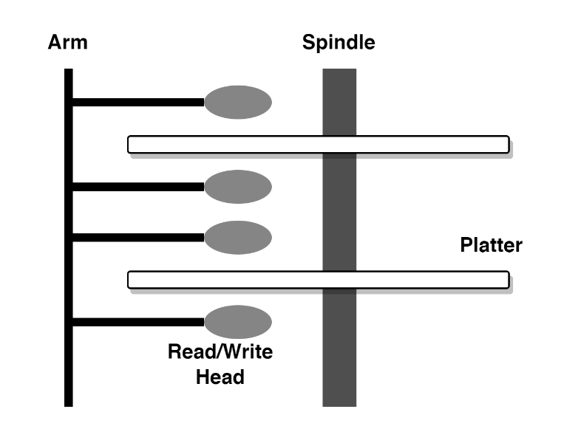
Magnetic Disk Storage

Slide 24
Magnetic Disk Storage
Seek time
Slowest time and is the time required to position the read/ write arm.
Search time
Rotational delay - the time it takes to rotate the disk until the requested record is moved under the read/write head.
Transfer time
Fastest time - time when data is transferred from the disk to the main memory.

Slide 25
Seek Time
The I/O device handler has a seek strategy
Predetermined policy that the device handler uses to allocate access
Determines the order in which the processes get the device.
Keep the seek time at a minimum.
Notes:
to the device among the many processes that may be waiting for it [1]
Remember the seek time is considered the slowest time among access times.

Slide 26
Seek Strategies
Several strategies exist
  First-Come First-Served (FCFS)
  Shortest Seek Time First (SSTF)
  SCAN
Algorithms aim to
  Minimize arm movement
  Minimize mean response time
  Minimize the variance in the response time [1]

Slide 27
Seek Strategies
FCFS works well with shorter queues of jobs.
When the waiting list grows the service time becomes long.
SSTF works well with average queues of jobs.
When introduced to heavy or longer queues then it is unable to manage and lower the seek time.
SCAN is like SSTF regarding throughput and the mean service time.
It mainly works well with average queues.
Notes:
SSTF is popular and appealing and

Slide 28
Optical Disk Storage
Like magnetic disks
Difference
  Number of tracks
  Size of sectors
  Spinning speed
  Surface layer.
  Has only one spiral disk.
Types of optical disks exist CDs, DVDs, and Blu-Rays.
Difference -way that the devices write data to the discs.

Slide 29
Solid State Drives
Fast but costly as they use flash memory.
No movable parts
Seek and search times do not apply to these devices.
Difference
  Power consumption
  Cost
  Capacity
  Noise production
  Access times much faster

Slide 30
RAID
Redundant Array of Independent Disks.
Several small-capacity disks are better than having fewer larger-capacity disks.
RAID disks result in faster I/O performance and improved data recovery in case a disk fails [1].
A normal RAID may have up to 5 disks connected to a controller that allows for the transfer of data.
RAID has seven levels from Level 0 to 6 with different I/O request rates, different error correction methods and different data transfer rates.

Slide 31
Summary
Input and output management.
Categories of I/O devices
How I/O performance can be improved
Various times used during the performance.
Organization of the I/O function.

Slide 32
Discussion Topic
Conduct a small web research and identify three areas that may benefit from the use of RAID drives.
Identify how access times would be affected by using RAID drivers.

Slide 33
References
[1] McHoes, A., & Flynn, I., Understanding Operating Systems. Boston: Cengage Learning, 2018
[2] Stallings, W., Operating Systems: Internals and Design Principles. Harlow: Pearson Education Limited, 2018.

Slide 34
Next lesson will cover
File Management

