Slide 1
MONETARY THEORY AND POLICY
Week 3- Analysis of Trade-offs in Monetary policy

Slide 2
Analysis of Trade-offs in Monetary Policy.
Chapter Outline
The analysis of trade-offs in monetary Policy can be discussed in the trade-off of the following-
(I) Phillip’s curve
(II) Freidman/Phelps analysis
(III)The Taylor curve.

Slide 3
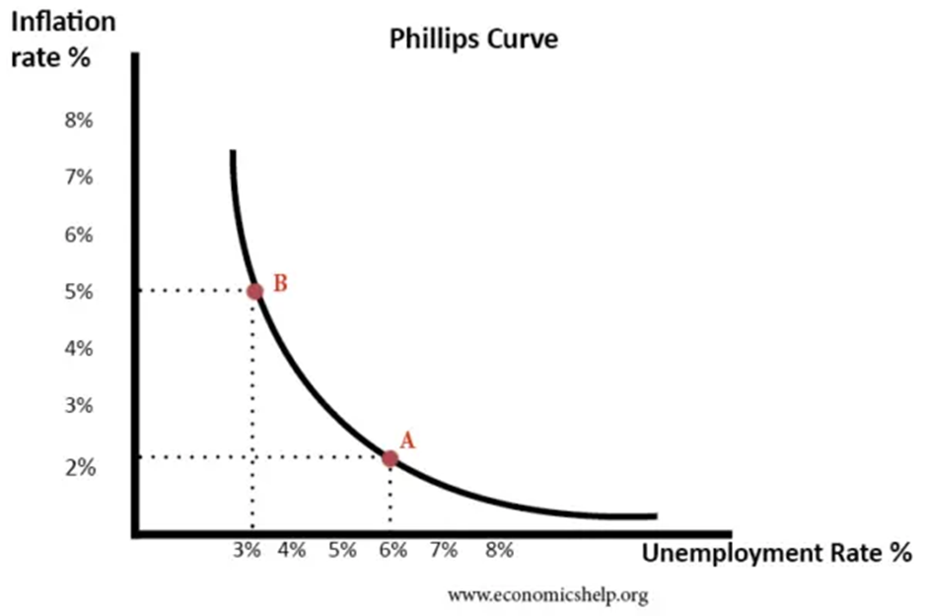
1. THE PHILIPS CURVE
In 1958, W. A. Phillips gave an empirical negative relation between the rate of inflation and the level of unemployment.

Slide 4
Philips curve suggests that;
Policymakers have a choice between prioritizing inflation or unemployment.
There was a trade-off-
-Policymakers could use demand management (fiscal and monetary policy) to influence the rate of
economic growth and inflation.
In the 1970s, there seemed to be a breakdown in the Phillips curve-
- Stagflation (higher unemployment and higher inflation) occurred.
Monetarist economists argued there was no trade-off between unemployment and inflation in the long
run.

Slide 5
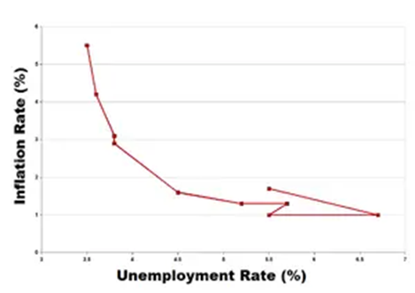
Origins of the Phillips Curve
Originated out of analysis comparing money wage growth with unemployment.
Suggested an inverse correlation between the rate of change in money wages and unemployment.

Slide 6
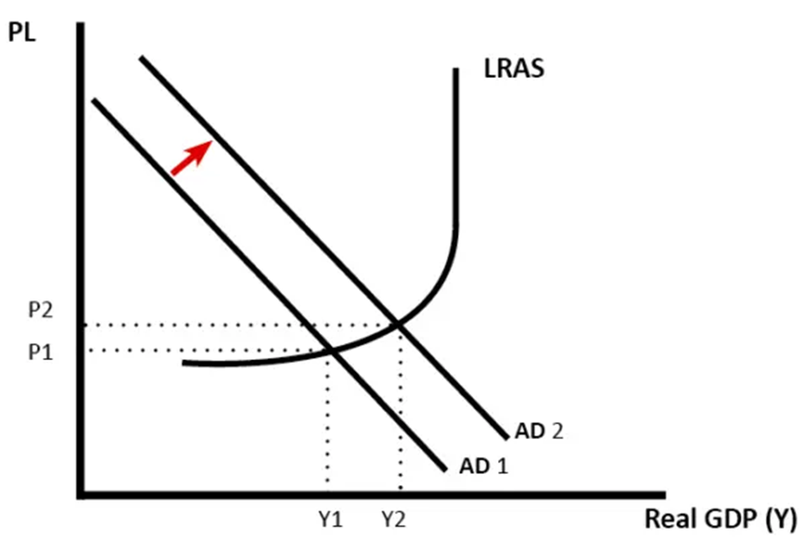
Why is there a trade-off between unemployment and inflation?
Increase in aggregate demand (AD1 to AD2) causes higher real GDP (Y1 to Y2).
-Firms employ more workers and unemployment falls.
As the economy gets closer to full capacity, we see an increase in inflationary pressures.
With lower unemployment, workers can demand higher money wages.
-This causes wage inflation.
-Firms raise prices due to increasing demand.
-The result is falling unemployment and rising inflation.

Slide 7
Monetarist View of Phillips Curve
Monetarists argue that –
In the long run, there is no trade-off as Long Run AS is inelastic.
When aggregate demand increases, then workers demand higher nominal wages.
When workers receive higher nominal wages, they work longer hours.
Aggregate demand increase causes temporary increase in output.
Shifts in short run aggregate supply leads to higher inflation and output.
The result is a temporary fall in unemployment.

Slide 8
The Phillips Curve and Stagflation
Stagflation occurs when an economy experiences-
- Stagnant economic growth
- High unemployment
- High price inflation
Stagflation contradicts the Philips curve unemployment and inflation trade-off argument.

Slide 9
Summary of Monetarist vs Keynesian view
Monetarists would argue that-
-Unemployment is a supply-side phenomenon.
-Using demand-side policies can only temporarily reduce unemployment by an ever-accelerating
inflation rate.
-Unemployment is determined by the natural rate of unemployment.
Keynesians argue that-
There can be demand deficient unemployment.
During a recession, demand-side policies can reduce unemployment in the long term (with perhaps some inflation).

Slide 10
Conclusion on Phillips Curve
If the economy is operating below full capacity, a significant increase in aggregate demand is likely to cause a reduction in unemployment and higher inflation.
In the short term, there can be a trade-off between unemployment and inflation.
There is a disagreement about whether this policy is valid for the long-term and emphasizes the supply side of the economy.
Monetarists would tend to argue the trade-off will prove short-term.
Keynesians argue that demand deficient unemployment could persist in the long term.

Slide 11
Relevance of Phillips Curve Today
In the current economy, Central Banks and policymakers are concerned with the question-
How much importance should they give to reducing unemployment and inflation?
Central banks are considering using monetary policy to achieve an unemployment target and a willingness to accept higher inflation e.g.
(i)In the US, the Federal reserve
(ii) in 2009-13, the Bank of England
Policymakers feel that the trade-off of higher inflation is worth the benefit of lower unemployment.

Slide 12
Critics argue that if inflationary pressures are allowed then, monetary policy will lose credibility.
for example, the ECB would be unwilling to tolerate higher inflation – even as a measure to reduce unemployment in Europe.

Slide 13
2. FRIEDMAN/PHELPS
In 1966 and 1967, W. A. Phelps and I criticized the Philips approach.
He argued that the Phillips curve was a short-term relationship.
In the long run, there was a natural rate of unemployment which could be combined with any level of inflation.
The long-run Phillips curve was vertical.
Inflation was a monetary phenomenon, not a real phenomenon.
The great inflation of the 1970s, was labeled stagflation because both inflation and unemployment rose together.
The stagflation confirmation of the natural rate of unemployment view.

Slide 14
According to the Friedman-Phelps model-
- The Phillips curve is wrongly specified because it is the real wage and not the money
wage, which responds to the excess labour demand.
-Changes in money wage rates can offset the rate of unemployment only in the short
run.
It is only in the short run that employers and labourers confuse money wage changes with real wage changes and thus wrongly interpret inflation.
Expansionary monetary policy results in price and wage inflation in an economy.

Slide 15
This increase in money wages will be incorrectly interpreted by the producers as a reduction in the real wages and by the labourers as an increase in real wages.
The short-run effect will therefore be an increase in both employment and the rate of inflation.
inflation has led to a reduction in unemployment. But this is only a temporary phase.
Eventually, the producers and the labourers will correctly learn about the higher rate of inflation.
-They will both incorporate this correct expectation into new labour contracts.
-Unemployment rate will return to its old natural level. Thus, there is no long-run trade-off between inflation and unemployment.

Slide 16
Implications of the model
That the anticipated changes in the price level will be fully incorporated into money wage contracts.
The rate of change in money wages will be a function of both the unemployment rate and the anticipated rate of prices.

Slide 17
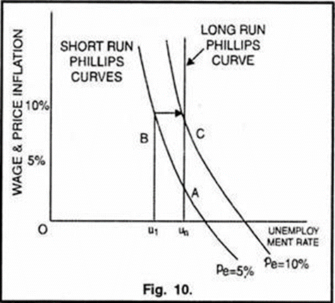

Graphical representation of Friedman-Phelps model
At point A,-5% inflation is expected
-Unemployment is at its natural
rate U.
If new inflation is anticipated, the economy will move from A to B
Both employers and labourers realize actual inflation is 10% and move from B to C

Slide 18
In the long- run, there is no trade­off between inflation and unemployment.
Thus, the Friedman-Phelps model can explain the existence of
(a) short-run Phillips curve and
(b) a long-run Phillips curve based on a set of shifting, unstable Phillips curves.
The policy implication of the Friedman-Phelps model is that-
-Monetary policy (or fiscal policy) can affect employment and output in the short run because people make errors in anticipating inflation, in the short run.

Slide 19
In the long run, these policies will become ineffective because,
-Employers and employees will fully and correctly anticipate the inflation rate.
-Unemployment returns to its natural rate.
Natural Rate of Unemployment
It is the rate of unemployment to which the economy returns in the long run after the stabilization policies are correctly anticipated by the people.

Slide 20
Natural rate of unemployment consists of two kinds of unemployment.
Frictional unemployment or the type of unemployment experienced by people who are between steady jobs.
Unemployment due to rigidities in the economic system and its interferences with labour mobility or wage rate changes.
Various rigidities and interferences are:
(a) Union activity that restricts the supply of labour
(b) Licensing arrangements granted by regulatory agencies;

Slide 21
c) Minimum wages laws and
(d) Welfare system that reduces incentives to work.
Criticisms:
Friedman-Phelps model of stagflation has been criticized on the following grounds:
Persistence of Unemployment
Degree of Adjustment to Inflation
Empirical Evidence

Slide 22
4. Implication of Money Illusion
5. Formation of Expectations Criticised
6. Rational Expectations Hypothesis
7. Vague Concept of Natural Rate of Unemployment
1. Persistence of Unemployment
Model fails to provide an explanation on unemployment persistence above or below the natural rate.
Model explains persistence as being caused by delay in the flow of information generated by inflationary or deflationary surprises.

Slide 23
2. Degree of Adjustment to Inflation
Depends on specific assumption regarding the degree of adjustment of expected inflation to actual inflation(the value of ∝ in the model).
The value of ∝ in the model
There are 3 possibilities
(i) α in the model can take the value unity.
-Inflation is fully incorporated into current wages.
-No trade off between unemployment and inflation.
-The long run Philips curves is vertical.

Slide 24
(ii) α takes the value zero.
-Phillips’ original formulation is correct
-There is only one negatively sloping Phillips curve regardless of price expectations.
-Inflation-unemployment trade-off exists and workers have money illusion.
(iii) In between these two extreme cases is the situation in which 0 < ∞ < 1,
-There is partial but not complete compensation for anticipated inflation.

Slide 25
-This implies that there is a long-run Phillips curve which, although more steeply sloped than the short-run ones, is not vertical.
-There is some trade-off between inflation and unemployment.
-workers have money illusion even in the long-run
Friedman-Phelps model, with its prediction that there is no inflation-unemployment trade-off in the long- run-
-is based on the assumption of α = 1 ,i.e..
-the first possibility) and ignores the other possibilities (i.e.., second and third).

Slide 26
3. Empirical Evidence
What is the actual value of α in the actual world?
-Research studies have shown α ranges between 0.3 to 0.8.
-These implies the existence of a negatively sloping long-run Phillips curve.
4. Implication about Money Illusion
The presence of money illusion not implied even if the value of α is significantly less than one.

Slide 27
5. Formation of Expectations Criticized
The model assumes current expectations are equal to the weighted average of past rates of inflation.
However recent developments show that current expectations are equal to the weighted average of past rates of inflation.
6. Rational Expectations Hypothesis
Model maintains that monetary policy can affect real variables like employment and output only in the short run.
Rational expectations hypothesis implies that the stabilization policy cannot systematically influence employment and output even in the short run.

Slide 28
7. Vague Concept of Natural Rate of Unemployment
Concept of natural unemployment has not been defined in specific terms.
Tobin suggested a compromise between the negatively sloping and vertical Phillips curves i.e.
-His modified Phillips curve is vertical at low levels of unemployment
-The curve becomes negatively sloping at relatively high levels of unemployment.
It means that at higher levels of unemployment increasing inflation will reduce unemployment.
This might be due to the downward stickily nature of wages; workers resist a decline in wages.

Slide 29
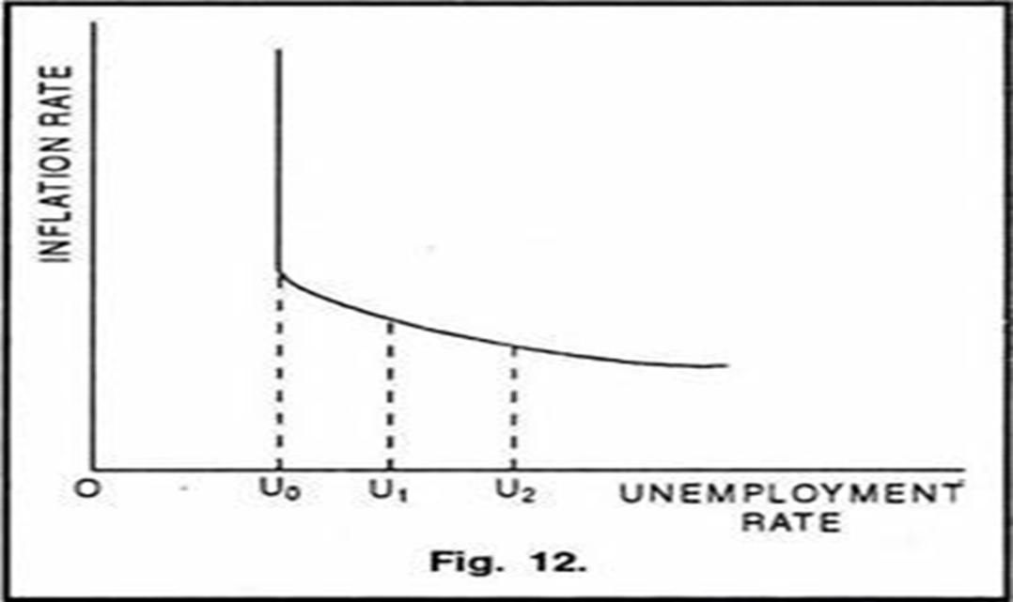
TOBIN,S CURVE
Vertical portionU0-indicates that there is no trade-off.
Negatively sloping portion, beyond U0 indicates, there is trade-off.
At higher levels of unemployment increasing inflation will reduce unemployment (from U2 to U1 and to U0).

Slide 30
Conclusion
Broad conclusions of the Friedman-Phelps model of stagflation are-
(i) The phenomenon of stagflation (or the instability of the Phillips curve).
(ii) The problem of stagflation cannot be solved by adopting a stabilization policy.
(iii) Demand-management (monetary and fiscal) policies should be aimed at achieving stable and lower inflation, and not at reducing the unemployment rate.
Supply-side policies, such as changes in the tax structure to improve incentives to work and return to investment, may be more successful in increasing employment.

Slide 31
3. TAYLORS RULE
Topic highlights
The definition and importance
The guiding principles
The formula
Examples for the Taylor Rule in economics
Benefits and limitations of the formula

Slide 32
Definition and importance of the Taylor Rule
It is a principle used in the management of interest rates.
Central banks use the rule to make estimates of ideal short-term interest rates.
When there is an inflation rate that does not match the expected inflation.
Useful when the expected gross domestic product (GDP) is different from the actual GDP growth in the long term.
Taylor rule’s main aim is to bring stability to the economy for the near term, while still sustaining long-term expansion.

Slide 33
Taylor’s rule Guiding Principles
The Taylor rule is based upon three factors:
(i) The targeted rate of inflation in relation to the actual inflation rates.
(ii) The real levels of employment, as opposed to full employment.
(iii) An interest rate consistent with full employment in the short term.
Central bank should increase short-term interest rates when one or both of the following occurs-
-The expected inflation rate exceeds the target inflation rate or
-The anticipated GDP rate of growth exceeds its long-term rate of growth.
Conversely, when inflation rates and GDP growth rates are below what was expected, interest rates are expected to decrease.

Slide 34
Formula for the Taylor Rule
Below is a simple formula used to calculate appropriate interest rates according to the Taylor rule:
Target Rate = Neutral rate + 0.5 (GDPe - GDPt) + 0.5 * (Ie - It).
Where;
Target rate: the interest rate that the central bank should target in the short term
Neutral rate: the current short-term interest rate when the differences found among actual and expected inflation and GDP growth rates are equal to zero
GDPe: expected GDP growth rate
GDPt: long-term GDP growth rate
Ie: expected inflation rate
It: target inflation rate

Slide 35
Application of Taylors formula
We use the following variables-
-Long-term GDP growth rate of 2.5%
-An annual GDP growth rate of 3% during the first two months
-An expected rate of inflation of 4%
Substituting those variables into the target rate formula:
Target short-term interest rate = 4% + 0.5 * (3% - 2.5%) + 0.5 * (4% - 2%) = 5.25%.

Slide 36
Benefits of the Taylor Rule
(i) It can provide a useful benchmark for policymakers.
(ii) Helps financial market participants form a baseline for expectations regarding the future course of monetary policy.
(iii) Useful in the central bank’s communication to the public on monetary policy.
Limitations
Taylor’s rule requires that a single measure of inflation be used to obtain the rule prescriptions.
(ii) The rule and other related rules require determining the level of the equilibrium real interest rate and the level of potential output; neither of them are observable variables.
(iii) The rule involves the use of only a small number of variables that may not be applicable to a complex economy.

Slide 37
REFERENCES
Adesoji, J.J., (2014). Introduction to Monetary Policy, 4th edition, Dale Publication limited.
Carl E. Walsh (2010) .Monetary Theory and Policy,3rd edition, The MIT Press, Cambridge, Massachusetts
Jhingan, M.L (2004) Monetary Economics, 6th edition, Vrinda Publication Limited.

Slide 38
REFERENCES
Orphanides, Athanasios (2003). "The Quest for Prosperity without Inflation," Journal of Monetary Economics, vol. 50 (April), pp. 633-63.
Poole, William (2007). "Understanding the Fed (210 KB PDF)," Federal Reserve Bank of St. Louis, Review, vol. 89 (January/February), pp. 3-14, http://research.stlouisfed.org/publications/review/past/2007.
Taylor, John B. (1993). "Discretion versus Policy Rules in Practice," Carnegie-Rochester Conference Series on Public Policy, vol. 39, pp. 195-214, http://econpapers.repec.org/article/eeecrcspp/default1993.htm.

Slide 39
The end
THANK YOU!

