Slide 1
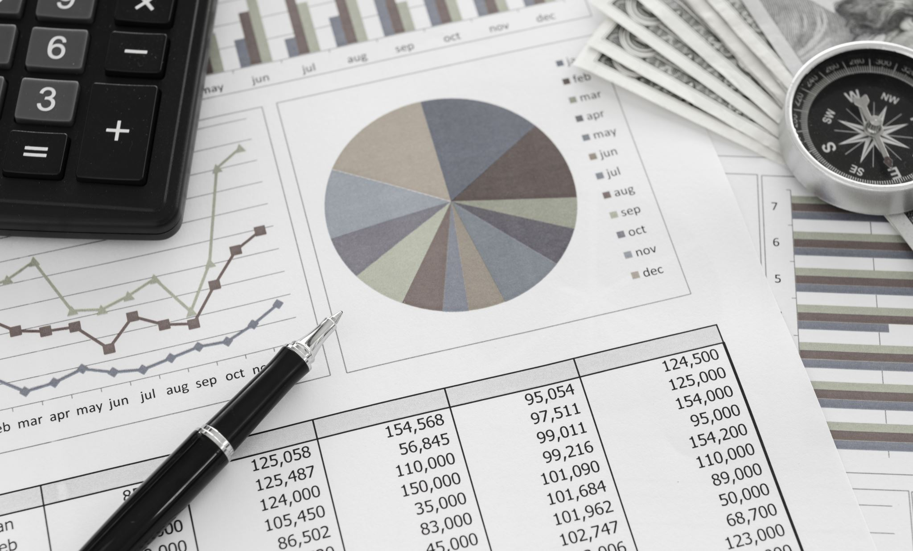
MONETARY THEORY AND POLICY
WEEK 6-TRADE-OFFS IN MONETARY POLICY GOALS
LECTURER-EVELYN TIPAPE

Slide 2
Topic list
1.0 Introduction
2.0. Objectives
3.0. Main content
3.1. Full Employment and Economic Growth
3.2. Economic Growth and Price Stability
3.3. Full Employment and Price Stability

Slide 3
3.4. Full Employment and Balance of Payment
3.5. Price Stability and Balance of Payment.
4.0 Potential policy conflicts and trade-offs
5.0 Stabilization Policy
6.0 Policy Lags
7.0 Conclusion

Slide 4
Topic objectives
By the end of this topic, you should be able to;
Define and comprehend the Full Employment and Economic Growth
Recognize the connection between price stability, the balance of payments, and full employment.
Recognize the balance of payments and price stability
Evaluate the stabilization policy
Discuss the various policy lags

Slide 5
3.1 Economic Growth and Full Employment
Most economists believe that full employment and economic growth do not always contradict.
A 4% unemployment rate in the economy is consistent with full employment.
As a result, there is a trade-off between growth and unemployment in the relationship between full employment and economic expansion.
Low unemployment is related with periods of high growth, and growing unemployment is associated with periods of low growth.

Slide 6
Okun’s law
Okun identified a link between fluctuations in the unemployment rate and real GNP in 1961.
According to this rule, the unemployment rate decreases by one percentage point annually for every three percentage points of real GNP growth.
Okun discovered that the link between the unemployment rate and the difference between real GDP growth and potential GDP growth changed over time.

Slide 7
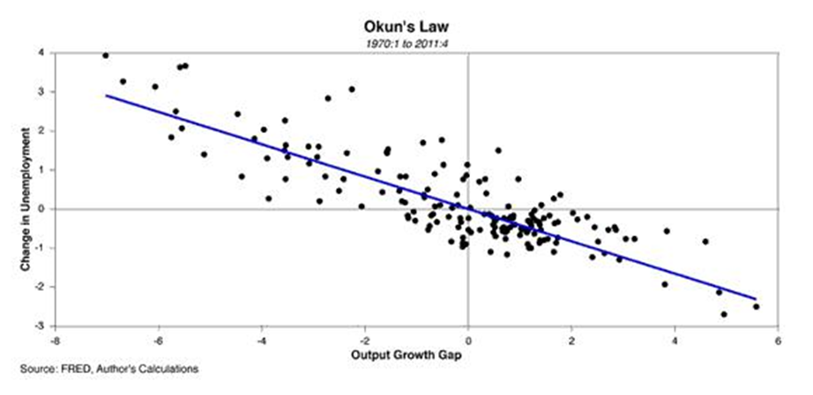
Figure 1: Graphical representation of Okun’s Law

Slide 8
In contrast, some economists argue that when growth rates climb, unemployment rates rise as well.
Economic expansion causes the economy's resources to be redistributed.
The kind and amount of labor that is required changes.
The demand for labor shifts from one area of the economy to another.
Workers who have been trained for a particular job are replaced when there is a decline in demand for the goods produced by that industry.

Slide 9
Difference between full employment and economic growth.
(a) Full employment implies
Exploitation of job opportunities.
lifting the actual production frontier up to its maximum limits under
the constraint of available resources.
-While economic growth means the creation of more employment
opportunities
-by raising the potentialities of the production frontier by
developing additional resources.

Slide 10
(b) Full employment is a static notion.
-It refers to the full utilization of existing capacity of the economy
with given productive resources, technology, and production methods.
-Economic growth is a dynamic concept that implies
-Enhancement of productive resources through technological
advancement.
Exploitation of new fields, new territories, new methods ,etc.
It involves uplifting the county’s production possibility frontier as a whole.

Slide 11
(c) Full employment objective is relatively a short-span phenomenon.
- It aims at economic stabilization through the elimination of cyclical
fluctuations that are faced by an advanced capitalist economy.
Economic growth, on the other hand, is a long­-term objective of monetary policy.
-Its aim is to improve the standard of living of the people, to remove
poverty by increasing the level of income, output and employment
in the economy. This objective is largely adopted by governments of
underdeveloped countries. However, there is no reason why an advanced
economy should not adopt it.

Slide 12
(d) Full employment objective implies raising the actual output
schedule of a country to its production possibility frontier with a
reasonable degree of economic stability.
-Economic growth implies raising the production possibility frontier
itself, together with the actual output schedule. It involves structural
changes.

Slide 13
(d) Full employment objective lays stress on the maintenance of
effective demand.
-During a depression, it implies correcting the deficiency of demand and
when there is inflation due to excess demand, it implies curbing it.
-Economic growth focuses on increasing the volume of the
complementary resources (land, capital, etc.) essential for securing
the productive employment of available labour rather than on the
maintenance of effective demand as such.

Slide 14
3.2 Price stability and economic growth
The importance of price stability
Inflation and deflation
Price stability implies avoiding both prolonged inflation and deflation.
Inflation is a rise in the general price level of goods and services in an economy over a long period of time.
Deflation is a decrease in the general price levell of goods and services over a long period of time.

Slide 15
Rapid inflation is negative for many reasons including-
-It complicates the economic decision-making process and slows
economic growth, diminishing the value of savings.
Deflation causes a slowdown in economic growth, inflationary gaps, low investments, increases in loan defaults, and increases in unemployment.
Price stability contributes to achieving high levels of economic activity and employment by improving the transparency of the price mechanism.

Slide 16
Price stability and economic growth-the trade -offs
The objectives of price stability and economic expansion are at odds with one another.
Price increases are a natural part of the growth process.
As large-scale investments increase and incomes rise as a result, there is an increase in demand for products and services.
Prices rise as a result of inflation, especially once full employment is attained.
Long-term price increases will be restrained by the development of new resources, expansion, and increased production of commodities

Slide 17
3.3. Price stability and full employment
Full employment and price stability was one of the goals of monetary policy in 1950.
However, research conducted in the 1960s by Philips, Samuelson, Solow, and others revealed a tension between the two goals.
-Philips curve is used to explain these observations.
-They contend that greater inflation can lead to full employment
-That a 5- to 6-percent unemployment rate can lead to price stability.
-There is no tension between price stability and unemployment, according to economists.
-They contend that there will be price stability as long as resources are idle. --Prices only begin to increase once all available resources are utilized.

Slide 18
Full employment and price stabilization are also incompatible objectives of monetary policy.
There is a trade-off between the rate of unemployment and the rate of inflation.
To curb inflation, a contractionary monetary policy is needed. But, this has an adverse effect on the level of employment.
When monetary policy is directed to reduce inflation and bring price stability, there tends to be an increase in the rate of unemployment.
When the rate of unemployment is to be reduced through expansionary monetary policy, there occurs a rising price level

Slide 19
3.4. Balance of Payment and Full Employment
Balance of payment and full employment has a significant problem
A balance of payments deficit is always correlated with full employment.
Maintaining either internal or external balance is the issue.
-A decrease in government spending
-Will lower imports if there is a balance of payments imbalance, but it would increase unemployment in the nation.
-If the government increases total spending to boost employment, this will increase demand for imports and throw the balance of payments out of balance.

Slide 20
3.5 Price Stability and Payment Balance
The goals of price stability and balance of payments of a nation don't appear to contradict with one another.
To manage inflation attempts to manage inflation to achieve balance of payment equilibrium.
Tension arises when government attempts to reduce unemployment while allowing some inflation inside the economy.
Arise in prices will stimulate imports, however if costs increase at the same rate in other nations this might not happens.

Slide 21
4.0 Potential Policy Conflicts and Trade-Offs
The policies used to pursue the macroeconomic objectives can also be conflicting.
Fiscal Policy
If there is concern over the size of the budget deficit or national debt, the government may reduce spending and raise taxes.
An expansionary fiscal policy may reduce unemployment and raise growth in the short term.
This results in higher inflation and a worsening balance of payments.
It may also add to the national debt if higher government spending or lower taxes results in a budget deficit.

Slide 22
Monetary policy
An expansionary monetary policy can increase short-term growth and reduce unemployment as aggregate demand increases.
This may lead to faster inflation and a deterioration in the balance of payments.
Contractionary monetary policy will have the opposite effect.
Supply side policies
This may raise the potential output of the economy and increase the long-term growth rate.

Slide 23
But some supply-side policies increase inequality.
Policies to boost investment may also cause higher inflation in the short run as investment spending is part of AD.
Environmental policies
Measures to improve or protect the environment may involve a trade-off with economic growth.
-For instance, carbon taxes raise the cost of production for goods and
services and may discourage investment.
Environmental measures may stimulate the growth of industries involved in ‘clean technologies’, such as solar power and wind farms and electric vehicles.

Slide 24
5.0 Stabilization policy
Definition
-A strategy implemented by the government of a nation to ensure that the economy is steady.
-The policy reduces price fluctuations and monitors economic cycles.
-Governments implement fiscal policy or monetary policy to keep the economy in check.
-The policy is used as both an economic and discretionary policy that keeps the economy in a healthy state.

Slide 25
Origin of stabilization policy
John Maynard Keynes was the first economist who introduced the stabilization policy.
-Introduces the policy as a key process to prevent erratic movements and surges in the prices of goods in an economy.
-Policy aims to control aggregate demand in an economy.
-Sudden changes in price can affect many aspects of an economy, including employment rate, money supply, and others.
-Policy is used during economic crisis, as a recovery mechanism.

Slide 26
Stabilization Policy
Expansionary monetary policy causes the economy to grow faster in the short run.
-Increases in the money supply.
-Output is higher, unemployment lower, and inflation rate is higher over
time.
Contractionary monetary policy causes the economy to grow more slowly in the short run.
-Decreases in the money supply.
-Output is lower, unemployment higher, and inflation rate is lower over
time

Slide 27
6.0 Policy lags
-Occur when monetary authorities are working to stabilize the policy objectives.
-Time lags occur between the onset of an economic problem and the full impact of the policy intended to correct the problem.
-Policy lags can reduce the effectiveness of business-cycle stabilization policies and can even destabilize the economy.
-Policy lags, especially inside lags, are often different for monetary policy than for fiscal policy.

Slide 28
Policy lags arise because government actions are not instantaneous.
The use of any stabilization policy encounters time lags between
-the onset of an economic problem and
-the full impact of the policy designed to correct the problem.
Example-in the event of a business-cycle contraction hitting the economy on 1st January, stabilization will not correct the problem on 2nd January.
The use of any stabilization policy, especially fiscal policy and monetary policy, takes time to work through the system.

Slide 29
Lag categories
Policy lags are commonly divided into two broad categories-
1. Inside lag -they occur when getting the policy activated, and
2. Outside lag – refers to the subsequent impact of the policy.
Inside lags
The three specific inside lags are-
(i) Recognition lag,
(ii) Decision lag, and
(iii) Implementation lag.

Slide 30
Outside lags
The one specific outside lag is termed impact lag.
Inside Lag
Inside lag is the time it takes between the actual onset of a problem and the launching of the corrective action by government.
The wheels of government often spin slowly and deliberately.
Three types of inside lag occur.

Slide 31
(i) Recognition Lag
The existence of the actual problem must be identified before stabilization policy is implemented.
It takes time to collect and analyze economic data.
Unemployment and inflation data are usually available only a month or so after the fact.
Production and income data are reported quarterly and have an even longer lag.
Once data are obtained, it must be analyzed and evaluated to ensure that it reflects the onset of an actual problem.
This often requires several months of data to document an actual trend.

Slide 32
(ii) Decision Lag
Government policy makers need to decide on the suitable course of action once the problem has been identified.
Government will need to pass legislation administrative rules that are necessary.
The congress/parliament negotiates make amendments and promote particular political interests.
Parliament is likely to debate over an expansionary fiscal policy use of increased government spending or decreased taxes.
These decisions could take days, weeks, or months.

Slide 33
(iii) Implementation lag
Once policy is selected, steps to implement need to be taken.
Change in spending, the appropriate government agencies need to be contacted.
Most agencies require competitive bids to identify product suppliers before they can make the expenditures.
. The implementation of fiscal and monetary policy is also likely to take weeks if not months.
Inside lags are likely to take several months.

Slide 34
2.Outside Lags
This lag is the time it takes after a policy is selected and implemented by appropriate government entities to be effective and achieve the desired change in the economy.
The effectiveness of results of a policy action are not instantaneous.
The principal outside lag is termed the impact lag.

Slide 35
Impact lag
This lag is the time it takes any change initiated by a government policy to impact the producers and consumers in the economy.
A key part of the impact lag is the multiplier.
An initial change in government spending, taxes, the money supply, interest rates must work through the economy.
-This causes more changes in production and income, which induces further changes in consumption.
-Each round of changes takes a month or two. Several rounds are required

Slide 36
Monetary versus Fiscal Policy time lags
Monetary and fiscal policy encounter time lags.
The outside, impact lag for each is very much the same.
Once the policies are activated, then the economy works through several rounds of production, income, and consumption before results are realized.
The decision and implementation lags tend to be different for monetary versus fiscal policy.

Slide 37
Monetary policy
The decision lag for monetary policy tends to be relatively short.
Monetary policy decisions are made by the monetary authorities through the monetary policy committees.
The implementation lag is also relatively short.
Policy decisions are implemented by a special branch of the central bank devoted to this task.
Once a policy action is identified, then the implementation steps are begun almost immediately.

Slide 38
Fiscal policy
The decision lag for fiscal policy tends to be relatively long.
Fiscal policy decisions are made by government through an act of parliament.
Decision lag is experienced since policy needs to be acceptable by the majority policy makers.
The implementation lag also tends to be relatively long.
The government bureaucracies tends to lengthen the time needed to implement the fiscal policy.

Slide 39
Destabilization policies.
The goal of stabilization policies is to stabilize the business cycle.
To counter contractions and expansions.
policy lags can actually make stabilization policies destabilizing.
That is, they can worsen the ups and downs of the business cycle.
For example
If expansionary policy effects are not seen within a year after the onset of a business cycle contraction, the stimulation may occur during the expansion and overstimulate the economy.

Slide 40
contractionary monetary policy designed to reduce inflation created during an expansion might not occur until the onset of a subsequent contraction.
In both cases, the resulting policy is not counter-cyclical, but pro-cyclical.
The policies reinforce and thus destabilize the business cycle.
6.0 Conclusion -The Future of Stabilization Policy
-Fiscal and monetary policies will be used by central banks and governments to keep the economy stable.
-Stabilization policy remains key to the achievement of monetary goals.

Slide 41
REFERENCES
Davids, S.O., (2015). Monetary Policy and its Benefits to an economy, Journal vol 2 pg 22-37, West-point Publisher, Lagos, Nigeria.
Jhingan, M.L (2004) Monetary Economics, 6th edition, Vrinda Publication limited.
Kelechi, I.U., (2016). Monetary Economics, 1st edition, Jaen Publication Limited
Sanjo, F.J., (2015). Monetary policy and the economy, Journal vol 2, Mill worldPublication limited
Tianishi, G. H., (2014). Monetary Policies in Developing Countries, 1st edition, Griller Publication limited.

Slide 42
THE END
THANK YOU.

