Slide 1
MONETARY THEORY AND POLICY
WEEK 11- THE QUANTITY THEORY OF MONEY AND ITS VARIANTS

Slide 2
CONTENTS
1.0 Introduction
2.0 Objectives
3.0 Main content
3.1 Meaning of value of money
3.2 Fisher‘s quantity theory of money: the cash transactions Approach
3.2.1 Quantity theory of money: Income version

Slide 3
3.2.2 Assumption of the Theory
3.2.3 Criticisms of the theory
4.0 Conclusion
5.0 Summary
6.0 References/Further Readings

Slide 4
1.0. INTRODUCTION
Value for money is in the perception of the buyer or receiver of goods and/or services.
Proof of good value for money is in believing or concluding that the goods/services received was worth the price paid.
Examples of the types of factors that may be considered are suitability, quality, skills, price, whole of life costs and other criteria.
The mix of these and other factors and the relevant importance of each will vary on a case by case basis.

Slide 5
It is also the difference between the amount of work that should have been paid for and the actual amount paid.
To calculate the labor rate variance, determine the difference between actual labor rate per hour and standard labor rate per hour and then multiply by number of hours actually worked.

Slide 6
2.0. OBJECTIVES
At the end of this topic you should be able to
1. Define the concept of value for money,
2. Discuss the measurement of changes in the value of money.
Analyze Fisher‘s quantity theory of money.
Explain the quantity theory of money: Income version
Evaluate the assumptions and criticisms of the quantity theory of money.

Slide 7
MAIN CONTENT
3.1 Meaning of Value of Money
The value of money is means the purchasing power of money over goods and services in a country.
What a shilling can buy in Kenya represents the value of money of the Kenya shilling.
The phrase, value of money is a relative concept which expresses the relationship between a unit of money and the goods and services which can be purchased with it.
This shows that the value of money is related to the price level because goods and services are purchased with a money unit at given prices

Slide 8
The relation between the value of money and price level is an inverse one.
If V presents the value of money and P the price level, then, V = 1/P. When the price level rises, the value of money falls, and vice versa.
Thus, in order to measure the values of money, we have to find out the general price level.
The value of money is of two types, namely:
  1. The internal value of money and
  2. The external value of money.

Slide 9
The internal value of money refers to the purchasing power of money over domestic goods and services.
The external value of money refers to the purchasing power of money over foreign goods and service.
Measurement of Changes in the Value of Money
Changes in prices are not uniform. Some prices rise, others fall; while still others remain stationary.
A comparison of price changes would give a very confusing picture.

Slide 10
Index Numbers
An index number is a statement in the form of a table which represents a change in the general price level.
When it is desired to find out to what extent prices have risen or fallen, an index number is prepared.
In every advanced country, index numbers are being regularly prepared officially by the governments and also non-officially by other bodies interested in economic changes.

Slide 11
Preparation of Index Numbers:
The following steps are necessary for the preparation of index numbers:
Selection of the Base Year:
It is the year with which we wish to compare the present prices, in order to see how much the prices have risen or fallen.
The base year must be a normal year.
It should not be a year of famine, or war, or a year of exceptional prosperity.

Slide 12
(b) Selection of Commodities
The commodities will depend on the purpose for which the index number is prepared.
Suppose we want to know how a particular class of people has been affected by a change in the general price level.
In that case, we should include only those commodities which enter into the consumption of that class.
(c) Collection of Prices
Retail prices are the best for the purpose, because it is at the retail prices that a commodity is actually consumed.

Slide 13
But retail prices differ almost from shop to shop, and there is no proper record of them.
Hence we have to take the wholesale prices of which there is a proper record.
(d) Finding Percentage Change:
Involves representing the present prices as the percentages of the base year prices.
The base year price is equated to 100, and then the current year’s price is represented accordingly.
(e) Averaging:
Finally, we take the average of both the base year and the current year figures in order to find out the overall change.
In May 1985, the price index was 355 which means that the price on the average were more than three-and a-half times as much or 255 per cent higher than what they were in 1970-71.

Slide 14
Uses of Index Numbers:
Index numbers can be used for a number of purposes:
(i) Index numbers are used to measure quantitative change.
Thus, we can prepare an index number of wages, imports, exports, industrial production, unemployment, profits, area under cultivation, enrolment in a college, etc.
(ii) Such quantitative changes as are measured by index numbers can indicate social and economic trends and help in framing policies with respect to them.
For instance, an index number of cost of living can guide us in the adjustment of wages to changing prices.

Slide 15
iii) We can also compare, with the help of index numbers, economic conditions of a class of people at two different periods.
(iv) Index numbers can be used as basis for, and equitable discharge of, contracts relating to borrowing and lending.
We know when prices rise, creditors lose. It may perhaps be considered more just to ensure that the creditor gets back the same purchasing power.
Hence, when prices rise, the debtor may be asked to pay a correspondingly higher sum to discharge a debt.

Slide 16
Limitations
Approximations: Index numbers are at best only approximations.
They cannot be taken as infallible guides.
Their data are open to question and they lead to different interpretations.
(ii) International Comparisons Difficult:
Use of index numbers for international comparisons presents several difficulties.
The result is that such comparisons are difficult, if not impossible, on account of the different bases, different sets of commodities or differences in their quality, etc.

Slide 17
iii) Comparisons between Different Times Difficult:
It is not easy to institute comparisons between different periods of time. Over long periods, some popular commodities are replaced by others.
Entirely new commodities come to figure in consumption, or a commodity may be vastly different from what’ it used to be.
iv) Measure Sectional Price Levels Only:
Index numbers measure only changes in the sectional price-levels. An index number, therefore, prepared for a particular purpose, may not be useful for another.

Slide 18
An entirely different set of commodities will have to be selected. Different people use different things and hold different assets.
People from different classes are affected differently by a given change in the price-level. Hence, the same index numbers cannot throw light on the effects of a price change on all sections of society.
(v) Weighting Changes Result:
One set of weights may yield quite a different result from another, and weighting is all arbitrary.

Slide 19
3.2. Fisher’s Quantity Theory of Money: The Cash Transactions Approach
The quantity theory of money states that the quantity of money is the main determinant of the price level or the value of money.
Any change in the quantity of money produces an exactly proportionate change in the price level.
In the words of Irving Fisher, ―Other things remaining unchanged, as the quantity of money in circulation increases, the price level also increases in direct proportion and the value of money decreases and vice versa.

Slide 20
If the quantity of money is doubled, the price level will also double and the value of money will be one half.
On the other hand, if the quantity of money is reduced by one half, the price level will also be reduced by one half and the value of money will be twice.
Fisher has explained his theory in terms of his equation of exchange:
PT=MV+ M* V*…………………………………………….. (1)

Slide 21
Where P = price level, or 1/P. = the value of money;
M = the total quantity of legal tender money;
V = the velocity of circulation of M;
M* = the total quantity of credit money;
V* = the velocity of circulation of M;
T = the total amount of goods and services exchanged for money or transactions performed by money.

Slide 22
This equation equates the demand for money (PT) to supply of money (MV= M* V*).
The total volume of transactions multiplied by the price level (PT) represents the demand for money.
According to Fisher, PT is SPQ. In other words, price level (P) multiplied by quantity bought (Q) by the community (S) gives the total demand for money.
This equals the total supply of money in the community consisting of the quantity of actual money M and its velocity of circulation V plus the total quantity of credit money M* and its velocity of circulation V*.

Slide 23
Thus, the total value of purchases (PT) in a year is measured by
MV+ M* V*. Hence, the equation of exchange is PT=MV+ M* V*‘.
In order to find out the effect of the quantity of money on the price level or the value of money, we write the equation as
P= MV+ M* V* …………………………………………………….. (2)
  T

Slide 24
Fisher points out the price level (P) (M+M*) provided the volume of transactions remain unchanged.
This proposition is evident from the fact that if M and M* are doubled, while V, V* and T remain constant, P is also doubled, but the value of money (1/P) is reduced to half.
Fisher‘s quantity theory of money is explained with the help of Figure 4. (A) and (B).
Panel A of the figure shows the effect of changes in the quantity of money on the price level. To begin with, when the quantity of money is M, the price level is P.

Slide 25
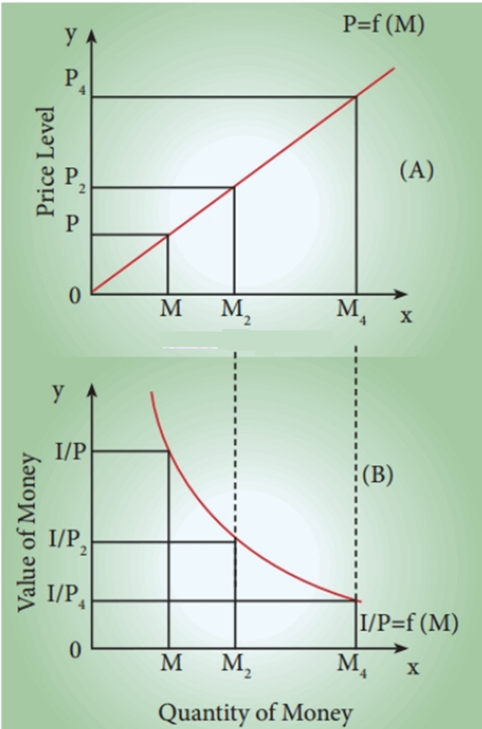
FISHER’S QUANTITY THEORY OF MONEY-FIGURE A AND B

Slide 26
1. Figure (A) shows the effect of changes in the quantity of money on the price level.
When the quantity of money is OM, the price level is OP.
When the quantity of money is doubled to OM2 , the price level is also doubled to OP2 .
Further, when the quantity of money is increased four–fold to OM4 , the price level also increases by four times to OP4 .
This relationship is expressed by the curve OP = f (M) from the origin at 45°.

Slide 27
2. Figure (B), shows the inverse relationship between the quantity of money and the value of money, where the value of money is taken on the vertical axis.
When the quantity of money is OM1 , the value of money is 01 / P1 .
But with the doubling of the quantity of money to OM2, the value of money becomes one–half of what it was before, (01 / P2 ).
But, with the quantity of money increasing by four-fold to OM4, the value of money is reduced by 01 / P4.
This inverse relationship between the quantity of money and the value of money is shown by the downward-sloping curve 1 / OP = f (M).

Slide 28
Numerical example
Suppose the quantity of money (M) is Kshs. 5,000,000 in an economy.
The velocity of circulation of money (V) is 5.
The total output to be transacted (T) is 2,500,000 units.
The average price level (P) will be:
P = MV/T
5, 000,000 × 5/ 2,500,000 = 2,500,000/ 2,500,000
= Kshs.10 per unit.

Slide 29
If now, other things remaining the same, the quantity of money is doubled, i.e., increased to Kshs.10,000,000 then:
P = 10,000,000 × 5/ 2,500,000 = Kshs.20 per unit
Conclusion-Quantity theory of money, price level varies in direct proportion to the quantity of money.
A doubling of the quantity of money (M) will lead to a doubling of the price level.
Since changes in the quantity of money are assumed to be independent or autonomous of the price level, the changes in the quantity of money become the cause of the changes in the price level.

Slide 30
3.2.1. Quantity Theory of Money: Income Version:
Fisher‘s transactions approach to the quantity theory of money is described in equation (1) and (2) above considers such variables as-
Total volume of transactions (T) and the average price level of these transactions are conceptually vague and difficult to measure.
The later formulation of the quantity theory considers
-Real income or national output (i.e., transactions of final goods only) rather than all
transactions.

Slide 31
The data regarding national income or output is readily available, the income version of the quantity theory is being increasingly used.
-The average price level of output is a more meaningful and useful concept.
The general price level in a country is measured taking into account only the prices of final goods and services which constitute national product.
Note
(i) Even in this income version of the quantity theory of money, the function of money is considered to be a means of exchange as in the transactions approach of Fisher.

Slide 32
(ii) In this approach, the concept of income velocity of money has been used instead of
transactions velocity of circulation.
By income velocity we mean the average number of times per period a unit of money is used in making payments involving final goods and services, that is, national product or national income.
In fact, income velocity of money is measured by Y/M where Y stands for real national income and M for the quantity of money.

Slide 33
The income version of quantity theory of money is written as under:
  MV = PY………………………………………………………….. (3)
  P = MV/PY ……………………………………………………… (4)
Where, M = Quantity of money
V = Income velocity of money
P = Average price level of final goods and services Y = Real national income (or aggregate output)

Slide 34
3.2.2. Assumptions of the Theory:
1. P is a passive factor in the equation of exchange which is affected by the other
factors.
2. The proportion of M* to M remains constant.
3. V and V* are assumed to be constant and are independent of changes in M and M*.
4. T also remains constant and is independent of other factors such as M, M*, V and
  V*.

Slide 35
5. It is assumed that the demand for money is proportional to the value of
transactions.
6. The supply of money is assumed as an exogenously determined constant.
7. The theory is applicable in the long-run.
8. It is based on the assumption of the existence of full employment in the economy.

Slide 36
3.2.3. Criticisms of the Theory:
(i)Truism: According to Keynes, ―The quantity theory of money is a truism.
Fisher‘s equation of exchange is a simple truism because it states that the total quantity of money (MV+M*V*) paid for goods and services must equal their value (PT).
But it cannot be accepted today that a certain percentage change in the quantity of money leads to the same percentage change in the price level.
(ii) Other things not equal-The direct and proportionate relation between the quantity
of money and price level in Fisher‘s equation assumes that other things remain unchanged.

Slide 37
But in real life, V, V* and T are not constant.
They are not independent of M, M* and P. Rather, all elements in Fisher‘s equation are interrelated and interdependent. For instance, a change in M may cause a change in V.
(iii) Constants Relate to Different Time
Multiplying M and V because M relates to a point of time and V to a period is inconsistent. The former is a static concept and the latter a dynamic one.
It is, therefore, technically inconsistent to multiply two non-comparable factors.

Slide 38
(iv) Fails to Measure Value of Money:
Fisher‘s equation does not measure the purchasing power of money but only cash transactions, that is, the volume of business transactions of all kinds or what Fisher calls the volume of trade in the community during a year.
But the purchasing power of money (or value of money) relates to transactions for the purchase of goods and services for consumption.
Thus the quantity theory fails to measure the value of money.

Slide 39
(v) Weak Theory:
According to Crowther, the quantity theory is weak in many respects
It cannot explain ‘why’ there are fluctuations in the price level in the short run.
It gives undue importance to the price level as if changes in prices were the most critical and important phenomenon of the economic system.
It places a misleading emphasis on the quantity of money as the principal cause of changes in the price level during the trade cycle.

Slide 40
(vi) Neglects Interest Rate:
One of the main weaknesses of Fisher‘s quantity theory of money is that it neglects the role of the rate of interest as one of the causative factors between money and prices.
Fisher‘s equation of exchange is related to an equilibrium situation in which rate of interest is independent of the quantity of money.
(vii) Unrealistic Assumptions:
Keynes in his General Theory severely criticized the Fisherian quantity theory of money for its unrealistic assumptions.

Slide 41
The quantity theory of money is unrealistic because it analyses the relation between M and P in the long-run. Hence, it neglects the short-run factors which influence this relationship.
Fisher‘s equation holds well under the assumption of full employment. But Keynes regards full employment as a special situation. The general situation is one of the under-employment equilibrium.
Keynes does not believe that the relationship between the quantity of money and the price level is direct and proportional.

Slide 42
(viii) V not Constant:
Further, Keynes pointed out that when there is underemployment equilibrium, the velocity of circulation of money V is highly unstable and would change with changes in the stock of money or money income.
Thus it was unrealistic for Fisher to assume V to be constant and independent of M.
(ix) Neglects Store of Value Function:
The theory concentrates on the supply of money and assumes the demand for money to be constant.
It neglects the store-of-value function of money and considers only the medium-of-exchange function of money. Thus the theory is one-sided.

Slide 43
(x) Neglects Real Balance Effect:
Don Patinkin has criticized Fisher for failure to make use of the real balance effect, that is, the real value of cash balances.
A fall in the price level raises the real value of cash balances which leads to increased spending and hence to a rise in income, output, and employment in the economy.
According to Patinkin, Fisher gives undue importance to the quantity of money and neglects the role of real money balances.

Slide 44
(xi) Static:
Fisher‘s theory is static in nature because of its unrealistic assumptions as long-run, full employment, etc. It is, therefore, not applicable to a modern dynamic economy.
4.0 CONCLUSION
The quantity theory of money is the idea that the supply of money in an economy determines the level of prices and changes in the money supply result in proportional changes in prices.
A given percentage changes in the money supply results in an equivalent level of inflation or deflation.
This concept is usually introduced via an equation relating money and prices to other economic variables.

Slide 45
5.0 REFERENCES/FURTHER READINGS
Becker, B. R., (2012). Money and Banking, 3rd edition Forensic Publication limited
Dotun, G. G., (2014). Money and Banking, 1st edition, Dale Publication limited
Jhingan, M.L (2004) Monetary Economics, 6th edition, Vrinda Publication limited.
Kelechi, I.U., (2016). Monetary Economics, 1st edition, Jaen Publication Limited

Slide 46
THE END
THANK YOU

