Slide 1
COURSE TITLE:
ENGINEERING ECONOMIC ANALYSIS
Chapter 3 - (Week 4)
BASIC METHODOLOGIES OF ENGINEERING ECONOMIC ANALYSIS
LECTURE – 4
MARR, Equivalent Worth Method, Rate of Return Method (IRR)
Er. Ishwar Adhikari
Associate Professor
Kathmandu Engineering College, Nepal

Slide 2
Learning Objective
After studying this lecture students will be able to learn:
The concept of Minimum Attractive rate of Return (MARR)
The concept of equivalent worth method (Present Worth, Future Worth, and Annual Worth).
The Concept of rate of return method, Internal rate of return (IRR)

Slide 3
Introduction
If an organization have a huge sum of money in the investment pool and there are many alternatives (projects) whose initial investment cost and annual revenues are known then the organization has to select the best alternative among the different projects.
The worthiness of the project has to be determined, Whether a proposed project can generate revenue or not to recover the invested capital. [1]

Slide 4
Basic Methods for determining worthiness
1. Equivalent Worth Method
Present worth method (PW)
Future worth method (FW)
Annual worth method (AW)
2. Rate of Return Method
Internal rate of return (IRR)
External rate of return (ERR)
3. Benefit Cost Analysis (B/C ratio)
Conventional B/C
Modified B/C
4. Payback Period Method
Simple payback period
Discounted payback period

Slide 5
Minimum Attractive Rate of Return
The minimum attractive rate of return (MARR) is the interest rate at which a firm can always earn or borrow money. [2]
It is the rate set by an organization to designate the lowest level return that makes an investment acceptable. [3]
MARR is determined from the opportunity cost viewpoint, which results from the capital rationing phenomenon.
Capital rationing refers to the situation where the funds available for capital investment are not sufficient to cover potentially acceptable projects.

Slide 6
Minimum Attractive Rate of Return (Cont’d….)
It is generally dictated by management considering the following points: [2]
The amount of money available for investment - Source and cost of these funds (equity, borrowed funds etc.)
The number of good project available for investment
The amount of perceived risk associated with the investment
The type of organization involved (government, public, private)

Slide 7
Determination of MARR
Consider the firm has
Available amount
= $ 60 million
Seven projects available with total amount = $ 75 million
40
Annual rate of profit (%)
35%
35
A
30%
30
A
Capital Supply
25
B
26%
23%
C
19%
20
15
D
16%
E
14%
Reject project F and G
10
5
F
G
20
30
40
50
60
70
80
$ in million
Fig : MARR Determination [2]

Slide 8
Determination of MARR (Cont’d…)
Last funded project = Project E
Prospective rate of profit = 19%
Best rejected project = F (by not being able to invest in project F, the firm would presumably be forfeiting the chance to realize on 16% annual return)
MARR = 16% per year (as the amount of investment capital and opportunities available change over time, the firm’s MARR will also change)

Slide 9
Equivalent worth Method
Present worth method (PW) or Net Present Value (NPV)
The NPW or Present Worth or (NPV) of a given series of cash flow is the equivalent values of the cash flows at the end of year zero (i.e. beginning of year 1). [4]
In other words, how much money we have to set aside to provide for future cash flow.
All cash inflows and outflows are discounted to present point in time at MARR.
Net present worth = Equivalent present worth of future cash flow – Initial investment
Here we use NPW or NPV as PW

Slide 10
Present Worth Analysis (PW)
Determine the interest rate that the firm wishes to earn on their investment, which is referred as either required rate of return or MARR (minimum attractive rate of return). [5]
Estimate the service life of the project.
Estimate the cash inflow and out flow for each service period.
Determine the net cash flows
= Cash inflow – cash out flow

Slide 11
Present Worth Analysis (PW) (Cont’d…)
Present worth of each net cash flow as shown in figure , at MARR as:-
PW (i%) = A₁/ (1+i)¹ + A₂ / (1+i)² + A₃ / (1+i)³…… A_{N}/(1+i)^{N}
=
=
A₁
A₂
A₃
A₄
A_{N-1}
A_{N}
0
1
2
3
4
N-1
N
PW
A_{n} will be +ve if the corresponding period has a net cash inflow and -ve if there is net cash outflow.

Slide 12
Decision Rule for PW
If PW (i) > 0’ accept the investment
If PW (i) = 0’ remain indifferent
If PW (i) < 0’ reject the investment

Slide 13
Present Worth Example
A construction company needs equipment which costs $ 10, 00,000 and has a salvage value of $ 1, 00,000 at the end of 10 years. The equipment suppliers are also willing to provide the equipment on hire for $ 1, 25,000 per year for 10 years. What will you do? Purchase or Hire. Use PW. MARR =12%

Slide 14
Present Worth Example (Cont’d….)
For the purchasing case
Initial cost (P) = $ 10,00,000 ,
Salvage Value (S) = $ 1,00,000, N = 10 years
Using PW
PW (12%) = - 10,00,000 + 1,00,000 (P/F, 12%,10)
= -10,00,000 + 1,00,000 (1+0.12)⁻¹⁰
= $ – 9, 67,802.67
Present worth of purchasing the equipment is
$ 9, 67,802.67
1, 00,000
0
10
10, 00,000

Slide 15
Present Worth Example (Cont’d….)
For the Hiring case
Annual cost (A) = $ 1, 25,000
Using PW formulation
PW (12%) = - 1, 25,000 (P/A, 12%, 10)
= - 1, 25,000 [ (1+0.12)¹⁰ -1/(1+0.12)¹⁰ *0.12]
= $ -7, 06,277.87
Present worth of hiring the equipment is $ 7, 06,277.87
Since the PW of Hiring cost is less than the PW of the Purchasing cost, Hire the equipment.
1
2
3
4
8
9
10
0
1, 25,000

Slide 16
Future worth method (FW) or Net Future Value (NFV)
Net present worth measures the surplus in an investment project at time zero where as net future worth measures this surplus at time period other than zero. [5]
Net future worth analysis is particularly useful on an investment solution where we need to compute the equivalent worth of a project at the end of investment period rather than its beginning.

Slide 17
Decision Rule for FW
If FW (i%) > 0’ accept the investment
If FW (i%) = 0’ remain indifferent
If FW (i%) < 0’ reject the investment

Slide 18
Future Worth Example
A construction company needs equipment which costs $ 10, 00,000 and has a salvage value of $ 1, 00,000 at the end of 10 years. The equipment suppliers are also willing to provide the equipment on hire for $ 1, 25,000 per year for 10 years. What will you do? Purchase or Hire. Use FW. MARR =12%

Slide 19
Future Worth Example (Cont’d….)
For the purchasing case
Initial cost (P) = $ 10,00,000 ,
Salvage Value (S) = $ 1,00,000, N = 10 years
Using FW
FW (12%) = - 10,00,000 (F/P, 12%,10) + 1,00,000
= -10,00,000 (1+0.12)¹⁰ + 1,00,000
= $ – 3,005,800
Future worth of purchasing the equipment is
$ 3,005,800
1, 00,000
0
10
10, 00,000

Slide 20
Future Worth Example (Cont’d….)
For the Hiring case
Annual cost (A) = $ 1, 25,000
Using FW formulation
FW (12%) = - 1, 25,000 (F/A, 12%, 10)
= - 1, 25,000 [ (1+0.12)¹⁰ -1/0.12]
= - $ 2,193,587.5
Future worth of hiring the equipment is $ 2,193,587.5
Since the FW of Hiring cost is less than the FW of the Purchasing cost, Hire the equipment.
1
2
3
4
8
9
10
0
1, 25,000

Slide 21
Annual worth Method (AW) or Net Annual worth Method (NAW)
Annual worth method provides the basis for measuring investment worth by determining equal payments on an annual basis. [5]
The AW of a project is its annual equivalent receipts (R) minus annual equivalent expenses (E) minus annual equivalent capital Recovery (CR). R, E, and CR are calculated at MARR [2]
AW (i) = R – E – CR
R = annual revenues, E = annual expenses, CR = capital recovery

Slide 22
Capital Recovery (CR)
In any investment project, two types of costs are involved, i.e. Capital cost and operation cost.
Operating cost is recurred over the life of project and they are estimated on annual basis.
Capital costs tend to be one time cost. This one time cost must translated into its annual equivalent over the life of the project.
This annual equivalent of capital cost is given a special name: Capital Recovery cost designated as CR (i)

Slide 23
Capital Recovery (CR) (Cont’d..)
S
CR (i%) = I (A/P, i%, N) – S (A/F, i%, N)
Where,
I = Initial Investment of a project.
S = Salvage value at the end of project.
N = project study period.
Capital recovery amount for a project is the equivalent uniform annual cost of the capital invested.
i %
0
N
I

Slide 24
Decision Rule for AW
If AW (i%) > 0’ accept the investment
If AW (i%) = 0’ remain indifferent
If AW (i%) < 0’ reject the investment

Slide 25
Annual Worth Example
You purchased a building 5 years ago for $ 10,00,000. Annual Maintenance cost is $ 50,000 per year. At the end of 3 years $ 90,000 was spent on roof repairs. At the end of 5 years you sell a building for $ 12, 00,000. During the period of ownership, you rented the building for $ 1, 00,000 per year paid at the beginning of each year. Use AW method to evaluate the investment if MARR = 12%

Slide 26
Annual Worth Example (Cont’d…)
$ 12,00,000
$ 100,000
i=12%
0
1
2
3
4
5
$ 50,000
$ 90,000
$ 10,00,000
CR (12%) = 10,00,000 (A/P,12%,5) – 12,00,000(A/F, 12%,5)
=10,00,000 { (1+ 0.12) ⁵ * 0.12} / (1+0.12)⁵ -1 }
- 12,00,000{0.12 / (1+0.12)⁵ -1}
= $ 88518.05

Slide 27
Annual Worth Example (Cont’d…)
Annual Expenses (E)
= 50,000 +{ 90,000 (P/F,12%,3)} (A/P,12%,5)
= 50,000 + { 90,000 (1+0.12)⁻³ } * ((1+ 0.12) ⁵ * 0.12} / (1+0.12)⁵ -1
= $ 67770.93
Annual Revenue (R)
=100,000 (F/P, 12%, 1)
= 1,00,000 (1.12)¹ = $ 112,000
AW (12%) = R - E - CR
=112,000 - 67770.93 - 88518.05
= - $ 44288.98
As, AW (12%) < 0, the investment is bad.

Slide 28
Rate of Return Method
A rate of return (ROR) is the net gain or loss of an investment over a specified time period, expressed as a percentage of the investment’s initial cost. [6]
Rate of Return is the interest rate earned on the unpaid balance of an amortized loan. [5]
Equivalent worth method is absolute measurement where as the rate of return is the relative measurement used for comparing mutually exclusive alternatives.

Slide 29
Rate of Return Example.
Suppose that a bank lends $10,000 and it is repaid $4021 at the end of each year for 3 years.
How can be the interest rate determined that the bank charges on this transaction?
P = A (P/A, i%, 3)
$10,000 = $4021 (P/A, i%, 3)
i = 10%
The bank will earn 10% return annually on its investment of $10,000.
Example Source: [5]

Slide 30
Internal Rate of Return (IRR)
IRR is that interest rate (return rate) which equates the equivalent worth of an alternative’s cash inflows to the equivalent worth of cash outflows. [1]
IRR is the interest rate that is charged on the un-recovered project balance of the investment such that, when the project terminates, the un-recovered balance will be zero. [5]
At this particular rate, the equivalent worth of revenue generated by project is enough to bear the equivalent worth of expenses absorbed by project without any financial burden.

Slide 31
Mathematical relation of IRR
A project’s return is referred as internal rate of return (IRR) promised by an investment project over its useful life.
Based on PW formulation
PW (i*%) = 0
PW _{inflow} – PW _{outflow} = 0
Based on FW formulation
FW (i*%) = 0
FW _{inflow} – FW _{outflow} = 0
PW _{inflow}
IRR
+
i*%
0
i%
-
PW _{outflow}

Slide 32
Method of Calculating IRR
Direct Solution Method
Trial and Error Method
Computer Solution Method

Slide 33
Direct Solution Method
For the very special case of a project with only a two-flow transaction (an investment followed by a single future payment) or service life of 2 years of return, we can apply direct mathematical solution for determining the rate of return. [5]

Slide 34
Trial and Error Method
The following steps are followed to calculate the IRR of any project’s cash flow:
Develop an equation for equivalent worth of any point of time indicating rate of interest by i*% whose value is to be found.
Equate the developed equation as to zero.
Solve it to get the value of i*% which would be IRR

Slide 35
Computer Solution Method
In Microsoft Excel,
Click Formula
Click Auto Sum
Click More Function
Type IRR in Search for a Function, Click Ok
Insert the value of Cash Flow
Click Enter,
The result gives the value of IRR.

Slide 36
Decision Rule of IRR
If IRR > MARR, accept the project
IRR = MARR, remain indifferent
IRR < MARR, reject the project

Slide 37
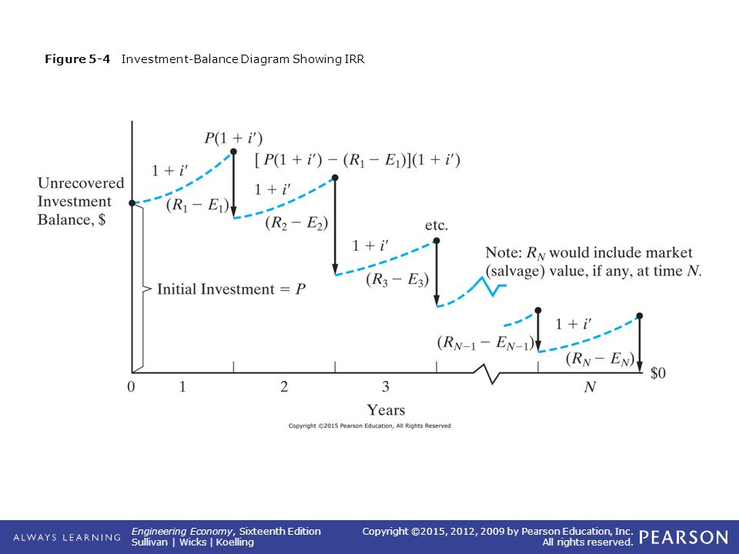
Graphical representation of IRR
Fig: Investment Balance Diagram [2]

Slide 38
Drawbacks of IRR
The recovered funds are re-invested at i*% rather than MARR, which leads to the concept of External rate of return (ERR).
It needs trial and error approach for the calculation.
If the algebraic sum of the cash flow changes in the middle of the project more than two times, we might obtain multiple IRR values.
When choosing between the mutually exclusive alternatives, IRR method can be misleading and does not compare the scale of investment.

Slide 39
References:
[1] A Textbook of Engineering Economics : Damodar Adhikari, First Edition, Dreamland Publication Pvt. Ltd. Kathmandu, Nepal, 2019.
[2] Engineering Economy: William G. Sullivan, James A. Bontadelli & Elin M. Wicks, Eleventh Edition, Pearson Educations, Inc. 2000 .
[3] Engineering Economics: James L. Riggs, David D. Bedworth and Sabah U. Randhawa, Fourth Edition, Tata McGraw Hill Education Private Limited, New Delhi, India, 2004.

Slide 40
References: (Cont’d….)
[4]Engineering Economics : Jose A. Sepulveda, William E. Souder and Byron S. Gottfried, Tata McGraw – Hill Publishing Company Limited, New Delhi, India, 2005.
[5] Contemporary Engineering Economics, Chan S. Park Second Edition, Addison-Wesley Publishing Company, 1997.
[6] https://www.investopedia.com/terms/r/rateofreturn.asp (viewed on September)

Slide 41
THANK YOU

