Slide 1
COURSE TITLE
ENGINEERING ECONOMIC ANALYSIS
Chapter 5 - (Week 9)
REPLACEMENT ANALYSIS
LECTURE – 9
Approach for comparing defender and challenger, economic service life, replacement analysis under infinite and finite planning horizon
Er. Ishwar Adhikari
Associate Professor
Kathmandu Engineering College, Nepal

Slide 2
Learning Objective
After studying this lecture students will be able to learn:
Approach for comparing defender and challenger
Economic service life of a defender and challenger
Replacement analysis under the infinite planning horizon
Replacement analysis under the finite planning horizon

Slide 3
Introduction
In previous lecture we have discussed about the basic concept of replacement analysis including the reasons for investment as well as the terminologies associated with it.
We are going to learn about the remaining topics regarding the replacement analysis under this lecture.
Replacement analysis is the economic comparison between the existing asset (defender) and the new asset (challenger)
The decision in the replacement analysis is to make whether the existing equipment should be retained or replaced by the new equipment?

Slide 4
Basic Comparison in Replacement
The first step in the replacement analysis is to identify the participants (defender and challenger)
Challenger is chosen from a mutually exclusive set of challengers.
Best challenger should be chosen based on challengers minimum cost life.
Economic comparison is made between defender and chosen challenger to decide whether to continue with defender or replace it by new challenger.

Slide 5
Approach for comparing Defender and Challenger
Two basic approaches are considered for the analysis of replacement decision.
(a) Cash Flow approach
(b) Opportunity Cost approach
The analysis is made where the defender and the challenger have the same useful life.
Presumably the defender has been around for a while before this time, and the required service period for the defender is relatively short. [1]

Slide 6
Cash Flow Approach
In a cash flow approach, proceeding from the sale of the old machine is treated as down payment towards purchasing the new machine.
This approach is meaningful when both the defender and challenger have same useful life.
Net present worth method and annual equivalent worth method is used for the comparison.

Slide 7
Opportunity Cost Approach
In an opportunity cost approach, proceedings from the sale of old machine is treated as the investment required to keep the old machine.
Also known as the ‘outsider viewpoint’ because it represent the view of an impartial third party to establish the fair market value of used asset. [2]
If the current market value of the defender is assigned to the defender then it cannot also be assigned as a benefit in regard to the challenger.
This approach is more commonly practiced in replacement analysis.

Slide 8
Example [1]
Decide whether replacement is justified for using cash flow and opportunity cost approach.
Defender | Challenger
Market Price = $ 10,000 | Initial Cost = $ 15,000
Remaining Useful life = 3 years | Useful Life = 3 Years
Salvage Value = $ 2500 | Salvage Value = $ 5,500
Operation and Maintenance cost = $ 8000 | Operation and Maintenance = $ 6,000
MARR = 12%

Slide 9
Example (Cont’d…..)
From Cash Flow Approach
Sales proceeds
from defender
$10,000
$ 5500
$ 2500
0 1 2 3
0 1 2 3
$ 6000
$8000
(a) Defender
(b) Challenger
Source : [1]
$15,000

Slide 10
Example (Cont’d…..)
Defender:
PW (12%) _{D} = $ 2, 500 (P/F, 12%, 3) – $ 8, 000 (P/A, 12%, 3)
= - $ 17, 434.90
AW (12%) _{D} = PW (12%) _{D} (A/P, 12%, 3)
= -$7, 259.10
Challenger:
PW (12%) _{C} = $ 5, 500 (P/F, 12%, 3) - $ 5, 000- $ 6, 000 (P/A, 12%, 3)
= - $15, 495.90
AW (12%) _{C} = PW (12%)_{C} (A/P, 12%, 3)
= - $6, 451.79
Here AW of Challenger is greater than Defender, replace the defender.

Slide 11
Example (Cont’d…..)
(b) From Opportunity Cost Approach
Defender
$ 2500
Challenger
$ 5500
0 1 2 3
0 1 2 3
$ 8000
$ 6000
$10,000
Proceeds from sale viewed as
an opportunity cost of keeping
the asset
$ 15,000
Source : [1]

Slide 12
Example (Cont’d…..)
Defender:
PW (12%) _{D} = - $ 10, 000 - $8,000(P/A, 12%, 3) + $2, 500(P/F, 12%, 3)
= - $ 27, 434.90
AW (12%) _{D} = PW (12%) _{D} (A/P, 12%, 3)
= - $ 11, 422.64
Challenger:
PW (12%) _{C} = - $ 15, 000 - $ 6, 000(P/A, 12%, 3) + $ 5, 500(P/F, 12%, 3)
= - $ 25, 495.90
AW (12%) _{C} = PW (12%) C (A/P, 12%, 3)
= - $ 10, 615.33
Here AW of Challenger < AW of Defender, replace the defender now.

Slide 13
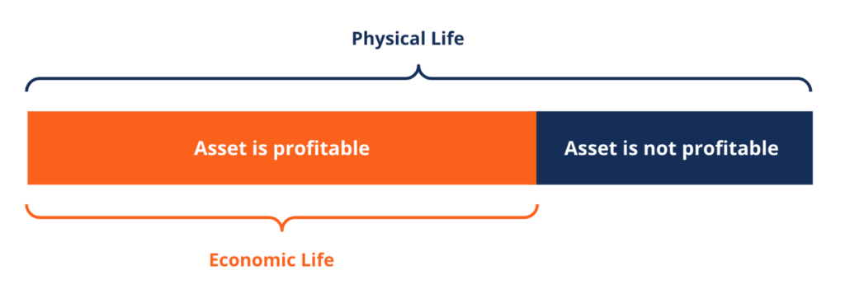
Economic service Life (ESL)
Economic life is the expected period of time during which an asset remains useful to the average owner. When an asset is no longer useful to its owner, then it is said to be past its economic life. [3]
An asset should be retained for a time period that minimizes its cost to the owner.
We need to consider how long an asset should be held once it is placed in service.
Source : [4]

Slide 14
Economic service Life (Cont’d….)
In engineering economic analysis, an asset’s operating and maintenance (O&M) costs increase with age, we are more interested in knowing the asset’s practical service life, rather than its remaining physical life. [1]
The economic service life (ESL) is the number of year n at which the equivalent uniform annual worth (AW) of costs (EUAC) is the minimum, considering the most current cost estimates over all possible years that the asset may provide a needed service.
The smallest total AW of costs identifies the ESL value. [5]

Slide 15
Economic service Life (Cont’d….)
The “economic service life” is the useful life of a defender, or a challenger, that results in the minimum uniform equivalent annual cost (EUAC) of owning & operating the asset.
Any defender & challenger comparison should be based on their respective economic service lives.
Minimization of
Ownership or Capital Cost
+
Operating
Cost

Slide 16
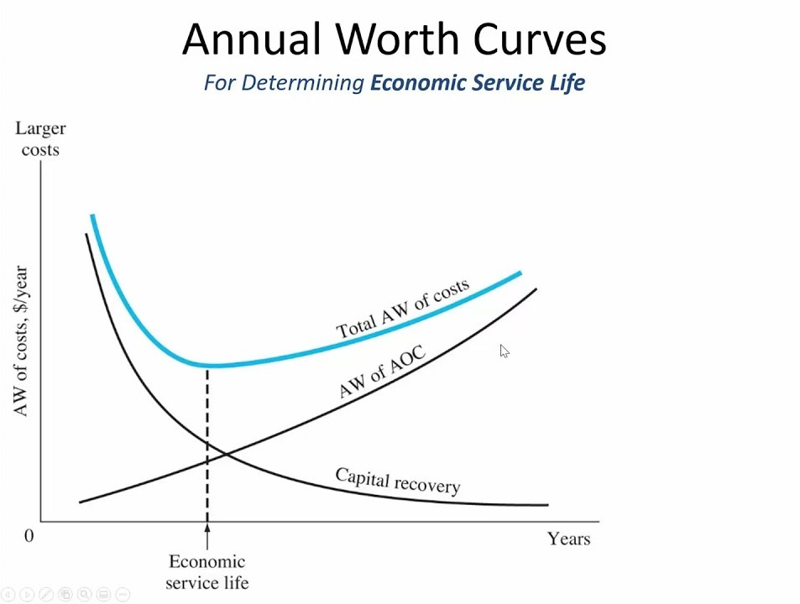
Economic service Life (Cont’d….)
Total AW of costs is the sum of the asset’s annual capital recovery and AW of annual operating cost, i.e.
Total AW = (-) Capital recovery – Aw of annual operating costs
= (-) CR – AW of AOC
Source : [5]

Slide 17
Economic service Life (Cont’d….)
In figure, the curve of total AW of costs is represented by the concave shape.
The capital recovery cost (CR) decreases as the time is elapsing and the annual operating cost (AOC) increases.
At any year ‘n’ the capital recovery cost (CR) and annual operating cost (AOC) is calculated as:
(CR)_{n} = - I (A/P, i%, n) + S (A/F, i%, n)
AW of (AOC)_{n} = { AOC₁(P/F, i%, 1) + AOC₂(P/F, i%, 1) …… + AOC _{n} (P/F, i%, n) } (A/P, i%, n)

Slide 18
Minimum Cost life of an asset
Minimum cost life of any new (existing) asset is the number of years at which the equivalent uniform annual cost (EUAC) of the ownership is minimized.
That is we need to identify the year in which the total EUAC is minimized.
The minimum cost life is normally shorter than the useful life of the asset because of increasing operating and maintenance cost in the later years of asset life.

Slide 19
EXAMPLE
A piece of machinery costs $7500 and has no salvage value after it is installed. No maintenance or repair is required in the first year. The second year, the maintenance cost will be $900 and will increase on a $900 arithmetic gradient in the subsequent years. The first year operating expense will be $500 and will increase on a $400 arithmetic gradient in the following years. If interest is 8%, compute the useful life of the machinery that will result in a minimum EUAC (Find its minimum cost life).

Slide 20
EXAMPLE (Cont’d)
Year | EUAC of Capital Recovery cost $ 7500 (A/P,8%,n)-0 | EUAC of Maintenance and Repair cost $ 900 (A/G, 8%,n) | EUAC of operating costs 500 + 400 (A/G,8%,n) | EUAC Total
1 | $8100 | $0 | $500 | $8600
2 | $4206 | $ 433 | $692 | $5331
3 | $2910 | $ 854 | $880 | $4644
4 | $2264 | $1264 | $1062 | $4589
5 | $1878 | $1661 | $1238 | $4779
6 | $1622 | $ 2048 | $1410 | $5081
The EUAC are estimated for 15 years period and plotted in the following figure. From either the table or the figure, the minimum cost life of the machinery is 4 years, with minimum EUAC of $4589 for each of those 4 years.

Slide 21
EXAMPLE (Cont’d)
Year | EUAC of Capital Recovery Rs 7500 (A/P,8%,n) | EUAC of Maintenance and Repair Cost Rs 900 (A/G, 8%,n) | EUAC of Operating Costs Rs 500 + Rs 400 (A/G,8%,n) | Total EUAC (Rs)
1 | 8100 | 0 | 500 | 8600
2 | 4205.77 | 432.69 | 692.31 | 5330.77
3 | 2910.25 | 853.87 | 879.50 | 4643.62
4 | 2264.41 | 1263.56 | 1061.58 | 4589.55
5 | 1878.42 | 1661.82 | 1238.59 | 4778.84
6 | 1622.37 | 2048.71 | 1410.54 | 5081.62
7 | 1440.54 | 2424.30 | 1577.47 | 5442.31
8 | 1305.11 | 2788.67 | 1739.41 | 5883.19
9 | 1200.60 | 3141.93 | 1896.41 | 6238.94
10 | 1117.72 | 3484.18 | 2048.53 | 6650.43
11 | 1050.57 | 3815.55 | 2195.80 | 7061.93
12 | 995.21 | 4136.17 | 2338.30 | 7469.68
13 | 948.91 | 4446.19 | 2476.08 | 7871.18
14 | 909.73 | 4745.75 | 2609.22 | 8264.69
15 | 876.22 | 5035.01 | 2737.78 | 8649.02

Slide 22
EXAMPLE (Cont’d)
Economic life is where the Total EUAC is minimized

Slide 23
PERFORMING REPLACEMENT STUDY
REPLACEMENT STUDY
Infinite Planning Horizon
Finite Planning Horizon
Find ESL of Defender and Challenger
Find PW /FW/AW over specified period
Select better AW using Marginal cost analysis
Select the better Option

Slide 24
Performing replacement analysis (Cont’d…)
While performing replacement analysis , the analysis period (planning horizon) could be long i.e. infinite and finite.
Economic Service life is used to determine when is the right time to replace the defender?
If now is not the right time, when is the optimal time to replace the defender? For answering the above question the following three assumptions are made. [1]
Planning horizon (study period)
Technology
Relevant cash flow information

Slide 25
Performing replacement analysis (Cont’d…)
Planning horizon
By planning horizon it is mean that the service period required by the defender and a sequence of future challenger. [1]
Infinite planning horizon: It is used when we are unable to predict when the activity under consideration will be terminated.
Finite planning horizon: When the project has a definite and predictable duration, replacement policy should be formulated more realistically based on a finite planning horizon.

Slide 26
Performing replacement analysis (Cont’d…)
Technology
A number of possibilities exist in predicting purchase cost, salvage value and operating cost dictated by the efficiency of machine over the life of an asset.
If we assume that all future machines will be same as those now in service, there is no technological progress in the area will occur.
We may recognize the possibility of future machine that will be significantly more efficient, reliable or productive than those currently on the market.

Slide 27
Performing replacement analysis (Cont’d…)
Relevant cash flow information
Many varieties of cash flow can occur while estimating the revenues, costs and salvage value during the life of an asset.
Sometimes revenue is constant, but costs increase, while salvage value does not, over the life of the machine.
In other situations, a decline in revenue over equipment life can be expected.
The specific situation will determine whether replacement analysis is directed toward cost minimization (with constant revenue) or profit maximization (with varying revenue). [1[

Slide 28
Replacement analysis under infinite planning horizon
Under the infinite planning horizon, the service is required for a very long time.
Either we continue to use the defender to provide the service or we replace the defender with the best available challenger for the same service requirement.

Slide 29
Procedure for replacement analysis (infinite planning horizon)
Compute the economic service life of the both defender and challenger. Use N_{D}* (economic service life of defender) and N_{C}* (economic service life of Challenger) respectively.
The annual equivalent cost for the defender and challenger at their economic lives are indicted by AE_{D}* and AE_{C}*.
Compare AE_{D}* and AE_{C}*. If AE_{D}* is bigger than AE_{C}*, we know that it is more costly to keep the defender than to replace it with the challenger. Thus the challenger should replace the defender now.

Slide 30
Procedure for replacement analysis (infinite planning horizon) (Cont’d…)
If the defender should not be replaced now, when should it be replaced? First, we need to continue to use until its economic service life is over.
Then we should calculate the cost of running the defender for one more year after its economic life.
If this cost is greater than AE_{C}*, the defender should be replaced at the end of its economic life .
This process should be continued until we find the optimal replacement time.

Slide 31
Procedure for replacement analysis (infinite planning horizon) (Cont’d…)
This approach is called the marginal cost analysis, i.e.to calculate the incremental cost of operating the defender for just one more year.
Marginal analysis is the process of breaking down a decision into a series of ‘yes or no’ decisions.
Marginal costs are year by year estimates of the cost to own and operate an asset for that year.
More formally, it is an examination of the additional benefits of an activity compared to the additional costs incurred by that same activity. [6]

Slide 32
Replacement Analysis under infinite planning horizon (Example)
A company is considering the replacement of the old inspection machine. If the machine is repaired, it can be used for 5 more years. It can be sold to the other firm in $5,000. If the machine is kept it will require an immediate overhaul (renovation) of $1200 to make it in operable condition. Overhaul charge is not extended for service life. The operation costs are estimated at $ 2000 during first year and these are expected to increase by $1500 per year thereafter. Future market values are expected to decline by $1000 per year.
The new machine costs $ 10,000 and will have operating costs of $ 2000 in the first year, increasing $ 800 per year thereafter. Salvage value is $ 6000 after one year and will decline by 15% each year. The company requires a rate of return of 15%. Determine Economic life of each option and when the defender should be replaced?

Slide 33
Replacement Analysis under infinite planning horizon (Example) (Cont’d….)
Relevant cash flow information for defender
n | Overhaul ($) | Operating Cost ($) | Salvage Value ($)
0 | 1200 | 0 | 5000
1 | 0 | 2000 | 4000
2 | 0 | 3500 | 3000
3 | 0 | 5000 | 2000
4 | 0 | 6500 | 1000
5 | 0 | 8000 | 0
When n=1
CR (15%) = 6200 (A/P, 15%, 1) – 4000 (A/F, 15%, 1)
= 6200 *1.15 – 4000 *1 = 3,130.
Annual equivalent cost (AEC) ₁ = 3130 + 2000 = 5,130

Slide 34
Replacement Analysis under infinite planning horizon (Example) (Cont’d….)
When n=2
CR (15%) = 6200 (A/P, 15%, 2) – 3000 (A/F, 15%, 2)
= 6200 *0.6151 – 3000 *0.4631
= 2,418.32
Operating Cost = {2000 (P/F, 15%, 1) + 3500 (P/F, 15%, 2)} (A/P, 15%, 2)
= 2000*0.8696 + 3500 * 0.7561} * 0.6151
= 2697.55
Annual equivalent cost (AEC) ₂ = 2,418.32 + 2697.55
=5,115. 87

Slide 35
Replacement Analysis under infinite planning horizon (Example) (Cont’d….)
When n=3
CR (15%) = 6200 (A/P, 15%, 3) – 2000 (A/F, 15%, 3)
= 6200 *0.4380 – 3000 *0.2880
= 2,139.60
Operating Cost = {2000 (P/F, 15%, 1) + 3500 (P/F, 15%, 2) + 5000 (P/F, 15%, 3)} (A/P, 15%, 3)
= 2000*0.8696 + 3500 * 0.7561 + 5000 * 0.6575} * 0.4379
= 3360.02
Annual equivalent cost (AEC) ₃ = 2,139.60 + 3360.02 = 5,499.82

Slide 36
Replacement Analysis under infinite planning horizon (Example) (Cont’d….)
When n=4
CR (15%) = 6200 (A/P, 15%, 4) – 1000 (A/F, 15%, 4)
= 6200 *0.3503 – 3000 *0.2003= 1,972.56
Operating Cost = {2000 (P/F, 15%, 1) + 3500 (P/F, 15%, 2) + 5000 (P/F, 15%, 3) + 6500 (P/F, 15%, 4)} (A/P, 15%, 4)
= 2000*0.8696 + 3500 * 0.7561 + 5000 * 0.6575 +6500* 0.5718} * 0.3503
= 3989.43
Annual equivalent cost (AEC) 4 = 1,972.56 + 3989.43= 5,960.99

Slide 37
Replacement Analysis under infinite planning horizon (Example) (Cont’d….)
When n=5
CR (15%) = 6200 (A/P, 15%, 5) – 0
= 6200 *0.3503 = 1,850
Operating Cost = {2000 (P/F, 15%, 1) + 3500 (P/F, 15%, 2) + 5000 (P/F, 15%, 3) + 6500 (P/F, 15%, 4) +8000 (P/F, 15%, 5)} (A/P, 15%, 5)
= 2000*0.8696 + 3500 * 0.7561 + 5000 * 0.6575 +6500* 0.5718 +0.4972} * 0.2983
= 4584
Annual equivalent cost (AEC) ₅ = 1,850 + 4584= 6,434

Slide 38
Replacement Analysis under infinite planning horizon (Example) (Cont’d….)
From year one to five, the annual equivalent cost of defender is as follows:
Year (n) | AEC ($)
1 | 5,130
2 | 5,115.87
3 | 5,499.62
4 | 5,960.99
5 | 6,434
When n= 2 years, we can see the lowest AEC value. Thus the defender’s economic service life is 2 years.

Slide 39
Replacement Analysis under infinite planning horizon (Example) (Cont’d….)
In similar fashion the economic service life of the challenger is calculated. From year one to five, the annual equivalent cost of challenger is as follows:
Year (n) | AEC ($)
1 | 7,500
2 | 6,151
3 | 5,857
4 | 5,826
5 | 5,897
When n= 4 years, we can see the lowest AEC value. Thus the challenger’s economic service life is 4 years.

Slide 40
Replacement Analysis under infinite planning horizon (Example) (Cont’d….)
Replacement Decision
The annual equivalent cost (AEC) of defender (5116) < The annual equivalent cost of Challenger (5826). Hence the defender is not replaced now. If there is no technological advancement in the next few years the defender should be used for at least 2 more years.
We have to calculate the cost of keeping and using defender for the third year from today. That is not selling the defender at the end of year 2 using it for the third year and replacing it at the end of year 3.

Slide 41
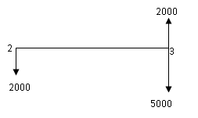
Replacement Analysis under infinite planning horizon (Example) (Cont’d….)
Opportunity cost at the end of year 2 = $ 3000 (market value of the defender at the end of year 2)
Operating Cost for 3rd Year = $ 5,000
Salvage value of the defender at the end of year 3 = $ 2000
3000

Slide 42
Replacement Analysis under infinite planning horizon (Example) (Cont’d….)
Calculate the equivalent cost of the defender one more year from the end of its economic service life.
3000 (F/P, 15%, 1) + 5000 -2000 = $ 6450
Compare this cost with annual equivalent cost of challenger (AEC) = $5857 in the year 3.
Since the equivalent cost of the defender is greater than annual equivalent cost of the challenger, it is concluded that the defender should be replaced at the end of year 2.

Slide 43
Procedure for replacement analysis (finite planning horizon)
If the planning period is finite, comparison based on the annual equivalent cost (AEC) method over a defender’s economic service life does not generally apply. [1]
The procedure for solving such a problem with a finite planning horizon is to establish all ‘reasonable’ replacement patterns and then use the equivalent worth value for the planning period to select the most economical pattern.

Slide 44
Procedure for replacement analysis (finite planning horizon) Example
An existing machine has a market value of $ 50,000 and can be used for six years after repair. The machine will require an immediate $ 12000 overhaul to restore it to operable condition. The opportunity costs are estimated $ 20,000 during first year and expected to increase by $ 15,000 per year thereafter. Book value of the machine is expected to decline by 25% each year over the previous year’s value.
New machine can be bought at $1, 00,000 and will have operating cost of $ 22,000 in the first year and increases by 20% per year thereafter. Salvage value will be $ 60,000 after one year and will decline 15% each year. This new machine will last for eight years. Find the economic service life of both the alternatives and determine the best replacement strategy if a firm has a contract to perform a given service for next eight years. MARR =15%

Slide 45
Procedure for replacement analysis (finite planning horizon) Example (Cont’d….)
If the existing machine (defender) is retained, total cost will be equal to $ 50,000 + $ 12,000 = $ 62, 000 i.e. $ 50,000 as opportunity cost and $ 12,000 as overhaul cost. Operating costs and book values can be calculated as following:
Year | O&M (increasing by $15,000 per year) | Salvage Values
1 | 20,000 | 75% of 50,000 = 37,500
2 | 35,000 | 75% of 37,500 = 28,130
3 | 50,000 | 75% of 28,130 = 21,090
4 | 65,000 | 75% of 21,090 = 15,820
5 | 80,000 | 75% of 15,820 = 11870
6 | 95,000 | 75% of 11870 = 8,900

Slide 46
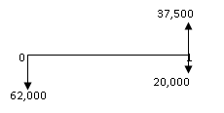
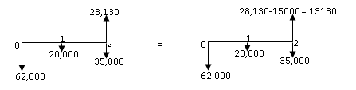
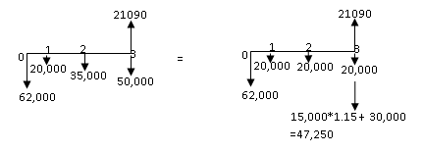
Procedure for replacement analysis (finite planning horizon) Example (Cont’d….)
AEC for N =1
62,000 *1.15 + 20,000 -37,500
= $ 53,800
AEC for N=2
62,000 (A/P, 15%, 2) + 20,000 -13,130 (A/F, 15%, 2)
= $ 52,030
AEC for N=3
62,000 (A/P, 15%, 3) + 20,000 + {15000 *1.15 + 30,000 -21090} (A/F, 15%, 3)
= $ 54,690

Slide 47
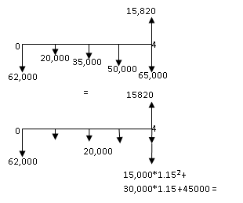
Procedure for replacement analysis (finite planning horizon) Example (Cont’d….)
AEC for N=4
62,000 (A/P, 15%, 4) + 20,000 + {15000 *1.15² + 30,000*1.15 + 45,000 – 15820} (A/F, 15%, 4)
= $ 58440
Similarly, for N= 5 years, AEC = $ 62,580
for N = 6 years, AEC = $ 66,820
AEC is minimum i.e. $ 52030 when N =2 years. Thus, the defender’s economic service life is 2 years.

Slide 48
Procedure for replacement analysis (finite planning horizon) Example (Cont’d….)
In similar fashion, Economic service life (ESL) is calculated for the challenger.
For Challenger,
For n = 1 years, AEC = $ 53,800
n = 2 years, AEC = $ 61,840
n = 3 years, AEC = $ 57,560
n = 4 years, AEC = $ 56,250
n = 5 years, AEC = $ 56,310
n = 6 years, AEC = $ 57210
n = 7 years, AEC = $ 58,690
n = 8 years, AEC = $ 60660
Minimum AEC of Challenger is $ 56250 when N = 4years. Thus, the challenger’s economic service life is 4 years.

Slide 49


Procedure for replacement analysis (finite planning horizon) Example (Cont’d….)
Many replacement scenario options would fulfill an eight year planning horizon as below.
Option 1: Use Challenger for eight years (4C+ 4C years)
PW = 56,250 (P/A, 15%, 8) = $ 2,52,410
Option 2: Use defender for 2 years, challenger for next four years and challenger for two more years again (2D+4C + 2C)
PW = 52,030 (P/A, 15%,2) + 56,250 (P/A,15%,4) * {P/F,15%,2} + 61,840 (P/A, 15%,2) * {P/F,15%,6}
= $ 2, 49,480

Slide 50


Procedure for replacement analysis (finite planning horizon) Example (Cont’d….)
Option 3: Using defender for four years and challenger for remaining four years (4D + 4C )
PW = 58,440 (P/A, 15%, 4) + 56,250 (P/A, 15%,4) * {P/F,15%,4} = $ 2, 58,660
Option 4: Using defender for three years and challenger for remaining five years (3D + 5C )
PW = 54,690 (P/A, 15%, 3) + 56,310 (P/A, 15%, 5) * {P/F, 15%, 3} = $ 2, 48,980 (minimum)
From above calculations, least cost solution options considered appear to be option 4 with present worth equivalent of $ 2,48,980. So, retain the defender for three years, purchase the challenger and keep it for five years.

Slide 51
References:
[1] Contemporary Engineering Economics, Chan S. Park, Second Edition, Addison-Wesley Publishing Company, 1997.
[2] Engineering Economy: William G. Sullivan, James A. Bontadelli & Elin M. Wicks, Eleventh Edition, Pearson Educations, Inc. 2000 .
[3] https://www.investopedia.com/terms/e/economic-life.asp (viewed October 2022)
[4] https: // corporatefinanceinstitute.com / resources / knowledge /accounting/economic-life/ (Viewed October 2022)

Slide 52
[5] Basics of Engineering Economy: Leland Blank and Anthony Tarquin, Indian Edition, Tata McGraw Hill Education Private Limited, New Delhi, India, 2013.
[6] https://pressbooks.bccampus.ca/uvicecon103/chapter/1-3-marginal-analysis/ (Viewed October 2022)

Slide 53
THANK YOU

