Slide 1
Energy, Environment and
Society
Chapter - 2
Basics of Energy
Assoc. Prof. Manchan Tiwari
Kathmandu Engineering College
Nepal

Slide 2
Learning objectives of the lecture
Introduction to Energy
Types of Energy
Energy Sources
Types of Energy Sources
Role of Energy in Achieving Human Development Index

Slide 3
Introduction to energy
Energy is vital for each activity in our day to day life.
Energy is required to address even the basic needs of human beings.
Energy consumption of a country or civilization depicts the extent of development
Every technological advances are possible due to improvement in the quality of energy.
Earliest form of energy used were work done by human and animals along with wind and water available in nature

Slide 4
Energy Characteristics
Energy can neither be created nor be destroyed
Energy can exist and can be transformed from one form to another
Energy can be stored in proper devices and equipment
The general unit of energy is N-m or Joule.
The value of energy is measured with reference to a datum. The commonly used datum or reference are ground level, atmospheric pressure and temperature at 0 K. Which means that the heat energy at 0 K is considered zero. The potential energy at ground level is considered zero.

Slide 5
Energy Characteristics
The natural flow of energy takes place from higher energy to lower energy.
Energy can be graded as per their availability or exergy.
Availability is the measure of the useful form of work that a energy source can be converted to.
High grade energy can be converted to useful work without significant loss where as low grade energy can not be converted to useful work without significant loss.
Electrical energy is an example of high grade energy and heat energy is an example of low grade energy. (Singal, 2011)

Slide 6
Forms of energy
Energy are available in various forms. Some of them are
  Mechanical Energy
  Electrical Energy
  Chemical Energy
  Nuclear Energy
  Heat Energy

Slide 7
Mechanical Energy
Mechanical Energy of a body is the result of either its position or its movement. The basic form of mechanical energy can be classified as
Kinetic Energy
  Due to the motion of a body
  Amount of work done to move a body at a given velocity from the position of rest.
Potential Energy
  Due to the position of a body with respect to a relative datum or ground
  Energy a body has when raised to a height above the ground.

Slide 8
Mechanical energy
Shaft Energy
  Energy possessed by the rotation of shaft
Flow Energy
  Energy possessed by a pressurized flowing fluid in a closed conduit

Slide 9
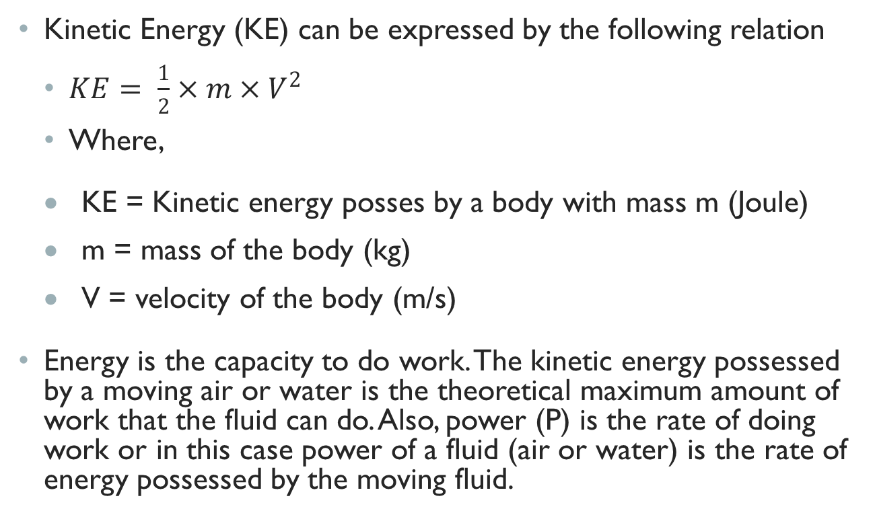
Kinetic energy
Kinetic Energy (KE) can be expressed by the following relation
  $KE= \frac{1}{2}×m×V^{2}$
    Where,
  KE = Kinetic energy posses by a body with mass m (Joule)
  m = mass of the body (kg)
  V = velocity of the body (m/s)
Energy is the capacity to do work. The kinetic energy possessed by a moving air or water is the theoretical maximum amount of work that the fluid can do. Also, power (P) is the rate of doing work or in this case power of a fluid (air or water) is the rate of energy possessed by the moving fluid.

Slide 10
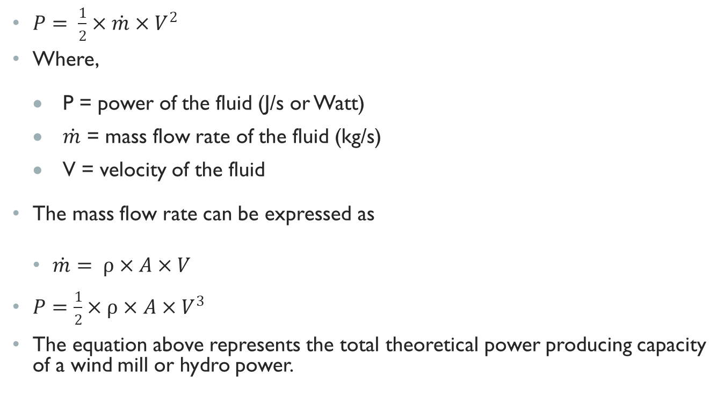
Kinetic energy
$P= \frac{1}{2}×\dot{m}×V^{2}$
  Where,
  P = power of the fluid (J/s or Watt)
  $\dot{m}$ = mass flow rate of the fluid (kg/s)
  V = velocity of the fluid
The mass flow rate can be expressed as
  $\dot{m}= ρ×A×V$
$P=\frac{1}{2}×ρ×A×V^{3}$
The equation above represents the total theoretical power producing capacity of a wind mill or hydro power.

Slide 11
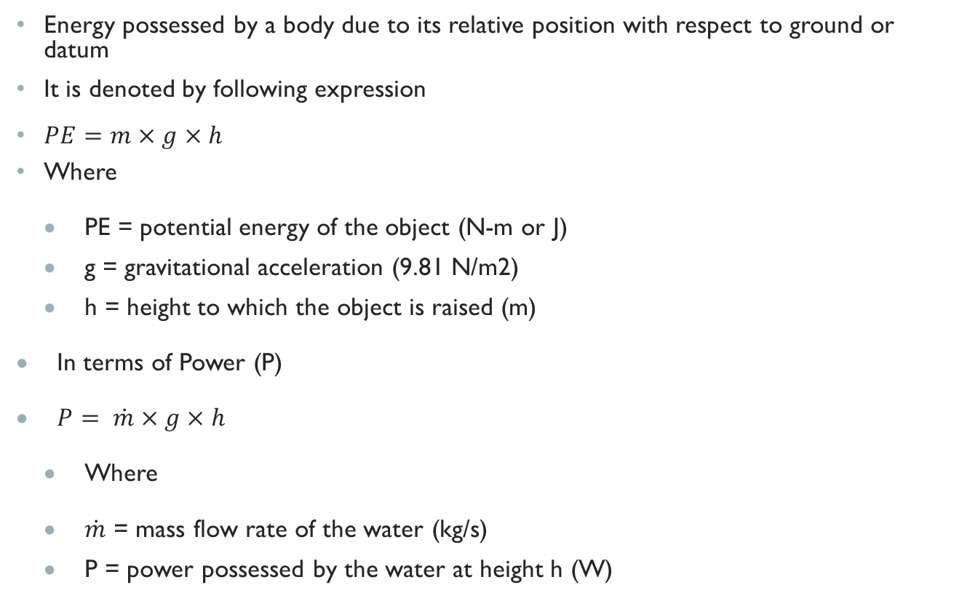
Potential energy
Energy possessed by a body due to its relative position with respect to ground or datum
It is denoted by following expression
$PE=m×g×h$
  Where
  PE = potential energy of the object (N-m or J)
  g = gravitational acceleration (9.81 N/m2)
  h = height to which the object is raised (m)
In terms of Power (P)
$P= \dot{m}×g×h$
  Where
  $\dot{m}$ = mass flow rate of the water (kg/s)
  P = power possessed by the water at height h (W)

Slide 12
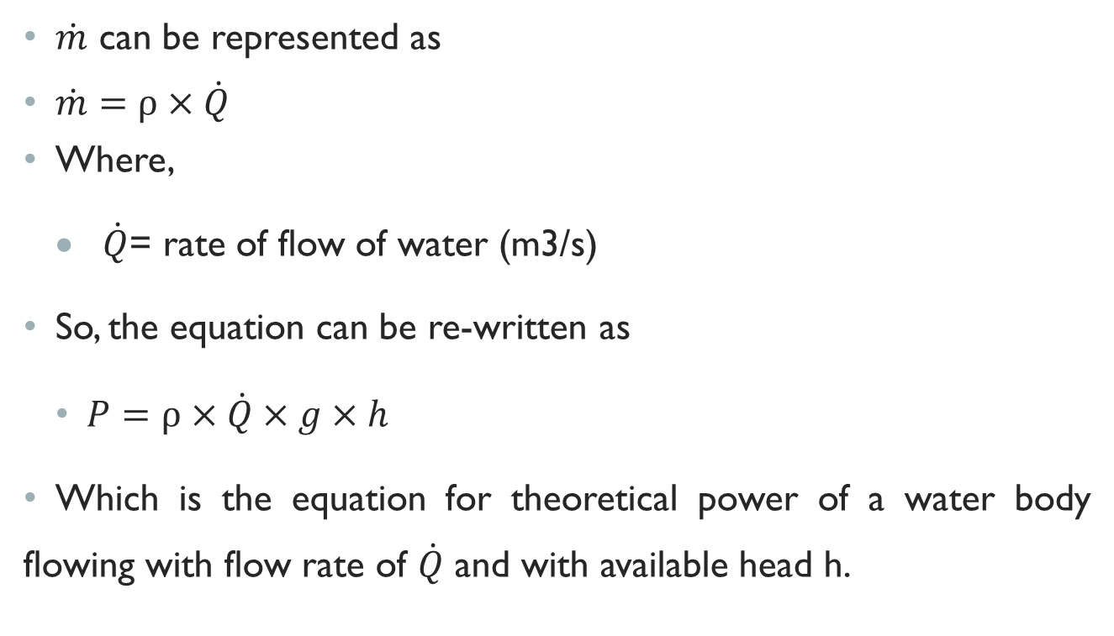
Potential energy
$\dot{m}$ can be represented as
$\dot{m}=ρ×\dot{Q}$
  Where,
  $\dot{Q}$= rate of flow of water (m3/s)
So, the equation can be re-written as
    $P=ρ×\dot{Q}×g×h$
Which is the equation for theoretical power of a water body flowing with flow rate of $\dot{Q}$ and with available head h.

Slide 13
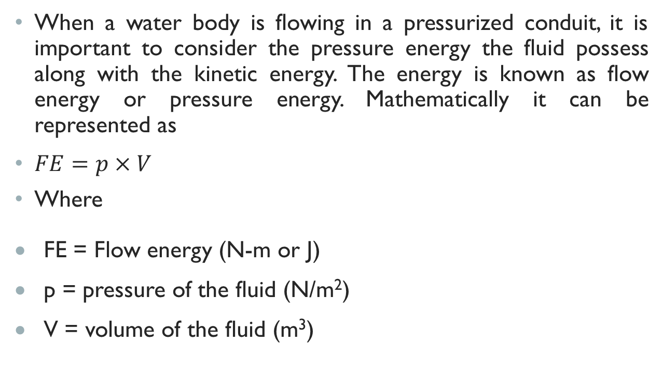
Flow Energy
When a water body is flowing in a pressurized conduit, it is important to consider the pressure energy the fluid possess along with the kinetic energy. The energy is known as flow energy or pressure energy. Mathematically it can be represented as
$FE=p×V$
Where
FE = Flow energy (N-m or J)
p = pressure of the fluid (N/m²)
V = volume of the fluid (m³)

Slide 14
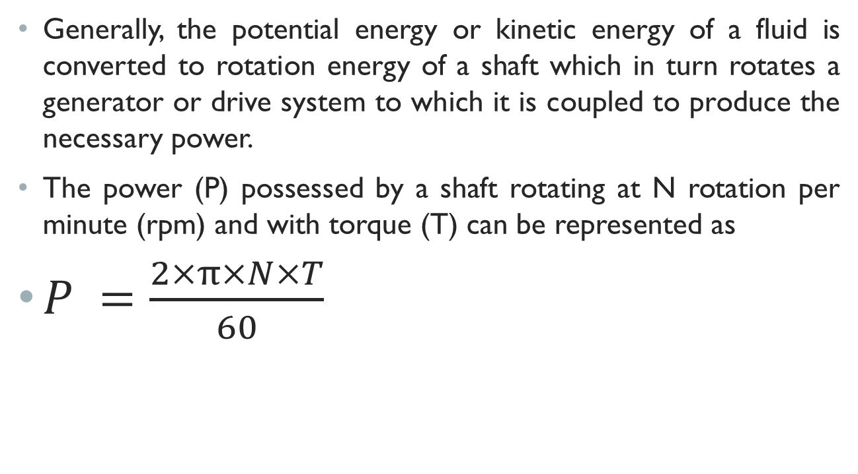
Shaft Energy
Generally, the potential energy or kinetic energy of a fluid is converted to rotation energy of a shaft which in turn rotates a generator or drive system to which it is coupled to produce the necessary power.
The power (P) possessed by a shaft rotating at N rotation per minute (rpm) and with torque (T) can be represented as
$P =\frac{2×π×N×T}{60}$

Slide 15
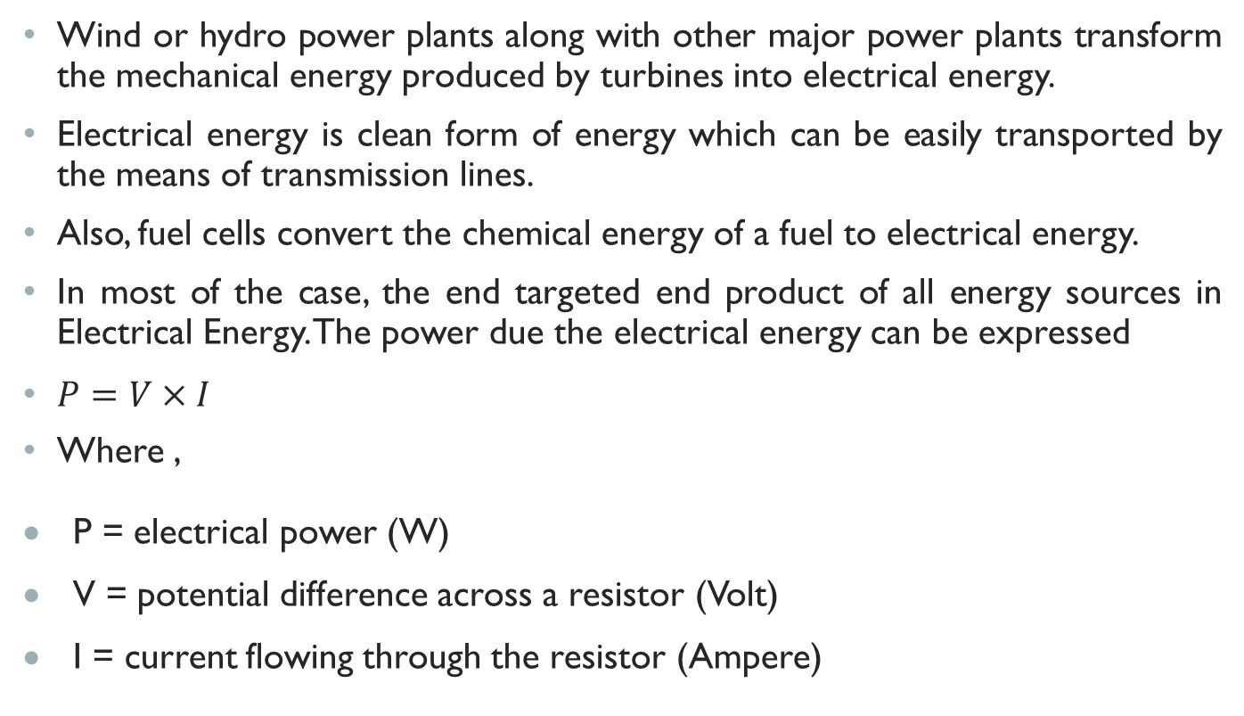
Electrical Energy
Wind or hydro power plants along with other major power plants transform the mechanical energy produced by turbines into electrical energy.
Electrical energy is clean form of energy which can be easily transported by the means of transmission lines.
Also, fuel cells convert the chemical energy of a fuel to electrical energy.
In most of the case, the end targeted end product of all energy sources in Electrical Energy. The power due the electrical energy can be expressed
$P=V×I$
Where ,
P = electrical power (W)
V = potential difference across a resistor (Volt)
I = current flowing through the resistor (Ampere)

Slide 16
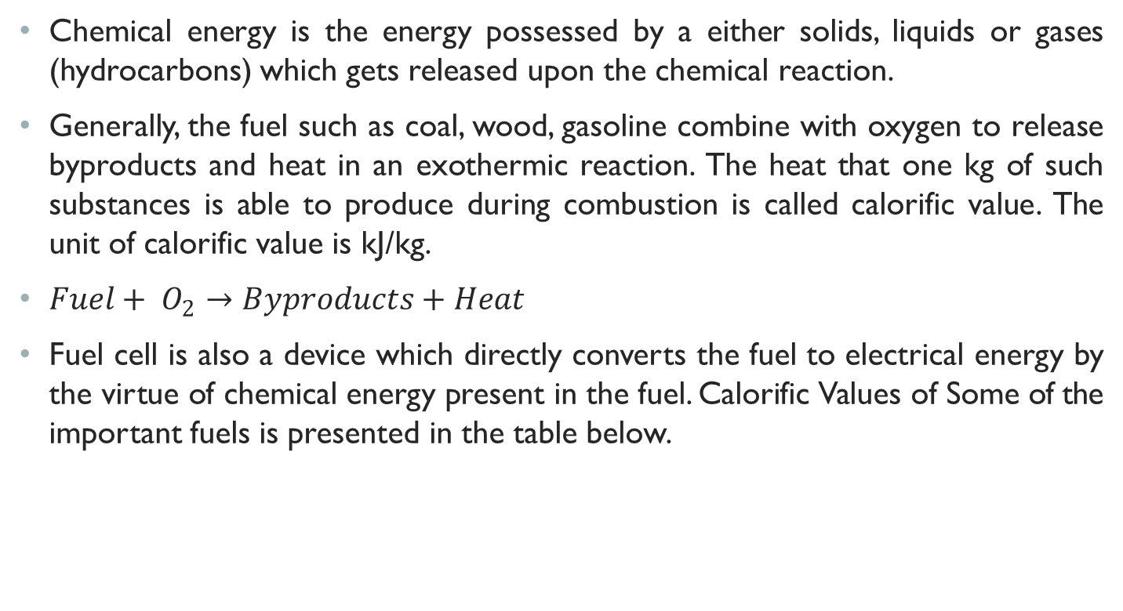
Chemical energy
Chemical energy is the energy possessed by a either solids, liquids or gases (hydrocarbons) which gets released upon the chemical reaction.
Generally, the fuel such as coal, wood, gasoline combine with oxygen to release byproducts and heat in an exothermic reaction. The heat that one kg of such substances is able to produce during combustion is called calorific value. The unit of calorific value is kJ/kg.
$Fuel+ O_{2}→Byproducts+Heat$
Fuel cell is also a device which directly converts the fuel to electrical energy by the virtue of chemical energy present in the fuel. Calorific Values of Some of the important fuels is presented in the table below.
Fuel | Calorific Value (kJ/kg)
Cow Dung Cake | 6,000-8,000
Coal | 25,000-33,000
Petrol | 45,000
LPG | 55,000
Hydrogen | 150,000
(Collegedunia, 2022)

Slide 17
Chemical energy
Fuel | Calorific Value (kJ/kg)
Cow Dung Cake | 6,000-8,000
Coal | 25,000-33,000
Petrol | 45,000
LPG | 55,000
Hydrogen | 150,000
Source: (Collegedunia, 2022)

Slide 18
Nuclear Energy
Nuclear Fusion
When two or more atomic nuclei combine to produce one or more different atomic nuclei and subatomic particles (neutrons and protons), the reaction is called nuclear fusion reaction.
The reaction results in difference in the mass of the products compared to the reactants which is either consumed or produced as energy depending on whether the mass or the products increase or decreases.
The example of the nuclear fusion is the reaction in sun and stars, where due to continuous fusion reaction four nuclei of hydrogen fuse resulting in one nucleus of helium.

Slide 19
Nuclear Energy
Nuclear Fusion
The difference between the mass of the 4 hydrogen atoms and 1 helium atoms results in energy generation during the process (WWU, 2022).
This energy is responsible for heat produced which results in extremely high temperatures in the sun or stars.

Slide 20
Nuclear energy
Nuclear Fission
In nuclear fission reaction one heavy nucleus such as uranium or plutonium is split to form two smaller nuclei.
Large amount of energy is produced during the fission process which results in formation of radioactive elements as well as many neutrons (byjus, 2022).
The controlled example of nuclear fission is the production of energy in nuclear reactor whereas uncontrolled nuclear reaction results in formation of atom bombs.

Slide 21
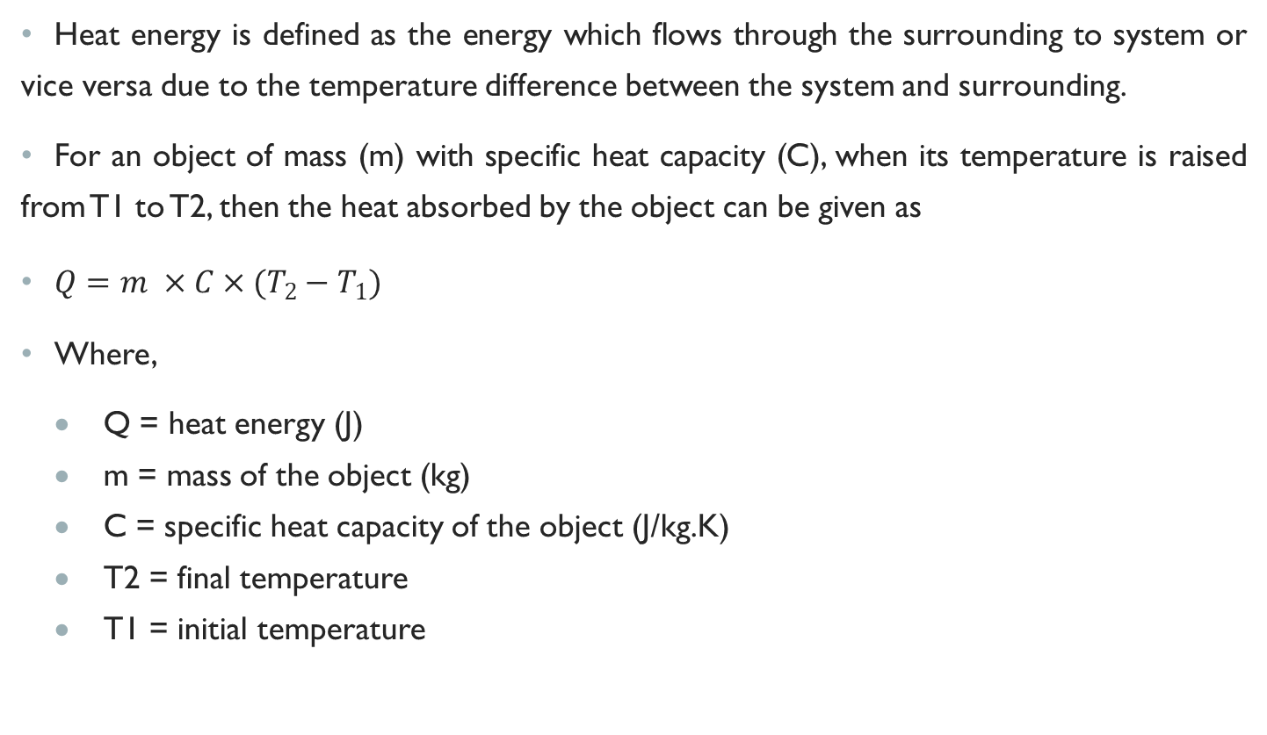
Heat energy
Heat energy is defined as the energy which flows through the surrounding to system or vice versa due to the temperature difference between the system and surrounding.
For an object of mass (m) with specific heat capacity (C), when its temperature is raised from T1 to T2, then the heat absorbed by the object can be given as
$Q=m ×C×(T_{2}−T_{1})$
Where,
  Q = heat energy (J)
  m = mass of the object (kg)
  C = specific heat capacity of the object (J/kg.K)
  T2 = final temperature
  T1 = initial temperature

Slide 22
Classification of energy sources
Commercial and Non-Commercial Energy Resources
  Commercial energy resources are also known as primary energy resources.
  These are generally available in raw form in nature eg. coal, natural gas, wind and water etc.
  Non-commerical energy resources are those which are available freely in nature such as solar energy, agricultural waste

Slide 23
Classification of energy sources
Renewable and Non-renewable Energy Resources
  Renewable energy sources are those which do not deplete upon continuous use and can be reused continuously such as solar energy, wind energy, geothermal energy, tidal energy etc.
  Non renewable energy sources are those which deplete upon use and can get exhausted upon use for a limited period of time such as coal, oil, gas etc.
  Dependency on non-renewable energy sources can contribute to fuel crisis in future as the supply cannot be adjusted according to the demand (Sharma & Hasan, 2009).

Slide 24
Classification of energy sources
Conventional and Non-conventional Energy Resources
  Conventional energy sources are those which are being used orthodoxly in the world today.
  Coal, oil and gas are commonly known as conventional energy resources.
  Conventional energy sources get depleted and are non-renewable.
  Solar energy, wind energy, agricultural waste etc. are classified as the non-conventional energy resources.

Slide 25
Relationship of energy and development
Energy is directly related with development.
The measure of energy consumption of a country reflects the development of the country as well.
It can be understood by the fact that the quantity and quality of energy consumed varies greatly among developed and developing countries (Singal, 2011).
Energy is basic requirement to fulfill the basic human needs.
For every aspect of human development that is social, economic and environment, energy is required.
Researches have shown two-way causality relationship between the energy consumption and economic growth (Zhang & Xin, 2011).

Slide 26
Relationship of energy and development
With the increase in availability of energy, economic development takes place and economic development also triggers the usage of energy.
Replacing the traditional energy sources which contribute to pollution and harmful environmental impact, with clean energy sources can lead to environment conservation.
With the development in infrastructures, industries and technological advances, the energy consumption also increases.

Slide 27
Role of energy in achieving hdi
Human Development Index is the representation of mean years of schooling, expected years of schooling, life expectancy at birth and gross national income (GNI) per capita.
It was developed by United Nations since 1990 to measure the social and economic development level of various countries (Investopedia, 2022).
HDI is the geometric mean of normalized indices for each of the three dimension; a long and healthy life, being knowledgeable and have a decent standard of living.
The measure of healthy life is given by the life expectancy at birth, education is given by the mean years of schooling for adults aged 25 years and more and expected years of schooling for children of school entering age.
The standard of living dimension is measured by gross national income per capita.
The three HDI dimension indices are then represented by a composite index using geometric mean (UNDP, 2022).

Slide 28
Role of energy in achieving hdi
HDI Rank | Country | Human Development Index (HDI) | Life Expectancy at birth (Years) | Mean years of Schooling (Years) | Gross national income (GNI) per capita ($) | Per Capita Energy Consumption (kWh) {2021]
1 | Switzerland | 0.962 | 84 | 13.9 | 66,933 | 34,227
2 | Norway | 0.961 | 83.2 | 13.0 | 64,660 | 103,944
19 | Korea (Republic of) | 0.925 | 83.7 | 16.5 | 44,501 | 68,087
132 | India | 0.633 | 67.2 | 6.7 | 6,590 | 7,063
143 | Nepal | 0.602 | 68.4 | 5.1 | 4,192 | 1,530
(UNDP-HDR, 2022)

Slide 29
Role of energy in achieving hdi
Human Development Index is the representation of mean years of schooling, expected years of schooling, life expectancy at birth and gross national income (GNI) per capita.
It was developed by United Nations since 1990 to measure the social and economic development level of various countries (Investopedia, 2022).
HDI is the geometric mean of normalized indices for each of the three dimension;
  a long and healthy life,
  being knowledgeable and
    have a decent standard of living.

Slide 30
Role of energy in achieving hdi
The measure of healthy life is given by the life expectancy at birth, education is given by the mean years of schooling for adults aged 25 years and more and expected years of schooling for children of school entering age.
The standard of living dimension is measured by gross national income per capita.
The three HDI dimension indices are then represented by a composite index using geometric mean (UNDP, 2022).

Slide 31
Role of energy in achieving hdi
Hence, the relationship between Energy consumption and HDI can be explained according to following aspects:
Life Expectancy:
Education
Living Standard

Slide 32
Role of energy in achieving hdi
Life Expectancy:
  Availability of Energy directly linked with low infant mortality or high life expectancy, which in turn contributes to better HDI.
  With better availability of Energy, the people will have access to better health facilities.
  Only with proper and reliable availability of energy, the facilities will have proper equipment.
  Also, to spread awareness regarding proper health, energy is required.

Slide 33
Role of energy in achieving hdi
Education:
  The mean number of years which a person spends in school is considered for calculating HDI.
  Availability of proper education facilities required energy, which in turn contributes to the students in the region being better involved in the education.
  More advanced education facilities contribute to high energy consumption compared to the education facilities in rural regions.

Slide 34
Role of energy in achieving hdi
Living Standard:
  Better economic condition of a country implies to technological advancements, proper resource utilization, good trade and foreign investments in the country.
  All these required reliable energy qualitatively and quantitatively.
  So, the economic advancement of a country is directly linked with energy consumptions and energy availability which in turns leads to the better living standard of the people.

Slide 35
References
(2022). Retrieved 9 14, 2022, from byjus: https://byjus.com/jee/nuclear-fission/
(2022). Retrieved September 24, 2022, from Investopedia: https://www.investopedia.com/terms/h/human-development-index-hdi.asp
Collegedunia. (2022). Retrieved 9 14, 2022, from https://collegedunia.com/exams/calorific-value-biology-articleid-1224
Sharma, D., & Hasan, S. (2009). Non-Conventional Energy Sources (Second Edition ed.). Delhi: S.K. Kataria and Sons.
Singal, D. (2011). New Delhi: S. K. Kataria and Sons.

Slide 36
References
UNDP. (2022). Retrieved September 24, 2022, from https://hdr.undp.org/data-center/human-development-index#/indicies/HDI
UNDP-HDR. (2022). Human Development Report 2021/2022. New York: United Nations Development Program.
WWU. (2022). Retrieved 9 14, 2022, from Western Washington University: https://www.wwu.edu/astro101/a101_sun.shtml#:~:text=In%20the%20core%20of%20the,mass%20is%20converted%20into%20energy.
Zhang , Z., & Xin, R. (2011). Causal Relationships between Energy Consumption and. Energy Procedia, 2065-2071. doi:10.1016/j.egypro.2011.03.356

Slide 37
THANK YOU

