Slide 1
ENERGY, ENVIRONMENT
AND
SOCIETY
Chapter - 3
Energy Trends, Global Warming
Assoc. Prof. Manchan Tiwari
Kathmandu Engineering College
Nepal

Slide 2
LEARNING OBJECTIVES OF THE LECTURE
Current Energy Trends, World Energy Scenario
World Renewable Energy Scenario
Energy Consumption/Production Scenario of Nepal
Introduction to Global Warming

Slide 3
WORLD ENERGY CONSUMPTION
Total world energy consumed in 2021 amounts to 595.14 Exajoules.
Majority of the energy consumed are non-renewable sources mainly oil, coal and natural gas
Nuclear energy, hydro-electricity and renewable sources comprises the remaining energy consumption
Data source: “Statistical Review of World Energy” by British Petroleum published in 2022
Fig: World Energy Consumption (2021)
Source: (bp, 2022)

Slide 4
WORLD ENERGY CONSUMPTION
S. No. | Fuel Type | Consumption Value (Exajoules) | % Consumption
1 | Oil | 184.21 | 30.95
2 | Coal | 160.1 | 26.90
3 | Natural Gas | 145.35 | 24.42
4 | Hydro-electricity | 40.26 | 6.76
5 | Renewables | 39.91 | 6.71
6 | Nuclear Energy | 25.31 | 4.25
 | TOTAL | 595.14 | 100.00
Table: World Energy Consumption (2021)
Source: (bp, 2022)

Slide 5
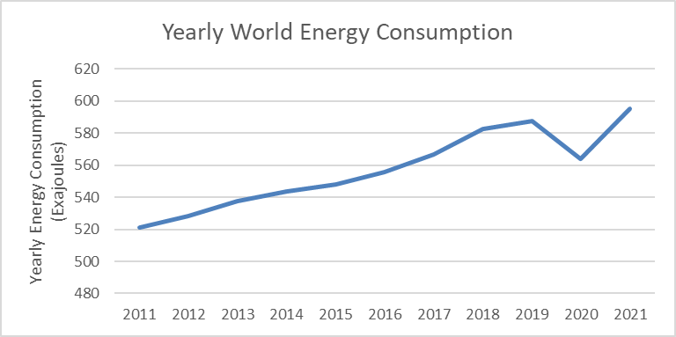
WORLD ENERGY CONSUMPTION
Source: (bp, 2022)

Slide 6
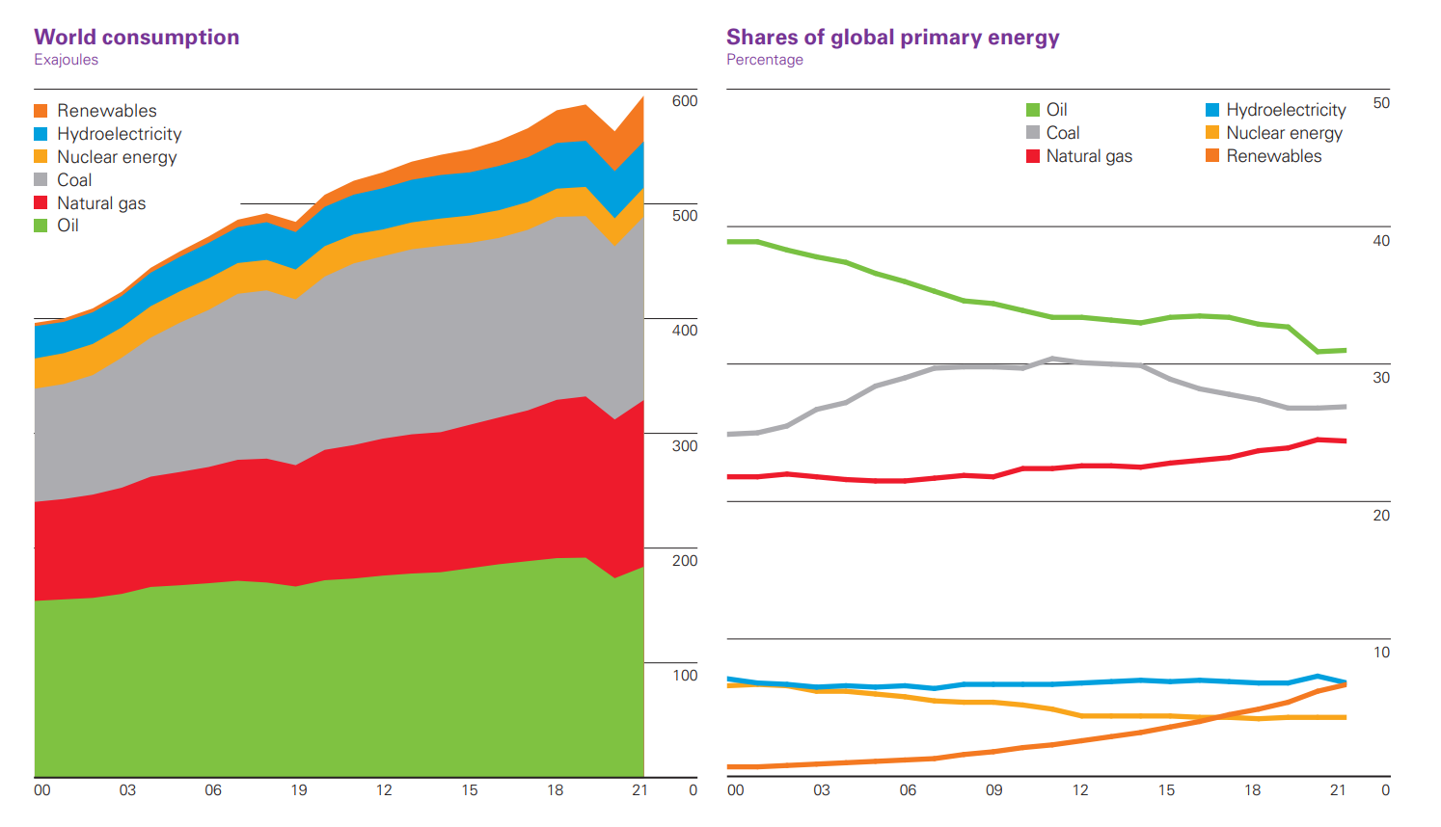
WORLD ENERGY CONSUMPTION
Source: (Worldometer,2022)

Slide 7
WORLD ENERGY CONSUMPTION
While the total amount of energy consumption has been increasing in the recent years, the share of Oil and Coal in the total energy consumption has been decreasing while the contribution of Renewable Energy sources has been increasing in the past decade.
The trend in energy consumption scenario shows gradual increment in the total energy consumed in the world except for the year 2020 when whole world was largely effected by Covid-19 crisis.

Slide 8
WORLD ENERGY CONSUMPTION BY COUNTRY IN 2021
Source: (bp, 2022)
S. No. | Country | Share of World Energy Consumption
1 | China | 23.80%
2 | United States | 16.80%
3 | Russia | 5.60%
4 | India | 5.20%
5 | Japan | 3.30%
6 | Canada | 2.60%
7 | Germany | 2.40%
8 | South Korea | 2.20%
9 | Brazil | 2.20%
10 | Iran | 2.00%
14 | Others | 33.90%

Slide 9
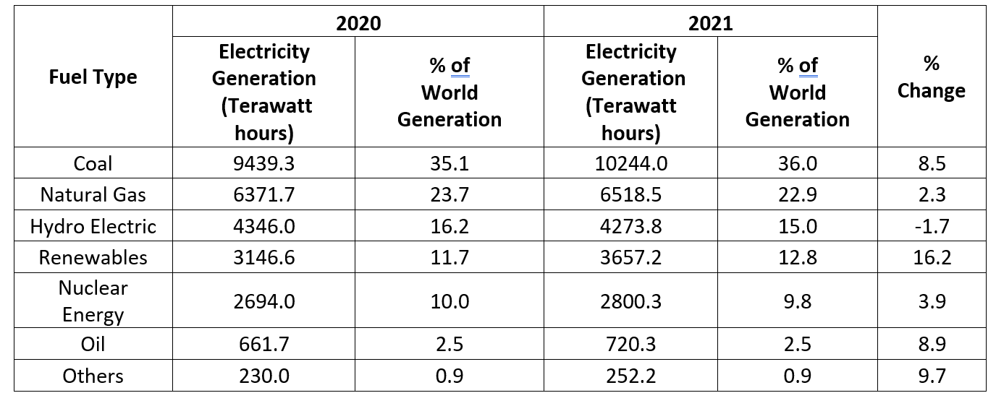
WORLD ELECTRICITY GENERATION
Source: (bp, 2022)

Slide 10
WORLD ELECTRICITY GENERATION
As electricity is the most prominent form of secondary energy source, apart from transportation and cooking, electricity is the most widely used form of secondary energy.
The major energy source used for production of electricity is Coal. In 2021, 36% of the total electricity produced in the world was produced by utilization of coal as primary energy source.
The use of coal is followed by natural gas and hydro-electric power.

Slide 11
WORLD ELECTRICITY GENERATION ACCORDING TO COUNTRY (2021)
Country | Electricity Generation (Terawatt hours) | % of World Generation
China | 8534.3 | 30.0
US | 4406.4 | 15.5
India | 1714.8 | 6.0
Russian Federation | 1157.1 | 4.1
Japan | 1019.7 | 3.6
Brazil | 654.4 | 2.3
South Korea | 600.4 | 2.1
Germany | 584.5 | 2.1
France | 547.2 | 1.9
Others | 9247.5 | 32.5
Source: (bp, 2022)

Slide 12
WORLD OIL PRODUCTION BY REGION (2021)
Region | Oil Production (thousands of barell per day) | % of World Production
Total Middle East | 28156.00 | 31.3
Total North America | 23942.00 | 26.6
Total CIS | 13829.00 | 15.4
Total Asia Pacific | 7335.00 | 8.2
Total Africa | 7286.00 | 8.1
Total South and Central America | 5909.00 | 6.6
Total Europe | 3420.00 | 3.8

Slide 13
WORLD OIL PRODUCTION BY REGION (2021)
Major share of oil produced in world as per data of 2021 is contributed by the middle east countries which includes Iran, Iraq, Kuwait, Oman, Qatar, Saudi Arabia, Syria, United Arab Emirates, Yemen and other Middle East Countries.
North American countries has also major contribution to the world oil production, mainly United States of America which alone contributes to the 18.45% of the world oil production.
Another major contributor country is Saudi Arabia which contributes 12.18% of the world energy production as of 2021 (bp, 2022).
CIS countries are Commonwealth of Independent States formed after dissolution of Soviet Union in 1991 which includes countries such as Azerbaijan, Armenia, Belarus, Kazakhstan, Kyrgyzstan, Moldova, Russia, Tajikistan, Turkmenistan, Uzbekistan and Ukraine.

Slide 14
WORLD OIL PRODUCTION BY COUNTRY (2021)
S. No. | Country | Oil Production (thousands of barell per day) | % of World Production
1 | US | 16585.00 | 18.45
2 | Saudi Arabia | 10954.00 | 12.19
3 | Russian Federation | 10944.00 | 12.18
4 | Canada | 5429.00 | 6.04
5 | Iraq | 4102.00 | 4.56
6 | China | 3994.00 | 4.44
7 | UAE | 3668.00 | 4.08
8 | Iran | 3620.00 | 4.03
9 | Brazil | 2987.00 | 3.32
10 | Kuwait | 2741.00 | 3.05
11 | Norway | 2025.00 | 2.25
12 | Mexico | 1928.00 | 2.15
13 | Qatar | 1746.00 | 1.94
14 | Oman | 971.00 | 1.08
15 | India | 746.00 | 0.83
Source: (bp, 2022)

Slide 15
WORLD OIL CONSUMPTION (2021)
Region | Total Oil Consumption (thousands barrels 2021) | % of World Consumption
Total Asia Pacific | 35806 | 38.06
Total North America | 22264 | 23.66
Total Europe | 13527 | 14.38
Total Middle East | 8640 | 9.18
Total South and Central America | 5622 | 5.98
Total CIS | 4307 | 4.58
Total Africa | 3922 | 4.17
The oil consumption over the world is dominated by Asia Pacific region where China alone consumed 16.4% of total world consumption in the year 2021 as per data in the “Statistical Review of World Energy” published in 2022.
United States of America is the most oil consuming country in the world contributing to 19.9% of total consumption in the world.
Source: (bp, 2022)

Slide 16
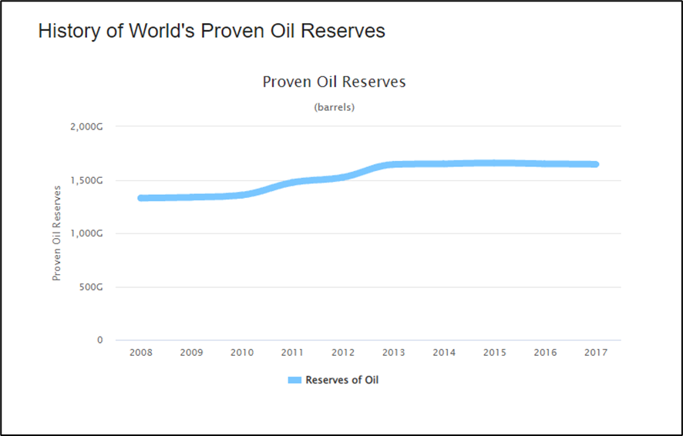
WORLD OIL RESERVES

Slide 17
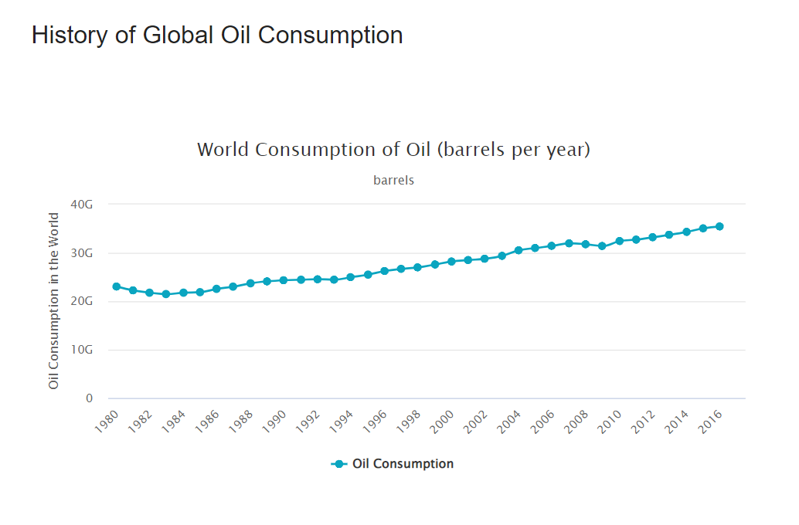
WORLD OIL CONSUMPTION TREND

Slide 18
WORLD DAILY OIL REFINING CAPACITY
Source: (bp, 2022)

Slide 19
WORLD OIL CONSUMPTION/PRODUCTION SCENARIO
The oil consumption has been increasing
No new oil reserves have been discovered and the existing reserves are in the course of depletion over time
Decrease in world oil refining rate by 0.4% in the year 2021. The increase in refining capacity from the year 2011 to 2021 has been 0.7%.
Middle east countries contribute most to the world oil production while China and US are the major stakeholders in world oil consumption.

Slide 20
WORLD NATURAL GAS PRODUCTION/CONSUMPTION
Natural Gas is the second most consumed energy sources in the world.
Since 2011 to 2021 its production as well as consumption has been gradually increasing throughout the world.
North America and CIS countries combinedly produce around 50% of the world’s total natural gas.
Middle East countries and countries in the Asia Pacific region are the other major contributors to the production.
Country wise US (23.1%), Russian Federation (17.4%), Iran (6.4%), China (5.2%) along with other countries were the major contributors for the production of natural gas in the year 2021 (bp, 2022).

Slide 21
WORLD NATURAL GAS PRODUCTION/CONSUMPTION
Source: (bp, 2022)

Slide 22
WORLD NATURAL GAS PRODUCTION (2021)
Region | Gas Production (Billion Cubic metres) | % of World Production
Total North America | 1135.8 | 28.1
Total CIS | 896 | 22.2
Total Middle East | 714.9 | 17.7
Total Asia Pacific | 669 | 16.6
Total Africa | 257.5 | 6.4
Total Europe | 210.4 | 5.2
Total South and Central America | 153.3 | 3.8
Source: (bp, 2022)

Slide 23
WORLD NATURAL GAS CONSUMPTION (2021)
Region | Gas Consumption (Billion Cubic metres) | % of World Consumption
Total North America | 1034.1 | 25.6
Total Asia Pacific | 918.3 | 22.7
Total CIS | 610.8 | 15.1
Total Middle East | 575.4 | 14.3
Total Europe | 571.1 | 14.1
Total Africa | 164.4 | 4.1
Total South and Central America | 163.3 | 4.0
Source: (bp, 2022)

Slide 24
WORLD COAL PRODUCTION (2021)
As coal is second most used energy source in the world, most countries are dependent on coal for energy production
Region | Coal Production (in Exajoules) | Percentage of World Production
Total Asia Pacific | 129.5 | 77.3
Total North America | 13.0 | 7.7
Total CIS | 11.4 | 6.8
Total Africa | 6.0 | 3.6
Total Europe | 5.8 | 3.4
Total South and Central America | 1.9 | 1.1
Total Middle East | 0.0 | 0.0
Source: (bp, 2022)

Slide 25
COUNTRY WISE WORLD COAL PRODUCTION (2021)
Country | Coal Production (in Exajoules) | Percentage of World Production
China | 85.2 | 50.8
Indonesia | 15.2 | 9.0
India | 13.5 | 8.0
Australia | 12.4 | 7.4
US | 11.7 | 7.0
Russian Federation | 9.1 | 5.5
South Africa | 5.6 | 3.3
China lead the world production of Coal by a significant margin which is also reflected in the fact that Total Asia Pacific region alone produces 77.3 % of the total world coal production.
Consumption wise too, China consumes around 86.2% of the total share of world coal consumption followed by India at 12.5% and US at 6.6%.
Source: (bp, 2022)

Slide 26
COUNTRY WISE WORLD COAL CONSUMPTION (2021)
Region | Coal Consumption (in Exajoules) | % of World Consumption
China | 86.2 | 53.8
India | 20.1 | 12.5
US | 10.6 | 6.6
Russian Federation | 3.4 | 2.1
South Africa | 3.5 | 2.2
Japan | 4.8 | 3.0
Source: (bp, 2022)

Slide 27
WORLD NUCLEAR ENERGY CONSUMPTION (2021)
The table shows the country wise data for world nuclear energy consumption. It can be seen from the table that US leads the world consumption of nuclear energy followed by China. The data is for the year 2021.
Country | Energy Consumed (Exajoules) | % of World Consumption
US | 7.4 | 29.24
China | 3.68 | 14.54
France | 3.43 | 13.55
Russian Federation | 2.01 | 7.94
South Korea | 1.43 | 5.65
Others | 3.26 | 12.88
Source: (bp, 2022)

Slide 28
WORLD HYDRO-ELECTRICITY CONSUMPTION (2021)
Country | Energy Consumed (Exajoules) | % of World Consumption
China | 12.25 | 30.4
Canada | 3.59 | 8.9
Brazil | 3.42 | 8.5
US | 2.43 | 6.0
Russian Federation | 2.02 | 5.0
India | 1.51 | 3.8
Norway | 1.35 | 3.4
Source: (bp, 2022)

Slide 29
WORLD RENEWABLE ENERGY GENERATION (2021)
Country | Renewable Energy Generation (Terawatt hours) | % of World Generation
Total Asia Pacific | 1690.1 | 46.2
Total Europe | 946.5 | 25.9
Total North America | 714.1 | 19.5
Total South and Central America | 229.3 | 6.3
Total Africa | 49 | 1.3
Total Middle East | 18.5 | 0.5
Total CIS | 9.6 | 0.3
Source: (bp, 2022)

Slide 30
WORLD RENEWABLE ENERGY GENERATION (2021)
Country | Renewable Energy Generation (Terawatt hours) | % of World Generation
China | 1152.5 | 31.5
US | 624.5 | 17.1
Germany | 217.6 | 5.9
India | 171.9 | 4.7
Brazil | 144 | 3.9
Japan | 130.3 | 3.6
UK | 116.9 | 3.2
Spain | 95.8 | 2.6
Italy | 71.4 | 2.0
Turkey | 62.7 | 1.7
Australia | 61.3 | 1.7
Canada | 50 | 1.4
South Korea | 40.2 | 1.1
Source: (bp, 2022)

Slide 31
WORLD RENEWABLE ENERGY GENERATION (2021)
China leads the production of renewable energy in the world by producing 31.5% of the total world production by itself. This is shown in the fact that Total Asia Pacific region leads the production of renewable energy in the world.
US also contributes to the major share of world renewable energy production.
The most used types of renewable energy source for production is Wind Energy, followed by Solar Energy.
Source: (bp, 2022)

Slide 32
WORLD RENEWABLE ENERGY GENERATION (2021)
Renewable Energy Type | Renewable Energy Generation (Terawatt hours) |  | % Growth Rate
 | 2020 | 2021
Wind Energy | 1596.4 | 1861.9 | 17%
Solar Energy | 846.2 | 1032.5 | 22.30%
Others | 703.9 | 762.8 | 8.70%
Total | 3146.5 | 3657.2 | 16.50%
Source: (bp, 2022)

Slide 33
INSTALLED WIND ENERGY CAPACITY (2021)
Country | Installed Wind Capacity (Gigawatts) | % of World Production
China | 329 | 39.9
US | 132.7 | 16.1
Germany | 63.8 | 7.7
India | 40.1 | 4.9
Spain | 27.5 | 3.3
UK | 27.1 | 3.3
Brazil | 21.2 | 2.6
France | 18 | 2.2
Source: (bp, 2022)

Slide 34
INSTALLED SOLAR PV CAPACITY IN WORLD (2021)
Country | Installed Solar PV Capacity (Gigawatts) | % of World Production
China | 306.4 | 36.3
US | 93.7 | 11.1
Japan | 74.2 | 8.8
Germany | 58.5 | 6.9
India | 49.3 | 5.8
Italy | 22.7 | 2.7
Source: (bp, 2022)

Slide 35
BIOFUEL PRODUCTION IN WORLD (2021)
Country | Biofuel Production (Thousand barrels of oil equivalent per day) | % of World Production
US | 643 | 36.8
Brazil | 376 | 21.5
Indonesia | 140 | 8.0
China | 64 | 3.7
Germany | 54 | 3.1
France | 48 | 2.7
Thailand | 40 | 2.3
Netherlands | 38 | 2.2
India | 37 | 2.1
Source: (bp, 2022)

Slide 36
ENERGY SUPPLY AND CONSUMPTION SCENARIO IN NEPAL
Source: (ADB, 2017)
Particulars | 1990 | 1995 | 2000 | 2005 | 2010 | 2014
Total Primary Energy Supply | 5789 | 6712 | 8108 | 9132 | 10211 | 11690
Coal | 49 | 74 | 258 | 248 | 303 | 484
Oil Products | 244 | 501 | 713 | 724 | 983 | 1359
Natural Gas | 0 | 0 | 0 | 0 | 0 | 0
Hydro | 75 | 100 | 140 | 216 | 276 | 326
Biomass | 5425 | 6039 | 6988 | 7928 | 8592 | 9403
Total Final Energy Consumption | 5761 | 6667 | 8041 | 9050 | 10107 | 11534
Industry | 106 | 161 | 379 | 388 | 449 | 665
Transport | 111 | 203 | 270 | 275 | 637 | 858
Residential | 5465 | 6170 | 7199 | 8128 | 8718 | 9624
Commercial and public services | 43 | 60 | 97 | 165 | 171 | 219
Agriculture/Forestry | 33 | 60 | 75 | 72 | 118 | 151
Non-Energy use | 4 | 7 | 11 | 20 | 10 | 8

Slide 37
ENERGY SUPPLY AND CONSUMPTION SCENARIO IN NEPAL
The energy supply and consumption trend in Nepal as shown in table in previous, shows that Nepal has been heavily dependent on Biomass as primary source of energy.
The major use of energy source has been on residential sector where fuel wood is primarily used for cooking purpose.
Second most used energy source is petroleum products (oil products) which is used in transportation sector in Nepal.
Industry and commercial sectors comprises of only low percentage of total energy use in the country.
Though hydropower production has been on the rise, its contribution to total energy use is still small compared to biomass and oil products. As Nepal do not have its own oil production, all of the petroleum products have to be imported.

Slide 38
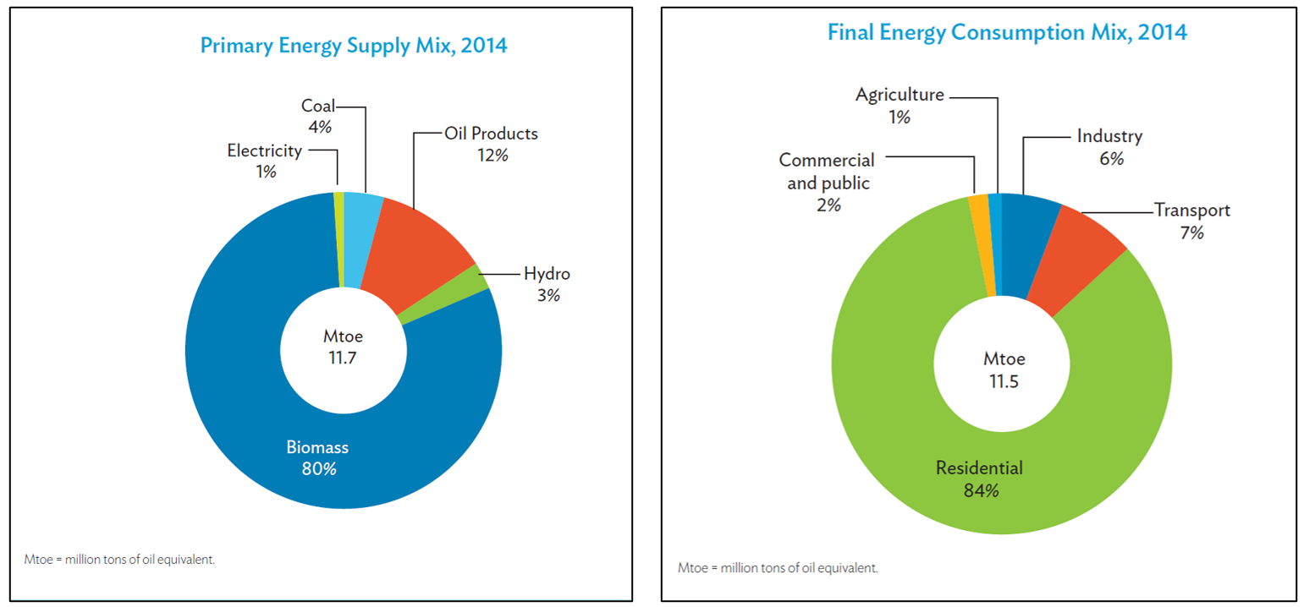
ENERGY SUPPLY AND CONSUMPTION SCENARIO IN NEPAL
Source: (ADB, 2017)

Slide 39
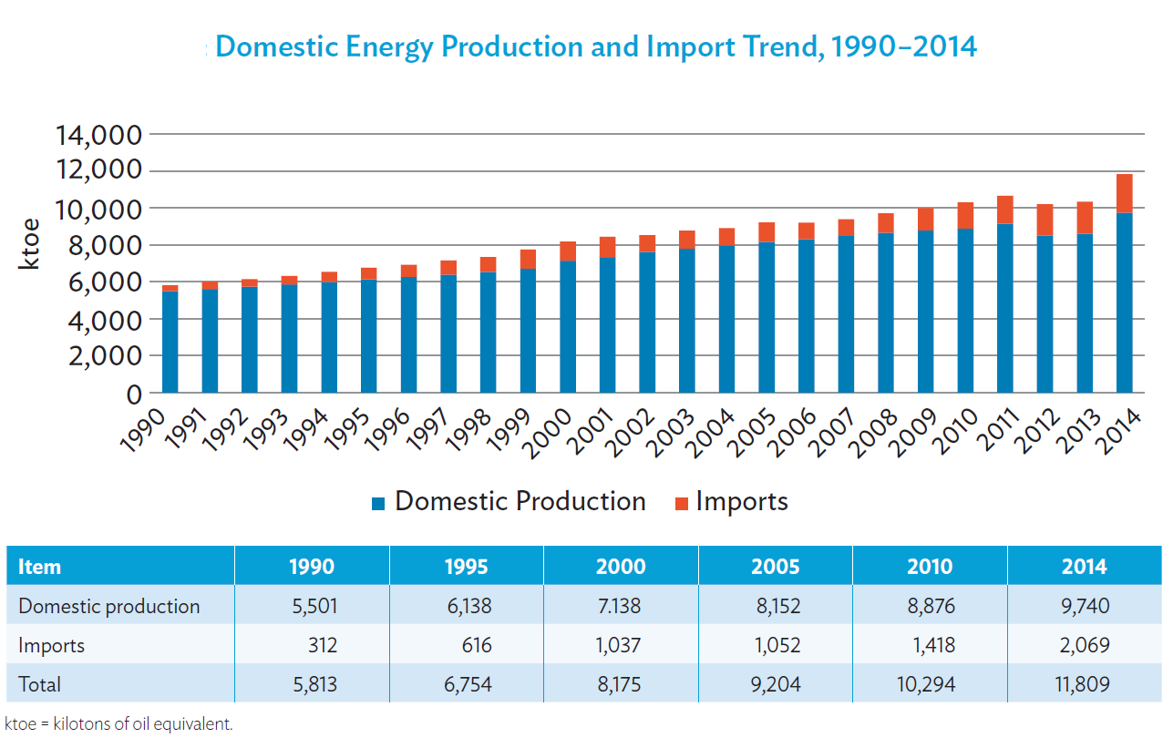
ENERGY PRODUCTION AND IMPORT TREND NEPAL
Source: (ADB, 2017)

Slide 40
NEPAL ELECTRICITY PRODUCTION AND CONSUMPTION SCENARIO
Source: (ADB, 2017)
Particulars | 2011 | 2012 | 2013 | 2014 | 2015 | 2016
Installed Capacity (MW) | 706 | 719 | 762 | 787 | 787 | 856
Peak Demand (MW) | 946 | 1027 | 1095 | 1201 | 1292 | 1385
Supply Capacity Shortage (MW) | 240 | 308 | 333 | 414 | 505 | 529
The table 25 below shows the electricity supply and demand capacity of Nepal from year 2011 to 2016. There is considerable gap in the demand and supply which is often bridged to some extent by import of electricity from India. In 2019, the installed capacity was 1127 MW (IHA, 2022). As of 2021, the installed capacity of Nepal is 2190 MW which has exceeded the demand for the first time (Bhusal, 2022).

Slide 41
GLOBAL WARMING
Global Warming is the increase of Earth's average surface temperature due to effect of greenhouse gases, such as carbon dioxide emissions from burning fossil fuels or from deforestation, which trap heat that would otherwise escape from Earth. This is a type of greenhouse effect (NRDC, 2022).

Slide 42
GLOBAL WARMING
Greenhouse Effect
  Solar radiation incident on earth’s atmosphere is absorbed by the greenhouse gases present in the atmosphere, which keeps the earth’s surface and atmosphere warm.
  The greenhouse gases are:
  Chlorofluro carbons (CFCs)
  Nitrous Oxide
  Methane
  Carbon dioxide (NRDC, 2022)

Slide 43
GLOBAL WARMING
Human beings have increased the CO2 concentration in the atmosphere by about thirty percent, which is an extremely significant increase, even on inter-glacial timescales.
It is believed that human beings are responsible for this because the increase is almost perfectly correlated with increases in fossil fuel combustion.
Combustion of Fossil Fuels, for electricity generation, transportation, and heating, and also the manufacture of cement, all result in the total worldwide emission of about 22 billion tons of carbon dioxide to the atmosphere each year.
About a third of this comes from electricity generation, and another third from transportation, and a third from all other sources. This enormous input of CO2 is causing the atmospheric levels of CO2 to rise dramatically which has in turn lead to rising in average temperature of Earth’s surface hence leading to global warming.

Slide 44
GLOBAL WARMING
Causes
  CO2 emission – From fuels – From powerplants, industries
  Aerosols
  Methane emission from plants and animals (agricultural residues), and from seabeds.
  Deforestation
  Use of chemical fertilizers in agricultural land

Slide 45
GLOBAL WARMING
Causes
  CO2 emission – From fuels – From powerplants, industries
  Aerosols
  Methane emission from plants and animals (agricultural residues), and from seabeds.
  Deforestation
  Use of chemical fertilizers in agricultural land

Slide 46
GLOBAL WARMING
Effects
  Surface and Atmospheric Climate Change
  Changes in Snow, Ice and Frozen Ground
  Oceanic Climate Change and Sea Level
  Extreme Weather conditions
  Changes in intensity, type and frequency of precipitations
  Vegetation shift
  Bird Migrations
  Projected Impacts includes impact on food supply, food security, health related diseases (malaria, diarrhea etc)

Slide 47
REFERENCES
ADB. (2017). Nepal Energy Sector Assessment, Strategy, and Road Map. Asian Development Bank. doi:http://dx.doi.org/10.22617/TCS178936-2
Bhusal, R. (2022). The Third Pole. Retrieved October 8, 2022, from https://www.thethirdpole.net/en/regional-cooperation/indian-developers-replace-chinese-some-of-nepals-largest-hydropower-projects/#:~:text=Nepal%20added%20710%20MW%20of%20hydropower%20to%20its,creating%2010%2C000%20MW%20of%20installed%20capacity%20by%2020
bp. (2022). bp Statistical Review of World Energy, 71st Edition. British Petroleum.
IHA. (2022). International Hydropower Association. Retrieved October 8, 2022, from https://www.hydropower.org/country-profiles/nepal
NRDC. (2022). Natural Resources Defense Council. Retrieved October 8, 2022, from https://www.nrdc.org/stories/global-warming-101#warming
Worldometer. (2022). Retrieved September 27, 2022, from https://www.worldometers.info

Slide 48
THANK YOU

