Slide 1
ENERGY, ENVIRONMENT
AND
SOCIETY
Chapter - 4
Types of Energy Sources, Solar Radiation
Assoc. Prof. Manchan Tiwari
Kathmandu Engineering College
Nepal

Slide 2
LEARNING OBJECTIVES OF THE LECTURE
Types of Renewable Energy Sources
Advantages of Renewable Energy Sources
Basics of Solar Radiation
Important terminologies of Solar Radiation

Slide 3
CLASSIFICATION OF ENERGY SOURCES
Commercial and Non-commercial energy resources
Renewable and Non-renewable energy resources
Conventional and Non-conventional energy resources

Slide 4
RENEWABLE ENERGY SOURCES
Renewable energy sources are often non-conventional energy sources. The various types of renewable energy sources are
  Solar Energy
  Wind Energy
  Geothermal Energy
  Biomass
  Ocean Energy and Tidal Energy
  Micro-hydro Projects

Slide 5
SOLAR ENERGY
Solar energy is continuously incident on the earth in form of electromagnetic radiation at the rate if around 1,7 x 10¹⁷ W (Singal, 2011).
If a person would require 10 kW of energy for sustaining life, then a population of 10 billion will require around 10¹¹ which is much less than the solar energy incident on the earth.
So, theoretically solar energy is sufficient to fulfill all the energy requirement of the people of earth.

Slide 6
SOLAR ENERGY
However, there are limitations which restrict the actual usage of solar energy such as solar energy is very diffuse, cyclic and often undependable.
However, much of the limitations have been addressed by modern energy conversion devices which either convert solar energy to heat or directly generate electricity in reliable manner.

Slide 7
SOLAR ENERGY APPLICATIONS
Conversion to electricity (Solar PV)
Conversion to thermal energy (Solar Thermal)

Slide 8
SOLAR ENERGY APPLICATIONS
The main applications of solar energy are:
Heating of buildings
Cooling of buildings
AC and refrigeration
Solar cookers
Solar water heaters
Solar air heaters
Solar water pumping devices
Building integrated solar photovoltaic
Community based solar photovoltaic system
Standalone solar PV power systems
Solar water heating
Solar water heating
Solar drying of agricultural and animal products
Solar distillation on a small community scale
Salt production by evaporation of seawater or inland brines
Solar engines from water pumping
Bio conversion and wind energy which are indirect sources of solar energy
Solar furnace
Solar electric power generation
Solar pond
Steam generation heated by rotating reflectors
Solar PV cells

Slide 9
WIND ENERGY
Sunlight has to travel varying distance to reach the surface of the earth depending on its latitude.
That is, sunlight reaches perpendicularly at tropical region and becomes more oblique in high latitude region.
This results in uneven heating of the earth’s surface which results in tropical region being hotter than the polar regions.

Slide 10
WIND ENERGY
This results in variation of atmospheric pressure at different regions which results in movement of air from high pressure to low pressure regions.
This phenomenon is the principal cause of Earth’s wind system (Boyle, 2013).
This wind energy is dependent mainly on the velocity at which the wind travels and can be harnessed by using different form of wind turbines.

Slide 11
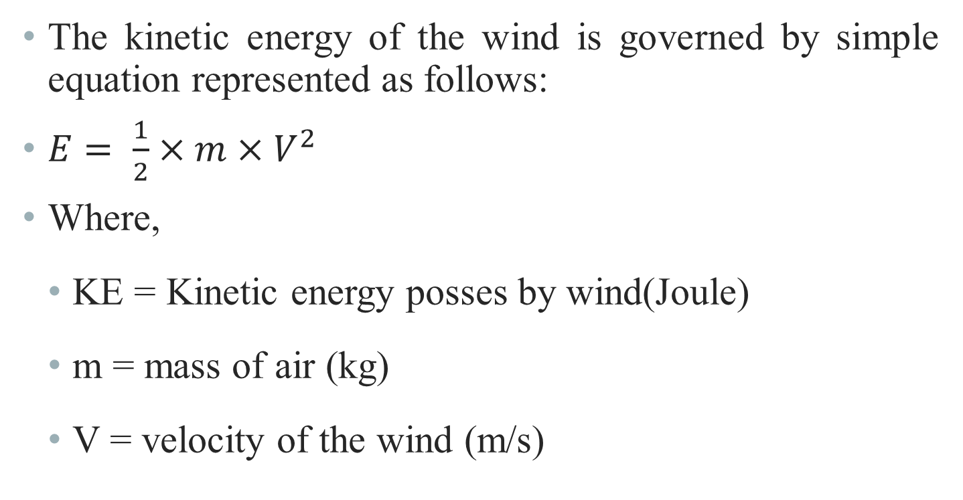
WIND ENERGY

Slide 12

WIND ENERGY
Generally rotor diameter of 50m and heights of 100m are typical dimensions for a wind turbine which can produce appreciable amount of power (Singal, 2011).
The large variability of wind has resulted in unreliable power production in wind energy.
Figure: Wind Turbine (Source: IEA 2022)

Slide 13
GEOTHERMAL ENERGY
Earth is composed of inner core, outer core, lower mantle, upper mantle and crust.
The depth of crust is about 40 kms.
The temperature is highest at earth’s core.
At the base of the crust the temperature ranges from 200 to 100 degree Celsius.
Due to various faults and fractures in earth’s surface (due to earthquakes or surface movement), rain water can seep down such faults for miles.
After being heated it can return to the surface as steam or hot water. Geothermal springs can reach temperature of 370 degree Celsius (Singal, 2011).
The heat stored beneath the earth’s crust can be used for various purpose such as space heating, electricity generation, cooking and medicinal purposes.

Slide 14
BIOMASS
Biomass are basically the organic matter derived from various plant and animal sources. Energy derived from such biomass is known as biomass energy.
Biomass is also indirect manifestation of solar energy as the solar energy received by the plants converts carbon dioxide present in the atmosphere to carbohydrates which forms the basis of much complex molecules.
In developing countries, biomass (or in form of biofuels) are the major source of energy.

Slide 15
BIOMASS
Gaseous and liquid fuels derived from biomass are significant source of power in some countries (Boyle, 2013).
However, biomass or biofuels are considered renewable source of energy only when the rate at which they are consumed is less than the rate at which new plants are regrown which is unfortunately, is often not the case (Boyle, 2013).
Inefficient combustion of biomass can result in significant amount of green house gases to be released in to atmosphere.

Slide 16
OCEAN ENERGY AND TIDAL ENERGY
Gravitation pull of the moon along with little contribution from the Sun results in formation of Ocean tides, which results in the regular rise and fall of water level of the ocean as the Earth rotates.
Also, flowing wind blowing over the open sea causes wave which are also significant source of power.
These tides and waves in the ocean can be harnessed by various means to generate power.
The concept behind harnessing the tidal energy is capturing the rising water during high tide and allowing it to flow back through electricity generating turbines.

Slide 17
MICRO HYDRO POWER
Micro hydropower is considered renewable energy source even though large hydropower plants are generally not categorized as renewable energy due to its considerable environmental impact.
In context of Nepal, micro hydropower is defined as hydro plants of capacity less than 100 kW.
Hydropower plant is an energy system which derives its power from the flowing river system.
The water is either stored in a reservoir or blocked by weir/dam from where the water is diverted through canal and/or penstock pipe to rotate a turbine in powerhouse.
The rotating turbine drives generators that produce electricity. The amount of water which flows in the river and the height from which it falls (head) is directly proportional to the power capacity of hydropower.
Basically in a hydropower the potential energy of the water is converted to kinetic energy in the nozzle which is then converted to mechanical energy in turbine. The mechanical energy of the turbine is converted to electrical energy by generator.

Slide 18
ADVANTAGES OF RENEWABLE ENERGY SOURCES
Renewable in nature and inexhaustible
No operating cost for fuel
Are site specific, lesser need for transmission and distribution.
Renewable energy sources have negligible or no contribution to the pollution and hence are considered as clean energy sources
Most devices or technology used for conversion of renewable energy sources are simple in nature and can be fabricated easily locally.
Renewable technology can serve rural areas better with locally available source of renewable energy.

Slide 19
REVISION OF HEAT TRANSFER MODES
Conduction
  Conduction is the mode of heat transfer occurring in within one or more solid object due to the direct physical contact between them, without the appreciable movement of molecules or atoms forming the substance (Koirala, 2019).
Convection
  Convection heat transfer occurs within fluid or between solid surface and adjacent liquid or gas, due to the random motion of molecules within the fluid medium.
Radiation
  Radiation is the transfer of heat energy in the form of electromagnetic wave from one object to another.

Slide 20
SOLAR RADIATION
Solar radiation is the primary natural energy source of the Earth (other natural sources are: geothermal heat, natural terrestrial radioactivity, cosmic radiation, tidal energy due to gravitational pull).
Solar radiation mainly reaches the earth as electromagnetic radiation from the surface of the sun.
The radiation is originated due to high temperature of sun which is a result of several nuclear fusion processes occurring in the interior of the sun.
Sun is the most prominent feature in our solar system
The sun is an enormous nuclear fusion reactor, which causes four hydrogen nuclei to fuse together and form helium nucleus.

Slide 21
SOLAR RADIATION
The difference in the mass of helium is 0.7% less than that of four hydrogen nuclei.
This difference in mass is expelled in form of energy and radiated from the surface of the Sun (S. Hasan & Sharma, 2009).
It radiates energy by virtue of its high surface temperature around 6000 ⁰C.
Only small part of energy radiated from sun reaches to the earth.
Almost one third of the radiation incident on Earth is simply reflected back.
Even though we perceive solar radiation as white light, in fact it spreads over a wide spectrum of wavelengths, from short-wave infrared to ultraviolet.

Slide 22
SOLAR RADIATION
Sun Statistics
Mass (kg) : 1.98 x 10³⁰
Equatorial radius : 695000
Mean Density : 1.41 gm/cm3
Mean Surface Temperature : 6000 C
Hydrogen : 92.1%
Helium : 7.8%

Slide 23
SOLAR RADIATION
Solar radiation is the electromagnetic radiation emitted by the sun which can be converted to useful forms of energy such as heat and electricity by using various technologies
The electromagnetic radiation emitted by the sun shows a wide range of wavelengths.
It can be divided into following major regions
  Ionizing radiation (x-rays and gamma rays)
  Non ionizing radiation (UVR, Visible and infrared radiations)
The highly injurious ionizing radiation does not penetrate the earth’s atmosphere
The wavelength distribution of solar radiation consists of short wave as well as long wave radiations.
The different region of solar spectrum has varying wavelengths
The region of the spectrum that is visible to human has wavelengths around 400 to 700 nm.
Visible range of the electromagnetic radiation is practically useful for us.
Short wavelength radiation has higher energy level that the long wavelength radiation.

Slide 24
SOLAR RADIATION
The sunlight while it passes through the earth’s atmosphere, some of its part is absorbed and reflected by air molecule, water vapors, clouds, dust and pollutants.
The radiation which have been reflected is known as Diffused radiation. The diffused radiation does not have a particular path.
The solar radiation other than diffused radiation which reaches the earth’s surface without being scattered is known as Direct radiation. The sum of the direct and diffused radiation is called global radiation.

Slide 25
BASIC TERMINOLOGIES
Solar Constant
Solar constant is defined at the rate at which solar radiation strikes earth’s upper atmosphere.
The solar constant is the average amount of energy received in unit time on a unit area of surface perpendicular to the direction of propagation of the radiation at the mean distance of the earth from the sun.
In literature a value of 1367 W/m² is given frequently.

Slide 26
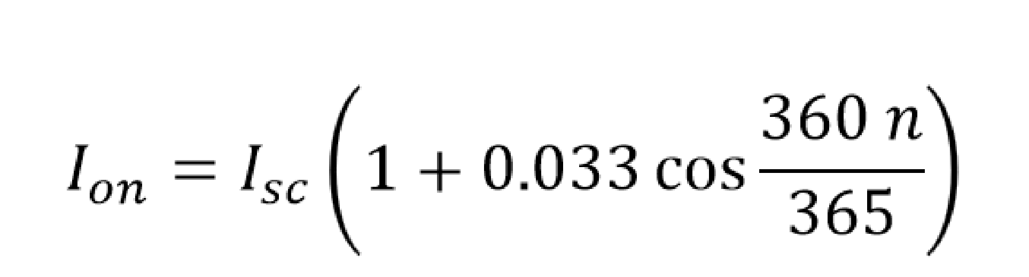
BASIC TERMINOLOGIES
Extraterrestrial Radiation
The orbit of the earth around the sun is slightly elliptical with the sun at one of the foci and therefore causes a change of the sun-earth distance throughout the year.
Extraterrestrial radiation is the intensity (power) of the sun at the top of the Earth’s atmosphere.
It is usually expressed in irradiance units (Watts per square meter) on a plane normal to the sun.
It varies throughout the year because of the Earth’s elliptical orbit, which results in the Earth-Sun distance varying during the year in a predictable way.
This effect can be represented empirically with the following equation:

Slide 27
BASIC TERMINOLOGIES
Irradiance
Irradiance (I) is defined as the intensity of solar radiation per unit time on a unit surface area of the earth. Its unit is W/m².
Insolation
Insolation is the total energy received from the sun in a day in a unit surface area on the earth. Its unit is Wh/m² per day (watt hour per meter square per day).
The average insolation for Nepal can be taken as 4500 to 5500 Wh/m²/day

Slide 28
BASIC TERMINOLOGIES
Radiosity
Radiosity is defined as the rate at which radiant energy leaves a surface per unit area by combined emission, reflection and transmission.
Emissive Power
It is defined at the rate at which radiant energy leaves a surface per unit area, by emission only.
Poles of the Earth
The ends of axis of rotation of the earth are called poles of the earth.
Earth’s Equator
It is an imaginary circle normal to the earth’s axis which divided the distance from two south and north poles into two equal halves.

Slide 29
BASIC TERMINOLOGIES
Meridian
As a reference is required to measure a location on earth, the location of Royal Observatory Greenwich, London has been globally accepted as a reference point.
An imaginary circle passing through this reference point and the two south and north poles, which also intersects the equator at right angles, is called the prime meridian

Slide 30
BASIC TERMINOLOGIES
Peak Sun
Peak sun is the number obtained by division of insolation by 1000 W/m²/day.
The unit of Peak Sun is hour (h).
In case of solar system design the peak sun is used as the hours of sunshine in the region.
In case of Nepal standard value of peak is used as 4.5 to 5.5 hours for design considerations

Slide 31
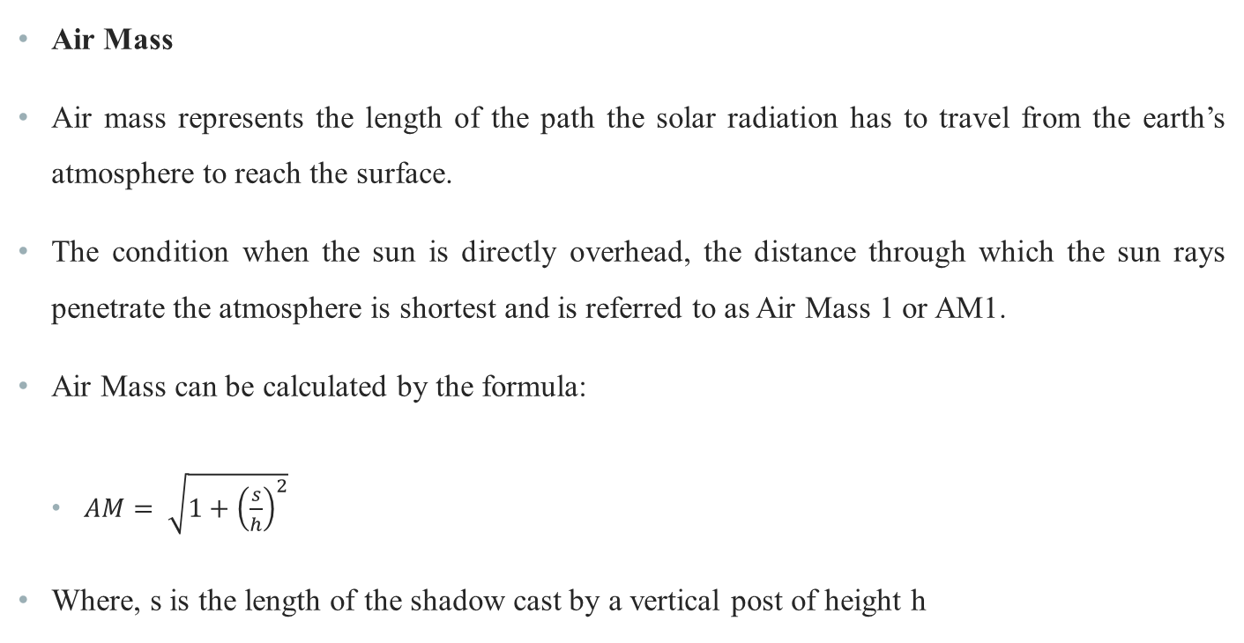
BASIC TERMINOLOGIES

Slide 32
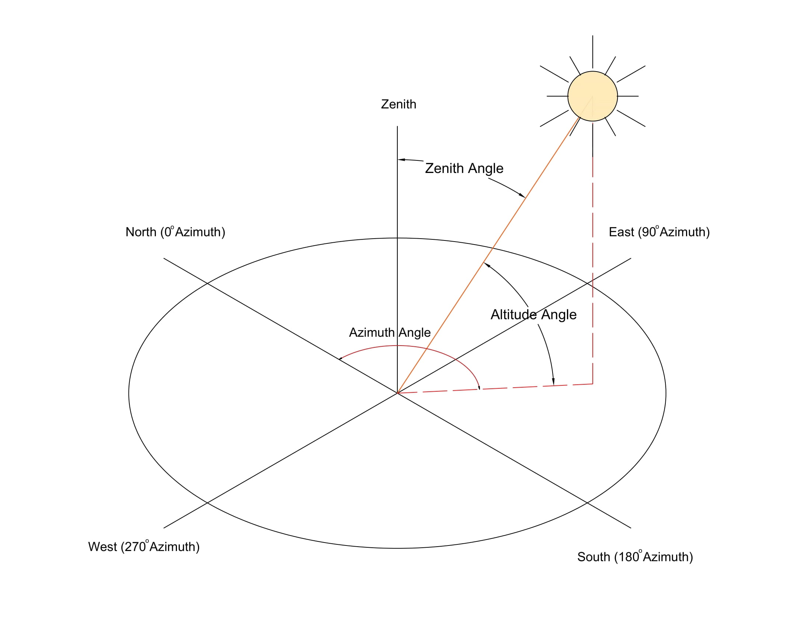
SOLAR GEOMETRY

Slide 33
BASIC TERMINOLOGIES
Zenith Angle
It is the angle made by the ray of light from Sun with the zenith (vertical line). It can also be called as complimentary angle of Sun’s altitude angle.
Solar Azimuth Angle
It is the angle made by the projection of Sun’s ray on Earth’s surface with the North direction (Singal, 2011).

Slide 34
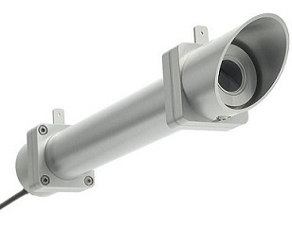
MEASUREMENT OF SOLAR RADIATION
Pyrheliometer
  It is an instrument for measuring direct solar radiation flux at normal incidence. It is a small telescope like equipment which follows the path of the sun throughout the day.
Figure: Pyrheliometer (Source: Elprocus, 2022)

Slide 35
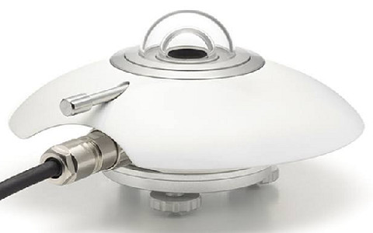
MEASUREMENT OF SOLAR RADIATION
Pyranometer
  It is an instrument used for measuring of direct and diffused irradiance arriving from the whole hemisphere i.e. from the complete sky dome.
  A Pyranometer can be used in a tilted position as well, in which case it will also receive the ground reflected radiation.
Figure: Pyranometer (Source: Elprocus, 2022)

Slide 36
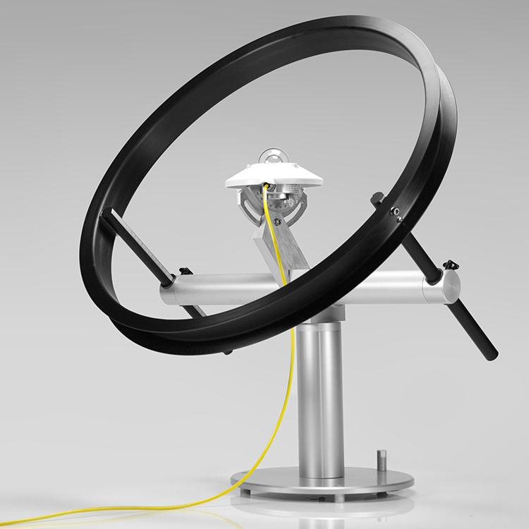
MEASUREMENT OF SOLAR RADIATION
Pyranometer with shading device
  Pyranometer with a shade ring is used to measure diffused solar irradiance
Figure: Pyranometer with shade ring
(Source: ESS, 2022)

Slide 37
AVAILABILITY OF SOLAR RADIATION
Pyranometer is used to accurately measure the solar radiation for the purpose of mapping the solar energy resources over the world.
A Pyranometer consists of a calibrated thermoelectric elements fitted under a glass cover , which is exposed to the sunlight, such that a voltage proportional to the total incident light is generation which is then recorded electronically.
Detailed approach of measurement of solar radiation is required by using Pyranometer which then separately measures the direct and diffused radiation which is then combined to calculate the total radiation
The annual solar radiation on a horizontal surface is highest near the equator, over 2000 kWh per square metre per year, and especially high in the desert areas.
Compared to northern Europe which receives around 1000 kWh per square metre per year
In southern France or Spain, the annual radiation levels are around 1500 kWh per square metre per year whereas in southern USA, the levels can reach as high as 2500 kWh per square metre per year

Slide 38
TILT AND ORIENTATION
In the northern hemisphere, to receive maximum radiation in a flat surface, the surface should be facing south and must be tilted towards Sun.
The angle of tilt is dependent on the latitude of the location and time of the year when the maximum radiation is required incident on the flat plate
If the tilt angle between a surface and the horizontal is qual to the latitude, it will be perpendicular to the Sun’s rays at midday in March and September
Also, there is difference between summer and winter as the high latitude regions receive more solar energy in summer than in winter as the sun rays strikes perpendicularly in the summer and is oblique during the winter due to revolution of the earth around the sun.
To maximize solar collection in summer, when the radiation available is high, the tilt angle should be less than the latitude.
To maximize solar collection in winter, the tilt angle should be greater than the latitude angle (Boyle, 2013)

Slide 39
REFERENCES
Boyle, G. (2013). Renewable Energy Power For A Sustainable Future (Vol. Third Edition). Oxford: Oxford University Press.
lprocus. (2022). Retrieved October 9, 2022, from https://www.elprocus.com/what-is-pyranometer-construction-types-applications/
IEA. (2022). Retrieved October 9, 2022, from https://www.iea.org/reports/offshore-wind-outlook-2019
Koirala, D. R. (2019). Principals of Engineering Thermodynamics and Heat Transfer. Kathmandu: Shree Chandeswori Publication Pvt. Ltd. .
S. Hasan, S., & Sharma, D. (2009). Non-Conventional Energy Resources. Delhi: S. K. Kataria and Sons.
Sharma, D., & Hasan, S. (2009). Non-Conventional Energy Sources (Second Edition ed.). Delhi: S.K. Kataria and Sons.
Singal, R. (2011). Non-Conventional Energy Resources (Vol. Third Edition). Delhi: S. K. Kataria and Sons.

Slide 40
THANK YOU

