Slide 1
Energy, Environment and
Society
Chapter - 5
Solar Thermal
Assoc. Prof. Manchan Tiwari
Kathmandu Engineering College
Nepal

Slide 2
Learning objectives of the lecture
Solar thermal energy
Different types of solar thermal applications
Working of various solar thermal applications

Slide 3
Solar thermal systems (ste)
Solar thermal energy (STE) is a technology for harnessing solar energy for thermal energy.
The basic purpose of a solar thermal energy system is to collect solar radiation and convert it into useful thermal energy.
Most solar thermal systems are based on simple working principal and are effective for rural area where no source of electricity is available.

Slide 4
Solar energy scenario in nepal
Nepal has a high potential for harnessing solar energy being located in favorable latitude (WECS, 2010).
The solar insolation in Nepal varies from 3.6 to 6.2 kWh/m2/day and the sunshine is for about 300 days per year (WECS, 2010).
The monthly daily global solar radiation varies from 120 to 260 w/m² with the annual sun shine duration ranging from 1900 to 2500 hours

Slide 5
Solar energy scenario in nepal
As per report published by Alternative Energy Promotion Centre, Nepal under Solar and Wind Energy Resource Assessment in Nepal (SWERA), the commercial potential of solar power for grid connection is 21080 MW.
National average sunshine hours of 6.8 hrs per day and average solar insolation of about 4.7 kWh/m2/day, there is a huge potential for solar thermal devices such as Solar water Heaters, Solar Dryers, Solar Cookers.

Slide 6
Types of solar thermal systems
Solar collector
Solar pond
Solar dryer
Solar cooking system
Solar still
Solar swimming pool

Slide 7
Solar collectors
Solar collector is a device which absorbs the incoming solar radiation, converts it into heat, and transfers this heat to a fluid flowing through the collector.
Such converted heat can be used for heating purpose or for the purpose of electricity generation as well.
Solar collector can be either flat plate or evacuated tube type (non concentrating type) or concentrating (focusing) type.

Slide 8
Solar collectors
So, basically the solar collectors can be classified into three types:
Types of Collector
Flat Plate Collectors
Evacuated Tube Collectors
Stationary compound parabolic collectors

Slide 9
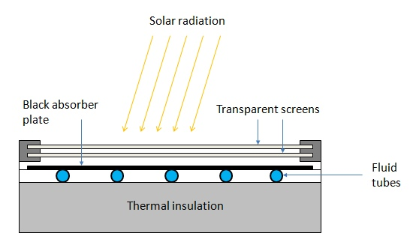
Flat plate collectors
Flat plate solar collector consists of an absorber plate, cover glass, insulation, housing and heat transfer fluid tube.
Absorber plate is generally made of metal to increase the absorption of solar radiation. A large portion of the incident energy is absorbed by the plate and then transferred to the transport medium in the fluid tubes.
Figure 1 Flat Plate Collector (PennState, 2022)

Slide 10
Flat plate collector
The cover glass or glasses are used to reduce convection and re-radiation losses from the absorber.
Insulation is used on the back edges of the absorber plate to reduce conduction heat losses.
The housing holds the absorber with insulation on the back and edges and cover plates.
The working fluid (water, air) is circulated through the absorber plate to carry the solar energy to its point of use.
It is used to achieve moderate temperature of up to 100 ⁰C.
It is used for building heating, industrial process heating

Slide 11
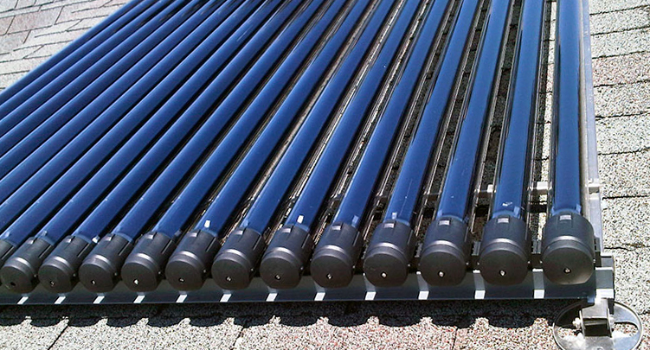
Evacuated tube collector
Evacuated tube collectors comprises of parallel rows of tubes containing water or fluid used for heating.
Each tube is made of metal tube surrounded by a larger glass tube.
The space between the tube and the glass tube is a vacuum, due to which very little heat is lost from the fluid.
Figure 2 Evacuated Tube Collector (Waterloo, 2022)

Slide 12
Evacuated tube collector
The vacuum ensures that there is negligible loss due to conduction or convection, which ensures that the collector can operate at higher temperature that the flat plate collectors.
Evacuated tube collectors are used for reduction of losses.
ETC can achieve water temperature of up to 250 ⁰C.

Slide 13
Concentrating collectors
These types of collectors are used for medium and high temperature applications.
It is made of a reflecting surface such as reflecting mirror or Fresnel lense which is used in concentrating device such that the solar radiation incident is reflected to a single point and focused on to the absorber.
Such concentrator are also rotated through tracking mechanism which helps to track the sun path for increase in the efficiency of the collector.
The performance of concentrating collectors is measured by concentration ratio which is the ratio of the aperture area of the concentrator to the area of the absorber.

Slide 14
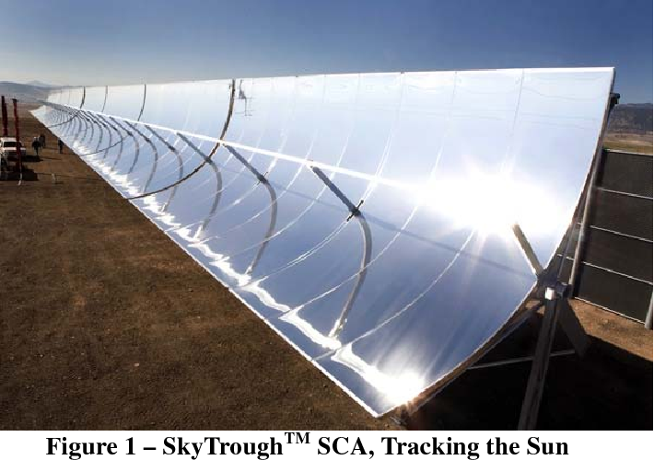
Concentrating collectors
The various types of concentrating collectors are:
  Parabolic Trough Concentrator
  Parabolic Disc Concentrator
  Fresnel Lens Concentrator
Parabolic Trough Concentrator
  It is a linear concentrator
  It has concentration ratio of around 20 to 100
Figure 3 Parabolic Trough Concentrator
Source: (Farr, 2010)

Slide 15
Concentrating collectors
Parabolic Disc Concentrator
  It is a point focus concentrator.
  It has concentration ratio of 100 to 4000 for parabolic and heliostat field concentrator.
  These are fixed collectors which uses parabolic shaped collectors. The parabolic shaped collectors are made from two sections of a parabola facing each other. These type of collectors can accept incoming radiation over a relatively wide range of angles, by using multiple internal reflections
Fresnel Lens Concentrator
  It is capable to achieve temperature as high as 1000 ⁰C.
  This type of concentrator is se for power generation and process heat supply.

Slide 16
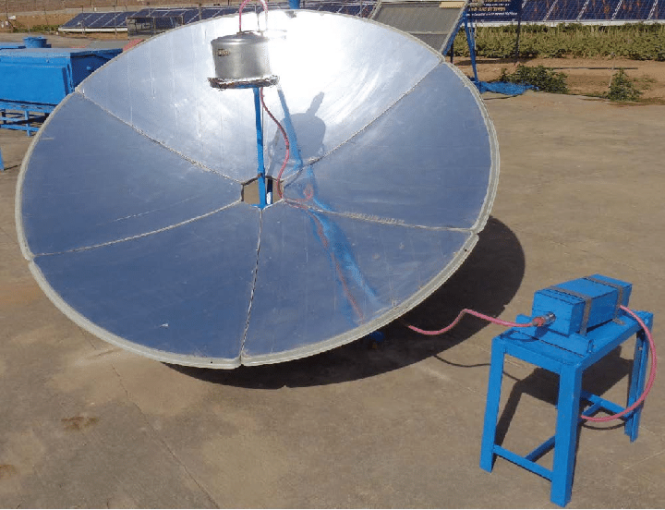
Concentrating collectors
Figure 4 Parabolic Disc Concentrator
Source: (Dr. Poonia, 2010)

Slide 17
Applications of flat plate collectors
The flat plate collector have many applications such as
Water heating
Space heating
Power generation

Slide 18
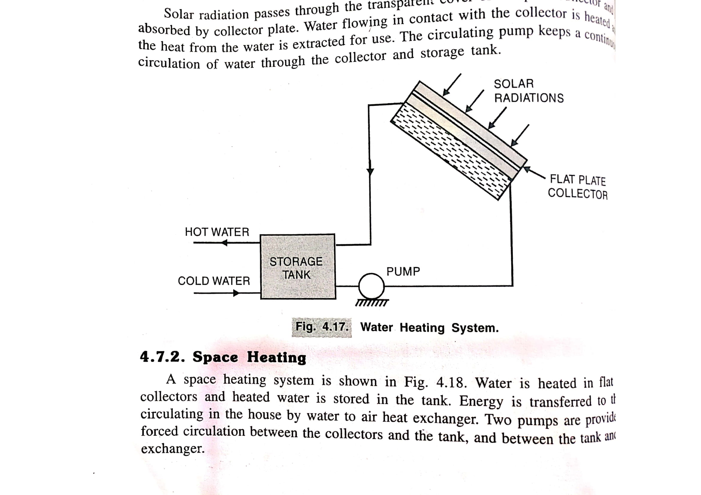
Applications of flat plate collectors
Water Heating
The radiation passing through the collector is absorbed by the collector plate which heats the water flowing in contact with the collector plate. Either thermosiphon effect or a pump circulates the water from storage tank to the collector.
Figure 5 solar water heater
Source: (Hasan & Sharma, 2009)

Slide 19
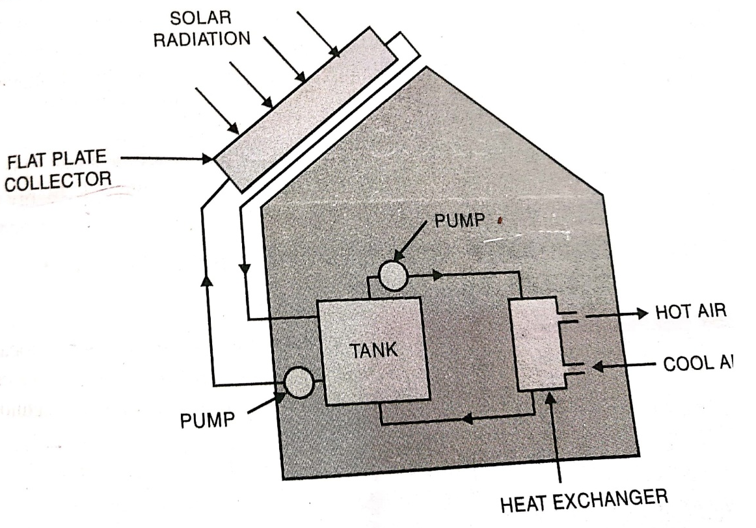
Applications of flat plate collectors
Space heating
Flat plate collector is initially used to heat water which is stored in a tank. The hot water is used to heat air being circulated by secondary pump which is then circulated to the space required to be heated.
Figure 6 solar space heating
Source: (Hasan & Sharma, 2009)

Slide 20
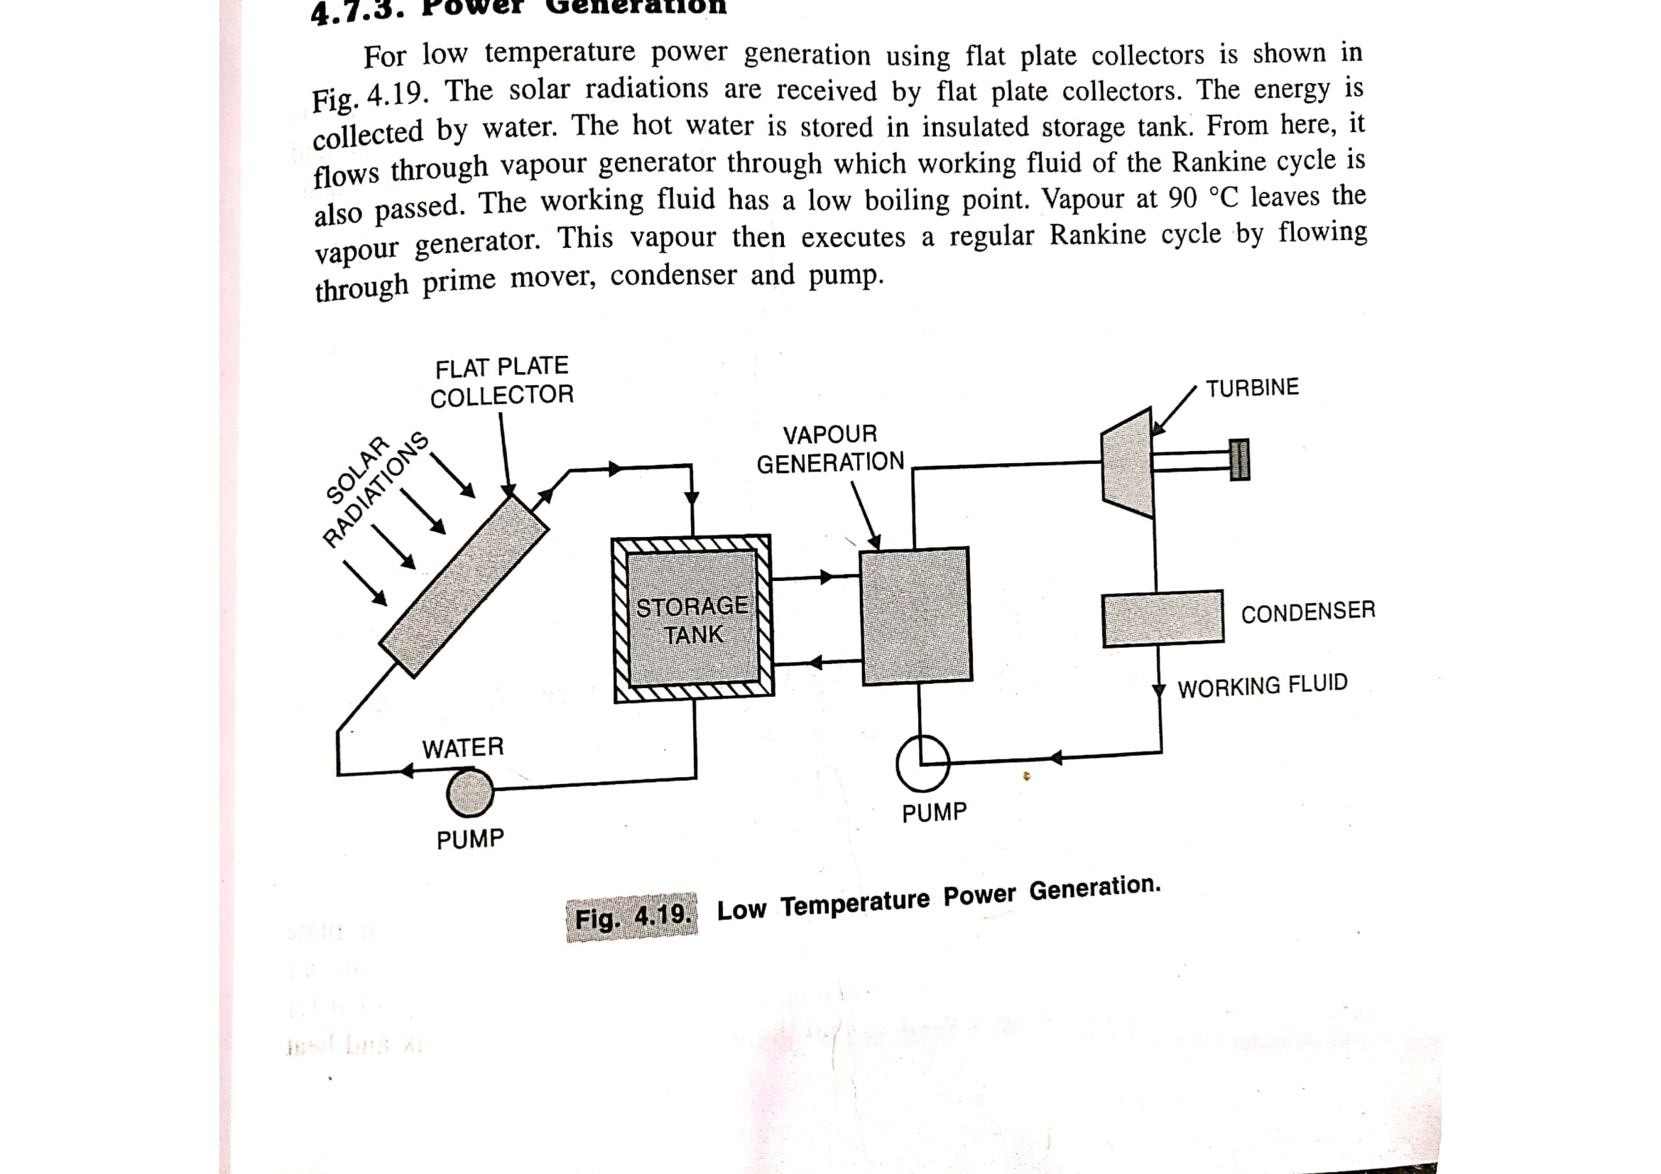
Applications of flat plate collectors
Power generation
The hot water generated from solar collector is used to convert a working fluid with low boiling point to vapor which then operates a rankine cycle to generate power.
Figure 7 solar power generation
Source: (Hasan & Sharma, 2009)

Slide 21
Types of solar heating system
Types of Solar Water Heating Systems
  Active Solar Water Heating System
  Passive Solar Water Heating System
Active Solar Water Heating System
  Active Solar Water Heating System utilizes external power source (pump) to circulate the working fluid to transfer heat from the collector to the desired space.
  There are two types of Active Solar Water Heating Systems:
  Direct Circulation Systems
    In this system pump circulates the heating fluid (water) through the collectors and in to the home or desired heating space. They work well in climates where the water does not freeze.
  Indirect Circulation Systems
    In this system pump circulates a non-freezing heat transfer fluid through the collector to a heat exchanger. In the heat exchanger the fluid the heats water which is then circulated into home. This type of system work well in climates prone to freezing temperatures.

Slide 22
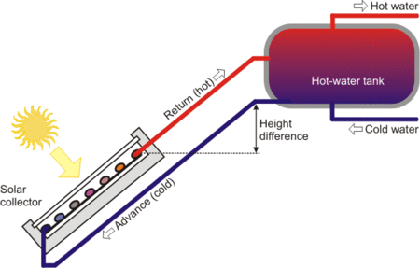
Types of solar water heating system
Passive Solar Water Heating System
  In this system no external power source (pump) is used to circulate the heating fluid or water. Instead, these systems are based on thermos siphon principle.
Thermosiphon System
  In thermosiphon system, there is no need for circulating pump and controller. Collector is place below the altitude level of the water tank such that the water flow into the collector due to gravity.
  When the water in collector gets heating, due to density difference between the hot water in collector and relatively cold water in water tank, the hot water rises up to the tank and consequently the cold water from tank flows to the collector.
  Due to this the water keeps circulating into the collector and the water temperature is raised. This effect is also called thermo siphon effect.
Figure 4 Thermosiphon Effect
Source: (Appropedia, 2022)

Slide 23
Solar Pond
In an ordinary pond, water warmed by the sun expands and rises as it becomes less dense.
Once, it reaches the surface, the water loses its heat when it comes in contact with the surrounding through convection, or evaporation.
Hence, in an ordinary pond, due the loss of heat into the atmosphere, there is no considerable increase in temperature of the water.

Slide 24
Solar Pond
Solar pond use a large, salty lake as a kind of flat plate collector.
If a lake has salty water at the bottom and fresh water at the top and the water is clear enough, the solar energy is absorbed at the bottom of the pond.
The hot and salty water cannot rise as it is heavier than the fresh water at the top.
Hence the upper layer acts as insulating blanket to preserve the heat in the bottom layer of the pond. Solar pond is also called as solar salt pond.

Slide 25
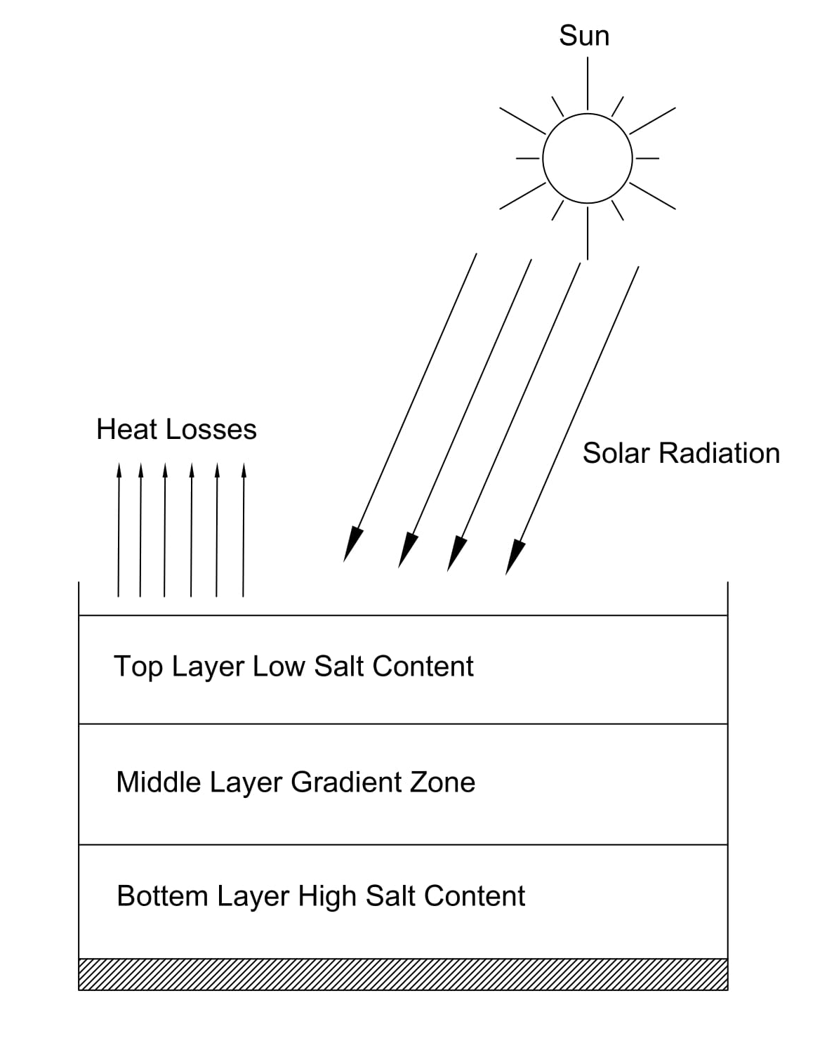
Solar pond
A solar pond consists of three main layers
Top layer near exposed to atmosphere (near ambient temperature) and has low salt content
Bottom later is hot and has high salt content
The middle layer between these two layers is a gradient zone which allows the sunlight to pass to the bottom layer but acts as transparent insulator.
Figure 5: Solar Pond Working

Slide 26
Solar pond
A leak proof pond is constructed such that 330 kg of salt per square meter of the pond is added to maintain the gradient.
The temperature of the bottom layer can reach around 93 ⁰C (Singal, 2011). Solar ponds are useful in two ways:
Due to the temperature difference in the upper most and lower most layer, the temperature difference used to convert the solar thermal energy to useful work
Solar pond can be used as a thermal storage medium (Singal, 2011)

Slide 27
Solar pond
Applications of Solar Pond
Industrial process heat applications
Electrical power generation
Space heating and cooling
Water supply (for desalination)
Fruit and vegetable canning industry (vine fruit drying and for grain drying)
Limitations of Solar Pond
Solar pond requires large area and sunny climate
Availability of large amount of water

Slide 28
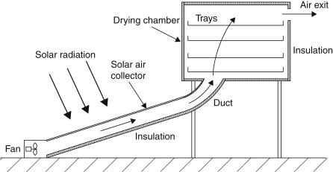
Solar dryer
Solar drying is the process of removing moisture from a product to be used in various application as well as to preserve it for a longer period of time.
Drying of a product is dependent on temperature, humidity and velocity of air stream and also on the properties of the material to be dried.
Figure 6: Solar Dryer (Kalogirou, 2014)

Slide 29
Solar dryer
Air is drawn through the dryer either by natural convection or by used of fan in some cases.
The air is then passed through the collector where it receives heat and the temperature is raised so that the relative humidity is decreased.
The warm air can hold more moisture than the cold air, so when the heated air is passed through the drying chamber where, the particulars to be dried are placed, the air withdraws the moisture hence drying the input.

Slide 30
Solar cooking system
Solar radiation is also used for cooking by either using box type solar cooker or parabolic solar cooker (parabolic solar concentrator).
The basic principle of the solar cooker is to concentrate or reflect the solar radiation incident in an area to a single point where the cooking vessel is placed.
The solar cooker utilizes direct radiation.
However there are various types of solar cooker based on the working principal. Some of the basic principals of the solar cooker are:
Concentrating sunlight: similar to principal of solar concentrators where reflecting devices are used to concentrate solar radiation incident on a large area to a single smaller area where cooker is located
Converting light to heat: any surface coated black will absorb greater amount of heat and hence increase the effectiveness of converting light to heat.
Trapping heat: the heat is trapped inside by placing the cooker in a enclosed space using a clear solid as glass cover which allows the radiation to be incident on the cooker but does not allow the heat to escape by reducing the convection loss.

Slide 31
Solar swimming pool
Solar thermal energy can also be utilized for heating the swimming pool using various kind of collector as per requirement.
Generally, solar swimming pool utilized flat plate or vacuum tube solar collector.
The size of the collector depends on several factors such as, size of the pool, climate, desired water temperature, wind conditions, availability of shading in the pool and also the frequency of usage of the pool.
Normally, the total area of the solar collector is at least the half of the pool surface area.

Slide 32
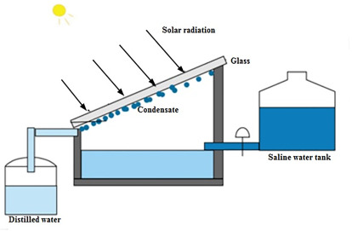
Solar still
Solar still are the device which uses solar radiation as energy source for purification of liquids for eg. for desalination or distillation of water.
In a solar still, impure water is contained in a container outside the collector.
Figure 7: Solar Still (Ren, 2020)

Slide 33
Solar still
In the solar collector, the impure water evaporates and condenses when it strikes the inclined transparent surface that is placed at the top of the collector.
The water then condenses and small drops of water is formed which flows into a container where the pure water is collected.

Slide 34
Solar refrigeration
Refrigeration using solar thermal energy from a solar collector is achieved by operation of vapor absorption refrigeration cycle.
Such solar refrigeration is feasible and used in rural regions where electric power is not available.
Solar refrigeration can be used to store food in such rural areas. In a conventional vapor compression refrigeration system, the input energy is electricity which operates motor to produce cooling effect.
In vapor absorption cycle, the input energy is heat, which is used to operate absorber and generator instead of compressor to produce cooling effect in the evaporator.
Hence, the heat required for the vapor absorption cycle is supplied by solar collector to produce refrigeration effect.
The main components of absorption cooling device are generator, condenser, evaporator and absorber.
Cooling systems based on absorption cycle is simple and quiet in operation.

Slide 35
Solar water pump
Water pumps are the devices which operate when a motor driven by electrical power converts the electrical power to mechanical power which then operates the water pump.
In solar water pump operated by thermal energy, organic vapor rankine cycle system with rotary machines or screw expanders or reciprocating engine or spiral expander is used to provide the mechanical power to the water pump.

Slide 36
Solar Thermal power plants
There are two types of solar thermal power plants
Solar distributed collector power plants
Solar central receiver power plants
Solar distributed collector power plants
Collectors are used in this type of power plants
Large area is required. Parabolic trough or Parabolic disc concentrators are used instead of flat plate collectors due to higher efficiency
The hot water from the large collector is supplied as feed water into the boiler to operate rankine cycle
The feed water is then converted to steam in Boiler.
Steam is passed through the steam turbine which is coupled to electric generator which generates electric power.

Slide 37
Solar Thermal power plants
Solar central receiver power plants
  A boiler is mounted on top of a tower located near the centre of the field of large mirrors called heliostats.
  The sunrays incident on the heliostats are focused on the boiler which generates high temperature steam
  The high temperature steam is used to drive steam turbine coupled to an electric generator
  The complete system consists of following components:
    Heliostat
    Receiver or tower
    Steam turbine and generator
    Cooling tower
    Storage system

Slide 38
References
Boyle, G. (2013). Renewable Energy Power For A Sustainable Future (Vol. Third Edition). Oxford: Oxford University Press.
Kalogirou, S. A. (2014). Solar Energy Engineering Processes and Systems (Second Edition ed.).
Koirala, D. R. (2019). Principals of Engineering Thermodynamics and Heat Transfer. Kathmandu: Shree Chandeswori Publication Pvt. Ltd. .
PennState. (2022). Retrieved October 8, 2022, from Pennsylvania State University: https://www.e-education.psu.edu/eme811/node/685
S. Hasan, S., & Sharma, D. (2009). Non-Conventional Energy Resources. Delhi: S. K. Kataria and Sons.
Sharma, D., & Hasan, S. (2009). Non-Conventional Energy Sources (Second Edition ed.). Delhi: S.K. Kataria and Sons.

Slide 39
References
Singal, R. (2011). Non-Conventional Energy Resources (Vol. Third Edition). Delhi: S. K. Kataria and Sons.
WECS. (2010). Energy Sector Synopsis Report. Kathmandu, Nepal: Government of Nepal, Water and Energy Commission Secretariat.

Slide 40
THANK YOU

