Slide 1
ENERGY, ENVIRONMENT
AND
SOCIETY
Chapter - 6
Solar Cell (PV Technology)
Assoc. Prof. Manchan Tiwari
Kathmandu Engineering College
Nepal

Slide 2
LEARNING OBJECTIVES OF THE LECTURE
Solar Photovoltaics
Solar PV Cell, Module and Array
Types of Solar Cell
Solar PV Systems

Slide 3
SOLAR PHOTOVOLTAICS
Solar photovoltaics refers to utilization of solar radiation to generate electrical energy using conversion device such as solar photovoltaic (PV) cell.
The amount of electricity or electrical energy generated depends on intensity of solar radiation, size of solar cell, type of semiconductor material and ambient temperature (Sharma & Hasan, 2009).
Unlike most of the electricity generation systems, the solar PV cell does not need working fluid such as steam or air, or any mechanical cycle for the conversion of the primary solar energy into electricity.
Hence, a photovoltaic system is reliable, simple and convenient without any moving parts (Singal, 2011). Solar cell is a basic unit of a photovoltaic system.

Slide 4
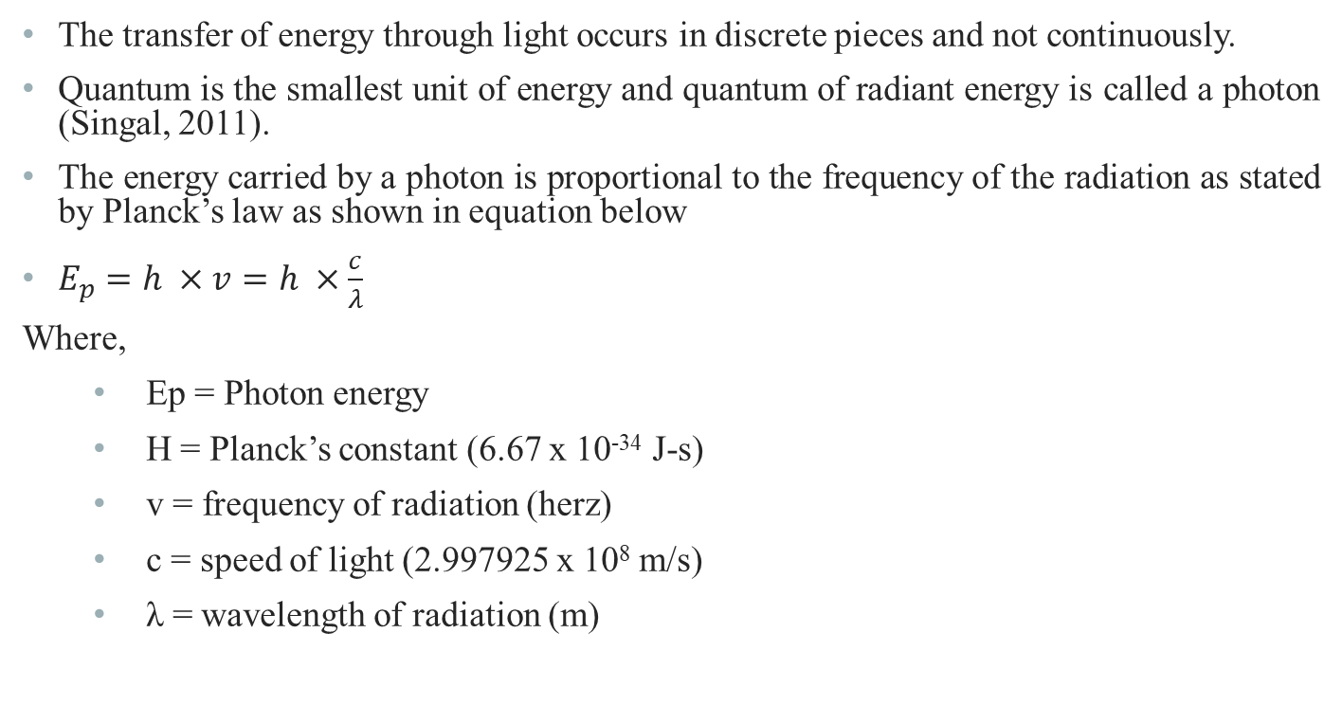
ENERGY IN LIGHT (PHOTON ENERGY)

Slide 5
SOLAR CELL
Solar cell is a photovoltaic device, composed of p-n semiconductor junction, which converts the light energy into electrical energy based on the principles of photovoltaic effect.
The photovoltaic effect is the creation of voltage or electric current in a material upon exposure to light.
The photovoltaic effect can be observed in nature in a variety of materials, but the materials that have shown the best performance in sunlight are the semiconductor.
When photons from the sun are absorbed in a semiconductor, they create free electrons with higher energy.
Once the electrons are created, there must be an electric field to induce these higher electrons to flow out of the semiconductor to do useful work.

Slide 6
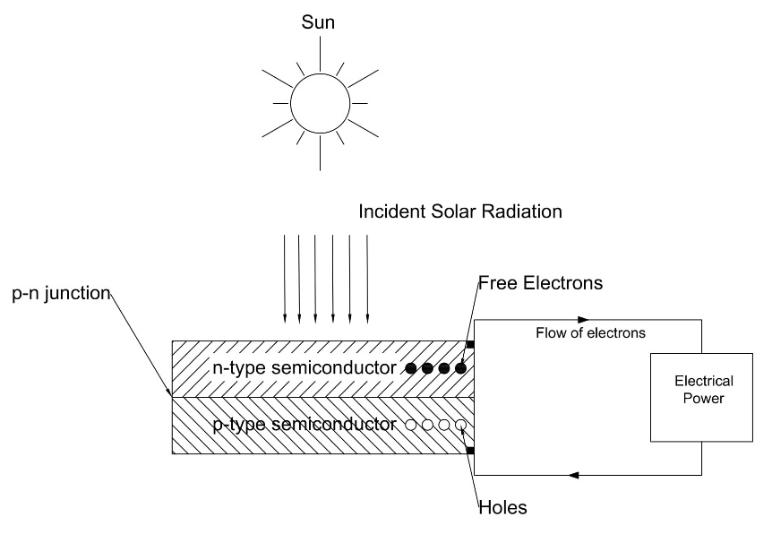
WORKING OF A SOLAR CELL
A solar cell consists of P-type semiconductor and n-type semiconductor. Generally, n-type are made from crystalline silicon that has been doped with tiny quantities of impurities (usually phosphorus) such that it possesses a surplus of free electrons.
Figure 1: Working of Solar Cell

Slide 7
WORKING OF A SOLAR CELL
P-type semiconductor are also made from crystalline silicon, but are doped with small amount of impurity (usually boron) which results in deficit of free electrons known are holes.
A p-n junction is created by joining the dissimilar semiconductors which sets up electric field in the region.
Although, the semiconductors can be made from other elements than silicon, we shall be considering semiconductors based on silicon for the purpose of simplicity.
Light can be considered as stream of tiny particles of energy, called photons.

Slide 8
WORKING OF A SOLAR CELL
When the photons from the light fall within the p-n junction, they can transfer their energy to some of the electrons in the material so promoting them to higher energy level.
In their excited state the electron becomes free to conduct electric current by moving through the material (Boyle, 2013).
Due to the absorbed energy, the free electrons are liberated and when an external circuit is used, it produces the DC current.
The DC current is converted into 240 V AC current using an inverter for different applications.

Slide 9
WORKING OF A SOLAR CELL
Over 95% of the solar cells produced worldwide are composed of semiconductor material Silicon (Si) (Boyle, 2013).
As abundantly found in earth’s crust, silicon has the advantage of being available in sufficient quantities.
A commercially available solar cell with the dimensions of 15.6 cm x 15.6 cm, the electricity output is more likely rated at 0.5 V with 7 A DC current. It can produce around 3-4 Watts.

Slide 10
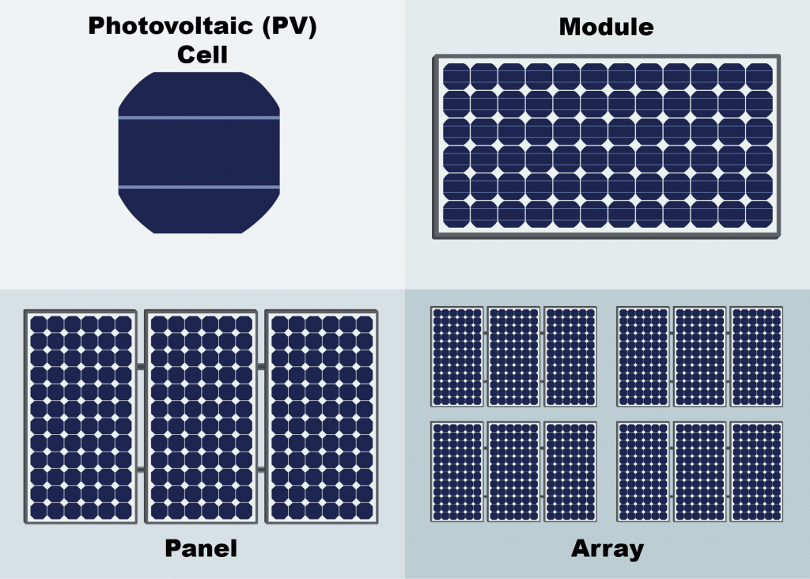
SOLAR MODULE AND ARRAY
Number of solar cells are combined either in series or parallel to form a solar panel or module to operate at desired voltage and current output.
Standard module consists of 36 to 72 solar cells.
A P-V module is made of very thin silicon wafer of around 300 micro meter in size.
Figure 2: Solar Cell, Panel and Array (FSEC, 2022)

Slide 11
SOLAR MODULE AND ARRAY
As it is very fragile, the layer of the module is protected from damage by sealing it between layer of toughed glass and layers of EVA (Ethyl Vinyl Acetate (S. Hasan & Sharma, 2009).
Below the EVA layer, an insulating sheet is provided , while whole module is attached to an outer frame to provide strength to the module.
Solar Array is a group of similar modules connected in series and parallel to increase the power delivered by the PV system.

Slide 12
SOLAR MODULE AND ARRAY
To increase the system voltage maintaining the current, the panel are connected in series connection.
To further increase the power by increasing the system current, the panel are connected in parallel connection.

Slide 13
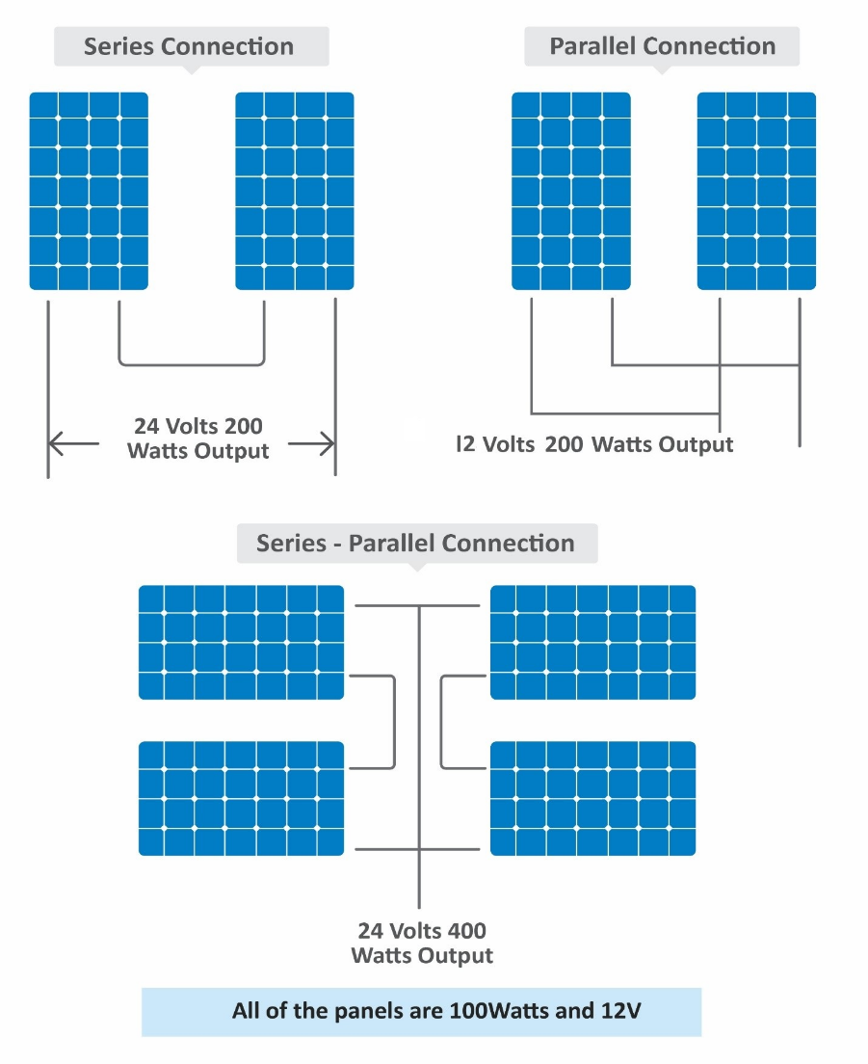
SOLAR MODULE AND ARRAY
As shown in the adjacent figure, series and parallel connection of various panel of same capacity of 100 Watts and 12 V is shown.
When two panels are used the power output is always 200 W, however the difference between series and parallel connection results in the change in output voltage hence varying the system voltage at which power generation takes place.
Figure 3: Series and Parallel Connection of Solar Panels (EPEVER, 2019)

Slide 14
SOLAR MODULE AND ARRAY
In series connection, two panel results in system voltage of 24 V where as in parallel connection, the output voltage is 12 V.
Consequently, the current rating of the system also changes which effects the wire sizing as well.
In series connection the current rating is fixed while the voltage rating of the system is increase while in parallel connection, the voltage rating is fixed while the current rating is increased for the system.

Slide 15
TYPES OF SOLAR CELLS
There are three types of solar cells
Monocrystalline PV Cell
Polycrystalline PV Cell
Amorphous PV Cell

Slide 16
TYPES OF PV CELL
Monocrystalline PV Cell
Monocrystalline silicon is produced from polycrystalline silicon in the sophisticated and expensive process.
Due to which the monocrystalline cells are highly efficient but expensive.
It has appearance of uniform blue color.
These modules have efficiency in the range of 15% to 18% and are generally used in medium and large sized plants (Singal, 2011).

Slide 17
TYPES OF PV CELL
Polycrystalline PV Cell
Polycrystalline PV cells are easier and cheaper to manufacture than the monocrystalline PV cells, but are less efficient.
Polycrystalline silicon essentially consists of small grains of monocrystalline silicon.
It has appearance of irregular blue color.
It has efficiency in the range of 12% to 14% (Singal, 2011).

Slide 18
TYPES OF PV CELL
Amorphous PV Cell
In amorphous silicon (a-Si), the silicon atoms are much less ordered than in the crystalline forms described above.
Amorphous silicon cells are cheaper to produce than those made from crystalline silicon.
It is also better absorber of light, so thinner (therefore cheaper) films can be used.
The manufacturing process operates at lower temperature, hence less energy is required.
However, a-Si cells are less efficient. The efficiency achieved is around 5% to 8% (Singal, 2011).

Slide 19
CHARACTERISTICS OF SOLAR CELLS
I-V and P-V characteristics at varying Irradiance levels
  At constant cell temperature, with the increase in Irradiance, the current produced is increased significantly, whereas the voltage produced is also increased by slight amount. Due to which, the increase in irradiance results in increase in power produced by the solar cell. This is represented in Figure 4.
I-V and P-V characteristics at varying temperature
  At constant value of Irradiance incident on the solar cell, with the change in cell temperature, the voltage drop is significant as compared to the increase in current. Increased temperature increases the heat which causes electrical resistance to the flow of electrons. Hence, increase in cell temperature results in decrease in power produced, at constant Irradiance. The figure 5 illustrates the characteristics at varying temperature

Slide 20
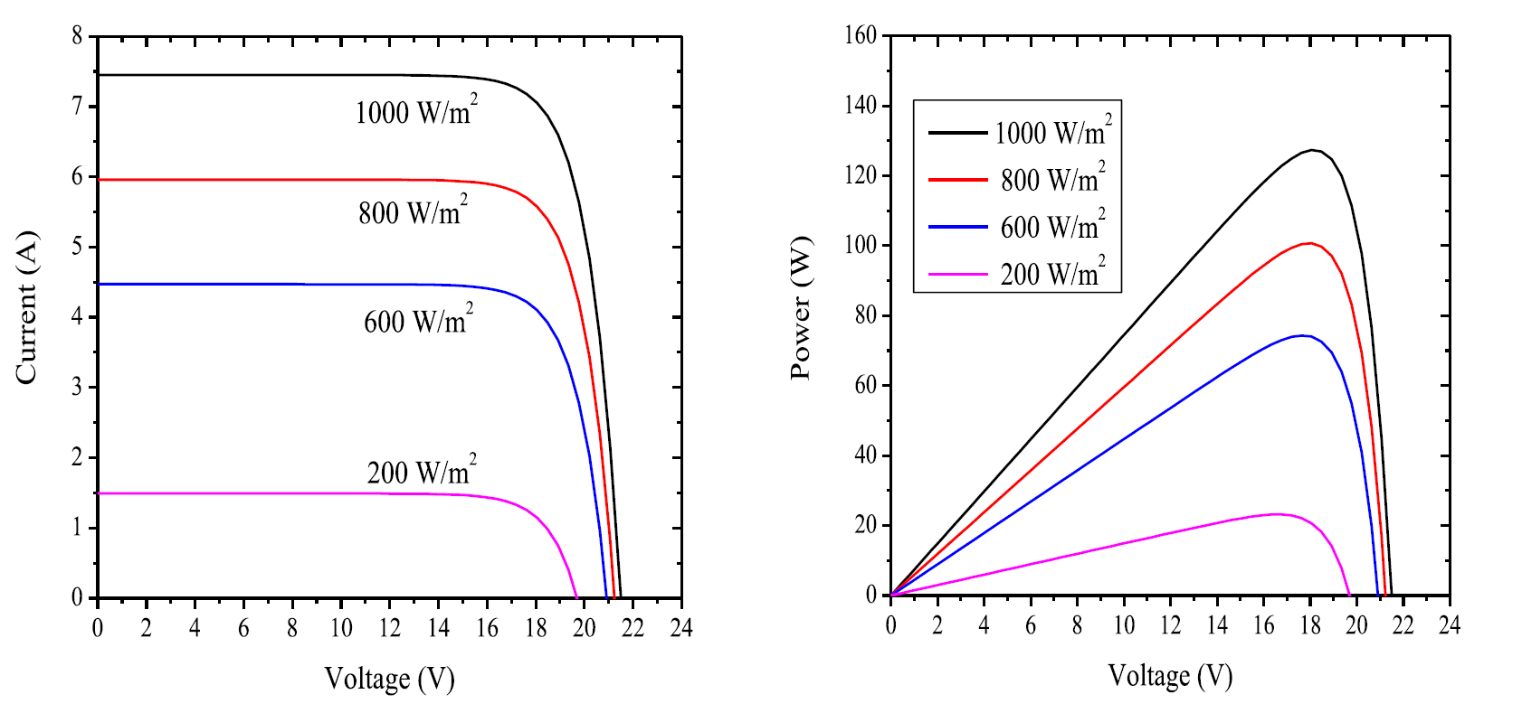
CHARACTERISTICS OF SOLAR CELLS
Figure 4: I-V and P-V characteristics at varying Irradiance (Saharia, 2014)

Slide 21
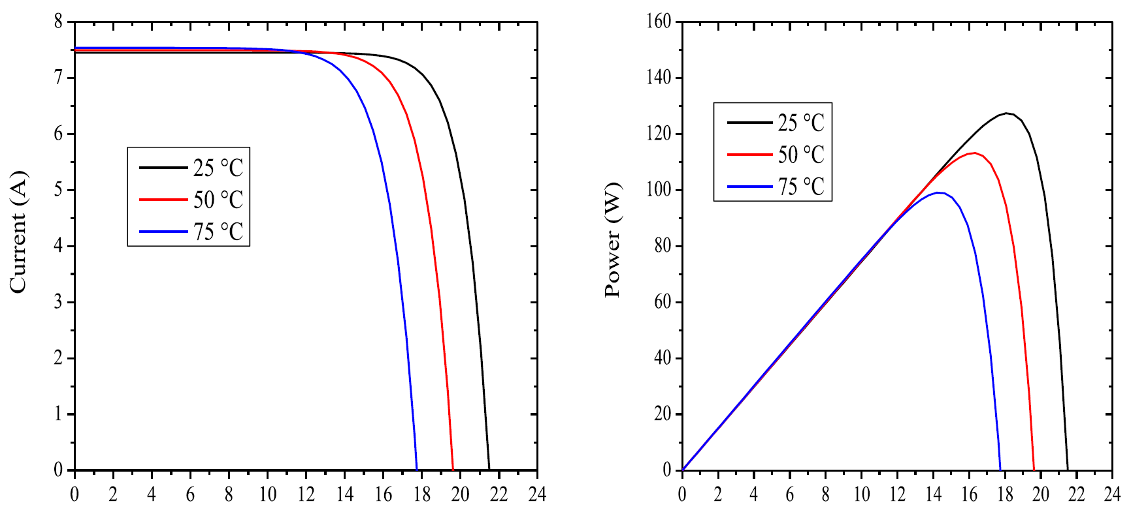
CHARACTERISTICS OF SOLAR CELLS
Figure 5: I-V and P-V Characteristics at varying temperature (Saharia, 2014)

Slide 22
SOLAR PV TERMINOLOGIES
Open circuit voltage
Short circuit current
Voltage at maximum power
Fill factor
Efficiency

Slide 23
SOLAR PV TERMINOLOGIES
Open circuit voltage
  It is the maximum voltage generated by the cell under given conditions of light and temperature. V_{oc} is the voltage when the load is open circuited, ie. the output current is zero. The output power at this point is again essentially zero.
Short circuit current
  It is the maximum current (in A or mA) produced by the cell under given conditions of irradiance and surrounding temperature. I_{sc} is the current when the load is short circuited. The output power at this point is zero.

Slide 24
SOLAR PV TERMINOLOGIES
Voltage at maximum power
  The voltage that results in maximum power output of a solar cell is called voltage at maximum power. V_{mp} is also called “rated” voltage of the cell
Current at maximum power
  The current that results in maximum power output of a solar cell is called current at maximum power. I_{mp} is also called “rated” current of the cell.

Slide 25
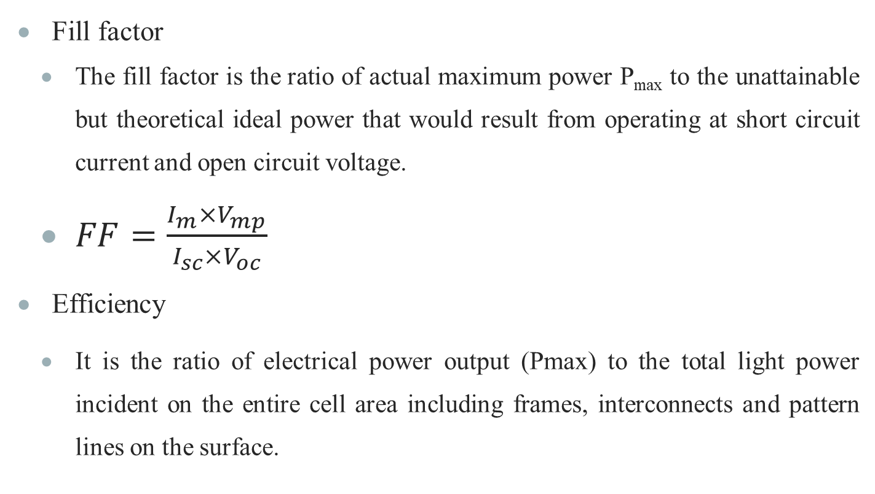
SOLAR PV TERMINOLOGIES

Slide 26
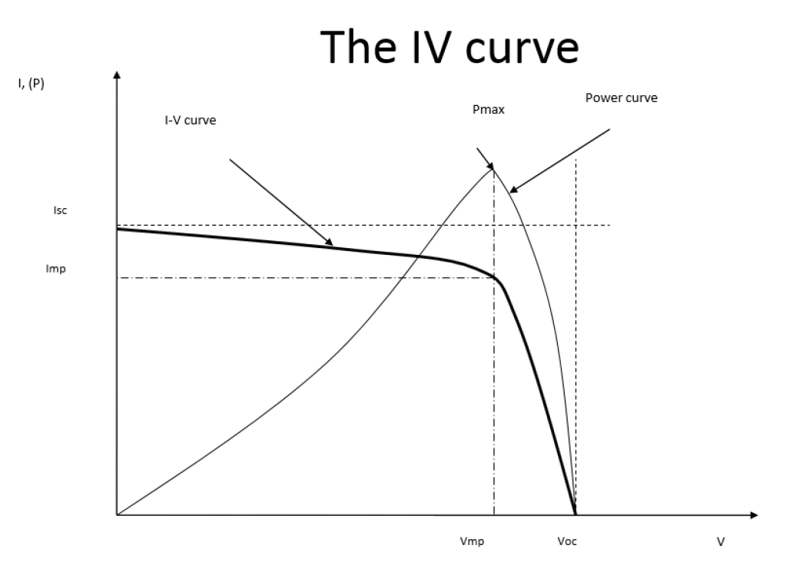
SOLAR PV TERMINOLOGIES
Figure 6: I-V characteristics of typical silicon PV cell under standard test conditions

Slide 27
FACTORS EFFECTING DURABILITY OF SOLAR CELLS
Location
Maintenance
Soiling
Environment
Solar Cell Degradation
Interconnections Effects of Solar Cell/Module
Mismatch Effect
Hot Spot Heating

Slide 28
FACTORS EFFECTING DURABILITY OF SOLAR CELLS
Location
Should be kept away from location that present the threat of damage from trees or falling rocks
Shadows should be avoided during peak sunlight hours
At output decrease is significant due to shading and can also cause hot spot heating, it is desirable to clear the surrounding area such that there is no shade on the panel.

Slide 29
FACTORS EFFECTING DURABILITY OF SOLAR CELLS
Maintenance
Regular maintenance is required
Basic maintenance such as washing dust and bird toppings should be done regularly
Soiling
Airborne particles settle on the glass surface of the module.
The deposition of such particles on solar pv panel restrict the light reaching the module hence reducing the power produced.
Module installed in wet climate results in regular washing of dirt through rain as compared to that of the dry climate

Slide 30
FACTORS EFFECTING DURABILITY OF SOLAR CELLS
Environment
Extreme weather conditions can compromise the solar panel’s durability
Weather condition such as violent storms can cause damage to solar pv panel.

Slide 31
MISMATCH EFFECT
When in a module the electrical parameter of a cell is altered from the rest of the cells, this results in mismatch effect.
Mismatch effect is mostly caused by varying of short circuit current or open circuit voltage of a cell even though any electrical parameters can cause the mismatch effect.
Mismatch effect results in power loss

Slide 32
HOT SPOT HEATING
Hot spot heating occurs when one of the cell in a module doesnot produce current due to either malfunctioning or shading
During such case, this results in power dissipation in the cell, due to which the cell overheats and results in formation of hot spots.
The shaded cell acts like a resistor, which rather than produce current dissipates the power produced and converts it into heat.

Slide 33
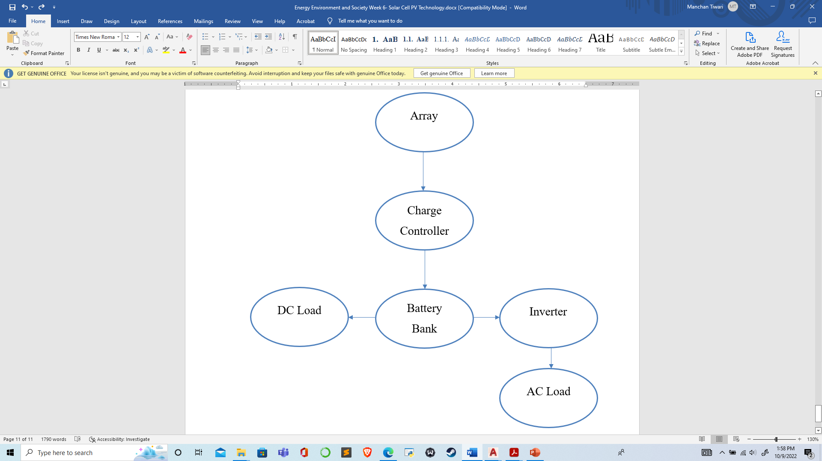
SOLAR PV SYSTEMS
A typical solar PV system comprises of solar panels/array used to power a given load which can be village load in a community or a specific load for a system such as water pump used for irrigation.
The major components of a typical solar PV system are DC-AC power inverter, battery bank, system and battery controller (charge controller), auxiliary energy sources and sometimes specified electrical load.
Figure 7: A typical solar PV system

Slide 34
SOLAR PV SYSTEMS
Some of the types of PV systems are:
Grid Connected Photovoltaic systems
Stand Alone Photovoltaic System
Grid Connected Photovoltaic Systems
These type of PV systems are interconnected with electric utility grid and operates parallelly.
A power conditioning unit is the major component of such system which converts the DC power produced by the PV array into AC power consistent with the requirements of the electric grid.

Slide 35
SOLAR PV SYSTEMS
Stand-Alone Photovoltaic Systems
This type of system operates independent of the electric utility grid and are designated to supply power to specific AC or DC load.
A simplest form of stand-alone PV systems is when the power produced from an array is directly used to operate DC load.
In such case, due to absence of storage device such as battery, the load can only be operated during sunshine hours.
However, many stand-alone PV systems use battery for storage of the power to operate the load outside of sunshine hours (Sharma & Hasan, 2009).

Slide 36
SOLAR PV WATER PUMPING SYSTEMS
Uses solar PV to produce DC current
Use to drive either DC water pump or use inverter to convert the DC to AC and power AC water pump
Common in rural Nepal, to pump water from river located far from the village to the village for either domestic purpose or for irrigation purpose.
The sizing of the pump is based on the water requirement for the village, the height through which the water is to be pumped.
The flow rate of pump is decided on the basis of water requirement for village or for the farm and on the basis of design peak sun value for the region.
Detail design to be discussed in next chapter.

Slide 37
ADVANTAGES OF SOLAR PV
Absence of moving parts
Direct conversion of light to electricity at room temperatures
Does not require constant attention and can function on its own
Low maintenance cost
No environmental pollution
Has very long life and is highly reliable
No cost of fuel
No starting time required
Solar PV system can be of varying size, used to operate small load, power a community of produce power in MW for a country
Limitations of Solar PV
High initial cost
Insolation is unreliable due to which storage devices are required
Requires very large land areas

Slide 38
SOLAR PV SYSTEM DESIGN
Steps of Design
  Load Calculation
  Module/Array Sizing
  Battery Sizing
  Charge Regulator Sizing
  Cable Sizing
  Inverter Sizing
  DC-DC Converter Sizing

Slide 39
LOAD CALCULATION
The design of a solar PV system begins with the calculation of energy consumed by the installed load in one day. Inaccurate calculation of the load may lead to system failure or high loss of load probability. Generally, people want more electricity, but there is always a tradeoff between what people want and what they actually are willing to pay for. There could be two approaches in calculating load:
  The fund available is fixed, and the load size is determined based on available fund;
  The fund is not a problem, and the load is determined based on user’s requirement.

Slide 40
LOAD CALCULATION
The first step in load calculation is to prepare a table of daily consumption of electrical energy by various appliances to be powered by the solar PV. By load we will refer to the energy consumed by particular appliances per day. There are few concerns that the designers need to check before preparing the load table.
  Accurate Load Knowledge
  Load Efficiency
  Load Profile
  AC or DC Load
  Apparent and Real Power Consideration

Slide 41
LOAD CALCULATION
Accurate load knowledge – The entire solar PV system design will be based on the size of the load. If the information is inaccurate, the initial cost will be too high or the battery and array/module could be too small and the system will eventually fail.
Load efficiency – Improving load efficiency is the quickest way to reduce PV power system cost. A more efficient load device may even be slightly more expensive than an existing or conventional load device (for example CFL against incandescent lamps).

Slide 42
LOAD CALCULATION
Load profile throughout the year – An average value (daily, weekly, monthly or yearly average) for the load is useful for rough system sizing, but seasonal variation of the load throughout the year will influence the choice of tilt angle for the array and the final array and battery size. The insolation on a flat surface varies greatly, with the least during the winter and the greatest during the summer. Now if the load demand is small in winter and large in summer, as with air cooling loads or refrigerators or water pumping for irrigation as well as drinking purpose, then tilting the array in optimum angle for summer days will give an insolation profile that best matches the load profile

Slide 43
LOAD CALCULATION
AC or DC – As far as possible DC loads should be preferred over AC loads to minimize the cost and avoid use of inverters. Use of inverters add the cost, reduces system reliability and introduce power loss.
Apparent and real power consideration – For sizing purpose, the real power in watts consumed in the load is the value needed. For wiring design and inverter choice, the apparent power will be important because the current that will be flowing in the wires into a heavily inductive load will be greater than what would be calculated by just dividing watts by volts. Also the inverter must be chosen so that it can handle the expected apparent power (or the power factor) of the loads.

Slide 44
LOAD CALCULATION
The load (or the energy consumed) is generally expressed in Watt-hours (Wh). But for more accurate sizing of the array and battery, sometimes the load is expressed in Amepre-hours (Ah). If Wh is known, Ah can be calculated as :
Ah = Wh / system voltage
For example if a 12V DC operated 10 Watt lamp is turned on for 5 hours, then the total load is:
Wh = 10 W x 5 hours = 50 Wh.
This value expressed in Ah would be 50/12 = 4.17 Ah.

Slide 45
LOAD CALCULATION
Now if a color television with 60 W power consumption is operated from 220 V AC for 5 hours, then the Wh value would be 60 W x 5 hours = 300 Wh and in Ah it would be 300/220 = 1.36 Ah.

Slide 46
REFERENCES
Boyle, G. (2013). Renewable Energy Power For A Sustainable Future (Vol. Third Edition). Oxford: Oxford University Press.
EPEVER. (2019, September 19). Retrieved October 9, 2022, from https://blog.epever.com/what-is-a-series-or-parallel-connection/
FSEC. (2022). Retrieved October 9, 2022, from Florida's Premier Energy Research Center at the University of Central Florida: https://energyresearch.ucf.edu/consumer/solar-technologies/solar-electricity-basics/cells-modules-panels-and-arrays/
Kalogirou, S. A. (2014). Solar Energy Engineering Processes and Systems (Second Edition ed.).
Koirala, D. R. (2019). Principals of Engineering Thermodynamics and Heat Transfer. Kathmandu: Shree Chandeswori Publication Pvt. Ltd. .
PennState. (2022). Retrieved October 8, 2022, from Pennsylvania State University: https://www.e-education.psu.edu/eme811/node/685

Slide 47
REFERENCES
Ren, J. (Ed.). (2020). Renewable Energy Driven Future: Technologies, Modelling, Applications, Sustainability and Policies. Academic Press. doi:https://doi.org/10.1016/C2019-0-01298-8
S. Hasan, S., & Sharma, D. (2009). Non-Conventional Energy Resources. Delhi: S. K. Kataria and Sons.
Saharia, B. J. (2014). A comparative study on converter topologies for maximum power point tracking application in photovoltaic generation. Journal of Renewable and Sustainable Energy 6. doi:10.1063/1.4900579
Sharma, D., & Hasan, S. (2009). Non-Conventional Energy Sources (Second Edition ed.). Delhi: S.K. Kataria and Sons.
Singal, R. (2011). Non-Conventional Energy Resources (Vol. Third Edition). Delhi: S. K. Kataria and Sons.
WECS. (2010). Energy Sector Synopsis Report. Kathmandu, Nepal: Government of Nepal, Water and Energy Commission Secretariat.

Slide 48
THANK YOU

