Slide 1
Trauma and Trauma Therapy
Lecture 4
Signs and Symptoms of Trauma
Lecturer: Susan Gitau (PhD)

Slide 2
Introduction
What is Trauma?
Trauma is a condition that occurs when an event or circumstance overwhelms you. You may respond with feelings of horror, fear, helplessness, or stress, which inhibit your ability to cope with the event (American Psychiatric Association, 2013).

Slide 3
Traumatic Experiences
A variety of experiences can be traumatic, including:
Emotional, physical, or sexual abuse
Neglect
Being in a war zone
Losing a close friend or family member
Being in an accident or a natural disaster
Being in abusive relationships

Slide 4
Expected Learning Outcomes
At the end of this lecture, you will be able to:
Identify signs and symptoms of trauma
Differentiate between trauma and PTSD
Discuss the impact of trauma
Explain the cognitive, behavioral and physical signs of unhealed trauma

Slide 5
Signs of Trauma & PTSD
Post-traumatic stress disorder, known as PTSD, is a serious mental condition related to trauma. PTSD is a disorder that some people who have been through traumatic experiences have.
This condition can be acquired either by witnessing scarring incidences or by actually experiencing them.
PTSD condition is also more common than what most people believe it to be.

Slide 6
Trauma and PTSD
Certain life experiences make it more likely for people to develop this condition. Likewise, certain uncontrollable factors increase the chances of a person developing PTSD. The following are some of the risk factors:
Gender: Men are more likely to experience trauma in the workplace or through accidents. Women, on the other hand, are more likely to be exposed to child abuse or domestic violence.

Slide 7
Trauma and PTSD
Career: A person’s career can directly affect the likelihood of PTSD. Those that work in high-risk environments, for example, are more prone to accidents that can lead to PTSD.
Exposure: Experiencing an accident is the most common cause of PTSD. Witnessing a traumatic event as a bystander can also cause the condition to develop in some people

Slide 8
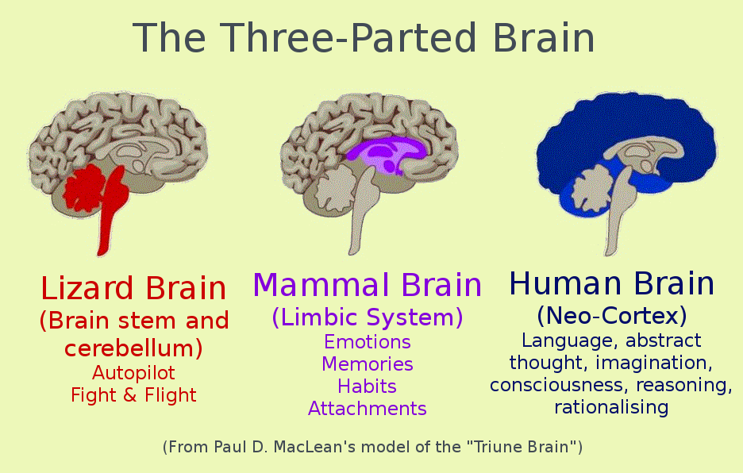
Our Brain and Trauma

Slide 9
How PTSD Interferes With Life
Academic and professional impact
The symptoms of PTSD can get in the way of school and work. Trouble concentrating, for example, can reduce a person’s productivity. Anxiety attacks can even cause a person to miss days. A person’s professional or academic life can suffer much as a result.

Slide 10
PTSD Impact
Relationships
PTSD can cause many negative changes in a person. It can put a strain on the personal relationships that they have. A study shows that people with PTSD are more likely to have marriage problems than those that do not.

Slide 11
PTSD Impact
Having memories that intrude: One of the classic signs of PTSD is the presence of intrusive memories. It is also the factor that’s most frequently shown in movies and TV. These memories return whether the person actively thinks about them or not.
The surge of traumatizing memories can cause increased stress, anxiety, guilt, and other negative emotions.

Slide 12
Impact of PTSD
Physical and mental health
PTSD causes an increased amount of stress in a person. It can directly impact one’s physical and mental health.
Many physical diseases and mental disorders are directly linked with elevated stress levels.

Slide 13
Impact of PTSD
Negative thoughts and mood
PTSD can also create a multitude of adverse effects on a person’s thoughts and mood.
The classic symptoms include feelings of hopelessness, detachment, self-blame, guilt, and more.
Some clients even report memory loss related to the traumatic event.
The condition can also temporarily stunt emotions.
Instances of this include difficulties in feeling joy, lack of interest in activities, and emotional numbness, among others.

Slide 14
Other Effects
Shifts in reactions: These are more commonly known to psychologists and therapists as arousal symptoms. Arousal symptoms lead to changes in behavior and shifts in how a person reacts.
Others: There are other signs and symptoms that some people with PTSD may exhibit. Some of these include the following:
Feelings of shame and guilt
Nightmares and dreams associated with the event
Aggression (seen in some clients)
Suicidal thoughts, feeling trapped

Slide 15
Causes Developmental Trauma
This is also referred to as adverse childhood experiences and can begin as early as the period after conception,during birth and pre verbal stage and abrupt separation from parents or primary caregivers.
Sources : Neglect, all forms of abuse against children, domestic violence, dysfunction in family systems, harsh environment and sometimes bullying in school.

Slide 16
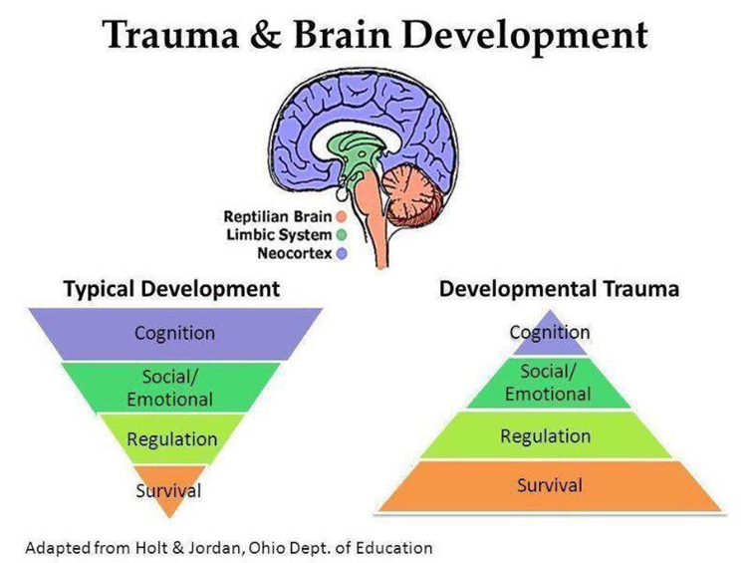
Developmental Trauma

Slide 17
Key Signs & Symptoms of Trauma and PTSD
1. Avoidance: People with PTSD tend to avoid things related to the source of the trauma.
These things can include places, objects, people, or memories. Exposure to these things can cause relapses.
More importantly, this involves a detachment of the person.

Slide 18
2. Cognitive
Each person who is battling trauma will see different symptoms. However, a loss of cognitive functions is one clear sign. You may experience nightmares or flashbacks that take you back to the traumatic event.
Furthermore, you may struggle with mood swings, as well as disorientation and confusion, which can make it challenging to perform daily tasks.

Slide 19
3. Emotional
You may also struggle with emotional difficulties, including:
Overwhelming fears
Depression
Guilt or shame
Anxiety
Anger
Irritability
Shock

Slide 20
4. Behavioral
Trauma can also lead to behavioral idiosyncrasies. For instance, you may avoid places or activities that make you think about the event.
You may withdraw from your friendships and become uninterested in the activities that you enjoyed in the past.
Addictions and Obsessions

Slide 21
5. Physical
Those that have experienced a traumatic event may be startled easily, which can cause heart problems and edginess.
You may also be extremely alert because you are constantly looking for the next potential danger.
Furthermore, you may be unable to sleep through the night, leading to excessive fatigue or feeling exhausted.

Slide 22
Conclusion
In this lecture we have identified signs and symptoms of trauma, compared trauma and PTSD and explained the cognitive, behavioral and physical signs of unhealed trauma as well as linking the experience of trauma and the brain.
It is important to note not all people who experience traumatic incidences develop PTSD, therefore adequate screening is encouraged.
In our followup lecture,we shall cover the effects of trauma.

Slide 23
References
Acevedo, V., & Hernandez-Wolfe, P. (2014). Vicarious resilience: An exploration of teachers and children's resilience in highly challenging social contexts. . Journal of Aggression, Maltreatment & Trauma, 23(5), 473–493.
Bartlett, J., Barto, B., Griffin, J., Fraser , J., Hodgdon, H., & Bodian, R. (2016). Trauma-informed care in the Massachusetts child trauma project. Child Maltreatment, 21(2), 101–112.
Farley , M., & Patsalides , B. (2001). Physical symptoms, posttraumatic stress disorder, and healthcare utilization of women with and without childhood physical and sexual abuse. Farley M , Patsalides BM . Physical symptoms, posttraumatic stress disorder, and healthcare utilization of women with and without childhood physical and sexual abuse . Psychol Rep 2001 ; 89 : 595 – 606, 89 (1), 595 – 606.
Wiest-Stevenson, C., & Lee, C. (2016). Trauma-informed schools. Journal of Evidence-Informed Social Work, 13(5), 498–503.
https://www.youtube.com/watch?v=QNUuMvSdH3M

