Slide 1
Trauma and Trauma Therapy
Lecture 6
Childhood Trauma
Lecturer: Susan Gitau (PhD)

Slide 2


Outline
A
Introduction
Definition
Sources of Childhood Trauma
Impact of Childhood Trauma
Coping

Slide 3
Introduction
Childhood trauma is the experience of an event by a child that is emotionally painful or distressful, which often results in lasting serious mental and physical effects. Childhood trauma can occur when a child witnesses or experiences overwhelming negative events in childhood that renders them vulnerable in coping with future stress and life challenges.

Slide 4
Expected Learning Outcomes
Define childhood trauma
Identify sources of childhood trauma
Explain the impact of childhood trauma
Discuss ways of coping with childhood trauma

Slide 5
Definition
Childhood trauma occurs when a child experiences unexpected stressful events with a variety of responses, such as intense and ongoing emotional upset, depressive symptoms or anxiety, behavioral changes, difficulties with self-regulation, problems relating to others or forming attachments, regression or loss of previously acquired skills, attention and academic difficulties, nightmares, difficulty sleeping and eating, and physical symptoms, such as aches and pains. These responses interfere with daily life of a child.

Slide 6
Types of Trauma
Physical abuse
Emotional abuse
Psychological abuse
Neglect
Sexual abuse

Slide 7
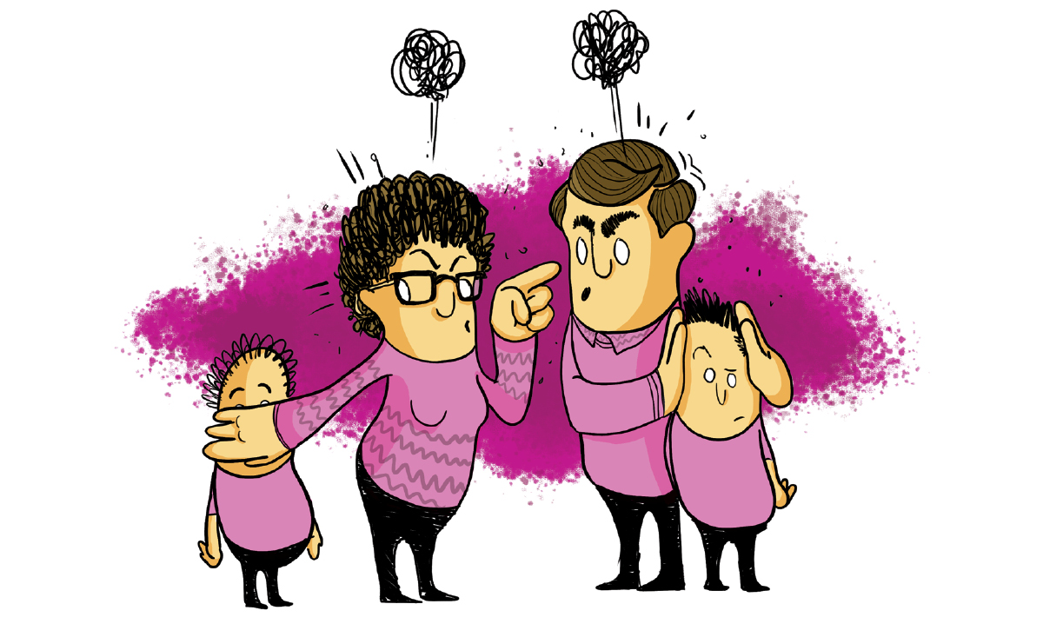
Domestic Violence

Slide 8
Sexual Violence
Rape,
Child marriages,
Forced prostitution,
Sexual slavery,
Sexual trafficking
Sexual exploitation
Inappropriate touch
Sexual harassment etc

Slide 9
Impact of Childhood Trauma
Hypervigilance (Hyper Stress Caused By Triggers)
Re-Experiencing (Flashbacks/Intrusive Memories)
Avoidance (Denial, Numbing, Shock)
Recurrent negative thoughts and emotions (major cause of depression and suicide).

Slide 10
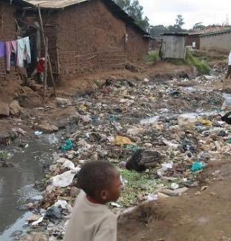
Developmental Trauma
Signs and Symptoms
Signs and Symptoms
Extreme Poverty
Altered Brain
Slow speech development
Attention and concentration deficits
Emotional dysregulation
Irritability
Memory problems
Regression
Poor life skills
Separation anxiety
Mistrust
Drug dependence
Physical pains
Withdrawal

Slide 11
Developmental Trauma: Intervention
Identifying children’s responses to trauma and loss reminders is an important tool for understanding how and why children’s distress, behavior, and functioning often fluctuate over time. Trauma and loss reminders can reverberate within families, among friends, in schools, and across communities in ways that can powerfully influence the ability of children, families, and communities to recover. Addressing trauma and loss reminders is critical to enhancing ongoing adjustment.

Slide 12
Trauma Risk Factors
Social Cultural
Severity of the event
Support
Caregiver’s response
Past traumas
Family and community factors
Proximity

Slide 13
Intervention
Different types of interventions have been proven to be effective for improving mental health in traumatized children. Particularly cognitive behaviour therapy (CBT) has emerged as one of the most effective and widely used treatments.
More evidence, however, is required in order to establish the effectiveness of different therapies in the longer term, and for comparability of different types of therapy, such as CBT, play therapy, eye movement desensitization and reprocessing (EMDR), art therapy, and psycho dynamic therapy (King, 2016).

Slide 14
Expressive Therapy
Creative arts therapy is a widespread approach in the treatment of child post trauma disorders. It includes different modalities of art, music, dance and drama in combination with other approaches to psychotherapy and counselling such as psycho dynamic, cognitive, developmental, systems, and narrative therapy. When using creative arts in this way as an adjunct, the key is to understand the various treatment goals and to carefully select creative arts activities that can support this process

Slide 15
Benefits of Expressive Therapies
Emotional relief and relaxation
Self awareness and mindfulness
Peer support
Sense of connection
Easy to communicate
Making sense

Slide 16
Who can do Expressive Therapy?
Creative arts in this way as an adjunct, the key is to understand the various treatment goals and to carefully select creative arts activities that can support this process.
Mental health professionals can be offered training in applying creative arts activities in psychotherapy, but always it is important to avoid challenging ethical boundaries by going beyond what someone was trained to do

Slide 17
Conclusion
In this lecture, we have defined childhood trauma, identified sources of childhood trauma, explained the impact of childhood trauma and discuss ways of coping with childhood trauma. In our follow up session, we shall learn more about theories of trauma counseling.

Slide 18
References
American Psychiatric Association (APA). (2013). Diagnostic and statistical manual of mental disorders (DSM-5®). USA: American Psychiatric Pub. doi:10.1176/appi.books.9780890425596.
Downy, C. & Crummy, A. The impact of childhood trauma on children's well-being and adult behavior. European Journal of Trauma & dissociation Volume 6, Issue 1, February 2022,100237
The ACT art therapy for PTSD interventions can be found here:Backos, A. & Mazzeo, C. (2017). Group therapy and PTSD: Acceptance and commitment therapy groups with Vietnam veterans with PTSD. In Howie (Ed.) Art therapy with military populations: History, innovations and applications (pp. 165–176). New York, NY: Routledge.
Hass-Cohen, N., Findlay, J. C., Carr, R., &; Vanderlan, J, (2014). Check, change what you need to change and/or keep what you want: Art therapy neurobiological-based Art Therapy & PTSD trauma protocol. Art Therapy: Journal of the American Art Therapy Association 31(2),69-78.
King, J. L. (2016). Art therapy: A brain-based profession. In D. E. Gussak & M. L. Rosal (Eds.), The Wiley handbook of art therapy (pp. 77–89). Wiley Blackwell.

Slide 19
Thank you
Susan Gitau
sgitau@anu.ac.ke

