Slide 1
Trauma and Trauma Therapy Lecture 12 Mindfulness and Mindful Self Compassion in Trauma Counseling Lecturer: Susan Gitau (PhD)

Slide 2
Introduction
Therapists are always engaged in alleviating human suffering and trauma is one of the most challenging mental suffering they have to deal with. Mindfulness is a deceptively simple way relating to experience and has been used to lessen the string of life suffering, especially those that are self imposed. Clients in therapy have an innate desire to feel better than they are feeling at the moment. Mindful self compassion is an experiment on self discovery and self transformation. In this lecture, we shall learn how to practically apply mindfulness mindful and self compassion in trauma therapy.

Slide 3
Expected Learning Outcomes
At the end of this lecture, you will be able to:
Define mindfulness and mindful self compassion
Explain mindfulness and mindful self compassion
Practice mindfulness and mindful self compassion

Slide 4
Definition
Mindfulness is a mental state achieved by focusing one's awareness on the present moment, while calmly, acknowledging and accepting one's feelings, thoughts, and bodily sensations. This is awareness is used as a therapeutic technique that allows a person to stay and experience moment to moment sensations and learn how this joins with own feelings and actions. Jon Kabat Zinn (1994) says “ Mindfulness is the awareness that emerges through paying attention on purpose, in the present moment, and non judgmentally to the unfolding of experience moment to moment” Chris Germer (2013) defined mindfulness as awareness of present moment, with acceptance” He also defined compassion as the awareness of individual suffering and the wish and desire to alleviate the same suffering. Self compassion as the care we give to ourselves as we would give a dear friend who is suffering (Germer, 2009).

Slide 5
Mindfulness and Trauma Therapy
When trauma destabilizes an individual’s life, this introduces long term suffering. Avoidance is one of the responses to trauma yet it only worsens the suffering, therefore calling for paying attention to one’s awareness and experiences; intentionally with a non judgemental attitude (Ivzan & Lomas, 2016).

Slide 6
Some of the guiding practice concepts of mindfulness include:
Nonconceptual - mindfulness is embodied, intuitive awareness, disentangled from thought processes
Non verbal - the experience of mindfulness cannot be captured in words because awareness occurs before words arise in the mind
Present centered - Mindfulness is always in the present moment to avoid full immersion in our thoughts that reinforce suffering

Slide 7
Non-judgemental - Allowing what one feels, acts and thinks in the moment of suffering without judgement
Participatory - Allowing the body and mind to interact in an intimate yet unencumbered manner
Liberating - Every moment of mindful awareness provides a bit of freedom from conditional suffering, a little space around one’s discomfort. The end result is wisdom and understanding of one’s suffering ( Germar, Siegel & Fulton, 2013).

Slide 8
Mindful Self Compassion (MSC) and Trauma Therapy
The aim of MSC is to help the traumatized person know when they are suffering and to respond with kindness and understanding. Sometimes the most skillful way to respond to suffering is to take a hot cup of chocolate, watch a movie, take a walk rather than ruminating on past pain.

Slide 9
Guiding Practice Principles of MSC
Self - Kindness vs Self -judgement
With self compassion, one treats, care, understanding and support, just as we would treat a friend one cared about. Most people treat themselves more harshly than they would treat a dear friend but MSC comes in to turn the same self kindness to self without self judgement. This is an action element to alleviate self suffering.

Slide 10
Common Humanity vs. Isolation
With MSC, we see suffering as a universal experience rather than personal. This creates a sense of belonging and realizing that we are reacting to an abnormal experience normally. Trauma experience for individuals who have no prior knowledge that this happens to other people may feel quite abnormal and isolation results. With MSC joining others in suffering creates inner strength and sense of hope (Germer & Neff, 2022).

Slide 11
Mindfulness vs Over -identification
The first step is for the traumatized person to know they are suffering. Mindfulness makes it possible for a traumatized person to face the pain, embrace the pain and just be with the pain as it is rather than manipulate it. Therefore, mindfulness, self compassion and common humanity help us to embrace life with a sense of loving connected presence, our presence making our experiences radically transformed.

Slide 12
Mindfulness Practice
Introduction
In this mindful awareness practice, you will visualize a wheel; and this wheel has a central hub, an outer rim, and four quadrants in between. In this metaphor of how the mind is structured, the hub represents our experience of awareness, and the quadrants represent anything we can be aware of, including sensory awareness (i.e., what we see, hear, smell, taste and touch), bodily awareness (i.e., what we can sense physically), mental activities (such as emotions, thoughts, memories, and urges), and our sense of connection to things outside ourselves (such as other people and other things).

Slide 13
The purpose of the practice is to cultivate a full sense of connection and awareness to both yourself and the world around you (Baer, R. A. 2003; Alberts; Schneider., & Martijn., 2012).
NB. The subtitles (bolded text) in Part 1 do not need to be read out as part of the meditation - these subtitles are in place to give the practice structures. Practitioners need only read the text in italics.

Slide 14
Part 1: Wheel of Awareness Meditation
1. Get into position
To begin, find a comfortable meditation position. Either sitting on a cushion on the floor, or in a chair. Allow your
spine to be straight and long, and let your shoulders drop, relaxed. Rest your hands in your lap, and gently close your eyes.

Slide 15
2. Breath awareness
Become aware of the rhythm of your breathing. There’s no need to change your breathing in any way, simply notice it exactly as it is.

Slide 16
3. Visualize the wheel
Now, bring to mind the image of a wheel. This wheel has a center, known as the “hub”, and four sections, or quadrants, surrounding this hub. There is a rim that encompasses everything - the four quadrants and the hub. For each part of this practice, you will zoom in on one portion of the wheel, and become aware of its contents with my guidance.

Slide 17
4. First quadrant: connect to the five senses
I’d like to invite you to first turn your attention to the top, left quadrant, which houses your five senses. Zoom in on this area of your wheel by engaging your sense of hearing… what can you hear? And now your sense of touch…
what can you feel? And now your sense of smell, and taste… what can you notice? Now gently open your eyes for a moment… what can you see?

Slide 18
5. Second quadrant: connect to bodily sensations
Good, and now close your eyes again, and bring your wheel back into your mind’s eye. Take a deep slow breath here.
Now I’d like to invite you to turn your attention to the top, right quadrant, which houses your “sixth sense”, which is the inner sensations of your own body. Take a few moments to scan through your body from head to toe, becoming aware of any and all physical sensations throughout. Tingling, heat, tension, numbness. Take your time to move through each body group. Just noticing, being curious, just observing.

Slide 19
6. Third quadrant: connect to mental activities
Good, let’s take another nice deep breath here. And next, I’d like to invite you to turn your attention to the bottom, left quadrant, which houses the activities of your mind itself, including your emotions, thoughts, memories, hopes, beliefs, dreams, attitudes, and intentions. First, simply become aware of everything that is entering your mind at this moment. Welcoming this mental activity into your awareness. What thoughts and feelings are showing up
right now? [30 second pause]. Next, begin to examine how these internal experiences arise and pass… do they
come up suddenly or gradually? Do they stay constant, or fade in and out? Are there gaps between the different mental activities, or do these exist as one long stream of consciousness?

Slide 20
7. Hub: awareness of awareness
Good, let’s take another nice deep breath here. And we’ll now bring our attention to the center of the wheel, the hub, which is where your awareness stems from. The hub is the ‘you’ that has noticed everything so far in this practice - the part of you that is observing, listening, looking, focusing, sensing. Take some time here, as cultivating this “awareness of awareness” takes practice.

Slide 21
8. Fourth quadrant: connect to others
Good, let’s take another deep, slow breath here. And then turn your attention to the bottom, right quadrant of your wheel, which houses your sense of connection to the outside world. First, notice the sense of connection to the people physically closest to you right now [15-second pause]. Then, expand this sense of connection to people further away [15-second pause]. And then tap into your sense of connection to your loved ones, wherever they may be right now [15-second pause]. Then, widen your sense of connection step-by-step to include those who live in your neighborhood, city, country, continent, in the whole world, and finally to all living beings on earth.

Slide 22
9. Ground yourself
As the meditation comes to an end, simply bring your attention back to your breath, as you did at the beginning of the practice. You might like to take a few deep, slow breaths here, to ground yourself back into this moment. Then, when you are ready, gently open the eyes.

Slide 23
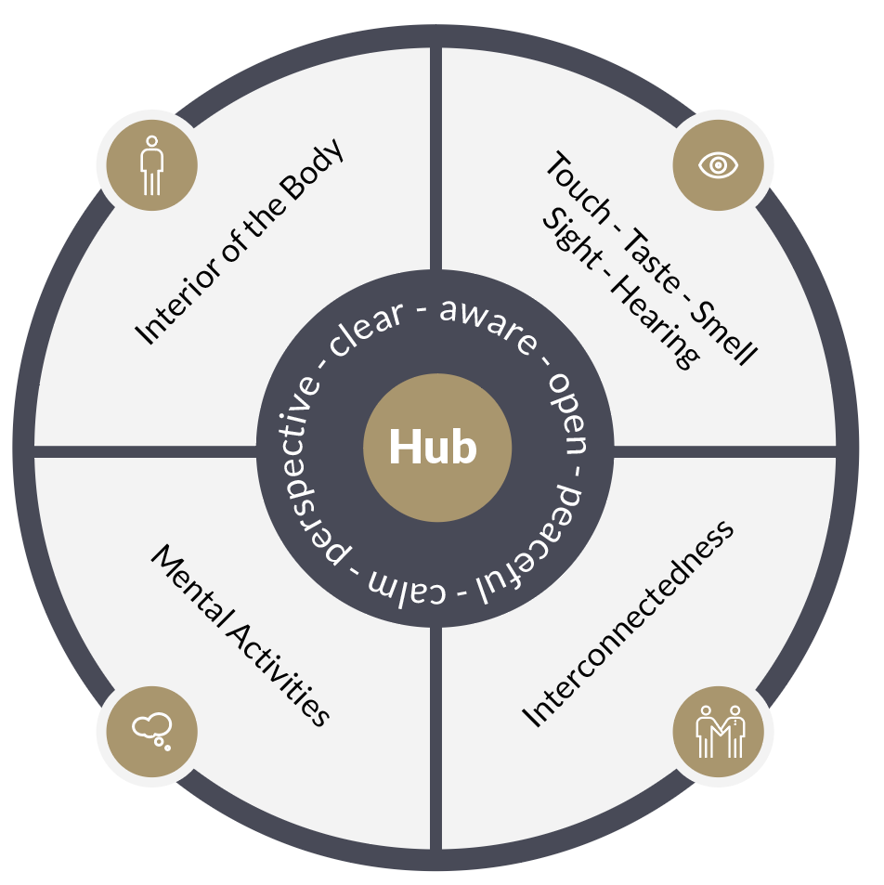
Part 2: Reflection
Now take a look at the wheel of awareness, displayed below.

Slide 24
Reflect on what you noticed during the meditation. Write down as much as you can remember from each of the four quadrants and from becoming aware of awareness itself (the hub). There are no wrong answers here! Everyone’s wheel of awareness experience is unique.
General discussion
■ How did you feel at the end of the practice?
■ Did you learn anything new about yourself?
■ When do you think this practice would be usefully applied in your everyday life?

Slide 25
MSC Practice (Facing Challenging Emotions)
Trauma brings with it a variety of emotions ranging from anxiety, fear, guilt , hurt among others. This MSC practice session will prepare you to face such difficult emotions (Germer & Neff, 2022).

Slide 26
Instructions
“Please find a comfortable position, sitting or lying down, close your eyes, and take three relaxing breaths. You should be very comfortable when practicing with difficult emotions.” • “Taking a moment to ground yourself in the present moment, perhaps by listening to sounds in the room, sensing your feet on the floor, or feeling the rhythm of your breathing.” • “Or offering yourself soothing or supportive touch for a few moments to remind yourself that you are in the room, and that you, too, are worthy of kindness.” • “Let yourself recall a mildly to moderately difficult situation that you are in right now—perhaps a health problem, a family problem, a work issue, or stress related to injustice. Please reflect carefully on the problem, choosing a situation that generates some stress in your body when you think of it, but doesn’t overwhelm you.

Slide 27
Also, because this practice emphasizes the tender qualities of softening and soothing, it is better not to choose a situation that makes you feel angry or one in which you feel that you need to protect yourself.” • “Clearly visualize the problem. Who was there? What was said? What happened? Or what might happen?” Labeling Emotions • As you recall this situation, notice if any emotions arise within you. (Pause) And if so, seeing if a label for an emotion comes up—a name.

Slide 28
Here are some examples: Worry? Sadness? Grief? Confusion? Fear? Longing? Despair? • “If you are unsure what emotion you are feeling, that's okay for now – simply experiencing and noticing your sensations is enough.” • “And if you are having many emotions, seeing if you can name the strongest emotion associated with the situation.” • “Now, repeating the name of the emotion to yourself in a tender, understanding voice, as if you were validating for a friend what they were feeling: ‘That’s longing.’ ‘That’s grief.’” Mindfulness of Emotion in the Body • “Now expanding your awareness to your body as a whole.” (Pause) • “Recalling the difficult situation again (if it has begun to slip out of your mind), naming the strongest emotion you feel, and scanning your body for where you feel it most easily. In your mind’s eye, sweeping your body from head to toe, stopping where you can sense a little tension or discomfort.

Slide 29
Just notice what is ‘feel-able’ in your body right now. Nothing more.” (Longer pause) • “And, if you can, please choose a single location in your body where the feeling expresses itself most strongly, perhaps a point of tension in your neck, an uncomfortable feeling in your stomach, or an ache in your heart region?” • “In your mind, inclining gently toward that spot, allowing yourself to experience the sensation directly, as if from the inside. If that’s too specific or feels too strong, see if you can just get a general sense of the discomfort.” • “And as always, if this exercise makes you too uncomfortable and you want to open your eyes or disengage from the exercise, please go ahead and do so.” Soften-Soothe-Allow • Soften: “Now beginning to soften into that location in your body. Letting the muscles soften and relax, as if in warm water. Softening . . . softening . . . softening . . . Remember that you’re not trying to change the feeling— you’re just holding it in a tender way, maybe just softening a little around the edges.”

Slide 30
• Soothe: “And then soothing yourself because of this difficult situation. If you wish, placing a hand over the part of your body that feels uncomfortable, or just feeling the warmth and gentle touch of your hand, or gently massaging that part of your body, whatever feels right to you. Perhaps imagining warmth and kindness flowing through your hand into your body. If it helps, you can think of your body as if it were the body of a beloved child, or some being you care about.” “And are there some comforting words that you might wish to hear? For example, you might imagine a friend who was struggling in the same way. What would you say to your friend? (‘I’m so sorry you feel this way.’ ‘It's so unfair.’ ‘I care deeply about you.’) Can you offer the same message yourself? (‘Oh, it’s so hard to feel this.’ ‘May I be kind to myself.’)”

Slide 31
• Allow: “Finally, allowing any remaining discomfort to be there, just as it is. Making room for it, releasing the need to make it go away. “And allowing yourself to be just as you are, just like this, if only for this moment.”
• “Softening . . . soothing . . . allowing. Softening . . . soothing . . . allowing. Taking some time and going through the three steps on your own.” (Long pause) “If you notice the feeling starts to shift, or even change location, that's okay. Just stay with it. Softening…soothing…allowing.” • “Now letting go of the practice and focusing on your body as a whole. Allowing yourself to feel whatever you feel, to be exactly as you are in this moment.” • (Gently ring the bell.)

Slide 32
Settling and Reflection
Some participants who chose a very tough situation in their lives may still be experiencing difficult emotions after this practice. Allow for settling and reflection moments.

Slide 33
CONCLUSION
In this lecture, we have covered the concepts of mindfulness and mindful self compassion and how they can be applied in trauma counseling. We have had two practical experiential exercises for the two. This is our last lecture in this course and in lecture 13, we shall have a general exam covering content for all lectures. Thank you for being a wonderful participant in this course.

Slide 34
REFERENCES
Ivzan, I ; & Lomas, T (2016). Mindfulness in positive psychology: The science of meditation and well being. London: Routledge
Germer, C & Neff, K (2022). Mindful self compassion: Teacher guide. California: CMSC
Van Der Kolk, B (2014). The body keep the score: Brain, mind and body in the healing of trauma. California: Penguin Group
Germer, C; Siegel,R,D; & Fulton.P,R (2013). Mindfulness and psychotherapy (2nd ed.). New York: The Guild Press
Germer, C (20090. The mindful path to self compassion: Freeing yourself from destructive thoughts and emotions. London: The Guild Press
Alberts, H., Schneider, F., & Martijn., C. (2012). Dealing efficiently with emotions: Acceptance-based Coping with Negative Emotions Requires Fewer resources than Suppression. Cognition and Emotion, 26, 863-70.
Baer, R. A. (2003). Mindfulness training as clinical intervention: A conceptual and empirical review. Clinical Psychology: Science and Practice, 10, 125–143.

