Slide 1

BUSINESS-TO-BUSINESS MARKETING
WEEK 6
PRODUCT STRATEGY IN BUSINESS MARKETS
Dr John Kamau
Spring 2023

Slide 2
Introduction
Welcome to week six lecture!
It is my joy to have you in this class!
We are now halfway through the course.
Congratulations for making it so far!
In the next four lessons we want to delve into the application of four Ps of marketing in business.
In this lesson we will examine product strategy as developed in business markets

Slide 3
Intended Learning Outcomes
At the end of this lecture, you will be able to:
Define and classify business markets products.
Describe business products strategy.
Discuss new product development process.
Examine the product lifecycle in business markets context

Slide 4
Definition of business markets products
A product is an offering of a firm which satisfies the needs of customers.
It is a bundle of benefits that Customers are seeking and willing to part with items of value (including money and time) in exchange for gaining these satisfactions (Blythe and Zimmerman, 2013).
According to Corey (1976) business marketing products includes not only the functional utility of the product but also technical assistance, the assurance of dependable supply, product service and a range of personal and technical relationship between the buyer and seller organizations.

Slide 5
Business products attributes
Tangible (core and augmented) and intangible.
1. A) The core of a product represents basic features which describe the simple capabilities of the product and are generic to all product offerings in the market.
They are the physical functional aspects of a product.
B) Augmented products consist of features added to the core attributes, which either provide extra facilities and performance :Styling, performance capabilities, packaging, size, or weight are features that help distinguish a product or enable it to perform better than competitive products.

Slide 6
Business products attributes
2. Intangible products constitute additional elements that are provided to improve the atmosphere that surrounds a product.
Technical service and support, financial services, warranties, and delivery serve to embellish products and assist differentiation.
Form basis for market competition and differentiation of products.
Determinant attributes are perceived by buyers as both important and differentiating.
Non-determinant are either important or differentiating but not both.

Slide 7

Classification of business market products
1. Equipment: It consists of products such as machinery, building, computers, generators, earth moving equipment (caterpillar), vehicles.
The demand for major equipment is considered inelastic.
In view of price, and technical requirements, the purchase of major equipment usually requires close cooperation between the technical and sales staff of both the business buyer and seller.
Instalments payment schedules and leasing arrangements are common because of the large investment involved.
The seller’s marketing strategies include strong personal selling efforts, exposure to multiple buying influences in most cases and a strong engineering service supported by the salesperson or sales team.

Slide 8

Classification of business market products cont.
2. Accessory Equipment: They are used to facilitate production, administrative, clerical, and marketing activities and examples include calculators, stationery, staples, fire extinguishers.
They are mainly light equipment.
In general accessory equipment’s tend to be standardized and less costly than major equipment.
The purchase may be considered routine, distribution channels are usually longer, and fewer buying influences are involved in the purchase decisions.

Slide 9

Classification of business market products cont.
3. Fabricated and component part: There are products that are purchased for inclusion into the final product E.g., Stereo in vehicles, batteries, switches.
Although they typically become part of another product, fabricated and component parts can often be easily identified and distinguished.
Business buyers purchase such items according to their own predetermined prescription or by standards common within an industry.
In purchasing component parts, buyers expect the part the consistently meet a specified quality level and to be delivered on time so that production is not slowed or stopped.

Slide 10

Classification of business market products cont.
4. Process materials: They differ from fabricated and component part in that most of them cannot be identified or regrouped in the finished product.
Examples include chemicals, plastics, cement and so on.
Most processed materials are marketed to customers who are original equipment
Process materials are generally bought per specification prepared by the users or bought according to standards developed by a particular trade or industry.
Generally, price and service are important factors in the sales of the process materials.

Slide 11

Classification of business market products cont.
5. Maintenance, Repair, and Operating supplies (MRO):
MRO supplies do not become part of the finished product but are used up in the production process.
Example of maintenance supplies include paint, nails, cleaning compounds, light bulbs.
Repair supplies include: - bearing filers.
Typing paper, ink, paper clips, pencils and lubrication oils are types of operating supplies.
MRO items are usually standardized, involve longer channel of distribution, expose the seller to fewer buying influences and they show a more elastic dd curse than accessory equipment.

Slide 12

Classification of business market products cont.
6. Raw materials: are supplied primarily by the agriculture or forestry, mining, and fishing industry.
Raw materials become part of a manufactured product, are generally bought in large quantities and exhibit an inelastic demand curve.
They are usually purchased based on such recognized standards as grade designations or central specification.
Channel of distribution can be either long or short and multiple buying influences are involved in the purchase at least in the initial stages of the procurement cycles.

Slide 13

Classification of business market products cont.
7. Business services: Services are provided to the firms by commercial banks insurance companies, advertising agencies, accounting firms, law firms and employment agencies and management consultants.
Business services are expense items that do not become part of the final product.
The buyer decides to buy the service from outside specialists if it is less costly than having company employees performing it.
Multiple buying influences may be present when the cost of a service exceeds a pre-established amount.

Slide 14

Business product strategy
The product strategy of a firm relates to making decisions about the features, quality, and the entire offering.
Product strategy involves developing a rational relationship between and among product offerings.
At the core of the product the strategy will consider Features/ functions/ benefits and Value to customers.
At the product attributes level, the strategy will examine brand, design, country of origin, price, and packaging.
At the support service level, the strategy development will consider delivery, installation, warranty and after sales

Slide 15
Product portfolio
Product item: each individual product.
Product line: clusters of products and services that are offered, in combination, to a designated market segment(s).
Product mix: the number of product lines.
Depth of line: the number of products offered within each line.

Slide 16
Product line classification
Product lines can be classified based on the degree to which: the content of product lines is standardized, and mass produced, or customized to meet the individual, personal needs of each business customer.
Four categories include:
a) Proprietary or catalogue products: These products are produced in anticipation of orders.
Product line decisions in this category concern levels of stock to be made and held, the type of stock to be carried (adding and deleting lines) and the repositioning of products within the line.

Slide 17

Product line classification cont
b) Custom-built products: these are products which are assembled for customers using preformed parts, subassemblies, and components.
They are then configured in particular ways so that they meet a specific customer’s needs.
product-line decisions revolve mainly around presenting different solutions to customer problems.

Slide 18

Product line classification cont
c) Custom designed products: These products are custom-designed and built to meet the specific needs of a particular customer or very small group of customers.
These products are often of high capital value.
Product-line decisions are based around identifying and understanding the very specific needs of customers and then being able to present proposals that provide a tight fit with those needs.

Slide 19
Product line classification cont
d) Business services: The main offering may be a product but there are services attached such as order processing, invoicing, delivery, and warranty-based support.
Some organizations provide a specific service package to support their products.
Support services are provided to augment product offerings and provide distinction between firms.

Slide 20

New product development process
New product development for business markets requires a project team
Teams are made up of engineers, pure scientists, finance experts, marketing people, product managers members of the market, customers, research team outside consultants and suppliers.
The cross functional team may be global or locally constituted.
The use of internet has helped teams to be constituted globally and work more effectively to achieve the objective of the firm

Slide 21
Managing a new product team
Stage setting: project goals, empowering, assigning the required human resources, and creating a conducive climate.
Create teamwork enablers. These are team leaders, senior managers, and product champions.
Team behaviors: such as cooperation, commitment to the project, ownership of the project, and respect and trust
Control systems: a control system must be put in place to enable the business marketer to monitor the project and ensure it is on course.
Reward system: the system must be put in place to act as a motivator for the team.
Conflict resolution:

Slide 22

Types of new products
New-to-the-world products – These are inventions such as the first automobile or computer.
New category entries – Products introduced by firms into a product category where the firm had not been doing business up to this time.
Additions to product lines – These are line extensions in the firm’s current markets such as a tablet computer introduced by Apple.
Product improvements – Current products made better in some way.
Repositioning – Taking a current product and attempting to find a new use for it.

Slide 23

Stages in new product development cont.
1. New Product strategy development: link idea generation, screening, and evaluation and business analysis more closely together in the context of an overall strategic direction.
Identifies the strategy requirements that new product ideas should satisfy such as defending a market share position or maintaining a market position as a technical leader etc.
Improved mortality of new product ideas (Webster, 1995).

Slide 24
Stages in new product development cont.
2. Idea generation: new product ideas are generated from sales representatives, customers, distributors and managers as well as investors, shareholders, suppliers and so on. Industrial firms usually organize scientists and engineers into departments with specific purpose of generating, developing, and exploiting new products ideas.
A new product idea collection system includes an informed sales force on the lookout for new product ideas from customers and distributors and a well-defined procedure for communicating these ideas to the appropriate collection point in the firm.

Slide 25
Stages in new product development cont.
3. Idea screening
Checks consistency of the idea with firms' strategic direction
Do we have or can we develop access to the necessary raw materials?
Is the project or a scope i.e., feasible within our existing financial capability?
Is there some synergy with our existing product line?
Is it likely that our present customers represent a potential market?
Could the product be marketed through our existing sales force?
What impact would successful development of this project have on our existing product, market, and marketing organization?

Slide 26

Stages in new product development cont.
4. Business Analysis: a detailed and substantial evaluation of a new product idea in terms of required investment, expected sales volume, prices, costs, profit margins and projected return on investment.
It includes a market analysis with sales forecast.
The stronger the positions held by established firms, the less attractive the possibilities for market entry with a new product idea.
The ultimate purpose of the business analysis is to develop a reasonable thorough and defensible estimate of the profitability of the proposed new product.

Slide 27

Stages in new product development cont.
5.Product Development: scientists, engineers and technicians create the desired product.
This process involves management of research and development, the nature of creativity in scientific work, technological forecasting etc.
Information from marketplace about customers’ needs and reaction of customers, sales representatives, and distributors to product concept (idea) in the various steps of development is essential to the effectiveness and efficiency of development process.

Slide 28

Stages in new product development cont.
6. Testing: begins with testing of new product ideas or concepts then moves to evaluation of various forms of the product in the laboratory and in the field.
Pilot production test and the results carefully tested for quality, costs, and other considerations.
Product presented to the market under test conditions including
Challenges:
Measurement errors in testing.
Time lag between product concept testing to commercialization.
Risk of tipping the firm’s hand to competition in field test

Slide 29
Stages in new product development cont.
7. Commercialization and Product positioning: the company makes a full commitment to marketing a new product
The new product marketing program requires careful definition of market segments, developing marketing objectives, short-term and long-term and training of the sales force and distributor organizations.
Positioning is a central strategic issue in the marketing of a new industrial product.
It means carving out a niche in the market by stressing certain product features vis-à-vis competition.
Positioning may involve primarily the tailoring of the bundle of services to accompany the actual product, although advertising and sales promotion decision requires very careful segmentation analysis.

Slide 30
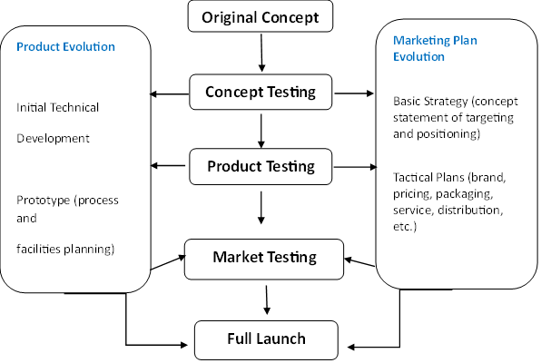
New product development and marketing plan

Slide 31

Causes of business markets products failure
Failure of the product to perform as expected or intended.
Introduction of an incomplete product in the market
Inadequate preparation of customers and the marketing organization.
There is lack cooperation in making the product successful from departments in the organization.
Poor definition of target market and inadequate market segmentation.
Failure to reach all the relevant buying decision influences.

Slide 32
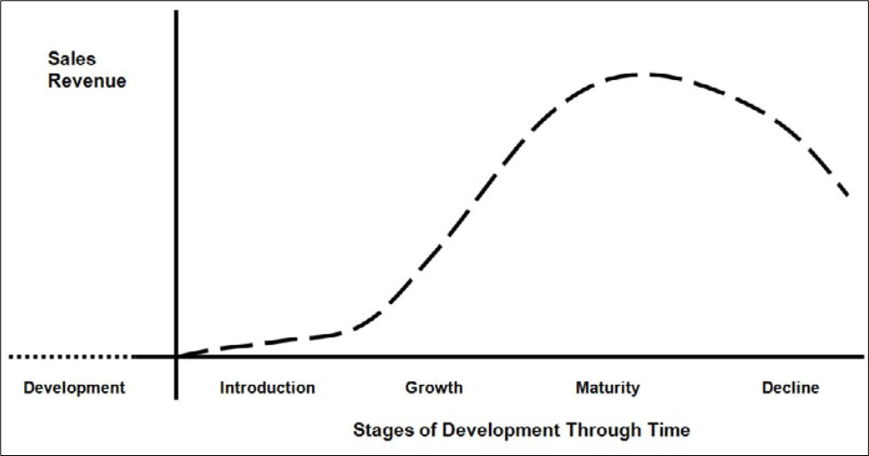
Product lifecycle

Slide 33
Product lifecycle
1. Development stage: Resources are allocated to testing and analyzing materials and prototypes.
2. Introduction: Sales are building slowly as customers are attracted to and want to try the product.
3. Growth: Increased demand boosts sales, which together with profits start to increase quickly and the overall market expands rapidly.
4. Maturity: Most potential buyers have adopted the product and soon sales reach their highest point before starting to slow.
5. Decline: The product eventually loses customer appeal as new products and new technologies enter the market

Slide 34

Implications of product lifecycle to a business marketer.
Products have a limited life, and their sales history follows an S-shaped path, at industry and product levels.
Products move through the different stages, within an overall cycle at different. speeds (development, introduction, growth, maturity, and decline).
The life of the product can be extended by many ways, such as introducing. new ways of using the product, finding new users, developing new attributes (for example, service enhancements).
The average profitability per unit rises and then falls as products move through the later stages.

Slide 35
Adoption process for business markets products
This is the intra-firm process in which the firm builds an increasing commitment to use a product or process.
Its stages include:
1) Awareness – firm becomes aware of the new product but does not have information about it.
2) Interest – the firm seek information about the new product.
3) Evaluation – tries whether the new product makes sense.
4) Trial – the firm tries a new product on a small scale.
5) Adoption – the firm decides to make full and regular use of the product.

Slide 36

Factors that influence intra firm rate of adoption
1. Size of the firm: The larger the firm, the longer it takes to move through adoption decision process.
2. Number of people involved in decision process: The more people involved in decision process the more time required.
3. The size of the market share: Firm with larger market share tend to take longer to move from awareness to adoption.

Slide 37

Characteristics of earlier adopters of industrial product
They tend to be the largest firm in the industry.
Potential applications.
Fast growing firm. That is, firm with high predicted growth in revenue.
Firms with more borrowing powers i.e., they can finance the required investment.
Firms with managerial and technical progressiveness.
Firms that spend more on research and development
Firms with CEO who are younger and better educated are likely to be early adopters/innovators.
Firms with fewer people involved in buying Centre and are more open, less formalized and has a structured decision process.
Firm whose buying Centre people have wider job experience.

Slide 38
Conclusion
In this lecture we have defined industrial products, examined the new product development process
We have also discussed business markets product strategy
We have also discussed the product lifecycle and new product adoption process

Slide 39
References
Brockhoff, K. (1967). A test for the product life cycle, Econometrica, 35 (3–4), 472–484
Cherunilam, F. (2007) Marketing of Industrial Goods. Himalaya Publishing House Pvt. Limited.
Cooper, R. G. (1975). Why New Industrial Products Fail. Industrial Marketing Management (4), 315–326
Corey, E. R. (1976). Industrial Marketing: Cases and Concepts. 2nd ed., Prentice-Hall, Englewood Cliffs, New Jersey
Crawford, C. Merle and DiBenedetto, Anthony (2003). New Products Management. New York: McGraw-Hill/Irwin.
Dean, J. (1950). Pricing policies for new products, Harvard Business Review, 28 (6), 45–53.
Fill, C., & McKee, S. (2011). Business marketing face to face. Goodfellow Publishers, Limited.
Hansiota, Behram J., Shaikh, Muzaffar A., and Sheth, Jagdish N. (1985). “The Strategic Determinancy Approach to Brand Management.” Business Marketing, Vol. 70, Iss. 2, 66 83.

Slide 40

References
Hutt, M., Hutt, M.D. and Speh, T.W. (2009) Business Marketing Management, 10 edn, Fort
Krishnan V. and Ulrich, Karl T. (2001). “Product Development Decisions: A Review of the Literature.” Management Science, Vol. 47, No. 1, January, 1–21.
Lam, Ping-Kit, and Chin, Kwai-Sang (2005). “Identifying and prioritizing critical success factors for conflict management in collaborative new product development.” Industrial Marketing Management, Vol. 34, Iss. 8, 783–96.
McDonough, Edward F. III (2000). “Investigation of Factors Contributing to the Success of Cross-Functional Teams.”Journal of Product Innovation Management, Vol. 17, No. 3, 221–35.
Meenaghan, A., and Turnbull, P.W. (1981) The application of product life cycle theory to popular record marketing, European Journal of Marketing, 15 (5), 1–50
Rickard, L. and Jackson, K. (2000) The Financial Times Marketing Casebook, 2nd edn, London: Prentice Hall, pp. 52–59.
Shapiro, B.P. (1977). Industrial Product Policy: Managing the Existing Product Line, Cambridge, MA: Marketing Science Institute, pp. 37–39.
Webster F.E (1995) Industrial marketing strategy. Wiley; 3rd edition
Worth, TX: Harcourt

Slide 41

End
Thank you
See you in lecture 7

