Slide 1

BUSINESS-TO-BUSINESS MARKETING
WEEK 8
MARKETING COMMUNICATION IN BUSINESS MARKETS
Dr. John Kamau
Spring 2023

Slide 2
Introduction
Welcome to week 8 lecture
It is my joy to have you in this class
We have now looked at two elements of marketing mix: product and price.
We now want to focus on the third P which is promotion or marketing communication mix.

Slide 3
Intended learning outcomes
At the end of this lecture, you will be able to
Define marketing communication in business market context.
Compare and contrast business and consumer markets communication.
Explain the roles of marketing communication in marketing strategy.
Develop business market communication strategy.
Examine marketing communication strategies.
Review the role of communication in building relationship.
Determine the contributions of personal selling in marketing communication.

Slide 4

Definition of marketing communication
Marketing communication is the art of informing consumers about a company’s offering with an aim of making them become consumers.
Ali (2021) defines business marketing communication as a management process through which organizations contact with its various audiences with an aim of influencing the perception and understanding of the organization, and/or its products and services, with a view to generating specific meanings and ongoing attitudinal and behavioral responses.
marketing communication represents the collection of all elements in an organization marketing mix that facilitates exchanges by establishing shared meaning with the organization customers or clients.

Slide 5
Definition cont.
Fill and McKee (2011) hold the view that Business-to-business marketing communications are concerned with the way in which an organization communicates with other organizations regarding its products, services and its own desired corporate identity and associated reputation.
Marketing communications is an audience-centered activity which attempts to encourage engagement between participants and provoke conversations.

Slide 6
Definition cont.
From these two definitions we note that:
All marketing mix variable and not just the promotional variables communicate with the customers.
Marketing communication can be either intentional or unintentional.
Marketing communication is both a sender and receiver of messages.

Slide 7
Definition cont.
Dialogue is critical in business to business and must be stimulated through marketing communication.
Relationships. Communication should build trust that leads to involvement and commitment.
Cognitive response. B2B audiences should be regarded as active problem solvers, who use marketing communications to help them in their purchasing and organization related activities.

Slide 8
Comparison Between Consumer and Business Market Communication
Consumer markets | Business to business markets
Availability of mass media | Mass media of little use.
Greater use of emotional appeals. | More rational approach used.
Greater tendency on the part of consumers to avoid the message. | Greater preparedness to seek out information
Selective retention means that communications are quickly forgotten. | Communications are frequently stored for future reference – brochures, advertisements, and leaflets may be filed away.

Slide 9
Comparison Between Consumer and Business Market Communication
Consumer markets | Business to business markets
Copy is almost always short and punchy, usually just ten or a dozen words. | Copy is frequently long, even a thousand words or more.
Communication is aimed at individuals, who are in most cases solely responsible for purchasing decisions. | Communication is aimed at groups, who in most cases need to agree on purchasing decisions.
Characterized by mass media, reaching broad market segments. | Characterized by industry-specific media, widely read by decision-making unit members.

Slide 10
Roles of marketing communication in business markets (Drip model)
Differentiate: marketing communications can differentiate products, services, and organizations, particularly in markets where there is little to separate competing offerings.
Reinforce: Communications can also reinforce perceptions and images associated with organizations and their products.
This is done by constantly reminding them of the existence of the brand and its benefits through various methods of communication,

Slide 11
Roles of marketing communication cont.
Inform: this is particularly useful when new products or services have been developed.
Promotion offers an opportunity for customer to learn about new features and usage of both old and new products.
Persuade: communications may also attempt to persuade current and potential customers of the desirability of purchasing an organization’s offerings and thus lay down the foundation for an exchange relationship.

Slide 12
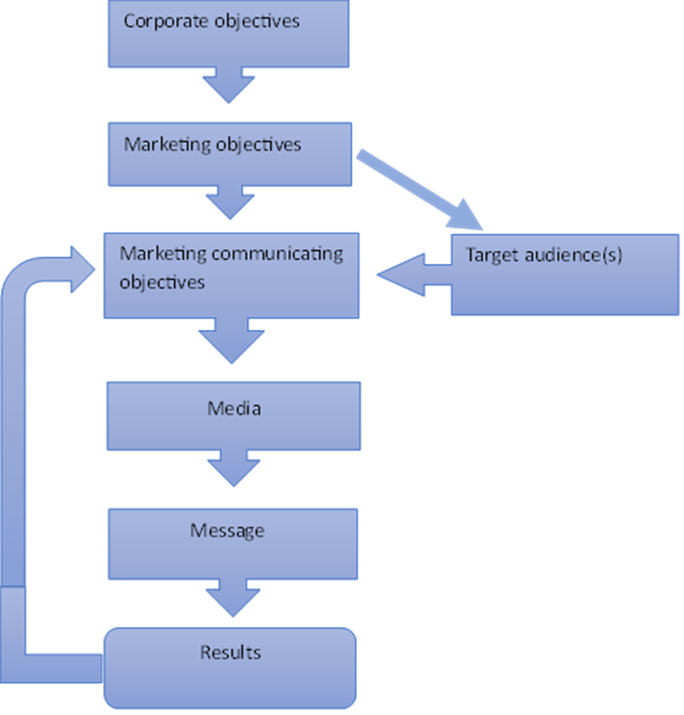
Developing marketing communication program.

Slide 13
Developing marketing communication program
1. Determine marketing communications objectives:
Reminder
Changing attitude, perception, and beliefs
Reinforcing attitude
Product line building
Relating products to consumer needs
Image

Slide 14
Developing marketing communication program cont.
b) Target audience:
The target market could be existing customers, potential customers, consumers, purchase from competitor, infrequent users or only use size or flavors, people with low awareness , negative attitude towards the brand
Two different approaches can be used to identify target audience.
First, for the industry and the individual companies, this will consider aspects such as size and number of customers in the market, the industry, benefits wanted, and competitor activities.
Second approach will be the need to identify the people who might or might not have a vested interest in the purchase (the DMU).

Slide 15
Developing marketing communication program cont.
c) Choosing appropriate media:
In business marketing, personal selling is the most effective media.
Media may be electronic but is often web-based, print (either business or trade publications), exhibitions, brochures, or mailings.
An effective website is an essential component in the communications effort.

Slide 16
Developing marketing communication program cont.
d) The core message:
The core message identifies the precise information that must be conveyed by the promotion campaign.
Communication must be persuasive and differentiate between features and benefits.
Marketing communication stick close to the product and the brand and in fact to the everyday lives of ordinary people.
While business marketing communications focus on transmitting more fact than emotion, well-turned, rational appeals will always attract more attention than simple emotional appeals.

Slide 17
Developing marketing communication program cont.
e) Assess the results: If the objectives have been set as has been described above, the manager will be able to
compare the results with the objectives,
evaluate any shortfalls and change the objectives, audiences, media or messages in order to improve results.

Slide 18
Marketing Communication Strategies
a) Pull-positioning strategies – these are intended to influence end-user customers (consumers and business)
b) Push-positioning strategies – these are intended to influence marketing (trade) channel buyers.
c) Profile-positioning strategies – these are intended to influence a wide range of stakeholders, not just customers and intermediaries.

Slide 19
Relationship Marketing and Communications
Relationship stage | Role of marketing communications
Acquisition | Differentiation to establish position. Information about organizational credentials and product features. Persuasion to stimulate behavioral action
Development | Differentiation and information provision predominate as organizations become increasingly open and reveal more about themselves. Increasing levels of trust emerge as the boundaries of the relationship become established.
Retention | The provision of knowledge and sharing of information becomes regularized and a common part of the relationship. Reinforcement messages, based on both reminding and reinforcing, are used to provide trust and commitment to support valued relationships.
Decline | Discrete relationships resort to persuasion to extract remaining value from the relationship.

Slide 20
Communication mix for business marketers
Tool | Definition | Main role | Types
Advertising | Advertising is a non-personal form of mass communication, paid for by an identifiable sponsor. | To inform and remind, | Online and print advertising in trade journals and newspapers.

Slide 21
Communication mix for business marketers
Sales promotion
Sales promotion seeks to offer buyers additional value, as an inducement to generate action, often to make an immediate sale
Aimed at moving buyers along the buying process rather than making a complete transaction
Buying allowance, Count and recount, buy-back, merchandising, promotional, gifts and premiums
Sales promotion | Sales promotion seeks to offer buyers additional value, as an inducement to generate action, often to make an immediate sale | Aimed at moving buyers along the buying process rather than making a complete transaction | Buying allowance, Count and recount, buy-back, merchandising, promotional, gifts and premiums

Slide 22
Communication mix for business marketers cont.
Tool | Definition | Main role | Types
Public relations | Public relations are about establishing and maintaining relationships with various stakeholders and with enhancing the reputation of the organization | Improves firms’ image and reputation | Press release, press conferences, interviews, events, lobbying, corporate advertising, crisis management, Investor relations

Slide 23
Communication mix for business marketers cont.
Tool | Definition | Main role | Types
Direct marketing | seeks to target individual customers with the intention of delivering personalized messages and building a relationship with them based on their responses | complements personal selling activities and in doing so reduce costs and improve. overall performance | Direct mail, telemarketing and web-supported

Slide 24
Communication mix for business marketers cont.
Personal selling | It is interpersonal. communication tool which involves face-to-face activities undertaken by individuals, often representing an organization. | building relationships with members of buying centres. | Suppotered by trade shows and field marketing.

Slide 25
Classification of business-to-business media
Media class | Media types
Broadcast | Television and radio
Print | Newspaper and magazines
Outdoor | Billboards
Digital | Website
In-store | Signages
‘Others’ | Brochures

Slide 26
Digital Media and B2B Marketing Communications
The Internet is a medium that allows for interactivity and is possibly the purest form of marketing communications dialogue outside personal selling.
It is a two-way communication very fast, allowing businesses and individuals to find information and enter exchange transactions in such a way that some traditional communication practices and exchanges are being reconfigured.
The digital media overcomes many of the challenges of traditional media and is the fastest growing.

Slide 27
Comparison between traditional and digital media
Websites/Internet | Traditional media
Good at providing rational, product-based information. | Better at conveying emotional brand values.
More efficient as costs do not increase in proportion to the size of the target audience. | Costs are related to usage.
Better at prompting customer action | Less effective for calling to action except point-of-purchase and telemarketing
Effective for short-term, product-oriented brand action goals and long-term corporate identity objectives | Normally associated with building long-term values
Increasingly good at generating awareness and attention (e.g., seeding online video) | Strong builders of awareness
Measures of communication effectiveness weak and/or in the process of development. Measures of website use very high. | Established methodologies, some misleading or superficial, (mass media); direct marketing techniques are superior
Dominant orientation- cognition | Dominant orientation- emotion

Slide 28
Digital media channels used in business-to-business marketing.
Digital media channel | Explanation
Email marketing | Email can be directed at clearly defined target groups and individuals and the email messages can be personalized and refined to meet the needs of individual buyers. In-bound and out-bound emails must be managed.
Mobile marketing | Mobile marketing is developing rapidly and is perceived to be good for customer acquisition as well as developing relationships.
Social media | a group of Internet based applications that build on the ideological and technological foundations that allow the creation and exchange of user generated content. Examples include. Examples include social networks blogs. Microblogging, podcasting, and Online communities.

Slide 29
Digital media channels used in business-to-business marketing cont.
Digital media channel | Explanation
Website | Should be attractive and one that encourages interactivity and engagements. B2B website design and content influence business buying and selling behavior, negotiation strategies, pricing practices, and performance in a B2B context
Search Engine Marketing | The website designer must endeavor to raise rankings. The two main techniques used are the search engine optimization and pay per click

Slide 30

Personal selling in business markets communication
Personal selling is the most important tool of marketing communication in business markets
This is since business marketing communication requires face to face conversation in most cases
Personal selling is key in relationship building, a major characteristic of business marketing
It requires trained personnel to do it effectively

Slide 31

Order taking in personal selling
Four types of order taking may be realized
Order takers are salespersons to whom customers are drawn at the place of supply.
Order getters operate away from the organization and attempt to gain orders largely with demonstration and persuasion.
Order collectors attempt to gather orders over the telephone, through email or a combination involving the Web.
Order supporters are all those who support salespeople in that they are involved with the order once it has been secured,

Slide 32
Tasks of personal selling.
Activity | Explanation
Market research | The analysis and forecasting of market trends and related activities. The identification of sales opportunities,
Inbound information | Reporting information to the organization about the market customers and associated stakeholders.
Outbound information | Reporting organizational information to customers and associated stakeholders about products and organizational issues.
Prospecting | Finding and using leads to generate new customers.
Marketing & sales team coordination | Developing strong internal links with sales support teams, the marketing department, and other agencies.
Selling | Leading prospects (and established customers) to a successful close.
Customer relationship | Developing mutually satisfying relationships with customers.
Sales service | Pre-sales support to encourage buyer engagement and trust prior to any transaction. Post-sales support to provide reassurance and formative collaborative gestures.

Slide 33

Personal selling situations
Dealing with complex items
Buyer significance attached to the item
Communication effectiveness
Channel factors considerations

Slide 34
The roles of manager in personal selling
Selection and recruitment
Training and coaching
Deployment
Motivation and supervision
Evaluation, control and reward.

Slide 35

References
Ali.S,S (2021) Business -to -business marketing . Syrian Virtual University Publication
Blythe J & Zimmerman A (2013) Business to Business Marketing Management A global perspective Second Edition, Routledge
Fill, C., & McKee, S. (2011). Business marketing face to face. Goodfellow Publishers, Limited.
Guenzi, P. (2002). Sales force activities and customer trust, Journal of Marketing Management, 18, 749–778 Hannah, G. (1998). From transactions
Yeshin,T (2006), Advertising, Thompson Learning UK

Slide 36
End
Thank you for watching
I will see you in the next lesson
Blessings

