Slide 1
BUSINESS TO BUSINESS MARKETING WEEK 11
MARKET PLANNING, IMPLEMENTATION AND CONTROL IN BUSINESS MARKETS
Dr John Kamau
Spring 2023

Slide 2
Introduction
Welcome to week 11 lecture!
This is our second last session and I want to congratulate you for making it so far!
In the last few weeks, we have looked at development of business markets strategy.
We have examined the strategy at product, price, place, and promotion as well as at e-commerce.
Once the strategy is developed, the next step is implementation.
In this chapter we shall focus on strategy implementation and how business marketers evaluate it to determine whether strategic objectives are being realized.

Slide 3
Intended Learning Outcomes
At the end of this lecture, you will be able to
1. Describe the planning process in business markets
2. Discuss ways in which marketing plans are implemented
3. Examine some of the problems of implementing marketing plans
4. Critically analyze ways of developing control systems for marketing plans.

Slide 4
Market planning
The success of any business strategy is based on the effectiveness of the plan developed.
The marketing plan is the central instrument for directing and coordinating the marketing effort.
Planning is the establishment of objectives and the formulation, evaluation and selection of policies, strategies, tactics and actions required to achieve them.

Slide 5
Market planning cont.
Strategic planning operates at two levels: strategic and tactical.
The strategic marketing plan lays out the target markets and the firm’s value proposition, based on an analysis of the best market opportunities
Tactical marketing plan specifies the marketing tactics, including product features, promotion, merchandising, pricing, sales channels, and service (Kotler, 2003).

Slide 6
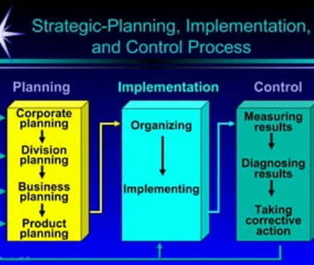
Strategic Market planning process.

Slide 7

Market planning cont.
At the corporate and division level of strategic planning the firm will focus on
1. Defining the corporate mission
2. Establishing strategic business units
3. Assigning resources to each strategic business units
4. Assessing growth opportunities

Slide 8
Market planning cont.
1. Defining corporate mission, vision and strategic goals.
A good mission statement will:
Focus on a limited number of goals
Stress the company’s major policies and values
Define the major competitive spheres within which the company will operate.
Take a long-term view and
Should be short, memorable, and as meaningful as possible.

Slide 9
Market planning cont.
2. Establishing strategic business units (SBUs).
An SBU has three characteristics:
A) It is a single business, or a collection of related businesses, that can be planned separately from the rest of the company.
B) It has its own set of competitors.
C) It has a manager responsible for strategic planning and profit performance.
The purpose of identifying the company’s strategic business units is to develop separate strategies and assign appropriate funding.

Slide 10
Market planning cont.
3. Assigning resource to SBUs
Once it has defined SBUs, management must decide how to allocate corporate resources to each.
This will be guided by portfolio-planning models such as GE/McKinsey and BCG consulting group matrix.

Slide 11
Market planning cont.
4. Assessing growth opportunities:
Planning new businesses
Downsizing
Terminating older businesses.

Slide 12
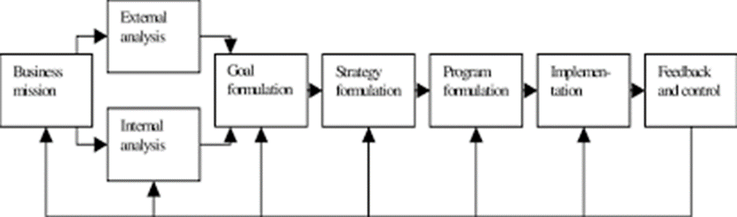
SBU strategic planning process.

Slide 13
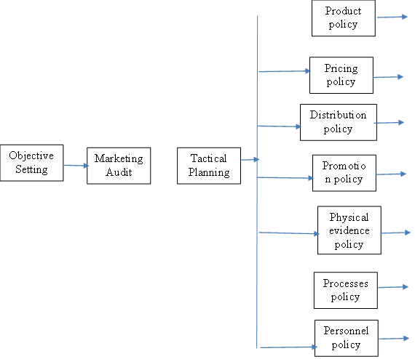
Market planning process cont.

Slide 14
Market planning cont.
1. Objective setting:
Corporate objectives that inform the marketing plan.
Helps the firm to know which market the firm should be in,
The strengths and weaknesses the firm is bringing to the marketplace,
How the firm’s networks can help it achieve its goals,
Where the firm intend to be in 5 to 30 years’ time,
What the firm’s competitors will do in response to the market
Whether the firm has sufficient resources to achieve the objectives

Slide 15
Market planning process
2. Marketing audit
The marketing audit is a review of the firm’s current objectives, strategies, organization, performance and activities
Marketing audit primary purpose is to pick out the firm’s strengths and weaknesses so that managers can improve on them in future.
Evaluates how effectively the organization is performing its marketing tasks within the context of the seven Ps –products, price, place, promotion, people, processes, and physical evidence (Band, 1984).
It is a comprehensive review of the firm’s current position in terms of its marketing activities.

Slide 16
The marketing audit process
 | Type of audit | Explanation
1. | The macro environment audit | This takes account of all the factors which impact on the industry, including the economy, technology, political-legal, cultural, and ecological factors.
2. | The task environment audit | This is concerned with factors which impact on the company itself, for example, markets, customers, competitors, distribution and dealers, suppliers, facilitators, and publics.
3. | The market strategy audit | This area is concerned with the appropriateness of the business mission, marketing objectives, and strategic aim.
4. | The marketing organization audit | This area is about the formal structure of the marketing function, functional efficiency, and interface efficiency.
5. | The marketing systems audit | This is concerned with the marketing information systems, marketing planning systems, control systems, and new product development systems
6. | The marketing productivity audit. | This section brings in financial measures such as profitability analysis and cost-effectiveness analysis.
7 | The marketing function audit. | These audits the seven Ps and determines how effective the company is in each of those areas

Slide 17
Challenges of conducting marketing audit
1. The marketing audit can be time-consuming: it involves a degree of subjectivity, and a considerable amount of introspection.
2. Expensive exercise, both in time and in emotional labor. For the audit to be effective, it must be more than a simple “tick the box” exercise.
3. Marketing audit it tends to lead people into the trap of thinking of all the activities as being separate from each other, whereas of course everything impacts on everything else.
4. The marketing audit implies that each activity is separate and can be treated in isolation which leads to “wicked” problem.
5. Marketing audit tends to view the company as a discrete entity, surrounded by an environment which is mainly hostile which may not be the case in business marketing.

Slide 18
3. Tactical planning:
The third step in the market planning process is tactical planning.
The business marketer must determine appropriate tactics to make him more competitive.
marketers are usually looking for a competitive edge as
The business marketer will either apply differentiation or focus strategy in conducting their business.
Differentiation means distinguishing the firm and its products from all competitors; and focus, which is about concentrating on specific segments of the market (Porter, 1980).

Slide 19
Determining the most appropriate tactics
1. Try to do something that the competition has not thought of yet.
2. Always consult everybody who is involved in the day-to-day application of the plans.
3. Do not expect instant results from anything you do – but monitor the results anyway.
4. Ensure that the messages you give the consumers, the middlemen, the suppliers and all your other publics are consistent.
5. Be prepared for a response from your competitors – try to anticipate what it might be when you are formulating your plans.
6. Communications tools cannot be used to achieve marketing objectives; they can only achieve communications objectives.

Slide 20
Implementing marketing plan
The beauty of any plan lies in implementation.
Implementation requires
A) appropriate structures
B) personnel
C) other resources.

Slide 21
Implementing marketing plan: structures
1. Functional organization: Each marketing activity has a specialist in charge of it.
This structure would have an advertising manager, a product development manager, a market research manager and so forth.
2. Product organization: Each manager is responsible for all the marketing decisions concerning a particular product.

Slide 22
Implementing marketing plan: structures cont.
3. Regional organization: The regional managers are each responsible for all the marketing activities within their own geographical region.
4. Segmental organization: each manager is responsible for a given market segment.
5. Matrix: Here there is joint decision-making between the specialist market researchers, sales managers, etc. and the product managers.
No one manager is in overall control, and decisions are made by balancing each person’s role and demands.

Slide 23
Implementing marketing plan: resources
The business marketer must consider both tangible and intangible resources.
Tangible resources include financial, physical, technological, and organizational categories (Peng, 2009).
Tangible resources also include ability to raise money or generate external funds, machinery, buildings, vehicles, raw materials, work in progress, possession of patents trademarks and copyrights, planning, command-and-control systems, and management information systems which can be measured.

Slide 24
Implementing marketing plan: resources
Intangible resources include human, innovation and reputation resources and capabilities.
Intangible resources also include relational resources and competences.
Relational resources are all of the means available to the firm derived from its relationship with its environment (Lowendahl,1997).
Eng (2008)notes that “managers must develop skills and knowledge of their business networks, combined both tangible and intangible resources, and integrate resources and processes . . . to enhance performance.”

Slide 25
Resource audit
1. Financial: This should include the sources of money (whether internal or external), the resources liabilities the organization has, and the possible availability of capital or loans should it become necessary to acquire more funding – this is essentially the firm’s credit rating.
2. Physical: A list of the fixed assets of the organization, for example machinery, buildings resources and equipment.
The audit needs to include the age and condition of the assets, their location, and their capability as well as their financial value (which is often calculated in an arbitrary manner in any case).

Slide 26
Resource audit cont.
3. Technological: This includes patents, trademarks, copyrights, and trade secrets.
4. Human This can be a problematical area, since much of the value of staff depends on resources their motivation and commitment
5. Innovation: This relates to research and development capabilities and the capacity for the organization to innovate and change.
6. Reputation: This includes customer perceptions of product quality and reliability, and company reputation as a good employer and responsible corporate citizen.

Slide 27
Strategy implementation requirements
a) Basic assets. These are the tangible and intangible assets of the business, as expressed in the financial reporting systems.
b) Explicit knowledge. This is knowledge which can be written down or otherwise recorded.
c) Tacit knowledge. This is knowledge, which is difficult or impossible to codify, and usually resides in the heads of employees.
d) Procedure. This is the mechanism by which the basic assets, explicit knowledge, and tacit knowledge are brought together.

Slide 28
Monitoring and evaluation-control process
1. Establish criteria and standards: these could be
Quantitative such as profitability, market share, return on investment
Qualitative such as company image, employee motivation and customer satisfaction.
Standard is the planned level of performance which must be realistic
2. Measure and compare performance:
the actual performance is measured and compared with the planned performance to determine if the standards are met.
If there is shortfall, it constitute performance gap.

Slide 29
Monitoring and evaluation-control process cont.
3. Performance gap analysis:
This is the difference between the planned performance and the actual performance.
It must be recognized to determine the actual cause to necessitate the correct measures of correction.
4. Taking corrective measures.
This could be modification of objectives, reviewing of performance standards, among others.

Slide 30
Types of control
1. Annual plan control: its purpose is to monitor the marketing performance by identifying deviations from the plan, if any, and take corrective measures to ensure progress as planned.
Annual plan control may take different approaches such as sales analysis, market share analysis, sales to expense ratio, financial analysis, and market based-score card analysis.
2. Profitability control: examines where the company is making and losing money.
This is usually done with reference to products, territories, customers, segments, trade channels order size among others.
3. Efficiency control: seeks to evaluate and improve the spending, efficiency, and impact of marketing expenditures.
Usually done in respect to sales force, advertising, sales promotion, and distribution.

Slide 31
Types of control cont.
4. Strategic control: concerned with tracking the strategy as it is being implemented, detecting problems or changes in underlying premises and making necessary adjustments.
Strategic control takes different forms
A) Premise control is designed to check systematically and continuously whether the premises (assumptions and conditions) set during the planning and implementation process are still valid)
B) Implementation control: designed to assess whether the overall strategy should be changed in the light of unfolding events and results associated with incremental steps, and actions that implement the overall strategy.
C) Strategic surveillance: designed to monitor a broad range of events inside and outside the company that are likely to threaten the course of the firm’s strategy.

Slide 32
Types of control cont.
5. Balance scorecard: developed by Kaplan and Norton (1992). Balance scorecard considers four measures of performance.
A) Financial measures. These would include return on capital employed, cash flow, growth in share value and so forth.
B) Customers. These measures would include perceived value for money (not necessarily cheapness), competitive benefits package, and so forth.
C) Internal processes. These might be enquiry response time, conversion rate from enquiry to order.
D) Growth and improvement. This would include the number of new products on offer, the extent of employee involvement and empowerment, employee attitudes to the firm, and so forth.

Slide 33
Types of control cont.
6. Administrative control: Based on systems, rules and procedures, administrative control is typical in hierarchical organizations which often have large numbers of rules and regulations.
7. Social control: The control exercised by workmates and the organizational culture.
8. Self-control Control exercised by individuals on themselves, based on their own interpretation of correct behavior.

Slide 34
Difficulties with control systems
Control concepts are mainly borrowed from the engineering world and may not apply well in the world of management. Based on assumption that may not hold
1. Objectives can be devised and can be stated precisely: Most organizations do not have clear objectives, but rather have broad goals.
2. Achievement can be measured, and a measure of variance measured: Without measurable objectives, achievement cannot be measured.
3. Variance information can be fed back.: Unstructured activities involve judgment and are often unique, so feedback for one activity is unlikely to be directly applicable to another.
4. The feedback is sufficient to maintain control. The system will only work if the applied feedback is bigger than the environmental shift

Slide 35
Essential features of an effective evaluation and control system
1. Objective based: the business marketer must clarify purpose of evaluation.
2. Economical: costs must be justifiable with utility
3. Objectivity: evaluation system must be reality oriented.
4. Pervasiveness: the system must be appreciated throughout the organization, by functional departments and people directly associated with it.

Slide 36
Essential features of an effective evaluation and control system
5. Simplicity: the evaluation system should be simple to the extent possible
6. Communication and involvement: the system must build confidence and foster positive and active involvement at both mental and active level of participants.
7. Congruence: measurements must be congruence with the events measured.
8. Operational: controls must be focused on action.
findings of the control must reach the people responsible to take needed action in time.

Slide 37
References
Band, W A (1984).: ‘A marketing audit provides an opportunity for improvement’, Sales and Marketing Management in Canada, pp. 24–6.
Finlay, P. (2000). Strategic Management. Harlow: Financial Times Prentice Hall.
Kaplan, R.S. and Norton, D.P. (1992). “The balanced scorecard – measures that drive performance.” Harvard Business Review, Vol. 70, Iss. 1, Jan.–Feb., 71–80.
Porter, M.E. (1980): Competitive Strategy: Techniques for Analyzing Industries and Competitors
(New York, Free Press,).
Kotler, P (2003): Marketing Management, 11th edn (Pearson Education Inc., Upper Saddle
River, NJ.
Desmond, J (2004): ‘An evaluation of organizational control strategies for relationship marketing’, Journal of Marketing 20 (1) pp. 209–37.
Cherunilam, F. (n.d.) Marketing of Industrial Goods. Global Media, . p 207

Slide 38
End
Thank you
See you in the final lecture
Blessings

