Slide 1
Communication Systems in Africa
LECTURE 1
Course overview, Communication, and Traditional communication defined
BY DR. RAPHAEL OGUTU,
Mass Communication Department,
AFRICA NAZARENE UNIVERSITY

Slide 2
Objectives
Define Communication and African communication systems
Understanding the course overview and why Africa?
Explain the functions of communication.
Explain the two basic models of communication
Discuss Africa traditional communication/media systems.

Slide 3
COURSE OVERVIEW
The course examines the manner and means of operation of the media systems in Africa, which is principles or procedures according to which something is done; an organized scheme or method, and by tracing the rationale for these operations.
Consequently, it will you to the elements of African oral traditional communication systems and how the modern mass media systems have influenced African political culture.
It analyses media as a social system with power to influence social, cultural, economic and political systems.
It is important to note that in Africa, oramedia are highly effective than all other means of communication because they are interactive, inter-personal, combines verbal communications with non-verbal codifications, and they are simple, natural and less expensive.

Slide 4
COURSE OVERVIEW: Objectives
Show an understanding of indigenous or local communication that is unique to a given culture of society especially before the establishment of the modern communication systems in Africa.
Explain the merits and demerits or advantages and disadvantages of communication system in Africa.
Explain the evolution of communication systems in Africa that is the relationship of communication, change, new media, and internet in Africa.
Discuss the role of politics in the structuring of communication systems in Africa that is the influence of information on politics.
Analyze the relationship between power, political power and sovereignty.

Slide 5
COURSE OVERVIEW
Why African Communication Systems?
Africa is a vast continent that is the second largest continent in the world, and it is made up of diverse peoples from north, west, east and southern parts.
These peoples existed for centuries before their contacts with early explorers, missionaries and finally the colonial administrators.
Each community had its own unique language and cultural patterns that is the Bantus, Cushites, Nilotes, and others.
Each cultural setting, had a well established systems for communication or sharing information, opinion formation and cultural values.
Unfortunately Africa did not have forms of recording written information, studies into traditional and local channels of communication is quite recent, African scholars in the past and even up till now have concentrated much of their research efforts mainly on the western media
As a result, this text therefore brings into focus the various aspects of African indigenous communication systems and its evolving nature to the present age of communication, the internet

Slide 6
Communication defined:
In Latin is communicare, which means to share, or to make common
sharing occurs when you convey thoughts, feelings, ideas, or insights to others.
The act or process of transmitting information (as about ideas, attitudes, emotions, or objective behavior), exchange of information between individuals through a common system of signs, symbols, or behavior.

Slide 7
Communication defined:
The giving and receiving or exchange of information opinion or ideas by writing, speech or visual means – or any combination of the three – so that the material communicated is completely understood by everyone concerned.
The process of transferring information from a sender to a receiver with the use of a medium in which the communicated information is understood by both sender and receiver

Slide 8
LOCATION OF AFRICA ON THE GLOBE
EUROPE
NORTH AMERICA
ASIA
AFRICA
SOUTH AMERICA
AUSTRALIA

Slide 9
Key characteristics of communication
Communication is human though other animals and creatures communicate; human communication is a complex one. Sometimes we communicate with our pets.
Communication is a process it is a continuous ongoing process. it is more like a motion picture in which the meaning comes from unfolding of an interrelated series of images.
Communication is symbolic: symbols are used to represent things, ideas, or events. We overcome the arbitrary nature of symbols by linguistic rules and customs. Effectively depends on agreement among people about these rules. Spoken or written words are verbal, however nonverbal behaviour also do have symbolic meaning for example in many countries nodding your head up and down means “yes”. (Adler and Rodman, 2006)

Slide 10
Functions of Communication
Physical needs: Personal communication is essential for our wellbeing, an absence of satisfying communication can jeopardize life itself such as early deaths, terminal cancers, common cold, and coronary disease and so on depending on the nature of isolation.
Identity needs: our sense of identity comes from the way we interact with other people. The others’ messages shaping who we think we are.
Social needs: communication provides a vital link with others. Some of social needs we satisfy by communicating are Pleasure, affection, inclusion, escape, relaxation and control.
Practical needs: communication is an important key to effectiveness in a variety of everyday settings. Communication is important for any practical instruction to be carried out
(Adler and Rodman, 2006).

Slide 11
Functions of Communication
Information: the collection, storage, processing and dissemination of news, data, pictures etc. required for everyday life.
Socialization: the provision of a common fund of knowledge which enables people to operate as effective members of the society in which they live.
Motivation: the fostering of individual or community activities, geared to the pursuit of agreed goals.
MacBride et al (1981)

Slide 12
Functions of Communication
Education: the transmission of knowledge so as to foster intellectual development, character formation and acquisition of skills.
Cultural promotion: the dissemination of cultural and artistic products for the purpose of preserving the heritage of the past.
Entertainment: the diffusion through signs, symbols, sounds and images for personal and collective recreation and enjoyment.
MacBride et al (1981)

Slide 13
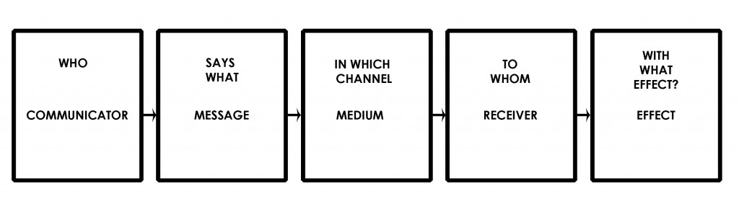
Models of Communication
A model is a systematic representation of an object or event in an idealized and abstract form.
Models are arbitrary by nature.
The linear model views communication as a one-way or linear process in which the speaker speaks and the listener listens. Laswell’s 1948 model was based on the five questions.
Source: https://www.communicationtheory.org/lasswells-model/

Slide 14
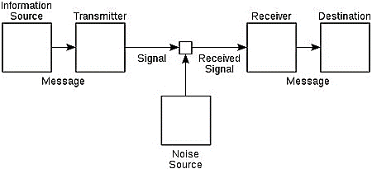
Models of Communication
Shannon-Weaver model of communication
The Shannon-Weaver model of communication was developed by Warren Weaver and Claude Shannon in 1948 to describe how communication occurs between a sender and a receiver.
Source: https://study.com/learn/lesson/shannon-weaver-model-communication-theory-parts-transmission-model.html

Slide 15
The Seven Key Components of the Shannon-Weaver Model
Sender - The model begins with the source of information or the sender. The sender chooses the message, the recipient, and the channel they will use to relay the information. The message can be sent in body language, in writing, through spoken word, or as music.
Transmitter - This is also known as the encoder. This is the person or machine used to convert the message into a signal that can be relayed from a sender to a receiver. The model was initially created to explain how communication occurs using radio waves and binary numbers in computers and telephones.
Channel - This is the medium or device that carries information from the source and through to the decoder and receiver.
(study.com 2022).

Slide 16
The Seven Key Components of the Shannon-Weaver Model
Noise - Is the interruptions that occur as a message moves from a sender to a receiver. It can be physical and psychological, such as when a mental distraction arises from something that happened some time ago.
Decoder - Is the reception place where a signal is converted into a message which can be deciphered. Examples of decoders are equipment, software, machines, and individuals.
Receiver – Is also known as the destination. This is the end-point of the communication process.
Feedback - Comes as a response from a receiver to a sender. An example is a reply to a text message.
(study.com 2022).

Slide 17
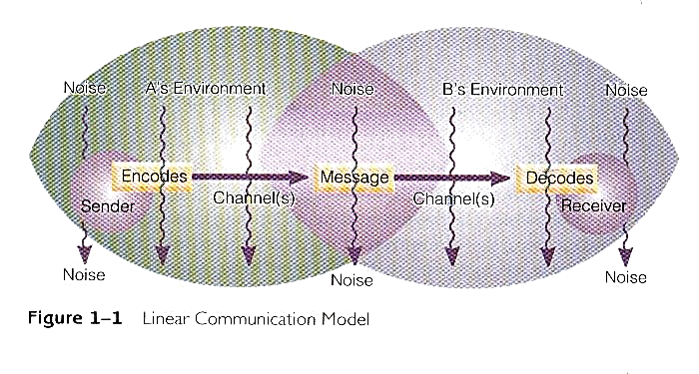
Models of Communication
Linear model shows that communicators often occupy different environments. Environment refers to a physical location, personal experiences and cultural backgrounds that participants bring to a conversation. The model shows that environment A and B overlap, the background that the communicators must have in common.
Communication is like giving an injection: A sender encodes ideas and feelings into some sort of message and then conveys them by means of a channel (speech, writing, and so on) into a receiver who decodes the message. (Adler and Rodman, 2006).

Slide 18
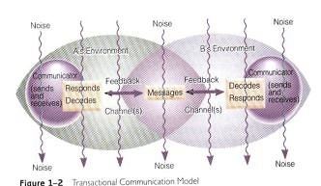
Models of Communication
The transactional model reflects the fact we usually send and receive messages simultaneously. In this model we are capable of receiving, decoding and responding to another person’s behaviour, while at the same time that person is receiving and responding to ours.
The response of a receiver to a sender’s message whether verbal or non- verbal is called a feedback. It shows that communication is indeed a two-way affair.
(Adler and Rodman, 2006).

Slide 19
What is a system?
According to Oxford online dictionary (2023) a set of things working together as parts of a mechanism or an interconnecting network; a complex whole for example "the state railway system".
It could also be defined as a set of principles or procedures according to which something is done; an organized scheme or method for example “the public school system."
According to Merriam Webster Dictionary, a system is a group of interacting or interrelated elements that act according to a set of rules to form a unified whole. A system, surrounded and influenced by its environment, is described by its boundaries, structure and purpose and expressed in its functioning.

Slide 20
What is a communication system?
According to Wikipedia (2023), a communications system or communication system is a collection of individual telecommunications networks, transmission systems, relay stations, tributary stations, and terminal equipment usually capable of interconnection and interoperation to form an integrated whole.
The components of a communications system serve a common purpose, are technically compatible, use common procedures, respond to controls, and operate in union.

Slide 21
Transferring information
Transference can occur between two humans, a human and an animal or a human and a machine. In traditional and contemporary African societies, there was and still is a system which is a complex organized way of living.
These societies have communication systems made of interconnection and interoperation to form an integrated whole. The cultural orientation Africa societies is collectivist.
Ubuntu pronounced [ùbúntú], is a traditional African concept. The word ubuntu comes from the Zulu and Xhola languages, and can be roughly translated as "humanity towards others or “I am because we are” ." https://www.newworldencyclopedia.org/entry/Ubuntu_ (philosophy)

Slide 22

UBUNTU PHILOSOPY IMAGE REPRESENTATION
Source: https://www.alamy.com/stock-photo/ubuntu.html

Slide 23
African Traditional Media
Indigenous means of communication used in the past from various countries of the World’s second largest continent after Asia.
Africa as the source of humanity and civilization is not only unique in customs, tradition, and culture, but in its means of communication.
All the means of communication originated from the earliest Africans in the old Egypt. The civilization later spread to China, India, Greece and Rome

Slide 24
African Traditional Media
The African oramedia like the use of gongs, drum beats, town criers, puppet shows, dance, singing and masks actually influenced the Greek and the Roman civilizations (Scannell,2009:127) which Harold Adams Innis, a Canadian economic historian of the 1940s, who influenced the thoughts of McLuhan, describes as the best means of communication that will be enduring.

Slide 25
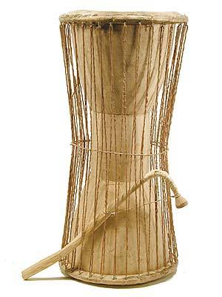
African Traditional Media
talking drum, any of various types of drums that, by imitating the rhythm and the rise and fall of words in languages, are used as communication devices. Such drums occur in East and West Africa, Melanesia, and Southeast Asia. https://www.britannica.com/technology/talking-drum
https://africanperspectivesblog.wordpress.com/2011/08/11/oramedia/

Slide 26
African Traditional Media
Africa remains a continent that its history, heritage, culture, and customs have been distorted.
The historical accounts about Africa are mostly incorrect, slanted, and dented to tilt the true account of history from Western perspective (Osho, 2011).

Slide 27
African Traditional Media
Traditional media or oramedia are body languages and other non-verbal languages being used in the traditional societies for millennia for a variety of purposes, their validity and importance today, despite obvious limitations.
The messages and ideas are transmitted by means of itinerant dance and mime groups, puppet shows and other folk media which serve not only to entertain but to influence attitudes and behavior
MacBride et al (1981)

Slide 28
African Traditional Media
Oramedia or traditional media ‘are the local means of communication that remain what essentially sustain the information needs of the population which represents over 70 per cent of the national population in the rural areas’.
It is important to note that oramedia are highly effective than all other means of communication because they are interactive, inter-personal, combines verbal communications with non-verbal codifications, and they are simple, natural and less expensive.
Wilson (1999)

Slide 29
African Traditional Media
starting with the simplest vocal and gestural signals rooted in their physical structure, human beings developed a whole range of non-verbal means for conveying messages: music and dance; drum messages, signal fires, drawings and other forms of graphic symbols, including the pictogram, followed by the ideogram, important especially because it associated with the representation of an object with an abstract idea…facial expression, gesture, mime, dance, images, music, songs, drawings, paintings, sculptures, sport…of special value are lip reading and sign languages used by millions of handicapped persons’.
MacBride et al (1981

Slide 30
African Traditional Media
Oramedia is culturally based as it is natural with the tradition and customs of the people.
It involves their language, dialect, individual occupation or family occupation or communal occupation.
So, people of another culture may not necessarily understand the message within a particular oramedia, because it is culturally situated and conditioned (Osho, 2011).

Slide 31
SUMMARY
The root of the word “communication” in Latin is communicare, which means to share, or to make common.
Some specific functions of communication include: information, socialization, motivation, education, cultural promotion and entertainment.
A model is a systematic representation of an object or event in an idealized and abstract form. Models are arbitrary by nature.
The African traditional media are the indigenous means of communication in the various countries of the second largest continent in the world.
Oramedia or traditional media ‘are the local means of communication that remain what essentially sustain the information needs of the population which represents over 70 per cent of the national population in the rural areas. Oramedia is culturally based as it is natural with the tradition and customs of the people.

Slide 32
THANK YOU
LECTURE 1
BY DR. RAPHAEL OGUTU,
Mass Communication Department,
AFRICA NAZARENE UNIVERSITY.

