Slide 1
Communication Systems in Africa
LECTURE 4
WEEK FOUR: Colonialism and indigenous communication systems in Africa
BY DR. RAPHAEL OGUTU,
Mass Communication Department,
AFRICA NAZARENE UNIVERSITY

Slide 2
Objectives
Understanding the functionalist theory proposed by Jakobson
Explain the traditional system of communication: the primacy of phatic function
Effect of Colonial Rule in Africa
Analysis of media during and after colonialism in Africa

Slide 3
COURSE OVERVIEW
The course examines communication during colonialism and how Africa suffered an intense, prolonged and violent process of subjugation to external forces.
Firstly, between the 7th and 19th centuries, the Arabs captured between 10 and 18 million Africans, making them slaves (Miller, 2002). Later
Western powers colonized many African territories, firstly indirectly, in order to capture slaves who had to work on the cotton farms in the Americas.
And then directly (from the Berlin of 1885 Conference until the 1970s), occupying almost all African regions (Bussotti, 2014).

Slide 4
Introduction: Colonialism and indigenous communication systems
According to Jakobson (1960), communication can be classified into six basic functions. One of the least important, is the phatic function, since it is not focused on the message, on the sender or on the receiver, but rather on the situation.
in Africa or in most non-European countries, this function is traditionally the most relevant. However, colonization imposed a new form of communication, reducing the phatic function and, consequently, destroying the traditional manner of communication by the indigenous people.
Today, most African elites continue to use the “colonized” language. This could be one of the main reasons for explaining the current permanent gap between lay people and the ruling African classes, also in the field of communication
(Bussotti, 2015).

Slide 5
The functionalist theory proposed by Jakobson
He identifies six main functions of communication, which are:
• Denotative or cognitive, focused on the context;
• Emotive, sender-oriented;
• Conative or persuasive, receiver-oriented, with a frequent use of imperative sentences;
• Phatic, channel-oriented, centered not on messages (which often do not have important meanings), but on establishing or maintaining a sense of community among the participants in the process of communication;
• Metalinguistic, code-oriented (Tarski, 1930), such as a text on grammar and syntax structures;
• Poetic or aesthetic, message-oriented.
(Jakobson,1960)

Slide 6
The functionalist theory proposed by Jakobson
Linguistics has not considered Phatic as pivotal due to the fact that it is considered meaningless and waste of time ( especially the West).
The phatic function or term was first probably coined by the anthropologist Malinowski. He spoke, in a classic essay written in 1923, of “phatic communion” as a “language used in free, aimless, social intercourse” (Malinowski, 1972: 142), whose main function was the “mere change of words”
Only in relatively recent times has the phatic side of communication been recovered.
An anthropological and micro-sociological, Goffman, with his sociology of interaction, considered conversation to be the key factor for communicating with others
(Goffman, 1967, 1969).

Slide 7
The primacy of phatic function
A “traditional African communication” can be considered, according to Des Wilson, “as a continuous process of information dissemination, entertainment and education used in societies which have not been seriously dislocated by western culture or any other external influence as is the case in many parts of the world” (Wilson, 1987: 89)
The great transformation occurred when slave trades and especially modern colonialism became the main factors in African societies.
the phatic function lost its primacy, in favour of the conative function, which was necessary to impose a form of communication on native people in accordance with the objectives of colonial regimes.

Slide 8
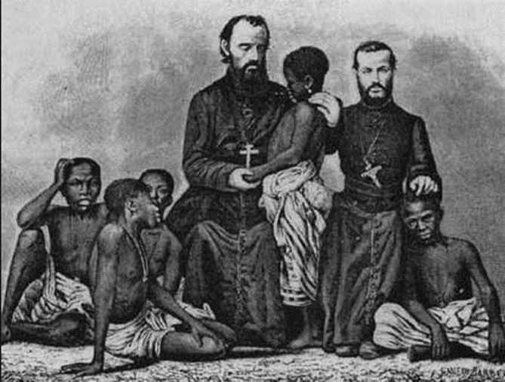
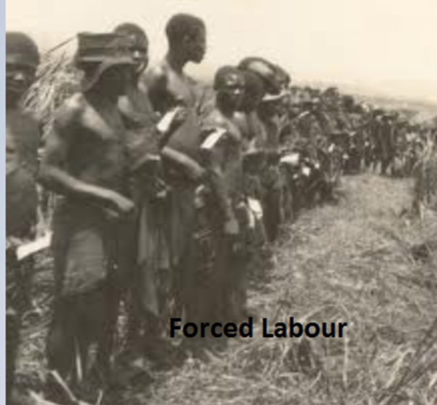
INVASION OF AFRICA BY THE WEST
An image of early missionaries
An image on forced labour
Source: https://learn.e-limu.org/topic/view/?t=244&c=45

Slide 9
Effect of Colonial Rule in Africa
Negative effects
• The Africans lost their political independence.
• Some traditional political institutions were destroyed and replaced with foreign ones.
• Foreign culture was imposed on Africans without regard for their own culture. This led to the loss of the African culture.
• Many followers of traditional religion were converted into Christianity. They were made to believe that their traditional beliefs were primitive.
• Africans lost large tracts of their land to the European settlers.
• Many Africans were forced to live in crowded areas and were never able to regain their land again.

Slide 10
Effect of Colonial Rule in Africa
Negative effects
• Africans were discriminated against and mistreated in their own countries.
• Africans were viewed as slaves rather than free people. Africans provided free forced labour on settler farms.
• The African continent was broken up into political units that later became independent countries.
• People from the same traditional communities were divided and placed in different countries or colonies.
• The Africans were forced to trade with the colonial master much more than with fellow Africans living in neighbouring states.
• Development within the colonies was not balanced or uniform. It tended to favour areas occupied by white settlers.

Slide 11
Effect of Colonial Rule in Africa
Positive effects
According to Elimu (2015) the following are some of the positive effects:
• Colonial rule brought an end to slave trade.
• Modern health facilities, formal education and other social services were introduced into the country.
• New breeds of animals and crops that could do well under the African climate were introduced.
• The African people developed the desire to control their own future and worked towards achieving justice and equality.
• Colonialism introduced a common currency which had not existed in the past.

Slide 12
Effect of Colonial Rule in Africa
Positive effects
It introduced a new legal system.
• It brought manufactured goods some of which could not be produced locally.
• It introduced modern machines which are now used in agriculture and industries.
• Colonial governments introduced modern methods of communication.
• Cash crop farming was introduced.
• Traditional farming methods were improved through research and adopting new methods.

Slide 13
Establishment of the colonial communication systems
After the Berlin Conference (1885), colonialism penetrated into African societies, imposing a kind of communication and a new mentality, among which it is possible to distinguish the following three as being the most significant:
1. As a means for political and social control;
2. As a means for creating ethno-cultural unity among indigenous people;
3. As a means for looking down on indigenous people, provoking a fall in their self-esteem and proposing Western values as the main points of reference.

Slide 14
Establishment of the colonial communication systems
The colonizers create a very negative image of Africa and Africans, so that, in our common language, the word “black” is constantly related to “evil, bad, dirty”, while white connotes honesty, cleanliness and beautiful people (Idem).
But some colonizers who tried to use the conative way of communication in its proper sense. In the Portuguese in Mozambique, for example, thought that persuasion could be used in order to educate native people.
In a harder or softer way, images of inferiority have been continuously inculcated into African people.
Today, a large proportion of African elites tend to reproduce this language in order to control local people and to continue a dialogue with the former colonizers (van der Puye, 2023).

Slide 15
African Culture and Indigenous Communication
Culture or `the way of life of a people, their ideas, acts, and artifacts' is one of the main determinants of whether a society develops rapidly or slowly.
Numerous studies by anthropologists show that the traditional values of a people are closely related to the pace with which they accept or reject the demands of modern industrial or commercial operations.
Since no society in the modern world exists in a vacuum, it is the pre-established patterns of culture which, to a large extent, determine whether that society accepts or resists innovation and change and the speed with which this is done
(van der Puye, 2023).

Slide 16
African Culture and Indigenous Communication
African culture is functionally linked to the popular media forms -- radio, TV, and the press -- since they played a very significant role in their struggles against colonialism and exploitation. The media have helped to rescue, incorporate, preserve, and mediate elements which serve the interests of these popular classes.
Today, in spite of modern-day inclinations, the drum continues to assemble school children in Ghana because of its importance as a medium with communal significance.
Throughout history, popular theater forms such as dances, dramas, musical compositions, narratives, and others have played a role in the cultural struggles of the African peoples and their development (van der Puye, 2023).

Slide 17
African Culture and Indigenous Communication
Colonialism disrupted not only the political organization and economic production of the many African political entities, it also brought forms of cultural alienation, invasion, and disorientation.
Control of wealth, natural resources, and cultural products were the main aims of colonialism.
New systems for the production and distribution of wealth were initiated, along with mental and psychological control of self-perception and awareness.
Consequently, African culture was destroyed, undervalued, undermined, and distorted.

Slide 18
African Culture and Indigenous Communication
Elements of African culture survived in its various languages, performing and other arts, religions, oration, and literature and depicts the strength of African culture.
These elements also underscored African resistance to annihilation and cultural destruction.
During the fight for independence, African theater and cultural forms became elements of resistance and the struggle for independence.
Songs, dances, and ritual dramas mobilized people to understand and reject their colonial situation. (Adler and Rodman, 2006).

Slide 19
African Culture and Indigenous Communication
Establishing mass communication was a political necessity, an international demonstration of African sovereignty, and a way of consolidating national unity.
For these young political entities, the mass media helped to develop and encourage a feeling of national identity among the new citizens
Today, using popular art forms with the available modern media have helped strengthen the national bonds that Africans desire to forge ahead. This cultural and communication hybridization has also encouraged the African resolve to accept what is good whilst perfecting one's own cultural dimensions.
(van der Puye, 2023).

Slide 20
An early History of Radio Broadcasting in Africa
According to British Broadcasting Corporation (BBC), the first radio broadcasts in Sub-Saharan Africa were made in the early recording of a radio broadcast in 1923 in South Africa. It was Mendelssohn's "Auf Fluegeln des Gesanges."
Kenya had its own radio station in 1927, Mozambique in 1933, and Senegal in 1939. But these were only broadcasting programmes made for expatriates..
It wasn't until World War II that radio broadcasting was tailored to the needs of people in Africa. People wanted local news but also information about the theatres of war where their relatives and friends had gone to fight.
For the first time there were broadcasts in African languages and dialects.

Slide 21
An early History of Radio Broadcasting in Africa
During the war the first language service for Africa was set up by the BBC. It was in Afrikaans and aimed to counterbalance the pro-Nazi stands taken by some Afrikaners. After the II World War radio expanded throughout the continent broadcasting news, music and even drama.
The radio became a key tool of government, and in the event of a coup, the radio station was the first stop for the coup makers, where they would then get their message broadcast to the nation.
In Africa, community radio grew out of the need to respect linguistic plurality and to ensure that people in rural areas were better informed. In Broadcasting in Africa, Sydney Head listed over 175 indigenous African languages used in radio broadcasting in 1973.
His list was incomplete and the true total today certainly exceeds 200, but still, over a thousand African languages are not heard on the radio.

Slide 22



Radio broadcast in Africa
Source: https://www.freepik.com/search?format=search&query=radio%20broadcast%20in%20Africa

Slide 23
Early Newspapers in Africa
According to BBC, the first English newspaper on the continent of Africa was published in Cape Town in 1800.
The following year in Sierra Leone The Royal Gazette and Sierra Leone Advertiser was published in Freetown. Both were European undertakings concerned with matters of government.
In 1826 Charles Force, an American freed slave, published the Liberia Herald.
He died some months later, but the title was revived in 1830 by Edward Blyden, the anti-colonial thinker and academic, who moved from the Caribbean island of St. Thomas to Liberia.
This marked the beginning of an African press which was critical of the European presence in Africa.

Slide 24
Early Newspapers in Africa
West African newspapers
The first African produced paper in West Africa was Charles Bannerman's Accra Herald, produced in 1858 in the Gold Coast (modern Ghana).
The following year the first Yoruba newspaper was produced, Iwe Ihorin ('The Paper with the News') which cost 30 cowrie shells.
In 1863 a West Indian immigrant called Professor Robert Campbell brought out the Anglo African.

Slide 25
Early Newspapers in Africa
East Africa newspapers
Africans in East Africa were not as well served by the press as in West Africa. By the 1930s the English speaking press was dominated by the Standard Group, whose titles included the East African Standard (originally The African Standard started by the Asian journalist A. M. Jeevanjee), The Mombasa Times, the Tanganyika Standard and the Uganda Argus.
The African run-press in East Africa took off in the 1920s and 1930s.
One of the earliest known newspapers in an African language was Sekanyola, published in 1920, written in Luganda and aimed at the Baganda in Uganda and Kenya.

Slide 26
Early Newspapers in Africa
In South Africa,
the first African edited paper was Isigidimi Sama Xhosa. It came out in 1876 with the backing of the Lovedale missionary press. One of its editors, John Tengo Jabavu, a devout Methodist and Pan Africanist, who was educated in Britain and America, then went on to publish and edit Imvo Zabantsundu in 1884.
This was a bilingual paper with an English and Xhosa speaking readership.
In 1903, John L. Dube, later to be President of the ANC, published Ilanga Lase Natal.
Once the ANC became established as the leading opponent to white rule, it voiced its concerns primarily through the publication Abantu Batho.

Slide 27
Early History of Television in Africa
According to Zimbo Jam Network, it states that although the birth of TV broadcasting is widely known – 1936 in Europe, 1939 in North America – the evolution of TV in Africa is less well known.
It is said the establishment of a Moroccan television station in 1954 marked the beginning of the television age in Africa, while others maintain that the first terrestrial television broadcast signals on the continent occurred on October 31, 1959, sent out by to the Western Nigeria Television Service.

Slide 28
Early History of Television in Africa
Zimbabwe’s first broadcasts came in November 1960, when black and white programming started in Harare.
This was followed soon afterwards by broadcasts in other parts of the then Federation of Rhodesia and Nyasaland: from stations in Bulawayo, Zimbabwe, and Ndola, Zambia.
By the 1980s these broadcasts had become colour, and by the early 1990s, almost 80 percent of the country was in receipt of terrestrial signals.

Slide 29
Early History of Television in Africa
Algeria, Kenya, Uganda and Senegal launched television stations in the late 1950s and early to mid-60’s, but some countries like South Africa and Cameroon TV stations until the 1970s and 1980s.
Nigeria was a front-runner in introducing news and specific genres of content too.
Nigerian Television – now the Nigerian Television Authority – started with a takeover of regional television stations in 1976 by the then Nigerian military authorities, and became the mouthpiece of the government.
News programming was the bedrock of government’s plan to forge national unity, and the scripted news was introduced by this monopoly in the late 70s.

Slide 30
The New Form of Colonialism in Africa
in most parts of the African region, the British, French, Portuguese and Spanish meticulously cultivated a domestic petty bourgeoisie consisting of tribal chiefs, businessmen, labour leaders, lawyers, doctors, engineers and military officers before independence.
It was to this elitist class that they handed over political power while retaining other powers, ensuring economic domination of the States in the post-colonial period.
In marked difference to conditions in the colonial period, Sub Saharan Africa no longer depends on Britain, France, Spain or Portugal singly, but on the entire international capitalist system.

Slide 31

Imperialism in Sub-Saharan Africa is no more unilateral but multilateral (Domatob, 1988).
Other imperialist powers, especially the U.S. and Japan, have seriously challenged the historical British hegemony, to integrate the countries of the world into a multilateral capitalist system.
The instrument of neo-colonialism are import-export trade, foreign investments, foreign aid and cultural penetration.
In particular, the giant multinational corporations have emerged, through the medium of foreign investments, as the dominant agents of neo-colonialist (Onimode, 1981).

Slide 32
SUMMARY
The Sub-Saharan media system was born in the colonial era. Following the partition of Africa in Berlin in 1885, the colonial era saw the establishment of mass media systems that initially served minority white settlers located in the emerging urban centers.
Both early print and broadcasting frameworks were affected by the different policies and approaches of the colonial powers. The use of European languages, state-biased ownership systems, and limited media freedom are among colonial media attributes that continue today.
Sub-Saharan Africa's media training, policies, technology, news values, language and advertising, heavily favour the neo-colonial status quo.

Slide 33
THANK YOU
LECTURE 4
BY DR. RAPHAEL OGUTU,
Mass Communication Department,
AFRICA NAZARENE UNIVERSITY.

