Slide 1
Communication Systems in Africa
LECTURE 8
WEEK EIGHT: Communication and Political Development.
BY DR. RAPHAEL OGUTU,
Mass Communication Department,
AFRICA NAZARENE UNIVERSITY

Slide 2
Objectives
Understand an overview of political communication
Explain political communication from Africa’s perspective
Critic media and political reforms in Africa.
Discuss the political development communication opportunities and challenges in Africa.

Slide 3
LECTURE OVERVIEW
Africa has a great size of the region and the related political, religious, linguistic and cultural heterogeneity and as such it is impossible to make any kind of generalizations.
Differences result in political methods and behaviors that could vary greatly from one country to another.
a broad characteristic of political communication is that it deals with how means of communication function within political processes
entails the interaction of three main actors: political actors, the media and the public.
entails formal and informal settings, public and private environments and all forms of mediation.

Slide 4
Defining Political Communication
According to Mutsvairo and Karam (2018), several definitions of political communication have been proposed by various scholars:
Chaffee’s (1975: 15) ‘the role of communication in the political process’.
Norris (2004: 1) ‘an interactive process concerning the transmission of information among politicians, the news media and the public’.
McNair (2011: 4) ‘all forms of communication undertaken by politicians and other political actors for the purpose of achieving specific objectives’.

Slide 5
Defining Political Communication
Political communication has always been central to the electoral and policymaking process
since the early 1990s certain important developments have fundamentally altered this process, particularly postwar trends in the mass media moving from the traditional world of newspapers, radio, and television broadcasting toward the Internet.
relations between the media and state players in several post-colonial African countries have always been guarded, with members of the press corps working to actively promote the ruling party
In Zimbabwe, for example, the tendency to use radio for hegemonic political purposes has been reported both in the pre- and post-colonial state

Slide 6
ASPECTS OF POLITICAL COMMUNICATION RESEARCH
Political communication as a field of research deals with the following aspects: the creation, shaping, dissemination, processing and effects of information within the political system and the media system.
As well as activity of citizens, individual political figures, public and governmental institutions, the media, political campaigns, advocacy groups and social movements.
The processing of stories in the media, finding the story, identifying sources, creating the story through framing and the rhetorical slanting of mainly journalistic content - involves both an investigation into the content and effects of political messages on audiences of different kinds and users of a variety of media.
(Orgeret and Rønning, 2020).

Slide 7
ASPECTS OF POLITICAL COMMUNICATION RESEARCH
voter behavior and election studies are important areas
deals with how information, stories, images, debates and opinions presented in the media promote certain values and interests and with how political decisions are being influenced by the media.
Under what circumstances do media affect voters, leaders and the political system? How do exchanges among individuals and groups affect what they know about politics and how do they interpret and act about politics?
the context of the political processes and the forms of communication is essential for the analyses of media and politics
(Orgeret and Rønning, 2020).

Slide 8
ASPECTS OF POLITICAL COMMUNICATION RESEARCH
the context varies with political systems as well as with media structures.
the issues in political communication research have to do with access to and control over the means of communication, contents of the media, strategies for reaching diverse audiences, impact on opinions and behavior.
the debate over media and control, whether a political system is authoritarian or democratic. The different communication platforms and who control them decide the context of political communication.
Do we deal with an open or closed society? Who gets their voices heard? What role do stereotypes play in the political communication processes, content and effect and the ensuing narrative? (Orgeret and Rønning, 2020).

Slide 9
ASPECTS OF POLITICAL COMMUNICATION RESEARCH
What are the limits to communication and political action and influence?
1. Media always function to a greater or lesser degree as channels for information from state institutions informing or persuading citizens to act politically.
2. In an authoritarian society, the media will function as propaganda machine of the government.
3. In a democratic society, the media will provide channels for debate and inform citizens of their rights as well, promoting engagements in issues of central importance to the development of society.

Slide 10
ASPECTS OF POLITICAL COMMUNICATION RESEARCH
What are the limits to communication and political action and influence?
4. Political communication is ideally about the interactions between government and citizens. In a democracy, public communication deals with matters of public interest and with scrutinizing those holding social and political power.
5. The different media platforms support political communication that provides channels for messages from social movements, civil society advocacy groups and political parties in order to create a sphere for an Open and free public discourse. Ideally, it should be the role of the state to secure that this is the case.
6. However, even in closed societies, new communication platforms provide opportunities for public debate of issues that are of interest to citizens (Orgeret and Rønning, 2020).

Slide 11
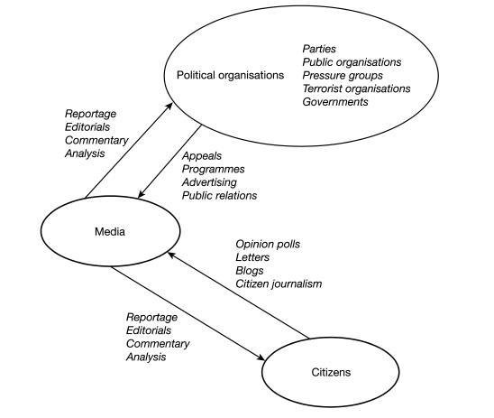
ASPECTS OF POLITICAL COMMUNICATION RESEARCH
B. McNair's three-element model of political communication. strata.
Source: https://www.researchgate.net/figure/B-McNairs-three-element-model-of-political-communication_fig5_277954126

Slide 12
Political communication from Africa’s perspective
there is no room for generalizations because Africa is clearly not a single country.
various countries in Africa demonstrates a diversity of experiences when it comes to the rickety or unbalanced relationship between politicians, mass media and citizens.
To understand this heterogeneity, one needs to look no further than the diverse cultural, social, historical, religious and indeed linguistic differences associated with the African continent.
unlike the situation in liberal democracies of the West where the press plays a watchdog role in seeking ‘to prevent the abuse of power’ or take the function of the Fourth Estate the case studies presented in this study show a systematic marginalization of media institutions aimed at keeping them out of political power and influence (Mutsvairo and Karam, 2018).

Slide 13
Political communication from Africa’s perspective
The role played by technology
Gone are the days when citizens were considered passive political players if not receivers.
The capacity for citizens to gather and in many instances even disseminate news through social media channels such as YouTube is also significantly changing the field of political communication in the region, considered home by up to 1.216 billion people.
A booming civil society has had a key role to play in empowering the citizens, but thanks to the advent of online technologies, citizens are taking it upon themselves to empower each other politically.
Through the Internet, citizens have taken a new active role not only in determining a country’s political shape but ensuring that those who abuse power are brought to book.

Slide 14
Political communication from Africa’s perspective
Politicians are emboldening themselves with a firm grasp of online technologies, so as to make the process of reaching out to constituents and supporters simple and useful.
Social media platforms are being used to drum up support for candidates during elections across the continent.
Other politicians are maximizing the potential of new technologies to their fullest extent by building political websites or blogs to support their political base.
The enduring hashtag #WhatWouldMagufuliDo that universally trended on Twitter and Facebook is a key pointer to Africa’s increasing importance in global politics (Tanzanian President cracked down on corruption and wasteful spending in the aftermath of his inauguration in November 2015. ).

Slide 15
Political communication from Africa’s perspective
A study on digital political participation in 2014 found that six out of ten Kenyans were actively participating in political issues, along with 52% of Senegalese, but also concluding that just 24% of Ghana’s population were highly engaged political participants (Pew Research 2014).
shows the varying nature of online-based political participation in Africa.
Particularly pressing issues, including restricted civil liberties, digital divide and digital illiteracy, have been highlighted by Mutsvairo and Harris (2016) as key factors inhibiting the Internet’s potential to influence African politics.

Slide 16
Political communication from Africa’s perspective
Challenges
the prohibitive cost of accessing the Internet either via mobile phones or computers, and also slow connections: a lack of information technology (IT) infrastructure remains a major hindrance to Africans attempting to go online.
Realizing the potential for social media to facilitate active citizen political engagement, some African governments are opting to regulate and restrain these digital spaces. One way of doing this is by switching off WhatsApp or any social media platforms.
measures to shut down social media ahead of election or mass anti-government protests so that ‘social media are not used to send misleading information that could destabilize the country’

Slide 17
Critics of media and political reforms in Africa.
Globalization has in part steered African political and media systems in the direction of reform but these endeavors have been religiously resisted.
The adoption of Western models of journalism as a hallmark of media and political democratization continue to face enduring opposition among long-standing African leaders.
African leaders are determined to extend their political longevity by controlling media institutions.
While privately owned media have flourished across Africa, Eritrea has refused to warm to the idea, steadfastly remaining in its own league by denying operational licenses to would- be independent journalists and closing down the lone opposition voice in 2001.

Slide 18
Critics of media and political reforms in Africa.
President Robert Mugabe of Zimbabwe, in power since independence from Britain in 1980‚ but ousted in 2017‚ who arrested Western journalists and attempted to silence reporters from the private media, accusing them of being regime change agents.
Media control is a notable habit of other long-serving African presidents, including Paul Biya of Cameroon, Eduardo Dos Antos of Angola and Equatorial Guinea’s Teodoro Obiang Nguema, who have a combined uninterrupted leadership reign of over 105 years. Dos Antos quit active politics in 2017.
under Mugabe’s reign the monopolisation of news remained the government’s closely guarded ambition, with state journalists clearly enjoying privileged access to the president and other state functionaries (Mutsvairo and Karam, 2018).

Slide 19
Critics of media and political reforms in Africa.
Long-serving presidents within totalitarian African states consider independent journalists agents of the neo-liberal model of democracy, which is mostly supportive of Western institutions such as the World Bank and International Monetary Fund.
independent journalists agents are mostly aligned with opposition politics, which in many countries face the accusation of representing Western imperial interests, hence the need to resist reform and maintain hegemonic powers.
In rejecting reform, the law and regulatory mechanisms normally work hand in glove to stifle media development and the freedom of expression.

Slide 20
Critics of media and political reforms in Africa.
Nigeria’s revised constitution falls short of guaranteeing media freedoms or freedom of the press, choosing instead to provide provisions for the freedom of expression.
This means, therefore, that the law does not explicitly protect the work of journalists.
The democratic credentials of African governments have been doubted by Joseph (1998), who contends that the holding of regular elections is largely symbolic: the shambolic nature of voting leaves the process with little credibility and legitimacy

Slide 21
The Roles of a vibrant civil society
Gyimah-Boadi’s (1998) research in Tanzania has flaunted the notion that key to transforming African political systems is the presence of a vibrant civil society.
African leaders’ ideology that civic society and non-governmental organizations represent the interests of the imperialists makes it nearly impossible for these institutions to play a role in fulfilling the media or political reform agenda as they are viewed with suspicion.
In 2015, Haki Africa, a Mombasa-based non-governmental organization, was banned by Kenyan authorities for operating without a license.

Slide 22
The Roles of a vibrant civil society
American John Lombardo, who had led the non-governmental outfit Artworks for Youth, was in 2016 declared an undesirable immigrant after overstaying his visa by a day in South Africa
in Zimbabwe, civic society members were accused of being spies for Mugabe’s erstwhile or former foes, the British.
While African governments have vociferously (vocal) been critical of the continent’s colonial heritage, which favored the protection of White interests, it must be noted that in many instances they have also turned to political rhetoric, hypocritically using the same privileges, and in some cases settler laws, to protect their own interests and those of their associated political elites at the expense of nation building.

Slide 23
A historical overview of political communication in Africa: The Case of South Africa
In South Africa a distinct body of multi-disciplinary work has emerged, and this political communication research can be separated into five distinct themes.
The first is that of political economy and the media. Much academic research, since the end of apartheid and colonialism, is concerned with complex issues such as the role of the state broadcaster (SABC) in a political economy; the effects, patterns and organization of media ownership; and the number of ways in which the national press has been seen to support the neo-liberal agenda of government privatization.
In one such article, for instance‚ Duncan (2014) argues that the African National Congress (ANC) has become dominated by secur-ocrats.

Slide 24
A historical overview of political communication in Africa: The Case of South Africa
A second major body of work has evolved around the analysis of local and presidential elections either from the vantage point of politicians, political parties, analysts or expert consultants.
A third distinct theme to be identified within this body of work is that of pressure groups, non-government organizations and professional bodies and analysts.
These include, but are not limited to, the Freedom of Expression Institute, Media Monitoring Project and the Media Tenor South Africa.
These analysts, researchers and political activists are considered ‘largely invisible’ (Glenn and Mattes 2012).
The experts and analysts are often consulted by both the ruling government and opposition parties in order to critique media coverage at distinct junctures in South Africa’s socio-political history.

Slide 25
A historical overview of political communication in Africa: The Case of South Africa
A fourth influential body of work within political communication has developed out of the study of South Africa’s Truth and Reconciliation Commission (TRC) (1996).
Initially the research documented the TRC’s procedures and outcomes in a descriptive manner.
More recently, though, research has been published on the politics of memory, history and reconciliation in the democratic public sphere.
The studies address various issues, such as, how the forgiveness of the transgressors of violence in the past goes hand in hand with building a stable, transitioning society and thereby encouraging a robust public sphere with active, questioning and critical citizens.
It is assumed that attending to past injustices will ideally lead to a reconciled society, while burying these collective and individual traumas would lead to a polarized or schizophrenic society, and public sphere, even delaying transition, thereby jeopardizing the birth of democracy.

Slide 26
A historical overview of political communication in Africa: The Case of South Africa
Lastly, the theme of new media and ICT and their relation to, and within, political communication.
The Internet functioning as a public sphere; the impact on democratization; the use of new media as a form of political communication; the use of social networking sites functioning as agents of change, and even of sub-activism.
Bosch’s study on the growing use of Facebook by South African youth as a form of ‘political sub-activism that works at the margins of the dominant public sphere’ (2013: 119).
Bosch makes use of the South African student-mobilised campaign Rhodes Must Fall (#RhodesMustFall or #RMF) to explore ‘youth activism and counter- memory’ as these students campaigned to remove the monumental statue of Cecil John Rhodes, a British imperialist and colonialist. These students argue that the statue promotes institutionalized racism and exclusion.

Slide 27
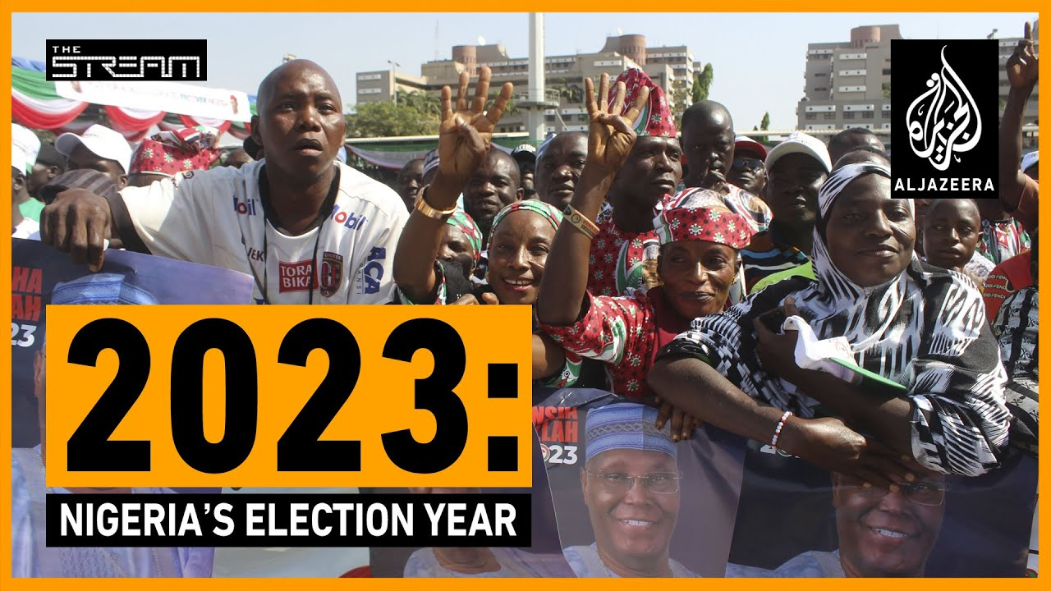
Election fever hits West Africa
The good, bad, and the ugly: West Africa’s big issues in 2022. Source:
https://www.aljazeera.com/news/2022/12/22/the-good-bad-and-the-ugly-west-africas-big-issues-in-2022

Slide 28
Political development communication opportunities and challenges in Africa
New technologies have both positively and negatively transformed the dynamics of political communication in twenty-first-century Africa.
Take South Africa, a country that is considered well connected digitally in comparison with other nations on the continent.
Estimates by Bosch and Mutsvairo (2017) show that up to 7.4 million South Africans have access to Twitter while 8.28 million are subscribed to YouTube, yet exorbitant accessibility costs are normally not put in the frame by technological deterministic evangelists.
Mobile operators claim the loss of potential revenue caused by the lack of 100% rural connectivity leaves the cost of accessing broadband mobile Internet highly expensive and at US$146 a gigabyte, perhaps one of the most highly priced in the world.

Slide 29
Political development communication opportunities and challenges in Africa
Tanzania apparently has the cheapest 1 GB at US$0.89.
In South Africa this is pegged at nearly US$5‚ as the South African parliamentary hearings heard in September 2016 in response to the #DataMustFall protests against the colossal costs of wireless data‚ which took lawmakers by storm across the country.
In Zimbabwe, 1 GB cost US$35 per month.
The lack of sustainable competition could be the main reason behind these excessive Internet costs, with leading telecom firms Vodacom and MTN enjoying a preponderant monopoly that leaves them accounting for a 70% total market share.

Slide 30
Political development communication opportunities and challenges in Africa
Internet costs are a limiting factor to political participation in a highly unequal society such as South Africa, where nearly half of the country’s 51.8 million citizens live in poverty.
However, on the contrary a study of trends in political participation in fifteen African countries concluded that social status or poverty did not influence participation rates (Bratton 2008).
the tendency to assume there wasn’t technology in Africa before the colonial arrival is worrisome and misleading, as indigenous communication has always prospered.
The preference for Western or Chinese models of technology is hurting Africa’s potential. It is also killing opportunities for local initiatives.

Slide 31
Political development communication opportunities and challenges in Africa
Traditional chiefs have historically safeguarded and controlled all forms of communication at village or community levels. In emerging systems, local chiefs have lost their political power, with Western-oriented parliamentarians becoming key political representatives.
The opportunities presented by modern technologies appeal to nearly everyone, politicians, citizens and media professionals alike, but it cannot be forgotten that they also cripple local initiatives.
Africa is haunted by a lack of innovation as more and more people look to the West instead of advancing their own political models.
Why should African politicians aspire to attract democracy to their countries when they can adopt simple models that befit their cultural, political and economic circumstances?

Slide 32
SUMMARY
Africa as a region has its own shared yet sometimes complicated history in addition to very diverse religious and social cultures.
Remarkably, and complicating things further, it is possible to discover many cultures or religions within one African country.
History is key to understanding the complex African political terrain.
Political communication is a process that is central to political institutions and particularly the traditional news media but increasingly on other media platforms and formats such as social media.
Thus, political communication includes both traditional mass media and new media such as social media, and particularly now the interrelationship between old and new media and how they relate to political processes.

Slide 33
SUMMARY
Political communication as a field of research deals with the following aspects: the creation, shaping, dissemination, processing and effects of information within the political system and the media system.
Thus, it deals with the interplay of communication and politics. It includes the activity of citizens, individual political figures, public and governmental institutions, the media, political campaigns, advocacy groups and social movements.
It encompasses the communication from those who govern to those who are governed as well as the debate about the political system and events in the media.
Relations between the media and state players in several post-colonial African countries have always been guarded, with members of the press corps working to actively promote the ruling party in what has been called the Soviet media model.
New technologies have both positively and negatively transformed the dynamics of political communication in twenty-first-century Africa.

Slide 34
THANK YOU
LECTURE 8
BY DR. RAPHAEL OGUTU,
Mass Communication Department,
AFRICA NAZARENE UNIVERSITY.

