Slide 1
Communication Systems in Africa
LECTURE 9
WEEK NINE: Media Power in Relation to Political Powers and Sovereignty
BY DR. RAPHAEL OGUTU,
Mass Communication Department,
AFRICA NAZARENE UNIVERSITY

Slide 2
Objectives
Understand the concept of Democracy
Explain Democracy in Africa
Critic The Mass Media and Democratic Consolidation in Africa
Discuss New Media and Democracy in Africa.

Slide 3
LECTURE OVERVIEW
In this lecture, attempts have been made to to understand media power in relation to political establishments and the place of democracy in Africa.
There is no doubt that democracy, as we know it today, could not have survived in the western world without the constant vigilance of the media.
The euphoria of the South African struggle for liberation encouraged the African masses in the 1990s to believe the time has come to be liberated from dictatorial autocrats who while promoting obscure notions of national development and stability deterred all forms of opposition.

Slide 4
LECTURE OVERVIEW
In spite of the positive changes that the western media have brought about, we cannot expect the African media to play exactly the same role in sustaining democracy as defined by Europe or America.
one of the elements of democracy and the rule of law is the freedom of expression. To democratize is to ensure free unhindered two-way communication between the government and the governed.
The essence is to ensure the responsiveness of the government to the yearnings of the people and for the people to put their views across to government without fear or hindrance and in an atmosphere devoid of interference.
The role of the media is facilitative, supportive and integrative.

Slide 5
The Concept of Democracy
democracy is popularly conceptualized as government of the people, by the people and for the people.
As a concept, has problems of homogeneity in that it is often used in an ambiguous and inconsistent way, such that it means different things to different people; in different contexts.
As an ideology is the philosophy of governance which sets a high premium on the basic freedom or fundamental human rights of the citizens, the rule of law, the right to property, the free flow of information and the right of choice between alternative political positions.
On the other hand, democracy as politics is concerned with the institutions and processes of governance that may elicit, tend to foster consensus whilst simultaneously promoting and sustaining respect for the ideology of democracy
(Obasanjo and Mabogunje 1992:1).

Slide 6
The Concept of Democracy
Democracy as conceived in the West may present an ideology of democracy that has problems for developing countries in Africa and other developing countries.
As Nwabueze (1993) observed, “western democracy places people into artificial antagonistic boxes, turn friends into enemies and aims at arousing unnecessary competition”.
Democracy is a concept concerned with conditions of things, conditions such as a virile society, a democratic society, a free society, a just society, equal treatment for all citizens by the state, an ordered, stable society, a society infused with the spirit of liberty, democracy, justice and equality.

Slide 7
The Concept of Democracy
Democratization requires that a society, the economy, politics, the constitution of the state, the electoral system and the practice of government be democratized.
Against this background,: Kabira et al (1993) have argued that no society qualifies as democratic, representative and progressive until there is free and voluntary participation of all its citizens in all spheres of life.
According to them, no society participating fully and meaningfully in politics are removed.

Slide 8
The Concept of Democracy
Certain institutions are fundamental for democratic processes and the sustenance of the process. These were identified by Obasanjo and Mabojunje (1992:19) to include;
pressure groups, political parties, the civil bureaucracy and the court system.
Even they are vital for proper democratic practices, most of them were created by government, enjoy government subventions and government has virtually eaten their way into the operations and activities of these institutions.
For democracy to survive, these are some fundamental processes such as: a visionary and effective executive, a committed and responsible legislative, a fearless and firm judiciary, a forthright and courageous press, an active and tolerant multiparty system, and a free and fair electoral system sustained by an independent and incorruptible electoral commission

Slide 9
The Concept of Democracy
Essential Basic Rights in a Democracy
According to Obasanjo and Mabogunje, there are certain basic rights that are essential for popular and participatory democracy. These include economic, political, social and human rights.
a. Economic rights; The right to work, the right to choose one’s trade and profession and the right to participate in controlling and managing economic activities of the nation.
b. Political rights: These include the right to participate in the decision making process in the country, the right to have full residence opportunities, the right to form associations and the right to equality before the law

Slide 10
The Concept of Democracy
Essential Basic Rights in a Democracy
c. Social Rights: These entails the right to free education at all levels, the right to health insurance and care, the right to safety and welfare of all citizens, and the right to equal treatment before the law.
d. Human rights: These includes the right to life, to human dignity, to fair hearing, to private and family life, the right to freedom of thought, conscience and religion, the right to freedom of expression and of the press, the right to peaceful assembly and association, the right to freedom from discrimination.

Slide 11
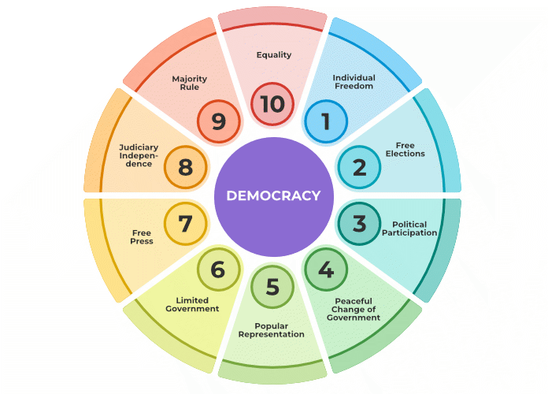
What is Democracy?
Democracy refers to the political structure where people directly exercise political power or elect members from themselves to represent the people, like that of parliament. It is also referred to as majority rule and people can’t inherit the power. People have the power to choose their representatives. The representatives participate in an election and the voters elect their members.
Source: https://www.geeksforgeeks.org/broader-meaning-of-democracy/

Slide 12
Democracy in Africa
Democracy as a concept is not new to Africa (Obasanjo and Mabogunje 1992:11).
In some African communities, the traditional system of government was relatively democratic.
The political structure and processes of most pre-colonial communities within the enclave of what is present day Nigeria were relatively democratic.
In Botswana, the, Kothia system of native administration is reasonably democratic and participatory.
In Igbo traditional society in Nigeria, there was an element of democracy in the way the people governed themselves.

Slide 13
Democracy in Africa
Today, the varieties of democratic governance reflect the diverse cultural and historical antecedents and varieties of traditional governance system among the constituent nationalities.
may not strictly conform to the realities and nature of modern democratic governance and universal standard which prescribes participation and inclusion by rotation through elections among political groups that compete to occupy positions of power in the governance process.
democracies on the African countries are at the infantile stage compared to western liberal democratic standard.
They are still grappling to fathom a balance between traditional political culture and the modern system of governance, hence the emergence of “Sit tight” dictators and protracted single party rules in some African countries

Slide 14
Democracy in Africa
Nigeria, Ghana, Mali, Burkina Faso, etc. have witnessed military rule before embarking on the path to democracy.
The northern African countries have tempted to combine western style democracy with classical Islamic governance culture which does not permit complete participation of individual citizens as expounded by western democracy (Isola, 2008:24).
Rather, an element of theocracy which justifies divine ascendancy of leaders into governance is much more deep rooted.
In Egypt, Libya, Algeria and Sudan, four north African countries, the same leadership has been in power for almost three decades; even though elections take place occasionally to assert and legitimize the continuity of the extant leadership.

Slide 15
Mass Media and Democracy
The role of the media in a democracy therefore is to assist in building an environment conducive to democracy, by promoting free choice of leadership, respect for the rule of laws, by both the rulers and the ruled, social justice and equity as well as respect for human rights (Obasanjo and Mobogunje 1992:133).
Another important role of the mass media in a democracy is to assist in the entrenchment of a political culture that allows for free and orderly succession, especially of civilian to civilian administration.

Slide 16
Mass Media and Democracy
Objectives of the Mass Media in a Democracy
The objectives of the mass media in a democracy as suggested by Oseni (1992:133) include the following:
i. To convey information to the people with a view to letting them know how their mandate is being discharged.
ii. To provide a forum through which the governed could react to government policies and activities.
iii. To provide such analysis as would enable the people secure an adequate understanding of events and background to events.
iv. To assist in the articulation and pursuit of the national interest.

Slide 17
Mass Media and Democracy
Objectives of the Mass Media in a Democracy
v. To help strengthen the economic, social and political fabric of the nation.
vi. To provide informal criticism and viable alternatives.
vii. To monitor the performance of government with a view to preventing deviation from agreed objectives.
viii. To provide the medium for transmitting knowledge and education to the populace.
ix. To function as an agent of modernization.
x. To assist in setting an agenda for priorities in national development.

Slide 18
The Mass Media and Democratic Consolidation in Africa
Democratic consolidation is the capacity of the polity to nurture and sustain democratic values over a long spell with little or no threat of abortion of the democratic experiment in all ramifications (Sarton 1992 cited in Ojo, 2003 :5).
In this respect, the mass media has played a significant role in the struggle for democracy in several African countries
In countries that have gone through autocratic and dictatorial rule (military regimes) the mass media have helped entrench democracy and cooperation between the new leaders and the citizenry through ideological persuasions that helped to legitimize the government and win the loyalty of the people

Slide 19
The Mass Media and Democratic Consolidation in Africa
The mass media in Africa in promoting democracy has been limited from the onset by several factors.
Firstly, Africa had a long colonial history without the benefit of a solid mass communication foundation that is capable of serving as the bedrock for the formation of truly independent, democratic and viable nation states
Secondly, there was no favourable national political philosophy and ideology that is anchored on egalitarianism and democratic ideals (Ojo, 2003).
Thirdly, there was no reliable communication infrastructure needed for effective communication between the government and the vast majority of the people scattered over large geographical areas

Slide 20
The Mass Media and Democratic Consolidation in Africa
Human rights Factors
Human rights studies by the Amman Centre (ACHRS) in 2006 shows that the mass media in African countries, especially northern African Islamic countries are characterized by state intervention.
The studies show that the level of freedom for media practitioners operating in Arab countries such as Egypt, Morocco, Libya, Tunisia and Algeria is low. In these countries, media personnel face physical harassments, threats and assault by state agents.
In Somalia, a failed state where a protracted armed conflict and political crisis have rendered the state comatose, it has the worst record for providing the worst scenario for professional activities of the.. media. More journalists were killed in Somalia than in other Arab countries except for Iraq.

Slide 21
The Mass Media and Democratic Consolidation in Africa
Mauritania provides the best and most conducive operating environment for the African Arab media because the media are allowed enough freedom to encourage them to contribute to democratic governance.
In some weak and failed states, such as Somalia, Liberia, Sierra Leone and Rwanda, the mass media reflected the environment within which they operate.
The risk of operating as a journalist or media owner is high in such states, and this discourages media professionals and investors in the media, except when one aligns with the dominant political groups who may facilitate media operation in exchange for media support and patronage to sustain the ruling groups ideologies, interests or hold on to power

Slide 22
The Mass Media and Democratic Consolidation in Africa
Challenges Facing the Mass Media in Promoting Democratic Consolidation in Africa
The unstable political and economic climate that prevailed in the 1970s and 1980s coupled with idiosyncratic media policies and laws by autocratic leaders have led to a divisive disloyal, psychopathic praise singing, conscienceless and downright corrupt mass media in Africa.
Other factors include: low level of infrastructural development and essential facilities, pattern of media ownership and control, unstable socio-economic and political conditions, low level of literacy and political education, ethnicity, parochialism, unfavourable legal environment and lack of private sector involvement. Sadeeq (2003 ) and Edeani (1989)

Slide 23
The Mass Media and Democratic Consolidation in Africa
Pattern of Media Ownership and Control in Africa
The prevalence of government owned media is acting as a constraint to effective performance of the media as watchdog (Isola 2008:23).
The mass media in most African countries are mostly government owned.
The owners perform some gatekeeping functions that are conditioned by political, parochial and economic interests.
As a result, the media serve the interests of elites or the government in power at the expense of the majority.
Consequently, the impact of the socialization and democratization function of the mass media are limited.

Slide 24
The Mass Media and Democratic Consolidation in Africa
Poor Socioeconomic Situation
Poverty and democracy have an inverse relationship. In Africa, poverty is an all-consuming and multidimensional concept with multifarious causes and multidimensional effects that negatively affect the process of participatory democracy and decision making (Obasanjo, 1992:10).
There are three broad types of poverty which may affect the sustenance of democracy.
These are: Poverty of material wellbeing conceived as the lack of the basic necessity for the sustenance of life. Poverty of ideas among the leaders and the led resulting in lack of good judgment in supporting democratic processes in the society and Poverty of courage, typified by a situation where there is a timid citizenry very apprehensive and cautious in standing up against lapses on the part of those in power or telling the government what it has done wrong.

Slide 25
The Mass Media and Democratic Consolidation in Africa
Poor Infrastructure and Facilities
Most countries in Africa, South of the Sahara still carry the burden of irregular power supply to their urban and village communities and this has seriously impeded the usefulness of the electronic media, especially television.
Consequently, most of the citizens are not aware of what is happening in their communities, including the government policies and programmes that are being implemented.
Poor transport conditions and seasonal accessibility to some remote, arid or riverine areas make access to rural areas difficult for newspaper circulation, especially community newspapers which are fastly becoming elitist and mechantilistic (Sobowale 1989). Low level of technological development, and shortage of well trained mass communicators, have affected the quality of programming, production and transmission.

Slide 26
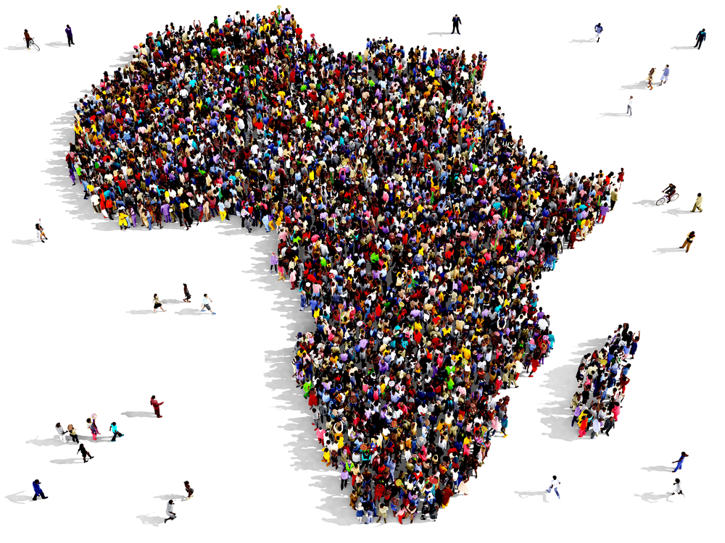
WHAT IS THE BIGGEST IMPEDIMENT TO DEMOCRATIC GOVERNANCE IN SUB-SAHARAN AFRICA?
. https://www.ned.org/big-question-biggest-impediment-democratic-governance-sub-saharan-africa/

Slide 27
The Mass Media and Democratic Consolidation in Africa
Ethnic and Parochial Loyalties
Democracy relies on divergence of interests and opinions to survive in pluralistic societies. In Africa, however, the pattern of horizontal and vertical segmentation among the multi-ethnic, multicultural and multilinguistic societies has given rise to familism, parochialism and chauvinism in the body polity (Imoh 2008).
This segmentation has served as a self limitation on the growth of the state and made it difficult for the mass media to effectively champion the cause of democracy.
In Nigeria, for instance, the Tribune represents the Yoruba interest, the New Nigerian, the northern interests while the West African Pilot was used by Dr. Nnamdi Azikiwe to promote the sociopolitical interests of Eastern Nigeria (The Ibos).

Slide 28
The Mass Media and Democratic Consolidation in Africa
Unconducive Legal Environment
The African environment has not been conducive for the mass media to promote democratic ideals among the people, because the laws and constitutions of the land have not allowed unhindered access to information by journalists, so as to promote accountability and transparency by government and public servants.
Unfortunately many countries in Africa including Nigeria and a majority of the Arab states have failed to entrench press freedom in their constitution.
Several media establishments and journalists have been maltreated by the governments in power in several African countries for publishing the truth that puts the government in bad light.

Slide 29
The Mass Media and Democratic Consolidation in Africa
Military Interventions in Politics; In the event of a coup, the mass media are the first victims. In Nigeria, Ghana, Uganda, Burkina Faso and Guinea Bissau, the military has disrupted democratically elected regimes and taken over the reigns of government.
Religious Pluralism; Africa is a multi-religious continent and religion has been a source of stress to democracy in many African countries, superiority of one religion over others have created a “we” and “they” syndrome that tend to undermine the growth of true democratic culture and the sustenance of democratic values and norms.
Inadequate Training of Journalists; The mass media on their own cannot design and produce messages or programmes on democracy, only journalists do.

Slide 30
New Media and Democracy in Africa
Morrisett (2003) identifies democratic uses of new technology as:
Access: Problems of access in African countries include power and technical deficiencies, the suspicion of technology transfer leading to increased dependency on the West, and struggles over control.
Information and education: While the quantity of online content has increased, its quality remains doubtful. Regulatory problems are likely.
Discussion: Institutional affiliations restrict participation. Further, online discussion currently seems to reflect rather than to challenge existing institutions (such as gender norms).
Deliberation: This is hindered in Africa by lack of access to technology, rigid structures of organizational and political decision-making, and people’s economic struggles.
Choices and action: Alternative public spheres are emerging that are structured around interest-based communities. These may not intend to generate sustained action, but arguably communication is itself an action.

Slide 31
SUMMARY
Media constitutes as the fourth pillar of democracy. The role of the media is vital in generating a democratic culture that extends beyond the political system and becomes engrained in the public consciousness over time.
Media is supplying the political information that voters base their decisions on. They identify problems in our society and serve as a medium for deliberation.
They also serve as watchdogs that we rely on for uncovering errors and wrongdoings by those who have power. Media is vital in generating a democratic culture that extends beyond the political system and becomes engrained in the public consciousness over time. The role of media in a democracy is as crucial as that of the politicians and should never be underestimated.
The role of the media in the consolidation of Democracy in any particular country is facilitative, supportive and determined by the nature of the society itself. To be effective, the media need an enabling environment.

Slide 32
SUMMARY
Since most media establishments are government owned and controlled by politicians with political biases and leanings, the involvement and participation of the private sector and civil society organizations would go a long way in achieving a balance.
In carrying out their functions, the media must not be merely a mirror of society, passively reporting events.
They must act as the watchdog of society and the instigators of positive change. But to effectively perform these roles, the media should be independent and given a free hand to perform within the ethics of their profession even when they are owned by private individuals, the government and non- governmental The media must also operate in a responsible manner, by exercising a strong sense of fair play and a deep respect for truth in the handling of news and opinions. Above all, the media must operate an effective system of self-monitoring and self-supervision.

Slide 33
SUMMARY
Media act as a catalyst for democracy and development, helping to make public participation meaningful .
If media is honest and committed in its job, democracy is bound to function more efficiently and the loopholes present in any democratic system can certainly be plugged to the fullest satisfaction of the people. On the contrary, if media is biased, corrupt and favours only a particular party or few individuals, it can prove to be very dangerous for the smooth functioning of democracy.
No one can become perfect and one can only strive to become so. The same holds true for our media also. Certainly there is still a lot of scope for improvement by which the media can rise upon the aspirations of the people for which it is primarily meant.

Slide 34
THANK YOU
LECTURE 9
BY DR. RAPHAEL OGUTU,
Mass Communication Department,
AFRICA NAZARENE UNIVERSITY.

