Slide 1
Communication Systems in Africa
LECTURE 11
WEEK ELEVEN: Democratization of Public Communication
BY DR. RAPHAEL OGUTU,
Mass Communication Department,
AFRICA NAZARENE UNIVERSITY

Slide 2
Objectives
Understand an overview of the democratization of African Media
Explain the relation between Media and Democracy
Analyze the role of the Media in Deepening Democracy in Africa
Discuss recommendations on factors affecting media and democratization process.

Slide 3
LECTURE OVERVIEW
Let us begin by looking at the following famous quotes on media:
Pandit Jawaharlal Nehru called media ‘the watchdog of our democracy’.
“If it were left on me to decide whether we should have a government without newspapers or newspapers without a government, I should not hesitate a moment to prefer the latter.” (Thomas Jefferson)
After independence in the 1960s most African governments embraced a developmental philosophy in their approach to political and economic issues.
Then after there were systematic suppression of organized opposition parties, and the elimination of all forms of dissent consequently the establishment of one-party states or military regimes.

Slide 4
LECTURE OVERVIEW
Because of the enormous problems facing many African and other developing countries, it was necessary to abridge civil and political rights in order to accelerate development .
The role of the media in a developing country should also be seen in this context of participation, meaning the critical examination, evaluation and report of the relevance, enactment and impact of development.
It is essential that the media be sufficiently free and independent of governmental control and political pressures (Mak’Ochieng, 1994).

Slide 5
The Role of Media in Democracy
Democracy is a government of the people, for the people and by the people and which gives equal chance to all the citizens to participate and play a significant role in the political process, ensures and guarantees certain rights and freedoms to the people constituting the policy.
Freedom of speech and expression is one of the most important ones as it gives substance and meaning to ‘participation’ of the people.
Thus reliable information sources form an important constituent of a democratic society.
This is where the role and importance of media arises.
They have provided information and entertainment to people across countries

Slide 6
The Role of Media in Democracy
Access to information is essential to the health of democracy for at least two reasons.
  First, it ensures that citizens make responsible, informed choices rather than acting out of ignorance or misinformation.
  Second, information serves a “checking function” by ensuring that elected representatives uphold their oaths of office and carry out the wishes of those who elected them. In some societies, an antagonistic relationship between media and government represents a vital and healthy element of fully functioning democracies.

Slide 7
The Role of Media in Democracy
Media supports democracy by bringing out the democratic norms and inculcating the same in the general public.
Providing live coverage of parliament proceedings, activities of politicians, programmes on democracies etc.
The rule of law may be further institutionalized by support for an independent media that keeps a check on the judiciary, reports on the courts, and promotes a legal enabling environment suitable for press freedom.
Free and fair elections conducted through transparent processes require a media sector which gives candidates equal access, and reports the relevant issues in a timely, objective manner

Slide 8
The Role of Media in Democracy
Role of Media in Good Governance
Good governance is an indeterminate term used to describe how public institutions conduct public affairs and manage public resources.
Is the process of decision making and the process by which decisions are implemented (or not implemented).
Is about the processes for making and implementing decisions.
Is making ‘correct’ decisions but about the best possible process for making those decision.
Centres on the responsibility of governments and governing bodies to meet the needs of the masses as opposed to select groups in society.

Slide 9
The Role of Media in Democracy
The role may yield results in governance activities, particularly those related to decentralization, anti-corruption, and citizen participation in the policy process.
An independent media that keeps a check on the judiciary, reports on the courts, and promotes a legal enabling environment suitable for press freedom.
Free and fair elections conducted through transparent processes require a media sector which gives candidates equal access, and reports the relevant issues in a timely, objective manner.
Article 19 of the 1948 Universal Declaration of Human Rights states, “Everyone has the right to freedom of opinion and expression; this right includes freedom to hold opinions without interference and to seek, receive, and impart information and ideas through any media and regardless of frontiers,”

Slide 10
The Role of Media in Democracy
Supporting democratic transitions
The goal of media development generally should be to move the media from one that is directed or even overtly controlled by government or private interests to one that is more open and has a degree of editorial independence that serves the public interest.
Goal of media assistance should be to develop a range of diverse media and voices that are credible, and to create and strengthen a sector that promotes such outlets.
Credible outlets enable citizens to have access to information that they need to make informed decisions and to participate in society.
A media that has a degree of editorial independence, is financially viable, has diverse and plural voices, and serves the public interest.

Slide 11
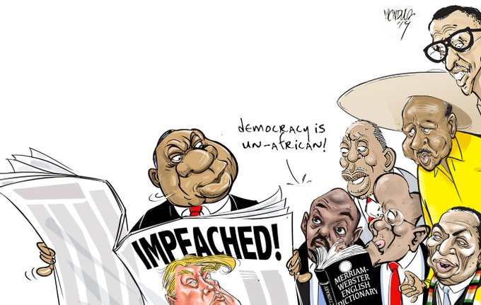
The Role of Media in Democracy
@ndula_victor
Editorial cartoonist and comics journalism. First prize winner of UN\RANAN LURIE INTERNATIONAL CARTOON AWARD 2012. Changing the world one drawing at a time.
Source: https://twitter.com/ndula_victor/status/1207899801024696325for @dailynation Africa following closely #trump #impeached

Slide 12
The Role of Media in Democracy
Distinction between North and South
the media is a critical ingredient in the transition of society from authoritarianism to democracy and it mirrors the level of democratic maturity in a country, and is in turn affected by the maturity of that democracy
the media supports the democratic system of free elections, majority rule, political freedom, political equality, minority rights, representative government and an independent judiciary.
democracy and media coexist and support each other through a process of negotiation hopefully aimed at developing a consensus about the public interest.
The media supply the political information that voters base their decisions on.

Slide 13
The Role of Media in Democracy
the watchdog
the watchdogs that we rely on for uncovering errors and wrongdoings by those who have power.
media services include:
  surveillance of socio-political developments,
  identifying the most relevant issues,
  providing a platform for debate across a diverse range of views,
  holding officials to account for the way they exercise power,
  provide incentives for citizens to learn,
  choose and become involved in the political process,
  and resist efforts of forces outside the media to subvert their independence.

Slide 14
The Role of Media in Democracy
Media Criticism
Media critics claim that commercial mass media controlled by a few multinational conglomerates have become an antidemocratic force supporting the status quo (Kellner 2004; Herman and Chomsky 1988; Herman and McChesney 1997; Alger 1998; McChesney 1999; Keane 1991).
The news is more entertaining than informing, supplying mostly gossip, scandals, sex, and violence.
Political news is more about personalities than about their ideologies.
In the absence of serious debate, voters are left with paid political propaganda containing only meaningless slogans making them disinterested and cynical about politics

Slide 15
The Role of Media in Democracy
The Democratic Space in Africa
The pillars that ensure democracy in any given sovereign state are:
  Sovereignty of the people,
  Government based upon consent of the governed,
  Majority rule,
  Minority rights,
  Guarantee of basic human rights, Free and fair elections,
  Equality before the law, Due process of law, Constitutional limits on government, Social, economic, and political pluralism,
  Values of tolerance, pragmatism, cooperation, and compromise (Ocitti, 1999).

Slide 16
The Role of Media in Democracy
Democratic reforms and structural economic adjustments in Africa.
The 1990s go down in history as the decade of sweeping democratic reforms and structural economic adjustments in Africa.
Growing domestic demands for political reforms in the face of increasing disenchantment with military rule or single party systems, and as pressure for political change gradually gained momentum from outside the continent in the aftermath of the Cold War
African leaders have found it increasingly difficult to hold on to power by force of arms
A combination of student activism, trade union strikes and ‘watch-dog’ journalism of the press were instrumental in paving the way for the new atmosphere of political pluralism.

Slide 17
The Role of Media in Democracy
Democratic reforms and structural economic adjustments in Africa
Economic aid by Western governments and multilateral institutions to Africa’s political and economic reforms was crucial in the democratic changes and economic liberalism that swept much of Africa in the 1990s.
For African leaders, the new momentum meant that survival became predicated on political adjustments towards liberalism, rather than the dictatorship or one-man rule of the past.
Structural adjustment meant economic reforms and political plurality.-t
Pluralism became synonymous with general elections; elections that have since become the rule rather than the exception in nearly all African countries (Ocitti, 1999).

Slide 18
The Role of Media in Democracy
The key functions of the media
- Use their platforms to promote good governance and accountability
- By enabling the free flow of information, the media stands as an important and key stakeholder of the political process in democracies.
- Use their platforms and programmes to educate through news and information dissemination.
- Provide the general public with entertainment programmes.
- Bridging of the gaps in societies, social institutions and cultures etc through news coverage and information dissemination.
- Act as watchdogs over governments’ officials, ministries agencies and institutions as well as over society and its institutions.
- Leads the setting of the agenda for debates and discussion on issues of importance and of national interest (MacQuail, 2000) .

Slide 19
The Role of Media in Democracy
Accountability of the governors to the governed
Democracy is impossible without a free press. Weaver (1977) defined press freedom as:
a) The relative absence of governmental restraints on the media;
b) The relative absence of governmental and other restraints on the media
c) The absence of restraints on the media and also the presence of those conditions necessary for the dissemination of a diversity of ideas and opinions to a relatively large audience such as enforced right of access to newspapers and radio stations.
Press Freedom is a precept that is deeply ingrained in democratic theory and practice.

Slide 20
Role of the Media in Deepening Democracy in Africa
Providing checks and balances
The media serve a very important role in making officials aware of the public’s discontents and allowing governments to rectify their errors (Holmes, 1991).
In recognition of this role, the press has been widely proclaimed as the “Fourth Estate,” a co- equal branch of government that provides the check and balance without which governments cannot be effective.
Thomas Jefferson, for all his bitterness against journalistic criticism celebrated the press, arguing that only through the exchange of information and opinion through the press would the truth emerge.
Jefferson’s declaration: “Were it left to me to decide whether we should have a government without newspapers or newspapers without government, I should not hesitate to prefer the latter.”

Slide 21
Role of the Media in Deepening Democracy in Africa
Accountability
Despite the present-day mass media’s propensity for sleaze, sensationalism and superficiality, they are still seen as essential democratic tools.
In both new and old democracies, the notion of the media as watchdog and not merely a passive recorder of events are widely accepted.
Governments, it is argued, cannot be held accountable if citizens are ill informed about the actions of officials and institutions.
The watchdog press is guardian of the public interest, warning citizens against those who are doing them harm.

Slide 22
Role of the Media in Deepening Democracy in Africa
Watch-dog:
Sustained investigative reporting on corruption, human rights violations and other forms of wrongdoing has helped build a culture of accountability in African governments and strengthened their democracies.
A fearless and effective watchdog is critical in fledgling democracies where institutions are weak and heavily criticized by political pressure.
When legislatures, judiciaries and other oversight bodies are powerless against the mighty or are themselves corruptible; the media are often left as the only check against the abuse of power.
This requires that they play a heroic role, exposing the excesses of presidents, prime ministers, legislators and magistrates despite the risks.

Slide 23
Role of the Media in Deepening Democracy in Africa
Adversarial Role of the Press
In the absence of mechanisms that monitor and evaluate the government's performance before public opinion, there is a great likelihood of the government falling into complacency, unresponsiveness and irresponsibility.
Then, the press fulfills the role of an opposition in the sense of presenting another point of view where necessary; by criticizing government decisions which are not in the best interests of the people, expose and criticize bureaucratic incompetence, denouncing abuses of power in society and defending human rights.
A press or media system that decides to do less than this, reneges on its responsibility and fails to contribute adequately to the democratic process or to national development based on democratic participation and decision-making.

Slide 24
Role of the Media in Deepening Democracy in Africa
Press as Public Forum
In an uneducated democracy, public opinion has to be generated and some agency is required to do the work.
The media also serve as a conduit between governors and the governed and as an arena for public debate that leads to more intelligent policy and decision-making.
The press is expected to draw citizens to the public square and provide a culture of community conversation by activating inquiry on serious public issues.
In new democracies, the expectation is that the media would help build a civic culture and a tradition of discussion and debate which was not possible during the period of authoritarian rule.

Slide 25
Role of the Media in Deepening Democracy in Africa
Injecting Marginalized Voices into the Public Sphere
The media is charged with the responsibility of giving a voice to those marginalized because of poverty, gender, ethnic or religious affiliation.
By giving these groups a place in the media, their views or afflictions become part of mainstream public debate and hopefully contribute to a social consensus that the injustices against them ought to be redressed.
Thus the media also contribute to the easing of social conflicts and to promoting reconciliation among divergent social groups.
Efforts such as these allow the public to raise questions about government actions, their impacts, and to hold their officials accountable, even if there is no immediate respite for the victims.

Slide 26
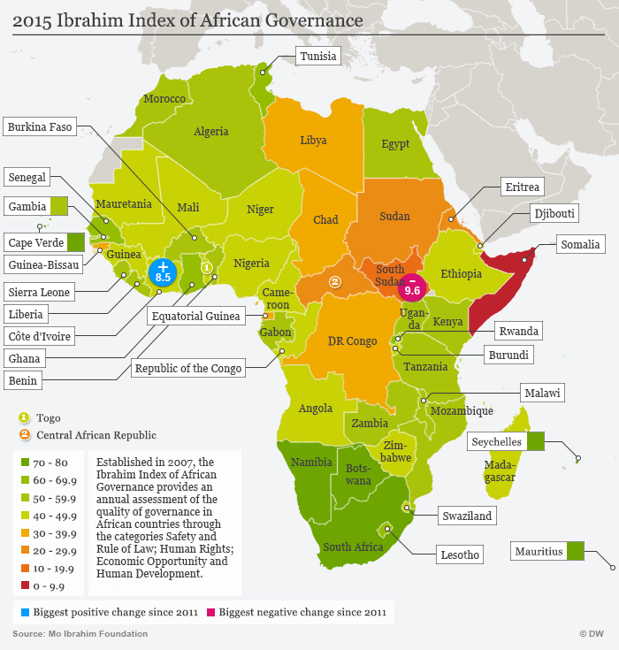
October 5, 2015
Mauritius has retained its top slot as the leading democracy in Africa, while Somalia lagged at the furthest end, according to the 2015 Ibrahim Index of African Governance (IIAG).
Isaac Mugabi
10/05/2015
Source:https://www.dw.com/en/ibrahim-index-democracy-in-africa-remains-stagnant-as-zimbabwe-makes-progress/a-18762639

Slide 27
Role of the Media in Deepening Democracy in Africa
Peace and Consensus Builder
Democracy cannot thrive in countries that are in the grip of violence and strife.
It should provide warring groups mechanisms for mediation, representation and voice so that they can settle their differences peacefully.
The media have been criticized for sensationalizing violence without explaining the roots of conflict.
In some cases, they have sowed hate speech and encouraged violence. At the height of the conflict in Rwanda in the 1990s, a radio station that had been supported by international donors became the mouthpiece of extremists who favoured and encouraged genocide (Office of Democracy and Governance, Bureau for Democracy, 1992).

Slide 28
Role of the Media in Deepening Democracy in Africa
Communication and Education Role of the Media
The media is charged with the role of opening up channels of communication to enable public access to government and its structures, and to engender public involvement and discussion of government activities.
By providing and facilitating the flow of information, the media constitute an important component of the political process in democracies.
The media educate through the provision of news and information; Provide entertainment; Bring societies, social institutions and cultures closer to each other through news coverage and the provision of information; Perform watchdog roles over Governments, their agencies and institutions as well as over society and its institutions; as well as set the agenda for debate and discussion on issues of importance.

Slide 29
Recommendations on factors affecting media and democratization process.
Media literacy needs to gain traction within the development community and innovative approaches are needed to promote media literacy skills among all citizens. Key recommendations for highlighting the need to:
▪ Support media watchdog and media monitoring groups as a tool for promoting media literacy and transforming civil society and the public into active participants in the media.
▪ Raise awareness of the role and function of the news ombudsman, which acts as a key link between citizens and news agencies, and helps to hold news agencies accountable and accessible to citizens.

Slide 30
Recommendations on factors affecting media and democratization process.
Develop media literacy skills through mobilization, public forums and debate on relevant topics such as current affairs, media practices, and citizens’ rights and obligations.
Incorporate media literacy as a core element of media development programmes.
Promote research on the impact of media literacy on citizen action, participation and good governance. Empirical evidence is also needed to build support for related policy development and advocacy efforts.
(https://ocd.lcwu.edu.pk, 2021).

Slide 31
SUMMARY
The media also exposes loopholes in the democratic system, which ultimately helps government in filling the vacuums of loopholes and making a system more accountable, responsive and citizen-friendly.
A democracy without media is like a vehicle without wheels.
So the ultimate goal of media should be to provide assistance to develop a range of diverse mediums and voices that are credible, and to create and strengthen a sector that promotes such outlets.
Traditionally and constitutionally, the media has no defined role in governance.
It doesn’t have the power to change any decisions made by the various arms of a state––the legislature, executive and the judiciary.
Yet, the media plays one of the most important roles in the functioning of any society.
It amplifies the voice of citizens and communicates their opinions to the lawmakers.

Slide 32
SUMMARY
Good governance is an ideal system which is difficult to achieve in its totality.
In other words, no country or society has ever said to achieve good governance in totality. We can only come close to this by our activities with the aim of making this ideal a reality.
It needs to be focused on the real matters, which are mostly social and economic in nature, instead of trying to divert the attention to the non issues. Achieving the good governance requires the understanding and participation of every member of the society.
The media, their significant roles, channels and contents, are considered to be the most powerful weapon to make this achievement a reality.
Today, despite the mass media’s propensity for sleaze, sensationalism and superficiality, the notion of the media as watchdog, as guardian of the public interest, and as a conduit between governors and the governed remains deeply ingrained.

Slide 33
THANK YOU
LECTURE 11
BY DR. RAPHAEL OGUTU,
Mass Communication Department,
AFRICA NAZARENE UNIVERSITY.

