Slide 1
Communication Systems in Africa
LECTURE 12
WEEK TWELVE: Problems of Human Rights. Public right and access to Information in Africa.
BY DR. RAPHAEL OGUTU,
Mass Communication Department,
AFRICA NAZARENE UNIVERSITY

Slide 2
Objectives
Understand an overview of Human rights and access to information.
Explain the Role of the Media in Protecting Human Rights
Understand Human rights and access to information in Africa.
Analyze the ATI Principles found in the African Platform on Access to Information (APAI) Declaration

Slide 3
LECTURE OVERVIEW
In this lecture, attempts have been made to understand the problems of human rights, public and access to information in Africa.
According Centre for Law and Democracy and the African Freedom of Information Centre (2015), the aim of the right to information (RTI) is to ensure the availability of information and the provision of equitable access to information to the general public.
Internationally, the RTI is recognised in Article 19 of the Universal Declaration of Human Rights (UDHR) and the International Covenant on Civil and Political Rights (ICCPR).

Slide 4
LECTURE OVERVIEW
In Africa, the RTI is recognized under Article 9 of the African Charter on Human and Peoples Rights (ACHPR), Article 19 of the African Charter on Democracy, Elections and Governance, Article 9 of the African Union Convention on Preventing and Combating Corruption, Article 10 and 11 of the African Union Youth Charter, Article 6 of the African Charter on Values and Principles of Public Service and Administration and Article 3 of the African Statistics Charter.
At a national level, sixteen countries across Africa have developed Access To Information (ATI) laws. These are South Africa, Uganda, Angola, Zimbabwe, Nigeria, Ethiopia, Tunisia, Rwanda, Mozambique, Guinea, Sierra Leone, South Sudan, Niger, Sudan, Ivory Coast and Liberia.

Slide 5
LECTURE OVERVIEW
While other African countries do not have an ATI law, there are rights in certain countries such as Kenya and Malawi while other countries recognize the right through the protection of the freedom of expression and ratification of the listed regional and international laws.
Transparency is central to the full realization of democracy in most African countries, which transitioned into democracy after decades of colonialism, war, one party rule, military dictatorships and similar systems of government which hampered good governance within some of these countries.
Access to information is a vital mechanism through which active citizens, civil society and journalists can hold government accountable and ensure government works for the people.

Slide 6
The Role of the Media in Protecting Human Rights
According to Human Rights Careers, when it comes to human rights, people know about entities like the United Nations, governments, and NGOs.
The media can raise awareness of human rights issues, expose violations, and empower people to take action. The media can also negatively impact human rights. Whether it’s making a positive or negative impact, the role of media should be understood.
Poor education: Here the level of education which is the key to every kind of success is too low and a times poor.
In third world countries the education, sector is dominated with all manner of malpractices which includes bribery, strikes, indefinite closure of school, due to illegality in its operations, unaccredited academic structures and all other shortcomings etc. , 2013)

Slide 7
The Role of the Media in Protecting Human Rights
Article 19 of the UN’s Universal Declaration of Human Rights reads: “Everyone has the right to freedom of opinion and expression; this right includes freedom to hold opinions without interference and to seek, receive and impart information and ideas through any media [emphasis added] and regardless of frontiers.”
States still have the power to decide what government information should be public or protected, but it is widely understood that freedom of expression and freedom of speech are entwined with a free media/press.
Free media is essential to human rights because, without information, people won’t know what’s going on locally, nationally, or internationally.
Free media has a responsibility to share information and help explain that information to the public in a clear, accessible way. The media also has a duty to hold people in power accountable.

Slide 8
The Role of the Media in Protecting Human Rights
The Case of the Boston Globe Spotlight Team exposes Catholic Church sex abuse
On January 6th, 2002, The Boston Globe’s Spotlight Team published the first part of an investigation into sex abuse in the Catholic Church.
The article revealed that while aware of a priest’s record of sex abuse against children, the archdiocese moved him from parish to parish for over three decades.
Since the mid-1990s, more than 130 people had come forward, but no action was taken.
The Globe’s coverage exploded into the national news, leading to the criminal prosecutions of five Catholic priests.
More survivors came forward around the world. In 2021, a report found that over 70 years, around 330,000 children were victims of sex abuse within France’s Catholic Church. The report also found that these abuses were systemically covered up, and what began with the Globe led to a global reckoning.

Slide 9
The Role of the Media in Protecting Human Rights
How the media covers a story impacts human rights
The media must report accurate facts, but their role doesn’t end there, it also plays a huge role in what people believe about the facts.
One of the most significant examples can be found in the coverage of climate change, which has huge implications for rights such as the right to food, development, housing, and life itself.
According to one study, at least 85% of the world is affected by human-induced climate change, while The World Health Organization estimates that from 2030 to 2050 climate changes will cause around 250,000 additional deaths each year.
Historically, the media has not covered climate change with appropriate concern (Human Rights Careers https://www.humanrightscareers.com).

Slide 10
The Role of the Media in Protecting Human Rights
What does responsible media look like?
Media plays a significant role in human rights for better or worse. How can it work to protect – and not harm – human rights?
There’s no simple solution. When it comes to news media, there are journalistic ethics and standards.
The Society of Professional Journalists, an organization that represents journalists in the United States, has four principles: seek truth and report it, minimize harm, act independently, and be accountable and transparent.
These principles are based on the Society’s belief that “public enlightenment is the forerunner of justice and foundation of democracy.”
Many news organizations have their own codes of ethics but follow these general principles.
If an organization does not state its ethics clearly or follow an ethical standard, this is a sign of an irresponsible media outlet.

Slide 11
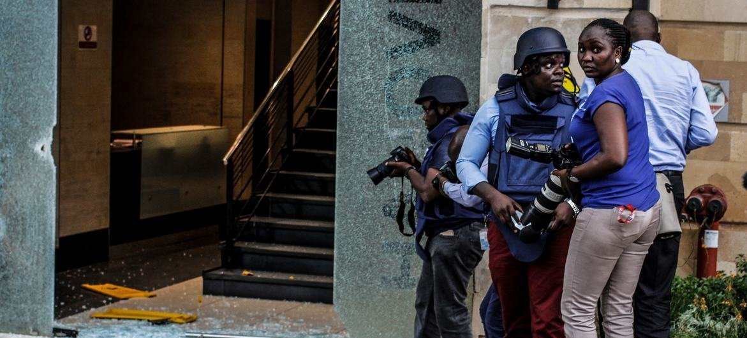
55 journalists killed in 2021, impunity ‘alarmingly widespread’ – UNESCO
Source: ©UNESCO/ Enos Teche Journalists covering a terrorist attack in Kenya.

Slide 12
The Role of the Media in Protecting Human Rights
What does responsible media look like?
What about new media? A big question today concerns social media platforms.
Just about anyone can use a platform like Twitter, Facebook, or YouTube. There’s no vetting.
When someone writes something, no editor goes over it. You just hit “post.”
Social media hasn’t been around that long, but its ability to harm human rights through the spread of violent rhetoric and disinformation is undeniable.
Unfortunately, these new media outlets have yet to recognize – and fulfill – their responsibility to human rights.
More regulation is needed, including updated laws
(Human Rights Careers https://www.humanrightscareers.com).

Slide 13
The Role of the Media in Protecting Human Rights
The cost of protecting human rights
Because the media plays such an important role in protecting human rights, it faces opposition.
According to United Nations (2022), in 2021, 55 journalists were killed. Journalists also face high rates of physical violence, intimidation, harassment, and high rates of imprisonment.
Women journalists are at an increased risk because of how much online harassment they receive.
The organization Reporters Without Borders (RSF) analyzes the state of press freedom around the world and in 2021, the situation was dire, and of the 180 countries and territories examined, journalism was “totally blocked or seriously impeded” in 73 countries and constrained in 59 countries.

Slide 14
The Role of the Media in Protecting Human Rights
Understanding Human Rights and Access to Information in Africa
According to Centre for Law and Democracy (CLD) and the African Freedom of Information Centre (AFIC) (2015), the last two decades have seen the advent of constitutional democracy across most countries in Africa which raised the hope for socially responsive governments.
While most states in Africa have supposedly elected governments, some are still regarded as undemocratic and as a result, the process of democratizing in some African states is still ongoing.
The importance of the right of ATI is now well established globally with clearly articulated principles as African States are also beginning to recognize the importance of this right in promoting transparency in government.

Slide 15
The Role of the Media in Protecting Human Rights
The importance of the right of ATI
There exists a general right of every citizen to have access to information that the state holds.
This is seen as a necessity for the principle of open government which requires that the public be granted access to information for meaningful public debate on the conduct of governmental affairs.
Over the years, the principles in support of the right of ATI have been debated. We now find, with the increased enactment by states of constitutional and statutory protections of this right, that the right of ATI exists is no longer in dispute.
Article 9 of the African Charter on Human and Peoples’ Rights (ACHPR) provides that ‘every individual shall have the right to receive information and every individual shall have the right to express and disseminate his opinions within the law.’

Slide 16
Human rights and access to information in Africa.
In 1999, Article 19, commissioned a set of principles upon which ATI laws should be based and they include:
1. MAXIMUM DISCLOSURE: ATI laws should be guided by the principle of maximum disclosure with a limited scope of exceptions; requiring information and public bodies to be defined widely. This principle also recommends that the wilful destruction of records should be labeled a criminal offence and prescribes minimum standards for maintenance and preservation of records by public bodies.
2. OBLIGATION TO PUBLISH: Public bodies should be under an obligation to publish key information.
3. PROMOTION OF OPEN GOVERNMENT: Public bodies must actively promote open government, active promotion, public education, and actively tackle the culture of official secrecy.

Slide 17
Human rights and access to information in Africa.
4. LIMITED SCOPE OF EXCEPTIONS: Exceptions should be clearly and narrowly drawn and subject to strict harm and public interest tests. The three part test to establish this is:
a. The information must relate to a legitimated aim listed in the law;
b. Disclosure must threaten to cause substantial harm to that aim;
c. The harm to the aim must be greater than the public interest in having the information It is important that refusals meet a substantial harm test and there should be the case for overriding public interest even if it can be shown that disclosure of the information would cause substantial harm to a legitimate aim if the benefits of disclosure outweigh the harm.

Slide 18
Human rights and access to information in Africa.
5. PROCESSES TO FACILITATE ACCESS: Requests for information should be processed rapidly and fairly and an independent review of any refusals should be available. This should be at three different levels including within the public body, appeals to an independent administrative body and appeals to the courts.
6. COSTS: Individuals should not be deterred from making requests for information by excessive costs.
7. OPEN MEETINGS: Meetings of public bodies should be open to the public.
8. DISCLOSURE TAKES PRECEDENCE: Laws which are inconsistent with the principle of maximum disclosure should be amended or repealed.
9. PROTECTION FOR WHISTLEBLOWERS: Individuals who release information on wrongdoing–whistleblowers–must be protected

Slide 19
Human rights and access to information in Africa.
ATI Principles found in the African Platform on Access to Information (APAI) Declaration
The APAI Declaration also recognizes some other principles and these are for access to information to become a fundamental right accessible to everyone
and established in law with application to public bodies and private bodies
and there should be clear and unambiguous processes with preferred language and accessibility by the requester of the information
and there should be oversight bodies to protect, promote and enforce the right which should include the right to personal data alongside a corresponding duty to collect and manage information as well as the duty to fully implement the declaration.

Slide 20
Human rights and access to information in Africa.
ATI Principles found in the African Platform on Access to Information (APAI) Declaration
Provides for journalists to respect editorial independence, professional ethics and journalism standards in their provision of information;
recognize the need for transparency and accountability with regard to their own output and institutions, while safeguarding the principal of protecting sources;
respect and promote equality, and provide equitable representation within their information output; promote the widest possible access to their information output;
enhance mechanisms for audience participation and response; recognize and be responsive to gender differences in regard to audience and market research; popularize the importance of, and issues around, access to information; and make optimum use of ATI laws to access information for the public interest

Slide 21
Human rights and access to information in Africa.
Global Principles on National Security and the Right to Information (Tshwane Principles)
limited exemptions can be found in the National security sphere and heavily relied on by most states in denying access to information.
To ensure that these exemptions are indeed limited, the Tshwane principles expounds on its application as follows:
a. The restriction is prescribed by law;
b. Is necessary in a democratic society;
c. To protect a legitimate national security interest;
d. And the law provides for adequate safeguards against abuse, including prompt full accessible and effective scrutiny of the validity of the restriction by an independent oversight authority and full review by the courts.

Slide 22
Human rights and access to information in Africa.
Global Principles on National Security and the Right to Information (Tshwane Principles)
e. The burden is on the public authority to establish legitimacy of any restriction;
f. No blanket exemption for any public authority that is:
i. No public authority may be exempted from disclosure requirements;
ii. Information may not be withheld on national security grounds simply on the basis that it was generated by, or shared with, a foreign state or inter-governmental body, or a particular public authority or unit within an authority (The CLD and the AFIC, 2015).

Slide 23
Human rights and access to information in Africa.
The African Charter on Human and Peoples Rights
The African Charter on Human and Peoples Rights states in Article 9 that:
1. Every individual shall have the right to receive information.
2. Every individual shall have the right to express and disseminate his opinions within the law.
The African Charter is legally binding on all States that are parties to it and all African States have ratified it. Provisions of the Charter are enforced by the African Commission on Human and People’s Rights (ACHPR).
The African Court on Human and People’s Rights located in Arusha, Tanzania is the court that exercises jurisdiction over the convention and the charter but unfortunately, no substantive case on access to information has appeared in this Court so far.

Slide 24
Human rights and access to information in Africa.
The AU Charter on Democracy, Elections and Governance provides in article 2.10 and article 6 respectively that countries must ‘promote the establishment of the necessary conditions to foster citizen participation, transparency, access to information, freedom of the press and accountability in the management of public affairs’ and for state parties to ensure ‘that citizens enjoy fundamental freedoms and human rights taking into account their universality, interdependence and indivisibility.’
Article 9 of the African Charter on Human and Peoples’ Rights and the Declaration of Principles on Freedom of Expression in Africa, guarantees the right of access to information consistent with Article 19 of both the Universal Declaration of Human Rights and the International Covenant on Civil and Political Rights; Other regional instruments such as Article 9 of the African Union Convention on Preventing and Combating Corruption require Member States to adopt legislative and other means to ‘give effect to the right of access to any information that is required to assist in the fight against corruption’,

Slide 25
The ATI Principles found in the African Platform on Access to Information (APAI) Declaration
African Union Convention on Preventing and Combating Corruption and Related Offences
This convention provides in Article 9 that each State Party shall adopt such legislative and other measures to give effect to the right of access to any information that is required to assist in the fight against corruption and related offences.
What does the Right to Information mean?
The right to information is a right to access records and information held by the state (the government) and in some cases, non-state entities (private bodies). The right to access records of the state is a right that is not reliant on any condition for the right to be exercised.
Why is access to information important?
Access to information has become the buzz word of the 21st Century. Governments and private corporations are collecting data on a monumental scale and the holder of information is far more powerful in influencing and shaping national interests. Access to information is often associated with good governance and the media is seen as the key to unlocking government secrecy.

Slide 26
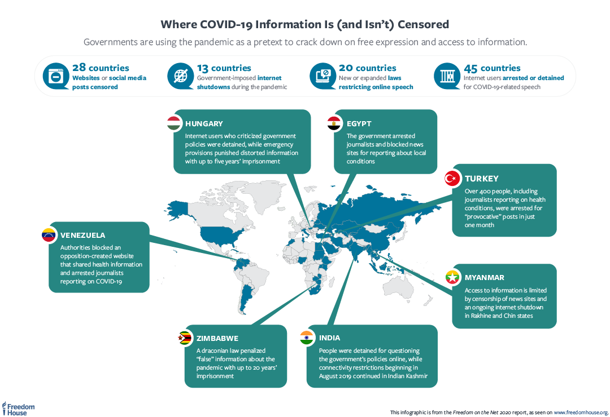
Source: https://freedomhouse.org/report/report-sub-page/2020/information-isolation-censoring-covid-19-outbreak

Slide 27
The ATI Principles found in the African Platform on Access to Information (APAI) Declaration
What is the legal right to information?
There is a general right of every citizen to have access to information that is held by the state. This is recognized through various international and regional instruments as well as in the constitutions of various countries. Sixteen African countries also have specific ATI laws. For other countries, a limited scope of access to information can exist in sector specific laws.
How is the right to information protected in Africa?
As discussed in earlier, in Africa, the right of ATI is more explicitly recognized. Article 9 of the African Charter on Human and Peoples’ Rights (ACHPR) provides that ‘every individual shall have the right to receive information and every individual shall have the right to express and disseminate his opinions within the law.’
Who can make a request for information? Everyone (including non-citizens and legal entities) has the right to file requests for information. In Zimbabwe and Kenya, only citizens are allowed to access information so the context varies from country to country.

Slide 28
The ATI Principles found in the African Platform on Access to Information (APAI) Declaration
What entities can you request information from?
the right of access to information should apply to the executive branch with no bodies or classes of information excluded. Most institutions define what constitutes a public body and will include constitutional and other statutory bodies broadly but exemptions will apply to the cabinet as in the case of South Africa, Zimbabwe and almost all other countries with an ATI law.
What information can you ask for?
The right of access to information will apply to all material held by or on behalf of public authorities which is recorded in any format, regardless of who produced it. In the case of Zimbabwe, this does not apply to computer recorded information.
As a requester, you have a right to access both information and ask for specific records/documents.

Slide 29
The ATI Principles found in the African Platform on Access to Information (APAI) Declaration
How do you request information?
Requests can be submitted though a formal channel such as writing a letter and if unable, orally, with the assistance of an employee of the relevant institution. Under an ATI law, there should be a system in place to allow you to get hold of this information.
What can you do if an official refuses to give you a record or information that you are entitled to?
If an information request is refused, in some countries, an internal appeal can be lodged, while in other cases, the requester has to go directly to court. If a request is refused, the person making the decision has to give reasons for the refusal.

Slide 30
The ATI Principles found in the African Platform on Access to Information (APAI) Declaration
How long does it take to respond to an information request?
Requests are to be provided within a reasonable amount of time. This varies from 7 days in the case of Nigeria and 30 days in the case of South Africa. These time periods can be extended for additional periods depending on the relevant provisions in the various laws. The AU model law recommends that a request must be made within 21 days.
How much does it cost to access information?
If the request is granted, the notice must state the applicable fee, the form in which access to the information will be given; and that the requester may apply for a review of the prescribed fee or form. paradigm of the West. The AU Model Law recommends the non- payment of fees except for reasonable reproduction or translation fees where necessary.

Slide 31
SUMMARY
1) What are the aims of a right of access to information or ATI laws? It enables the scrutiny of government practices, policies and the participation in decision making by public bodies. It is an attempt to promote transparency, accountability and effective governance in the public and private spheres.
2) Who does the right to ATI or ATI laws apply to? It applies to both public bodies and private bodies in most instances.
3) What are public bodies? They consist of mostly government departments at all levels of government, administrative bodies, but usually excludes the cabinet, legislature and the judiciary in most instances.
4) What are private bodies? A private body can consist of any person running a business or a juristic person as in the case of South Africa, or private companies exercising public functions as in the case of Nigeria.
5) Who can request a record? Generally, anyone can ask for records from a public body without giving any reason. In some countries, you have to be a citizen of that country.

Slide 32
SUMMARY
6) Who will make the decision on granting or refusing access to a record? It will be the head of the public or private body.
7) How can you find out as to where you can get the information/record that you require? If you apply to the wrong body, they should advice you on what the right institution to transfer your request should be. The AU model law on ATI provides that where a request is made to a public body or relevant private body requesting information which the public body or relevant private body
8) What kinds of information/records can you ask for? A person can request information that has been recorded in any way. Such information must be in the possession of the public or private body.
9) How should a record be requested? In most instances, the request must be written. There is a duty on public institutions to assist you to make the request if presenting your request orally.

Slide 33
SUMMARY
10)Which people and institutions are exempted from releasing information? Usually the executive cabinet, the legislature and judiciary are usually exempted.
11) What are exemptions? This is the list of information in the various ATI laws that are not subject to release when a request is made for the set of information.
12) What information must be given to you? Most laws contain information that you can access as a result of the public interest nature of such information.
13) How long might a response to a request for information take? The time period varies with countries.
14) What can you do if an official refuses to give you a record or information that you are entitled to? If an information request is refused, an internal appeal can be lodged, while in other cases, the requester has to go directly to court. The person making the decision has to give reasons for the refusal.
15) What does it cost to get a record? There are various prescribed fees that different countries prescribe.

Slide 34
THANK YOU
LECTURE 12
BY DR. RAPHAEL OGUTU,
Mass Communication Department,
AFRICA NAZARENE UNIVERSITY.

