Slide 1
Course: Corporate Finance
Week Two: Lecture 2:- Time Value Of Money
Lecturer: Dr. Charity Njoka

Slide 2
Concept of Time value of Money
Dollar/any currency losses value with time
$100,000 received today and $100,000 received at the end of the year do not have the same value
If the currency, say $ has to be compared with a dollar to be received in Nth year, then the two must be at the same values

Slide 3
What Is The Time Value of Money?
A dollar today is worth more than a dollar received tomorrow- Why?
  This is because a dollar received today can be invested to earn interest.
  The amount of interest earned depends on the rate of return that can be earned on the investment.
Time value of money quantifies the value of a dollar through time.

Slide 4
Importance of Time Value of Money1`
Understanding of time value of Value of money is
important for effective Financial Decision Making.
Every organisation tries to invest in new projects Ideas, new Product(s) or some Expansion activities
It can be used to compare Investment alternatives involving Loans, Mortgages, Leases, Savings etc

Slide 5
Uses Of Time Value Of Money
Time Value of Money or TVM is a concept that is used in all concepts of finance including:
  Valuation of financial assets like bond eg
  Bond valuation
  Stock/ Share valuation
  Accept/Reject decisions for new project/s
  Financial analysis of firms

Slide 6
Simple Interest And Compound Interest
What is the difference between simple interest
and compound interest?
  Simple interest:
  Interest earned only on the principal amount
  Compound Interest:
  Interest is earned on both the principal and accumulated interest of prior periods

Slide 7
Illustration
Suppose that you deposit $ 500 in your savings
account that earns 5% annual interest.
How much will you have in your account after two years using:
a.) Simple Interest?
b.) Compound Interest?

Slide 8
Simple Interest:
  Interest earned: 5% of $ 500
  = 500 x 0.05 = $ 25 per year
  Total interest earned = $ 25 x 2 = $ 50
  Balance in your savings account:
  = Principal + Accumulated interest
  = $ 500 + $ 50 = $ 550
Compound Interest: (assuming compounding once a year)
  Interest earned in Year 1:- 5% of $ 500 = $ 25
  Interest earned in Year 2:- 5% of ($ 500 + Accumulated interest)
  = 5% of ($. 500 + $ 25) = 0.05 x $ 525 = $ 26.25
  Balance in your savings account:
  = Principal + Interest earned
  = $ 500 + $ 25 + $ 26.25 = $ 551.25

Slide 9
Types of Time Value of Money Calculations
There are many types of TVM calculations.
The basic types covered in this course include:
  Present value of single amount
  Present Value of annuities (Ordinary annuities)
  Future value of single amount
  Future value of annuities ( Ordinary Annuities)

Slide 10
Present Value of a Single Amount/Lump sum
A lump-sum payment is an amount paid all at once,
as opposed to an amount that is paid in instalments
Present value calculations determine what the cash flow received in the future would be worth today (time 0)
The process of finding a present value is called “Discounting”
The interest rate used to discount cash flows is generally called the Discount Rate

Slide 11
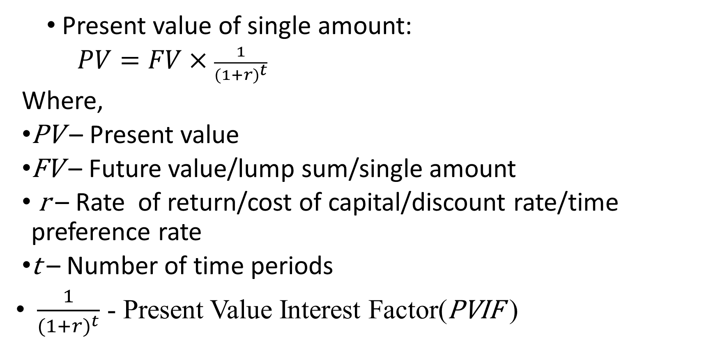
Formula for Present Value of Single amount

Slide 12
PRESENT VALUES
Present Value
Value today of a future cash flow
Discount Factor
Present value of a $.1 future payment.
Discount Rate
Interest rate used to compute present values of future cash flows

Slide 13
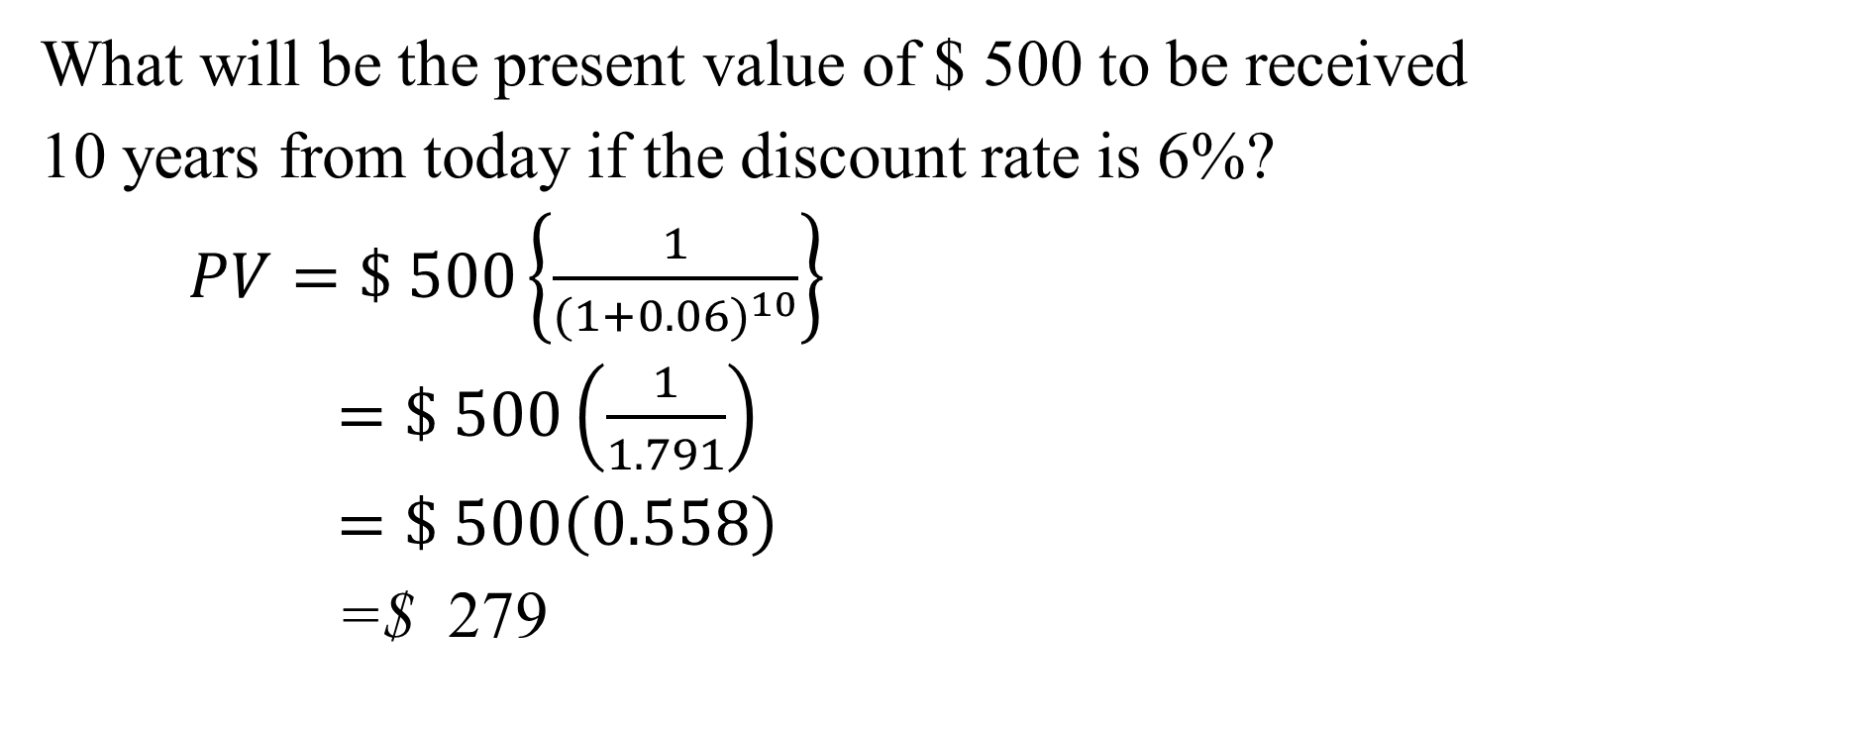
Illustration of PV of single amount

Slide 14
No. of Years | Interest Rate per Year
 | 5% | 6% | 7% | 8% | 9% | 10%
1 | 0.952 | 0.943 | 0.935 | 0.926 | 0.917 | 0.909
2 | 0.907 | 0.890 | 0.873 | 0.857 | 0.842 | 0.826
3 | 0.864 | 0.840 | 0.816 | 0.794 | 0.772 | 0.751
4 | 0.823 | 0.792 | 0.763 | 0.735 | 0.708 | 0.683
5 | 0.784 | 0.747 | 0.713 | 0.681 | 0.650 | 0.621
10 | 0.614 | 0.558 | 0.508 | 0.463 | 0.422 | 0.386
To determine PV we can simply read PVIF which is the intercept of 6% and 10 years; 0.558 x 500=279- See Table 1 in Lesson notes

Slide 15
Present Value of an Annuity
An annuity is an equally spaced level stream of cash flows eg $ 4000 payments per year
Those that occur at the end of the period – Ordinary annuity
Those that occur at the beginning of the period – Annuity due
NB: Annuity can start at year 1 to year 5, from year 3 to year 8 etc

Slide 16
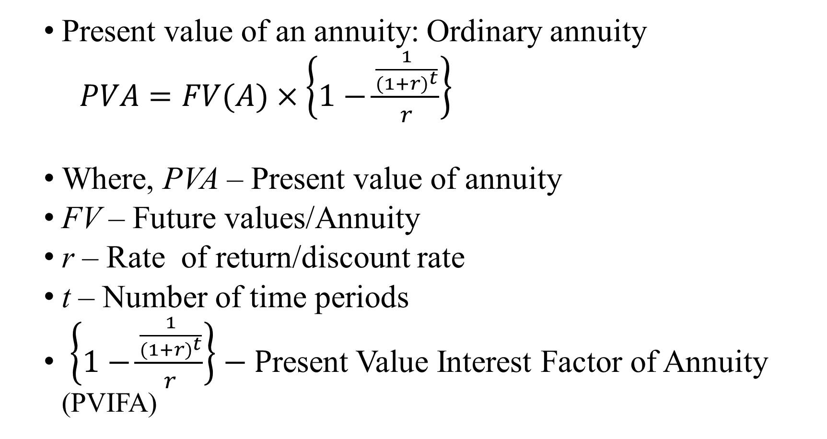
Formula for Present Value of Annuity

Slide 17
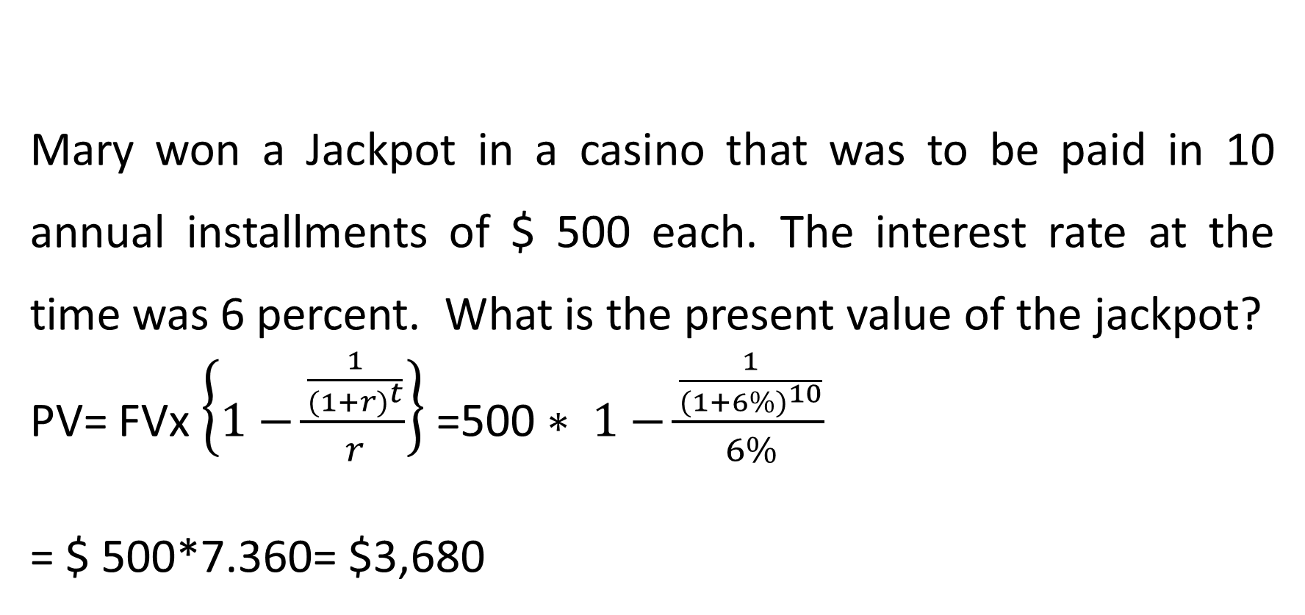
Illustration

Slide 18

No. of Years | Interest Rate per Year
 | 5% | 6% | 7% | 8% | 9% | 10%
1 | 0.952 | 0.943 | 0.935 | 0.926 | 0.917 | 0.909
2 | 1.859 | 1.833 | 1.808 | 1.783 | 1.759 | 1.736
3 | 2.723 | 2.673 | 2.624 | 2.577 | 2.531 | 2.487
4 | 3.546 | 3.465 | 3.387 | 3.312 | 3.240 | 3.170
5 | 4.329 | 4.212 | 4.100 | 3.993 | 3.890 | 3.791
10 | 7.722 | 7.360 | 7.024 | 6.710 | 6.418 | 6.145
To determine PVA we can simply read PVIFA which is the intercept of 6% and 10 years; 7.360 x 500=$ 3,680- See Table 2

Slide 19
Special Annuity- Perpetuity
Perpetuity- This is a stream of level cash payments that never ends. It is an annuity that never ends, in other words lasts forever.
Here we have two types;
1. Perpetuity that starts at end of year 1-Ordinary Annuity
2. Perpetuity that starts after a number of Years, say 3 years:-(Delayed perpetuity)
NB. In this course we shall concentrate on Perpetuity starting at end of year 1

Slide 20
Summary
Yr |  | 1 | 2 | 3 | 4 | 5 | 6 | Present Value
1 | Perpetuity A | $ 1 | $ 1 | $ 1 | $ 1 | $ 1 | $ 1 | 1/ r
2 | Perpetuity B | - | - | - | $ 1 | $ 1 | $ 1 | 1/r(1 + r)³
3 | 3-Year annuity | $ 1 | $ 1 | $ 1 | - | - | - | 1/r- 1/ r(1 + r)³

Slide 21
THE FUTURE VALUE OF MONEY

Slide 22
Future Value
Future value is the value of an asset at a
specific date in future
It measures the nominal future sum of money that a given sum of money is ‘worth’ at a specified time in future assuming a certain interest rate/ rate of return
Actually the future value does not include corrections for inflation or other factors that affect the true value of money in future.

Slide 23
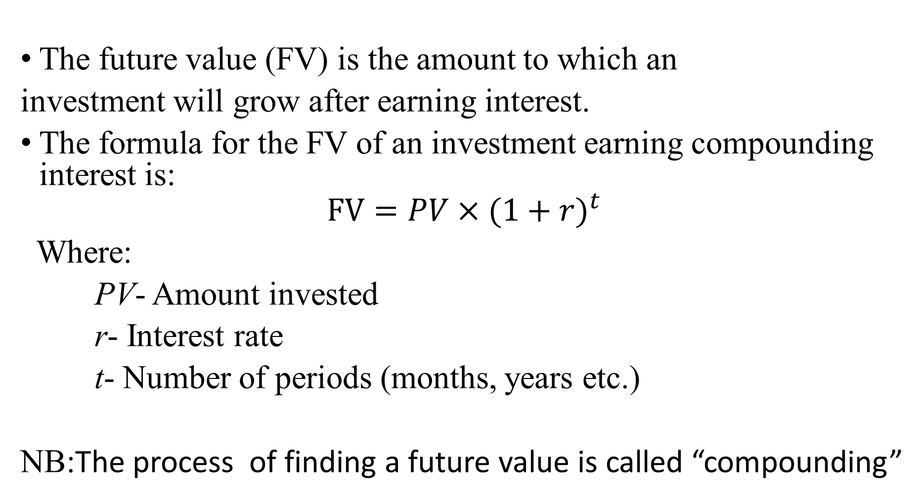
Future value of Single amount & Formula

Slide 24
Illustration -FV of a lump sum:
How much money will you have in 5 years if you
invest $100 today at a 10% rate of return?
  Draw a timeline
i=10%
$100
?
0
1
2
3
4
5

Slide 25
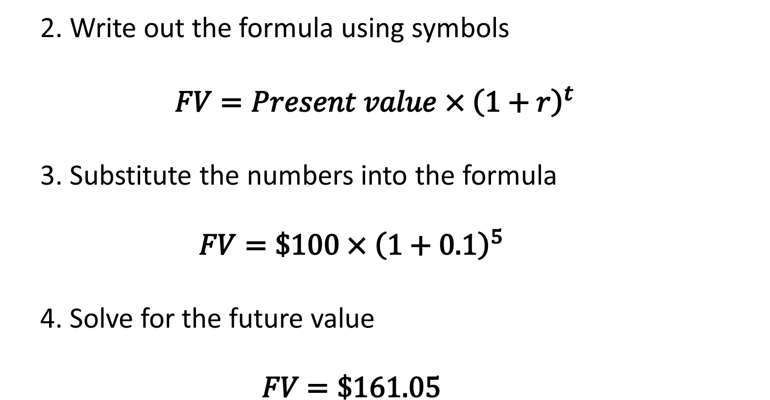
Solutions/Calculations CtD

Slide 26
Use Of Table Of Future Value Of A Lump Sum
No. of Years | Interest Rate per Year
 | 5% | 6% | 7% | 8% | 9% | 10%
1 | 1.0500 | 1.0600 | 1.0700 | 1.0800 | 1.0900 | 1.1000
2 | 1.1025 | 1.1236 | 1.1449 | 1.1664 | 1.1881 | 1.2100
3 | 1.1576 | 1.1910 | 1.2250 | 1.2597 | 1.2950 | 1.3310
4 | 1.2155 | 1.2625 | 1.3108 | 1.3605 | 1.4116 | 1.4641
5 | 1.2763 | 1.3382 | 1.3382 | 1.4026 | 1.5386 | 1.6105
10 | 1.6289 | 1.7908 | 1.7908 | 1.9672 | 2.3674 | 2.5937
To determine FV we can simply read FVIF which is the intercept of 10% and 5 years; 1.6105 x 100= 161.05 See Table 3 in Lesson notes

Slide 27
Future Value Of Annuities
An annuity is a cash flow stream in which the cash flows are regular and happen at regular intervals.
To be considered an annuity, the following conditions must be met:
  The periodic payment must be equal in amount
  The time period between payments should be constant
  The interest rate per year remains constant
  The interest is compounded at the end of each time period

Slide 28
Types Of Future Value Annuities
Ordinary annuity:
  Is one where the payments are done at the end of each period.
Annuity due:
  Is one where the payments are done at the beginning of each period.
Deferred annuity:
  Is one where the payments do not commence until periods of time have elapsed.
Perpetuity:
  Is an annuity in which the payments continue indefinitely.

Slide 29
Illustration
Consider an investment which promises to pay
$100 one year from now, another $100 two years from now,
another $100 three years from now and another $100 four years from now.
How much will be the future value of the cash streams at the end of year four, given that the interest rate is 10%?
  Draw a timeline
$100
$100
$100
$100
0
1
2
3
4
i=10%
?
?
?
?

Slide 30
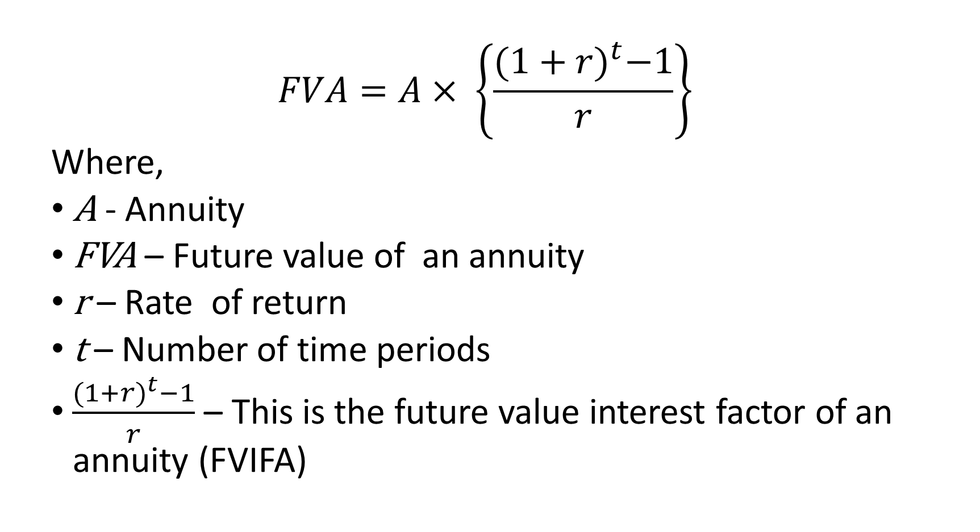
Future Value of Annuity Formula

Slide 31
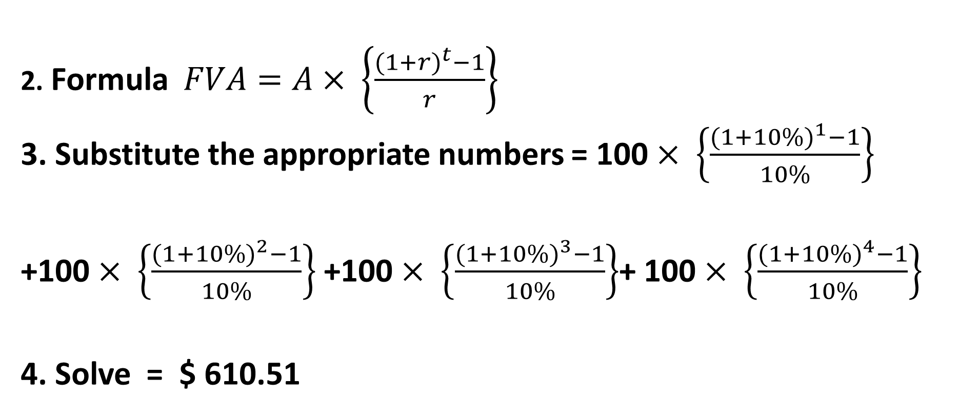
Solving the Illustration using the Formula

Slide 32
Use of Future value of annuities Table
No. of Yrs | Interest Rate per Year
 | 5% | 6% | 7% | 8% | 9% | 10%
1 | 1.0500 | 1.0600 | 1.0700 | 1.0800 | 1.0900 | 1.1000
2 | 2.0500 | 2.0600 | 2.0700 | 2.0800 | 2.0900 | 2.1100
3 | 3.1525 | 3.1836 | 3.2149 | 3.2464 | 3.2781 | 3.3100
4 | 4.3101 | 4.3746 | 4.4399 | 4.5061 | 4.5731 | 4.6410
5 | 5.5256 | 5.6371 | 5.7507 | 5.8666 | 5.9847 | 6.1051
 | 12.5779 | 13.1808 | 13.8164 | 14.4866 | 15.1929 | 15.9374
To determine FVA we can simply read FVIFA which is the intercept of 10% and 5 years; 6.1051 x 100= 610.51 See Table 4

Slide 33
Application of Future Value of Annuity
The future value annuity formula can be applied in different context.
Its important applications are:
  To know how much we have in future
  To know how much to save annually
  To find out the interest rate
  To know how long one should wait to get the accumulated money

Slide 34
PRESENT VALUE Vs FUTURE VALUE COMPARED
Present value factors are reciprocals of future value factors
Interest rates and future value are positively related
Interest rates and present value are negatively related
Time period and future value are positively related
Time period and present value are negatively related

Slide 35
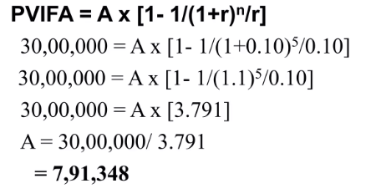
Illustrative Question With Solution
Mr. Anil wants to purchase an apartment costing
$ 30 million His employer is willing to give a loan at
10% for 5 years. Calculate the amount of installment paid every year.

Slide 36
REFERENCES
CFA level II ,Corporate Finance, Portfolio Management and Equity Module
Lectures on Corporate Finance, Bassaersts, P, Bernt O, World Scientific publishing Co.pte td, 2006
Principles of Corporate Finance, Brealey, Myers & Allen, the McGraw-Hill Companies, Inc., 2007.

Slide 37
THE END OF WEEK 2 LESSON

