Slide 1
Course: Corporate Finance
Week 4: Capital Budgeting
Under Uncertainty
Lecturer: Dr. Charity Njoka

Slide 2
Lesson Objectives
At the end of this lesson you should be able to:
Understand the Risk adjusted discounting rate
(RADR)and the Certainty Equivalent (CE) methods of project evaluation and selection, including their: (a) calculations; (b) acceptance criterion; (c) and advantages and disadvantages
Understand the concept of capital rationing and explain the calculation of projects NPVs where projects are divisible and indivisible

Slide 3
Overview of Capital Budgeting under
Uncertainty
Sometimes it is assumed that the investment
do not involve any risk and cash flows
of the project are known with certainty.
This assumption is taken to simplify the understanding
of the capital budgeting techniques and decision making
However, in practice, this assumption is not correct.

Slide 4
Types of decision making
1. Decision making under certainty:
When cash flows are certain
2. Decision making involving risk:
When cash flows involve risk and probability can be assigned.
3. Decision making under uncertainty:
When the cash flows are uncertain and probability cannot be assigned.

Slide 5
Risk And Uncertainty
Thin difference between risk and uncertainty.
In case of risk, probability distribution
of cash flow is known.
When no information is known to formulate probability distribution of cash flows,
the situation is referred as uncertainty.
NB: Two terms are used interchangeably

Slide 6
Sources of Risk
Project-specific risk- Risks which are related
to a particular project and affects the project’s
cash flows eg estimation in resources and allocation,
estimation of cash flows
2. Company specific risk- Risks which arise due to company specific factors like changes in key managerial persons,
dispute with workers etc. All these factors affect the cash flows
of an entity and access to funds for capital investments

Slide 7
Sources of Risk Ctd
3. Industry-specific risk- Risks which effects the
whole industry in which the company operates.
Eg regulatory restrictions on industry,
changes in technologies
4. Market risk – The risk which arise due to
market related conditions like entry of substitute,
changes in demand conditions, availability and access to resources

Slide 8
Sources of Risk Ctd
5. Competition risk-Related with competition in
the market in which a company operates. Eg entry
of rival product, change in taste etc
6. Risk due to Economic conditions – Related with
macro-economic conditions like new taxes, inflation, etc.
7. International risk – Risks related to conditions which are
caused by global economic conditions eg restriction on free trade,
restrictions political and geographical conditions, effects of Covid-19 etc.

Slide 9
Why Consider Risk &
Uncertainty in Capital Budgeting?
There is an opportunity cost involved while
investing in a project for the level of risk.
Adjustment hence required to make the
decision as to whether the returns out of the
project are proportionate with the risks borne
and whether it is worth investing in the project
2. Risk adjustment is required to know the real value of the Cash Inflows.

Slide 10
Techniques of Risk Analysis
In Capital Budgeting
A-Statistical Techniques
1. Probability
2. Variance or Standard Deviation
3. Coefficient of Variation
NB: The statistical techniques will be considered in detail in Lesson five

Slide 11
Techniques of Risk Analysis
In Capital Budgeting Ctd
B- Conventional Methods
Risk-adjusted Discount rate( RADR)
2. Certainty Equivalents (CE) Method

Slide 12
Techniques of Risk Analysis
In Capital Budgeting Ctd
C-Others techniques
1. Sensitivity analysis
2. Scenario analysis
3. Decision tree
4. Simulation ( Monte Carlo)

Slide 13
Risk Adjusted Discount Rate
(RADR)
The use of risk adjusted discount rate is based
on the concept that investors demands higher
returns from the risky projects.
The required rate of return on any investment should include compensation for delaying consumption equal to risk free rate of return, plus compensation for any kind of risk taken on

Slide 14
Risk Adjusted Discount Rate
A risk adjusted discount rate is a sum of risk
free rate and risk premium
RADR= Risk Free Rate+ Risk Premium
Risk free rate :-Rate of return on Investments that bear no risk
Risk Premium :-Rate of return over and above the risk-free rate.
For high risk project, the risk premium will be high and for low risk projects, the risk premium would be lower.

Slide 15
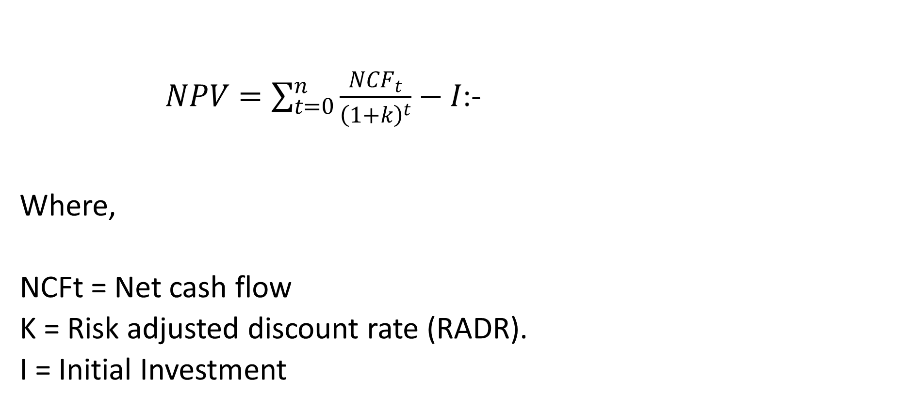
NPV - Using RADR
        $NPV=\sum_{t=0}^{n}{\frac{{NCF}_{t}}{{\left(1+k\right)}^{t}}−I}$:-
Where,
NCFt = Net cash flow
K = Risk adjusted discount rate (RADR).
I = Initial Investment

Slide 16
Illustration A -RADR
An enterprise is investing $100,000 in a project.
The risk-free rate of return is 7%.
Risk premium expected by the management is 7%.
The life of the project is 5 years.
Following are the cashflows that are estimated over the life of the project.(Next Slide)

Slide 17
Cashflows for the illustration
Year Cash Flows $,000
1 25
2 60
3 75
4 80
65
Required:
Calculate Net Present Value of the project based on Risk free rate and also on the basis of Risk adjusted discount rate

Slide 18
Solution -At Risk Free Rate 7%
Year Cashflows
$, 000 PVIF 7% PV of CashFlows
$, 000
1 25 0.935 23.38
2 60 0.873 52.38
3 75 0.816 61.20
4 80 0.763 61.04
5 65 0.713 46.35
Total of Present Values
of CashFlows………….................... 244.34
Less initial cash flow 100
NPV 144.34

Slide 19
Solution -At RADR (7+7) 14%
Year Cashflows
$, 000 PVIF 14% PV of CashFlows
$, 000
1 25 0.877 21.93
2 60 0.769 46.14
3 75 0.675 50.63
4 80 0.592 47.36
5 65 0.519 33.74
Total of Present Values
of CashFlows………………………........ 199.79
Less initial cash flow 100
NPV 99.79

Slide 20
Advantages of Risk-adjusted discount rate
It is simple and can be easily understood.
It has greatly appeals to risk-averse
Businessmen -those who fear risk
It incorporates risk premium in the discounting factor.
It incorporates an attitude (risk-aversion) towards uncertainty.

Slide 21
Disadvantages RADR
There is no easy way of deriving a RADR rate.
It does not make any risk adjustments in the numerate
- for the cashflows that are forecast over the future years.
It is based on the assumption that investors are risk averse- they fear (Not all investors are risk averse )

Slide 22
Certainty Equivalent (CE) Method
The certainty equivalent is a guaranteed return
that the management would accept rather
than accepting a higher but uncertain return.
This approach allows the decision maker to
incorporate his or her attitude towards risk into the analysis.
In this approach a set of riskless cash flow is generated in place of the original cash flows.

Slide 23
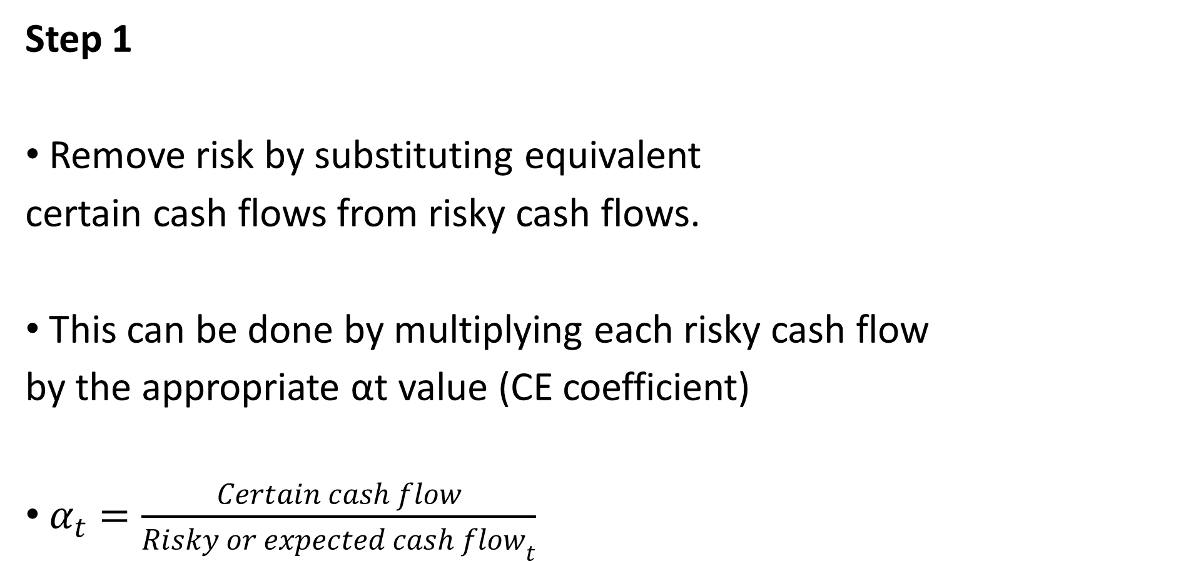
Steps -Certainty Equivalent (CE) Method
Step 1
Remove risk by substituting equivalent
certain cash flows from risky cash flows.
This can be done by multiplying each risky cash flow
by the appropriate αt value (CE coefficient)
$α_{t}=\frac{Certain cash flow}{{Risky or expected cash flow}_{t}}$

Slide 24
Steps of CE
Step 2
Discounted value of cash flow is obtained by
applying riskless rate of interest.
Since you have already accounted for risk in the numerator
using CE coefficient, then,
Using the cost of capital to discount cash flows will tantamount to double counting of risk.

Slide 25
Steps of CE Ctd
Step 3
After that apply normal capital budgeting method
except in case of IRR method, where
IRR is compared with risk free rate of interest
rather than the firm’s required rate of return.
Certainty Equivalent Coefficients transform expected values of uncertain flows into their Certainty Equivalents.
Value of Certainty Equivalent Coefficient lies between 0 & 1. CE of 1 indicates that the cash flow is certain or management is risk neutral.

Slide 26
Illustration One- CE method
An investor expects a risky cashflow of
$ 100,000 in period t and considers a certain
cashflow of $80,000 equally desirable,
the α_{t} will be:
α_{t} = 80,000 = 0.8
100,000

Slide 27
Illustration Two- CE Method
Assume a project costs $ 30,000 and
yields the following uncertain cashflows:
Year Cashflow
1 12,000
2 14,000
3 10,000
4 6,000

Slide 28
Illustration Two -Ctd
Assume also that the certainty
equivalent coefficients have been
estimated as follows:
α₀ = 1.00
α₁ = 0.90
α₂ = 0.70
α₃ = 0.50
α₄ = 0.30
The risk-free discount rate is 10%
Required: Compute the NPV of the project
.

Slide 29

NPV- Using CE
Where
C_{t} =Forecasted cashflows (without risk adjustment)
α_{t}=The risk-adjusted factor or the certainty equivalent coefficient
I_{o}= Initial cash outflow (cost of project)
K_{f}=Risk-free rate (assumed to be constant for all period).

Slide 30
Solution- Use formula for Present Value
=0.9 (12,000)+ 0.7 (14,000)+
1 + 0.1 (1 + 0.1)²
0.5 (10,000) + 0.3 (6,000) -30,000 = (7,103.6)
(1 + 0.1)³ (1 + 0.1)⁴

Slide 31
Solution – Use PVIF table
Year Certain Cashflows PVIF_{10%} PV
0 (30,000) 1.00 (30,000)
1 0.9 (12,000) 0.909 9,817.2
2 0.7 (14,000) 0.826 8,094.8
3 0.5 (10,000) 0.751 3,755.0
4 0.3 (6,000) 0.683 1,229.4
NPV (7,103.6)
The project has a negative NPV and therefore
should not be undertaken.
if risk was ignored the NPV would have been $ 4,080 and the project would have been accepted.

Slide 32
Merits of Certainty Equivalent approach
This method explicitly recognises risk.
It recognises that cashflows further away
to the future are less certain (therefore a lower α_{t})

Slide 33
Limitations of Certainty Equivalent approach
The method of determining α_{t} is subjective
and is likely to differ from project to project.
2. The forecaster, expecting the reduction
that will be made to his forecasts, may inflate
them in anticipation.
3. When forecasts have to pass through
several layers of management, the effect
may be to greatly exaggerate the original
forecast or to make it ultra conservative.

Slide 34
Sensitivity Analysis
Sensitivity Analysis is a way of analysing
change in the project's NPV for a given
change in one of the variables affecting the NPV.
It indicates how sensitive the NPV is to changes in particular variables.
The more sensitive the NPV, the more critical the variable.

Slide 35
Steps followed in use of Sensitivity Analysis
Identification of all those variables which
have an influence on the projects NPV.
Definition of the underlying (mathematical)
relationship between variables.
Analysis of the impact of the change in each of the variables on the projects NPV.
NB: Sensitivity Analysis allows the decision maker to ask "what if" questions.

Slide 36
Advantage of Sensitivity Analysis
Critical Issues: This analysis identifies
Critical factors that impinge on a project’s
success or failure.
2. Simplicity: This analysis is quite simple.

Slide 37
Disadvantage of Sensitivity Analysis
Assumption of Independence: This analysis
assumes that all variables are independent
i.e. they are not related to each other,
which is unlikely in real life.
2. Ignore probability: This analysis does not look
to the probability of changes in the variables.
3. Not so reliable: This analysis provides information
on the basis of which decisions can be made but
does not point directly to the correct decision.

Slide 38
Scenario Analysis
This is used to see the combined effects of
changes in the variables.
Scenario analysis brings in the probabilities of
changes in key variables
It allows for a change more than one variable at a time.
This analysis begins with base case or most likely
set of values for the input variables.
Then, go for worst case scenario (low unit sales,
low sale price, high variable cost and so on)
And lastly, best case scenario

Slide 39
Sensitivity and Scenario
Analysis Compared
Both help to understand the impact of the
change in input variable on the outcome of
the project.
There are certain basic differences
between the two.
Sensitivity analysis calculates the impact
of the change of a single input variable on the outcome
of the project viz., NPV or IRR.
The sensitivity analysis thus enables to
identify that single critical variable that can impact
the outcome in a huge way and the range of outcomes.
the project given the change in the input variable.

Slide 40
Sensitivity and Scenario
Analysis Compared-Ctd
Scenario analysis,is based on a scenario.
eg recession or a boom wherein depending
on the scenario, all input variables change.
It calculates the outcome of the project
considering this scenario where the variables
have changed simultaneously.
Similarly, the outcome of the project would also
be considered for the normal and recessionary situation.

Slide 41
Sensitivity and Scenario
Analysis Compared-Ctd
The variability in the outcome under the three
different scenarios helps the management
to assess the risk a project carries.
Higher deviation in the outcome can be assessed
as higher risk and lower to medium deviation
can be assessed accordingly.
Scenario analysis is far more complex than
sensitivity analysis due to calculations
In scenario analysis all inputs are changed simultaneously
considering the situation in hand while in sensitivity analysis
only one input is changed and others are kept constant.

Slide 42
Decision Tree analysis
Practically investment decisions have
implications for future or further investment
decisions.
They also impact future decision and events.
Such situation can be handled by taking a
sequence of decisions over a period of time.
The technique to handle this type of sequential
decisions is done through “Decision Tree” technique.

Slide 43
Decision Tree Analysis-Ctd
A Decision tree is a graphical representation
of relationship between future decisions and
their consequences.
The sequence of events is shown in a
format resembling branches of tree, each
branch representing a single possible decision,
its alternatives and the probable result in terms of NPV

Slide 44
Capital Budgeting
Under Capital Rationing
There may be a situation due to
resource (capital) constraints (rationing)
a firm may have to select some projects
among various projects, all having positive NPVs.
Capital rationing occurs any time there is a budget
ceiling, or constraint, on the amount of funds that can
be invested during a specific period, such as a year.

Slide 45
Types of Capital Rationing
Capital rationing can be classified as follows,
Soft capital rationing – capital rationing in
a department due to departmental budget ceilings
2. Hard capital rationing – capital rationing by the
entire firm due to lack of funds from external
sources/ financiers

Slide 46
Scenarios influencing the method of evaluation to be adopted.
Broadly
1. If projects are independent of each other
and are divisible in nature:
In such situation NPV Rule should be modified
And,
Accordingly projects should be ranked on the basis of
‘NPV per $ of Capital invested.

Slide 47
Scenarios influencing the method of evaluation to be adopted-Ctd
(ii) If projects are not divisible
In such situation projects shall be ranked
on the basis of absolute NPV and,
Should be mixed up to the point available
resources are exhausted.

Slide 48
Illustration One
Capital Rationing
Kemu Limited is planning its capital investment
programme for next year.
It has five projects all of which give a positive NPV
The company cost of capital of 15 percent.
The investment outflows and present values being as follows
( next slide)
.

Slide 49
  Question-
  Cashflows & Present values
Project Investment NPV @ 15%
` 000 ` 000
A (50) 15.4
B (40) 18.7
C (25) 10.1
D (30) 11.2
E (35) 19.3
CASE 1: The projects are independent of each other and
are divisible The company is limited to a capital spending of $ 1, 20,000. Required: Optimise the returns from a package of projects within the capital spending limit.

Slide 50
Solution-
Computation of NPVs per $ 1 of Investment &Ranking
Project Investment NPV 15% NPV 15% Ranking
per $ 1 Invested
$, 000 $, 000
A (50) 15.4 0.31 5
B (40) 18.7 0.47 2
C (25) 10.1 0.40 3
D (30) 11.2 0.37 4
E (35) 19.3 0.55 1

Slide 51
Solution Ctd
Project Cost/Investment Investment NPV 15%
to Undertake
$, 000 $, 000 $,000
E (35) (35) 19.3
B (40) (40) 18.7
C (25) (25) 10.1
D (30) (20) 7.5
(120) 55.6
2/3 of project D will be undertaken. This is given by 20/30; the amount remaining from the budget of $ 120,000 divide by investment required by project D. The NPV of 2/3rd of D is 2/3 x 11.2= 7.5 Thus Project A should be rejected and only two-third of Project D be undertaken

Slide 52
Case 2: The projects are not divisible
Project Investment NPV @ 15%
$,000 $, 000
E + B + C 100 48.1
E + B + D 105 49.2
In this case E + B + D would be preferable as it provides a higher NPV despite D
ranking lower than C.
.

Slide 53
THE END OF WEEK 4 LESSON

Slide 54
References
Professional Accountancy Notes, Strathmore School of Business Module, 2004
Bassaersts, P, Bernt O Lectures on Corporate Finance, World Scientific publishing Co.pte td, 2006
Brealey, Myers & Allen, Principles of Corporate Finance, the McGraw-Hill Companies, Inc, 2007.
Van Horne, James C, .Fundamentals of Financial Management 13th ed. Pearson Education Limited, 2005

