Slide 1
Course: Corporate Finance
Week 5
Risk and Return Analysis
Course Instructor: Dr. Charity Njoka

Slide 2
Lesson Objectives
By the end of this lesson 5,
You should be able to,
Understand the meaning of risk, return
and risk preferences.
2. Measure the risk and return of a single asset.

Slide 3
Outline
Introduction
What is risk?
Measuring performance
  Return and risk measures
Risk Attitudes

Slide 4
Introduction
The relation between risk and return is useful
For investors (who buy securities),
Corporations (that sell securities to finance themselves),
Financial intermediaries (that invest, borrow, lend, Price securities on behalf of their clients).

Slide 5
What is Risk?
Risk is defined as “the chance of financial loss”.
Risk is the potential for divergence
between the actual outcome and what is expected.
It is the variability (difference) of returns
from those that are expected.
In finance, risk is usually related to
whether expected cash flows will materialize,
whether security prices will fluctuate unexpectedly,
or whether returns will be as expected.

Slide 6
The concept of Risk and Return
Is the analysis of the likelihood of challenges
involved in investing while measuring the returns
from the same investment.
High-risk investments give better returns
to investors and vice-versa

Slide 7
Probability Distribution
Probability is a measure about the
chances that an event will occur.
When an event is certain to occur,
probability will be 1 and
0 when there is no chance of happening an event

Slide 8
Illustration -Probability
Chances that cash flow will be 300,000, 200,000 and
120,000 are 30%, 60% and 10% respectively.
Assumption Cash Flows ($) Probability
Best 300,000 0.3
High 200,000 0.6
Low 120,000 0.1

Slide 9
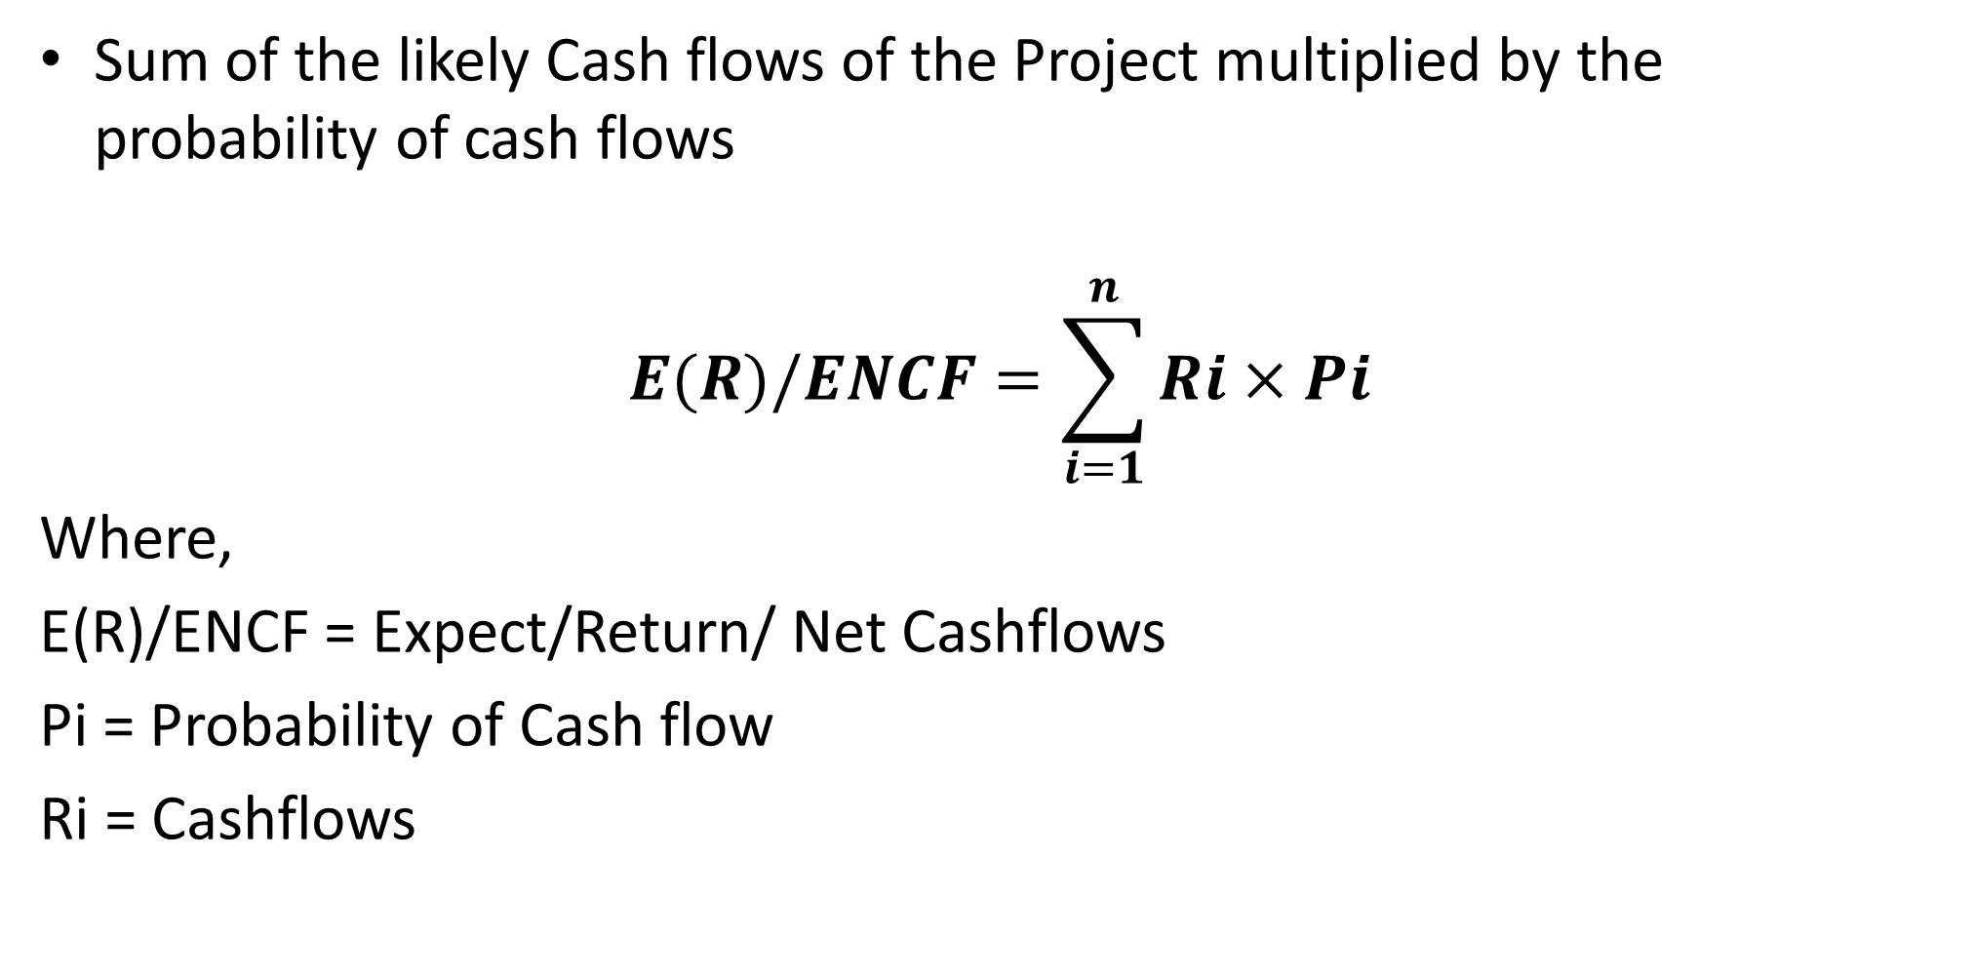
Expected Return/Net Cash Flows
Sum of the likely Cash flows of the Project multiplied by the probability of cash flows
$$E(R)/ENCF=\sum_{i=1}^{n}{Ri×Pi}$$
Where,
E(R)/ENCF = Expect/Return/ Net Cashflows
Pi = Probability of Cash flow
Ri = Cashflows

Slide 10
Illustration –Expected net Cash Flows
From illustration one, calculate
Expected return
Assumption(1) | Cash Flows ($) (2) | Probability(3) | Expected Cashflow($) (2x3)
Best | 300,000 | 0.3 | 300,000 × 0.3 = 90,000
High | 200,000 | 0.6 | 200,000 ×0.6 =120,000
Low | 120,000 | 0.1 | 120, 000 × 0.1=12,000
Expected Net cash flow (ENCF) 232,000

Slide 11
Attitudes towards Risk
Risk Aversion-Prefers less risky investment
Desire for Risk-Prefer risk
Indifference to Risk-is Indifferent to risk

Slide 12
Illustration-Attitudes towards Risk
States of nature Project A‘ Project B's Prob
cashflow cashflow
Optimistic $ 900,000 600,000 0.2
Moderate 600,000 600,000 0.6
Pessimistic 300,000 600,000 0.2
Calculate the expected cashflows
Which project appeals to risk averter
and risk seeker investor?

Slide 13
Solution- Expected return
Project A
Expected cashflow =
900,000 (0.2) + 600,000 (0.6) + 300,000 (0.2)
=$ 600,000
Project B
Expected cashflow
600,000 (0.2) + 600,000 (0.6) + 600,000 (0.2)
=$ 600,000
Project A is riskier project
Project B is less risky- Why?

Slide 14
Projects to Choose
A risk seeker would choose Project A
A risk averter would choose Project B.
A risk neutral decision maker would be
indifferent between the two projects since the
expected cashflows are equal.

Slide 15
Measurement of Risk
Variance /Standard Deviation
Coefficient of Variation(CV)
Beta (ß) – This is widely used with
portfolios of common stock

Slide 16
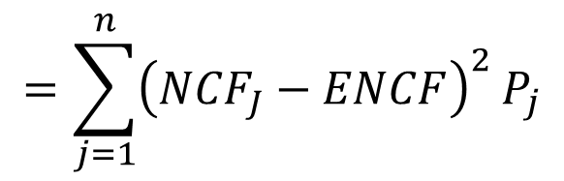
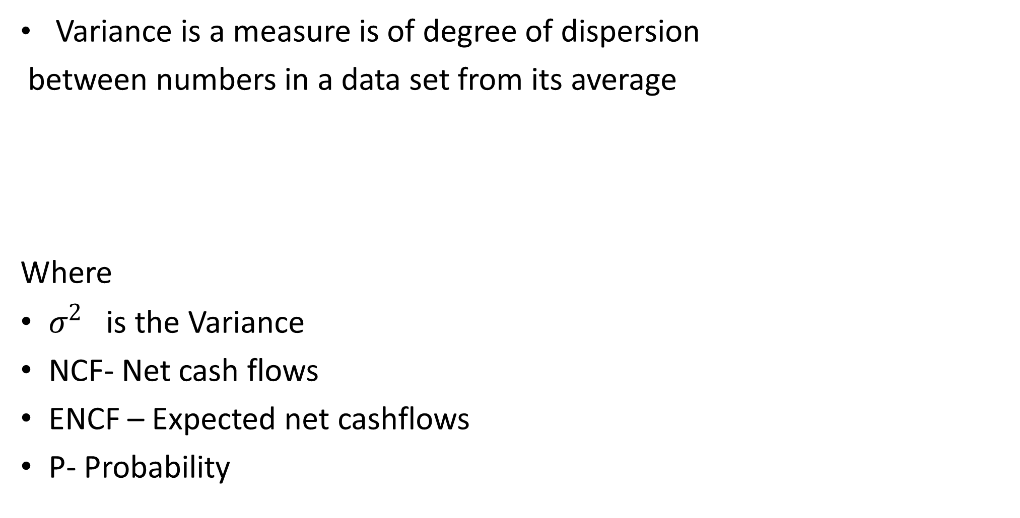
Variance /Standard Deviation
Variance is a measure is of degree of dispersion
between numbers in a data set from its average
Where
$σ^{2}$ is the Variance
NCF- Net cash flows
ENCF – Expected net cashflows
P- Probability
$$=\sum_{j=1}^{n}{{\left({NCF}_{J}−ENCF\right)}^{2}}P_{j}$$

Slide 17
Variance /Standard Deviation Ctd
Variance of Zero -cashfllows generated
over the lifetime of the project would be the same
A large variance -indicates large variability
between cashflows of different years
A small variance -indicates that
cashflows will a somewhat stable throughout the life of the project.

Slide 18
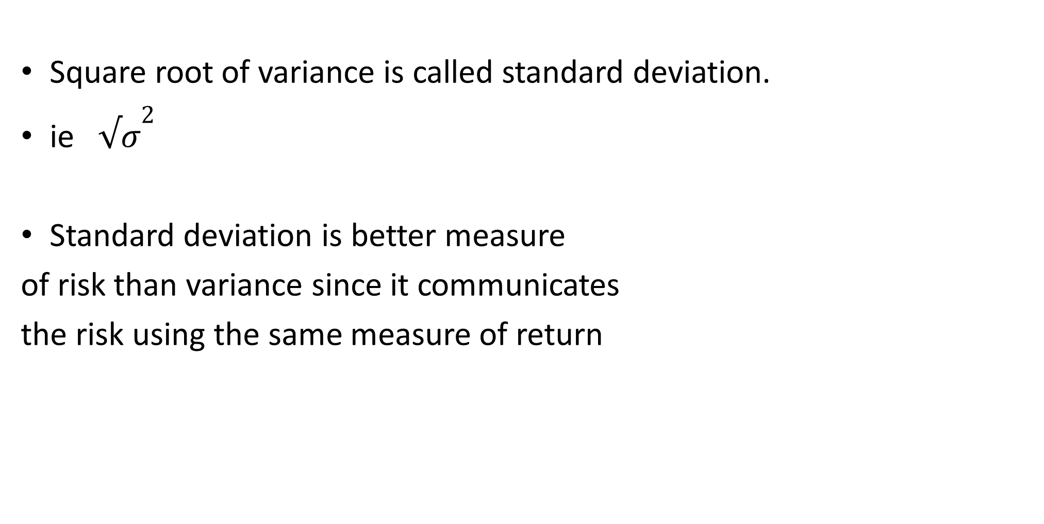
Standard deviation
Square root of variance is called standard deviation.
ie ${√σ}^{2}$
Standard deviation is better measure
of risk than variance since it communicates
the risk using the same measure of return

Slide 19
Illustration
Calculate the standard deviation of the following-

Slide 20
Solution step 1- Expected Cashflow

Slide 21
Solution Step 2- StD Deviation
Standard deviation $190

Slide 22
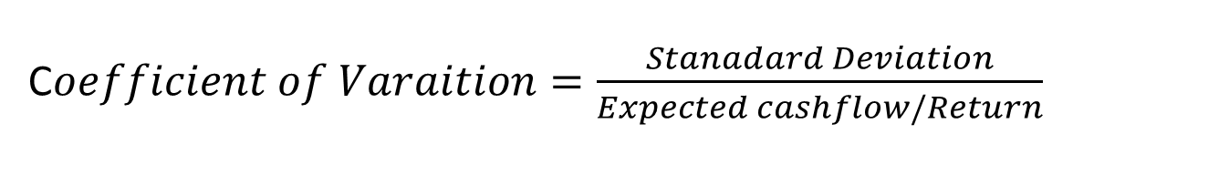
Coefficient of Variation
Coefficient of Variation enables
the management to calculate the
risk borne by the concern for
every unit of estimated return from
a particular investment
C$oefficient of Varaition=\frac{Stanadard Deviation}{Expected cashflow/Return}$

Slide 23
Illustration
Calculate the CV of the following projects and advice
Project Expected value Std Dev.
A 6,000 600
B $ 600 190
On the basis of expected outcome, one would choose Project A,
since it has higher outcome. However on the basis of Risk- standard deviation, one would choose Project B, since it has the lowest risk

Slide 24
Solution
Project A
CV = 600 = 0.100
6,000
Project B
CV = 190 = 0.317
600
Generally, the larger the coefficient of variation, the greater the risk.
Therefore, Project B carries a greater risk than Project A.

Slide 25
Comprehensive Illustration
Calculate CV of these projects and advice
Project A |  |  | Project B
Year | Cashflows $ | Prob. |  | Cashflows $ | Prob.
1 | 8,000 | 0.1 |  | 24,000 | 0.1
2 | 10,000 | 0.2 |  | 20,000 | 0.15
3 | 12,000 | 0.4 |  | 16,000 | 0.50
4 | 14,000 | 0.2 |  | 12,000 | 0.15
5 | 16,000 | 0.1 |  | 8,000 | 0.1

Slide 26
Solution-Comprehensive Illustration
Step1- Calculate Expected cashflows
Project A |  |  |  | Project B
Year | Cashflows $ | Prob. | Expected cashflows |  | Cashflows $ | Prob. | Expected cashflows
1 | 8,000 | 0.1 | 800 |  | 24,000 | 0.1 | 2,400
2 | 10,000 | 0.2 | 2,000 |  | 20,000 | 0.15 | 3,000
3 | 12,000 | 0.4 | 4,800 |  | 16,000 | 0.50 | 8,000
4 | 14,000 | 0.2 | 2,800 |  | 12,000 | 0.15 | 1,800
5 | 16,000 | 0.1 | 1,600 |  | 8,000 | 0.1 | 800
ENCF |  |  | 12,000 |  |  |  | 16,000

Slide 27
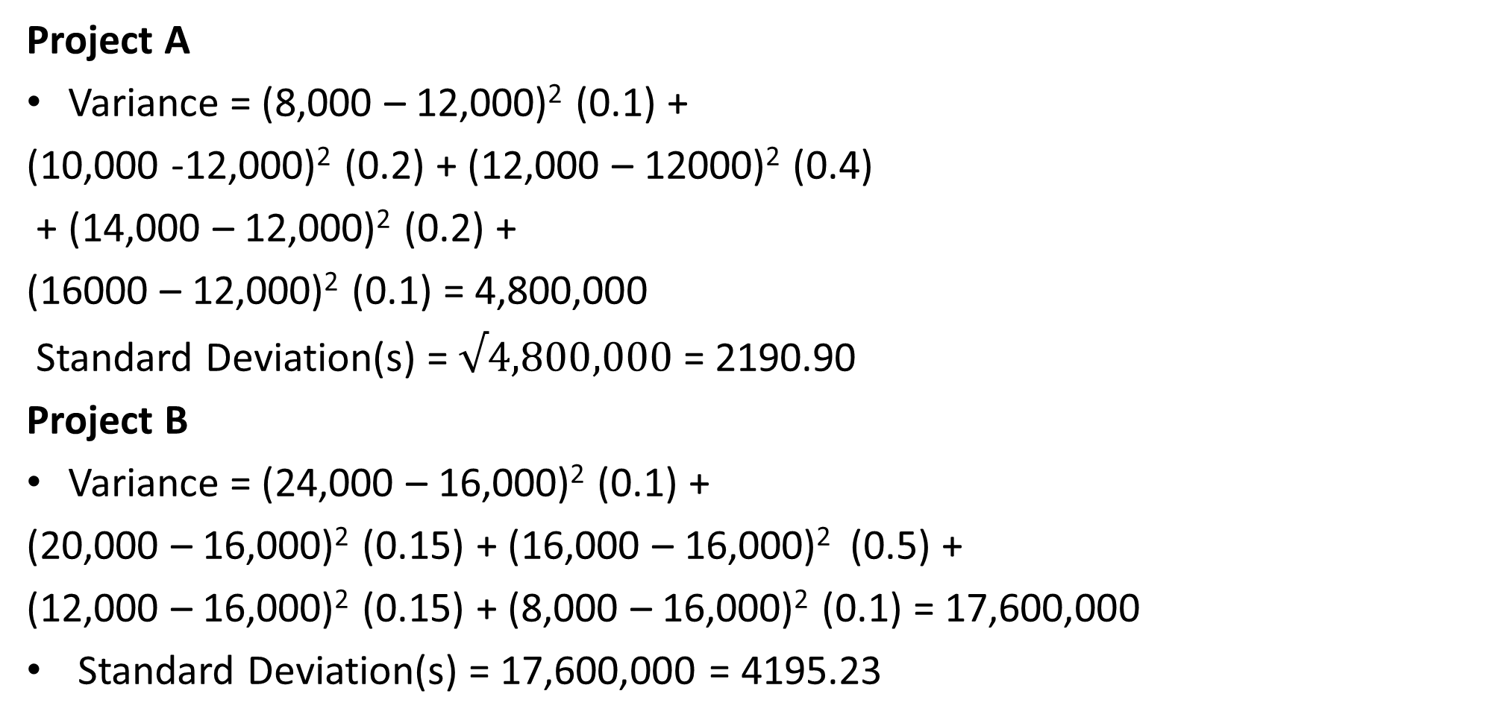
Solution Ctd-Variance & Standard Deviation
Project A
Variance = (8,000 – 12,000)² (0.1) +
(10,000 -12,000)² (0.2) + (12,000 – 12000)² (0.4)
+ (14,000 – 12,000)² (0.2) +
(16000 – 12,000)² (0.1) = 4,800,000
Standard Deviation(s) = $√4,800,000$ = 2190.90
Project B
Variance = (24,000 – 16,000)² (0.1) +
(20,000 – 16,000)² (0.15) + (16,000 – 16,000)² (0.5) +
(12,000 – 16,000)² (0.15) + (8,000 – 16,000)² (0.1) = 17,600,000
Standard Deviation(s) = 17,600,000 = 4195.23

Slide 28
Step 3- Calculate CV of the projects
Projects | Coefficient of Variation | Risk | Expected Value
A | 2190.90/12,000 =0 1826 | less | less
B | 4195 23/16, 000 =0 2622 | More | More

Slide 29
The beta (ß)
Beta measures the volatility of returns,
on an individual stock relative to a stock
market index of returns.
Beta can also be calculated
for a group pf assets( Portfolio)
(Note: Beta will be discussed in our next lesson under portfolio analysis).

Slide 30
Return Analysis
Return is “the total gain or loss experienced
on an investment over a given period of time”.
Some investments carry a predetermined
fixed rate of return eg bonds, fixed bank deposits
Some have reasonable return -Expected Rate of Return
(ERR) on given investments.

Slide 31
Historical Return
Holding period Return- Single period
Holding-period return (HPR)—
the rate of return that
is earned on an investment
over a particular period of time.
HPR=Ending value Beginning value – Beginning Value+ Cash received
Beginning value

Slide 32
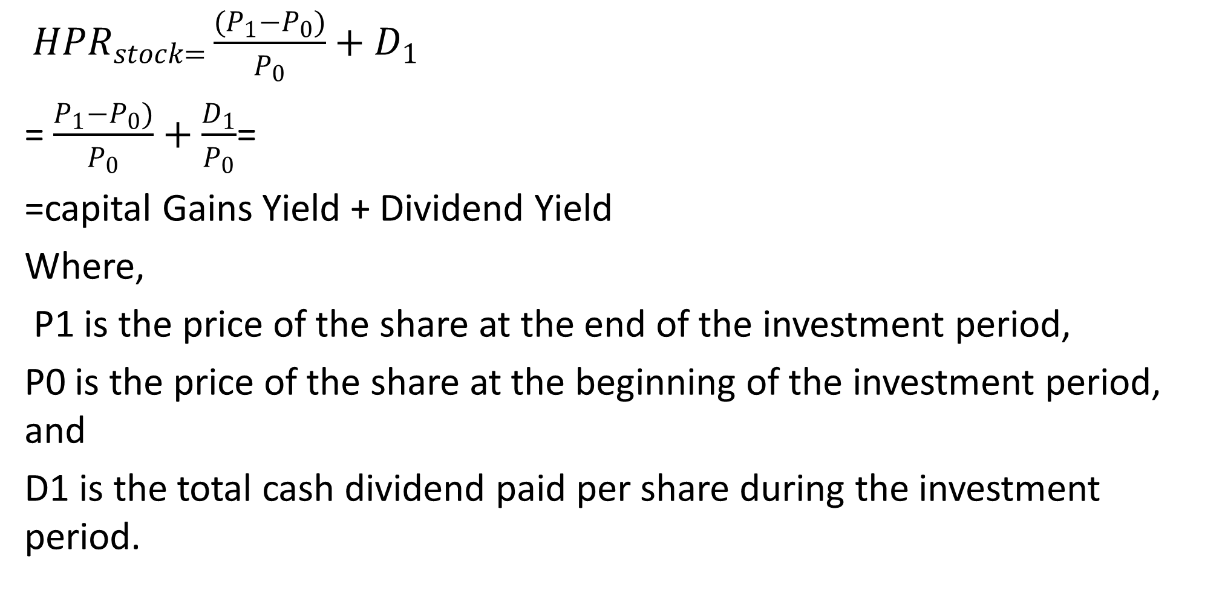
Historical Return formula
${HPR}_{stock=}\frac{(P_{1}−P_{0})}{P_{0}}+D_{1}$
= $\frac{P_{1}−P_{0})}{P_{0}}+\frac{D_{1}}{P_{0}}$=
=capital Gains Yield + Dividend Yield
Where,
P1 is the price of the share at the end of the investment period,
P0 is the price of the share at the beginning of the investment period, and
D1 is the total cash dividend paid per share during the investment period.

Slide 33
Illustration-HPR
A share is currently valued at $ 51.5.
It was purchased at $ 50 last year
and has earned a dividend of $2
Required:
a)Calculate the dollar return of an investor with
i) 1 share and ii) 50 shares
b)Calculate the HPR

Slide 34
Solution
Solution
Dollar return of one share
i= (51.5-50)+ 2= $ 3.5
Dollar return of 50 share
ii) 50 x 3.5= $ 165
HPR= [ (51.5-50)+ 2]/50 x 100= 7%
Can still be calculated all the share held by an investor

Slide 35
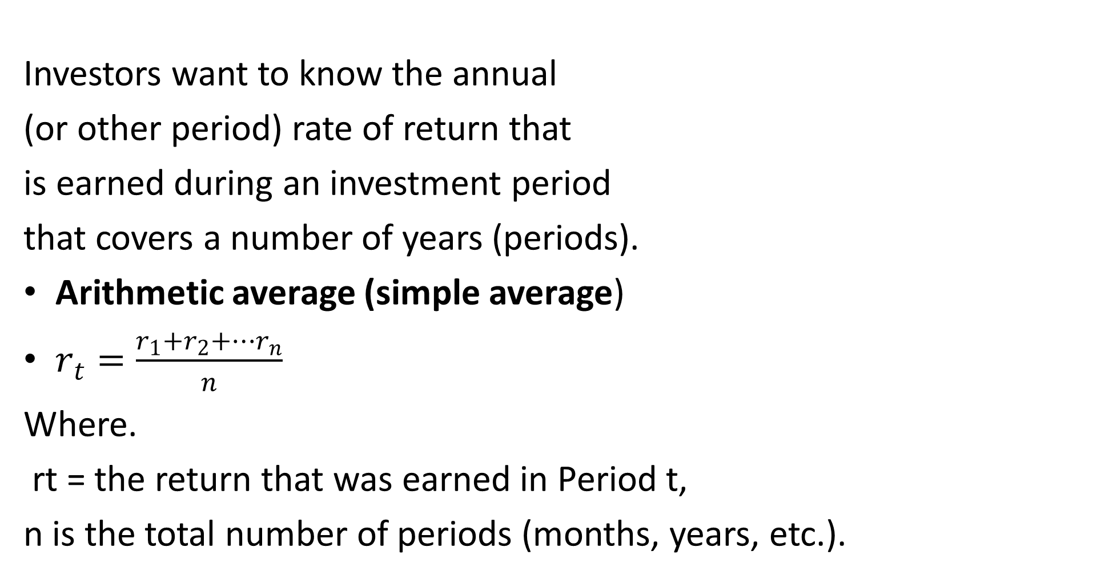
Multiperiod Return- Average Return
Investors want to know the annual
(or other period) rate of return that
is earned during an investment period
that covers a number of years (periods).
Arithmetic average (simple average)
$r_{t}=\frac{r_{1}+r_{2}+…r_{n}}{n}$
Where.
rt = the return that was earned in Period t,
n is the total number of periods (months, years, etc.).

Slide 36
Illustration of Arithmetic Mean
Assume that we have a 6-year sequence
of investment returns as follows:
{40% -30% 40% -30% 40% -30%}
Solution
The arithmetic mean return is simply the sum of all the returns divided by the number of returns, ‘n’ (6 in this case):
Arithmetic mean return = {(0.4 – 0.3 + 0.4 – 0.3 + 0.4 – 0.3 + 0.4 – 0.3)}/{6} = 0.05 = 5%

Slide 37
Limitations of Arithmetic Mean
The arithmetic return is actually misleading
Two factors cause the inaccuracy of this return:
1 The compounding of returns;-
returns are not compounded
2. The fluctuation in the percentage
return earned from year to year

Slide 38
Geometric Mean
Geometric mean, also referred to as
compounded annual growth rate or
time weighted rate of return,
is the average rate of return of a set
of values calculated using the
products of the terms.
It takes into account the effects of compounding

Slide 39
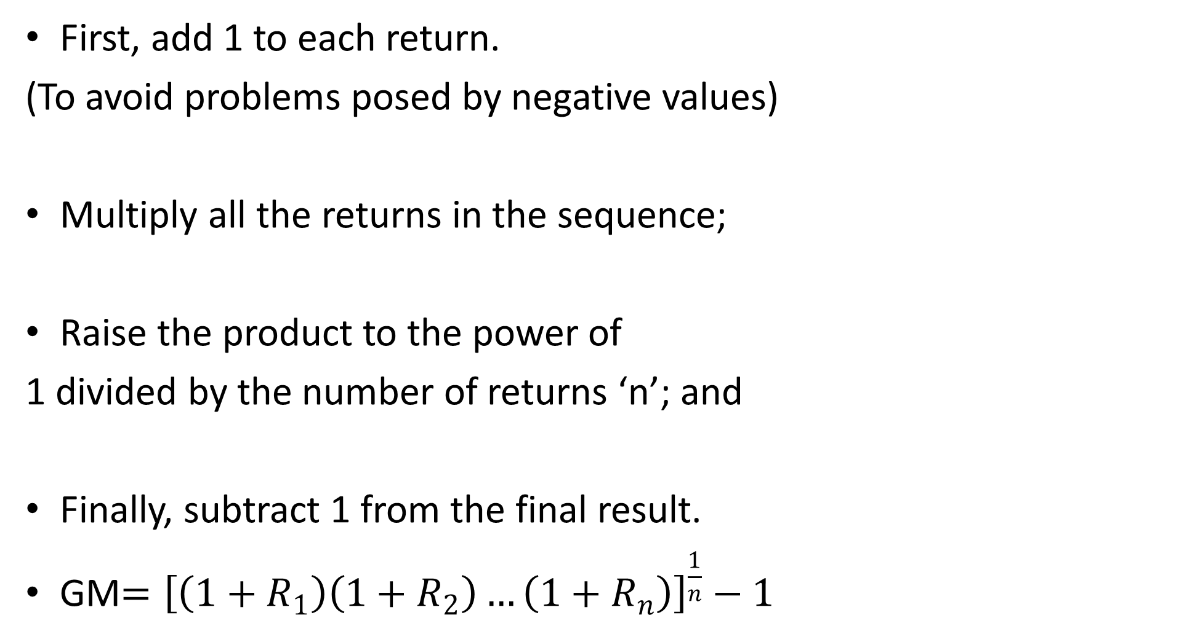
Steps of Calculating Geometric Mean
First, add 1 to each return.
(To avoid problems posed by negative values)
Multiply all the returns in the sequence;
Raise the product to the power of
1 divided by the number of returns ‘n’; and
Finally, subtract 1 from the final result.
GM$={\left[\left(1+R_{1}\right)\left(1+R_{2}\right)…\left(1+R_{n}\right)\right]}^{\frac{1}{n}}−1$

Slide 40
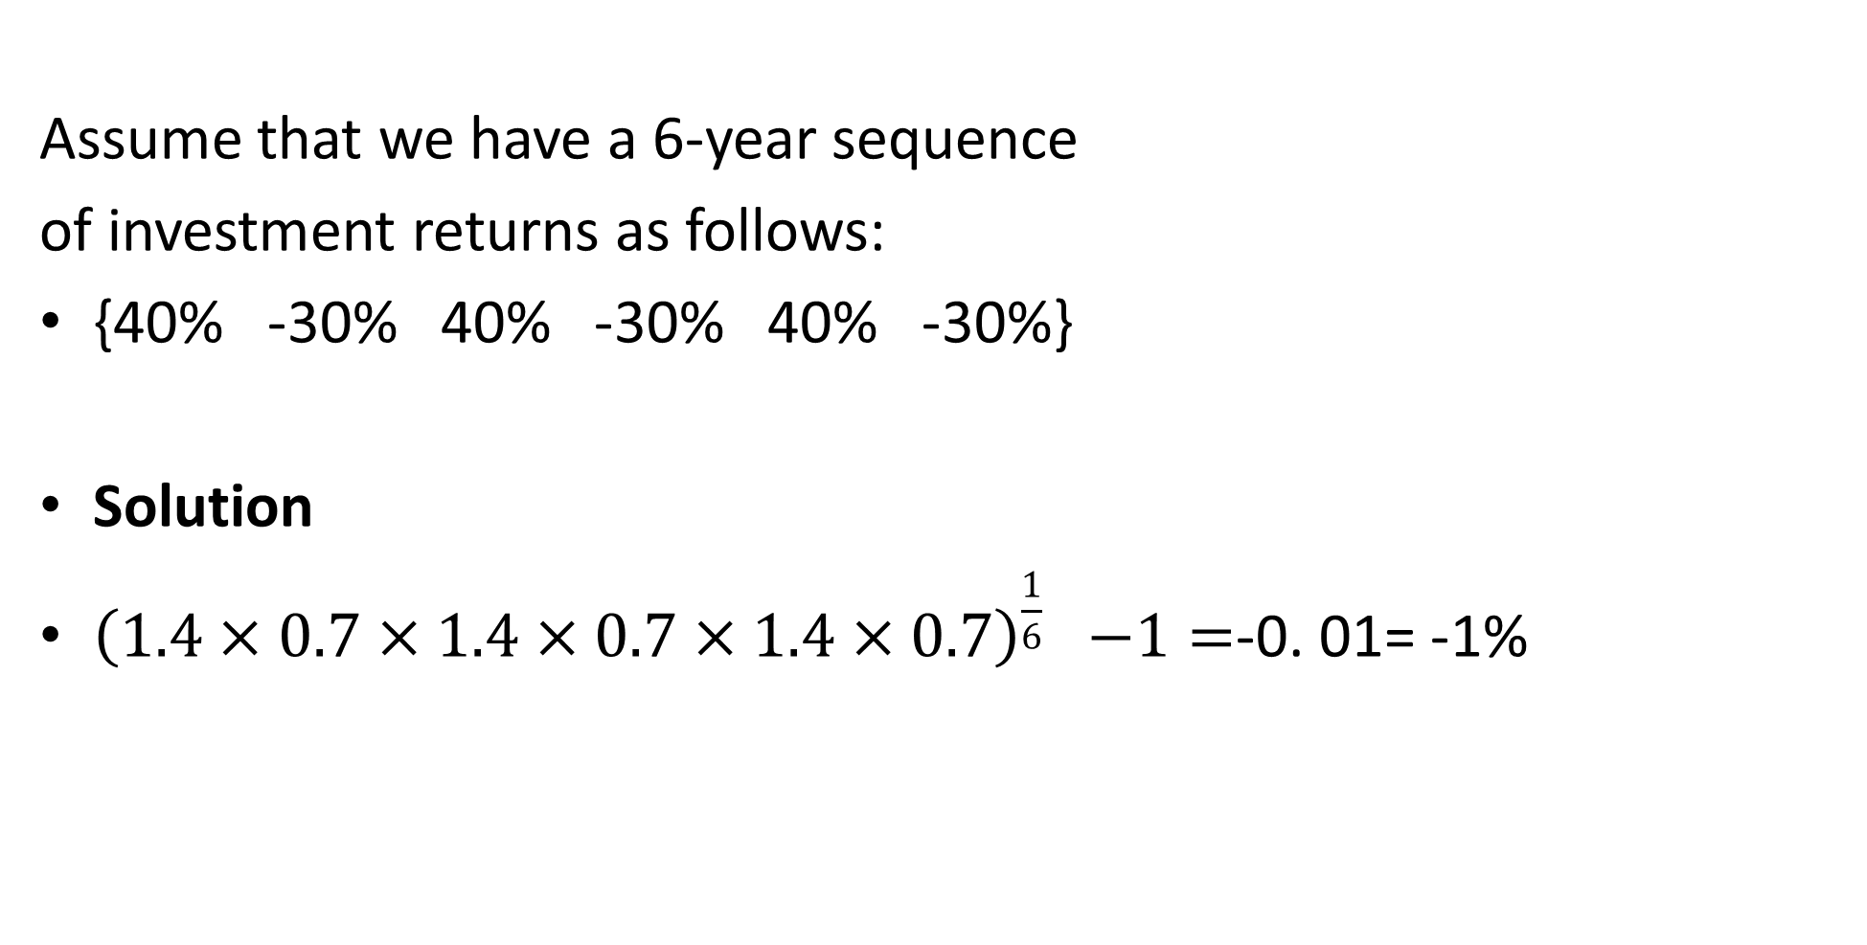
Geometric Mean Illustration
Assume that we have a 6-year sequence
of investment returns as follows:
{40% -30% 40% -30% 40% -30%}
Solution
${\left(1.4×0.7×1.4×0.7×1.4×0.7\right)}^{\frac{1}{6}}$ $−1=$-0. 01= -1%

Slide 41
Expected Return
:
These are the profit or loss anticipated by
an investor on an investment
that has known or expected return rates.
This is calculated by multiplying
potential outcomes by the likelihood
that they will occur and then adding up the results.

Slide 42
Illustration –Expected Return:
Calculate the expected return and risk
( standard deviation)
for each project
Probability Rate of return (%)
Occurrence
A B
0.1 10.0% 6.0%
0.2 10.0 8.0
0.4 10.0 10.0
0.2 10.0 12.0
0.1 10.0 14.0

Slide 43
Risk Preferences Three Preferences:
E(R_{A})=
10(0.1) + 10(0.2) + 10(0.4)
+ 10(0.2) + 10(0.1)= 10%
E(R_{B}) =
6(0.1) + 8(0.2) + 10(0.4) +
12(0.2) + 14(0.1)= 10%
Std Dev A= 0 since, (R_{Ai} - E(R)_{A}) = 0%
Std Dev B= √4.8 = 2.2%

Slide 44
Recap/The Risk-Return Trade-off
Investments must be analysed,
in terms of both their return potential
and their riskiness or variability.
Historically, its been shown that higher
returns are accompanied by higher risks.

Slide 45
END OF WEEK 5

Slide 46
References
Bassaersts, P, Bernt O Lectures on Corporate Finance, World Scientific publishing Co.pte td, 2006
Brealey, Myers & Allen, Principles of Corporate Finance, the McGraw-Hill Companies, Inc., 2007.
Gitman,L & Zutterc C.Principles of Managerial Finance, 14th ed. Pearson Education Limited, 2015
Van Horne, James C, .Fundamentals of Financial Management 13th ed. Pearson Education Limited, 2005

