Slide 1
Course: Corporate Finance
Week 6: Portfolio Theory
Lecturer: Dr. Charity Njoka

Slide 2
Lesson Objectives
At the end of this lesson you should be able to:
Calculate return of a two asset portfolio
Explain the concept of risk diversification
Determine risk of a portfolio
Define and demonstrate an efficient portfolio

Slide 3
Introduction
Introduction
H. Markowitz Portfolio Theory
Portfolio Return
Risk of a Portfolio
Efficient Portfolio
Recap of the lesson

Slide 4
Introduction
In lesson 5 we looked at a case of one asset
In practical situations investors do not
hold one asset
They hold a basket (portfolio) of assets
to earn higher returns and minimise risk

Slide 5
H. Markowitz Theory
Modern Portfolio Theory (MPT)
was developed by Markowitz in 1952
He derived the expected rate of return
for a portfolio of assets and an expected risk measure
Markowitz –Developed and defined efficient asset or a portfolio of assets

Slide 6
Definitions
A portfolio- Combination of assets
held by the investor for investment purposes.
A portfolio can then also be defined
by its asset weights
Diversification- combining assets whose
returns are not perfectly positively correlated to
reduce the aggregate risk of the total asset holdings ( portfolio).

Slide 7
Illustration-Portfolio Weights
An investment of $100,000 consists of 3 stocks:
200 shares of A, 1,000 shares of B,
& 750 shares of C
Determine the weights of the portfolio Assets
Asset Shares Price/Share Dollar Investment Port weights
A 200 50 10,000 10
B 1000 60 60,000 60
C 750 40 30,000 30
100,000 100

Slide 8
Portfolio Expected Returns
This is weighted average of the expected
return of each asset held in isolation
E(R_{P}) = W_{A}EX_{A} + W_{B}EX_{B} ...
(E(R_{P}) is the expected portfolio return
WA is the investment in asset A
WB is the investment in asset B
W_{A} is the expected return of asset A
W_{B} is the expected return of asset B

Slide 9
Factors affecting Portfolio return
Amount invested in each asset in the portfolio
( Weight of the assets)
2. Return of each asset in the portfolio

Slide 10
Illustration -Portfolio Returns
Consider two investments, A and B
each having the following
investment characteristics;
Investment Ex. Return (%) Proportion
A 10 2/3
B 20 1/3
Required. Compute the expected return of a portfolio of the two assets.

Slide 11
Solution
Note α = 2/3 ß = 1/3
EX_{A} = 10 EX_{B} = 20
E(R_{P}) = 2 (10%) + 1 (20%)
3 3
= 13.3%
NB: Not also α + ß = 1= 100%

Slide 12
What if weights are now equal?
Return of the portfolio will be-
Investment Ex. Return (%) Proportion
A 10 1/2
B 20 1/2
Required. Compute the expected return of a portfolio of the two assets.
solution = 15%

Slide 13
What if asset returns are now different?
Return of the portfolio will be-
Investment Ex. Return (%) Proportion
A 21 1/3
B 15 2/3
Required. Compute the expected return of a portfolio of the two assets.
solution = 17%

Slide 14
Risk of a Portfolio
Standard deviation is a measure of
risk of the investment-asset, portfolio etc
The riskiness of a portfolio is more complex
Portfolio standard deviation is not a
weighted average of standard deviations of assets held in isolation
This is because of the inter-relatedness of the assets

Slide 15
Factors affecting Risk of Portfolio
1. Correlation-relationship between asset returns
Covariance- Co-movement of asset returns
Weights of the assets in the portfolio
Risk of individual assets in the portfolio

Slide 16
Correlation Coefficient
The coefficient of correlation (τ)-rho
lies between -1 and +1. Hence -1 ≤ τ ≤+1.
τ_{AB} = +1 : A and B are perfectly positively correlated
and therefore the outcomes of A and B move in the
same direction at the same time
τ_{AB} = -1 : A and B are perfectly negatively correlated
and their results are inversely related.
That is they move in opposite directions simultaneously.
τ_{AB} = 0: No relationship between outcomes of A and B

Slide 17
Covariance
This is a measure which reflects both
the variance of an asset's returns and
the tendency of those returns to move up
and down at the same time or
the assets to move up or down separately.
Covariance is an absolute measure of co-movement of asset returns in absolute terms
A positive co-variance signifies movement of returns in the same direction
A negative co-variance signifies movement of returns in the opposite direction

Slide 18

Covariance Ctd
Where,
Cov(AB) is the covariance between A & B
R_{Ai} is the return on asset A under the ith state.
E(R_{A}) is the expected return of A
R_{Bi} is the return on asset B under the ith state
E(R_{B}) is the expected return of B
P_{i} is the probability of the ith state.

Slide 19

Formula for correlation coefficient
Where, Cov (AB) – Covariance of assets A and B
γ_{AB} _{I} is the correlation coefficient t of A and B
δ_{A} is the standard deviation of A
δ_{B} is the standard deviation of B

Slide 20
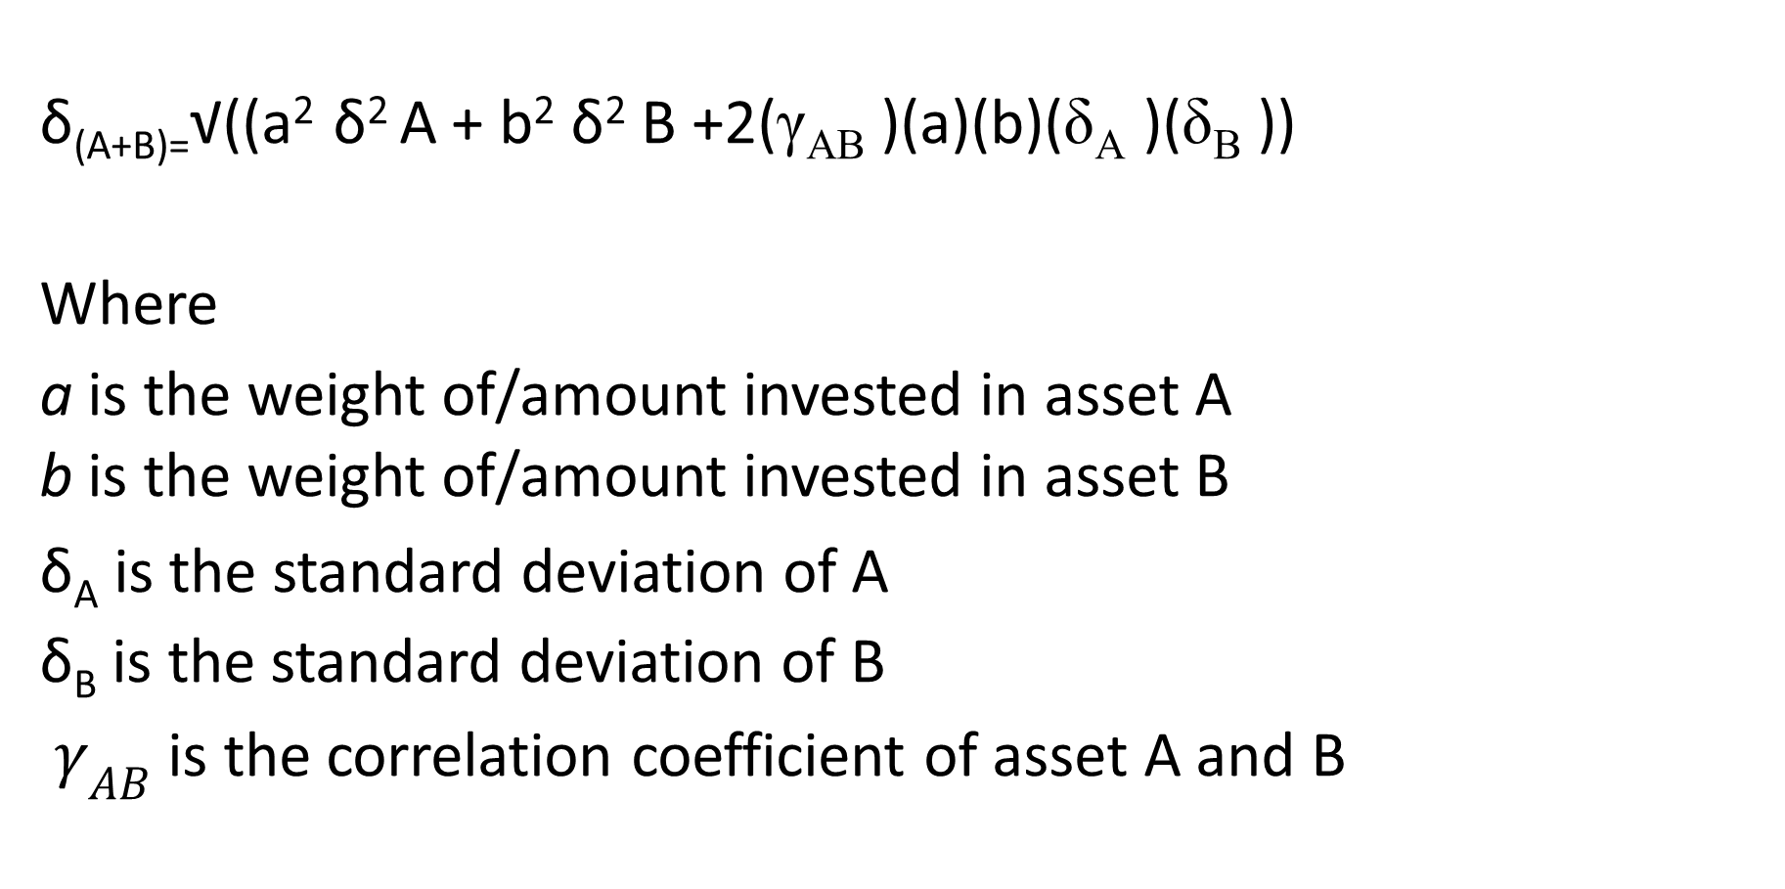
Standard Deviation Formula
δ_{(A+B)=}√((a² δ² A + b² δ² B +2(γ_{AB} )(a)(b)(δ_{A} )(δ_{B} ))
Where
a is the weight of/amount invested in asset A
b is the weight of/amount invested in asset B
δ_{A} is the standard deviation of A
δ_{B} is the standard deviation of B
$γ_{AB}$ is the correlation coefficient of asset A and B

Slide 21
Illustration- Perfect & Nil correlations
Consider two investments A & B
Investment Exp.Return (%) Prop.
A 20 2/3
B 40 1/3
Compute the portfolio standard deviation if the correlation coefficient between the assets is
a. 1
b. 0
c. -1

Slide 22

Solution
NB The standard deviation depends on the correlation coefficient if the proportion of investment is fixed

Slide 23
Solution Ctd
a.
a. r_{AB} = 1
δ_{A+B} = √(0.036 + 0.036) = 26.8%
b. If r_{AB} = 0 then
δ_{A+B} = √(0.036) =18.7%
c. If r_{AB} = -1
δ_{A+B} = √(0.036 - 0.036) =√0 = 0
There is no risk at all.
Note: If assets are perfectly negatively correlated then holding them in a portfolio greatly reduces their risk.

Slide 24
Comprehensive Illustration
Consider the following assets
Prob. Rate of return (%)
A B C D
0.1 10 6 14 2
0.2 10 8 12 6
0.4 10 10 10 9
0.2 10 12 8 15
0.1 10 14 6 20

Slide 25
Illustration Ctd
REQUIRED:
a. Compute the expected return
and standard deviation of each asset.
b. Compute the covariance of asset
i. A and B
ii. B and C
iii. B and D
c. Compute the correlation coefficient of the combination of assets in b above.

Slide 26
Solution-Expected returns
First, calculate expected returns
E(R_{A}) = 10(0.1) + 10(0.2) + 10(0.4)
+ 10(0.2) + 10(0.1) =10%
E(R_{B}) = 6(0.1) + 8(0.2) +
10(0.4) + 12(0.2) + 14(0.1) =10%
E(R_{C}) = 14(0.1) + 12(0.2) +
10(0.4) + 8(0.2) + 6(0.1) =10%
E(R_{D}) = 2(0.1) + 6(0.2) + 9(0.4) +
15(0.2) + 20(0.1) =10%

Slide 27

Solution Ctd –Risk of each asset
Then calculate risk of each asset
Use the formula
The results are
δ_{A} = 0 since (R_{Ai} - E(R)_{A}) = 0%
δ_{CB} = 2.2%
δ_{C} = 2.2%
δ_{D} = 5.0%

Slide 28

Solution ctd-Covariance
Use the Formula
I Cov(AB) = 0 since R_{Ai}-E(R_{A}) = 0
Ii Cov(BC) = (6-10)(14-10)(0.1) + (8-10)(12-10)0.2 + (10-10)(10- 10)0.4 + (12-10)(8-10)0.2 + (14-10)(6-10)0.1 = -4.8
Iii Cov(BD) = (6-10)(2-10)(0.1) + (8-10)(6-10)0.2 + (10-10)(9-10)0.4 +
(12-10)(15-10)0.2 + (14-10)(20-10)0.1 = 10.8

Slide 29
Correlation Coefficients
i. τ_{AB} =Cov_{(AB)} = 0 = 0
δ_{A}δ_{B} (0)(2.2)
ii. τ_{BC} =Cov_{(BC)} = -4.8 = -1.0
δ_{B}δ_{C} (2.2)(2.2)
iii. τ_{BD} =Cov_{(BD)} =10.8 = 0.98
δ_{B}δ_{D} (2.2)(5.0)

Slide 30
Components of Asset Risks
Systematic risks / Market risk
This risks affects all/ most assets
eg-inflation, increase in taxes etc
Systematic risks are non-diversifiable
Cannot be minimised by holding more
assets in the portfolio
2. Non-systematic risks/ stand alone risk
This risks affects specific to individual assets
eg. Low prices
Non-systematic risks are diversifiable
Ie can be minimised by increasing assets in the portfolio

Slide 31
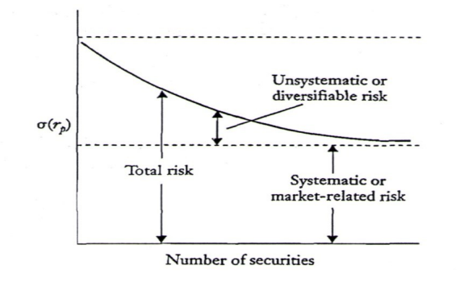
Risks illustrated
Diagram

Slide 32
Risk Reduction: Benefits of Diversification
Portfolio diversification
Diversification can increase the risk/return
tradeoff if the average correlation
coefficient between individual securities
in the portfolio is less than 1.0
Benefits of diversification increase as the
correlation coefficient gets smaller
Diversification across securities
As the number of securities in a portfolio
increases the portfolio risk decreases and
approaches the risk of the total market

Slide 33
Efficient Portfolio & the Efficient Frontier
Definition.
Efficient portfolio- is a portfolio that yields the
highest return for a specific risk, or,
stated in another way, the lowest risk for a given return.
Profits can be maximized by selecting an efficient portfolio
that is also an optimal portfolio, which provides
the most satisfaction — the greatest return —
for an investor based on his tolerance for risk.

Slide 34
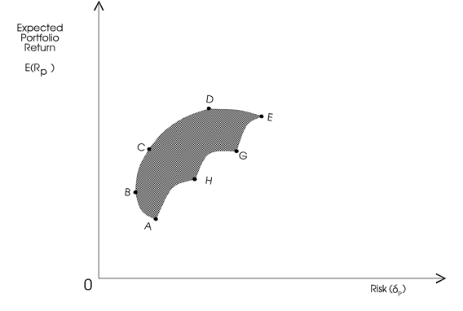
Efficient Portfolio & the Efficient Frontier Diagram

Slide 35
Efficient Portfolio & the Efficient Frontier Ctd
The shaded area is the attainable set of investment.
However, investors will invest in a portfolio
with the highest return at a given risk
or the lowest risk at a given return.
The efficient set of investment,
therefore, will be given by the frontier B C D E.
This frontier is referred to as the Efficient Frontier.
Any point on the efficient frontier
dominates all the other points on the feasible set.

Slide 36
Mean –Variance Portfolio
Given an expected return, the portfolio that
minimizes risk (measured by StD or variance)
is a mean-variance frontier portfolio.
B is the mean- variance portfolio in our diagram
The locus of all frontier portfolios in the mean-StD plane is called
portfolio frontier. A B C D in our diagram
The upper part of the portfolio frontier gives the efficient frontier
Portfolios, B C D in our diagram

Slide 37
Recap/ conclusions
Forming portfolios can eliminate non-systematic risks.
Investors hold diversified portfolios to reduce risk.
Investors care only about portfolio risks—systematic risks.
Investors hold frontier portfolios.
Large asset base improves the portfolio frontier.

Slide 38
Recap/ conclusions ctd
  When the HPR of two securities move
  in the same direction, by the same
  amount at the same time, the pair is
  perfectly positively correlated: rho = 1
  When the HPR of two securities are
  totally unrelated to each other, the
  pair is uncorrelated; rho = 0
  The risk of a portfolio is the weighted average
  of the risk of each security in the portfolio,
  and the correlations between each pair of assets in the portfolio

Slide 39
THE END OF WEEK 6 LESSON

Slide 40
References
Professional Accountancy Notes, Strathmore School of Business Module, 2004
Bassaersts, P, Bernt O Lectures on Corporate Finance, World Scientific publishing Co.pte td, 2006
Brealey, Myers & Allen, Principles of Corporate Finance, the McGraw-Hill Companies, Inc, 2007.
Van Horne, James C, .Fundamentals of Financial Management 13th ed. Pearson Education Limited, 2005

