Slide 1
Course: Corporate Finance
Week 7: Asset Valuation Models
- CAPM
Lecturer: Dr. Charity Njoka

Slide 2
Lesson Objectives
At the end of this lesson you should be able to:
1. Explain the concept of beta
2. Understand the concept of Capital Market Line
3. Derive and evaluate asset value using Security Market Line
4. State the assumptions of Capital Asset Pricing Model (CAPM)
5. Calculate the required rate of return using CAPM
6. Explain the weaknesses of Capital Asset Pricing Model

Slide 3
Introduction
      .
Portfolio theory analyzes investors’ asset
demand given asset returns.
To maximise returns while minimising the risks
an investors needs to:-
1. Diversify to eliminate non-systematic risk.
2. Hold only the risk-free asset and a fully diversified market portfolio or a portion of it

Slide 4
Risk Free Asset
Treasury Bills (T- Bills) are an example of Risk -free asset
With risk-free asset:
1. Expected return is entirely certain.
2. Standard deviation of return is zero.
3. Covariance with any risky asset or portfolio is always zero, as is the correlation.

Slide 5
Concept of Beta
Risk of an asset or portfolio is measured by:
variance or Standard Deviation
Standard deviation measures total risk
Total risk = systematic risk+ unsystematic risk
Systematic( undiversifiable) risk is measured using beta.
It is possible to calculate the Beta of an individual
asset as well as for a portfolio

Slide 6
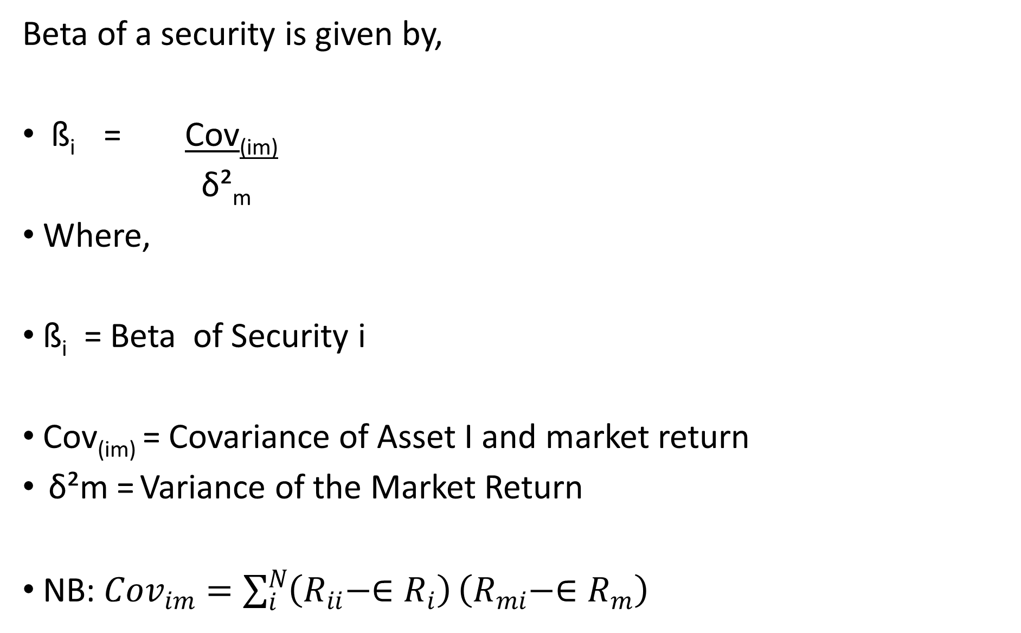
Beta of a Security
Beta of a security is given by,
ß_{i} = Cov_{(im)}
δ²_{m}
Where,
ß_{i} = Beta of Security i
Cov_{(im)} = Covariance of Asset I and market return
δ²m = Variance of the Market Return
NB: ${Cov}_{im}=\sum_{i}^{N}{\left(R_{ii}−{∈R}_{i}\right)}\left(R_{mi}−{∈R}_{m}\right)$

Slide 7
Beta of a Portfolio
It is the weighted average of betas of the
individual assets in the portfolio.
Thus B_{p}= W_{a} B_{a} + W_{b}B_{b}
Where,
B_{p}= Beta of the portfolio
W_{a}= Weight of Asset A
B_{a} = Beta of the Asset A
W_{b} =Weight of Asset B
B_{b} = Beta of Asset B

Slide 8
Illustration -Beta of a Portfolio
A company has two investments A and B.
75 % of its investments are in A which has a beta of 1.2
However the balance, 25% of the investments are held in B which is deemed to be 50% riskier in systematic risk terms
Required: Calculate the firm’s portfolio Beta

Slide 9
Solution -Beta of a Portfolio Question
B_{p}= W_{a} B_{a} + W_{b}B_{b}
Beta of Asset A= 1.2
Beta of Asset B= 1.2+ 50% * 1.2= 1.8
Bp= 0.75(1.2) + 0.25 (1.8) = 1.35

Slide 10
Capital Market Line (CML)
CML) represents portfolios that optimally combine
risk and return
CML is a line that is used to show the rates of return,
which depends on risk-free rates of return and
levels of risk for a specific portfolio
It represents all the portfolios that optimally combine the risk-free rate of return and the market portfolio of risky assets

Slide 11
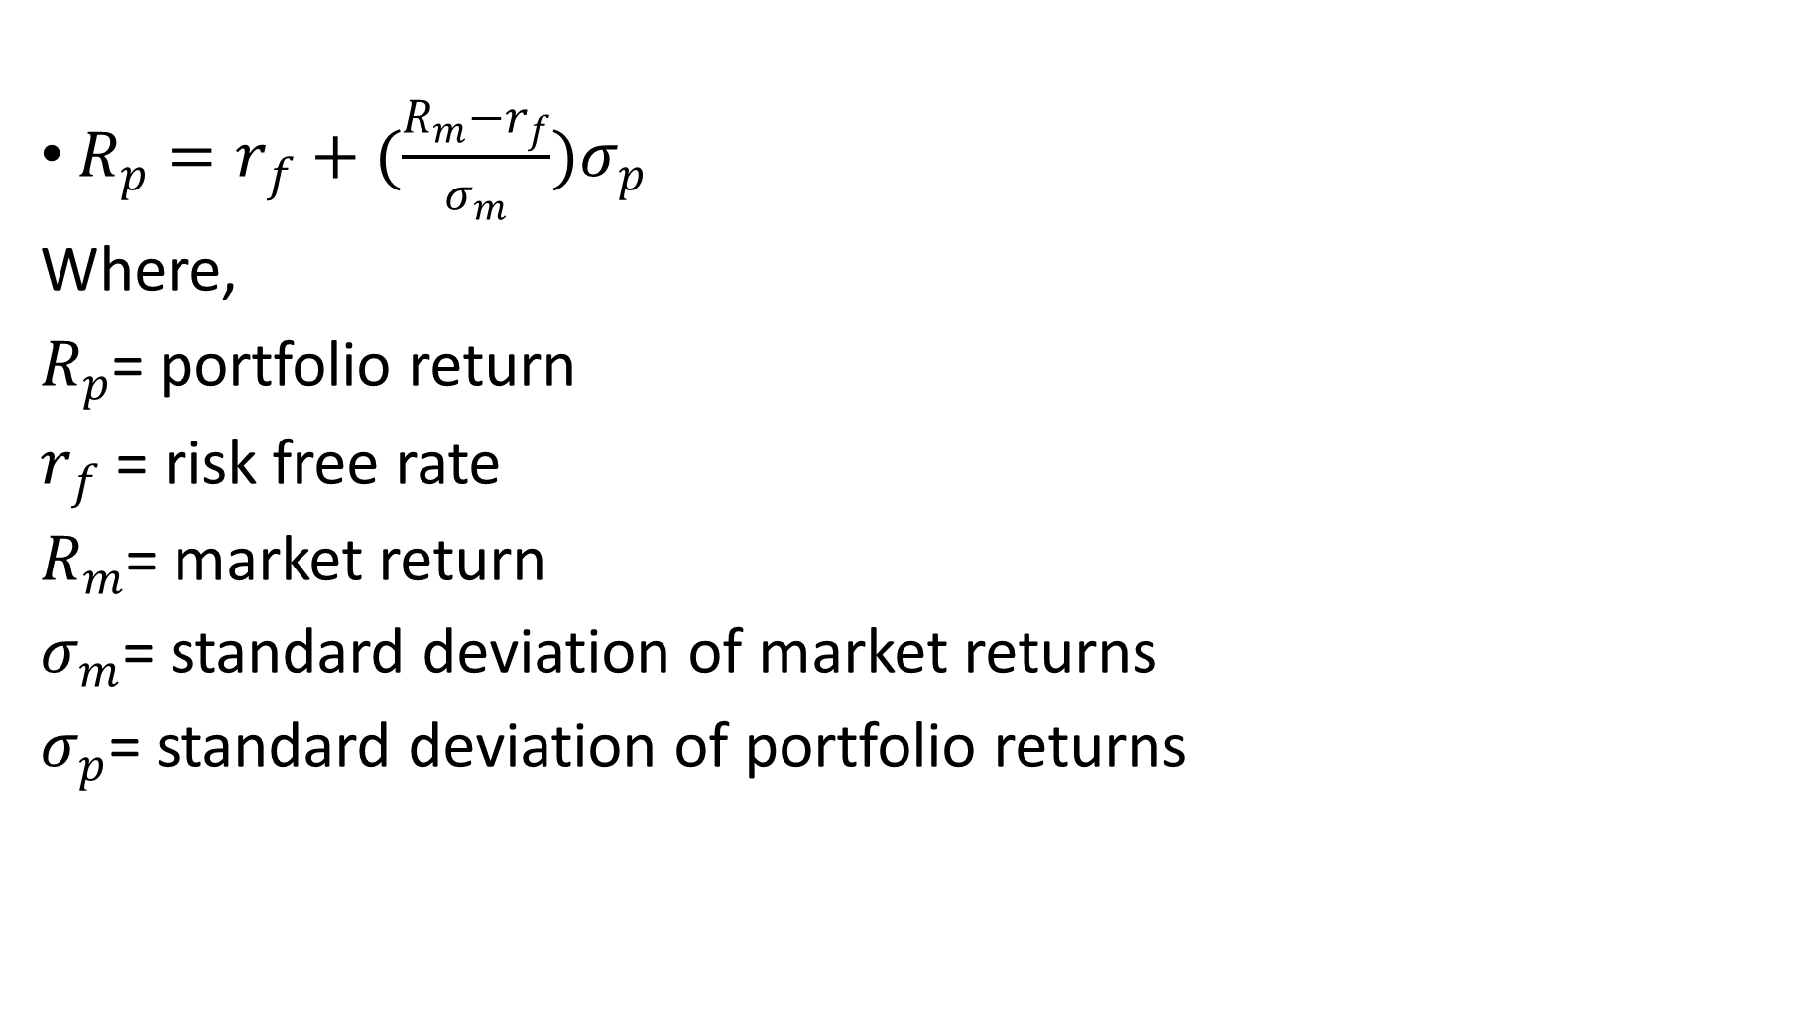
Capital Market Line (CML) Formula
$R_{p}=r_{f}+(\frac{R_{m}−r_{f}}{σ_{m}})σ_{p}$
Where,
$R_{p}$= portfolio return
$r_{f}$ = risk free rate
$R_{m}$= market return
$σ_{m}$= standard deviation of market returns
$σ_{p}$= standard deviation of portfolio returns

Slide 12
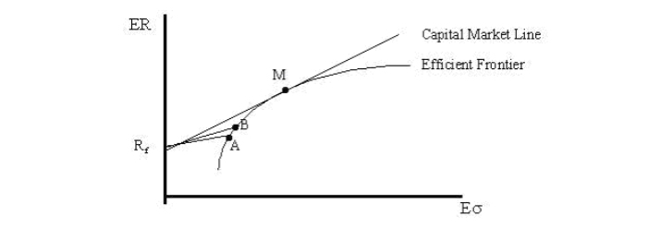
CML Graphically

Slide 13
CML Implications on Investments
Introduction of the risk-free asset significantly
changes the Markowitz efficient set of portfolios
Investors are better off because they
have improved investment opportunities
Investors can attain their desired risk preferences by
adjusting the weight of the market portfolio in their portfolios.

Slide 14
CML and Risk attitudes
A strongly risk-averse investor will-
-Lend some funds at the risk-free rate and
- Invest the remainder in the market portfolio.
A less risk-averse investor will
-Borrow some funds at the risk-free rate &
-Invest all the funds in the market portfolio.

Slide 15
Interpreting CML
The market portfolio of risky securities, M,
is the highest point of tangency between the
line emanating from Rf and the efficient frontier
and is the singular optimal risky portfolio
All assets are included in portfolio M in proportion to
their market value
Because the market portfolio includes all risky assets, portfolio M is by definition completely diversified
A portfolio that is completely diversified has a correlation with the market of 1.0.

Slide 16
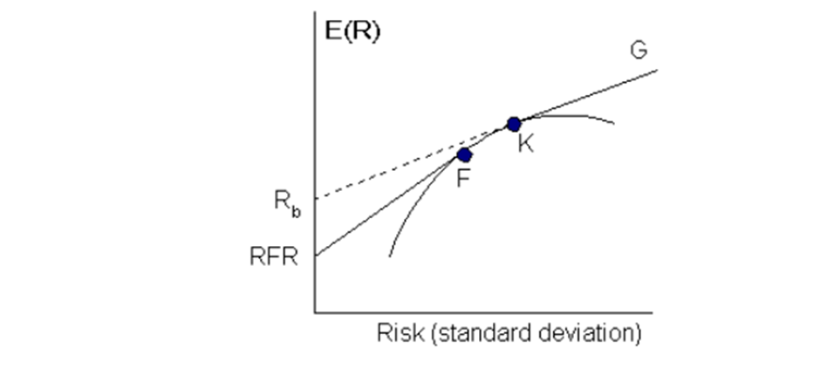
Borrowing /lending at Rf Illustrations

Slide 17
Interpretation of Borrowing/Lending diagram
The segment RFR-F indicates investment
opportunities available when an investor
Combines risk-free assets (lending at RFR) and
portfolio F on the Markowitz efficient frontier.
It is NOT possible to extend this line any further it is assumed that you cannot borrow at this risk-free rate to acquire further units of Portfolio F.

Slide 18
Interpretation of Borrowing/Lending Diagram Ctd
If you can borrow at Rb, you can use the
proceeds to invest in portfolio K to extend
the CML along the line segment K-G.
Then CML is made up of RFR-F-K-G. This implies that you can either lend or borrow, but the borrowing portfolio is not as profitable as when it was assumed that you could borrow at RFR.
Your net return is less, as the slope of the borrowing line (K-G) is below that for RFR-F.

Slide 19
Illustrations
Suppose the current risk-free rate is 5%,
and the expected market return is 18%.
The standard deviation of the market portfolio is 10%.
Portfolios A and B have standard deviations
of 5% and 15% respectively.
Required: Calculate the expected return of each of the assets using the Capital Market Line Formula

Slide 20
Solution
Calculation of Expected Return of Portfolio A
5% +5%* (18%-5%)/10%
ER(A) = 11.5%
Calculation of Expected Return of Portfolio B
5% +15% (18%-5%)/10%
ER(B) = 24.5%
CML differs from the more popular efficient frontier in that it includes risk-free investments. The intercept point of CML and efficient frontier results in the most efficient portfolio, called the tangency portfolio==

Slide 21
Capital Asset Pricing Model (CAPM)
Is a single factor model (or CAPM)
developed by Sharpe (1964) and Lintner (1965)
CAPM specifies the relationship between risk
And required rate of return on assets when they
are held in well-diversified portfolios.
Remember a well diversified portfolio is the risky market
Portfolio that has Beta of 1.0

Slide 22
Basic assumptions of CAPM
Investors are rational and they choose
among alternative portfolios on the basis of
each portfolio's expected return and standard deviation.
2. Investors are risk averse ( Fear risk)
3. Investors maximise the utility of end of period wealth. Thus CAPM is a single period model.

Slide 23
Basic assumptions of CAPM ctd
4 Investors have homogeneous expectations
With regard to asset return. Thus all investors will
perceive the same efficient set.
5. There exists a risk-free asset and all investors can
borrow and lend at this rate.
6. All assets are marketable and perfectly divisible.
7. The capital market is efficient and perfect- There are no transaction costs (taxes, frictions, and

Slide 24
CAPM Formula
Return of an asset using CAPM is as follows:
R_{i} = R_{F} + [E(R_{M} - R_{F})]ß
Where-R_{i} is required return of security i
R_{F} is the risk free rate of return
E(R_{M}) is the expected market rate of return
ß is Beta.
Note ß_{i} = Cov_{(im)}
δ²_{m}
Where ,Cov_{(im)} is the covariance between asset i and the market return.
δ²_{m} is the variance of the market return.

Slide 25
Illustration
Assume that the risk free rate of return is
8%, the market expected rate of return is 12%. The standard deviation of the market return is 2% while the covariance of return for security A and the market is 2%.
Required: What is the required rate of return on Security A?

Slide 26
Solution -
R_{i} = R_{F} + (E(R_{M}) - R_{F})ß
ß = Cov_{(AM)} = 2 = 2 = 0.5
δ_{M}² 2² 4
R_{i} = 8% + (12 - 8)0.5 =10%
The required rate of return on security A is therefore 10%.

Slide 27
Limitations of CAPM
.
1, It is based on some unrealistic assumptions eg.
i Existence of Risk-free assets
All assets being perfectly divisible and marketable
iii. Existence of homogeneous expectations about the expected returns
iv. Asset returns are normally distributed.

Slide 28
CAPM Limitations continued
2. CAPM is a single period model—
it looks at the end of the year return.
-3. CAPM cannot be empirically tested _
because we cannot test investors’ expectations.
4. CAPM assumes that a security's required rate of return is based on only one factor (the stock market—beta). However, other factors such as relative sensitivity to inflation and dividend payout, may influence a security's return relative to those of other securities.
NB: CAPM is the line that connects the risk-free rate of return with the tangency point on the efficient frontier of optimal portfolios

Slide 29
Security Market Line ( SML)
SML is the representation of CAPM
SML displays the expected return of individual
security as a function of systematic risk
NB While CML shows rates of return for a specific portfolio , the SML represents the Market risk and Return at a given point in times and shows the expected return of individual assets

Slide 30
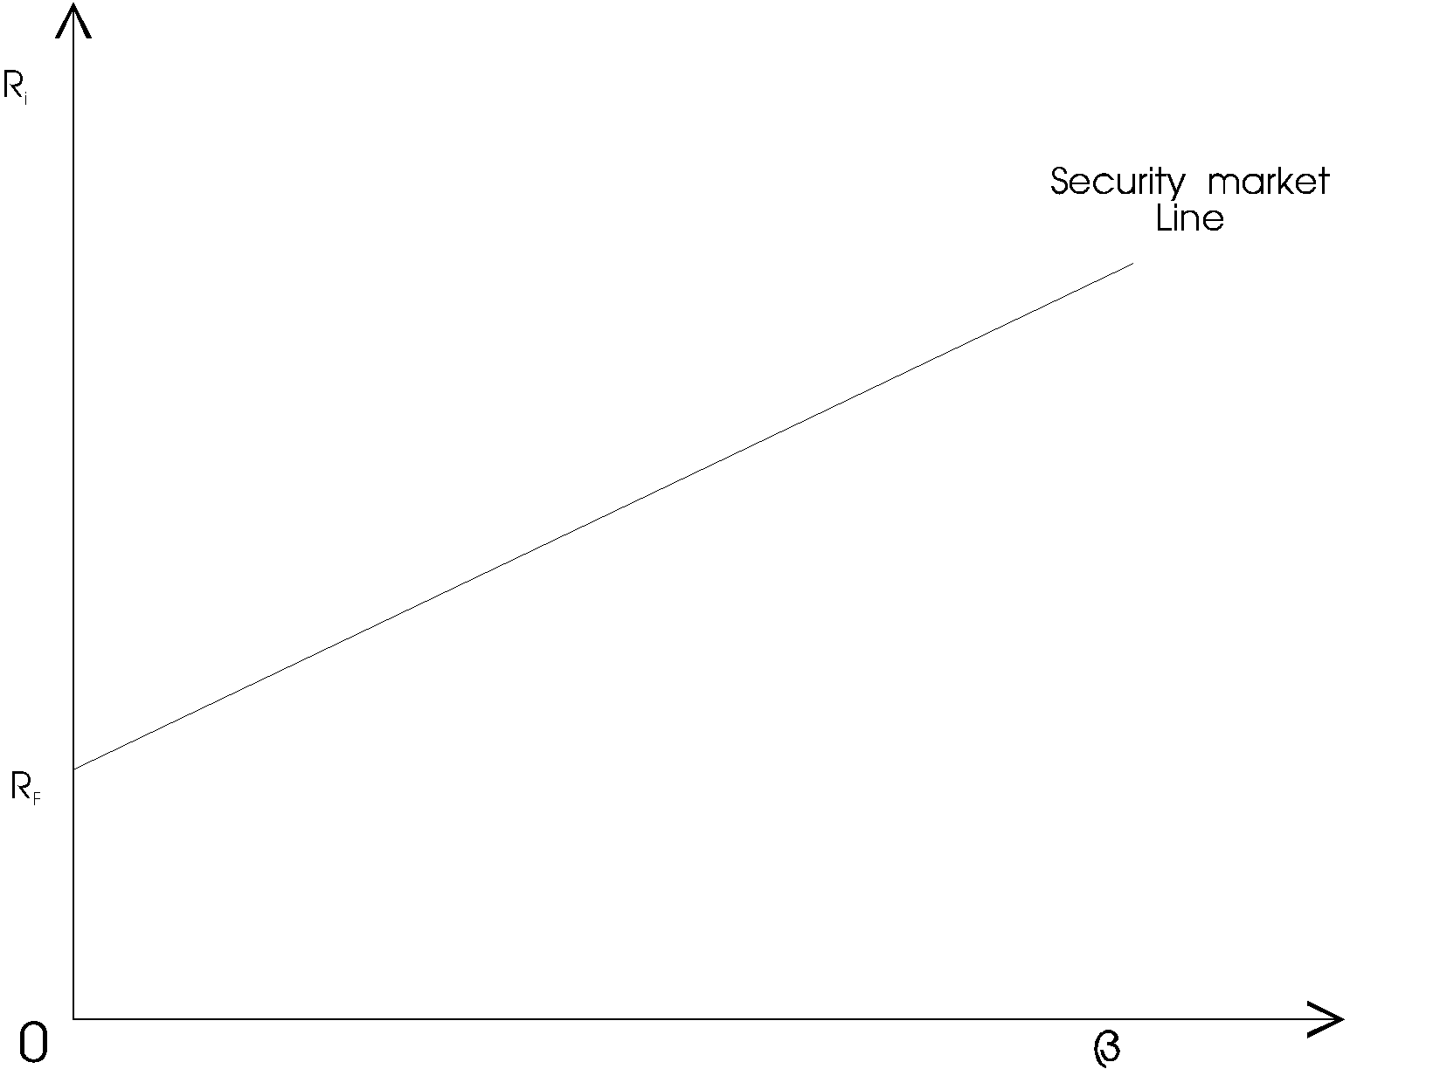
SML Graphically

Slide 31
Interpretation of SML
All correctly priced assets will lie on the SML
Any security off this line will either be
overpriced or underpriced
Any security plotted above the SML is interpreted
as undervalued and any security below the line is overvalued
The SML shows the pricing of all asset if the market is at equilibrium. It is a measure of the required rate of return if the investor were to undertake a certain amount of risk.

Slide 32
CML vs SML Compared
The SML is derived from the CML.
CML shows rates of return for a specific portfolio,
the SML shows the expected returns of individual assets
While the measure of risk in the CML is the standard
deviation of returns (total risk), the risk measure in
the SML is systematic risk or beta.
Securities that are fairly priced will plot on the CML and the SML underpriced will plot above and overpriced plot below the CML and SML. .

Slide 33
Drawbacks of CML
Presence of friction − CML considers that
there is always some friction in the market
irrespective of the volume and size.
Taxes and transaction costs − These costs are
needed to be paid by the investors and these costs
can vary from person to person and also in different geographies.
The difference in investors worldwide −
In the practical world, all investors do not have access to all the information required to make a good investment decision

Slide 34
Summary:
Standard deviation is the measure of risk in CML,
Beta measures the risk factors of the SML.
While the CML graphs define efficient portfolios,
the SML graphs define both efficient and
non-efficient portfolios
CML is considered to be superior when measuring the risk factors.

Slide 35
References
Analysis of Investments & Management of Portfolios Management of Portfolios 10th Edition
Financial Management: Theory and Practice, Brigham & Ehrhardt, 10th Edition, Cengage Learning, 2002.
Modern Portfolio Theory and Investment Analysis Elton, Gruber, Brown, and Goetzmann, 6th Edition (Wiley):
Principles of Corporate Finance, Brealey, Myers & Allen, 9th Edition The McGraw-Hill Companies, Inc., 2007.

Slide 36
THE END OF WEEK 7 LESSON

