Slide 1
Course: Corporate Finance
Week 8: CAPM and Arbitrage Pricing Theory
Lecturer: Dr. Charity Njoka

Slide 2
Lesson Objectives
At the end of this lesson you should be able to:
Determine return of an asset using CAPM and APT
Evaluate pricing of securities
3. Compare and Contrast CAPM and APT
4. Outline advantages and disadvantages of CAPM and APT

Slide 3
Introduction
      .
CAPM uses some ideal assumptions to the
identity of the tangency portfolio
Every investor will hold this same portfolio of risky assets
Beta coefficient is a relative measure of the sensitivity of an assets’ return to changes in the return on the market portfolio.
The beta factor of the market as a whole is 1.0.

Slide 4
Introduction Ctd
If the beta of a security is one, then it has the
same risk profile as the market as a whole,
the average risk profile.
If the beta is less than one, it is not as sensitive to
systematic or market risk as the average investment.
If beta is more than one, it is more sensitive to the
market or systematic risk than the average investment.

Slide 5
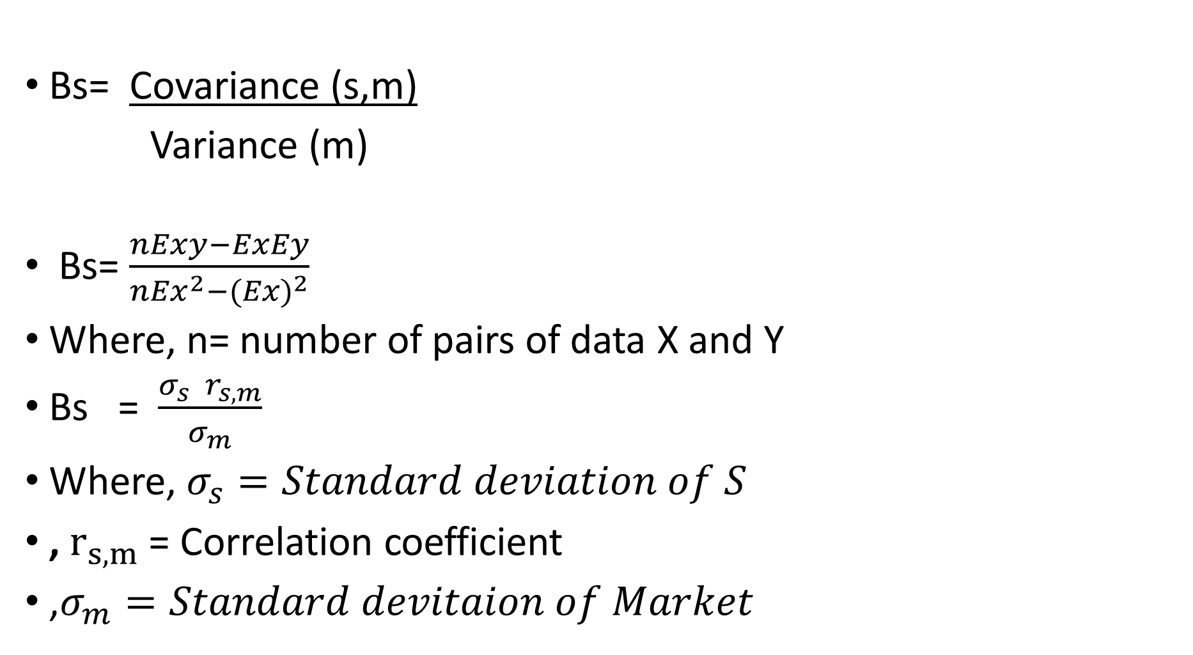
Beta Calculation
Bs= Covariance (s,m)
Variance (m)
Bs= $\frac{nExy−ExEy}{{nEx}^{2}−{(Ex)}^{2}}$
Where, n= number of pairs of data X and Y
Bs = $\frac{σ_{s} r_{s,m}}{σ_{m}}$
Where, $σ_{s}=Standard deviation of S$
, $r_{s,m}$ = Correlation coefficient
,$σ_{m}=Standard devitaion of Market$

Slide 6
Security Pricing
There are two methods of determining value
of an asset/stock
Use of SML - Graph Return of an asset plotted
against beta coefficients
Calculation of Stocks Alpha – Difference between
expected return and required return

Slide 7
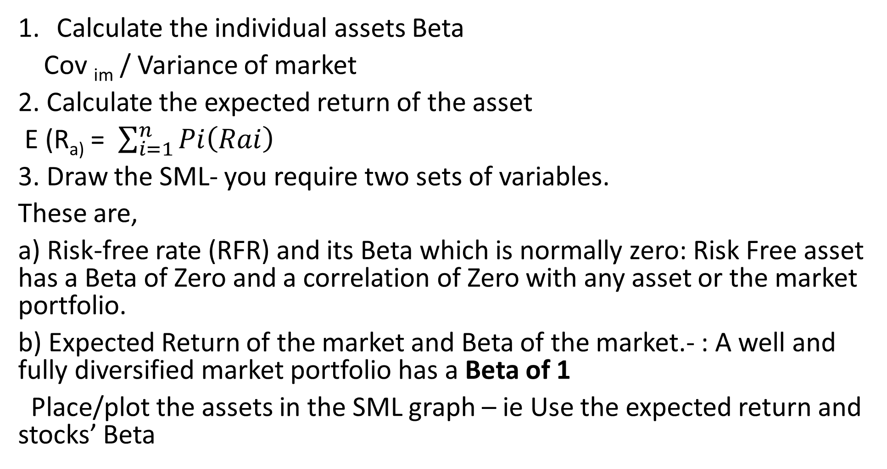
Use of SML
Calculate the individual assets Beta
Cov _{im} / Variance of market
2. Calculate the expected return of the asset
E (R_{a)} = $\sum_{i=1}^{n}{Pi\left(Rai\right)}$
3. Draw the SML- you require two sets of variables.
These are,
a) Risk-free rate (RFR) and its Beta which is normally zero: Risk Free asset has a Beta of Zero and a correlation of Zero with any asset or the market portfolio.
b) Expected Return of the market and Beta of the market.- : A well and fully diversified market portfolio has a Beta of 1
Place/plot the assets in the SML graph – ie Use the expected return and stocks’ Beta

Slide 8
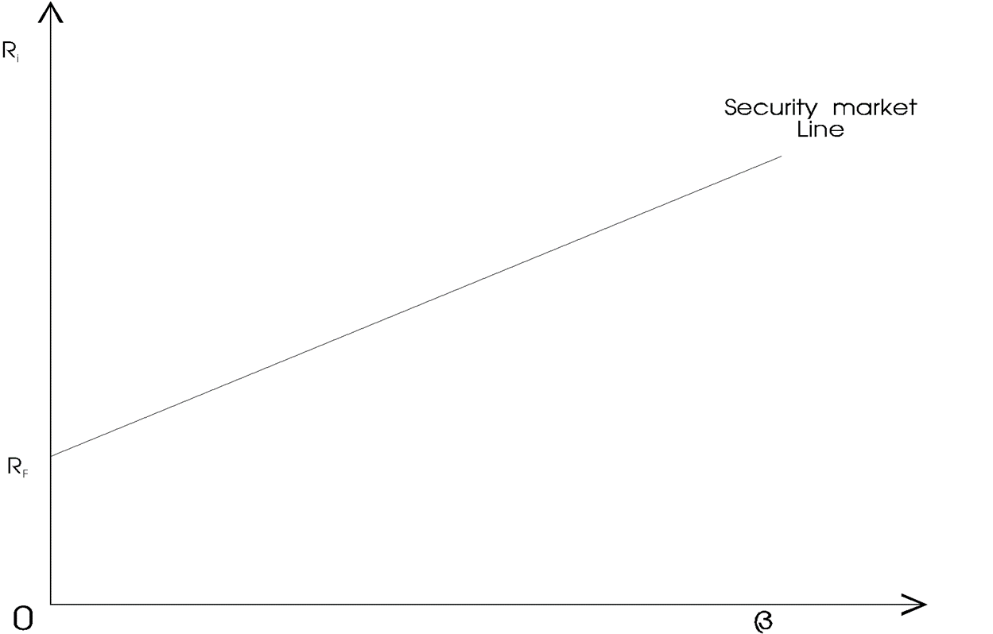
SML Graph
If the security is plotted above the SML, the stock
is interpreted as undervalued/ underpriced.
If the security is plotted below the SML, the
stock is interpreted as overvalued/ overpriced
A- Undervalued
A- Undervalued
B- Overvalued
B- Overvalued

Slide 9
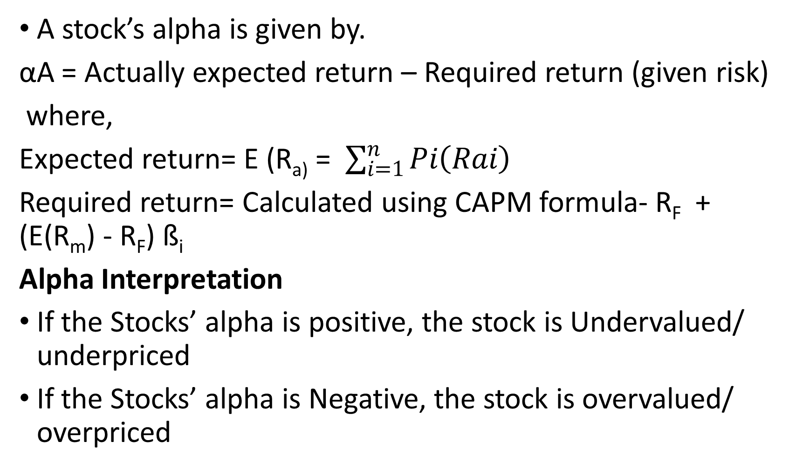
Calculation of Stocks Alpha
A stock’s alpha is given by.
αA = Actually expected return – Required return (given risk)
where,
Expected return= E (R_{a)} = $\sum_{i=1}^{n}{Pi\left(Rai\right)}$
Required return= Calculated using CAPM formula- R_{F} + (E(R_{m}) - R_{F}) ß_{i}
Alpha Interpretation
If the Stocks’ alpha is positive, the stock is Undervalued/ underpriced
If the Stocks’ alpha is Negative, the stock is overvalued/ overpriced

Slide 10
Illustration One
The risk free rate is 10% and the expected return on the market portfolio is 15%. The expected returns for 4 securities are listed below together with their expected betas
Security Expected Return Expected Beta
A 17.0% 1.3
B 14.5% 0.8
C 15.5% 1.1
D 18.0% 1.7

Slide 11
Illustration One Ctd
Required:
On the basis of these expectations, which securities are overvalued? Which are undervalued?
If the risk-free rate were to rise to 12% and the expected return on the market portfolio rose to 16%, which securities would be overvalued? Which would be under-valued? (Assume the expected returns and the betas remain the same).

Slide 12
Solution –Use SML and Alphas
.a) Required return = R_{F} + (E (R_{m}) - R_{F}) ß_{i}
Security A: Ri = 10% + (15% - 10%) 1.3
= 16.5%
Security B: Ri = 10% + (15% - 10%)0.8
= 14%
Security C: Ri = 10% + (15% - 10%) 1.1
= 15.5%
Security D: Ri = 10% + (15% - 10%) 1.7
= 18.5%
Security Expected Return Required Return Alpha (E_{R}- R_{R})
A 17.0% 16% 1%
B 14.5% 14% 0.5%
C 15.5% 15.5% 0%
D 18.0% 18.5% - 0.5%
Security D is overvalued while security A and B are undervalued. Security C is properly valued.

Slide 13
Solution b
(b) R_{F} = 12%
E(R_{M}) = 16%
Security A: Ri = 12% + (16% - 10%) 1.3 = 17.2%
Security B: Ri = 12% + (16% - 12%) 0.8 = 15.2%
Security C: Ri = 12% + (16% - 12%) 1.1 = 16.4%
Security D: Ri = 12% + (16% - 12%) 1.7 = 18.8%
Security Expected Return Required Return Alpha
A 17.0% 17.2% -0.2%
B 14.5% 15.2% -0.7%
C 15.5% 16.4% -1.1%
D 18.0% 18.8% - 0.8%
Securities A, B, C, and D will all be overvalued.

Slide 14
Benefits of CAPM
CAPM model of portfolio management can be effectively
used to:
Investments in risky projects having real assets can be evaluated of its worth in view of expected return.
CAPM analyses the riskiness of increasing the levels of gearing and its impact on equity shareholders returns.
CAPM suggests the diversification of portfolio in minimisation of risk

Slide 15
Practical Applications of CAPM
Used by investors to selected their portfolio
of securities
When beta factor of individual securities are published by analysists ef London Business School, investors are thus able to use CAPM to select portfolios that reflect their risks.
Nb Though CAPM assumes all investors to be risk averse, in practices investors have diverse risks preferences

Slide 16
Practical applications of CAPM Ctd
2. Evaluation of Capital investment Projects
When deciding which project to undertake , management
should be concerned with its systematic risk and not its overall risk.
If beta factor can be estimated it is possible to calculate the minimum required return on a project .
Thus CAPM would compare projects of different risks classes , unlike NPV method that does not consider risk in its discounting rate

Slide 17
Arbitrage Pricing Theory (APT)
Formulated by Ross 1976), the Arbitrage Pricing Theory
(APT) offers a testable alternative to the capital market
pricing model (CAPM).
The Arbitrage pricing theory is designed to help overcome weaknesses associated with CAPM.
Arbitrage opportunity arises where there is a possibility of taking advantage of a state of imbalance between two (or possibly more) markets and thereby making a risk-free profit,

Slide 18
APT and CAPM Compared
The APT makes no assumptions about the empirical distribution of asset returns. CAPM assumes normal distribution.
The APT makes no strong assumption about individuals’ utility functions (at least nothing stronger than greed and risk aversion).
The APT allows the equilibrium returns of asset to be dependent on many factors, not just one (the beta).

Slide 19
APT and CAPM Compared Ctd
The APT yields a statement about the relative pricing of any subset of assets; hence one need not measure the entire universe of assets in order to test the theory.
There is no special role for the market portfolio in the APT, whereas the CAPM requires that the market portfolio be efficient.
The APT is easily extended to a multi-period framework.

Slide 20
APT Model
At equilibrium when no further arbitrage opportunities
exist, the expected return (E(R_{i})) can be shown as follows:
E(R_{i})=R_{f} + β₁(R₁-R_{f})+β₂(R₂ -R_{f})+--------+ β_{n}(R_{n}-R_{f})+έ_{i}
Where:
E(R_{i}) is the expected return on the security
R_{f} is the risk free rate
R_{1,,} R_{2…} R_{n} = Return of the asset assuming factor i while holding all the other factors constant
Β_{i} is the sensitivity to changes in factor I
έ_{i} is a random error term.

Slide 21
Illustration of APT
Security returns depend on only three risk factors –
inflation, industrial production and the aggregate degree
of risk aversion. The risk free rate is 8%, the required rate of return on a portfolio with unit sensitivity to inflation and zero-sensitivity to other factors is 13.0%, the required rate of return on a portfolio with unit sensitivity to industrial production and zero sensitivity to inflation and other factors is 10% and the required return on a portfolio with unit sensitivity to the degree of risk aversion and zero sensitivity to other factors is 6%. Security i has betas of 0.9 with the inflation portfolio, 1.2 with the industrial production and-0.7 with risk bearing portfolio—(risk aversion)

Slide 22
APT Illustration Ctd
Assume also that required rate of return on the market
is 15% and stock i has CAPM beta of 1.1
Required:
Compute security’s required rate of return using
CAPM
APT

Slide 23
Solution
Using APT
R_{i} = 8% + (13% - 8%) 0.9 + (10% - 8%) 1.2 +
(6% - 8%) (-.7)
=16, 3%
Using CAPM
R_{i} = R_{F} + (E (R_{M}) - R_{F}) ß_{i}
R_{i} = 8% + (15% - 8%) 1.1
= 15.7%

Slide 24
Mechanisms of APT
Where stocks current price is too low: The implication is that at the end of the period the portfolio would have appreciated at the rate implied by the APT, whereas the mispriced asset would have appreciated at more than this rate. The arbitrageur could therefore, today:
Short-sell the portfolio –Sale of a portfolio that a seller does not have - selling borrowed security)
Buy the mispriced-asset with the proceeds.
At the end of the period:
  Sell the mispriced asset
  Use the proceeds to buy back the portfolio & Refund
  Pocket the difference.

Slide 25
APT Mechanisms Continued
Where current price is too high: The implication is that at the end of the period the portfolio would have appreciated at the rate implied by the APT, whereas the mispriced asset would have appreciated at less than this rate. The arbitrageur could therefore: Today:
Short sell the mispriced-asset
Buy the portfolio with the proceeds
At the end of the period:
  Sell the portfolio
  Use the proceeds to buy back the mispriced-asset
  Pocket the difference

Slide 26
Further APT Illustration
The company’s ordinary shares have been found to be influenced by three risk factors
asngive below:
X₁- An index reflecting energy costs
X₂- Changes in level of stock market prices
X₃- Changes in the exchange rate of the local currency relative to other currencies
The risk premium and the beta associated with each risk factor are as shown below:
Risk Factor Risk Premium Beta factor
X₁ 4.5% 0.70
X₂ 7.5% 1.10
X₃ 11.25% 0.30
The risk free rate is 8.25%
Required:
Determine the required rate of return on the company’s shares using:
Arbitrage pricing Theory (APT)
Capital Asset Pricing Model (CAPM)

Slide 27
Illustration
Risk Premium = (Market Return – Risk Free Rate)
Using APT
8.25%+ 4.5% (0.70) + 7.5% (1.10) + 11.25% (0.30)
=24.025%
Using CAPM
R_{i} = R_{F} + (E (R_{M}) - R_{F})ß_{i}
R_{i} = 8.25%+7.5% (1.10)
= 17%

Slide 28
APT Merits
APT has the following advantages over CAPM Model:
Need not create a similar risk portfolio for comparison and analysis
One beta involved in CAPM .But several in APT resulting in comparison for every individual factor
Requires less number of assumptions as compared to CAPM
Generalized risk factors are considered and not specific
Flexible to accommodate unanticipated changes

Slide 29
Limitations of APT
  APT does not identify the relevant factors that influence returns
  APT does not indicate the number of factors should appear in the model.
  The model is based on simplifying assumptions including portfolio theory and perfect competition

Slide 30
APT- Identifying the Factors
Their impact on asset prices manifests in their
unexpected movements.
2. They should represent undiversifiable influences (these are, clearly, more likely to be macroeconomic rather than firm-specific in nature).
3. Timely and accurate information on these variables is required.
4. The relationship should be theoretically justifiable on economic grounds.

Slide 31
Chen, Roll and Ross (1986) input in APT
Chen, Roll and Ross (1986) identified the following
macro-economic factors as significant in explaining security returns:
Surprises in inflation;
Surprises in Gross National Product (GNP) as indicted by an industrial production index;
Surprises in investor confidence due to changes in default premium in corporate bonds; (default premium is an additional amount the borrower must pay a lender for assuming default risk)
Surprise shifts in the yield curve (changes in interest rates of marketable securities e.g. bonds).

Slide 32
Summary
Beta coefficient is a measure of the volatility of stock price in relation to movement in stock index of the market, therefore, beta is the index of systematic risk.
APT holds that the expected return of a financial asset can be modelled as a linear function of various macro-economic factors or theoretical market indices, where sensitivity to changes in each factor is represented by a factor specific beta coefficient.

Slide 33
Summary CTD
The- APT- model-derived rate of return will then be used to price the asset correctly – the asset price should equal the expected end of period price discounted at the rate implied by model.
In the APT context, arbitrage consists of trading in two assets – with at least one being mispriced. The arbitrageur sells the asset, which is relatively too expensive and uses the proceeds to buy one that is relatively too cheap.

Slide 34
Summary Ctd
The APT differs from the CAPM in that it is less restrictive in its assumptions. It assumes that each investor will hold a unique portfolio with its own particular array of betas, as opposed to the identical “market portfolio”.
In some ways, the CAPM can be considered a “special case” of the APT in that the securities market line represents a single-factor model of the asset price, where Beta is exposure to changes in value of the market.

Slide 35
Summary:
Harry Markowitz is regarded as the father of modern portfolio theory. According to him, investors are mainly concerned with two properties of an asset: risk and return, but by diversification of portfolio, it is possible to tradeoff between them.
-The essence of his theory is that risk of an individual asset hardly matters to an investor.

Slide 36
References
Analysis of Investments & Management of Portfolios Management of Portfolios 10th Edition
Financial Management: Theory and Practice, Brigham & Ehrhardt, 10th Edition, Cengage Learning, 2002.
Modern Portfolio Theory and Investment Analysis Elton, Gruber, Brown, and Goetzmann, 6th Edition (Wiley):
Principles of Corporate Finance, Brealey, Myers & Allen, 9th Edition The McGraw-Hill Companies, Inc., 2007.

Slide 37
THE END OF WEEK 8 LESSON

