Slide 1
Course: Corporate Finance
Week 10: Hybrid Financing
Lecturer: Dr. Charity Njoka

Slide 2
Lesson Objectives
At the end of this lesson you should be able to:
1 Describe the features of Preference shares.
2. Compare Preferences shares and Common shares
3. Compare Preferences shares and Bonds
4. Describe the features of Convertible Securities
5. Know how to calculate the conversion premiums for warrants and convertibles

Slide 3
Introduction
      .
Convertible securities— bonds or preferred stocks that can be exchanged for common stock/shares
Mostly coupon rates are lower than would be required on nonconvertible securities.
Investors – May be still be willing to buy such securities since they have a lower risk compared to ordinary shares
However , they are risker than the non-convertible preference or bond securities

Slide 4
Introduction Ctd
      .
Hybrid securities have ownership and debt characteristics
Preferred stock-A hybrid security that represents a cross between debt and common equity
Warrants- Derivative securities issued by firms to facilitate the issuance of some other type of security
Convertibles- combine the features of debt (or preferred stock) and warrants.

Slide 5
Preference Shares
Special kind of shares
Preference shareholders enjoy priority, both as regards to
Payment of a fixed amount of dividend and
Repayment of capital on winding up of the company.
Preference shares are often considered to be hybrid securities since they have features similar to both common shares and bonds.

Slide 6
Similarity of Preference with Ordinary shares
The non-payment of dividend does not force the company into liquidation
2. Dividends are not tax deductible
3. Usually they are perpetual securities without a maturity period

Slide 7
Similarity of Preference with Bonds
The dividend rate is fixed
Preference shareholders do not participate in residual income
Preference shareholders have claims on income and assets prior to that of common shareholders
Preference shareholders usually do not have voting rights

Slide 8
Characteristics of preference Shares
Long-term funds from preference shares can be raised through a public issue of shares.
Such shares are normally cumulative i.e., the dividend payable in a year of loss gets carried over to the next year till there are adequate profits to pay the cumulative dividends.
2. The rate of dividend on preference shares is normally higher than the rate of interest on bonds, loans etc.

Slide 9
Characteristics of preference Shares Ctd
3. Most of preference shares carry a stipulation of period,
Funds have to be repaid at the end of a stipulated period.
4. Preference share capital is a hybrid form of financing
Has characteristics of equity capital and some attributes of debt capital.
Similar to equity because preference dividend- dividend is not a tax deductible payment.
It resembles debt capital because the rate of preference dividend is fixed.

Slide 10
Characteristics of preference Shares Ctd
5. Cumulative Convertible Preference Shares – The shares would carry a cumulative dividend of specified limit for a period of say three years
After which the shares are converted into equity shares.
These shares are attractive for projects with a long gestation
period.
6. Preference share capital may be redeemed at a pre decided future date
Promoters can reinvest in other profitable ventures

Slide 11
Types & features of Preference Shares
Type Salient Features
Cumulative Arrear Dividends are accumulative
Non-cumulative No right to arrear dividend
Redeemable Redemption should be done
Participating Participate also in the surplus of firm
Non- Participating Offer fixed rate of Dividend
Convertible Option of Converting into equity Shares

Slide 12
Advantages of Preference Shares
No dilution in earning per share (EPS) on enlarged capital base –
If equity is issued it reduces EPS, thus affecting the market perception about the company.
2. There is leveraging advantage as it bears a fixed charge.
Non-payment of preference dividends does not force company into liquidity.

Slide 13
Advantages of preference shares Ctd
3. There is no risk of takeover as the preference shareholders do not have voting rights.
The preference dividends are fixed and pre-decided.
Hence preference shareholders do not participate in surplus profits as the ordinary shareholders.
4. Preference capital can be redeemed after a specified period.
An advantage to owners to reinvest in other ventures

Slide 14
Disadvantages of Preference Shares
Preference dividend is not tax deductible
So does not provide a tax shield to the company.
Hence a preference share is costlier to the company than debt e.g. bond
2. Preference dividends are cumulative in nature.
If dividends are not paid, they shall need to be paid later and,
No dividend can be paid to ordinary shareholders.
The non-payment of dividend to ordinary shareholders could seriously impair the reputation of the company

Slide 15
Difference between Equity & Preference Shares:
Dividend- Preference dividend is preferred over equity dividend (paid before ordinary dividend),
Ordinary dividend preference is paid after all income Claims are paid to other suppliers of funds
2. Rate of dividend- Preference shares have a fixed rate of dividend
Ordinary shares have a fluctuating rate of dividends, since dividend payment is based on residual income

Slide 16
Difference between Preference Share & Bonds
1. Ownership.
Preference Share Capital is a special kind of share,
Share in the company’s profits, -no voting rights
While bonds is a type of loan which can be raised from the public
2 Payment of Dividend/Interest – Dividend is an appropriation of profits whereas, interest on debt is a charge on profits. Both holders enjoy priority both as regard to the payment of a fixed amount of dividend and a fixed percentage of interest .

Slide 17
Difference between preference Share & Bonds Ctd
3. Nature. Preference shares are a hybrid form of financing with some characteristic of equity shares and some attributes of Debt Capital. Bonds are Instrument for raising long term capital with a period of maturity.
4. Repayment of capital in case of winding up of a company. Bonds payment rank first. Bonds holders claim is paid before all the other stakeholders.

Slide 18
  Warrants
Warrants are certificates entitling the owner to acquire shares of stock on a certain price within a stated period.
It is an option to buy a stated number of shares at a specified price over a given time period.
Warrants are generally issued in conjunction with bonds (or sometimes preference shares) as "sweeteners".
They are issued by financially weaker companies to attract investors.

Slide 19
    How Warrants Arise
Warrants normally arises under three situations:
When issuing different types of securities, such as bonds or preferred stock, warrants are often included to make the security more attractive.
2. Upon the issuance of additional common stock, existing shareholders have a preemptive right to purchase common stock first. Warrants may be issued to evidence that right.
3.Warrants often referred to as stock options, and are given as compensation to executives and employees.

Slide 20
Features of Warrants
a) Exercise Price
This is the price at which holders of warrants can purchase common shares.
It remains constant over the life of the warrant.
b) Exercise Ratio
The exercise ratio (which states the number of common shares that can be purchased at the exercise price per warrant/unit)
c) Expiry date
Warrants have an expiry date after which they cannot be exercised.

Slide 21
Features of Warrants Ctd
d) Theoretical Value
The theoretical value of warrants depend on the market price of the ordinary shares.
It is given by
Theoretical Value = (Market share price — Exercise Price)
When the share price is less than the exercise price, the warrants theoretical value will be zero.
Warrants are options rather than contracts and therefore warrant holders will not exercise them if their value is negative.

Slide 22
Warrant Illustration
XPZ plc has issued 50 cents warrants which entitle the holder to purchase one share, at $1 .75 at a specified time in the future. If the current share price of XPZ is $ 1.50.
Required .Calculate the conversion premium
Solution $
Cost of warrant 0.5
Exercise price 1.75
2.25
Current share price 1.50
Premium 0.75
The premium is quoted as a percentage of the current share price. – In this case it is 50%

Slide 23
Advantages of Warrants
Smaller amount required than if the company were purchasing ordinary shares
2. Thus warrants’ potential loss is lower than for ordinary shares
3. Any increase in share value and hence increase in warrants price results in greater percentage increase in the wealth of warrant holder

Slide 24
  Advantages of Warrants Ctd
Profits from warrants is classed as capital gains rather than income
2. This may not be taxable in many countries hence a tax advantage
3. To the company, warrants are a potential source of future equity
4. They also do not require dividend payments immediately
5. They cannot cause dilution in earnings per share or current shareholder control

Slide 25
Convertible securities
Are securities that can be surrendered in exchange of a different class of security.
Most convertible securities are normally converted into common stock/share.
Convertible securities sometimes enable those investors who are risk averse to invest in a different kind of security
while at the same time acquiring the right to change the security to another form in the future.
The most notable feature of the convertible security is that it promises a fixed income associated with bond or preference shares as well as a chance of capital gain associated with common shares.

Slide 26
Convertible securities Ctd
Conversion terms -They number of common shares to be exchanged for the convertible security; the conversion price, and the conversion date are specified with issue of security
A convertible security can be a bond or a preference share that can be changed into a specified number of common shares at the option of the owner.

Slide 27
Convertible Preferred Stock
A corporation can make its preferred stock more attractive to investors by adding convertibility.
People who hold convertible preferred stock can exchange their shares of preferred stock for shares of the company’s common stock at a ratio stated in the preferred stock contract.
Convertibility appeals to investors first, because preferred stock earn regular dividends than common stock and secondly, because the convertibility of preference shares allows the holders of these shares to gain value should the common stock price improve

Slide 28
Convertible Bonds
Bonds that can be converted into common stock at the bondholder’s option are called convertible bonds.
A convertible bond combines the benefit of a bond with the privilege of exchanging it for stock at the holder’s option.
Corporations issue convertibles for two reasons:
1. one is the desire to raise equity capital without giving up more ownership control than necessary.
2. Second reason is that companies may want to obtain stock financing at a cheaper rate.

Slide 29
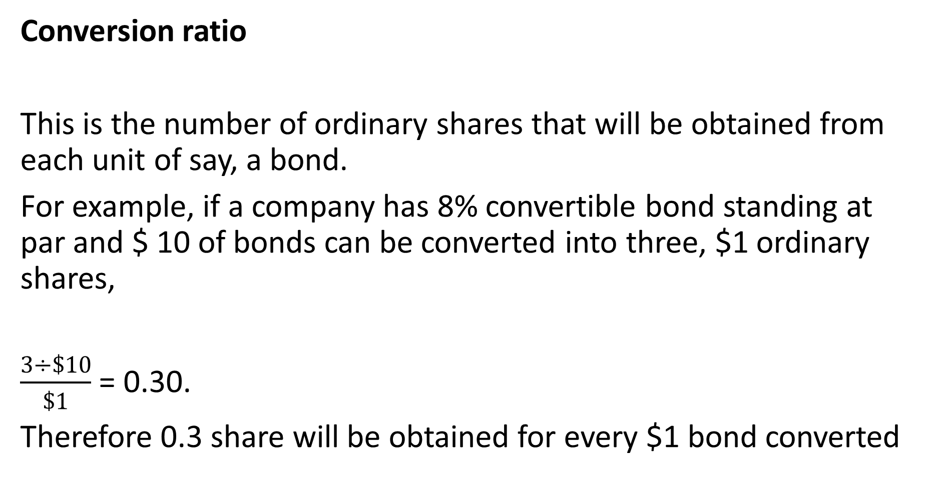
Terms of Conversion
Conversion ratio
This is the number of ordinary shares that will be obtained from each unit of say, a bond.
For example, if a company has 8% convertible bond standing at par and $ 10 of bonds can be converted into three, $1 ordinary shares,
$\frac{3÷\$10}{\$1}$ = 0.30.
Therefore 0.3 share will be obtained for every $1 bond converted

Slide 30
Terms of Conversion
Conversion Ratio
Is the number of common shares that an investor can receive when he exchanges his convertible securities
Can also be given by,
Conversion ratio = Par value of convertible security
Conversion Price

Slide 31
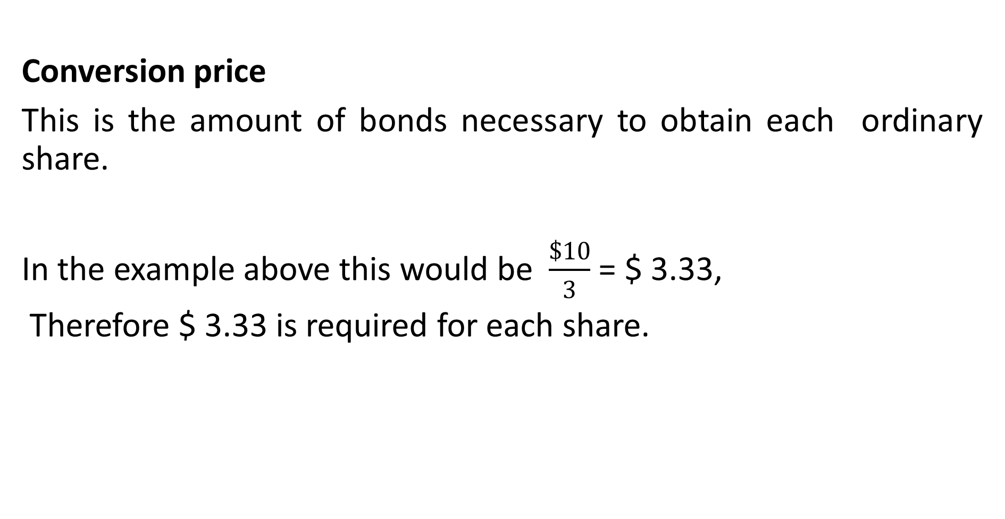
Terms of Conversion Ctd
Conversion price
This is the amount of bonds necessary to obtain each ordinary share.
In the example above this would be $\frac{\$10}{3}$ = $ 3.33,
Therefore $ 3.33 is required for each share.

Slide 32
Terms of Conversion Ctd
Conversion premium
This is the difference between the value of the loan stock (bond) and the conversion value of the bond on the date of issue.
Using our illustration further- $100 of bonds as worth $120 on issue .
We know that the $ 100 of bonds can be converted into 30 shares (We ascertained 0.30 shares can be obtained for every $1 bond.
Suppose that on the day of issue, the market value of the share was $ 3
Required; Calculate the conversion premium

Slide 33
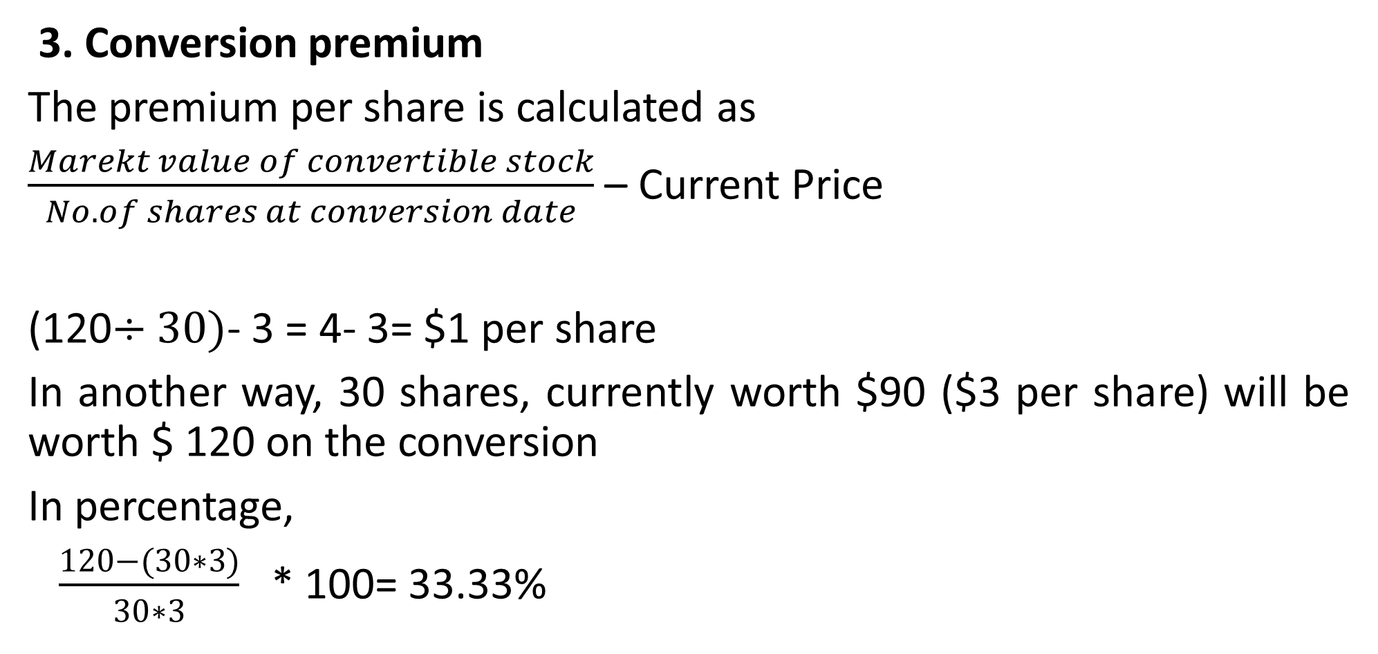
Terms of Conversion Ctd
3. Conversion premium
The premium per share is calculated as
$\frac{Marekt value of convertible stock}{No. of shares at conversion date}$ – Current Price
(120$÷30)$- 3 = 4- 3= $1 per share
In another way, 30 shares, currently worth $90 ($3 per share) will be worth $ 120 on the conversion
In percentage,
$\frac{120−(30∗3)}{30∗3}$ * 100= 33.33%

Slide 34
Illustration
Redbrick Plc’s 10% convertible loan stock is quoted at $ 138 per $ 100 nominal. The earliest date for the conversion is in 3 years’ time at the rate of 25 ordinary shares per $ 100 nominal loan stock.
The current price ordinary share is $5.20.
Required
1. Calculate the conversion price
2. Calculate the conversion premium

Slide 35
Solution
The conversion price is the amount( Par Value) of stock required to obtain each ordinary share
1. This is $100/25= $4
$4 of stock is necessary for each share
2. The conversion premium is
138/25- 5.20= 5.52-5.20
= $ 0.32

Slide 36
Valuation of Convertible Securities
More complex than that of non-convertible (or straight) securities since they combine features of both common shares and fixed income securities
The market value of a convertible security depends on
The market price of common shares,
Conversion value and the
Value of a straight bond (or preference share).
Conversion value = Conversion ratio x Share price

Slide 37

Valuation of a straight Bond
Where,
Vb is the value of the straight bond
Ct is interest expected at the end of Period t
M is terminal value (= Face Value)
r is the investors required rate of return

Slide 38

Value of a convertible security :
Where,
Vbc is the value of the straight bond
Ct is interest expected at the end of Period t
C.V. is the expected conversion value at the date of conversion.

Slide 39
Advantages of Convertible stocks to Companies
.
Stocks can be issued at a lower coupon rate- useful in times of high interest rates
2. Interest on loan stock should be tax deductible unlike dividends on equity
3. As it is a form of differed equity , there will be no cash outlay on redemption
4. Convertible loan stock may be counted as equity for gearing calculations , unlike ordinary loan stock

Slide 40
Advantages of Convertible stocks to Investors
The market value of stock cannot fall below that for similar ordinary shares of the same coupon rate
2. Increases in share prices will cause the value of the conversion to rise because this is the amount the investor will eventually receive.
3. Stockholders will be paid before shareholders in the event of liquidation
.

Slide 41
Employees Stock Purchase Plan
Employees can be given warrants under the employee stock purchase plans;
executive incentive option plans –
Key managers are given options to purchase shares. These are managers with direct/ material influence on the company's fortunes and so if they perform well the stock will go up and the option will become valuable.
There are plans for lower-level employees where the company uses its profits to buy the shares for the employees.

Slide 42
Summary
Preferred stock is a hybrid—it is similar to bonds in some respects and to common stock in other ways.
A warrant is a long-term call option issued along with a bond.
Warrants are generally detachable from the bond, and they trade separately in the market.
When warrants are exercised, the firm receives additional equity capital, and the original bonds remain outstanding.

Slide 43
Summary Ctd
Warrants and convertibles are sweeteners used to Make the underlying debt or preferred stock issue more attractive to investors.
Although the coupon rate or dividend yield is lower when options are part of the issue, the overall cost of the issue is higher than the cost of straight debt or preferred, because option-related securities are riskier.

Slide 44
Summary Ctd
A convertible security is a bond or preferred stock that can be for common stock at the option of the holder.
When a security is converted, debt or preferred stock is replaced with common stock, and no money changes hands.
• Although both warrants and convertibles are option securities,
there are several differences between the two, including separability, impact when exercised, callability, maturity, and flotation costs.

Slide 45
REFERENCES
Brealey, R., Myers, S. and Allen, F., 2008. Principles of corporate finance. 1st ed. Boston: McGraw-Hill/Irwin,
I.M. Pandey (Ed.), 2015. Financial Management, Eleventh Edition. India: Vikas Publishing House,
Ross, S., Westerfield, R., Jaffe, J. and Jordan, B., 2011. Core principles and applications of corporate finance. 1st ed. New York: McGraw-Hill/Irwin,
Van Horne, J. and Wachowicz, J., 2008. Fundamentals of financial management. 13th ed. Essex: Prentice-Hall.

Slide 46
THE END OF WEEK 10 LESSON

