Slide 1
CORPORATE FINANCE
Week 11: Cost of Capital
Instructor: Dr. Charity Njoka

Slide 2
Lesson Objectives
At the end of this lesson you should be able to:
1. Discuss the meaning of cost of capital for raising capital from different sources of finance.
2. Discuss the application of the cost of Capital
3. Measure cost of individual components of capital
4. Calculate weighted cost of capital

Slide 3
Introduction
      .
Cost of capital is the cost of having capital for long period from different sources of finance.
Cost of capital is the return expected by the providers of capital to the business as a compensation for their contribution to the total capital
Cost of capital can either be explicit or implicit
Cost of capital is also known as ‘cut-off’ rate, ‘hurdle rate’, ‘minimum rate of return’.

Slide 4
Determination of Cost of Capital
Cost of capital can either be explicit or implicit
Explicit -cash outflow of an entity towards the utilization of capital which is clear and obvious
Implicit--not a cash outflow but it is an opportunity loss of foregoing a better investment opportunity
Two factors are considered to determine the cost of capital:
(i) Source of Finance
(ii) Reciprocal payment of the using finance.

Slide 5
Importance of Cost of Finance/ Application
Long-term investment decisions – NPV method-the cost of capital is used to discount the cash flows. Under IRR method - cost of capital is compared with IRR
Capital structure decisions – The composition/mix of various components of capital is determined by the cost of each capital component.
Evaluation of performance of management – A high cost of capital is an indicator of high risk attached to the firm- usually attributed to poor performance of the firm.

Slide 6
Importance of Cost of Finance/ Application Ctd
4. Dividend policy and decisions – E.g Retained earnings mostly used new ordinary share capital since its cheaper.
5. Lease or buy decisions – A firm may finance the acquisition of an asset through leasing or borrowing long-term debt to buy an asset.
In lease or buy decisions, the cost of debt (interest rate on loan borrowed) is used as the discounting rate.

Slide 7
Factors that Influence Cost of Finance
Terms of reference – if short term, the cost is usually low and vice versa.
Economic conditions prevailing – if a company is operating under inflationary conditions, such a company will pay high costs in so far as inflationary effect of finance will be passed onto the company.
3. Risk exposed to venture – if a company is operating under high risk conditions, such a company will pay high costs to induce lenders to avail finance to it because the element of risk will be added on the cost of finance which may compound it.

Slide 8
Factors that Influence Cost of Finance Ctd
4. Size of the business – A small company will find it difficult to raise finance and as such will pay heavily in form of cost of finance to obtain debt from lenders.
5. Availability – Cost of finance (COF) prices will also be influenced by the forces of demand and supply such that low demand and low supply will lead to high cost of finance.
6. Effects of taxation – Debt finance is cheaper by the amount equal to tax on interest.

Slide 9
Factors that Influence Cost of Finance Ctd
7. Nature of security – If security given depreciates fast, then this will compound implicit costs (costs of maintaining that security).
8. Company’s growth stage – Young companies usually pay less dividends in which case the cost of this finance will be relatively cheaper at the earlier stages of the company’s development.

Slide 10
Measurement of Cost of Capital
Cost of capital involves different costs related to different sources of finance.
The evaluation process of cost of capital involves two steps.
Calculation of different costs which are the sources of finance.
ii) The overall cost is calculated by combining different costs into a composite cost.
1. Cost of Debt/ Bonds
2. Cost of Preferential Capital
3. Cost of Equity Capital
4. Cost of Retained Earnings.

Slide 11
  Cost of Debt
This is cost long term debt which includes;
Long term loans from the financial institutions,
Capital from issuing debentures or bonds etc

Slide 12
Features of Bonds:
Face Value: Bonds are denominated with some value; this denominated value is called face value of the debenture. Interest is calculated on the face value of the debentures.
Interest (Coupon) Rate: Interest (coupon) rate is applied to face value of bond/debenture to calculate interest, which is payable to the bondholders of periodically.
(iii) Maturity period: Debentures or Bonds has a fixed maturity period for redemption. However, in case of irredeemable debentures maturity period is not defined and it is taken as infinite.

Slide 13
Features of Bonds Ctd
(iv) Redemption Value: Redeemable debentures or bonds are redeemed on its specified maturity date. Redemption value may vary from the face value of the debenture.
(v) Benefit of tax shield: The payment of interest to the bondholders are allowed as expenses for the purpose of corporate tax determination. Hence, interest paid to the bondholders save the tax liability of the company. This saving tax shield.

Slide 14
Illustration
There are two companies namely X Ltd. and Y Ltd. X Ltd is fully financed by the shareholders whereas Y Ltd uses debt fund. The following Table shows the profitability statement of both the companies:
A comparison of the two companies shows that an interest payment of 40 by the Y Ltd. results in a tax shield (tax saving) of $14 ($40 paid as interest × 35% tax rate). Therefore the effective interest is $ 26 only.
 | X Ltd | Y Ltd
Earnings before Interest and Tax (EBIT) | 100 | 100
Interest paid to Bond holders | - | (40)
Profit after Tax( PAT) | 100 | 60
Tax @ 35% | (35) | (21)
Profit after Tax (PAT) | 65 | 39

Slide 15
Classification of Debts
Based on redemption (repayment of principal) on maturity the debts can be categorized into two types
(i) Irredeemable debts and
(ii) Redeemable debts.

Slide 16
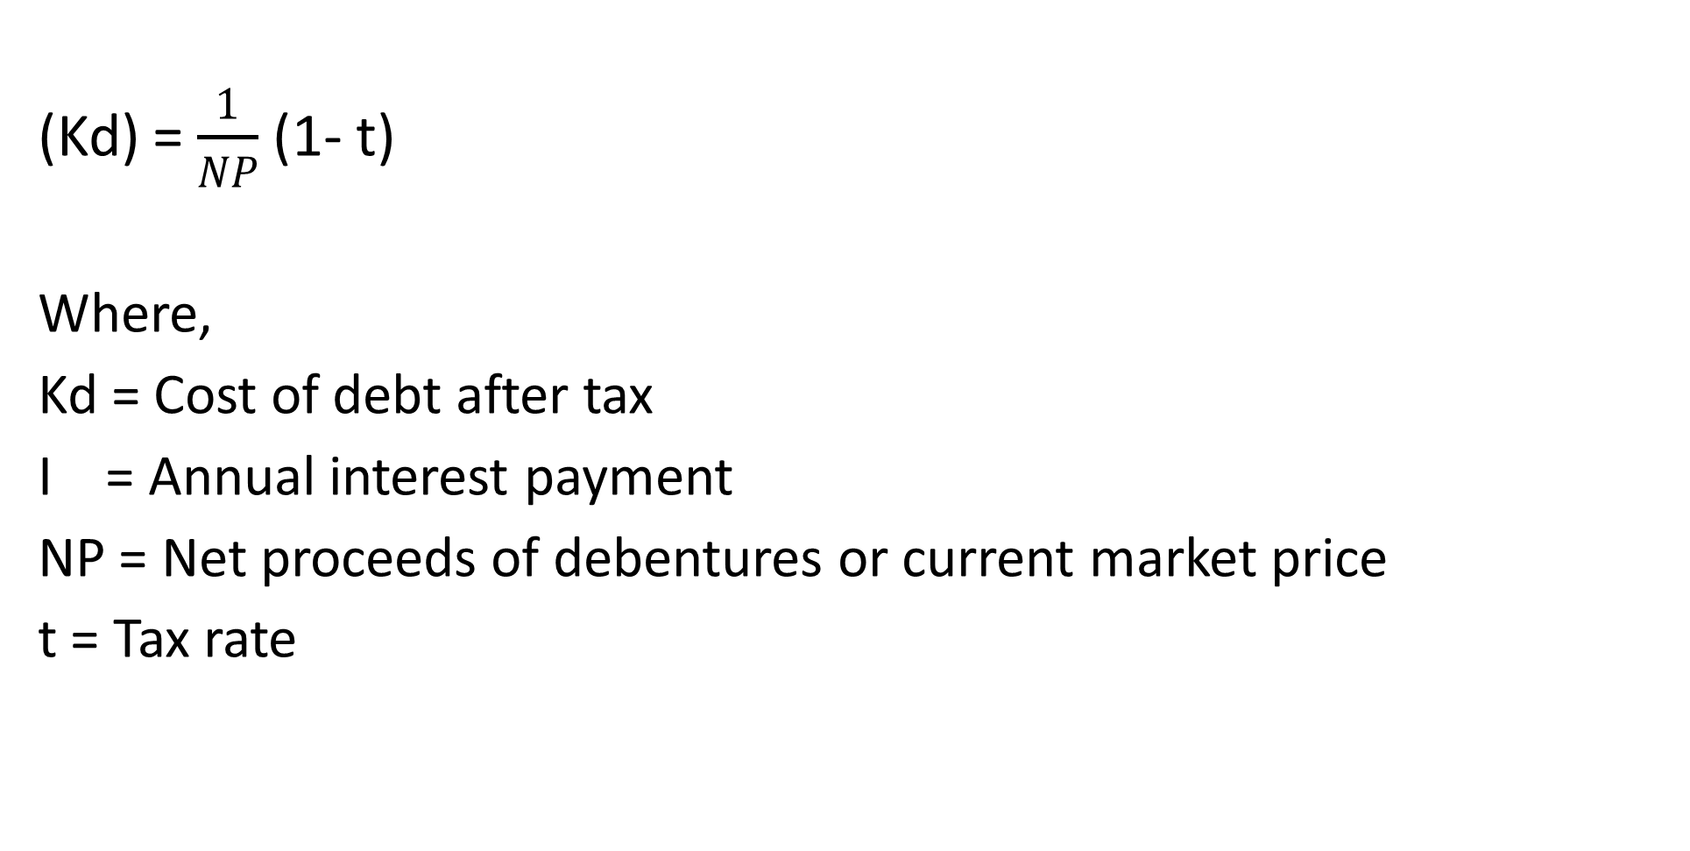
Cost of Irredeemable Debt
(Kd) = $\frac{1}{NP}$ (1- t)
Where,
Kd = Cost of debt after tax
I = Annual interest payment
NP = Net proceeds of debentures or current market price
t = Tax rate

Slide 17
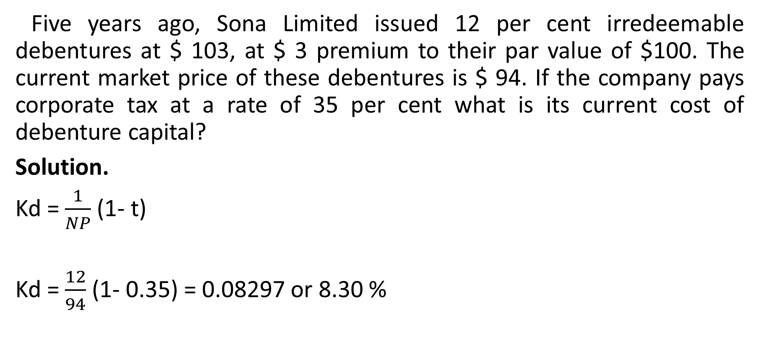
Illustration
Five years ago, Sona Limited issued 12 per cent irredeemable debentures at $ 103, at $ 3 premium to their par value of $100. The current market price of these debentures is $ 94. If the company pays corporate tax at a rate of 35 per cent what is its current cost of debenture capital?
Solution.
Kd = $\frac{1}{NP}$ (1- t)
Kd = $\frac{12}{94}$ (1- 0.35) = 0.08297 or 8.30 %

Slide 18
Calculation of the cost of debt
For calculation of the cost of debt following are required.
i. Net proceeds of bonds/debentures and amount of interest paid
ii. Kd = Interest / Principal (Before tax cost of debt)
iii.Kd = Interest / Net Proceeds( After tax cost)
iv. Tax rate

Slide 19
Cost of Debt after Tax
  The cost of debt after tax is calculated as follows:
Kd = Kd (I-t) = I / NP (I-t)
Where
Kd = After tax cost of debt
I = Interest
P = Principal
NP = Net Proceeds
t = Rate of Tax.

Slide 20
Cost of Redeemable Debt
The cost of redeemable debt capital after tax is calculated as follows:
Kd = I(1-t) + I/n (RV-NP)
1/2 (RV-NP)
Where,
I = Annual Interest payment
NP = Net proceeds of bonds or Current market price of existing debt.
RV = Redemption value of bonds/debentures
t = Tax rate applicable to the company
n = Life of bond

Slide 21
Illustration
ABC Limited company issued 10,000, 10% bonds of $ 100 each at a premium of 10% on 1st April 2019 to be matured on 1st April 2024.
The debentures will be redeemed on maturity.
Compute the cost of debentures assuming 35% as tax rate.

Slide 22
Solution
Kd = I(1-t) + I/n (RV-NP)
I/2 (RV-NP)
I = Interest on debenture = 10% of $ 100 = $10
NP = Net Proceeds = 110% of $100 = $110
RV = Redemption value = $100
n = Period of debenture = 5 years
t = Tax rate = 35% or 0.35
10(1-0.35) + 10/5yrs (100-110) = 10 x 0.65-2
1/2 (100+ 110) 105
= 4.5/105 = 0.0428 or 4.28%

Slide 23
Cost of Preference Capital (Kp):
Preference share capital is paid dividend at a specified rate on face value of preference shares.
Payment of dividend to the preference shareholders are not mandatory but are given priority over the equity shareholder.
The payment of dividend to the preference shareholders are not charged as expenses but treated as appropriation of after tax profit.
Hence, dividend paid to preference shareholders does not reduce the tax liability to the company.
Like the debentures, Preference share capital can be categorised as redeemable and irredeemable.

Slide 24
Features of Preference Shares
Preference shares are the fixed cost bearing securities.
2. In case of preference shares, the rate of dividend is fixed in advance at the time of issue.
3. Preference shareholders have a preferential rights unlike equity shareholders with regard to payment of dividend and return of principal amount.

Slide 25
Features of Preference Shares Ctd
4. Preference dividend is paid from after tax profits, so adjustments are not made in tax at the time of calculating cost of preference shares.
5. Preference dividend is considered as an appropriation of profits and not as a charge on profits.
6. There are two types of preference capital.
They are i) Irredeemable preference capital.
ii) Redeemable preference capital:

Slide 26
Cost of Irredeemable Preference Share Capital
Cost of Irredeemable Preference Share (KP) = PD
P0
Where,
PD = Annual preference dividend
P0 = Net proceeds in issue of preference shares

Slide 27
Illustration One
XYZ Company issues 2,000 10% preference shares of $ 100 each at $ 95 each.
Calculate the cost of preference shares.
Solution
Kp = 10 × 200,000
95 × 200,000 = 10/ 95 = 0.1053 = 10.53%

Slide 28
Illustration Two
Rick Energy Ltd has issued preferred stock at $ 100 per share, with a stated dividend of $ 12, and a floatation cost of 3%.
What is the cost of preference share?
Solution
Kp = Preferred stock dividend/
Market price of preferred stock (1- floatation cost)
= 12
100(1-0.03) = 12/97= 0.1237 or 12.37%

Slide 29
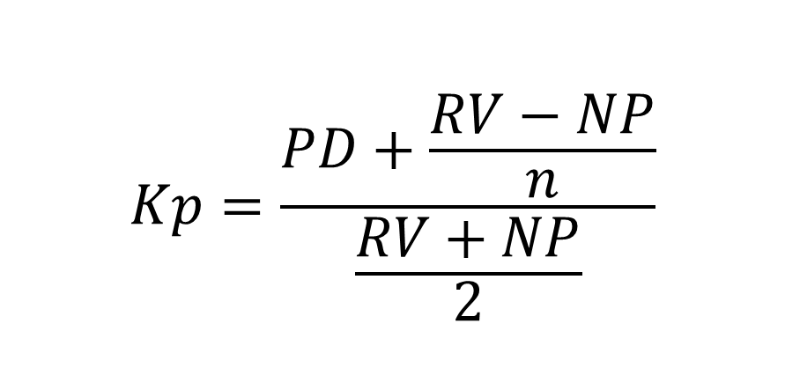
Redeemable Preference Capital:
$$Kp=\frac{PD+\frac{RV−NP}{n}}{\frac{RV+NP}{2}}$$
Cost is given by:
Where,
PD = Annual preference dividend
RV = Redemption value of preference shares
NP = Net proceeds on issue of preference shares
n = Life of preference shares.

Slide 30
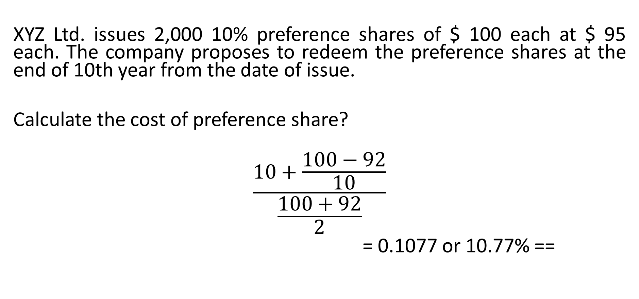
Illustration
XYZ Ltd. issues 2,000 10% preference shares of $ 100 each at $ 95 each. The company proposes to redeem the preference shares at the end of 10th year from the date of issue.
Calculate the cost of preference share?
$$\frac{10+\frac{100−92}{10}}{\frac{100+92}{2}}$$
= 0.1077 or 10.77% ==

Slide 31
Approaches /Methods of Calculating Cost of Equity Shares
Dividend Price Approach
i)Dividend Price Approach with Constant Dividend:
ii)Dividend Price Approach with Constant Growth:
Earnings/ Price Approach with Constant Growth:
i) Earnings/ Price Approach with Constant Earnings
ii) Earnings/ Price Approach with Growth in Earnings
3. Capital Asset Pricing Model (CAPM) Approach
4. Realised Yield Method:

Slide 32
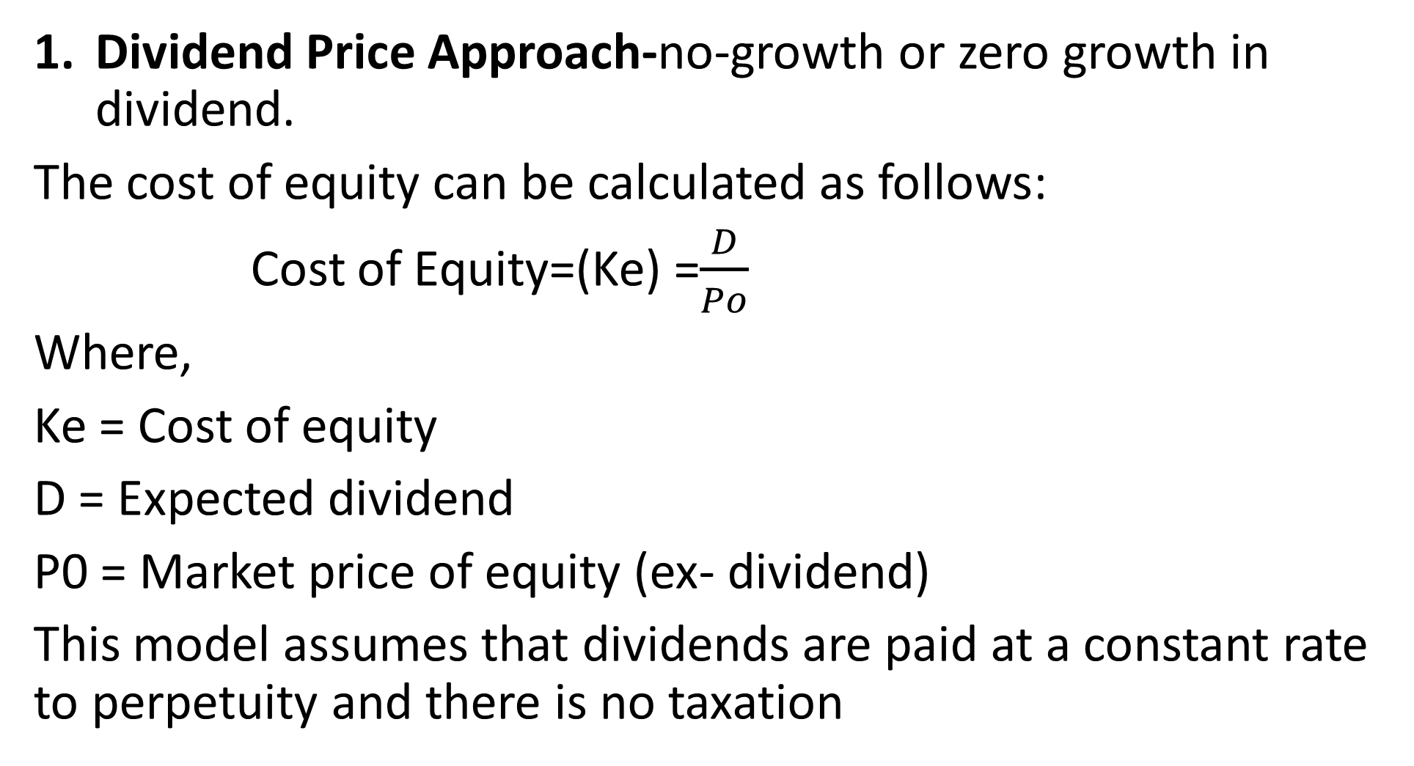
Dividend Price Approach- Constant Dividend
Dividend Price Approach-no-growth or zero growth in dividend.
The cost of equity can be calculated as follows:
Cost of Equity=(Ke) =$\frac{D}{Po}$
Where,
Ke = Cost of equity
D = Expected dividend
P0 = Market price of equity (ex- dividend)
This model assumes that dividends are paid at a constant rate to perpetuity and there is no taxation

Slide 33
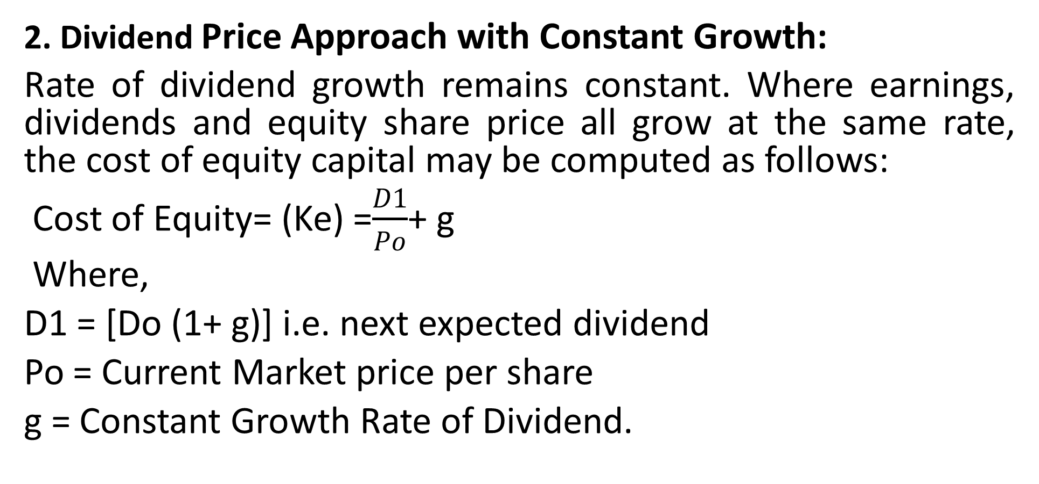
Dividend Price Approach-with Constant Growth:
2. Dividend Price Approach with Constant Growth:
Rate of dividend growth remains constant. Where earnings, dividends and equity share price all grow at the same rate, the cost of equity capital may be computed as follows:
Cost of Equity= (Ke) =$\frac{D1}{Po}$+ g
Where,
D1 = [Do (1+ g)] i.e. next expected dividend
Po = Current Market price per share
g = Constant Growth Rate of Dividend.

Slide 34
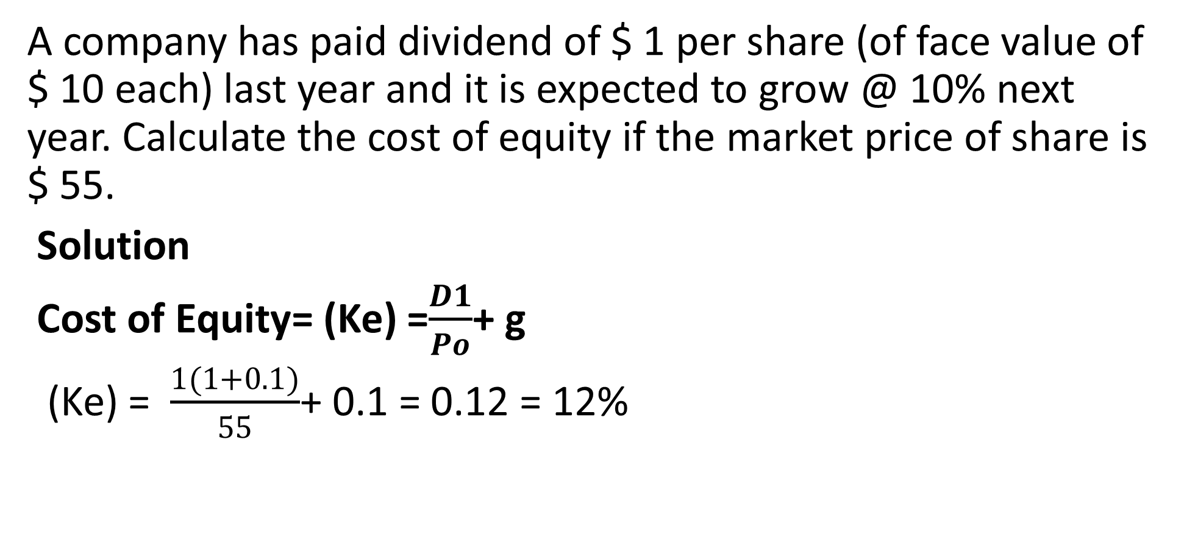
Illustration
A company has paid dividend of $ 1 per share (of face value of $ 10 each) last year and it is expected to grow @ 10% next year. Calculate the cost of equity if the market price of share is $ 55.
Solution
Cost of Equity= (Ke) =$\frac{D1}{Po}$+ g
(Ke) = $\frac{1(1+0.1)}{55}$+ 0.1 = 0.12 = 12%

Slide 35
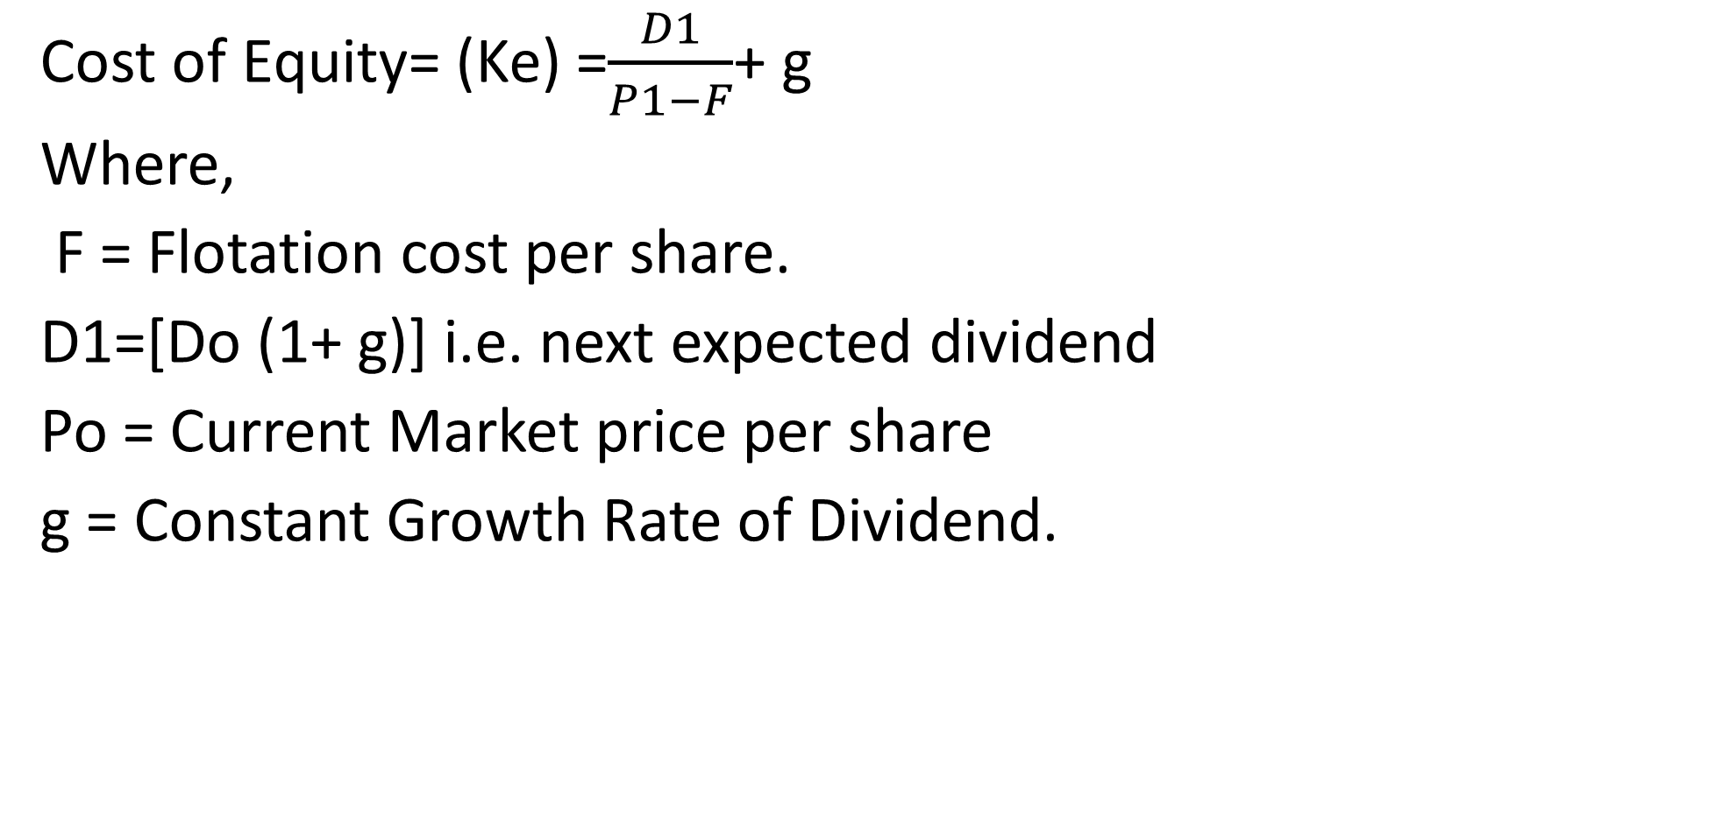
With Flotation costs,
Cost of Equity= (Ke) =$\frac{D1}{P1−F}$+ g
Where,
F = Flotation cost per share.
D1=[Do (1+ g)] i.e. next expected dividend
Po = Current Market price per share
g = Constant Growth Rate of Dividend.

Slide 36
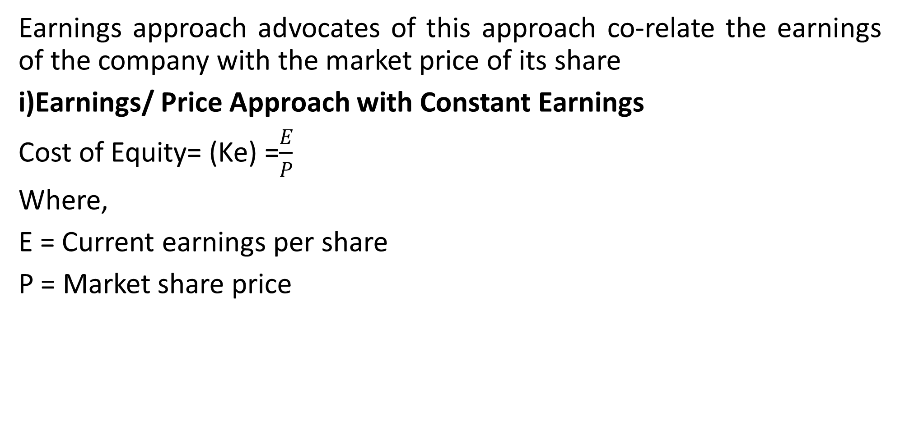
Earning/ Price Approach-with Constant Earnings
Earnings approach advocates of this approach co-relate the earnings of the company with the market price of its share
i)Earnings/ Price Approach with Constant Earnings
Cost of Equity= (Ke) =$\frac{E}{P}$
Where,
E = Current earnings per share
P = Market share price

Slide 37
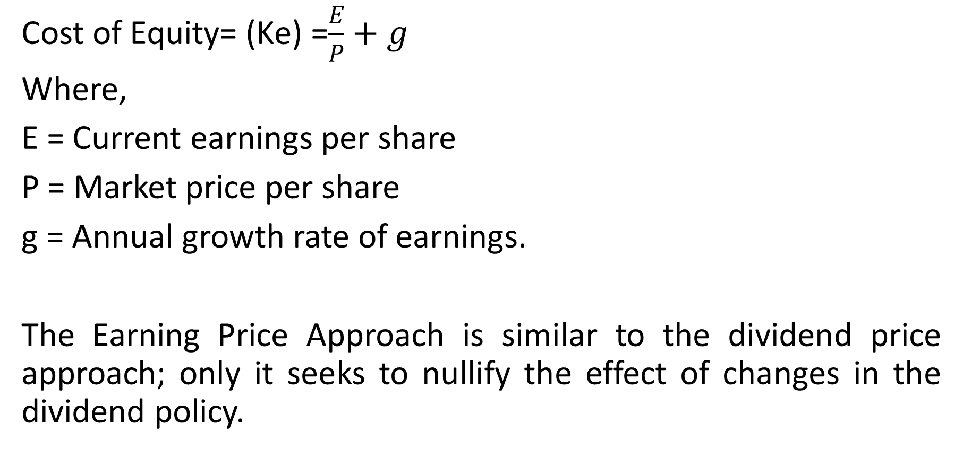
Earnings/ Price Approach with Growth in Earnings
Cost of Equity= (Ke) =$\frac{E}{P}+g$
Where,
E = Current earnings per share
P = Market price per share
g = Annual growth rate of earnings.
The Earning Price Approach is similar to the dividend price approach; only it seeks to nullify the effect of changes in the dividend policy.

Slide 38
Capital Asset Pricing Model (CAPM) Approach
CAPM model describes the risk-return trade-off for securities
The risks, to which a security is exposed, can be classified into two groups:
i) Unsystematic Risk:- Company risk
ii)Systematic Risk: It is the macro-economic or market specific risk
  Ke = Rf +bi (Rm – Rf)
  Where,
  Ke = Cost of Capital,
  Rf= Risk free rate of return,
bi = Beta of the Investment,
Rm= Average Market Return.
(Rm – Rf)= Risk Premium

Slide 39
Realised Yield Method:
The problem of evaluating the expectations of the investors relating to future dividends and earnings can be solved with the help of realized yield method.
It is difficult to calculate accurate future dividends and
earnings because of they are dependent on many uncertain factors.
This approach considers the actual average
rate of return realized in the past to calculate the
cost of equity share capital.

Slide 40
Realised Yield Method: Assumptions
a) The firm will have constant risk for a specific period of time.
b) The expectations of the shareholders are dependent on past realized yield.
c) Investors assume that they get same rate of return as the realized yield even if they invest somewhere else.
d) It is assumed that there are no remarkable changes in market price of shares.

Slide 41
Cost of Retained Earnings:
It is the opportunity cost of dividends foregone by shareholders.
In absence of any information on personal tax (t_{p}):
Cost of Retained Earnings (Ks) = Cost of Equity Shares (Ke)
If there is any information on personal tax (t_{p}):
Ks = Ke –tp

Slide 42
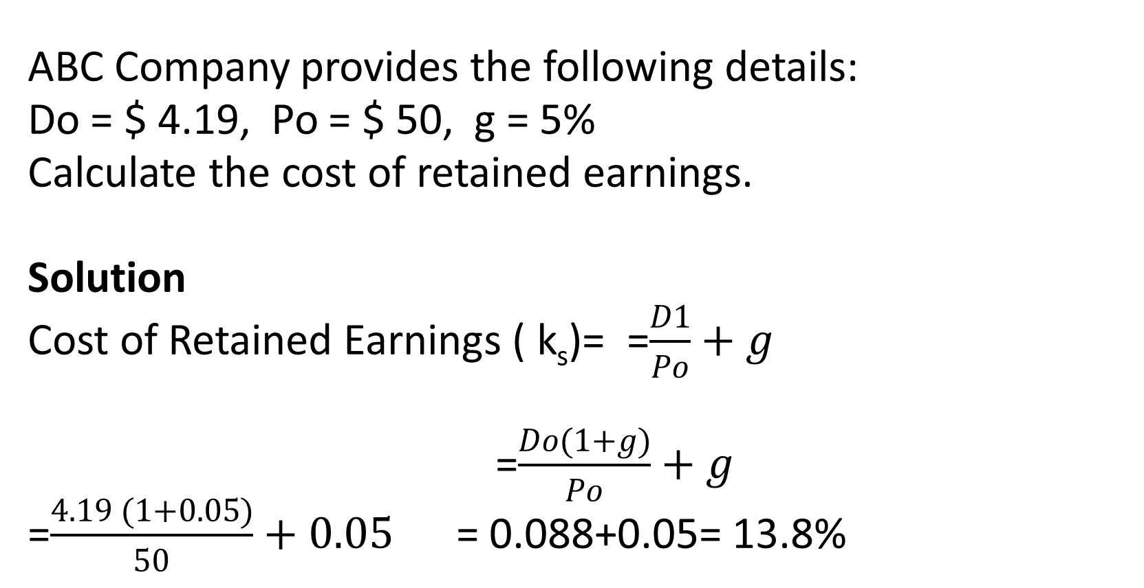
Illustration
ABC Company provides the following details:
Do = $ 4.19, Po = $ 50, g = 5%
Calculate the cost of retained earnings.
Solution
Cost of Retained Earnings ( k_{s})= =$\frac{D1}{Po}+g$
=$\frac{Do(1+g)}{Po}+g$
=$\frac{4.19 (1+0.05)}{50}+0.05$ = 0.088+0.05= 13.8%

Slide 43
Weighted Average Cost Of Capital (WACC)
This is the overall cost of capital of having capitals from the different sources
The steps to calculate WACC is as follows:
Step 1: Calculate the total capital from all the sources.
(i.e. Long term debt capital + Pref. Share Capital + Equity Share Capital +Retained Earnings)
Step 2: Calculate the proportion (or %) of each source of capital to the total capital.
i.e. Equity Share Capital (for example
Total Capital (as calculated in Step 1 above)

Slide 44
Weighted Average Cost Of Capital (WACC) Ctd
Step 3: Multiply the proportion as calculated in Step 2 above with the respective cost of capital.
(i.e. Ke × Proportion (%) of equity share capital (for example) calculated in Step 2 above)
Step 4: Aggregate the cost of capital as calculated in Step 3 above. This is the WACC.
(i.e. Ke + Kd + Kp + Ks as calculated in Step 3 above)

Slide 45
Computation of weights or proportions
Computation of the weights or proportions of various capital components, the following values may be used:
Market values
Book values
Replacement values
Intrinsic values

Slide 46
Weaknesses of WACC as a discounting rate Ctd
The overall cost of capital has the following problems as a discounting rate:
1. It can only be used as a discounting rate assuming that the risk of the project is equal to the business risk of the firm. If the project has higher risk then a percentage premium will be added to WACC to determine the appropriate discounting rate.
2. It assumes that capital structure is optimal which is not achievable in real world.

Slide 47
Weaknesses of WACC as a discounting rate
3. It is based on market values of capital which keep on changing thus WACC will change over time but is assumed to remain constant throughout the economic life of the project.
4. It is based on past information especially when determining the cost of each component e.g in determining the cost of equity (Ke) the past year’s DPS (Dividend Per Share) is used while the growth rate is estimated from the past stream of dividends.

Slide 48
References
Hillier, D, S Ross, R Westerfield, J Jaffe, & B Jordan, Corporate Finance: McGraw- Hill Education, 2022
I.M. Pandey (Ed.), 2015. Financial Management, Eleventh Edition. India: Vikas Publishing House,
Ross, S., Westerfield, R., Jaffe, J. and Jordan, B., 2011. Core principles and applications of corporate finance. 1st ed. New York: McGraw-Hill/Irwin,
Van Horne, J. and Wachowicz, J., 2008. Fundamentals of financial management. 13th ed. Essex: Prentice-Hall.

Slide 49
THE END OF WEEK 11 LESSON

