Slide 1
CORPORATE FINANCE
Week 12: Capital Structure
Instructor: Dr. Charity Njoka

Slide 2
Lesson Objectives
At the end of this lesson you should be able to:
1. State the meaning and significance of capital structure.
2. Discuss the various capital structure theories
3. Describe concepts and factors for designing an optimal capital structure.
4. Discuss essential features of capital structure of an entity.

Slide 3
Introduction
      .
Capital structure is the combination of capitals from different sources of finance.
The capital of a company consists of equity shareholders’ fund, preference share capital and long term external debts
Capital Structure decision refers to deciding the forms of financing, their actual requirements (amount to be funded) and their relative proportions (mix) in total capitalisation.

Slide 4
Factors that Affect Capital Structure
1. Availability of securities – This influences the company’s use of debt finance which means that if a company has sufficient securities, it can afford to use debt finance in large capacities.
2. Cost of finance (both implicit and explicit) – If low, then a company can use more of debt or equity finance.
3. Company gearing level – if high, the company may not be able to use more debt or equity finance because potential investors would not be willing to invest in such a company.

Slide 5
Factors that Affect Capital Structure Ctd
4. Sales stability – If a company has stable sales and thus profits, it can afford to use various finances in particular debt in so far as it can service such finances.
5. Competitiveness of the industry in which the company operates – If in highly competitive industry, it may be risky to use high levels of debt because chances of servicing this debt may be low and may lead a company into receivership.
NB. While deciding the optimal capital structure the prime objective is to maximise the value of the company

Slide 6
Value of the firm
Value of the firm= Earnings before Interest and Tax (EBIT)
Overall cost of capital/WACC
Ko = (Cost of debt × weight of debt) + (Cost of equity × weight of equity)
Ko = [{Kd × D/ (D+S)} + {Ke × S/(D+S)}]
Where:
Ko is the weighted average cost of capital (WACC)
Kd is the cost of debt
D is the market value of debt
S is the market value of equity
Ke is the cost of equity

Slide 7
Capital Structure Theories
There are approaches explain the relationship between
cost of capital, capital structure and value of the firm:
Net Income (NI) approach
Traditional approach
Net Operating Income (NOI) approach
Modigliani-Miller (MM) approach

Slide 8
Assumptions in Capital Structure Theories
There are only two kinds of funds used by a firm i.e. debt and equity.
The total assets of the firm are given. The degree of average can be changed by selling debt to purchase shares or selling shares to retire debt.
Taxes are not considered.
The payout ratio is 100%.( all earnings are paid out as dividend)
The firm’s total financing remains constant.
Business risk is constant over time.
The firm has perpetual life.

Slide 9
Net Income (NI) Approach
According to NI approach, capital structure decision is relevant to the value of the firm.
An increase in financial leverage will lead to decline in the weighted average cost of capital (WACC), while the value of the firm as well as market price of ordinary share will increase.
Conversely, a decrease in the leverage will cause an increase in the overall cost of capital and a consequent decline in the value as well as market price of equity shares.
.

Slide 10
Critical Assumptions of NI
The market capitalizes the value of the firm as a whole.
Ko depends on the business risk. If the business risk is assumed to remain constant, then Ko will also remain constant.
The use of less costly debt increases the risk of the shareholders. This causes Ke to increase and thus offset the advantage of cheaper debt.
Kd is assumed to be constant.
Corporate income taxes are ignored.

Slide 11
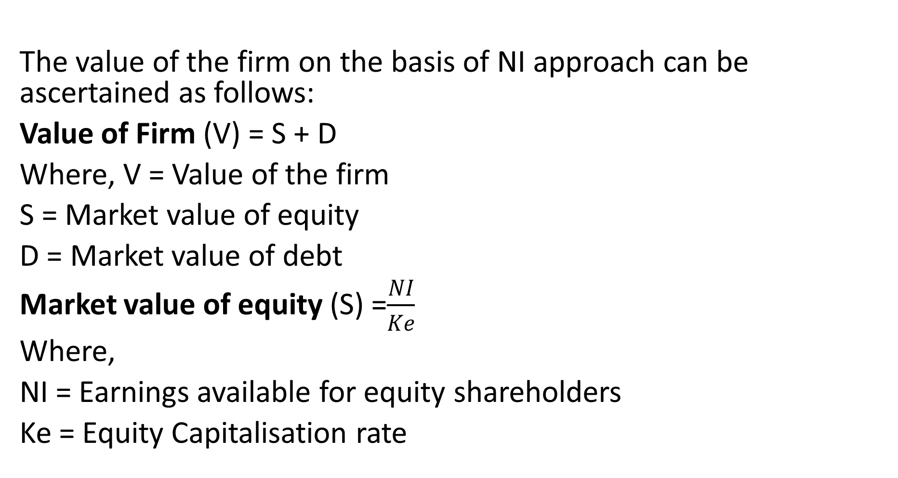
  Value of firm -NI

Slide 12
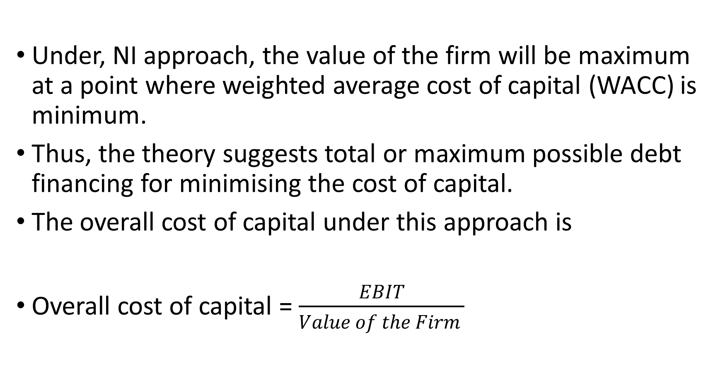
Cost Of Capital Under NI Approach

Slide 13
Illustration- NI Approach
Rupa Ltd.’s EBIT is $ 500, 000. The company has 10%, 2000,000 bonds. The equity capitalization rate i.e. Ke is 16%.
You are required to calculate:
(i) Market value of equity and value of firm
(ii) Overall cost of capital.

Slide 14
Solution
Statement showing value of firm
The firm can increase its total value by decreasing its overall cost of capital through increasing the degree of leverage
EBIT | 500,000
Less interest on bonds (10% x 2000,000) | (200,000)
Earnings available for equity holders Ie Net Income (NI) | 300,000
Equity Capital rate (k_{e}) | 16%
Market Value of Equity(S)=NI= (300,000 ) x 100 Ke (16) | 1875,000
Market Value of debt (D) | 2000,000
Total value of firm (V) =S+D | 3875,000
Overall cost of capital = EBIT 500,000 = 12.90%
Value of firm 3,875,000

Slide 15
Traditional Approach to Capital Structure
This approach favours that as a result of financial leverage up to some point, cost of capital comes down and value of firm increases. However, beyond that point, reverse trends emerge.
The principle implication of this approach is that the cost of capital is dependent on the capital structure and there is an optimal capital structure which minimises cost of capital.
Optimum capital structure occurs at the point where value of the firm is highest and the cost of capital is the lowest.

Slide 16
Criticisms for Traditional Approach
The traditional approach has been criticized as follows:
The market value of the firm depends on the net operating income and the risk attached to it, but not how it is distributed;
The approach implies that totality of risk incurred by all security holders of a firm can be altered by changing the way this totality or risk is distributed among the various classes of securities. In a perfect market this argument is not true.
NB:The traditional approach however has been supported due to tax deductibility of interest charges and market imperfections.

Slide 17
Main Highlights of Traditional Approach
The firm should strive to reach the optimal capital structure :At the optimal capital structure, the overall cost of capital will be minimum and the value of the firm will be maximum.
2. Value of the firm increases with financial leverage upto a certain point. Beyond this point the increase in financial leverage will increase its overall cost of capital and hence the value of firm will decline.

Slide 18
Illustration
Indra Ltd. has EBIT of $ 100,000. The company makes use of debt and equity capital. The firm has 10% debentures of $ 500,000 and the firm’s equity capitalization rate is 15%.
You are required to compute:
(i) Current value of the firm
(ii) Overall cost of capital.

Slide 19
Solution
(i) Calculation of total value of the firm
 | $
EBIT | 100,000
Less interest @10% of 500,000 | 50,000
Earnings available for equity holders | 50,000
Equity capitalization rate i.e. Ke | 15%

Slide 20
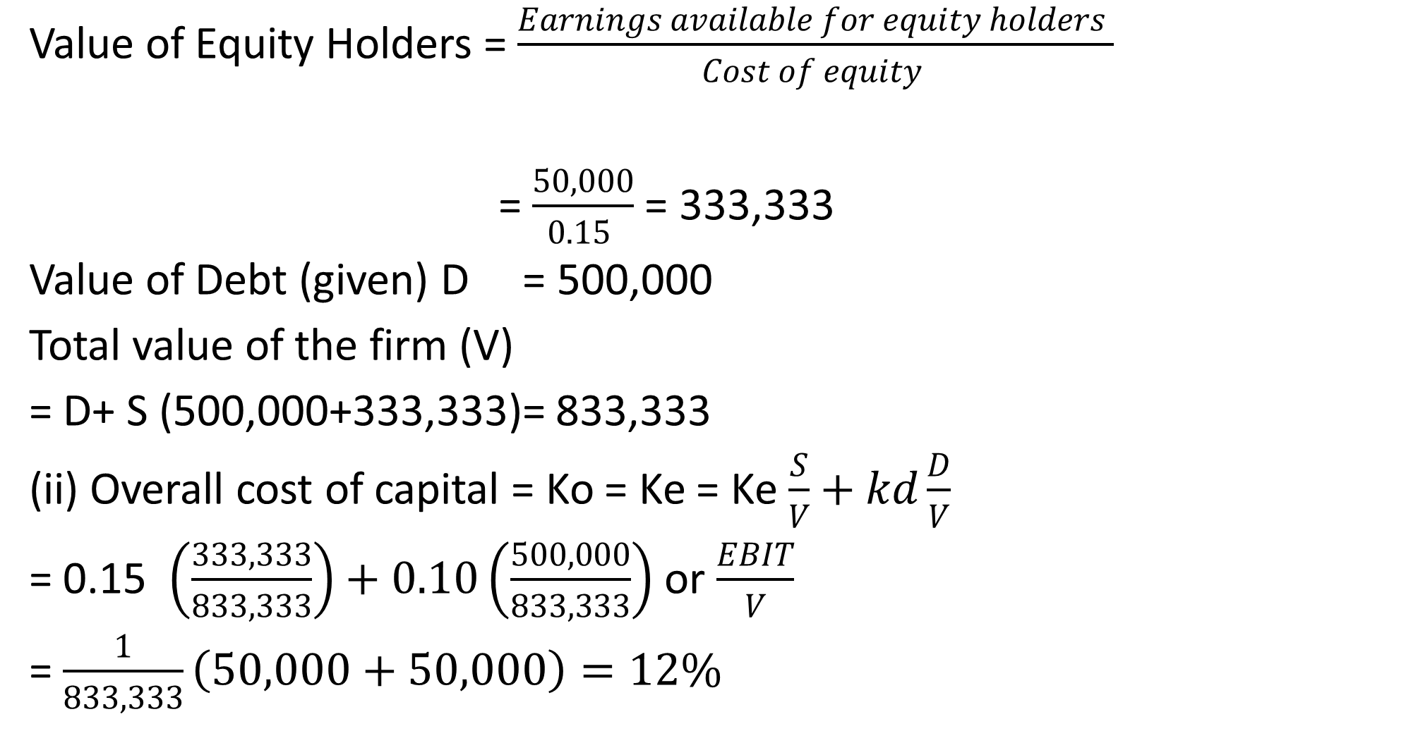
Solution ctd

Slide 21
Net Operating Income (NOI) Approach
NOI means earnings before interest and tax (EBIT).
According to NOI approach, capital structure decisions of the firm are irrelevant. Any change in the everage will not lead to any change in the total value of the firm. Hence any division between debt and equity is irrelevant.
As per this approach, an increase in the use of debt which is apparently cheaper is offset by an increase in the equity capitalisation rate. This happens because equity investors seek higher compensation as they are opposed to greater risk due to the existence of fixed return securities in the capital structure.

Slide 22
The assumptions/Features of NOI approach
The overall capitalization rate remains constant irrespective of the degree of leverage. At a given level of EBIT, the value of the firm would be “EBIT/Overall capitalization rate.”
Value of equity is the difference between total firm value and less value of debt, i.e., Value of Equity = Total Value of the Firm – Value of Debt.
WACC remains constant, and with the increase in debt, the cost of equity increases. An increase in debt in the capital structure results in increased risk for shareholders thus shareholders expect higher returns resulting in a higher cost of equity capital.

Slide 23
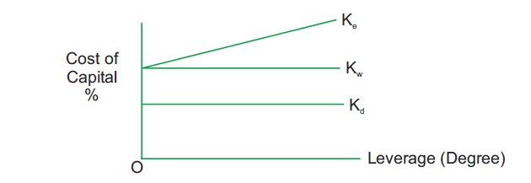
NOI in Graphical Form
The diagram shows that Ko (Overall capitalisation rate) and (debt – capitalization rate) are constant and Ke (Cost of equity) increases with leverage.

Slide 24
Illustration
Amita Ltd’s operating income is $ 500,000. The firm’s cost of debt is 10% and currently the firm employs $1,500,000 of debt. The overall cost of capital of the firm is 15%.
You are required to determine:
(i) Total value of the firm.
(ii) Cost of equity.

Slide 25
Solution
(i) Statement showing value of the firm
 | $
Net operating income/EBIT | 500,000
Less interest on bond @10% of 1,500,000 | 150,000
Earnings available for equity holders | 350,000
Total cost of capital(Ko)- given | 15%
Value of the firm (V)=EBIT/Ko=500,000/0.15 | 3,333,333

Slide 26
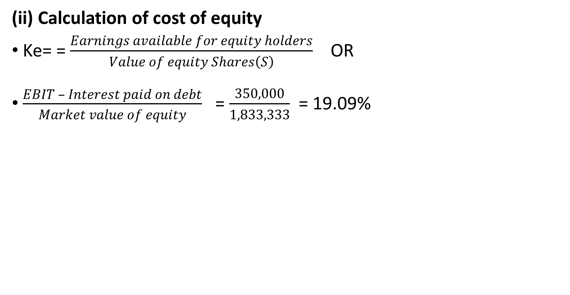
Solution Ctd
 | $
Market value of debt (D) | 1,500,000
Market value of equity (s) S = V − D = $33,33,333 – $1,500,000 | 1,833,333

Slide 27
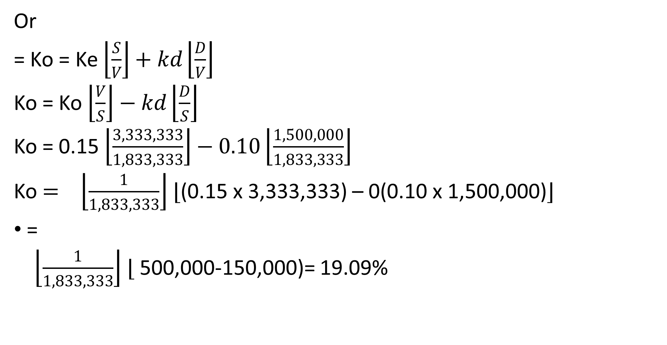
Solution Ctd

Slide 28
The Modigliani-Miller (MM) Hypothesis
The MM, in their first paper (in 1958) advocated that the relationship between leverage and the cost of capital is explained by the net operating income approach.
They argued that in the absence of taxes, a firm's market value and the cost of capital remains invariant to the capital structure changes.
The arguments are based on the some assumptions

Slide 29
Assumptions of MM
Capital markets are perfect and thus there are no transaction costs.
The average expected future operating earnings of a firm are represented by subjective random variables.
Firms can be categorized into "equivalent return" classes and that all firms within a class have the same degree of business risk
They also assumed that debt, both firms’ and individual's is riskless.
Corporate taxes are ignored.

Slide 30
MM Proposition I- No tax
The value of any firm is established by capitalizing its expected net operating income (If Tax = 0)
V_{L} = V_{U} = EBIT = EBIT
WACC K_{O}
Where .
VL= Value of levered Firm (with debt)
VU= Value of unlevered Firm (without debt)
EBIT- Earnings before interest and tax
WACC= Weighted average Cost of debt
Ko= Overall cost of funds

Slide 31
MM Proposition I
MM Proposition I Assumptions
The value of a firm is independent of its leverage.
2. The weighted cost of capital to any firm, levered or not is
(a) Completely independent of its capital structure and
(b) Equal to the cost of equity to an unlevered firm in the same risk class.

Slide 32
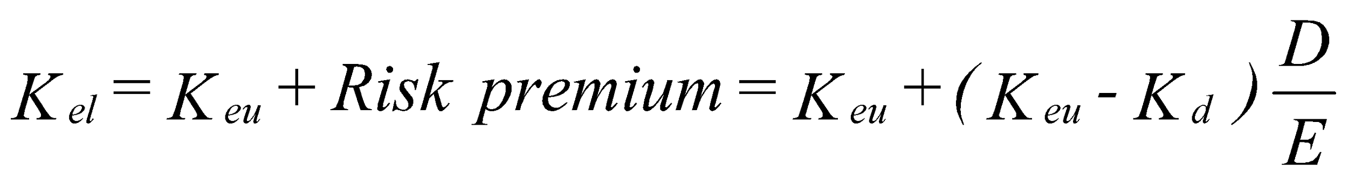
MM Proposition II
The cost of equity to a levered firm is equal to
The cost of equity to an unlevered firm in the same risk class plus
A risk premium whose size depends on both the differential between the cost of equity and debt to an unlevered firm and the amount of leverage used.

Slide 33
Implications of MM Proposition II
As a firm's use of debt increases, its cost of equity also rises. A firm's value is determined by its real assets, not the individual securities and thus capital structure decisions are irrelevant . This proposition allows for complete separation of the investment and financial decisions.
Any firm can use the capital budgeting procedures without worrying where the money for capital expenditure comes from.. The value of the firm therefore is determined by the assets of the firm and not the proportion of debt and equity issued by the firm.

Slide 34
Implications of MM Proposition II Ctd
The MM further supported their arguments by the idea that investors are able to substitute personal for corporate leverage, thereby replicating any capital structure the firm might undertake.
Taken together, the two MM propositions imply that the inclusion of more debt in the capital structure will not increase the value of the firm, because the benefits of cheaper debt will be exactly offset by an increase in the riskiness, and hence the cost of equity.
MM theory states that in a world without taxes, both the value of a firm and its overall cost of capital are unaffected by its capital structure.

Slide 35
The Trade-Off Theory
The trade-off theory of capital structure refers to the idea that a company chooses how much debt finance and how much equity finance to use by balancing the costs and benefits.
Tradeoff theory of capital structure basically entails offsetting the costs of debt against the benefits of debt.

Slide 36
The Trade-Off Theory Ctd
Trade-off theory deals with the two concepts - cost of financial distress and agency costs.
corporations usually are financed partly with debt and partly with equity.
There is an advantage to financing with debt-the tax benefits of debt and there is a cost of financing with debt,
However there are costs of financial distress - bankruptcy costs of debt and non-bankruptcy costs (e.g. staff leaving, suppliers demanding disadvantageous payment terms, bondholder/stockholder infighting, etc).
So that a firm that is optimizing its overall value will focus on this trade-off when choosing how much debt and equity to use for financing.

Slide 37
Pecking Order Theory Ctd
This theory is based on Asymmetric information, which refers to a situation in which different parties have different information.
This theory states that firms prefer to issue debt when they are positive about future earnings. Equity is issued when they are doubtful and internal finance is insufficient.
The pecking order theory argues that the capital structure decision is affected by manager’s choice of a source of capital that gives higher priority to sources that reveal the least amount of information.

Slide 38
Pecking Order Theory Ctd
Myres has given the name ‘PECKING ORDER’ theory as there is no well defined debt equity target and there are two kind of equity internal and external.
Managers may use various sources for raising of fund in the following order.
1. Managers first choice is to use internal finance
2. In absence of internal finance they can use secured debt, unsecured debt, hybrid debt etc.

Slide 39
Pecking Order Approach
Pecking order theory suggests that Managers may issue new equity shares as a last option.
So briefly under this theory rules are
Rule 1: Use internal financing first.
Rule 2: Issue debt next
Rule 3: Issue of new equity shares at last

Slide 40
Factors affecting Capital Structure
Certain fundamental principles should be kept in minds, to design capital structure,
Financial leverage of Trading on Equity: The use of long-term fixed interest bearing debt and preference share capital along with equity share capital is called financial leverage or trading on equity.
Growth and stability of sales: The rate of the growth in sales affects the capital structure decision -greater the rate of growth of sales, the greater can be the use of debt in the financing of firm and vice versa

Slide 41
Factors affecting Capital Structure Ctd
(3) Cost Principle: An ideal pattern or capital structure is one that minimises cost of capital structure and maximises earnings per share (EPS). e.g. Debt capital is cheaper than equity capital
(4) Risk Principle: More reliance should be placed on common equity for financing capital requirements than excessive use of debt.
Business risk: It is an unavoidable risk because of the environment in which the firm has to operate and it is represented by the variability of EBIT.
Financial risk: It is a risk associated with the availability of earnings per share caused by use of financial leverage. It is the additional risk borne by the shareholders when a firm uses debt in addition to equity financing

Slide 42
Essential Features of Sound Capital Structure
Maximum possible use of leverage.
The capital structure should be flexible.
To avoid undue financial/business risk with the increase of debt.
The use of debt should be within the capacity of a firm.
It should involve minimum possible risk of loss of control.
It must avoid undue restrictions in agreement of debt.

Slide 43
Essential features of sound capital structure Ctd
7. The capital structure should be conservative. It should be composed of high grade securities and debt capacity of the company should never be exceeded.
8. The capital structure should be simple in the sense that it can be easily managed and also easily understood by the investors.
9.The debt should be used to the extent that it does not threaten the solvency of the firm.

Slide 44
Summary
Capital Structure: Is the mix of a firm’s capitalization (i.e. mix of long term sources of funds such as debentures, preference share capital, equity share capital and retained earnings for meeting total capital requirement).
While choosing a suitable financing pattern, certain factors like cost, risk, control, flexibility and other considerations like nature of industry, competition in the industry etc. should be considered
Capital Structure Theories:- Theories that explain the relationship between cost of capital, capital structure and value of the firm: NOI, NI, MM etc

Slide 45
References
Hillier, D, S Ross, R Westerfield, J Jaffe, & B Jordan, Corporate Finance: McGraw- Hill Education, 2022
I.M. Pandey (Ed.), 2015. Financial Management, Eleventh Edition. India: Vikas Publishing House,
Ross, S., Westerfield, R., Jaffe, J. and Jordan, B., 2011. Core principles and applications of corporate finance. 1st ed. New York: McGraw-Hill/Irwin,
Van Horne, J. and Wachowicz, J., 2008. Fundamentals of financial management. 13th ed. Essex: Prentice-Hall.

Slide 46
THE END OF WEEK 12 LESSON

