Slide 1
CORPORATE FINANCE
Week 13: Dividend Policy
Instructor: Dr. Charity Njoka

Slide 2
Lesson Objectives
At the end of this lesson you should be able to:
Understand the Meaning of dividend decision and
dividend Policy
Understand the importance of Dividend Decision.
Discuss various Forms of Dividend.
Discuss various Determinants of Dividend.
Explain various theories of Dividend policy Decisions.

Slide 3
Introduction
Financial manager decision making role broadly covers three areas: i. financing decision, ii. Investment decision, and iii. Dividend decision.
management can decide to pay high dividends, normal dividend or low dividends
There are few theories which put light on the complexities involved in dividend decision. These theories are broadly classified as Irrelevance theories and Relevance theories

Slide 4
Meaning of Dividend
Dividend is that part of profit after tax which is distributed to the shareholders of the company.
The profit earned by a company after paying taxes can be used for:
i. Distribution of dividend or
ii. Can be retained as surplus for future growth

Slide 5
Significance of Dividend Policy/ Application
(i) Long Term Financing Decision
Equity can be raised externally through issue of equity shares or can be generated internally through retained earnings.
The decision is based on the following:
1. Whether the organization has opportunities in hand to invest the amount of profits, if retained?
2. Whether the return on such investment (ROI) will be higher than the expectations of shareholders i.e. Ke.

Slide 6
Significance of Dividend Policy/ Application Ctd
(ii) Wealth Maximization Decision
The concern is the amount of dividend to be distributed i.e. the Dividend Payout ratio (D/P) in relation to Market price of the shares (MPS).
a) shareholders give higher value to near dividends than future dividends and capital gains. Higher dividends increase value of shares and low dividends decrease it thus a proper balance is required
2. When a firm increases retained earnings, shareholders’ dividends decrease and consequently market price is affected and vice versa thus a balance required. Management should develop a dividend policy which divides net earnings into dividends and retained earnings in an optimum way so as to achieve the objective of wealth maximization

Slide 7
Forms of Dividend
  Cash dividend: It is the most common form of dividend. Cash here means cash, cheque, or directly through Electronic Clearing Service (ECS) but not in kind
  Stock dividend (Bonus Shares): It is distribution of shares in lieu of cash dividend to existing shareholders. When the company issues further shares to its existing shareholders without consideration it is called bonus shares.
  Bond Dividend Bond dividend is also known as script dividend. If the company does not have sufficient funds to pay cash dividend, the company promises to pay the shareholder at a future specific date with the help of issue of bond or notes.

Slide 8
Advantages of Stock Dividend To Share Holders:
Tax benefit – Some countries have tax on dividend received while in others, dividends received are not taxed thus an advantage to a shareholder.
2. Policy of paying fixed dividend per share and its continuation even after declaration of stock dividend will increase total cash dividend of the shareholders in future.

Slide 9
Advantages of Stock Dividend to the Company
Conservation of cash for meeting profitable investment opportunities.
2. Cash deficiency and restrictions imposed by lenders to pay cash dividend.
.

Slide 10
Limitations of Stock Dividend To Shareholders
Stock dividend does not affect the wealth of shareholders and therefore it has no value for them.
It merely divides the company’s ownership into a large number of share certificates.
Stock dividend does not give any extra or special benefit to the shareholder- proportionate ownership in the company does not change at all.
Stock dividend creates a favourable psychological impact on the shareholders and is appreciated as an indication of the company’s growth.

Slide 11
  Limitations of Stock Dividend to the Company
Stock dividends are more costly to administer than cash dividend.
It is disadvantageous if periodic small stock dividends are declared by the company as earnings.
Also, companies have to pay tax on distribution.

Slide 12
Determinants of Dividend Decisions
The dividend policy is affected by the following factors:
Availability of funds: If the business is in requirement of funds, then retained earnings could be a good source.
Cost of capital: If the financing requirements can be financed through debt (relatively cheaper source of finance), then it should be preferred to distribute more dividend
Capital structure: An optimum Debt equity ratio should also be under consideration for the dividend decision.

Slide 13
Determinants of Dividend Decisions Ctd
4. Stock price: Market price of the shares. Generally, higher dividends increase value of shares and low dividends decrease it.
5. Investment opportunities in hand: -if there are investment opportunities in hand, the company may prefer to retain more from the earnings
6. Internal rate of return: If the internal rate of return is more than the cost of retained earnings, it’s better to distribute the earnings as much as possible.

Slide 14
Determinants of Dividend Decisions Ctd
7. Trend of industry: Few industries have been seen by investors for regular income, hence in such cases, the firm will have to pay dividend for survival.
8. Expectation of shareholders: The shareholders can be categorised in two categories:
i) Those who invests for regular income, & (ii) those who invests for growth. Generally, the investor prefers current dividend more than the future growth.

Slide 15
Determinants of Dividend Decisions Ctd
9. Legal constraints: Many countries have legal provisions for declaration of dividend payment in a given year to be paid,
10. Taxation: In some countries, dividend is subjected to dividend distribution tax (DDT) in the hands of the company while in some dividend is subjected to tax known as withholding tax which is borne by the shareholder

Slide 16
Practical Considerations in Dividend Policy
The formulation of dividend policy depends upon answers to the questions:
Whether there should be a stable pattern of dividends over the years or
2. Whether the company should treat each dividend decision completely independent.

Slide 17
Practical Considerations in Dividend Policy-Specific
Financial Needs of The Company: Retained earnings can be a source of finance for creating profitable investment opportunities.
2. Constraints on Paying Dividends
(i)Legal provisions: Legal provisions for declaration of dividend payment in a given year
(ii)Liquidity: Ability to pay dividends depends in cash and liquidity position of the firm
iii) Access to the Capital Market: If denied, firms retain earnings
iv) Investment Opportunities: If investment opportunities are inadequate, firms pay dividends

Slide 18
Practical Considerations in Dividend Policy-Specific -Ctd
3. Desire of Shareholders: The desire of shareholders (whether they prefer regular income by way of dividend or maximize their wealth by way of gaining on sale of the shares) is a factor.
Stability of Dividends: Regular payment of dividend annually even if the amount of dividend may fluctuate year to year may not be related with earnings.
This can either be (i) Constant Dividend per Share,(ii) Constant Percentage of Net Earnings or (iii)Small Constant Dividend per Share plus Extra Dividend

Slide 19
Theories of Dividend
Modigliani and Miller (M.M) Hypothesis
Walter Model Dividend Model
Gordon Model (Dividend Discount Model)
Linters Model of Dividend policy
Information signaling theory
The clientele Effect Theory

Slide 20
Modigliani and Miller (M.M) Hypothesis
Modigliani – Miller theory was proposed by Franco Modigliani and Merton Miller in 1961.
MM approach is in support of the irrelevance of dividends ie Dividend does not affect the value of a share hence the value of a firm:

Slide 21
Assumptions of M.M Hypothesis
1. Perfect capital markets: The firm operates in a market in which all investors are rational and information is freely available to all.
2. No taxes or no tax discrimination between dividend income and capital appreciation (capital gain)
3. Fixed investment policy: It is assumed that all investment are financed through equity only.
4. No floatation or transaction cost: In reality, these costs may exists and differ country to country or market to market.
5. Risk of uncertainty does not exist. Investors are able to forecast future prices and dividend with certainty.

Slide 22
Implications of MM theory
According to MM hypothesis,
Market value of equity shares of a firm depends solely on its earning power and not how the earnings are split between dividends and retained earnings.
Market value of equity shares is not affected by dividend size.
MM hypothesis is based on the arbitrage arbitrage process that ensures that value of the firm remains same whether the firm pays dividend or not.

Slide 23
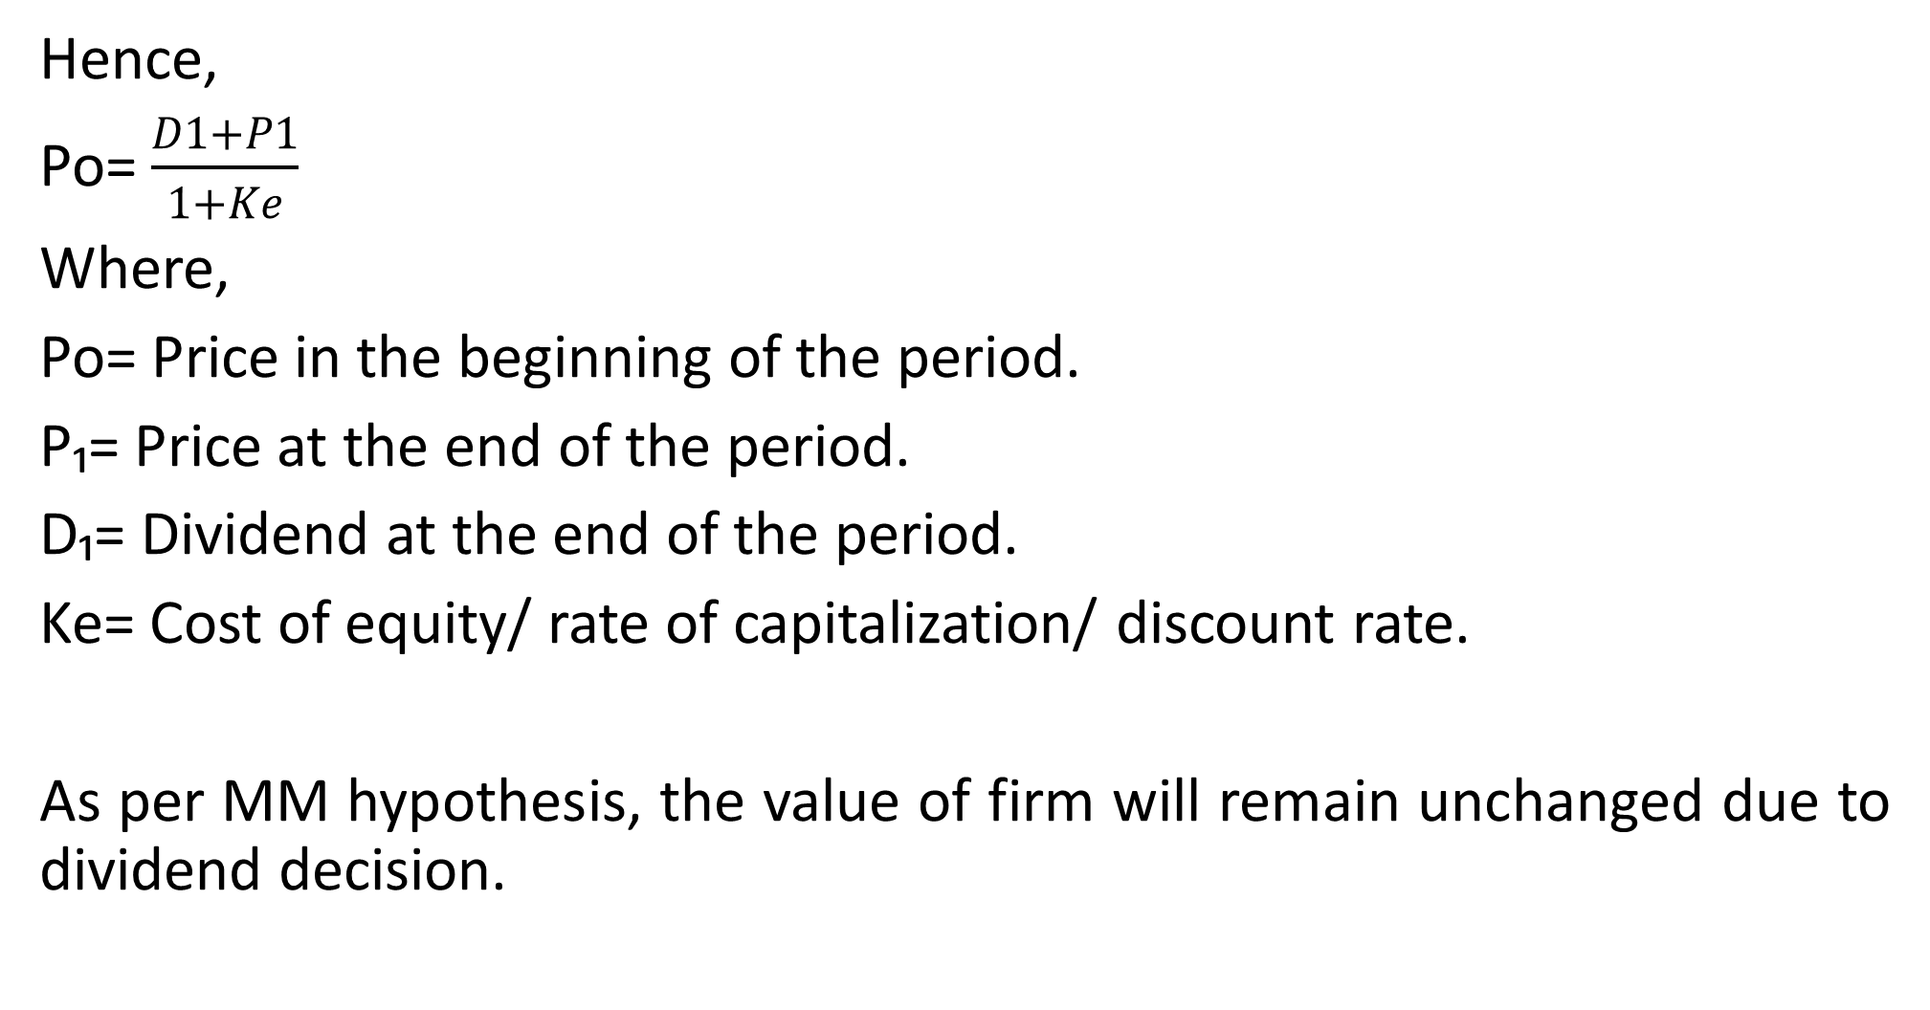
Implications of MM theory Ctd
Hence,
Po= $\frac{D1+P1}{1+Ke}$
Where,
Po= Price in the beginning of the period.
P₁= Price at the end of the period.
D₁= Dividend at the end of the period.
Ke= Cost of equity/ rate of capitalization/ discount rate.
As per MM hypothesis, the value of firm will remain unchanged due to dividend decision.

Slide 24
Advantages of MM Hypothesis
This model is logically consistent.
2. It provides a satisfactory framework on dividend policy with the concept of Arbitrage process.

Slide 25
Limitations of MM Hypothesis
Validity of various assumptions is questionable.
2. This model may not be valid under uncertainty.

Slide 26
Walter Model Dividend Model
Walter argues that the dividend policy almost always affects the value of the firm.
Walter model is based in the relationship between the following important factors:
Rate of return r
Cost of capital (k)
If r > k, the firm is able to earn more than what the shareholders could by reinvesting, if the earnings are paid to them. The implication of r > k is that the shareholders can earn a higher return by investing elsewhere. If the firm has r = k, it is a matter of indifferent whether earnings are retained or distributed.

Slide 27
Assumptions of Walter Model
All investments proposals of the firm are to be financed through retained earnings only
2. ‘r’ rate of return & ‘Ke’ cost of capital are constant
3. Perfect capital markets: The firm operates in a market in which all investors are rational and information is freely available to all.

Slide 28
Assumptions of Walter Model
4. No taxes or no tax discrimination between dividend income and capital appreciation (capital gain)
5. No floatation or transaction cost: Similarly, these costs may differ country to country or market to market.
6. The firm has perpetual life

Slide 29
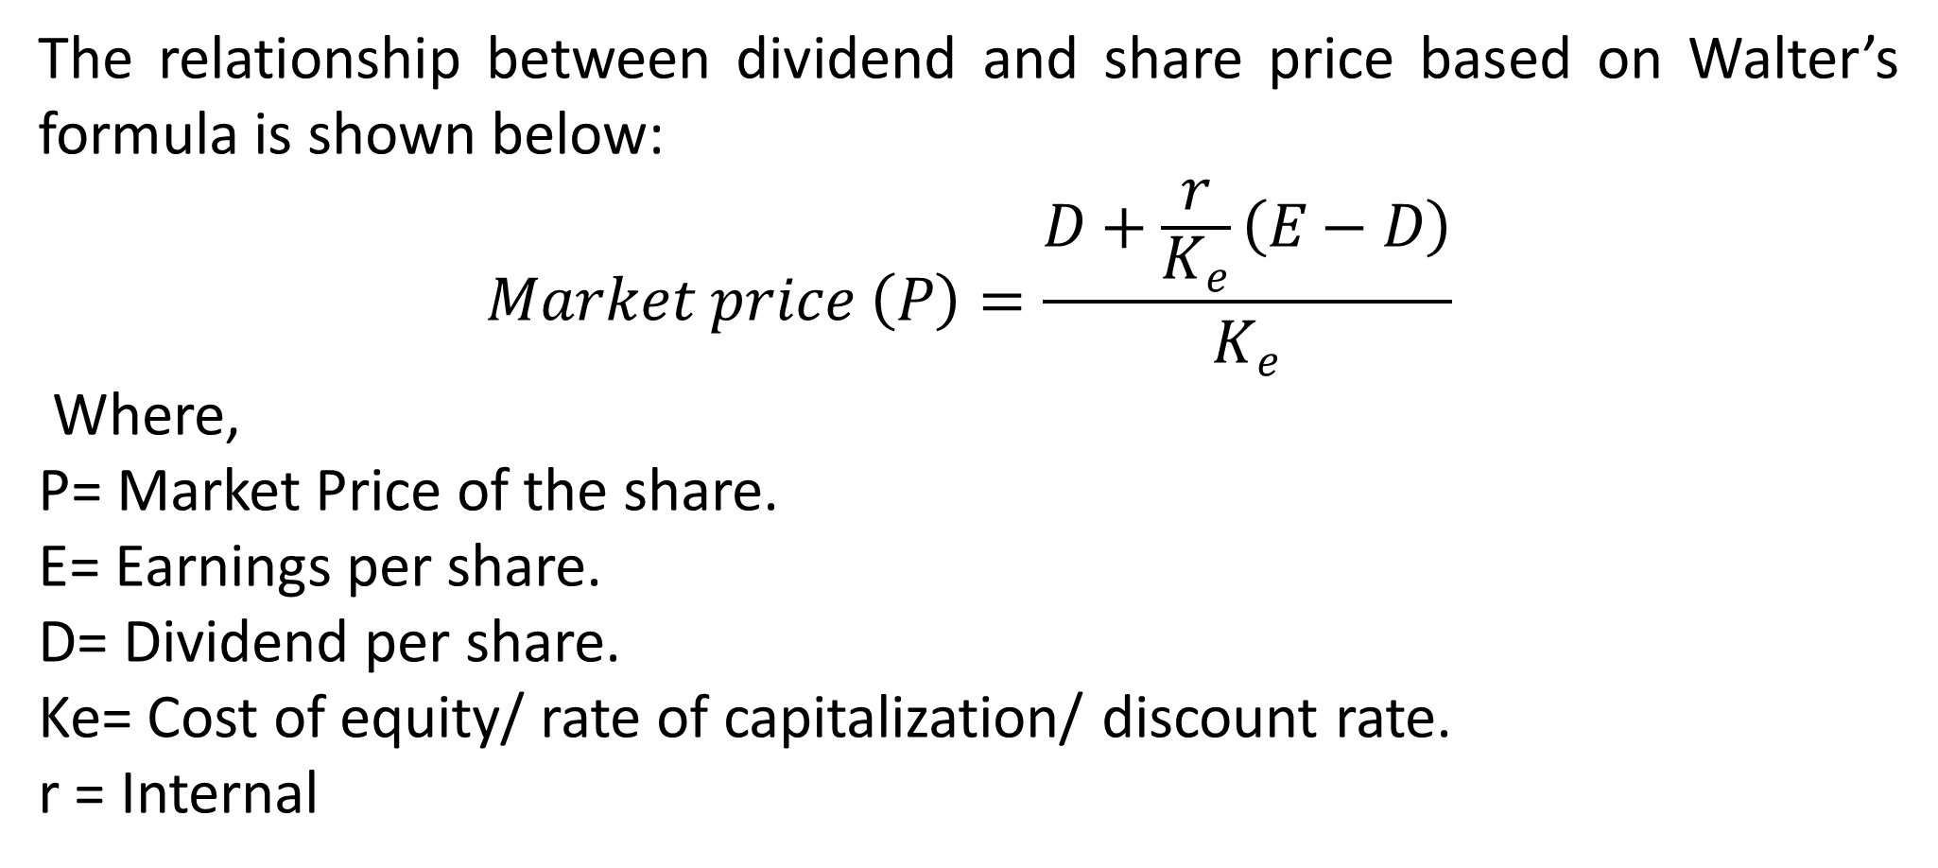
Walters Linkage of dividend and market share price
The relationship between dividend and share price based on Walter’s formula is shown below:
$$Market price \left(P\right)=\frac{D+\frac{r}{K_{e}}\left(E−D\right)}{K_{e}}$$
Where,
P= Market Price of the share.
E= Earnings per share.
D= Dividend per share.
Ke= Cost of equity/ rate of capitalization/ discount rate.
r = Internal

Slide 30
Factors which influence the market price of a share
Walter emphasises two factors which influence the market price of a share.
1) Dividend per Share
2) Relationship between Internal Rate of Return (IRR) and Cost of capital (Ke)/Market capitalization rate.
If the internal return of retained earnings is higher than market capitalization rate, the value of ordinary shares would be high even if dividends are low. However, if the internal return within the business is lower than what the market expects, the value of the share would be low.

Slide 31
Advantages of Walter Model
The formula is simple to understand and easy to compute.
2. It can envisage different possible market prices in different situations and considers

Slide 32
Limitations of Walter Model
The formula does not consider all the factors affecting dividend policy and share prices. Moreover, determination of market capitalisation rate is difficult.
2.. Further, the formula ignores such factors as taxation, various legal and contractual obligations, management policy and attitude towards dividend policy and so on.

Slide 33
Gordon Model (Dividend Discount Model)
It is financial model that values shares at the discounted value of the future dividend payments.
Under this model, the price a share will be traded is calculated by the NPV of all expected future dividend payment discounted by an appropriate risk- adjusted rate.
The dividend discount model price is the intrinsic value of the stock i.e. Intrinsic value = Sum of PV of Future cash flows
Stock Intrinsic Value =Sum of PV of Dividends + PV of Stock Sale Price

Slide 34
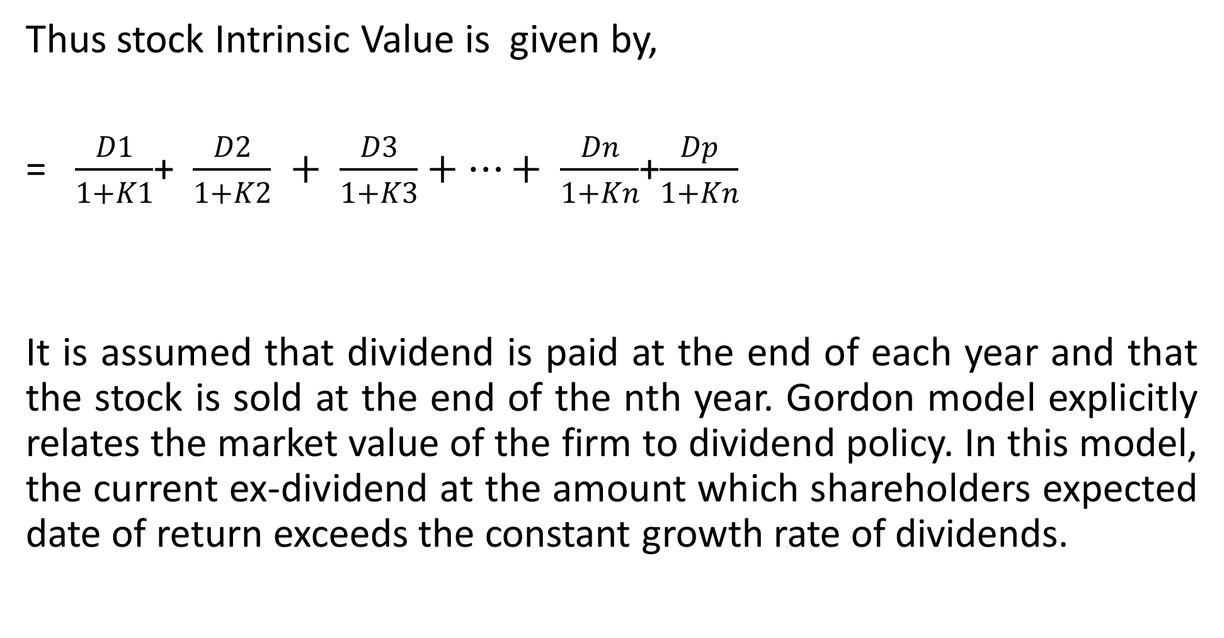
Gordon Model (Dividend Discount Model)
Thus stock Intrinsic Value is given by,
= $\frac{D1}{1+K1}$+ $\frac{D2}{1+K2} + \frac{D3}{1+K3}+…+ \frac{Dn}{1+Kn}$+$\frac{Dp}{1+Kn}$
It is assumed that dividend is paid at the end of each year and that the stock is sold at the end of the nth year. Gordon model explicitly relates the market value of the firm to dividend policy. In this model, the current ex-dividend at the amount which shareholders expected date of return exceeds the constant growth rate of dividends.

Slide 35
Assumptions of Gordon Model
1. Firm is an all equity firm i.e. no debt
2. IRR will remain constant, because change of IRR will change the growth rate and consequently the value will be affected. Hence this assumption is necessary.
3. Ke will remains constant, because change in discount rate will affect the present value.
4. Retention ratio once decided upon, is constant i.e. constant dividend payout ratio will be followed.

Slide 36
Assumptions of Gordon Model Ctd
:
5. Growth rate is also constant, since retention ratio and IRR will remain unchanged and growth, which is the function of these two variable will remain unaffected.
6. Ke> g, this assumption is necessary and based on the principles of series of sum of geometric progression for ‘n’ number of years.
7. All investment proposals of the firm are to be financed through retained earnings only
NB. Myron Gordon argues that what is available at present is preferable to what may be available in the future- investors would prefer to pay a higher price for shares on which current dividends are paid.

Slide 37
Implications of Gordons Model on MPS
When the rate of return is greater than the discount rate, the price per share increases as the dividend ratio decreases
If the return is less than discount rate the price per share decreases as the dividend ratio increases
The price per share remains unchanged where the rate of return and discount rate are equal.

Slide 38
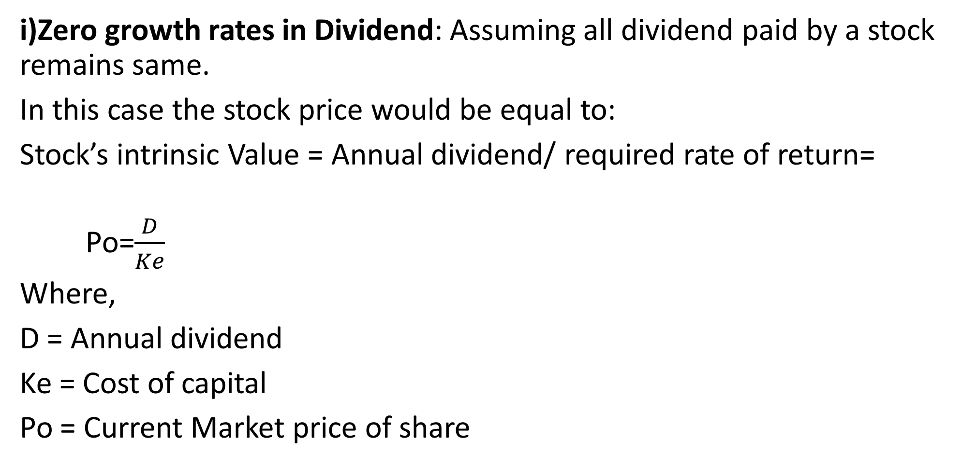
Market Price Calculations
i)Zero growth rates in Dividend: Assuming all dividend paid by a stock remains same.
In this case the stock price would be equal to:
Stock’s intrinsic Value = Annual dividend/ required rate of return=
Po=$\frac{D}{Ke}$
Where,
D = Annual dividend
Ke = Cost of capital
Po = Current Market price of share

Slide 39
Market Price Calculations Ctd
ii)Constant Growth Rate
According to Gordon model an investor prefer what is available at present compared to what may be available in the future.
They would prefer to pay a higher price for shares on which current dividends are paid.
This model explicitly relates the market value of the firm to dividend policy.

Slide 40
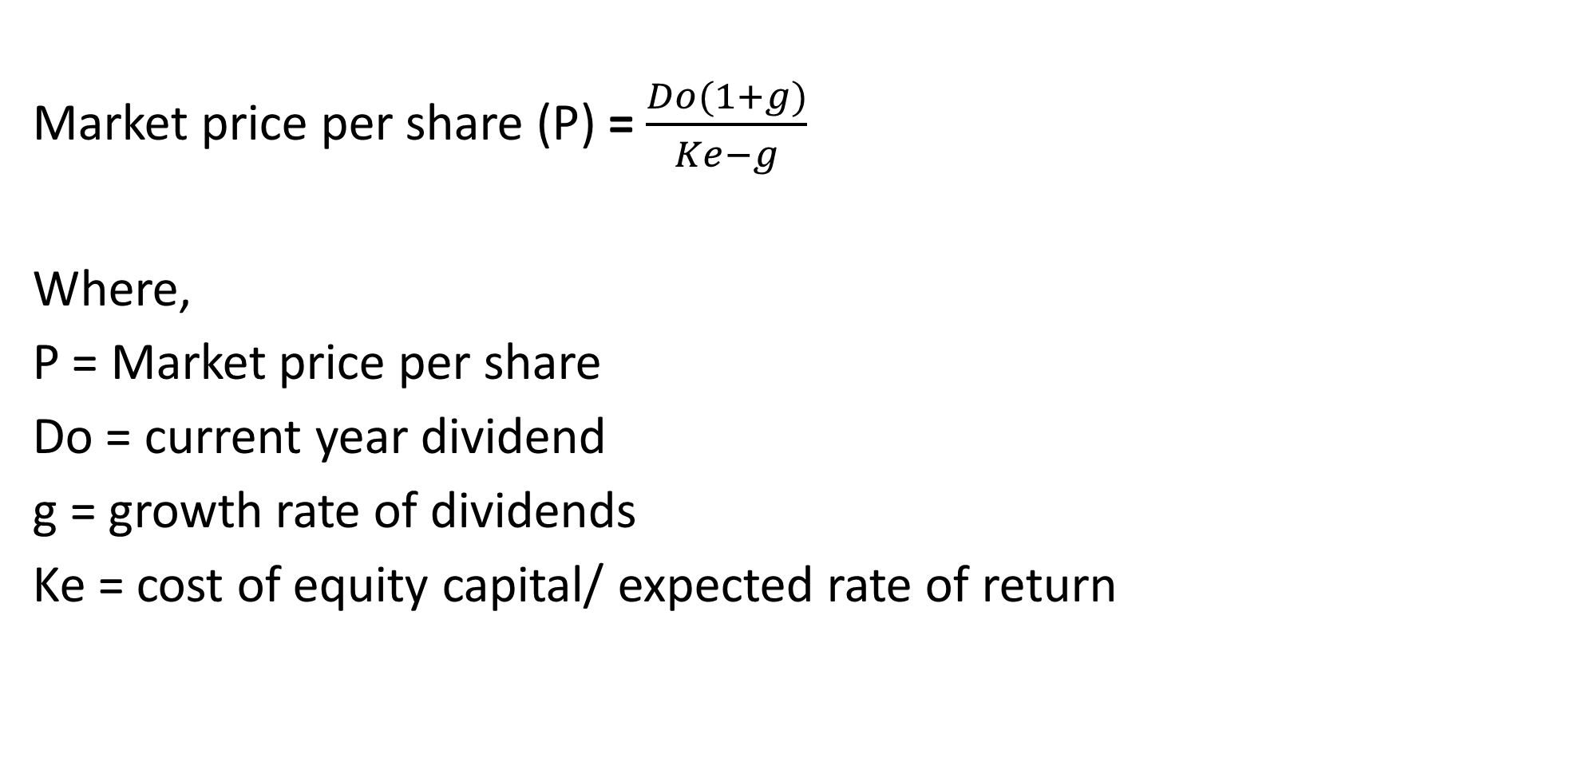
Market Price Calculations -Constant Growth Rate
Market price per share (P) = $\frac{Do(1+g)}{Ke−g}$
Where,
P = Market price per share
Do = current year dividend
g = growth rate of dividends
Ke = cost of equity capital/ expected rate of return

Slide 41
Gordons model- Variable-growth Rate Models
iii) Variable-growth rate models (multi-stage growth models) can take many forms, even assuming the growth rate is different for every year.
The most common form is one that assumes 3 different rates of growth: an initial high rate of growth, a transition to slower growth, and lastly, a sustainable, steady rate of growth
The present values of each stage are added together to derive the intrinsic value of the stock.

Slide 42
Gordon Model Assumptions:
1. Firm is an all equity firm i.e. no debt
2. IRR is constant
3. Ke remains constant
4. Retention ratio once decide upon, is constant
5. Growth rate is also constant
6. Ke> g –Cost of equity is greater than growth
7. All investment proposals of the firm are to be financed through retained earnings only

Slide 43
Advantages of Gordon Model
The dividend discount model is a useful model that relates the present stock price to the present value of its future cash flows.
2. This Model is easy to understand.

Slide 44
Limitations of Gordon Model
The dividend discount model, depends on projections about company growth rate and future capitalization rates of the remaining cash flows, which may be difficult to calculate accurately.
2. The true intrinsic value of a stock is unknowable,

Slide 45
Linters Model of Dividend policy
John Linter based his model on a series of interviews which he conducted with corporate managers in the mid 1950’s.
Assumptions:
1.Firm have a long term dividend payout ratio. They maintain a fixed dividend payout over a long term. Mature companies may have high payouts while growth companies usually have low payouts.
2. Managers are more concerned with changes in dividends than the absolute amounts of dividends.

Slide 46
Linters Model Assumptions Ctd
3. Dividend changes follow changes in long run sustainable earnings.
4. Managers are reluctant to affect dividend changes that may have to be reversed.
Under Linter’s model, the current year’s dividend is dependent on current year’s earnings and last year’s dividend.
Linter model has two parameters:
i. The target payout ratio,
ii. The spread at which current dividends adjust to the target.

Slide 47
Criticism of Gordons Model
This model does not offer a market price for the shares.
2. The adjustment factor is an arbitrary number and not based on any scientific criterion or methods.

Slide 48
Information Signaling theory
This theory was developed by Stephen Ross in 1977.
He argued that if stock markets stock are efficient then the management can use the dividend policy to signal some important information to investors.
Therefore, if a company pays high dividends, it shows that the company is profitable and will be able to maintain high dividends in the future.

Slide 49
The Clientele Effect Theory
The clientele effect indicates that investors will tend to hold stocks whose dividend policy fits their needs.
That is, investors preferring more certain dividends over uncertain future earnings, or having a preference for current income over capital gains, will tend to hold stocks with relatively high dividend payout, and vice versa
A stock will have a clientele attracted by its dividend policy). Under these conditions, it is not the dividend policy itself that is relevant, but the stability of the policy.
The theory was developed by Richard Petit in 1977.

Slide 50
Conclusions of the Clientele Effect Theory
i) A group of shareholders with high income will prefer low or no dividends to reduce tax burden. They prefer high capital gains that come in the future.
ii) Low income shareholders will prefer high dividends in order to supplement their low income. They will shift from low dividend company to high dividend company.
iii) As investors shift from one company to another in search of companies with dividend policies of their choice, the market price of shares will change due to demand and supply in the market. However, at equilibrium, the dividend policy will be irrelevant since it will be consistent with the requirement of the shareholders.

Slide 51
Types of Dividend Policy
Stable dividend policy or fixed dividend per share
Constant payout ratio
Residual dividend policy and
Low constant dividend per share plus surplus or bonus

Slide 52
Stable Dividend Policy /Fixed Dividend Per Share
Management maintains a fixed dividend per share each year
The company pays a fixed amount of dividend per share irrespective of earnings made during the year.
The shareholders are treated as if they were preference shareholders.
Because of the stability of dividend per share, the share price increases.
This type of policy is suitable to the small investors, retired persons and others.

Slide 53
Constant Payout Ratio
Management maintains a fixed percentage dividend payout ratio irrespective of profits made during the year. For example if a company payout ratio is 80% it means that, it distributes 80% of its earnings as dividends.
Since the earnings of the company fluctuate over time, the dividend per share is also expected to fluctuate over time and due the uncertainty, the share price also fluctuates over time.
This policy is necessary when the company want to maintain a constant part of the earnings for more investment and growing the company.

Slide 54
Residual Dividend Policy
Profits are used to fund new projects with the residual or remaining profit distributed as dividends.
If a company has a profit of $100 million and is going to fund a new development project costing $60 million, the remaining $40 million will be distributed as dividends.
Dividends are only paid when earnings are not exhausted by the company financial requirements and there are no profitable investment projects to invest in.

Slide 55
Low Constant Dividend Per Share Plus Surplus Or Bonus
Dividend per share is set at very low level and is paid for each period.
Extra dividend will be paid during periods of high earnings. This extra dividend is paid in such a way that is not seen as commitment on the part of the company to continue paying the extra dividend in the future.
This is necessary when the company’s profits fluctuate to a large extent.

Slide 56
References
Hillier, D, S Ross, R Westerfield, J Jaffe, & B Jordan, Corporate Finance: McGraw- Hill Education, 2022
I.M. Pandey (Ed.), 2015. Financial Management, Eleventh Edition. India: Vikas Publishing House,
Ross, S., Westerfield, R., Jaffe, J. and Jordan, B., 2011. Core principles and applications of corporate finance. 1st ed. New York: McGraw-Hill/Irwin,
Van Horne, J. and Wachowicz, J., 2008. Fundamentals of financial management. 13th ed. Essex: Prentice-Hall.

Slide 57
THE END OF WEEK 13 LESSON

