Slide 1
INTERNATIONAL FINANCE
WeEK10-FINANCING INTERNATIONAL TRADE

Slide 2
CONTENTS
1.0 INTRODUCTION
2.0 OBJECTIVES
3.0 INTERNATIONAL TRADE OVERVIEW-IMPORTS AND EXPORTS
4.0 PAYMENT METHODS IN INTERNATIONAL TRADE FINANCE
5.0 EXPORT AND IMPORT FINANCING MECHANISM
  5.1 Financing Exports
  5.2 Import Financing

Slide 3
  5.3 Warranties/guarantee
  5.3.1 Types of guarantees
6.0 BUYER’S CREDIT
  6.1 accounting treatment for buyer’s credit
  6.2 The benefits of buyer’s credit
7.0 SUPPLIER,S CREDIT
  7.1 Benefits of supplier’s credit
  -The difference between buyer’s credit and supplier’s
  credit

Slide 4
8.0 SELF ASSEMENT EXERCISE
9.0 REFERENCES

Slide 5
1.0 INTRODUCTION
Merchandise trade, i.e., exports and imports of goods is the oldest and least risky form of international business.
Of concern to the exporter is the risk of non-payment by the importer of goods.
Of concern to the importer is the risk that the exporter may not ship the products that have been paid for.
In trade finance banks act as intermediaries to ensure that the exporter gets paid while the importer receives the merchandise.

Slide 6
2.0 OBJECTIVES
At the end of this topic, you should be able to-
To describe the methods of payment for international trade;
To explain common trade finance methods; and
To describe the documents involved in international trade
To understand;
1. Export and Import financing mechanism

Slide 7
  2. Buyer’s credit
  3. Supplier’s credit
  4. The difference between buyer and supplier credit

Slide 8
3.0 INTERNATIONAL TRADE OVERVIEW-IMPORTS AND EXPORTS
a. Import or export transaction
A contractual exchange involving goods/services for money between parties in two countries that may have:
  Different legal systems,
  Currencies,
  Cultures

Slide 9
b. Two issues facing firm
1. Foreign Exchange Exposure:
Importing (Accounts Payable)
  Problem if the foreign currency strengthens
  Hedge with a forward purchase
Exporting (Accounts Receivable)
  Problem if the foreign currency weakens
  Hedge with a forward sale
2. Risk of Default
  Not receiving goods ordered/paid for!
  Not receiving payments for goods shipped/sold!

Slide 10
c. Basic elements of an import/export transaction
Each individual export sales transaction covers three basic elements:
  The Contract: description of goods (quantity, grade, quality, technical details, payment instructions).
  Prices (do they include shipping charges insurance fees), and
  Documents regarding shipping and delivery instructions. These include:
Bills of lading (B/L) – is issued to the exporter by a common carrier transporting the merchandise
Commercial invoice – is issued by the exporter and contains a precise description of the merchandise.
Unit prices, financial terms of sale, and amount due from the importer are indicated such as “FOB” (free on board), “FAS” (free alongside), “CFR” (cost & freight), or “CIF” (cost, insurance, freight).

Slide 11
Insurance documents – must be as specified in the contract of sale and must be issued by insurance companies or their agents.
Consular invoices – issued in the exporting country by the consulate of the importing country to provide customs information and statistics for that country and to help prevent false declarations of value.
Packing lists – may be required so that the contents of containers can be identified, either for customs purposes or for importer identification of the contents of separate containers.

Slide 12
d) Other elements of an import or export transaction
Shipping deadline – most importers insist on a specified deadline or time interval by which the shipment will be made
Payment instructions – which of the parties, exporter or importer, is to pay such charges as freight, insurance, import duties, handling fees, taxes, etc., must be carefully specified in the sales contract
Packaging and marking – depending on the nature of the goods, proper packaging may be critical to preserving and protecting items being shipped
Warranties, Guarantees, and inspection – assurances regarding the performance or qualities demonstrated by the goods from the exporter may also be included in the sales contract

Slide 13
e. Payment methods
In any international trade transaction, credit is provided by either-
  the supplier (exporter),
  the buyer (importer),
  one or more financial institutions, or
  any combination of the above.
The form of credit whereby the supplier funds the entire trade cycle is known as supplier credit.

Slide 14
Method 1 -Prepayments
The goods will not be shipped until the buyer has paid the seller.
Time of payment : Before shipment
Goods available to buyers : After payment
Risk to exporter : None
Risk to importer : Relies completely on exporter to ship goods as ordered

Slide 15
Method 2- Letters of Credit (L/C)
These are issued by a bank on behalf of the importer promising to pay the exporter upon presentation of the shipping documents.
Time of payment : When shipment is made
Goods available to buyers : After payment
Risk to exporter : Very little or none
Risk to importer : Relies on exporter to ship goods as described in documents

Slide 16
Method 3- Drafts (bills of exchange)
These are unconditional promises drawn by the exporter instructing the buyer to pay the face amount of the drafts.
Banks on both ends usually act as intermediaries in the processing of shipping documents and the collection of payment.
In banking terminology, the transactions are known as documentary collections.

Slide 17
Sight drafts(documents against payment)
When the shipment has been made, the draft is presented to the buyer for payment.
Time for payment-on presentation of draft.
Goods available to buyer-after payment.
Risk to the exporter-disposal of unpaid goods.
Risk to importer-relies on importer to ship goods as described in documents.

Slide 18
4.0 PAYMENT METHODS IN INTERNATIONAL TRADE FINANCE
The common payment methods are-
1. Cash In Advance
2. Open Account Terms
3. Consignment
4. Documentary Collection
5. Letters of Credit

Slide 19
1.Cash in advance
The safest method of payment in international trade is getting cash in advance of shipping the goods ordered.
It is mostly desired by exporters, especially in situations where the risks of non-payment are high,.
It is often much less desired by customers.

Slide 20
Pros and cons of cash in advance
 | Pros | Cons
Buyer | None. | - Affects cash flow. -Risk of not receiving shipment or no recourse for damaged goods.
Seller | Payment is made before goods are received. | -Not a competitive advantage.

Slide 21
2. Open account terms
Pros and Cons of Open Account Terms
Exporters can offer open account terms for payment in international trade by shipping goods to international customers before they receive payment for those goods.
 | Pros | Cons
Buyer | Enhanced cashflow because payment not due until good are received. | None.
Seller | Can increase sales as this payment option is advantageous to the buyer. | -No guarantee of payment - No protection against cancelled order.

Slide 22
3. Consignment
Consignment is an agreement that the buyer will pay for the shipment after the buyer sells the goods.
 | Pros | Cons
Buyer | Payment is made only after goods are received and sold. | -Relies on good faith that the seller will ship the goods.
Seller | Can reduce the costs of managing and storing inventory in a foreign country. | Delays payment and increases potential of not receiving payment.

Slide 23
4. Documentary collection
Documentary collection involves having a bank collect payment on the exporter’s behalf once the buyer has received the goods ordered.
 | Pros | Cons
Buyer | -Less costly than letters of credit. -Payment is made only once goods are delivered | -Payment is made before goods can be checked. -Relies on seller to ship goods as specified.
Seller | Seller retains the title to goods until paid | -No guarantee of payment. -No protection against cancellations. -Risk of having to pay for return transport if the buyer cannot pay.

Slide 24
5. Letters of credit
Letters of credit guarantee payment from one bank to another on behalf of the buyer and seller.
The buyer’s bank releases payment to the exporter as soon as it receives proof that all of the terms and conditions of the transaction have been satisfied by both buyer and seller.

Slide 25
letters of credit pros and cons
 | Pros | cons
Buyer | Payment made after goods are received. Terms can be customized | Expensive. Relies on seller to ship goods as specified. Time consuming to manage. Expiration dates. Currency fluctuations can make the cost rise.
Seller | Low risk of default because the sale is secured by the buyer's bank. Terms can be customized. | Strict documentary requirements to prove what was contracted was provided. Currency fluctuations can make profit fall.

Slide 26
5.0 EXPORT AND IMPORT FINANCING MECHANISM
5.1 EXPORT FINANCE/FINANCING EXPORTS
Export finance refers to the credit facilities extended to the exporters at pre-shipment and post-shipment stages.
It includes any loan to an exporter for financing the purchase, processing, manufacturing or packing of goods meant for overseas markets.
Credit is also extended after the shipment of goods to the date of realization of export proceeds.

Slide 27
The export financing process involves three parties:
  1.Financial institution
  2.Exporter
  3.Foreign importer
The financing must always be linked to an export operation.
The contract length will normally coincide with the payment deferment given to the importer or the person who receives the service.

Slide 28
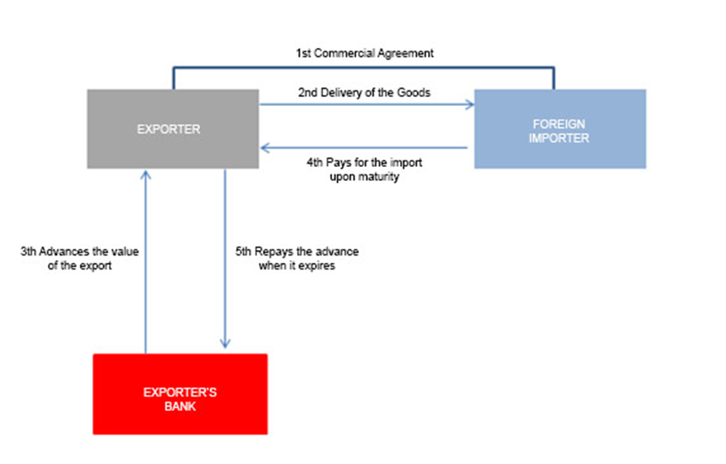
Export financing/advances-the process

Slide 29
If the periods differ there are two alternatives:
1. Pre-financing: The bank finances the exporter for the manufacture of the goods.
2. Post-financing (Advance): The bank advances, partly or in full, the value of the operation once the goods have been dispatched.
The maximum amount that can be financed is the value of the goods plus those costs.
The currency of the financing/advance may be any officially quoted currency.
Repayment must match the deadline set by the financing/advance.

Slide 30
The interest rate used will depend on the currency in which the financing is denominated.
When the currencies of the financing/advance and the repayment differ, an exchange rate risk is created to which the exporter may respond in one of two ways:
  accept it or
  offset it by taking out exchange rate insurance or a foreign currency option.

Slide 31
Forfaiting: financing & credit insurance
Forfaiting enables the banking institution to offer its exporter-customers the following:
  Collection of payment is guaranteed.
  The exchange and interest rate risk disappear, as the funds are advanced.
  The political and commercial risk of the operation is eradicated.
  It furnishes liquidity.
  It enables the transaction to be removed from the balance sheet.
  It enables more to be sold, or more expensively, by enabling longer credit terms to be offered.

Slide 32
5.2 IMPORT FINANCING
Finances the period needed to sell and receive payment for an imported product. The importer requests financing owing to:
  Insufficient funds to pay on delivery.
  The availability of better purchase prices.
It differs from domestic loans in that the payments are used only to pay for imports. This process requires the involvement of three players:
  Financial institution
  Importer
  Foreign exporter
  The financing operation must always be linked to the payment of imports.

Slide 33
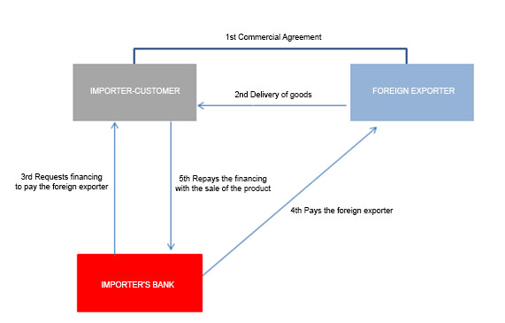
The process

Slide 34
The process
1. A sales agreement is struck between the importer (customer of the bank) and the foreign exporter.
2. The foreign exporter delivers the goods to the importer.
3. The importer (the bank’s customer) requests financing from their bank so that it can pay the foreign exporter.
4. The importer’s bank pays the foreign exporter.
5. When it expires, the importer (bank customer) repays the financing with the proceeds of the sales.

Slide 35
Characteristics of import financing
Length of contract
Amount
Currency
Repayment
Rate of interest
Exchange rate risk

Slide 36
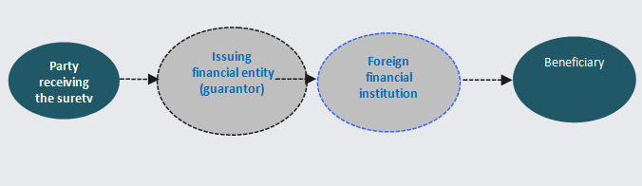
5.3 WARRANTIES/guarantee
"Surety" is taken to mean any form of guarantee whereby someone commits to making a payment on behalf of a third party.
The parties involved-

Slide 37
5.3.1 Types of guarantees
 | What is the purpose? | When is it issued? | When is it issued? | When is it issued?
Bid Bond Tender Guarantee | To ensure that participants in a tender process do not withdraw or modify their bids until the tender has been awarded and contracts have been signed in accordance with the terms offered. | At the outset of the project; they are presented at the bidding stage and are a requirement of the tender specifications. | Usually they are approximately 5% of the project or delivery. | Technical
Advance Payment Guarantee or Repayment Guarantee | To guarantee the total advanced. | When the commercial contract comes into force, once the disbursement has been made. | Usually in the range of 10-20% of the project. As a general rule, repayments of the initial sum are made in accordance with the projected timetable of the project or delivery. | Commercial

Slide 38
Performance Bond | To ensure that a project develops correctly and to plan (deadlines, technical specifications, quality issues and so on). | When the commercial contract comes into force. | Usually in the range of 10-20% of the project or delivery. | Technical
Maintenance Guarantee | To cover the contractually established maintenance period | Once delivery has been made or the project completed. | Usually in the region of 5% of the project or delivery. | Technical
Other Payment/Collection guarantees (e.g. Payment Guarantee) | Mechanism to ensure payment obligations arising from a sale/purchase or rendering of services are met. | Once the sale/purchase contract or service contract has been signed | Variable | Commercial

Slide 39
6.O BUYER’S CREDIT
A financial arrangement in which a bank or financial institution, or an export credit agency in the exporting country, extends a loan directly to a foreign buyer or to a bank in the importing country to pay for the purchase of goods and services from the exporting country.
It is also known as financial credit.
This term does not refer to credit extended directly from the buyer to the seller.
The Practical example is that foreign Bank makes payment to exporter based on either Letter of Undertaking from the Importer bank or based on their risk on Importer.
Letter of Undertaking is simply confirmation by a bank here in importer country to pay to exporter bank thus exporter bank risk get reduced.

Slide 40
6.1 Accounting treatment for buyer’s credit
If Secured, then it is under Secured Loan else under Current Liability Check the terms of this loan and the collateral provided with it and you will have following scenarios:
Term for more than 12 months and has collateral attached to it - Secured loan under non-current liability.
Term for more than 12 months with no collateral attached to it - Unsecured loan under non-current liability.
The answer will be vice versa if the term is less than less than 12 months and it will be classified under current liability.

Slide 41
6.2 The benefits of buyer’s credit
The benefits of buyer’s credit for the importer is as follows:
The exporter gets paid on due date; whereas importer gets extended date for making an import payment as per the cash flows.
The importer can deal with exporter on sight basis, negotiate a better discount and use the buyers credit route to avail financing.
The funding currency can be in any FCY (USD, GBP, EURO, JPY etc.) depending on the choice of the customer.
The importer can use this financing for any form of trade viz. open account, collections, or LCs.
The currency of imports can be different from the funding currency, which enables importers to take a favorable view of a particular currency.

Slide 42
7.0 SUPPLIERS’ CREDIT
Suppliers credit is a trade credit funded to the importer on basis of Letter Of Credit (LC).
It is beneficial to the seller as he receives payments immediately after the shipment of goods, which in turn helps the importer to negotiate for better prices.
7.1 Benefits of Suppliers Credit
For Importer
1. Availability of cheaper funds for import of raw materials and capital goods.
Ease short-term fund pressure as able to get credit.

Slide 43
Ability to negotiate better price with suppliers.
Able to meet the Suppliers requirement of payment at sight.
For the Supplier
Realize at-sight payment.
Avoid the risk of importer’s credit by making settlement with LC, the Importer enters a contract with supplier for import.

Slide 44
2 . With transaction details importer approaches arranger to get suppliers credit for
the transaction.
3. Arranger get an indicative pricing from overseas bank, which importer confirms.
4. Importer approach his bank and get LC issued, restricted to overseas bank counters
with other required clauses
5. Overseas Bank confirms the LC and advise LC to Supplier’s Bank. Suppliers
Bank provides the copy of the LC to Supplier.

Slide 45
6. Supplier ships the goods and submits documents at his bank counter.
7. Supplier’s Bank sends the documents to Overseas Bank.
8. Overseas Bank post checking documents for discrepancies (As per UCP 600) sends the document to importer’s bank for acceptance:
• If documents are as per order, the same is discounted and transferred to supplier’s bank.
• Incase of discrepant documents, documents are sent on acceptance basis.
On receipt of Importer bank acceptance, the same is discounted and transferred to
supplier’s bank. Supplier receives the payment for the LC.

Slide 46
Depending on who is bearing the interest cost:
If importer is bearing interest cost, supplier receives full payment.
If Suppliers is bearing interest cost, supplier will receive LC amount – Interest.
10. Importer’s Bank receives the documents. Importer’s bank and Importer accept documents.
Importer’s Bank provides acceptance to Overseas Bank, guaranteeing payment on due date.
11. On maturity, Importer makes the payment to his bank and Importer’s bank makes payment to Supplier’s Credit Bank

Slide 47
The difference between buyer’s credit and supplier’s credit
1.Supplier’s Credit can be arranged against LC transactions only, where as Buyer’s Credit can be arranged for any type of payment mode (LC Sight, LC Usance, DA and DP) except advance payment.
2.Clauses in the LC would need amendment, or few clauses will have to be incorporated as per the requirement of the supplier’s credit providing bank.
In buyer’s credit, as the arrangement is after documents reaches your banks counter, no such clause are required to be incorporated.

Slide 48
3.Supplier’s Credit has to be arranged before shipment of the goods or at the time of LC opening whereas Buyers Credit can be arranged only after documents come at your bank counter for payment or on due date.
4.There can a difference in time of your cash flow. Many banks are structuring the transaction where in overall pricing is divided between confirmation cost and discounting cost, where confirmation cost is payable upfront at the time of advising the LC.
Whereas in buyer’s credit, as the payment is in form of interest, and it is payable only on maturity.

Slide 49
8.0 SELF ASSESMENT EXERCISE
Discuss the basic elements of import and export transactions.
Differentiate between the 5 international trade payment methods.
List the various types of guarantees.
What are the benefits of buyer’s credit
Distinguish between supplier’s credit and buyer’s credit.
List 5 documents used in import and export trade finance.

Slide 50
9.0 REFERENCES
1. International Business, Alan.M.Rugnam, Prentice Hall(2006).
2. International business management, Sinha, P., Excel Books (2008).
3. A handbook on International Finance, Arora. A, Lucent Publication (2018)
4. International finance, 5th edition, Levi, M. D. (2009).
5. International Finance: Theory and Policy, Steve, S., Saylor Foundation. (2010).

Slide 51
      THE END, THANK YOU.

