Slide 1
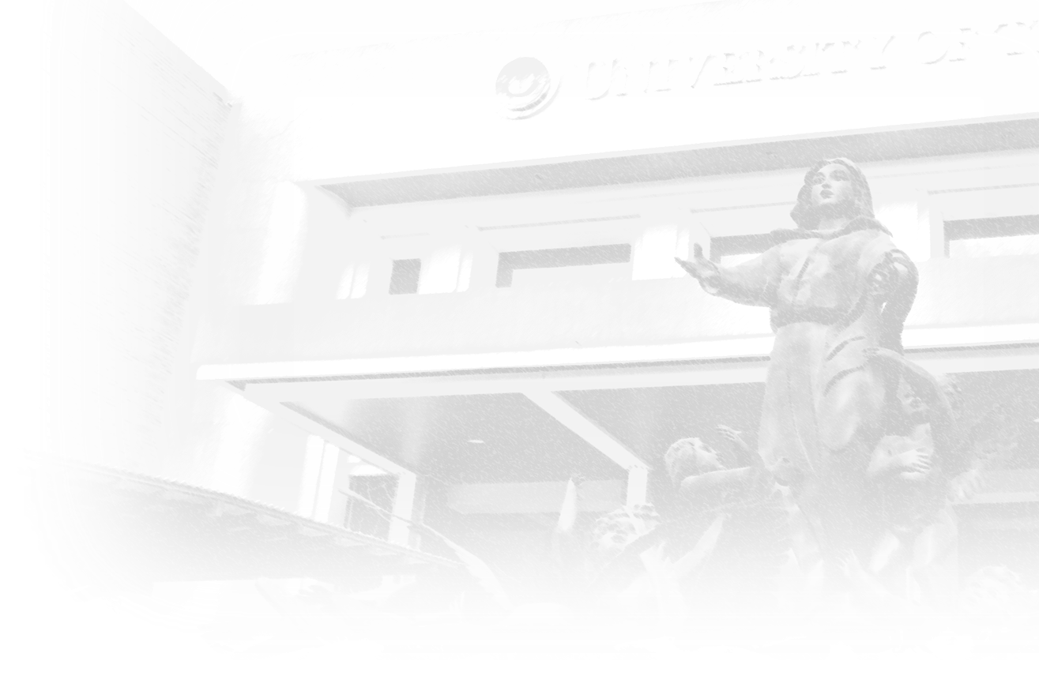

UNIVERSITY OF THE ASSUMPTION | School of Education | Educ 3A
C-EDUC10: Building & Enhancing New Literacies Across the Curriculum
Spring Semester AY 2022-2023
Session 1
Social Literacy
in the 21st Century
Image Credit: https://www.nicepng.com/

Slide 2
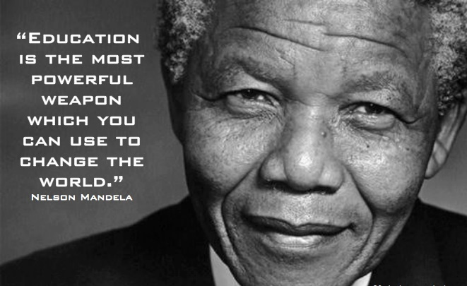
Let’s take this as our groundwork.
Image Credit: http://www.picturequotes.com/educational-quote-for-leaders-1-picture-quote-591036

Slide 3

TODAY’S SESSION OBJECTIVES
To walk through the scope, topics, and goals of the course
To discuss social literacy as the foundation of designing educational curricula in the 21st century
To illustrate how a teacher can exemplify social literacy in 21st-century teaching and learning

Slide 4
C-EDUC10: Building & Enhancing New Literacies Across the Curriculum Spring Semester AY 2022-2023
Course Description:
This course introduces the concepts of new literacies in the 21st century as an evolving special phenomenon and shared cultural practice across learning areas. The 21st-century literacies shall include globalization and multi-cultural literacy; social literacy; media literacy; financial literacy; cyber/digital literacy; eco-literacy; and arts and creative literacy. Field-based interdisciplinary explorations and other teaching strategies shall be
used in this course.

Slide 5
C-EDUC10: Building & Enhancing New Literacies Across the Curriculum Spring Semester AY 2022-2023
Course Objectives:
To discuss how multi-literacies relate with, influence, and transform the 21st-century society
To compare and abstract the different literacies that affect the educational curriculum in the Philippines and the whole world;
To rationalize strategies, functions, and programs in innovating teaching and learning according to the 21st-century social standards and the new literacies;
To justify pedagogies in the new and emerging normal that enhance the multi-literacy competence of the 21st-century teacher; and,
To propose an innovative curriculum in preparing future learners
to anticipate the 21st century and post-pandemic society.

Slide 6
C-EDUC10: Building & Enhancing New Literacies Across the Curriculum Spring Semester AY 2022-2023
Course Outline:
Week 1: Social Literacy in the 21st Century
Week 2: Understanding the Global Sustainable Development Goals and the Local "Ambisyon Natin 2040" (Our Ambition, Our Vision)
Week 3: Global Citizenship Education
Week 4: Twenty-First-Century Skill Categories in the K-12 Basic Education Curriculum
Week 5: New Literacies, Functional Literacy, and Multiliteracies
Week 6: Information, Media, and Cyber Literacy
Week 7: Health and Safety Literacy
Week 8: Financial and Economic Literacy

Slide 7
C-EDUC10: Building & Enhancing New Literacies Across the Curriculum Spring Semester AY 2022-2023
Course Outline:
Week 9: Ecological Literacy
Week 10: Creative and Literacy
Week 11: Arts and Creative Literacy
Week 12: The Roles of Education in Social Innovation
Week 13: Design Thinking in the Educational Curriculum
Week 14: Outcome-Based Educational Literacy
Week 15: Lesson Planning involving the New Literacies

Slide 8
How do you describe a LITERATE person?

Slide 9
LITERACY
A
Unscramble the letters of the word LITERACY to form four new 7-letter words that start with the given letters in the grid.
C
R
R
Notes:
Reflect on how these 4 terms formed from the letters of the word LITERACY relate with our roles as teachers in the 21st century.

Slide 10
R T I C L E
LITERACY
A
Four Domains of Study in Social Literacy in Education
Unscramble the letters of the word LITERACY to form four new 7-letter words that start with the given letters in the grid.
C
L A R I T Y
R
E A L I T Y
R
E C I T A L
Notes:
Reflect on how these 4 terms formed from the letters of the word LITERACY relate with our roles as teachers in the 21st century.

Slide 11
DOMAIN
Description Learning Application
ARTICLE
CLARITY
REALITY
RECITAL
Item or object
Evidence
Being clear
Exploration
Truth
Experience
Performance
Engagement
Notes:
ARTICLE – every data, idea, concept, issue, problem that affect our thoughts and aspirations --- INFORMATION that we need to discuss
CLARITY – understanding about what things happen and how they happen affecting our lives; how people think, feel, behave in society --- CULTURE of the people that we need to understand
REALITY – grounded from the social information and culture of people, reality is what we actually experience in the ENVIRONMENT that we need to live with and adapt with
RECITAL – performing and demonstrating the learning we got from the “information, culture, and environment”. These make up our “SELF” that we need build and enhance to become a contributor to local, national, and global development and sustainability.

Slide 12
How do you describe a LITERATE person
in the 21st century?

Slide 13
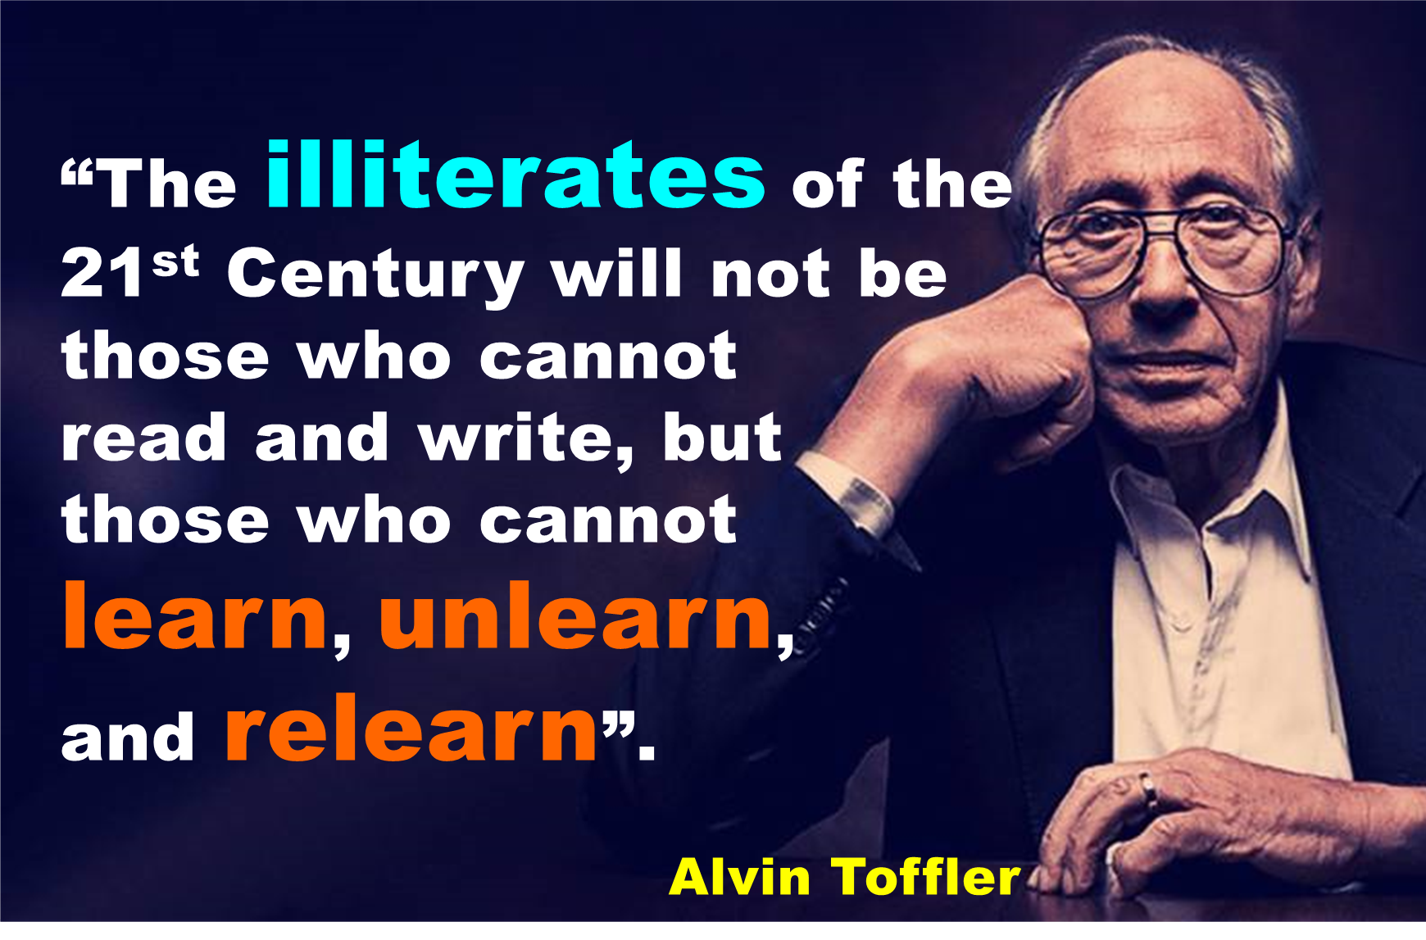
Image Credit:
https://igorbeuker.com/marketing-innovation-blog/a-tribute-to-futurist-alvin-toffler-author-of-future-shock/

Slide 14
What were your experiences of…
…Learning?
…Unlearning?
…Relearning?
Knowing for the first time
Forgetting the outdated idea
Updating an old perspective
Notes:
LEARNING – process of acquiring new information and ideas
UNLEARNING – getting over an old information that is not anymore applicable in the present time
RELEARNING – innovating a previous learning and making it more responsive to the demands of the present and the future
Our mission in C-EDUC10 is to discover and rediscover the meanings of life and living. As we prepare to be Professional Teachers, we equip ourselves with the social information that affect our lives. As we teach the curriculum, we allow our students to learn the actualities of life and aspire for the better for themselves, their families, their immediate communities, and the country. As teachers, we embark to be genuinely “SOCIALLY LITERATE”.

Slide 15
What were your experiences of…
…Learning?
…Unlearning?
…Relearning?
We become SOCIALLY LITERATE.
Notes:
LEARNING – process of acquiring new information and ideas
UNLEARNING – getting over an old information that is not anymore applicable in the present time
RELEARNING – innovating a previous learning and making it more responsive to the demands of the present and the future
Our mission in C-EDUC10 is to discover and rediscover the meanings of life and living. As we prepare to be Professional Teachers, we equip ourselves with the social information that affect our lives. As we teach the curriculum, we allow our students to learn the actualities of life and aspire for the better for themselves, their families, their immediate communities, and the country. As teachers, we embark to be genuinely “SOCIALLY LITERATE”.

Slide 16
Let’s learn further…
New LEARNING | UNLEARNING | RELEARNING
Because cultural diversity has become commonplace, students are encouraged to collaborate at school to be more socially productive. | Making students compete against each other in class will break good relationships among them. | Instead of ranking students on their achievements, provide them opportunities to collaborate in class and build better social relationships.
Understanding and mastery of concepts may be achieved through experiential learning. | Memorizing information from textual sources is found to be a sort of short-term concept remembering. | Set up the learning environment in the classroom (or outside the school) so that students can see and feel the exact situation related to the concept taught.
Providing diverse learning alternatives for children can uncover their unique intelligence. | Intelligent children are good in English, Math, and Science. | Differentiated Assessments: Allow students to choose the technique to demonstrate what they learned from the lesson.
What old belief should be disregarded now?
What will you do to replace the old belief with your new discovery?
What old belief should be disregarded now?
What will you do to replace the old belief with your new discovery?
What old belief should be disregarded now?
What will you do to replace the old belief with your new discovery?
Conclusion: The socially literate person treats new learning by unlearning an old related belief and relearning it with a better, more innovative practice.
How do you illustrate SOCIAL LITERACY based on Toffler’s contention about 21st-century teaching and learning?

Slide 17
Let’s learn further…
New LEARNING | UNLEARNING | RELEARNING
Because cultural diversity has become commonplace, students are encouraged to collaborate at school to be more socially productive. | Making students compete against each other in class will break good relationships among them. | Instead of ranking students on their achievements, provide them opportunities to collaborate in class and build better social relationships.
Understanding and mastery of concepts may be achieved through experiential learning. | Memorizing information from textual sources is found to be a sort of short-term concept remembering. | Set up the learning environment in the classroom (or outside the school) so that students can see and feel the exact situation related to the concept taught.
Providing diverse learning alternatives for children can uncover their unique intelligence. | Intelligent children are good in English, Math, and Science. | Differentiated Assessments: Allow students to choose the technique to demonstrate what they learned from the lesson.
Conclusion: The socially literate person treats new learning by unlearning an old related belief and relearning it with a better, more innovative practice.

Slide 18
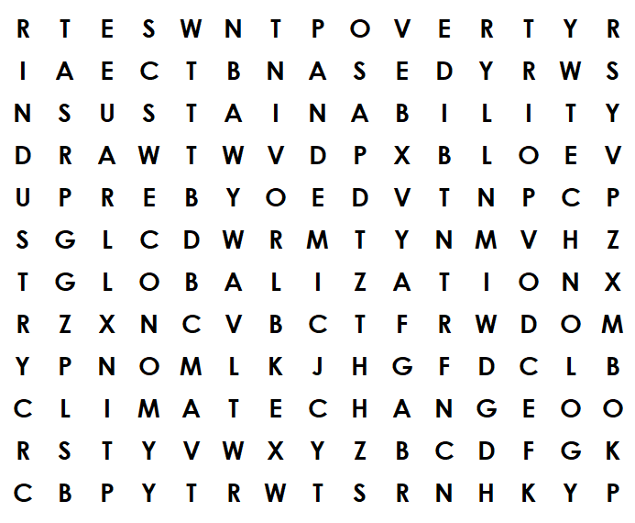
Let’s look forward…
WORD HUNT:
Look down & across to find the 8 hidden social issues.
Notes:
After finding the 8 terms (or at least 5 of them), reflect and introspect: How do these issues bring about “new literacies” that a teacher needs to understand?
How does each issue affect society? People’s lives? Aspirations? Future?
How do the ever-mutating social literacies influence the educational curriculum?
These are what we will discuss on February 2. See you then…

Slide 19
Let’s look forward…
WORD HUNT:
The terms found relate with SOCIAL LITERACY.

Slide 20


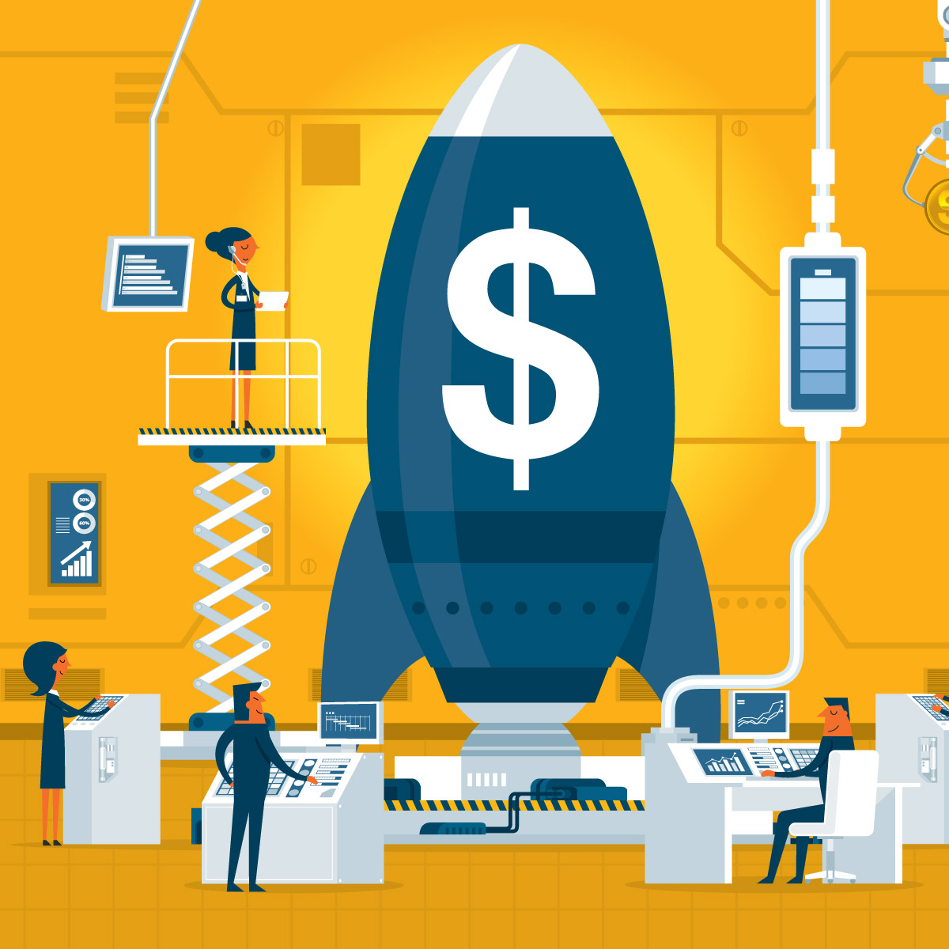
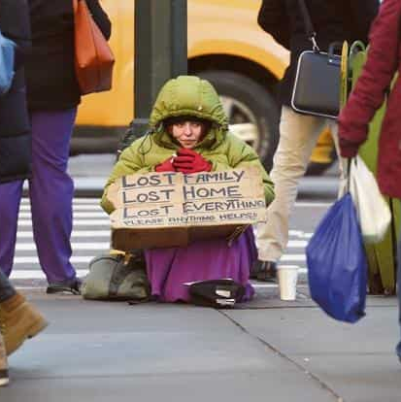

New Educational Literacies
Technology
Sustainability
Globalization
Industry
Economy
Pandemic
Poverty
Climate Change
How may the 21st-century teacher view and act upon these current issues and trends in education?
Image source: https://images.google.com/

Slide 21
New Educational Literacies
The Curriculum, Instruction, and Evaluation are anchored on these “relearned” issues.
Technology
Sustainability
Globalization
Industry
Economy
Pandemic
Poverty
Climate Change
Image source: https://images.google.com/

Slide 22
Let’s look forward…
Assignment: ESSAY
Choose one (1) of these trends and look for a new LEARNING about it. Identify something to be UNLEARNED and discuss how to RELEARN it.
Technology
Sustainability
Globalization
Industry
Economy
Pandemic
Poverty
Climate Change
Image source: https://images.google.com/

Slide 23
References and Media Sources:
Department of Education Order No. 42, series of 2017 (Republic of the Philippines): https://www.deped.gov.ph/wp-content/uploads/2017/08/DO_s2017_042-1.pdf
Future Shock by Alvin Toffler. Retrieved from https://blog.12min.com/future-shock-summary/ ; Image: https://igorbeuker.com/marketing-innovation-blog/a-tribute-to-futurist-alvin-toffler-author-of-future-shock/
Ng, DFS, & Wong, CP. The role of school leadership in Singapore's future-ready school reform. Eur J Educ. 2020; 55: 183– 199. https://doi.org/10.1111/ejed.12392
Schwab, K. (2016). The fourth industrial revolution: What it means, how to respond. Economy, Culture & History Japan Spotlight Bimonthly. July/ August. 3-5.

