Slide 1
Visual Programming
Introduction to Module. Algorithms and sequence Flowcharts. Pseudocode

Slide 2
Agenda
Module Logistics
  Syllabus
  Assessment
Intro to Visual Programming
  History of Programming
  Algorithms
  Pseudocode
  Flowcharts

Slide 3
Learning outcomes
Familiarize yourself with history of visual programming
Know problem solving process/pipeline
Draw flowcharts for particular solutions
Write pseudocode for particular solutions.

Slide 4
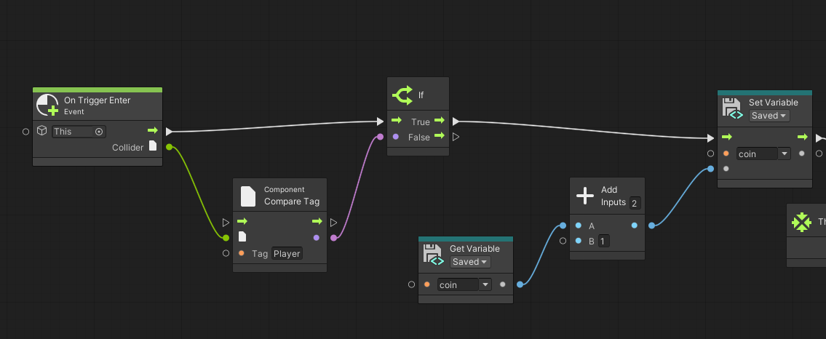
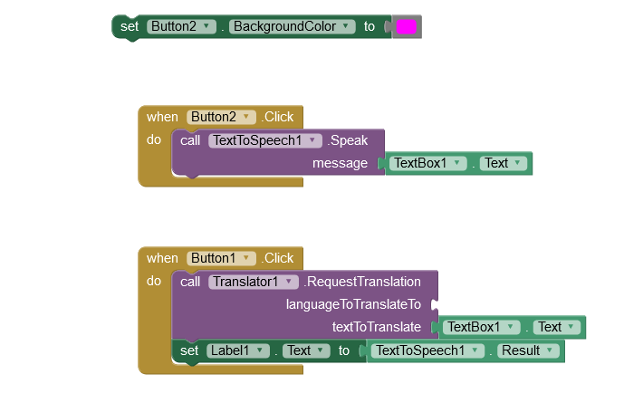
12 Teaching week calendar
Teaching week | Lecture
TW1. | Introduction to Module. Algorithms and sequence Flowcharts. Pseudocode
TW2. | Introduction to Unity DE. Game objects and materials. Basic concepts
TW3. | Types and variables. Scope. Graphs, Machines and Macros
TW4. | Control elements.
TW 5. | UI elements
TW 6. | Instantiating objects
TW 7. | Adding Audio. Clip, Source, Listener
TW 8. | State graphs
TW 9. | Into MIT app inventor. UI elements. Layout
TW 10. | Media elements and charts
TW 11. | Programming sensors
TW 12. | Storages, connectivity.
Unity
MIT AppInventor

Slide 5
Assessment
Coursework – 60%
PC lab in-class test – 40% - time constraint test
Quizzes

Slide 6
What is Programming
Programming
  Process of telling computer what to do
Program
  a set of instructions
Algorithm
  Sequence or order of instructions matters
  There is no right or wrong way, as long as it solves the problem
  Difference in factors, time and resources
Sequence
  the first programming construct. In programming, statements are executed one after another. Sequence is the order in which the statements are executed. The sequence of a program is extremely important as carrying out instructions in the wrong order leads to a program performing incorrectly.

Slide 7
Programming languages
5 generations
Programming languages
Low level
High Level
1st gen
2nd gen
3rd gen
4th gen
5th gen

Slide 8
1st generation
Machine code
  01010010101 - represents data and program instructions as 1s and 0s;
  Each instruction causes CPU to perform a very specific task;
  Different machine code is used by different CPU architecture;
  All programs are to be converted (compiled) into machine code to be executed;
  Error-prone, tedious, and time-consuming
Notes:
binary digits corresponding to the on and off electrical states in the computer

Slide 9
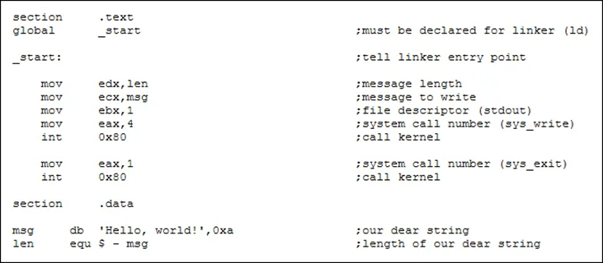
2nd generation
Assembly language (first in1947)
  Indented to communicate directly with computer hardware or to address critical performance issues;
  use mnemonic codes;
  requires a translator (assembler) to convert the assembly language program into machine language;
  language is detailed in the extreme
Jessie White. An Introduction to Assembly Language
https://medium.com/@jleveewhite/an-introduction-to-assembly-language-8144ce1dfb0e

Slide 10
3rd generation
High level
  starting from 1960s
  COBOL, BASIC, FORTRAN, Python, JS, C#, Perl, PHP, Ruby, Java, etc.
  strong abstraction from the details of the computer (variables, arrays, objects, loops, threads, functions, etc. rather than registers, memory addresses and call-stacks)
  making the process of developing a program simpler and more understandable
  compiled or interpreted

Slide 11
4th generation
Very high level
  designed to reduce the complexity (and time, effort and cost) and amount of source code required to create a program
  non-procedural, results-oriented, about 10 times more productive than 3GLs, easy to read and change, min training,
  SQL

Slide 12
5th generation
Natural languages
  based on solving using constraints given to the program rather than using an algorithm written
  Ill-defined, sometimes referred to as knowledge-based languages, because natural languages are used to interact with a base of knowledge on some subject
  Mercury, Prolog, OPS5

Slide 13
History of visual programming
1921
Introduction of flow process chart
Adapted from: https://www.outsystems.com/blog/posts/what-is-visual-programming/
1949
Goldstein and Von Neuman apply flowcharts to describe computer programs
1960
Sutherland creates Sketchpad to show that computers can model objects with physical characteristics that interact with each other
1975
Smith creates Pygmalion visual PL to bridge the difference between a human’s mental model of a problem and the computer’s state
PC arrives and computing becomes mainstream
Acadia Uni notes that diagrams describing the flow of a comp program is clearer to read than the code itself
Prograph visual language becomes available for Apple Mac
1980
Several visual programming experiments: CanDo for Amiga and HyperCard for Mac
Software solves ever more complex problems
Application become too complex to be represented visually
Visual programming splits into branches:
Games and education
Multimedia
business
1990s

Slide 14
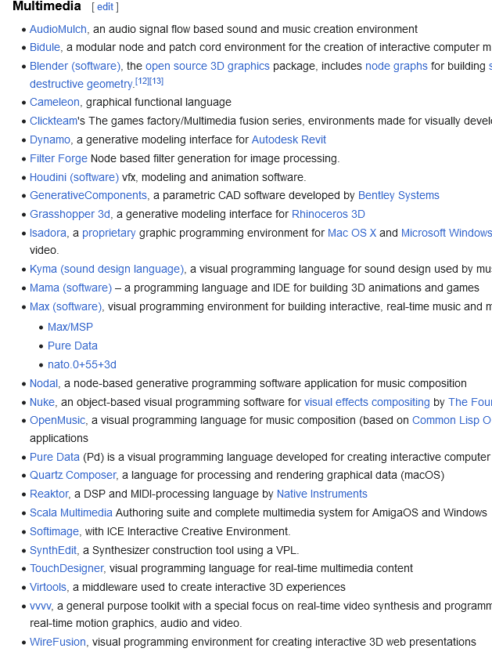
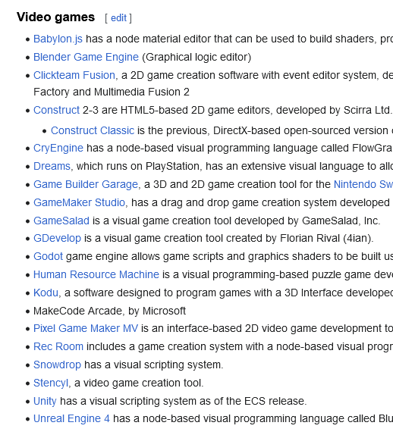
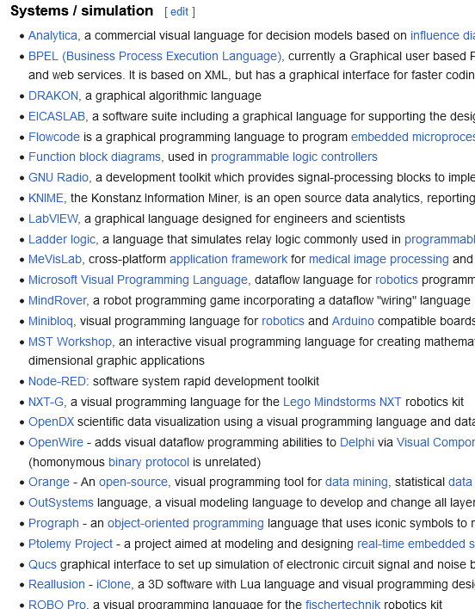
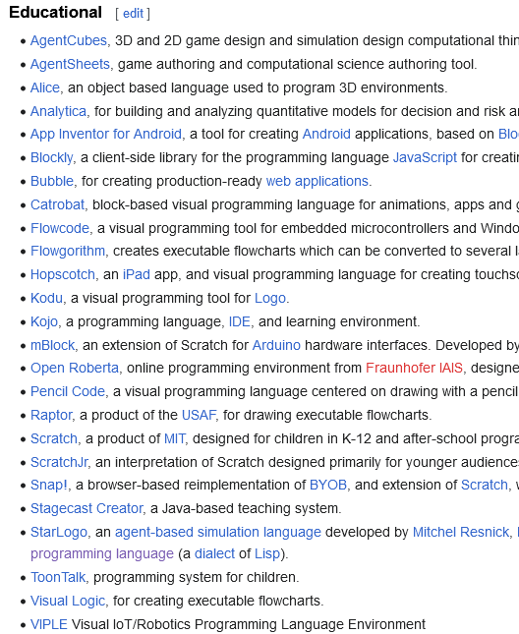
Visual Programming
lets users create programs by manipulating program elements graphically rather than by specifying them textually (4)
Very many platforms. Wikipedia has a list of:

Slide 15
Low code paradigm
Development platforms or applications which provide GUI for programming
Fast and minimized hand-coding efforts
Drag-and-drop interface
Low code development platforms contain the features of visual modeling, drag-and-drop interfaces, mobility, security, and scalability
Often used by professional developers within an enterprise IT department

Slide 16
No-code or zero-code
Requires few, if any, programming skills to quickly build an application
Offers an abstraction layer over code
Drawbacks:
  Application integration
  The tradeoff for simplicity and ease of use
When to use:
  Business process automation (HR, Workfrow, KPI, etc.)
  Web apps
  Mobile apps

Slide 17
Programming Process
Problem statement
Planning the solution
Code the program
Test and debug the program
Document the program

Slide 18
Pseudocode
Language agnostic
English-like nonstandard language that lets you state your solution with more precision than you can in plain English but with less precision than is required when using a formal programming language
permits you to focus on the program logic without having to be concerned just yet about the precise syntax of a particular programming language
pseudocode is not executable on the computer
When and where to use?

Slide 19
Tips
Sequence: we assume that computer executes a program from top to bottom (statement by statement)
Selection: if statement, a question – because more than one option available
Iteration: repeating steps
All statements showing "dependency" are to be indented. These include while, do, for, if, switch.

Slide 20
Sequence example
START
  OPEN fridge
  TAKE 2 eggs
  PUT frying pan on the stove
  TURN on the stove
  POUR oil on to pan
  BREAK 1 egg on the pan
  BREAK 1 egg on the pan
  FRY until done
  TAKE a plate
  PUT eggs on the plate
  ENJOY
END

Slide 21
Selection example
START
  DECLARE n
  INPUT n
  IF n>0 THEN
  OUTPUT n & “is positive”
  ELSEIF n==0 THEN
  OUTPUT n & “is equal to 0”
  ELSE
  OUTPUT n & “is negative”
END

Slide 22
Iteration
START
  DECLARE n, m, i, sum
  INPUT n
  ASSIGN sum=0
  FOR 1 to n
  INPUT m
  ASSIGN sum=sum + m
  ENDFOR
  OUTPUT “sum of “ & n & “ entered numbers equals to “ & sum
END

Slide 23
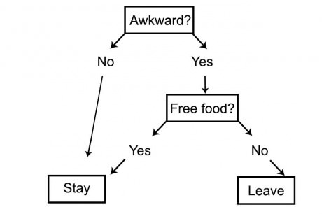
Flowchart
pictorial representation of a step-by-step solution to a problem
arrows representing the direction the program takes
boxes and other symbols representing actions
generally, flowcharts flow from top to bottom and left to right
the current standard, ISO 5807, was revised in 1985
When and where to use?
From: https://9gag.com/gag/amXAzv6

Slide 24
Common symbols
Arrow: process order
Terminator: Elongated circles, which signify the start or end of a process.
Process: A rectangular flow chart shape indicating a normal process flow step (instructions or actions).
Decision: A diamond flow chart shape indication a branch in the process flow. decisions that must be made
Connector: A small, labeled, circular flow chart shape used to indicate a jump in the process flow.
Data: A parallelogram that indicates data input or output (I/O) for a process.
Preparation: for iterative process
Function: predefined function or subprogram

Slide 25
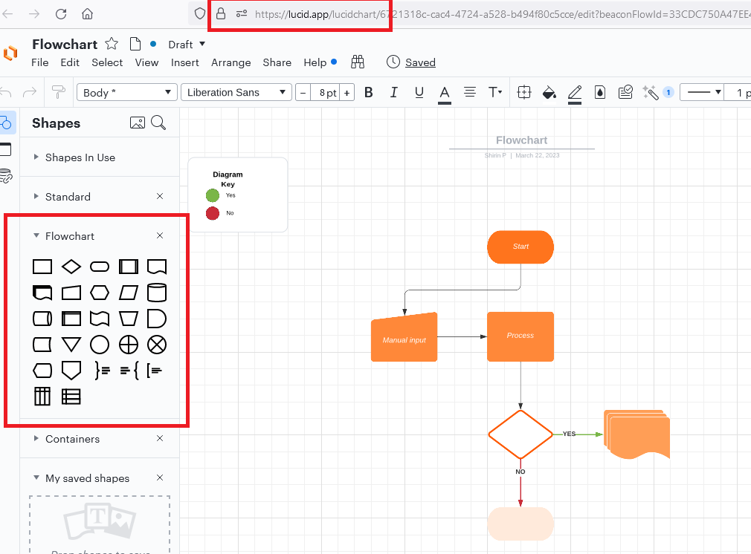
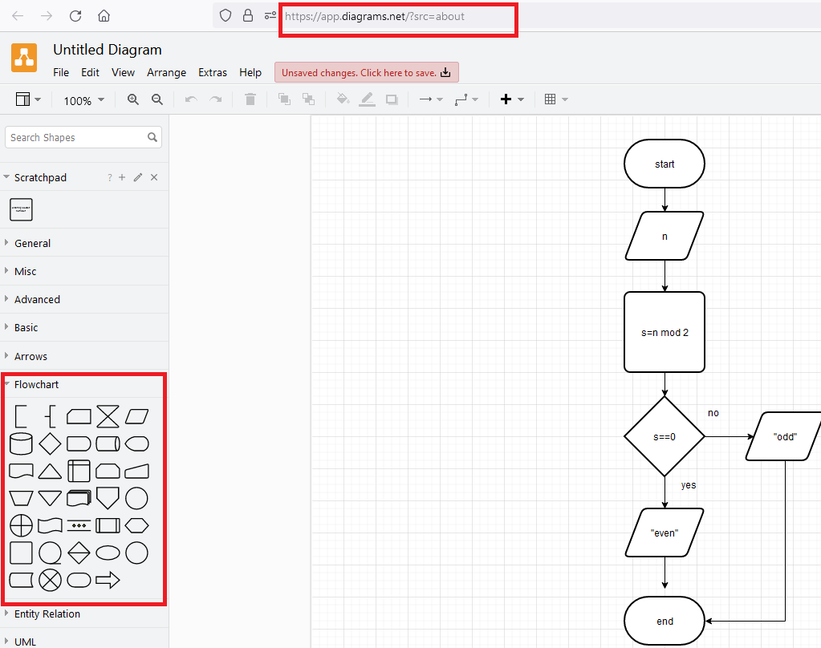
Online tools
Lucidchart.com
Diagrams.net

Slide 26
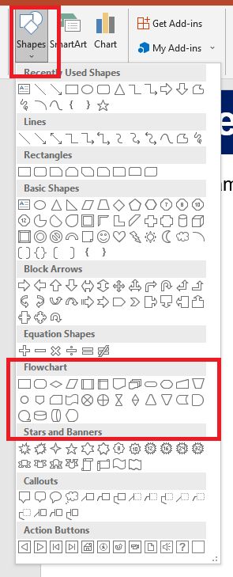
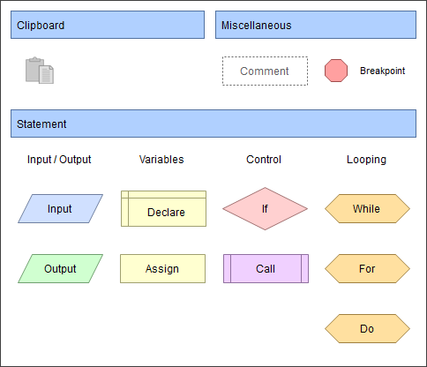
Software tools
MS office programs 🡪 Insert🡪Shapes🡪Flowchart
Flowgorithm

Slide 27
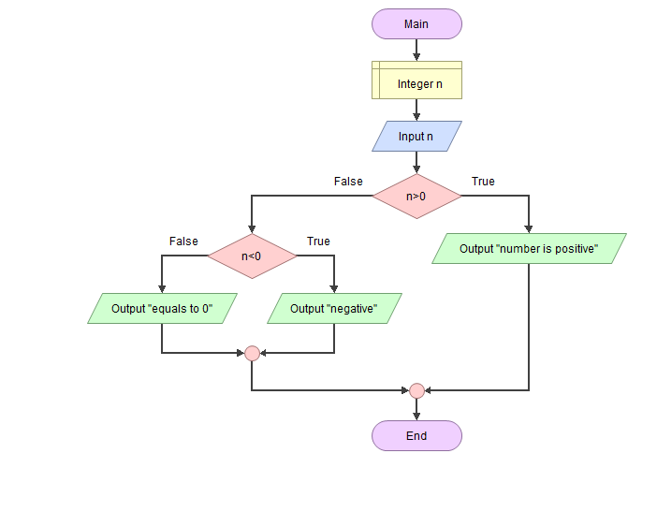
Example 1
Define if number is positive or negative.

Slide 28
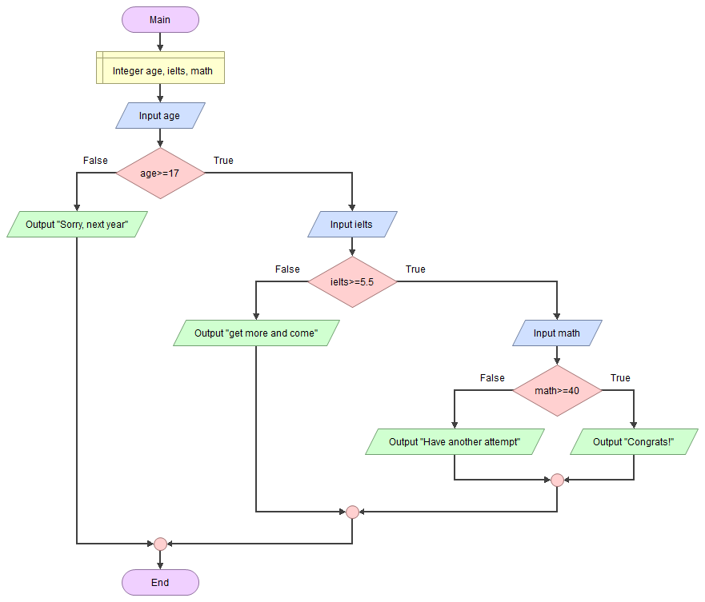
Example 2
Eligibility to study on CIFS

Slide 29
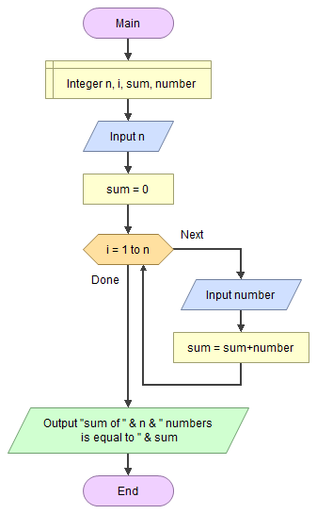
Example 3
Calculate sum of n numbers

Slide 30
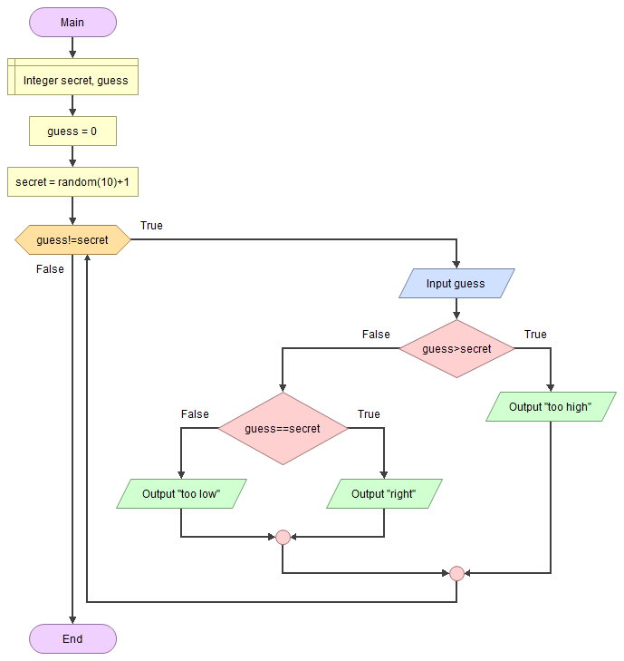
Example 4
Guess the number

Slide 31
References
https://medium.com/@jleveewhite/an-introduction-to-assembly-language-8144ce1dfb0e
https://www.techopedia.com/definition/9918/very-high-level-language-vhll
https://www.mylearningmania.com/2018/06/fifth-generation-language-5gl.html
Jost, Beate; Ketterl, Markus; Budde, Reinhard; Leimbach, Thorsten (2014). "Graphical Programming Environments for Educational Robots: Open Roberta - Yet Another One?". 2014 IEEE International Symposium on Multimedia. pp. 381–386. doi:10.1109/ISM.2014.24. ISBN 978-1-4799-4311-1.
https://www.techtarget.com/searchsoftwarequality/definition/no-code
https://homepage.cs.uri.edu/faculty/wolfe/book/Readings/Reading13.htm
https://www.bbc.co.uk/bitesize/guides/z3bq7ty/revision/1
https://www.youtube.com/watch?v=xdzN_dGaehw
https://warren2lynch.medium.com/a-comprehensive-guide-for-flowchart-over-50-examples-785d6dfdc380
https://www.outsystems.com/blog/posts/what-is-visual-programming/
https://www.outsystems.com/blog/posts/low-code-vs-no-code/
https://docs.unity3d.com/bolt/1.4/manual/bolt-states.html
https://creately.com/blog/diagrams/part-1-15-mistakes-you-would-unintentionally-make-with-flowcharts/

