Slide 1
Visual Programming
Introduction to Unity DE. Game objects and materials. Basic concepts

Slide 2
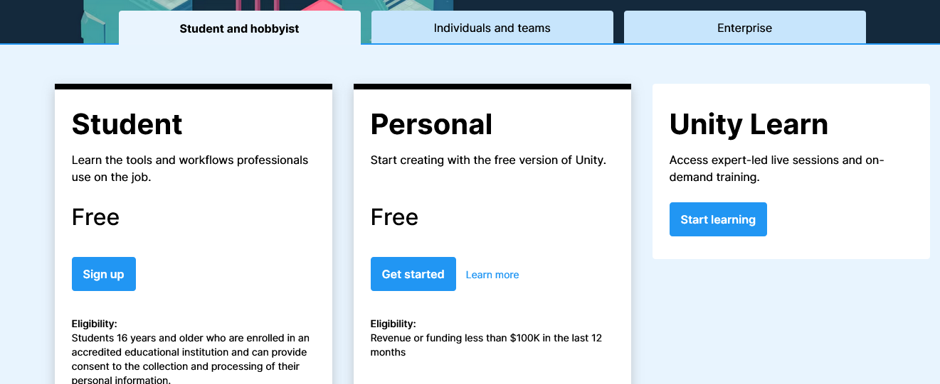
Get started with Unity
1. Choose your plan and get registered on Unity.com

Slide 3
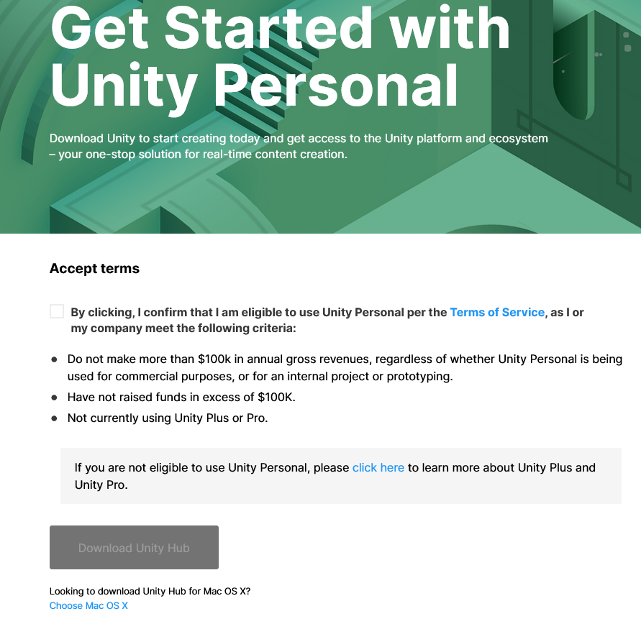
Download and install Unity Hub
From store.unity.com
Unity Hub is tool for managing the projects
System requirements for Unity 2021.1.20
Released: 9 September 2021
OS: Windows 7 SP1+, 8, 10, 64-bit versions only; macOS 10.12+; Ubuntu 16.04, 18.04, and CentOS 7.
GPU: Graphics card with DX10 (shader model 4.0) capabilities.

Slide 4
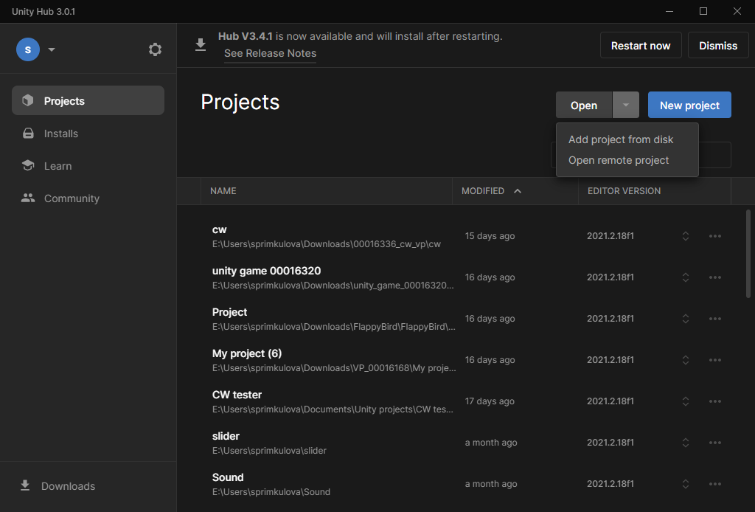
Unity Hub – Project tab
Project tab
You will work with multiple projects
You can
  Create
  Import project from disk
  Open remote project

Slide 5
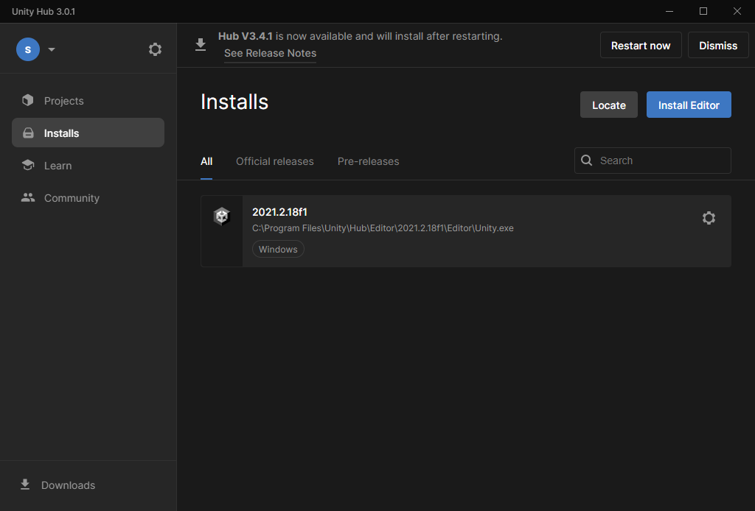
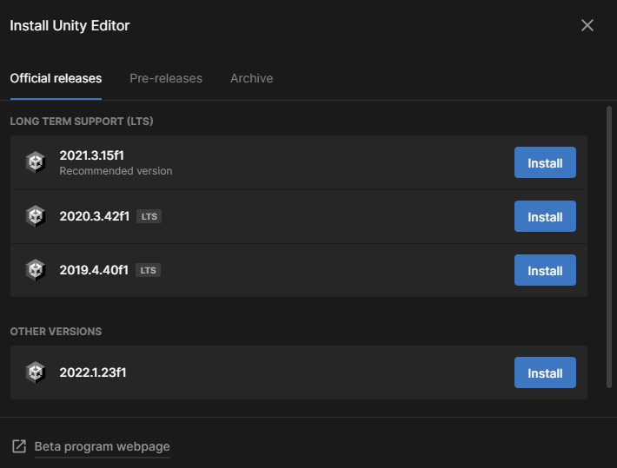
Unity Hub – Installs
Install Unity Editor
Control editors' versions

Slide 6
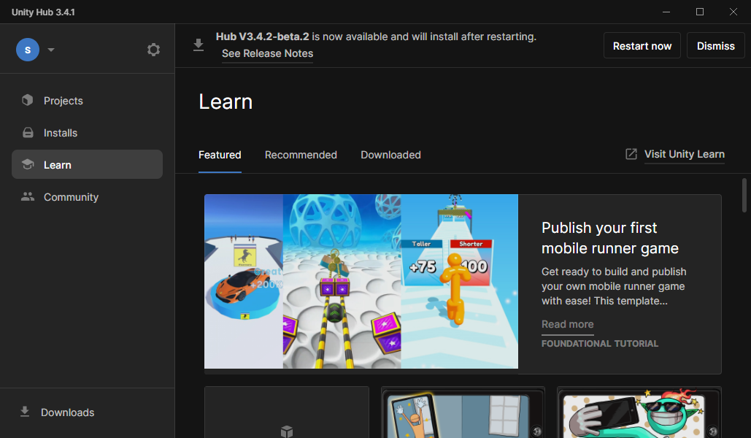
Unity Hub – Learn
You can find Featured, Recommended and Downloaded courses from Unity Learn.
You can also find those courses on learn.unity.com

Slide 7
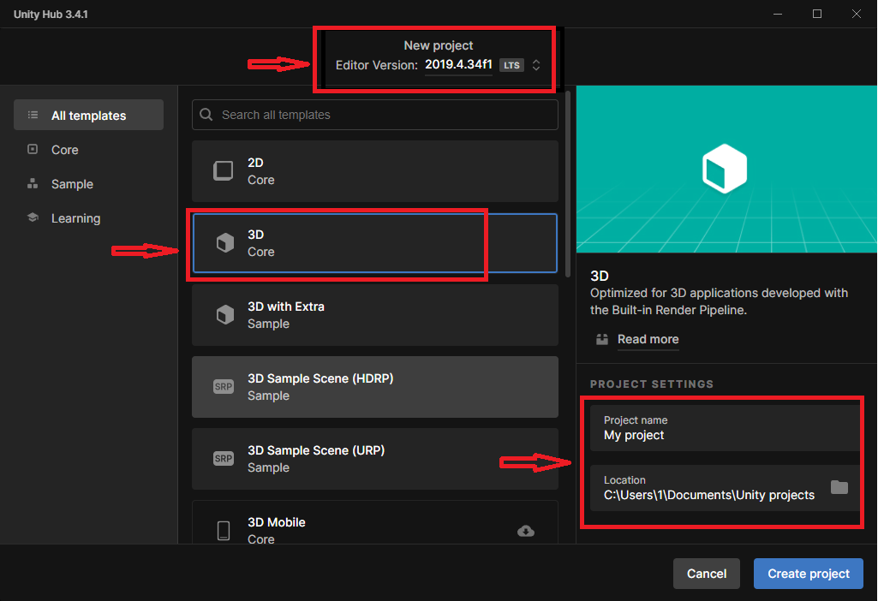
Create a new project
Once you install Unity editor, you can create a project.
Go to Project tab and click New Project.
For every project you should choose
  Editor version
  Template
  Project name
  Project location

Slide 8
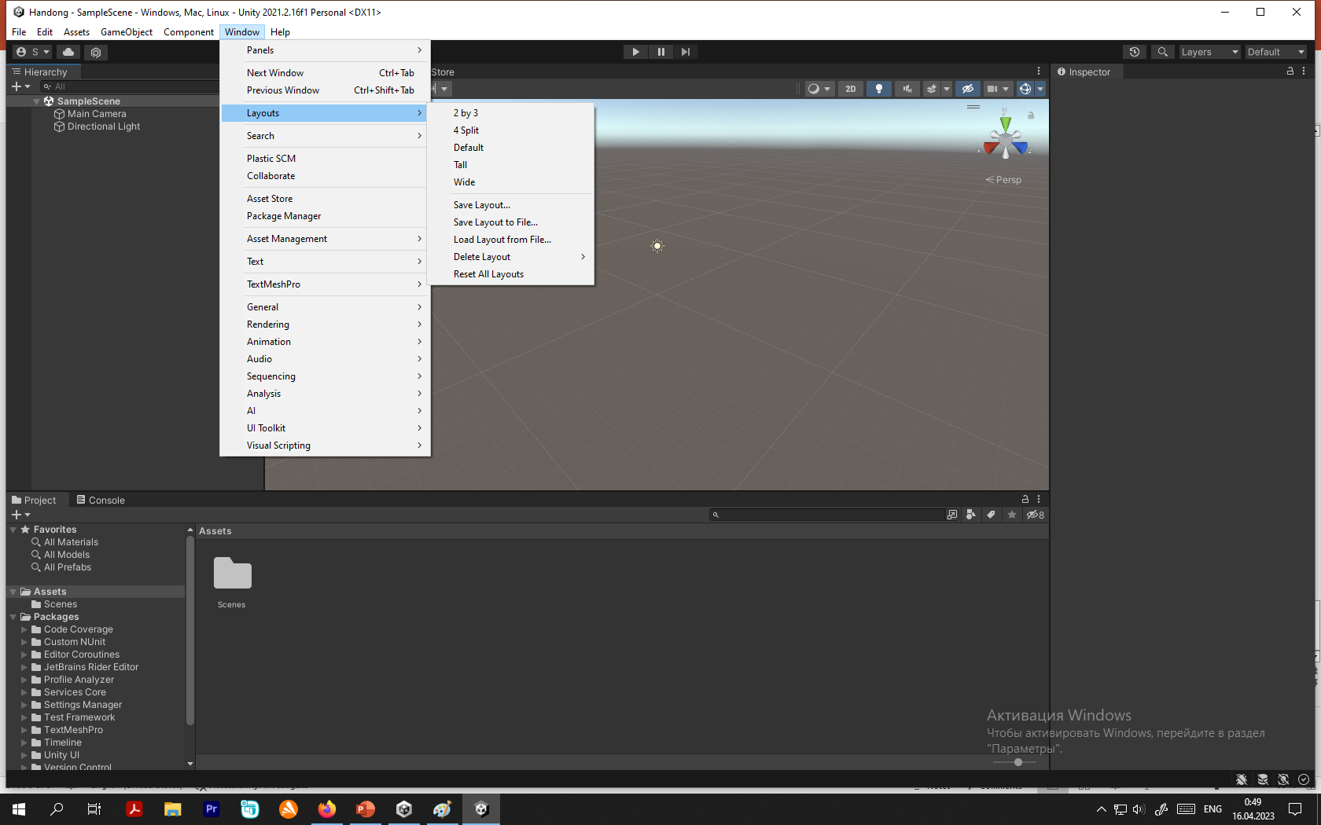
Layout
You see the tabs
  Hierarchy
  Scene
  Game
  Asset Store
  Inspector
  Project
  Console
  Profiler
  Animation
All tabs can be dragged and positioned to the place you like.
To bring layout to default view or to set your favorite layout, go Window - Layout

Slide 9
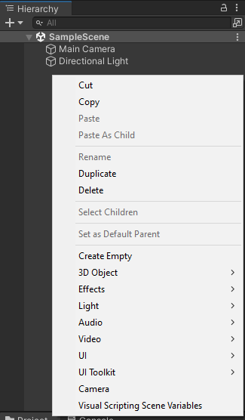
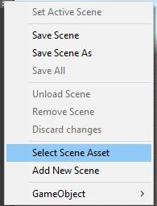
Hierarchy
Can add, unload, remove and discard Scenes
Shows all objects of selected scene
Can add, rename, delete objects

Slide 10
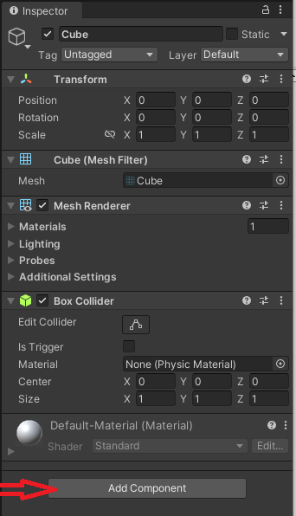
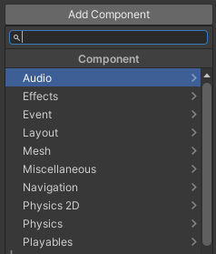
Inspector
Having selected object in Hierarchy tab or on Scene, there will be Inspector tab, which will show all properties and components of selected object.
Default properties (any of them can be added if missed in initial load):
  Transform
  MeshRenderer
  BoxCollider
  Material
To add any component – click Add Component

Slide 11
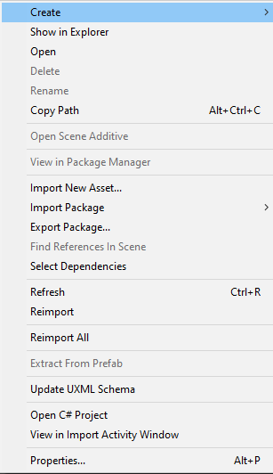
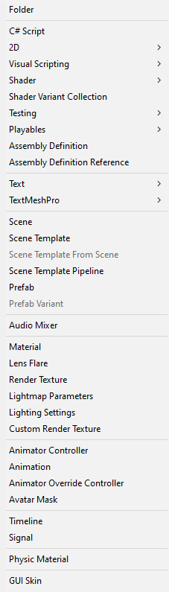
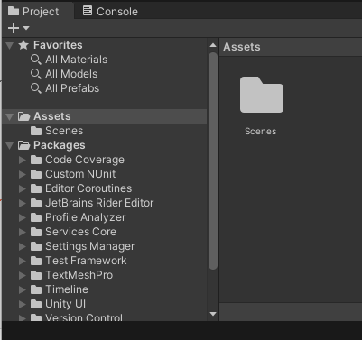
Project and Console
Project tab shows all depended folders and resources.
Assets tab – can import/export packages, add objects, scripts, materials, etc.
Assets tab – shows everything what is used in current project
Console tab is used to communicate errors to developet

Slide 12
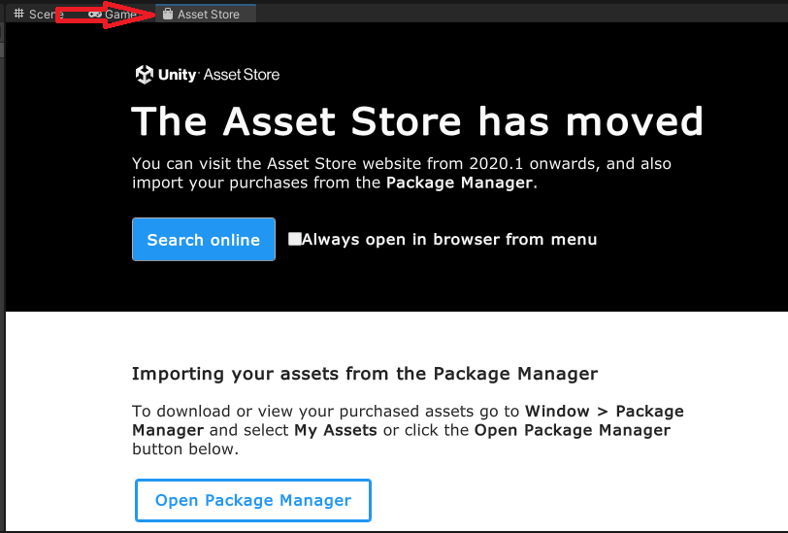
Asset store
Through Asset Store you can search and import free or paid assets or packages, which will aid to your project through rich visual or audial objects or materials or components.

Slide 13
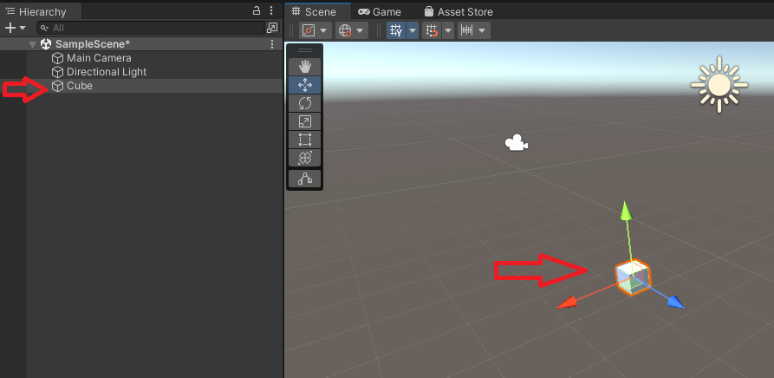

Scene 1
One of the main tab. All game design is taken place in this place.
Selecting object in the Scene, will select it in Hierarchy and vice versa
The best way to position objects is to change Transform property in Inspector, but also can be done in Scene itself using Tools.

Slide 14

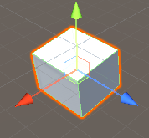
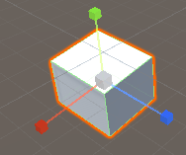
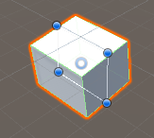
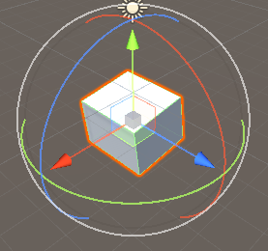
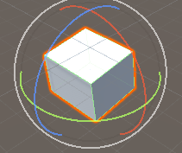
Scene 2
Tools
  1 - View tool
  2 - Move tool
  3 - Rotate tool
  4 - Scale tool
  5 - Rect tool
  6 - Transform tool
  7 - Edit bounding volume
View tool:
1. Mouse Scroll
2. Alt + Mouse Scroll
3. Context menu Scroll
Move tool
Scale tool
Rect tool
Transform tool
Rotate tool

Slide 15
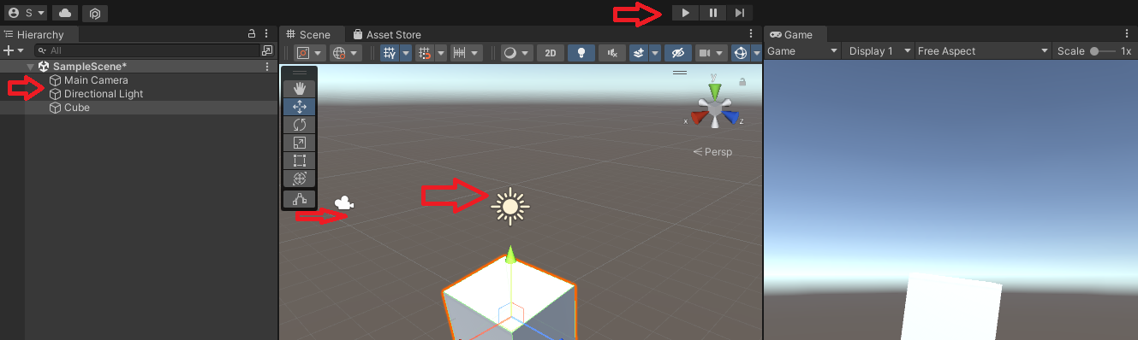
Game
Make sure you have Camera and Directional light in Hierarchy. If not, add them.
Game tab will show everything what Main Camera sees. Make sure you put elements in right place
There are three buttons to test your game play. Play button should be pressed to switch to game mode.
You can change: aspect ratio, display and scale.

Slide 16
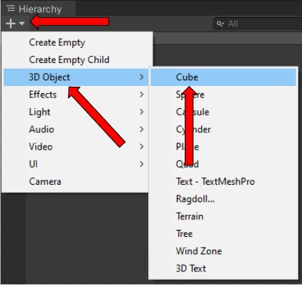
Example. Ball rolling game
1. Create a new project
2. Select 3D template
3. Add camera (if it was not added automatically)
4. Add cube

Slide 17
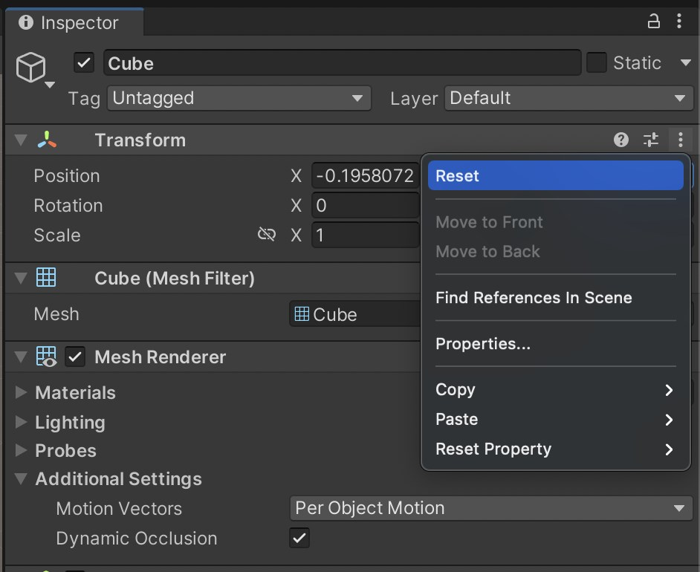
Transform position reset
Double check values of the cube so they are at 0,0,0 position. You can Reset the values by pressing this icon
Select each object in the hierarchy. See how the selected object is highlighted on the Scene. Explore the changes in the Inspector tab. Formulate the definition of purpose of Inspector tab.

Slide 18
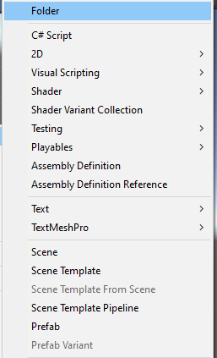
Creating folder
Create folder in project files “Scenes”
Save current scene as “Main” in folder created (File -> Save Scene as…). Explore the hot keys for the operation.

Slide 19
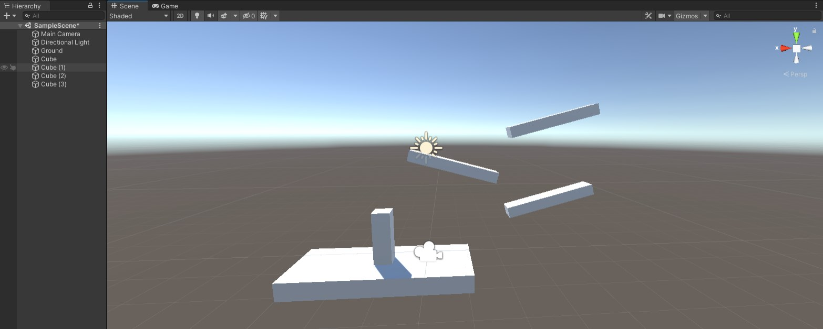
Building the level
Build a level using cubes and changing their scale values:

Slide 20
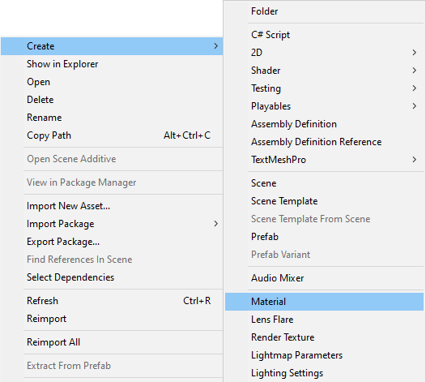
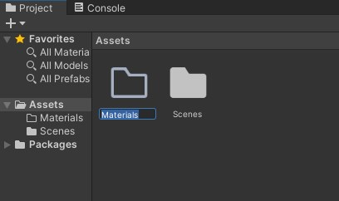
Materials
Create folder in Project tab and name it “Materials”
Open created folder and create a Material and name it “Ground”

Slide 21
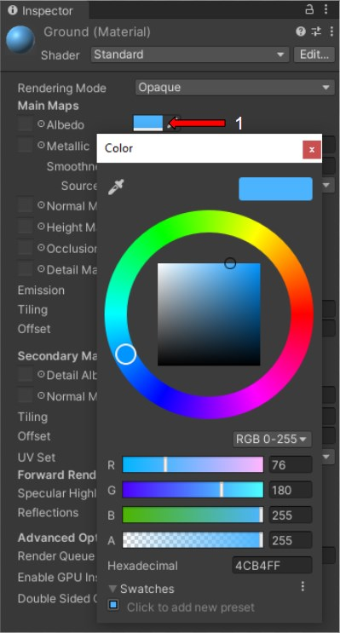
Materials
Choose created material and set the color of material to any color

Slide 22
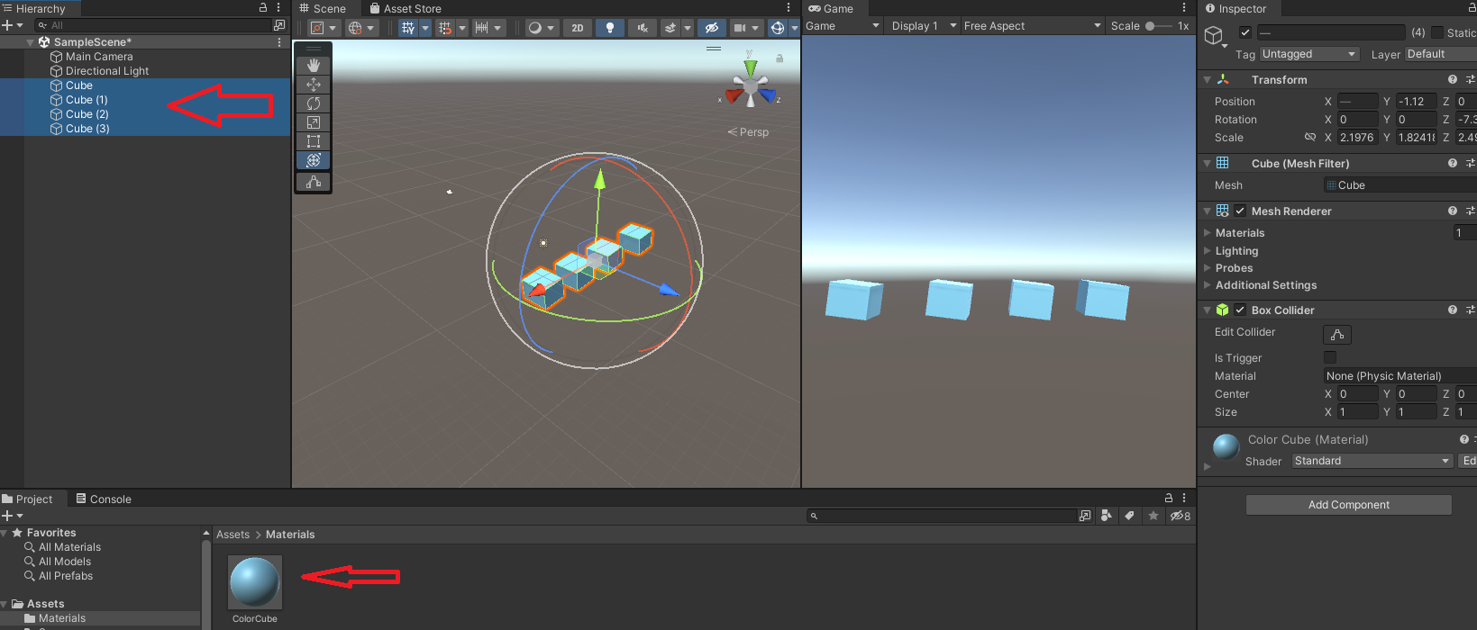
Materials
Drag and drop Material to all cubes in the hierarchy tab

Slide 23
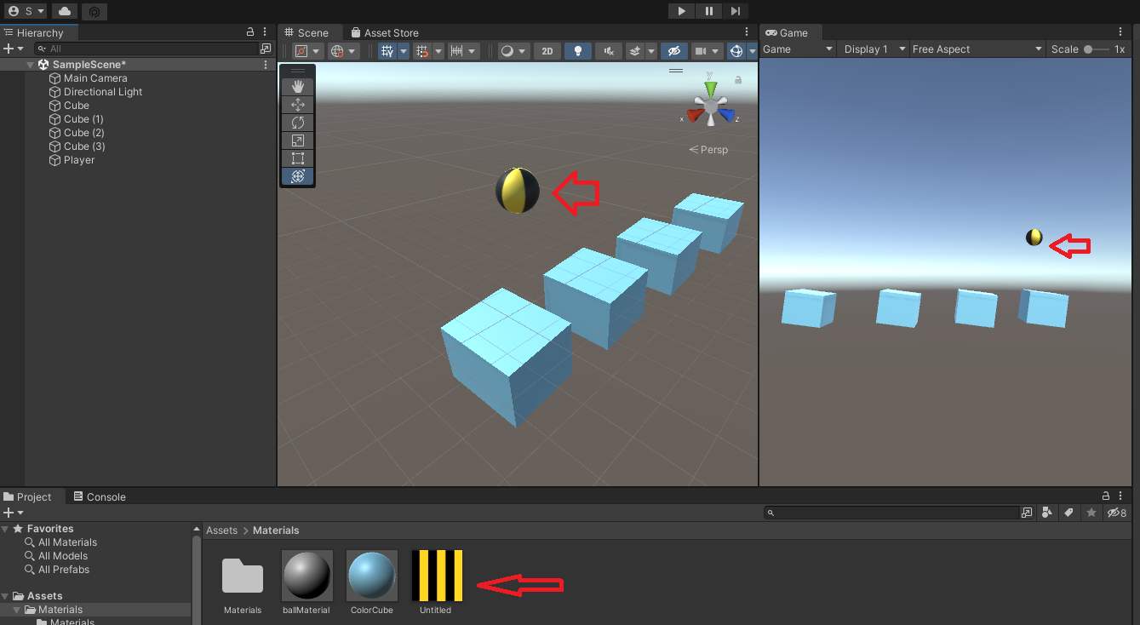
Ball
Create a Sphere object and name it “Player”
Import any stripe pattern image to Assets - Material folder.
Drag and drop imported image to ball, so ball will be stripped.

Slide 24
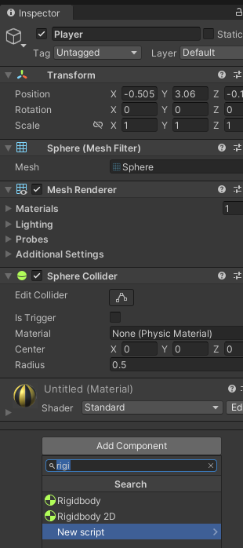
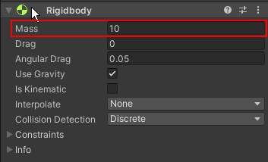
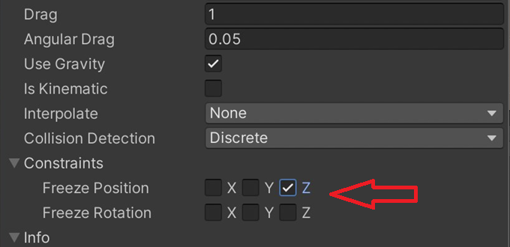
Rigidbody
Select your player and in the Hierarchy tab - add component “Rigidbody”
Set Mass of sphere to 10
Add Constraints to Z axis. It will keep the Ball straight by Z axis
Rigidbody allows a GameObject to react to real-time physics.
This includes reactions to forces and gravity, mass, drag and momentum.

Slide 25
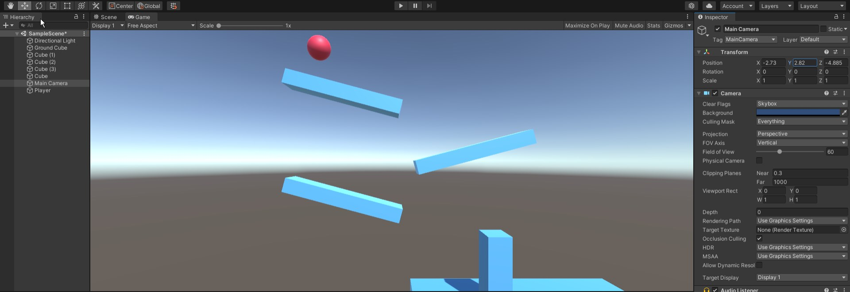
Camera
Change camera position so the ball is visible with level in game tab
You can use scene Transform tools or input values in Transform component in the Inspector tab.

Slide 26
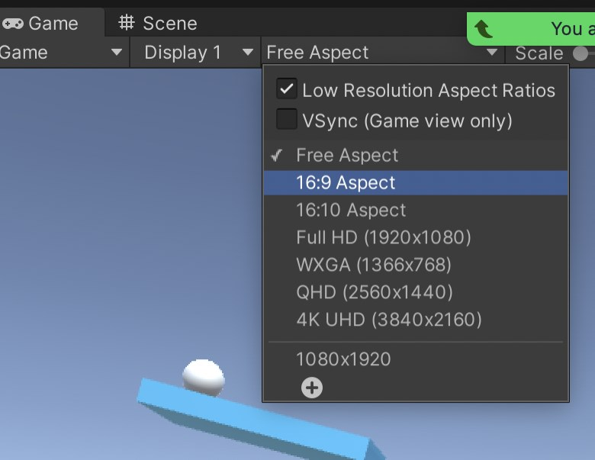
Aspect Ratio
Change Aspect Ratio to 16:9 in Free Aspect Tab

Slide 27
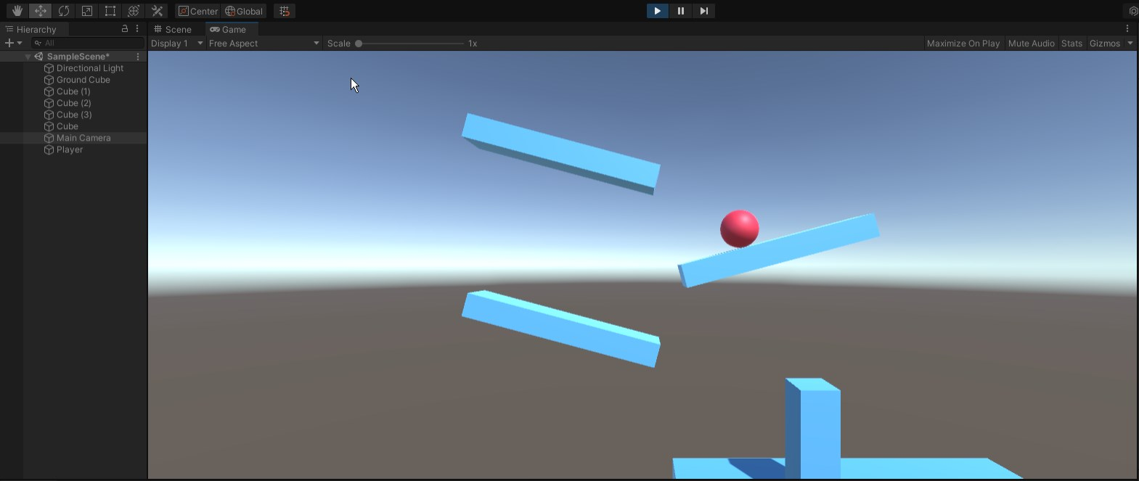
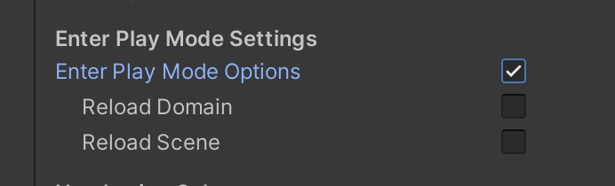
Play mode
Activate Play Mode to test physics
Play Mode Activation Speed. Go to Edit - Project Setting - Editor and check this box for faster load times of Play Mode

Slide 28
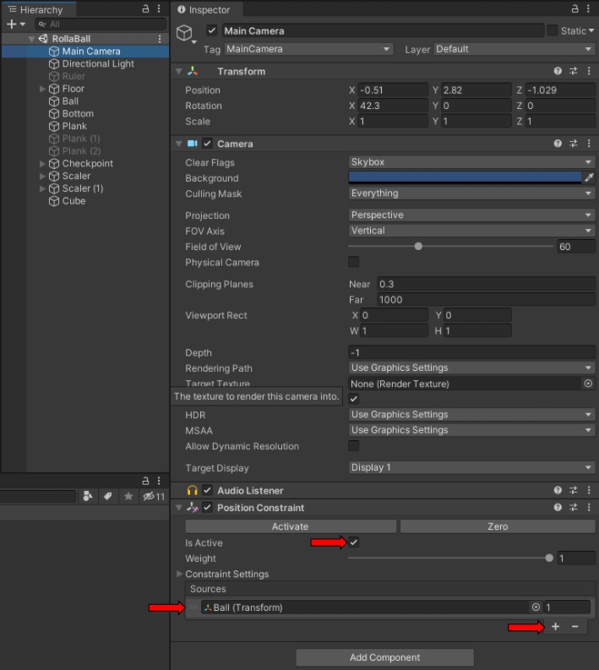
Position Constraint
To make your camera follow the movement of your Player do the following:
  Select the Main Camera and add the “Position Constraint” component in Inspector Tab.
  Click on plus button in “Sources” list and add player transform by drag and dropping it from hierarchy:

Slide 29
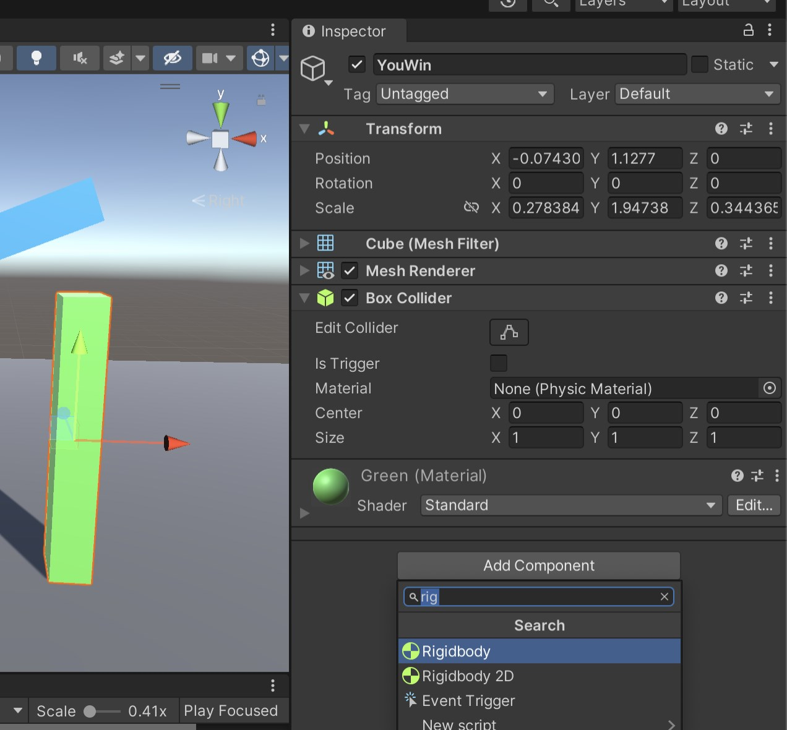
Making YouWin object
Rename the vertical rectangle as YouWin.
Create and attach green colored material to the it
Add Rigidbody component to YouWin object

Slide 30
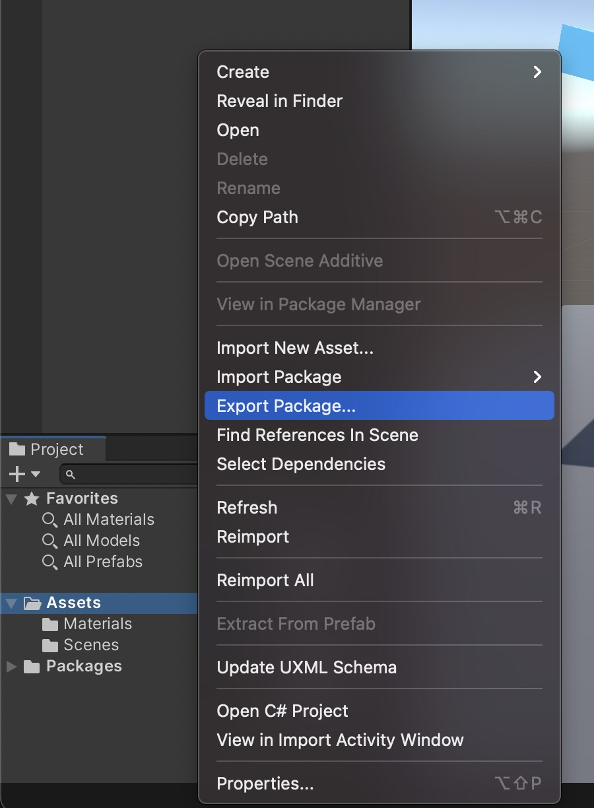
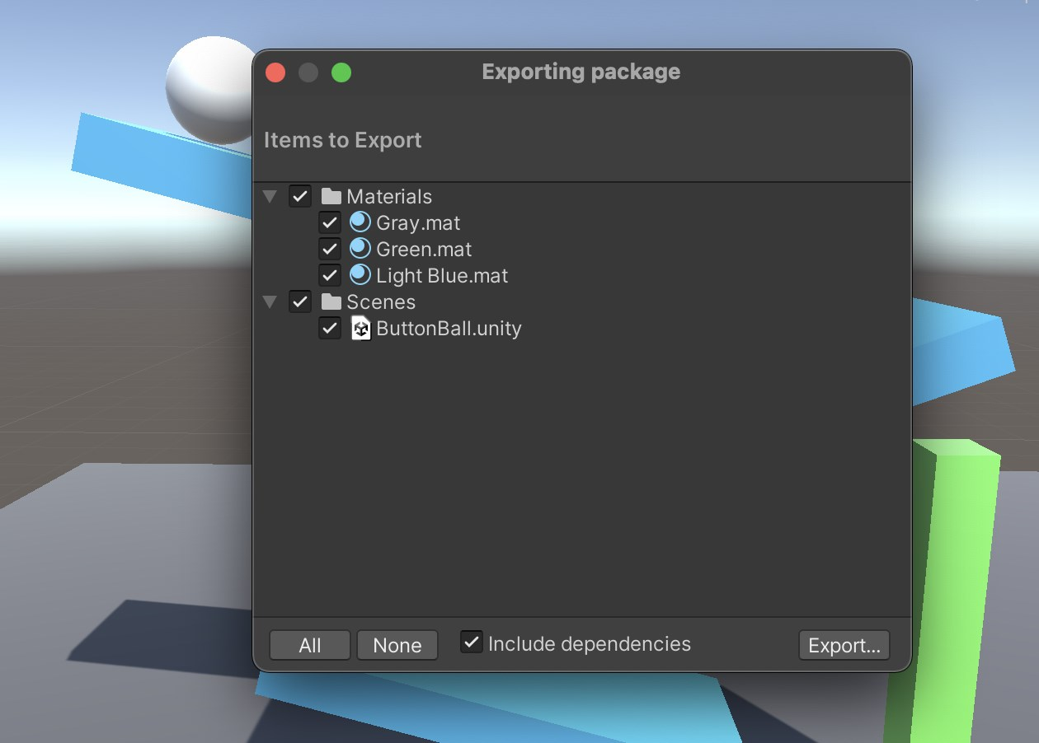
Export Package
Right click on Assets folder in Project Tab and select Export Package
Press export in the new Popup window
Select destination
Exported Package will appear in selected folder

Slide 31
References
Unity.com
store.unity.com
learn.unity.com

