Slide 1
Lecture 3.
Types and variables. Scope. Graphs, Machines and Macros

Slide 2
Visual Scripting vs Bolt
2021 vs 2020-2019
Differences:
2021 | 2020-2019
Default component | Import via Asset store
Script machine (Graph) | Flow machine
State machine (Graph) | State machine
Graph | Macro

Slide 3
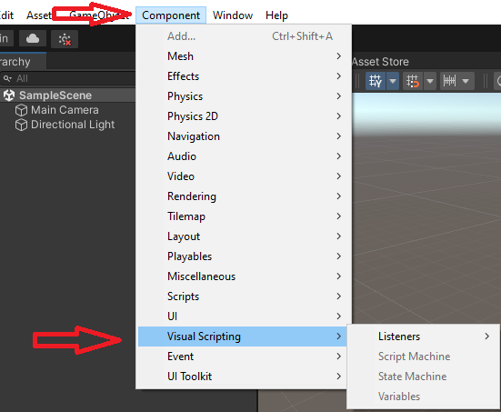
Visual Scripting
It is one of Unity Components
Visual scripting is a graphical way to manipulate objects and behaviors in Unity without writing code from scratch. (1)
Provides a visual representation of the node graph and how events trigger within it. (2)
Features
  Script machines
  State machines
  Live editing
  Debugging and analysis
  Codebase compatibility
2. https://www.noodl.net/post/visual-scripting-how-noodl-was-inspired-by-the-world-of-game-engines
1. https://unity.com/features/unity-visual-scripting

Slide 4
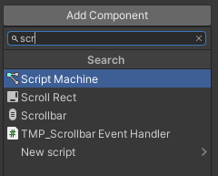
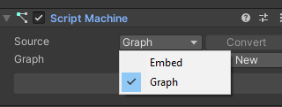
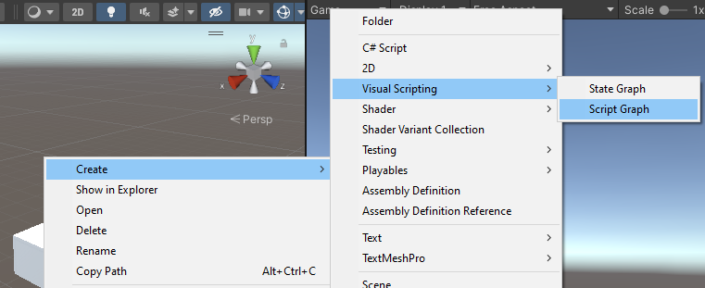
Script machine
A Script Machine is a GameObject component
Script Machines can either link to a graph asset, or they can contain an embedded Script Graph asset.
To create a Graph you can:
  press New in Script machine
  In Assets – Create – Visual Scripting - Script graph

Slide 5
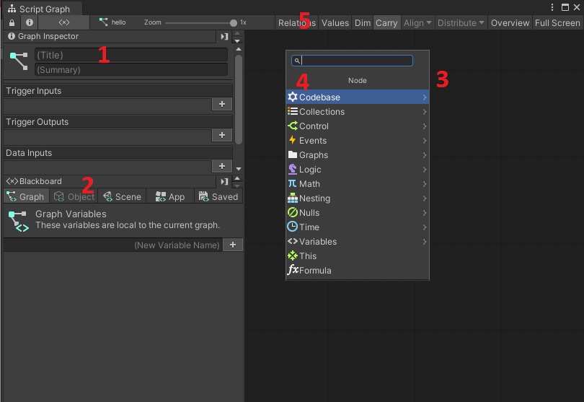
Graph interface
Graph Inspector – gives detailed information and additional configuration of the graph
Blackboard – where you define and edit variables
Graph Editor – where you place nodes and create, edit, arrange logic flows.
Fuzzy finder – helper where you can find needed nodes
Toolbar – provides different settings specific to the view of Graph Editor

Slide 6
Embed vs Graph
Graph is a visual representations of the logic in an application
Script graphs - control and connect specific actions and values.
Graph | Embed
A file, located in Assets | Contained directly inside the GameObject
Can be used for several objects | Belongs only to one object
Modifications made during play mode will stay | Modifications made during play mode will be lost

Slide 7
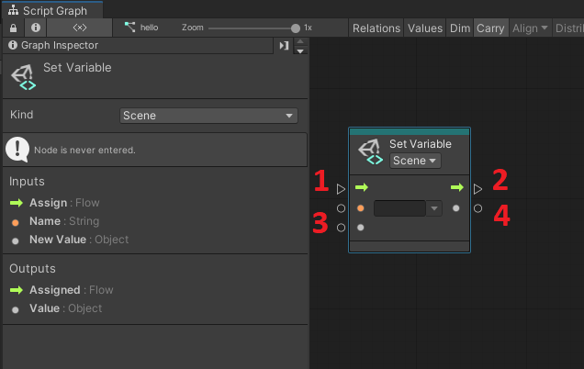
Nodes / Units
Can be added through Fuzzy Finder (right mouse click in Graph Editor)
Come with Input/Output ports:
  Control Input: Entry point to execute logic in the unit.
  Control Output: Trigger the next action connected to this port.
  Value Input: Any kind of data you want to pass to your unit.
  Value Output: Any kind of data you want to pass outside your unit.

Slide 8
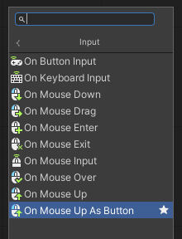
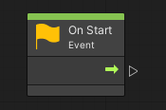
Creating flow
To connect nodes, simply drag Control output port from one Node to Control Input port of another Node.
To pass the value, connect Value output port from one Node to Value Input port of another Node.
Normally the flow starts on some kind of occasion – Event, which serves as a trigger for execution of the logic of the flow. Events do not have Control Input.
Logic controls may have logic input or output port.

Slide 9
Variables
Named space in memory
  Name should start from letter, can include numbers and underscore. Avoid other symbols.
Stores information that might change - value
Has data type, which defines how much memory should be allocated for potential value
Can be visible and accessible only with certain scope

Slide 10
Data Types
They are very many, but you need to be familiar with most common ones (1)
Type | Description
Float | A number with or without decimal values, like 0.5 or 13.25.
Integer | A number without any decimal value, like 3 or 200.
Boolean | A value that can only be either true or false. Commonly used in logic or in toggles.
String | A piece of text, like a name or a message.
Char | One single character in a string, often alphabetic or numeric. Rarely used.
Enums | There are many enums. Each one is a finite enumeration of options that are often seen in dropdowns. For example, in Unity, the "Force Mode" enum can be either "Force", "Impulse", "Acceleration" or "Velocity Change".
Vectors | Vectors represent a set of float coordinates, for example for positions or directions. There are 3 vectors in Unity: Vector 2, with X and Y coordinates for 2D; Vector 3, with X, Y and Z coordinates for 3D; Vector 4, with X, Y, Z and W coordinates, rarely used.
GameObject | Gameobjects are the base entity in Unity scenes. Each game object has a name, a transform for its position and rotation, and a list of components.
Lists | A list is an ordered collection of elements. The elements can be of any type, but most often, all elements of a list must be of the same type. You can retrieve and assign each element in a list by its zero-based index (position).
Dictionaries | A dictionary is a collection in which element has a unique key that maps to its value. For example, you could have a dictionary of age (integer values) by name (string key). You can retrieve and assign each element by its key.
Object | "Object" is a special type. Like we said, every other type is also an object. But when you see, for example, that a node asks for an object, it usually means that it doesn't care about the type of that object.

Slide 11
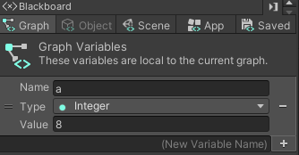
Scope
Kind | Description
Flow Variables | Flow variables which are the equivalent to local variables.
Graph Variables | Graph variables are local to an instance of a flow graph. They have the smallest scope and cannot be accessed or modified outside their graph.
Object Variables | Object variables belong to a game object. They are shared across all graphs on that game object.
Scene Variables | Scene variables are shared across the current scene.
Application Variables | Application variables persist even when the scene changes. They will be reset once the application quits.
Saved Variables | Saved variables will persist even after the application quits. Good example of use of them is best score in the games. Once best score is reached, it can be changed for another best score.
(1)

Slide 12
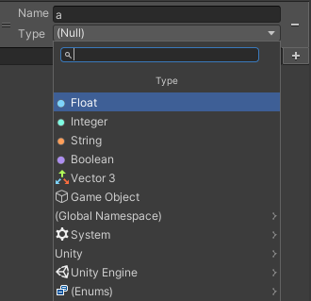
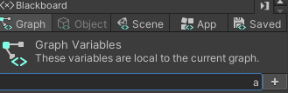

Creation
Open the graph for editing -> Go to Blackboard -> type the name of new variable
Press + sign -> select data type
Assign any initial value.
You may add as many variables as you wish. Just repeat the process.

Slide 13
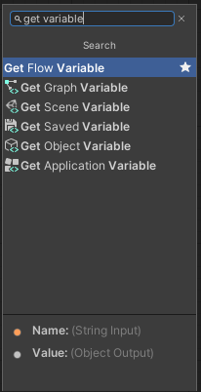
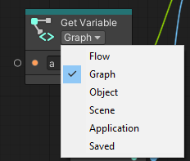
Reading variable’s value
To read variable’s value and use it in our program, we use Get Variable Unit.
Select the corresponding method
If mistakenly you chose not correct one, you can change the scope, clicking on drop down on GetVariable unit itself

Slide 14
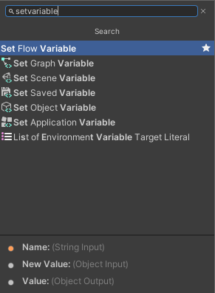
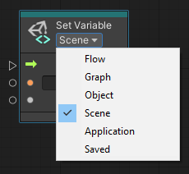
Writing variable’s value
To assign (change) value to a variable, find Set Variable in Fuzzy Finder
Select the corresponding method
If mistakenly you chose not correct one, you can change the scope, clicking on drop down on SetVariable unit itself

Slide 15
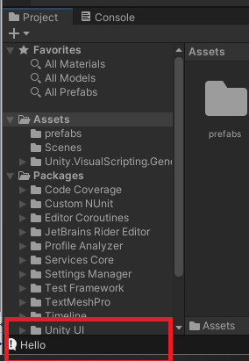

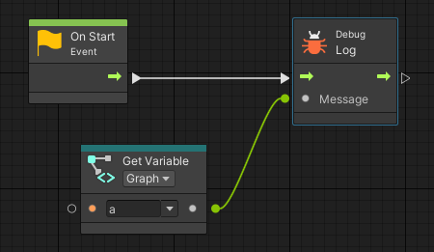
Example: String
Let’s create String variable and use its value in our program. The program will just writes the value of the variable out.
After running the program, we should check Console output log.

Slide 16


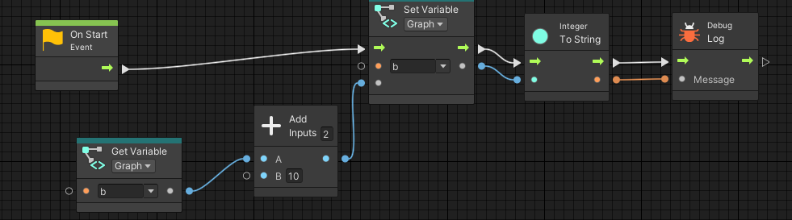
Example: Integer
Let’s create Int variable and use its value in our program. The program will increase the value of the variable by 10.
After running the program, we should check Console output log.
Pay attention to Integer to String Unit. We must explicitly convert the value from one datatype to another, to be able to print in the Message

Slide 17
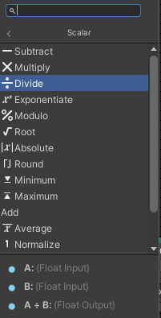
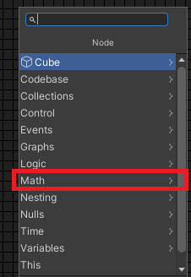
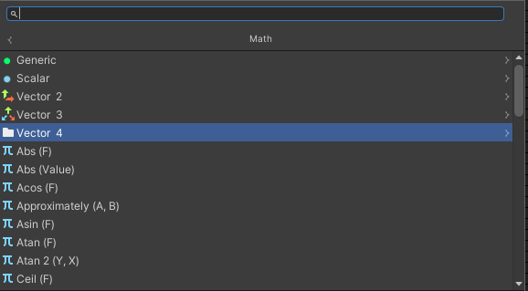
Mathematical functions
Can be found in Fuzzy Finder under Math category. It has 5 subcategories to work with Generic, Scalar, Vector 2, Vector 3 and Vector 4 datatypes.
In most cases, for simple mathematical calculations you will need Scalar subcategory.

Slide 18
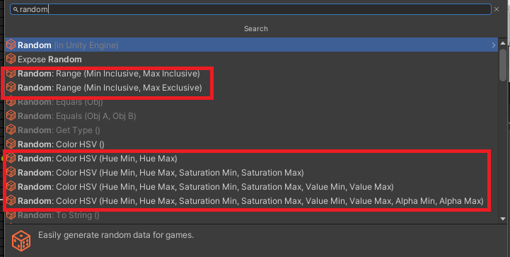
Random
You can generate Random number or Random color for your games. For this start typing Random in Fuzzy Finder
Random: Range – will generate number
Random: Color HSV () – color. There are several overloaded functions. You should select suitable one

Slide 19
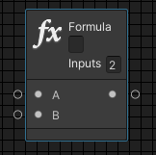
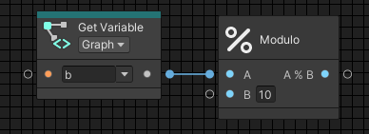
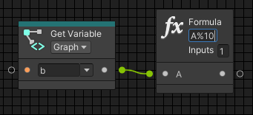
Formula
Formula unit can help substitute several math units.
You can change number of input parameters. It always has one output value – result of the formula. In formula place itself, you need to type the formula using A, B, etc., as parameters

Slide 20
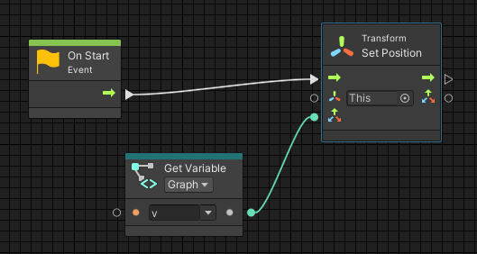

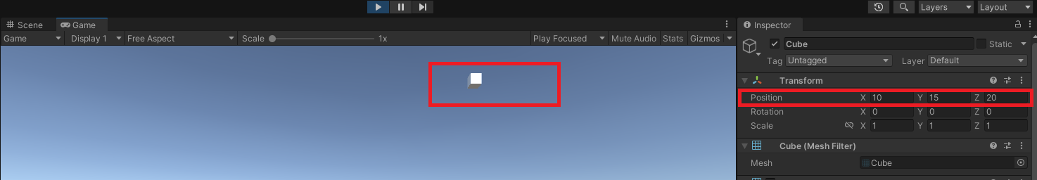
Example: Vector
Let’s create Vector variable and use its value in our program.
Assign some values for coordinates
Put the object in new location

Slide 21
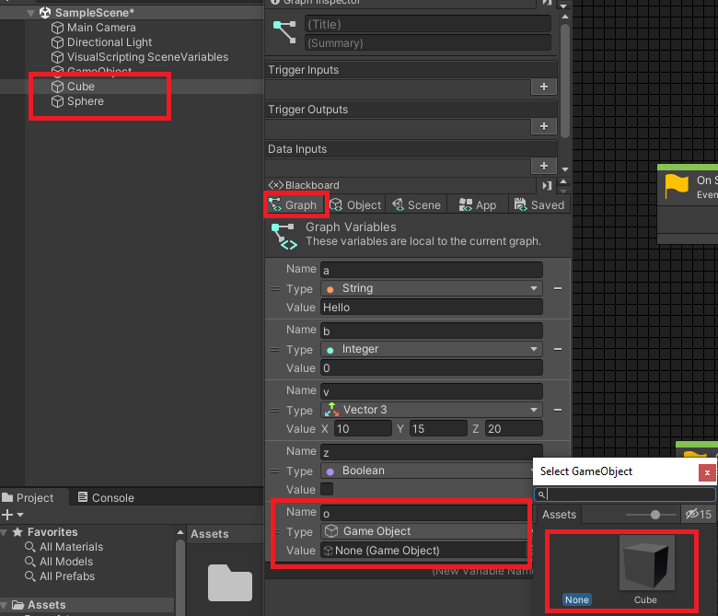
Example: GameObject
Every object which you add to Hierarchy or Assets is considered as Game Object. You can refer to any of the object or its component.
Scope of the variable is IMPORTANT!
Suppose, we have two objects: Cube and Sphere. We are working in Graph, which is attached to Cube’s Script Machine. If we create Graph level variable, we will not be able to find Sphere among available objects.

Slide 22
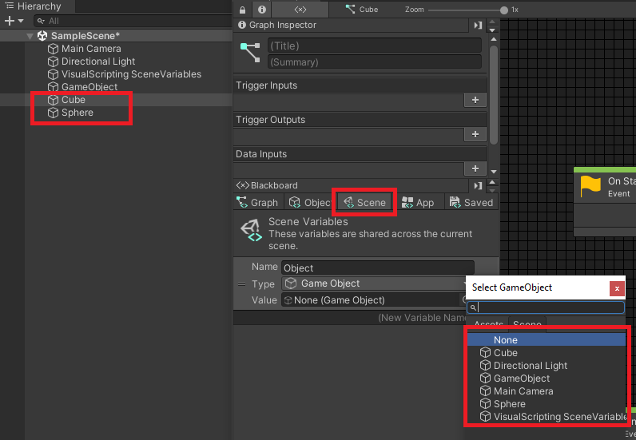
Example: GameObject
But, if we create Scene variable, we will be able to refer to Sphere.

Slide 23
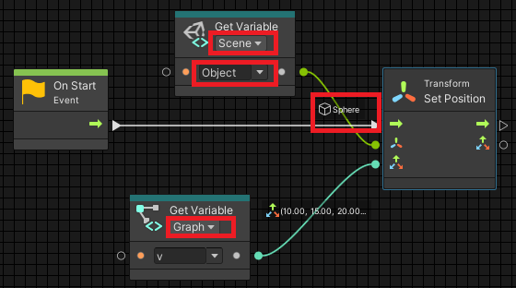
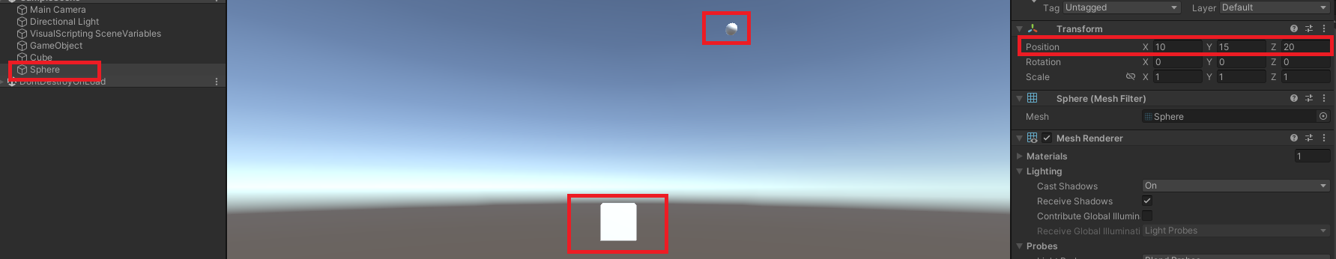
Example: GameObject
Change the position of Sphere in Graph attached to Cube’s Script machine

Slide 24
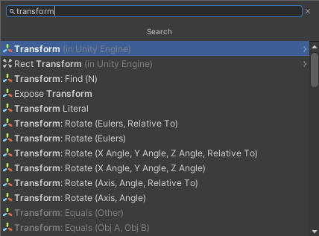
Transform
Transform is a component of the Object. It has several subcategories: Position, Rotation, Translate and Scale

Slide 25
Game example
Let’s create a game, which will randomly change the position and the color of the Cube every second.
If user clicks on the Cube – it should decrease its size for 20%.
  Calculate if one second passed from the beginning of the game and from last position change.
  Create a new vector for setting new position of the object. X and Y coordinates should be randomly generated, but they should be within some range, so we still can see them on the screen.
  Random color should be generated and assigned to the object.
  Check if the object is being clicked on, and if yes, decrease its size.

Slide 26
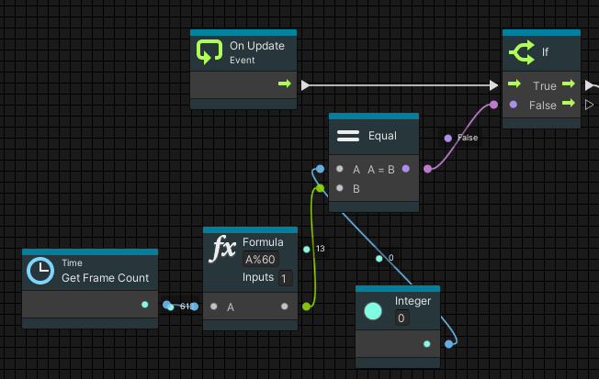
Calculating time.
One of the method to calculate the time is to use GetFrameCount – which counts how many frames passed from the beginning of the game.
Game is being updated 60 times per second – every time frame. So, to calculate one second, we need module GetFrameCount by 60. When it equals to zero – it is exactly one second.

Slide 27
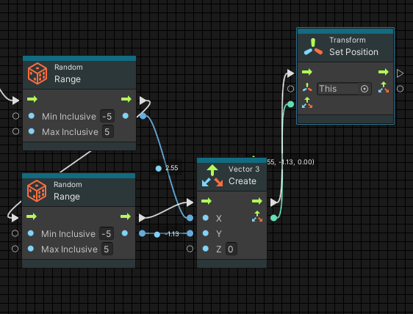
Randomly change the position

Slide 28
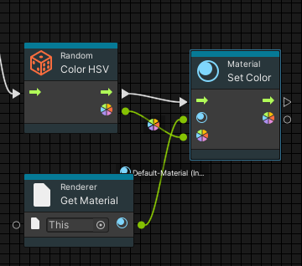
Random color is assigned
We can color the object adding and using its Material Component.

Slide 29
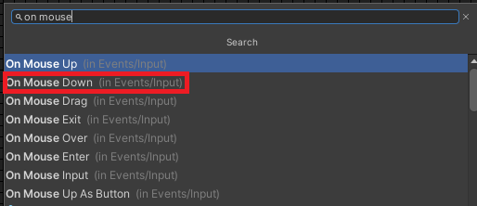
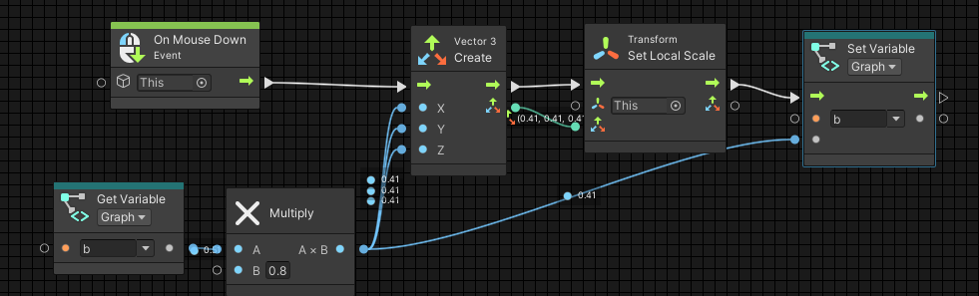
Detection of Click
To detect the click – we use the event OnMouseDown. Everything what will be connected to this unit will be executed only if Object was clicked on.
To change the size – use Transform.Scale property

Slide 30
Read and learn
References
https://docs.unity3d.com/bolt/1.4/manual
https://unity.com/products/unity-visual-scripting
https://www.sovereignmoon.studio/unity-bolt-introduction-tutorial/
https://www.youtube.com/watch?v=1YtnRkeicHY&list=PLrw9uFU6NhfOrlZ-Ze3P8BQFrNSKUXkYT

